Slide 1
CNS TRAUMA
BY Dr. TEJAS MANKESHWAR

Slide 2
CAUSES
Trauma is the most common cause of death and disability in children and young adults.
Trauma can be caused by missile and non missile injury.
The most common causes are :-
Motor vehicle collisions
Assaults
Falls

Slide 3
Closed head injuries
Closed head injuries are classified as either primary or secondary.
A primary injury results from the initial anatomical and physiological insult, which is usually direct trauma to the head, regardless of cause.
A secondary injury results from hypotension, hypoxia, acidosis, edema, or other subsequent factors that can secondarily damage brain tissue .

Slide 4
PRIMARY LESIONS
A) SKULL FRACTURE, SCALP HEMATOMA , LACERATION
B) EXTRACEREBRAL HEMORRHAGE
1.EDH
2.SDH
3. SAH

Slide 5
C) INTRA AXIAL LESIONS
1.DIFFUSE AXONAL INJURIES
2.CORTICAL CONTUSION
3.INTRAVENTRICULAR HEMORRHAGE
4.DEEP CEREBRAL GRAY MATTER INJURY
5.BRAINSTEM INJURY

Slide 6
SECONDARY LESIONS
1.CEREBRAL HERNIATION
2. TRAUMATIC ISCHEMIA
3.HYPOXIC INJURY
4.DIFFUSE CEREBRAL OEDEMA

Slide 7
On the basis of the GCS, patients may rapidly be assigned to a category of
-severe brain injury (score 3-8),
- moderate brain injury(score 9-12),
-mild brain injury (score 13-15) brain injury.
These categories determine the urgency of subsequent investigation and treatment. Total scores range from the lowest possible, 3, to the highest possible, 15.

Slide 8
Imaging Studies
CT scanning of the head is the criterion standard for patients with acute closed head injuries.
NECT scans from below the foramen magnum through the vertex needs to be performed.
Two sets of images are obtained one using brain and one with bone reconstruction algorithms.
Brain images should also be viewed with wider window width of 150-200 HU the so called subdural window.
Repeat CT should be done if there is sudden deterioration after 24-36 hrs.

Slide 10
WHO SHOULD BE IMAGED?
According to New Orleans Criteria-
CT indicated if GCS =15 plus any of the following.
Headache.
Patient >60yrs and children <2yrs.
Intoxication.
Short term memory deficits.
Seizures.
If GCS is between 13-15 and there is history of loss of consciousness, amnesia or confusion are imaged.

Slide 11
TRAUMA IMAGING- KEYS TO ANALYSIS
Scout image needs to be looked for cervical spine abnormalities, jaw or facial trauma and presence of foreign bodies.
Then brain window needs to be imaged for presence of scalp swelling, extra-axial bleeds, cortical contusions, intracranial air and intra-ventricular haemorrhage.
The most common extra-axial haemorrhage is traumatic sub arachnoid haemorrhage followed by sub and epidural hematoma.
Best place to look for subtle SAH is interpeduncular cistern where blood collects when the patient is supine.

Slide 12
High yield areas for contusions are antero-inferior frontal and temporal lobes.
Associated perilesional edema is usually noted.
Small subdural hematomas may be missed on standard narrow window widths of 75-80 HU and may be apparent when wider window widths of 150-200 HU are used.
Bone algorithm must be viewed to look for any fractures

Slide 13
Cranio-cervical CT angiography should be considered if :-
There is penetrating neck injury.
If a fractured foramen transversarium or facet Subluxation is identified on cervical spine CT.
If a skull base fracture traverses the carotid canal or dural venous sinus.

Slide 15
SCALP INJURIES
Skull and scalp injuries are common manifestation of cranial trauma.
They are helpful in identifying the location of direct head trauma.
Scalp injuries include lacerations and hematomas.
Lacerations are seen as focal discontinuity of skin.
Two types of hematomas are seen – Cephalhematoma and subgaleal hematoma.

Slide 16
CEPHALHEMATOMA:- These are sub-periosteal blood collections that lie between the outer surface of skull and elevate the periosteum.
These are extra cranial equivalent of intracranial epidural hematoma.
They are typically unilateral and do not cross suture line.
They usually do not attain large size as they are contained by tough fibrous periosteum.
NECT scans show lens shaped soft tissue mass that overlies single bone.

Slide 17
SUBGALEAL HEMATOMA
These are sub-aponeurotic collections in which blood collects under the aponeurosis of occipito-frontalis muscle.
It is not limited by suture line and can be bilateral.
Bleeding in subgaleal space can be extensive.
NECT scans show heterogeneous scalp mass that crosses one or more suture line.
Usually resolves without treatment.

Slide 19
SKULL FRACTURES
They can be simple or comminuted, closed or open.
In open fractures , skin laceration results in communication between the external environment and intracranial cavity, as a result risk of infection is more.
Various types of skull fractures are- Linear, depressed, elevated and diastatic fractures.

Slide 20
Linear skull fractures:- It is sharply marginated linear defect typically involves both inner and outer tables of the calvaria.
Depressed skull fractures :- A depressed skull fracture is a fracture in which the fragments are displaced inwards. These typically tear the underlying dura and arachnoid and are associated with contusions.
Elevated skull fractures:- They are often combined with depressed fracture.
Diastatic skull fracture:- A fracture that widens suture or synchondrosis. Linear skull fracture extends into adjacent suture. Spheno-occipital synchondrosis is the most common site.

Slide 21
TEMPORAL BONE FRACTURES:-
Longitudinal
most common (70-90%)
involves the squamous part of the temporal bone, the superior wall of the external auditory canal, and the tegmen tympani.
parallel to petrous ridge
CSF oto-/rhino-rrhea ,conductive hearing loss (ossicular disruption)
facial (VII n.) (10-20%)

Slide 22
Transverse, less common (10-30%).
They originate at the foramen magnum and extend through the cochlea and labyrinth, ending in the middle cranial fossa.
perpendicular to petrous ridge.
labyrinth/cochlear destruction.
Sensorineural hearing loss(VIII - both parts).
Facial (VII n.) (40-50%).
The incidence of facial nerve injury with a transverse fracture is twice that of a longitudinal fracture.

Slide 23
GROWING SKULL FRACTURES:- It is also known as post traumatic leptomeningeal cyst or craniocerebral erosion.
Most patients are under 3 years of age.
In pre phase skull fracture lacerates the dura and brain tissue or arachnoid herniates through the torn dura.
Stage I extends from time of initial injury to just before fracture enlarges.
Stage II is early phase of GSF which lasts for approximately 2 months following initial fracture enlargement.
At this stage bone defect is small and neurologic deficits are mild.

Slide 24
Stage III represents late stage GSF and begins 2 months after the initial enlargement begins.
Bone defect becomes larger.
Brain tissue and CSF extend between bony edges of fracture .
These cause pronounced skull deformities and progressive neurologic deficit if left untreated.

Slide 25
CT findings:- Middle cranial fossa is most susceptible because of its thin squamous bones and multiple foramina and fissures.
NECT demonstrates linear fractures as sharply marginated lucent lines.
Depressed fractures are typically comminuted and show inward implosion of fracture fragments.
Elevated fractures show elevated and rotated skull segment.
Stage I GSF are difficult to determine as scalp and contused brain are similar in density.
A lucent skull lesion with rounded scalloped margins and bevelled edges is typical in case of later stage GSF.
CSF and soft tissue appears entrapped within fracture.
On MRI bone detail is not well evaluated.
MR can demonstrate dural tear and differentiate herniated brain from contused edematous scalp.

Slide 30
Differential Diagnosis:-
Vascular grooves – have well corticated margins and are not as sharp or lucent as linear fractures.
Sutures – They occur in predictable locations and are densely corticated and are less distinct than fractures.
Sutures wider than 2mm in presence of linear skull fracture are diastatic.
Venous lakes and arachnoid granulations- are sooth and occur in predictable locations.

Slide 31
EXTRA-AXIAL HAEMORRHAGES
Epidural hematomas arise between inner table of skull and outer or periosteal layer of dura.
Subdural hematomas are located between the inner ( meningeal) layer of dura and the arachnoid.
Traumatic subarachnoid haemorrhage is found within the sulci and subarachnoid cisterns, between the arachnoid and pia matter.

Slide 32
ACUTE EPIDURAL HEMATOMA
ETIOLOGY:- The majority are caused by arterial injury most commonly to middle meningeal artery.
About 10 % are venous ,secondary to fracture that crosses dural venous sinus.
PATHOLOGY:-
Most of them are unilateral and supratentorial.
Squamous portion of temporal bone is most common site.

Slide 33
Gross pathology:- EDH are biconvex in shape because f adherence of periosteal dura to inner calvaria.
EDH rarely cross suture lines.
Gross intra-operative appearance is of dark purple or currant jelly lentiform clot.
EPIDEMIOLOGY:- EDH are much less common than SDH and tSAH.
Most are found in older children and young adults. M:F ratio is 4:1.
Clinical presentation:- Headache, nausea, vomiting, symptoms of mass effect( pupil involving 3rd nerve palsy followed by somnolence and coma.

Slide 34
Imaging
NECT is the procedure of choice for initial imaging.
Arterial EDH present as hyperdense (60-90 HU), lentiform extra axial collection is noted typically which does not cross suture line.
Presence f swirl sign i.e. hypodense component indicates active bleed.
EDH cause displacement of cortex medially with buckling of grey white matter interface inwards.
Venous EDH are smaller and develop slowly.
Usually seen after a skull fracture crosses dural venous sinus.
Venous EDH can cross sutures.

Slide 35
On MRI acute EDH are Isointense to underlying brain especially on T1W images.
The displaced dura can be identified as black line hematoma and brain.
ANGIOGRAPHY:- DSA may show lacerated middle meningeal artery with tram track fistulisation of contrast from middle meningeal artery into paired meningeal veins.
DIFFERENTIAL DIAGNOSIS:-
The major D/D is subdural hematoma which is cresecentic and crosses suture lines but confined by dural attachments of falx.
Occasionally infections( dural tuberculoma), neoplasm's such as meningioma, lymphoma and mets may present as hyperdense extra axial mass.

Slide 36
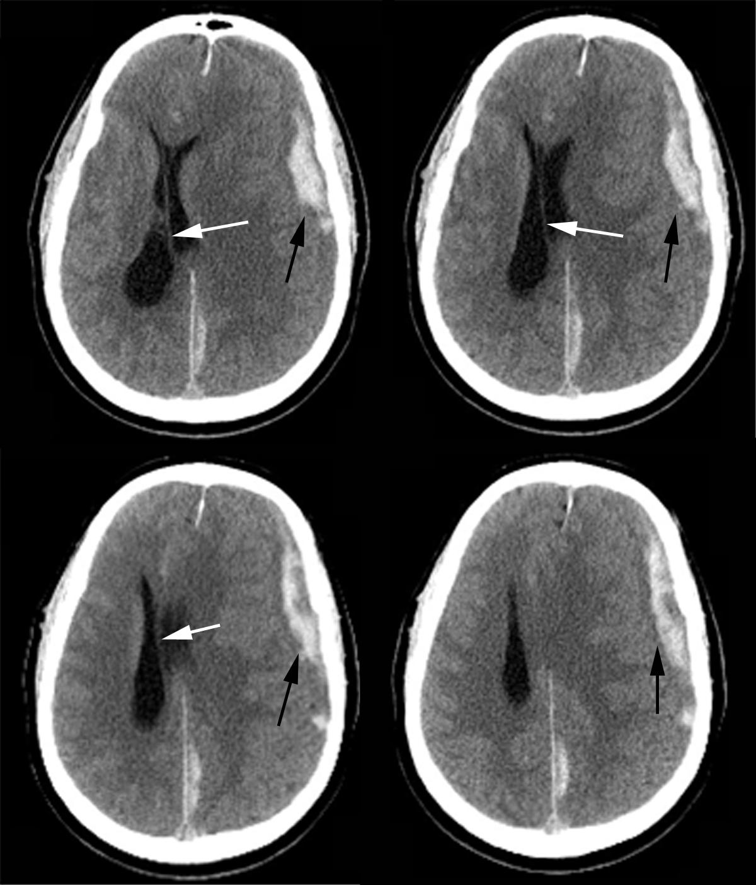
Notes:
CT scan of left frontal acute epidural hematoma (black arrow) with midline shift (white arrow). Note the left posterior falx subdural hematoma and left frontoparietal cortical contusion.

Slide 37
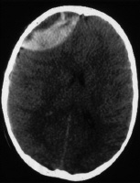
The reason for this lack of homogeneity is the presence of clotted blood (white) and unclotted blood (dark) within the hematoma.
Three reasons are possible:
1 The most common reason is that the patient is actively bleeding when the hematoma occurred and that the blood has not yet clotted
2. The second is that the patient was taking anticoagulants, which delayed the clotting time.
3.The third possibility is consumption coagulopathy in which all the patient's clotting factors are used up in other sites of trauma.

Slide 39
ACUTE SUBDURAL HEMATOMA
It is collection of blood or blood products that lies in or between the inner border of dura and arachnoid.
ETIOLOGY:- Trauma is the most common cause.
Tearing of cortical veins as they cross the subdural space to enter into dural venous sinus the most common etiology.
Tearing of cortical arteries from fracture may also give rise to aSDH .
Less common causes include aneurysm rupture, skull/dura-arachnoid metastasis fro vascular extra cranial neoplasm's and spontaneous haemorrhage in patients with coagulopathy.

Slide 40
PATHOLOGY:- Gross appearance is that of soft, purplish, currant jelly clot beneath the tense bulging dura.
EPIDEMIOLOGY:- It is the second most common extra axial hematoma exceeded only by traumatic SAH.
There is no gender predilection and can occur at any age.
Clinical findings may vary from none to loss of consciousness.
Most patients have low GCS on admission.
An acute SDH may remain stable or grow in size and prognosis depends upon the hematoma thickness, midline shift and presence of associated parenchymal injuries.

Slide 41
The classic finding of an acute SDH is supratentorial crescent shaped extra axial collection that displaces gray-white matter interface medially.
SDH may cross suture lines but does not cross dural attachments.
On NECT acute SDH are hyperdense.
Swirl sign usually indicates rapid bleeding.
Dots or Lines of CSF trapped within compressed and displaced sulci are often seen underlying an SDH.
Mass effect can be seen.

Slide 42
In some patients usually athletes with repeated head injury, brain swelling with unilateral hemisphere vascular engorgement occurs and mass effect is disproportionate to size of SDH.This is called as second impact syndrome which is probably caused by vascular dysregulation.
In case of extremely anaemic patients SDH may be isodense with underlying cortex.
CECT is useful for determining small isodense SDH.
Perfusion may show decreased cerebral blood flow and low perfusion pressure.

Slide 43
MRI:- Acute SDH are isointense o T1W image and hypo intense on T2W images.
On FLAIR images they are usually iso-hyperintense to CSF and hypointense to adjacent brain.
Blooming is noted on T2* images.DWI may show patchy foci of restricted diffusion in the underlying cortex.
Angiography may be useful in localising bleeding vessel.
Main differential is EDH which is lentiform in shape , crosses suture line and is usually associate with fracture.

Slide 44
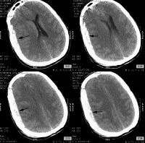
Notes:
CT scan of left frontoparietal acute subdural hematoma (black arrow). Note the moderate amount of midline shift

Slide 45
SUBACUTE SDH
A sub acute SDH is between several days and several weeks old.
It consists of partially liquefied clot with resolving blood products and is surrounded on both sides by granulation tissue.
Sub acute SDH show bimodal distribution with children and elderly being most commonly affected.
Clinically- Asymptomatic to loss of consciousness and hemiparesis caused by sudden haemorrhage into SDH, Headache and seizures.

Slide 46
imaging
Imaging findings are related to hematoma age and presence of encasing membranes.
Density of extra axial hematoma decreases approximately 1-2 HU each day.
On NECT sub acute SDH appear as crescent shaped fluid collections which are iso-hypodense compared to underlying cortex.
Medial displacement of gray-white interface is also present, along with dot like foci of CSF trapped partially effaced sulci.
CECT scans may be useful t shows-dense SDH.

Slide 47
MRI :- Early sub acute SDH are isointense to cortex on T1W and hypointense on T2W images but gradually becomes hyperintense as extracellular methemoglobin increases.
Late stage sub acute SDH are bright on T1W and T2W images.
FLAIR is the most sensitive sequence for detection of sub acute SDH as collection is typically hyperintense.
Blooming is noted in T2* sequences.
DWI commonly shows crescentic high intensity area with low intensity rim closer to brain surface giving it double layer appearance.
Low intensity are corresponds to resolved clot and CSF whereas high intensity area to solid clot.

Slide 48
TI+ C scan shows enhancing thickened encasing membranes.
Delayed scans may show gradual filling in and increasing hyperintensity of SDH.
DIFFERENTIAL DIAGNOSIS:- The major D/D of sub acute SDH is isodense acute SDH. This is typically seen in extremely anaemic or anticoagulated patient.
Subdural effusion that follows surgery or meningitis or that occurs as a component of intracranial hypotension can also mimic sub acute SDH.

Slide 49
Sub acute subdural hematoma in a right frontoparietal concavity. CT scan (CT) shows an isoattenuating-to-hypo attenuating subdural hematoma. Both T1-weighted (T1W) and T2-weighted (T2W) MR images show high signal intensity suggestive of a late sub acute haemorrhage

Slide 50
CHRONIC / MIXED SDH
It is an encapsulated collection of sanguineous or serosanguinous fluid confined within the subdural space.
Recurrent haemorrhages within pre-existing chronic SDH my produce mixed density SDH.
PATHOLOGY:- Blood within the subdural space incites tissue reaction around its margins.
Organisation and resorption of hematoma continues.
These neomembranes which are formed are fragile and easily rebleed causing mixed density SDH.Eventually only thickened dura and arachnoid layer remains with few pockets of scattered old blood trapped between inner and outer membranes.

Slide 51
IMAGING
Uncomplicated chronic SDH show homogenous density/signal intensity with slight gravity dependant gradation of there contents(hematocrit effect).
Mixed SDH with acute haemorrhage in pre-existing chronic SDH show hematocrit effect with distinct layering of old (top) and new (bottom )haemorrhages. Septated pockets may also be seen.
Long standing SDH with complete resorption are seen as pachymeningiopathies with diffuse dura arachnoid thickening.

Slide 52
NECT:- A hypodense crescentic fluid collection is the classic finding.
Uncomplicated chronic SDH approach CSF density.
Hematocrit effect may show slight gradation of density from top t bottom.
With age encapsulating membranes may appear thickened and hyperdense.
Peripheral calcifications may be seen.
In rare cases chronic SDH may densely calcify or even ossify , a condition called as armoured brain.
On CECT encapsulating membranes may show enhancement.

Slide 53
On T1W images uncomplicated chronic SDH are iso-slightly hyperintense compared to CSF.
On T2W images these are iso-hypointense to CSF.
Hyperintense on FLAIR and may show blooming on T2* scans if sub acute or chronic blood clots are present.
Uncomplicated chronic SDH donot restrict on DW images. With chronic SDH a double layer effect – a crescent of hyperintensity medial to non restricting fluid collection indicates acute rehaemorrhage.
Encapsulating membranes enhance after contrast administration.

Slide 54
DIFFERENTIAL DIAGNOSIS
Brain atrophy – chronic SDH exhibit mass effect with flattening of gyri and often extend over entire hemisphere whereas in cerebral atrophy predominantly frontal and temporal extra axial spaces are involved.
Traumatic subdural hygroma- it is accumulation of CSF in subdural space mostly secondary to arachnoid tear which follows CSF density on al sequences, has no blood products and shows no enhancement on post contrast images.
Subdural effusions – Generally associated with infective cause without any history of trauma.
Subdural empyema- history of infection, strongly restricts on DW images and shows strongly enhancing membranes.

Slide 56
TRAUMATIC SAH
Trauma is the most common cause f intracranial SAH.
ETIOLOGY:- Tearing of cortical arteries and veins, rupture of contusions and lacerations into subarachnoid space and choroid plexus bleed with intraventricular haemorrhage are common causes.
Less commonly traumatic SAH may arise from major vessel laceration or dissection.

Slide 57
LOCATION:- Traumatic SAH is predominantly found in perisylvian regions, in the anteroinferior frontal and temporal sulci and over hemispheric convexities.
GROSS PATHOLOGY;- It appears as curvilinear foci of bright blood collected in cisterns and surface sulci.
Clinically it has bimodal distribution and most commonly occurs in young adults and elderly.
Clinical symptoms are related to other traumatic injuries such as extra axial hematoma, contusions and axonal injury.

Slide 58
Acute traumatic SAH appears as linear hyper densities in sulci adjacent to cortical contusions or under epi or subdural hematoma.
Isolated SAH may be seen in interpeduncular fossa.
Chronic traumatic SAH may appear as hypodense fluid that expands sulci.

Slide 59
On MRI- hyperintense to brain on T2W and FLAIR images.
Iso intense to brain on T1W images.
Dirty sulci wit smudging of perisylvian cisterns is typical.
Blooming is seen on T2* images.
DWI may show foci of restricted diffusion in areas of frank ischaemia or trauma induced cytotoxic edema.
ANGIOGRAPHY:- Vasospasm may develop after trauma and is identified as multi focal areas of vessel narrowing or beading.

Slide 60
DIFFERENTIALS
Non traumatic SAH:- AneurysmalSAH is concentrated in basal cisterns and saccular aneurysm can be identified on contrast scans.
Sulcal cisternal hyperintensity on FLAIR is no specific and can be caused by meningitis, neoplasm, artifact and high inspired oxygen during general anaesthesia.
Pseudo sub arachnoid haemorrhage is seen in case of severe generalised cerebral edema. Hypodense brain makes circulating blood in arteries and veins look hyperdense.
Hyper density seen usually conforms to the shape f vessels and is smooth.

Slide 62
Cortical contusions
Contusions are formed in 2 ways:
Direct trauma causes injury at the site of impact, which is termed a coup contusion (scalp/skull Abnormal)
Acceleration / deceleration causes injury at a site opposite to the site of impact, which is termed a countercoup contusion. (scalp/skull Normal)
Cortical injury occurs adjacent to the floor of the anterior or posterior cranial fossa, the sphenoid wing, the petrous ridge, the convexity of the skull, and the falx or tentorium.
The inferior frontal and temporal lobes are particularly vulnerable.

Slide 63
The most worrisome trait of these contusions is their tendency to expand. This usually occurs from 24 hours to as long as 7-10 days after the initial injury. For this reason, cerebral contusions are often followed with a repeat head CT scan within 24 hours after injury.
On NECT they appear as petechial gyral haemorrhages adjacent to calvaria.
MRI is more sensitive and accurate than CT for detecting contusions because of its multiplanar capability and greater sensitivity for edema.
FLAIR is the most sensitive sequence .
Appear hyperintense on FLAIR images and Hypointense on T2W images with associated peripheral edema. Blooming is seen on GRE images .

Slide 64
Phase | Time | Hemoglobin, Location | Appearance
 |  |  | T1-Weighted MRI | T2-Weighted MRI
Hyperacute | <24 h | Oxyhemoglobin, intracellular | Isointense or hypointense | Hyperintense
Acute | 1-3 d | Deoxyhemoglobin, intracellular | Isointense | Hypointense
Early subacute | >3 d | Methemoglobin, intracellular | Hyperintense | Hypointense
Late subacute | >7 d | Methemoglobin, extracellular | Hyperintense | Hyperintense
Chronic (oedema and ME | >14 d | Ferritin and hemosiderin, extracellular | Hypointense | Hypointense

Slide 65
The main differential diagnosis to be considered is of DAI.
DAI is also associated with contusions but it is most commonly found in the corona radiata and along compact white matter tracts such as internal capsule and corpus callosum.

Slide 66
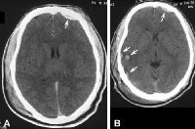
Evolution of an acute brain contusion. (A) Axial CT scan obtained immediately following severe blunt trauma to the head shows a small, left frontal epidural hematoma (arrow). Note that the previously isoattenuating contusion in the right posterior temporal area is now evident

Slide 68
DIFFUSE AXONAL INJURY
It is also known as traumatic axonal stretch injury.
It is the second most common parenchymal lesion seen after contusions.
Patients with DAI exhibit severe discrepancy between clinical status and initial imaging findings.
They result from inertial forces of rotation generated by sudden changes of acceleration and deceleration.

Slide 69
Cortex moves at different speed in relationship to underlying deep brain structures.
This results in axonal stretching especially where brain tissues of different density intersect(at grey-white matter interface).
Traumatic axonal stretching causes impaired axoplasmic transport, depolarisation, ion flux and release of excitatory amino acids with resultant development of cellular swelling and cytotoxic edema.

Slide 70
LOCATION:- Sub cortical and deep white matter is most commonly affected.
Cortex is typically spared.
Lesions in compact white matter tracts such as corpus callosum, especially genu and splenium, fornix and internal capsule are frequent.
STAGING AND GRADING:-
MILD- Lesions are seen in fronto-temporal grey-white matter interface.
MODERATE- Lobar white matter and corpus callosum are affected.
SEVERE- dorsolateral mid brain and upper pons are involved.

Slide 71
Peak incidence is in young adults (15-24 years old).
Males are affected more than females.
DAI often presents as immediate loss of consciousness which may be transient or progress to coma.
DAI itself rarely causes death but may result in persistent vegetative state.

Slide 72
IMAGING
Initial NECT is often normal or minimally abnormal.
Mild diffuse brain swelling with sulcal effacement may be present.
Few small round or ovoid sub cortical haemorrhages may be visible.
On MRI T2W and FLAIR images show hyper intensities in sub cortical white matter and corpus callosum.
T2* images show blooming in these areas s/o micro bleeds.
SWI sequence demonstrates more lesions than GRE.
DWI may show restricted diffusion especially within the lesions of corpus callosum.
DTI Tractography may show whte matter disruption.
MRS shows widespread decrease in NAA with increase in choline.

Slide 73
DIFFERENTIAL DIAGNOSIS:-
Cortical contusions- typically superficial in location along gyral crests.
Diffuse vascular injury- It represents extreme end of DAI. On SWI and T2* images punctate and linear blooming hypo intensities are also seen involving basal ganglia, thalami, brain stem and cerebellum. It is the number , severity and extent of haemorrhages that differentiate DVI from DAI.

Slide 74
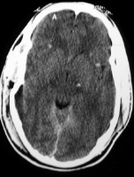
Note that the hemorrhages are characteristically located at the gray-white matter interface.

Slide 75
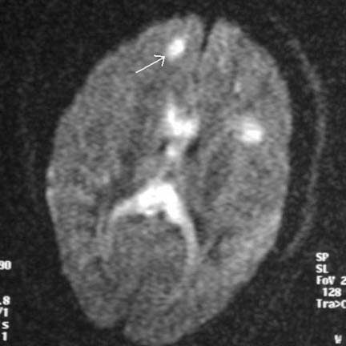
MRI) diffusion sequence demonstrating multiple foci of abnormal increased signal at the gray-white matter junction (arrow) and within the corpus callosum in a patient with diffuse axonal injury

Slide 76
THANK YOU!!!

