Slide 1
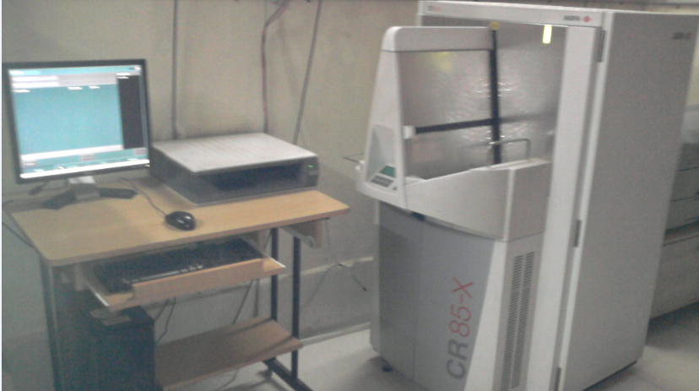
COMPUTED RADIOGRAPHY

Slide 2
Computed Radiography (CR)
Imaging system comprised of:
Photostimulable Storage Phosphor
-to acquire the x-ray projection image
CR Reader
-to extract the electronic latent image
Digital electronics
-to convert the signals to digital form

Slide 3
In CR , in place of a film to create the image , an imaging plate (IP) made of photostimulable phosphor is used.
Hence, instead of developing film in darkroom, the imaging plate is run through a special laser scanner, or CR reader, that reads the image.
The digital image can then be viewed and enhanced using software

Slide 4
PRINCIPLE
LUMINESCENCE is emission of light by a substance. Types:
FLORESCENCE
PHOSPHORSCENCE
CR is based on the principle of PHOSPHORSCENCE which is is emission of light that is delayed
for 10-8 seconds or more.
INTENSIFYING SCREENS are based on the principle of FLORESCENCE which is emission of light immediately within 10-8 seconds of exposure.

Slide 5
PHOSPHOR IN CR
The phosphor that is currently used is composed of
BARIUM FLUOROHALIDE DOPED WITH EUROPIUM.
Halide = BROMIDE (85 %) + IODIDE (15 %)
EUROPIUM -as impurity or activator. It creates positive energy traps where electrons can bind on excitation.

Slide 6
Phosphor powdered form - mixed with a
binder or adhesive material - laid down as a base
with a thickness of about 0.3mm.
The plate is inserted into a light tight cassette, mostly made of fibre.

Slide 7
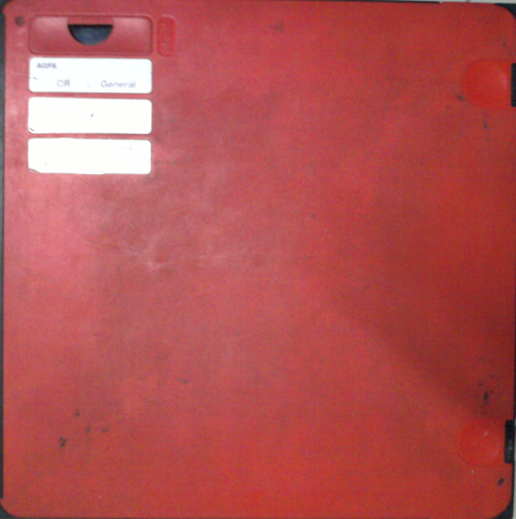

Slide 8
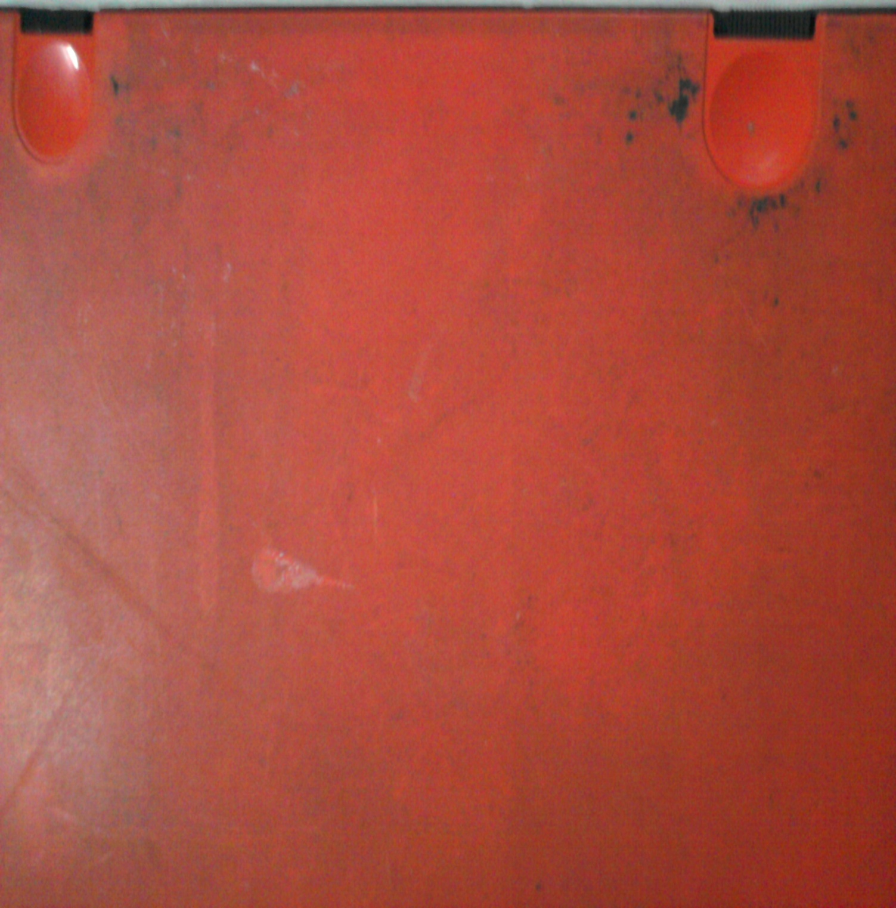

Slide 10
CASSETTES
12 cassettes can be read at a time.
Cassettes / plates available in different sizes:
Size is written on cassette-
- 43 x 35 cm
- 35 x 35 cm
- 10 x 12 inches
- 8 x 10 inches

Slide 11
Single cassette : 30,000 X-rays in lifetime.
Latent image is saved in the screen.
Lead- on backside of screen- prevents scattering of X-rays.

Slide 12
Cost of large cassette – around 41,000.
Plate – ideally cleaned after every 15 days
With solution containing ethanol
With cellulose cloth
Should be prevented from scratches for better life.

Slide 13
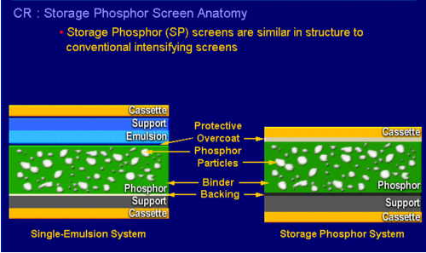

Slide 14
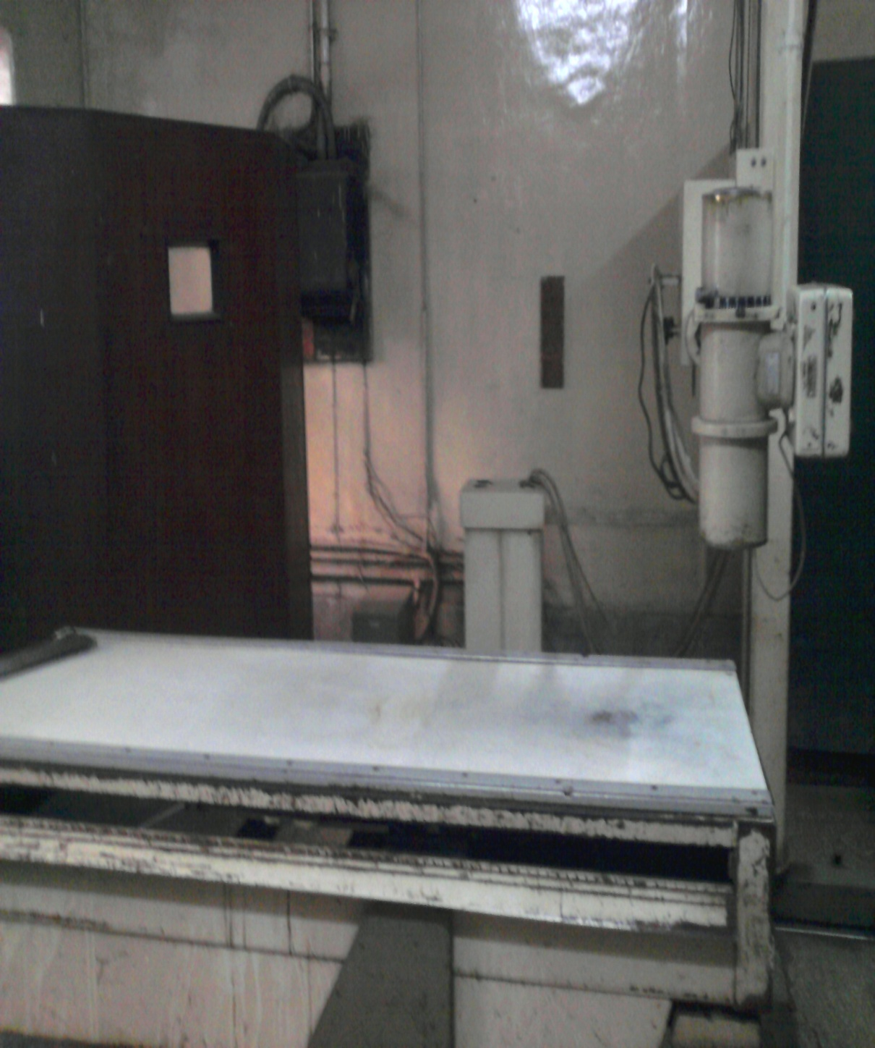
STEPS OF CR IMAGING
In CR, the radiographic exposure is made using conventional x ray equipment.

Slide 15
FORMATION OF LATENT IMAGE
Half these electrons return to normal energy state instantly- NOT AVAILABLE FOR IMAGE FORMATION.
Rest electrons trapped in europium - form the LATENT IMAGE.
The plate is exposed to x rays using standard radiographic equipment
Electrons in phosphor excited to high energy state.

Slide 16
Trapped electrons return to their normal energy state
Hence the image should be retrieved as soon as possible
Image readable upto 8 hours at room temperature
Degradation of the latent image.

Slide 17
Image retrieved by means of READER
plate scanned by a small dot of light (100 microns) from a helium neon laser.
Plate removed from the cassette - scanned using laser beam using rotating mirror
Electrons trapped in europium exposed to the laser light will absorb the light energy

Slide 18
Electrons free from their traps - return to their lower energy state.
EMIT A LIGHT PHOTON.
Light emitted on return to lower energy level will have more energy than the laser beam, hence it’s wavelength will be shorter than laser beam.
Laser light – red.
Emitted light - feeble greenish/ blue

Slide 19
The two lights are of different wavelength is critical for image retrieval.
Filter is used which absorbs the red light and allows the green light to pass through.
-An OPTICAL FIBRE is used to direct the light to the PHOTOMULTIPLIER TUBE.
-It converts the light signal into ELECTRIC SIGNAL.
-The entire plate can be scanned by moving the image plate perpendicular to the scan line of the laser beam.

Slide 20
The output of photomultiplier tube is in the form of
ELECTRIC ANALOG SIGNAL corresponding to absorbed
x rays.
signal from photomultiplier tube is then amplified
converted to a digital signal
stored in a computer by means of a
ANALOGE TO DIGITAL CONVERTER.

Slide 21
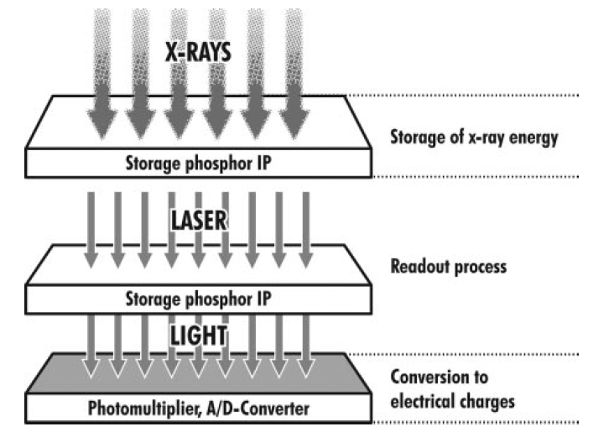

Slide 22
Following the read cycle the residual signal from the plate is erased by exposing it to a bright light source- high intensity Na discharge lamps.
The time for a CR reader to extract the image from the plate is generally between about 30 and 45s.

Slide 23
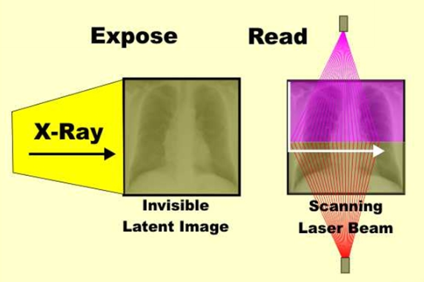

Slide 24
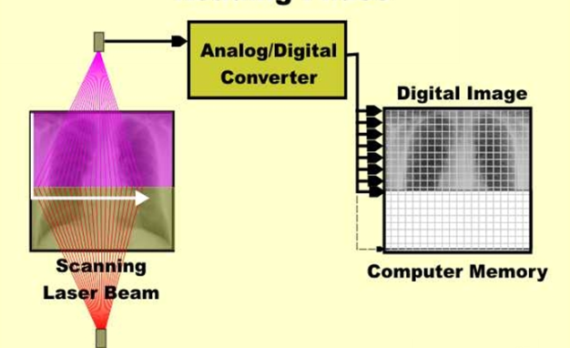

Slide 25
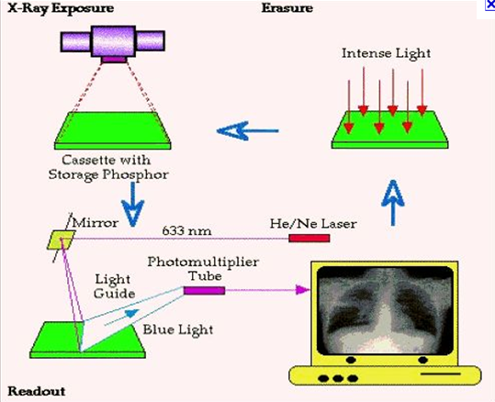

Slide 26
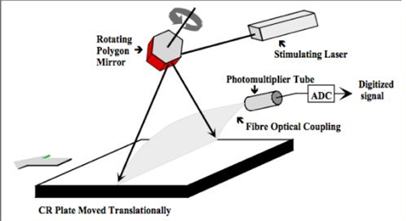

Slide 27
CR IN OUR SETUP
AGFA CR 85- X - BELGIUM
STORAGE CAPACITY AVR.
-1500 IMAGES / 160 GB
Connected through-
SCANDOC- 4 computers in department
APACS - Hospital network

Slide 28
CR IN OUR SETUP
- Cost around 18 LAKH.
- 12 CASSETTES READ AT A TIME
-Provided with printer- DRYSTAR 5302

Slide 30
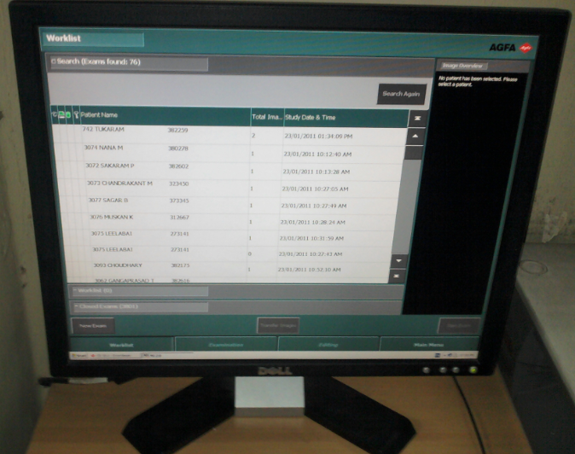

Slide 31
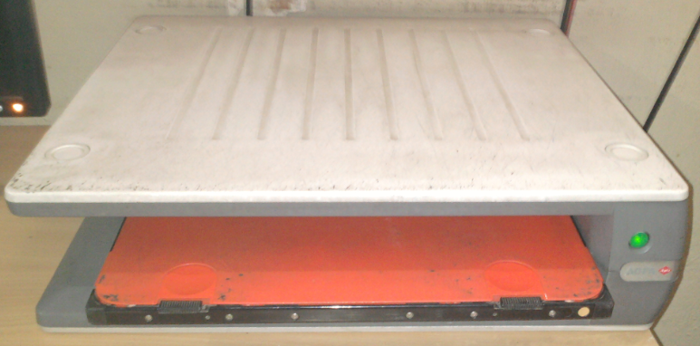

Slide 32
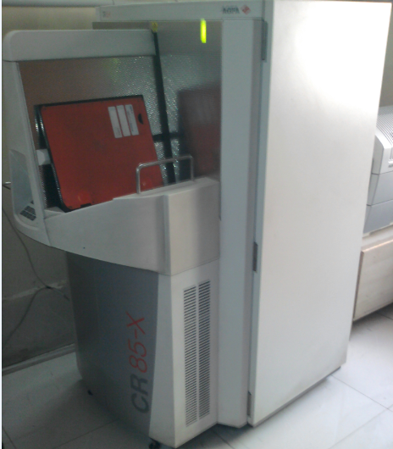
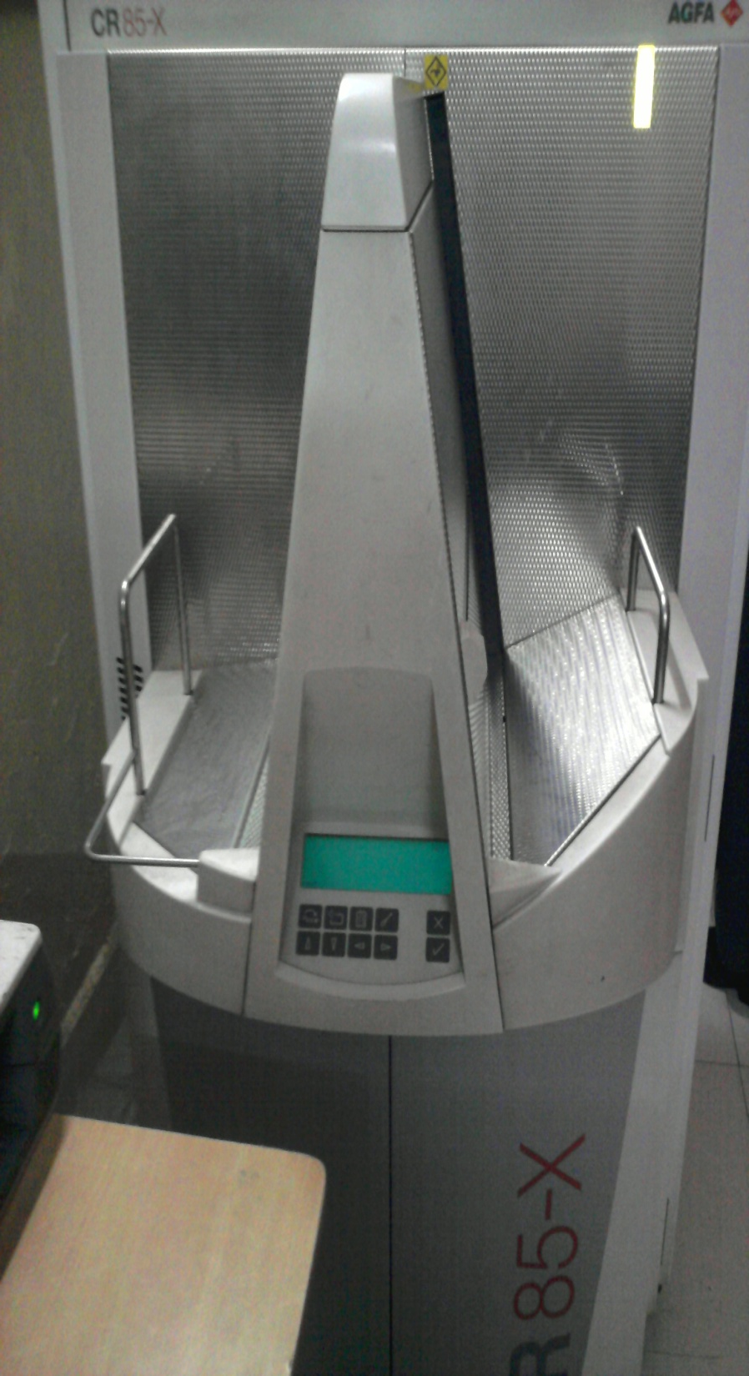

Slide 33
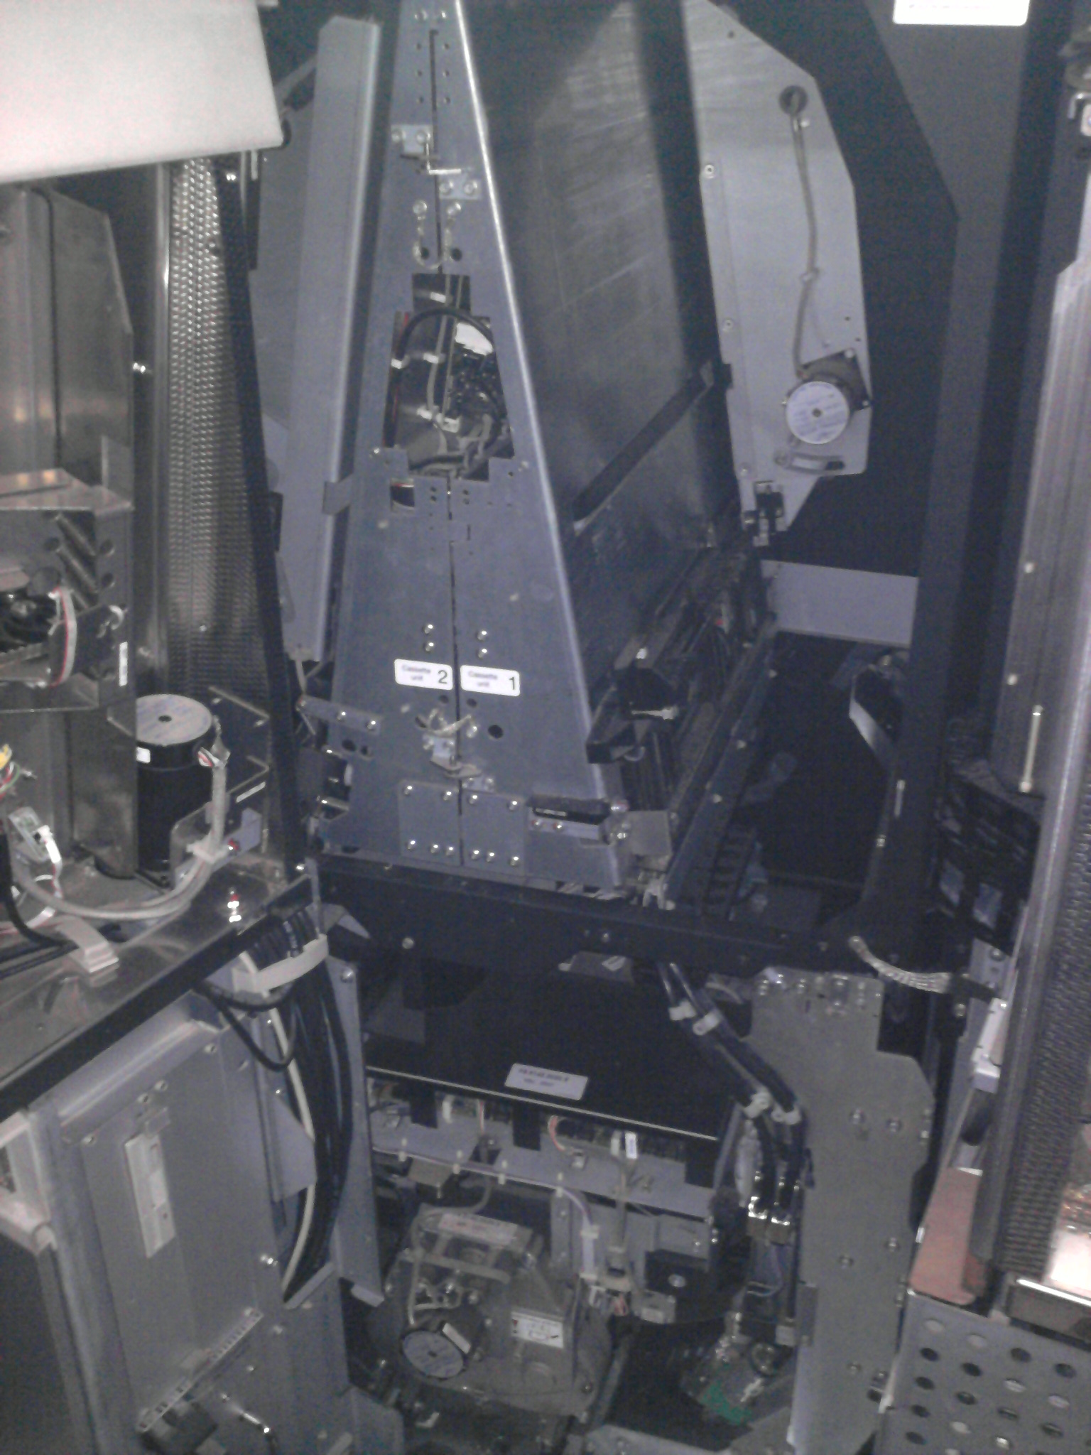

Slide 34
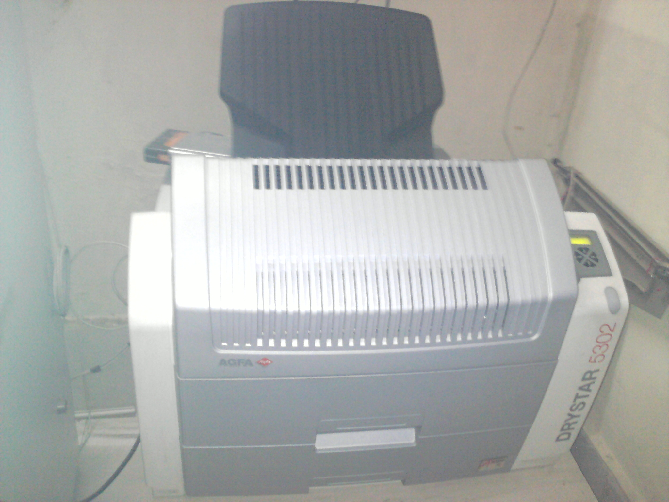

Slide 35
CONCEPTS IN DIGITAL IMAGING
DYNAMIC RANGE
PIXEL
SPATIAL RESOUTION
CONTRAST RESOLUTION
IMAGE NOISE

Slide 36
DYNAMIC RANGE
The dynamic range of CR is better compared to the film.
The dynamic range for
CR=10000:1
CONVENTIONAL=100:1
The dynamic range is graph of light emitted from the plate to dose of x rays produced.

Slide 37
The dynamic range of CR is linear.
- It will accept wider range of exposure
Dynamic range of conventional is S shaped.
- Low exposure and high exposure will lead to insufficient image quality and failed exposure.
Range of doses that can be imaged in CR/ DR is much greater than for conventional.

Slide 38
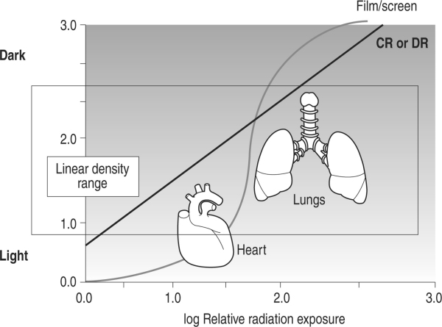
Notes:
Textured and layered background
(Intermediate)
To reproduce the first background layer on this slide, do the following:
On the Home tab, in the Slides group, click Layout, and then click Blank.
Also on the Home tab, in the Drawing group, click Shapes, and then under Rectangles, click Rectangle.
On the slide, drag to draw a rectangle.
Select the rectangle. Under Drawing Tools, on the Format tab, in the Shape Styles group, click Shape Fill, point to Gradients, and then click More Gradients. In the Format Shape dialog box, click Fill in the left pane, in the Fill pane, click Gradient fill, and then do the following:
In the Type list, select Linear.
In the Angle box, enter 70°.
Under Gradient stops, click Add gradient stop or Remove gradient stop until four stops appear in the slider.
Also under Gradient stops, customize the gradient stops as follows:
Select the first stop in the slider, and then do the following:
In the Position box, enter 0%.
Click the button next to Color, click More Colors, and then in the Colors dialog box, on the Custom tab, enter values for Red: 19, Green: 52, and Blue: 61.
In the Transparency box, enter 0%.
Select the next stop in the slider, and then do the following:
In the Position box, enter 37%.
Click the button next to Color, click More Colors, and then in the Colors dialog box, on the Custom tab, enter values for Red: 75, Green: 172, and Blue: 198.
In the Transparency box, enter 0%.
Select the next stop in the slider, and then do the following:
In the Position box, enter 73%.
Click the button next to Color, click More Colors, and then in the Colors dialog box, on the Custom tab, enter values for Red: 49, Green: 133, and Blue: 156.
In the Transparency box, enter 0%.
Select the last stop in the slider, and then do the following:
In the Position box, enter 100%.
Click the button next to Color, click More Colors, and then in the Colors dialog box, on the Custom tab, enter values for Red: 75, Green: 172, and Blue: 198.
In the Transparency box, enter 0%.
Also in the Format Shape dialog box, click Line Color in the left pane, in the Line Color pane, select No line.
Also in the Format Shape dialog box, click Size in the left pane, in the Size pane, under Size and rotate, enter 7.5” in the Height box and 10” in the Width box.
On the Home tab, in the Drawing group, click Arrange, point to Align, and then do the following:
Click Align to Slide.
Click Align Middle.
Click Align Center.
To reproduce the second background layer on this slide, do the following:
On the Home tab, in the Drawing group, click Shapes, and then under Rectangles click Rectangle.
On the slide, drag to draw a rectangle.
Select the rectangle. Under Drawing Tools, on the Format tab, in the Shape Styles group, click the Format Shape dialog box launcher. In the Format Shape dialog box, click Fill in the left pane, in the Fill pane, select Picture or texture fill, and then do the following:
Click the button next to Texture and then click Brown Marble (third row).
Clear the “Tile picture as texture” check box.
Under Stretch options, in the Transparency box, enter 80%.
Also in the Format Picture dialog box, click Line Color in the left pane, in the Line Color pane, select No line.
Also in the Format Picture dialog box, click Picture Corrections in the left pane, in the Picture Corrections pane, under Brightness and Contrast, enter 12% in the Brightness box and 44% in the Contrast box.
Also in the Format Picture dialog box, click Picture Color in the left pane, in the Picture Color pane, under Recolor, click the button next to Presets, and then click Grayscale (first row).
Also in the Format Picture dialog box, click Artistic Effects in the left pane, in the Artistic Effects pane, click the button next to Artistic Effect, click Glow Diffused (second row), and then do the following:
In the Transparency box, enter 47%.
In the Intensity box, enter 9.
Also in the Format Picture dialog box, click Size in the left pane, in the Size pane, under Size and rotate, enter 7.5” in the Height box and 10” in the Width box.
On the Home tab, in the Drawing group, click Arrange, point to Align, and then do the following:
Click Align to Slide.
Click Align Middle.
Click Align Center.
To reproduce the third background layer on this slide, do the following:
On the Home tab, in the Drawing group, click Shapes, and then under Rectangles click Rectangle.
On the slide, drag to draw a rectangle.
Select the rectangle. Under Drawing Tools, on the Format tab, in the Shape Styles group, click the Format Shape dialog box launcher. In the Format Shape dialog box, click Fill in the left pane, in the Fill pane, select Picture or texture fill, and then do the following:
Click the button next to Texture and then click Granite (third row).
Select the “Tile picture as texture” check box.
Under Tiling options, in the Transparency box, enter 95%.
Also in the Format Picture dialog box, click Line Color in the left pane, in the Line Color pane, select No line.
Also in the Format Picture dialog box, click Picture Corrections in the left pane, in the Picture Corrections pane, under Brightness and Contrast, enter -20% in the Brightness box and 100% in the Contrast box.
Also in the Format Picture dialog box, click Picture Color in the left pane, in the Picture Color pane, under Recolor, click the button next to Presets, and then click Grayscale (first row).
Also in the Format Picture dialog box, click Artistic Effects in the left pane, in the Artistic Effects pane, click the button next to Artistic Effect, click Photocopy (fifth row), and then do the following:
In the Transparency box, enter 30%.
In the Intensity box, enter 3.
Also in the Format Picture dialog box, click Size in the left pane, in the Size pane, under Size and rotate, enter 7.5” in the Height box and 10” in the Width box.
On the Home tab, in the Drawing group, click Arrange, point to Align, and then do the following:
Click Align to Slide.
Click Align Middle.
Click Align Center.
To reproduce the fourth background layer on this slide, do the following:
On the Home tab, in the Drawing group, click Shapes, and then under Rectangles, click Rectangle.
On the slide, drag to draw a rectangle.
Select the rectangle. Under Drawing Tools, on the Format tab, in the Shape Styles group, click Shape Fill, point to Gradients, and then click More Gradients. In the Format Shape dialog box, click Fill in the left pane, in the Fill pane, click Gradient fill, and then do the following:
In the Type list, select Radial.
In the Direction list, select From Center.
Under Gradient stops, click Add gradient stop or Remove gradient stop until two stops appear in the slider.
Also under Gradient stops, customize the gradient stops as follows:
Select the first stop in the slider, and then do the following:
In the Position box, enter 0%.
Click the button next to Color, under Theme Colors, click Black, Text 1 (first row).
In the Transparency box, enter 100%.
Select the last stop in the slider, and then do the following:
In the Position box, enter 100%.
Click the button next to Color, click More Colors, and then in the Colors dialog box, on the Custom tab, enter values for Red: 36, Green: 25, and Blue: 15.
In the Transparency box, enter 50%.
Also in the Format Shape dialog box, click Line Color in the left pane, in the Line Color pane, select No line.
Also in the Format Shape dialog box, click Size in the left pane, in the Size pane, under Size and rotate, enter 7.5” in the Height box and 10” in the Width box.
On the Home tab, in the Drawing group, click Arrange, point to Align, and then do the following:
Click Align to Slide.
Click Align Middle.
Click Align Center.

Slide 39
Due to wider dynamic range of CR, PSP should be read in 2 steps using PREREADING:
Small portion of image scanned by laser beam
Data analysed to compare exposure level of image
Sensitivity of photomultiplier tube is adjusted to that exposure level
Allows examination made with wide range of mAs settings to be converted to diagnostically imp image

Slide 40
pixel
In digital imaging each image is divided into a matrix of individual cells called as PIXELS .
Smallest complete sample of an image – expressed as binary codes ( bits ).
Smaller the size of pixel- Better resolution.

Slide 41
Spatial resolution
Minimum resolvable separation between high
contrast subjects.
Ability to detect fine detail.
FACTORS LIMITING SPATIAL RESOLUTION
Pixel size
-Scattering of laser beam in the phosphor layer
Diameter of scanning laser beam
Size of phosphor grains

Slide 42
The spatial resolution with CR IS LESS than with
conventional radiography as in depends on pixel size and OBJECTS SMALLER THAN PIXEL CANNOT BE READ.

Slide 43
CONTRAST RESOLUTION
It is colour / grey scale differentiation.
It indicates the number of shades of grey that a detector can capture.
Ability to distinguish between adjacent areas in an image.
Depends on properties of tissues & method of image formation.

Slide 44
Image noise
All images have unwanted fluctuations that are unrelated to object being imaged.
It may be due to:
X-ray quantum noise
Noise due to imaging system
Indirect DR system- conversion to light

Slide 45
DIGITAL IMAGE PROCESSING
ADJUST & OPTIMIZE CONTRAST
Look up table processing
Windowing
REDUCE IMAGE NOISE
INCREASE VISIBILITY OF DETAIL
EDGE ENHANCEMENT

Slide 46
DIGITAL IMAGE PROCESSING
ADJUST & OPTIMIZE CONTRAST
Look up table processing
Windowing
REDUCE IMAGE NOISE
INCREASE VISIBILITY OF DETAIL
EDGE ENHANCEMENT

Slide 48
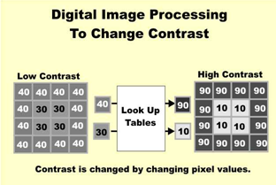
LUT PROCESSING
Look up tables (LUTs) are
data stored in computer that is used to substitute new values for each pixel during processing.

Slide 49
windowing
Process of selecting some segment of total pixel value range and then displaying the pixel values within that segment over full brightness.
Contrast will be visible only for the pixel values that are within the selected window.
All pixel values that are either below or above the window will be all white or all black and display no contrast.

Slide 50
windowing
To display and enhance the contrast in selected segments of the total pixel value range.
When the window is set to cover the lower segment of total pixel value range, we see good contrast in the lighter areas like the medistimum.
Setting the window to the higher segment produces good contrast in the darker areas like the lungs.

Slide 52
DIGITAL IMAGE PROCESSING
ADJUST & OPTIMIZE CONTRAST
Look up table processing
Windowing
REDUCE IMAGE NOISE
INCREASE VISIBILITY OF DETAIL
EDGE ENHANCEMENT

Slide 53
Image noise
All images have unwanted fluctuations in the levels of grey in the image that are unrelated to object being imaged.
Limits the ability to see the low contrast fine detail of an image.
Noise reduces as the number of photons increases.

Slide 54
It may be due to:
X-ray quantum noise- QUANTUM MOTTLE
Noise due to imaging system
Indirect DR system- conversion to light
X-ray scatter
Veiling glare

Slide 55
Quantum mottle
It is the statistical fluctuations in the number
of photons that exit the patient.
Generated because of very low signal levels being detected to produce the image.
Lower the number of photons detected- greater the variation in signal.
Limiting factor in all x ray imaging.
Causes fluctuations in brightness or density of image.

Slide 56
X ray scatter
1]It reduces radiographic contrast.
2]It causes small structures with equal attenuation
to have different contrast depending on whether
they are present on thick or thin part.
It nullifies even the log conversion.
3]It raises the patient dose required to obtain a given
x ray photon statistical confidence level.
X-RAY GRID & PRIMARY BEAM MAGNIFICATION
REDUCE SCATTER

Slide 57
VEILING GLARE
Light that is scattered and reflected by lens
system.
The image intensifier and TV system contribute to
it.
It has same effect on image as x ray scatter.
Important in CCD type of detectors in DR system.

Slide 58
NOISE SMOOTHENING
Noise reduced by low pass filtering.
Pixels are averaged with closest neighbouring pixels
Low contrast objects are better appreciated BUT…
Compromises some resolution… small details & edges are blurred.

Slide 59
Frame integration;
It is a method to reduce noise by adding together
several frames.
It reduces both electronic and quantum noise.

Slide 60
DIGITAL IMAGE PROCESSING
ADJUST & OPTIMIZE CONTRAST
Look up table processing
Windowing
REDUCE IMAGE NOISE
INCREASE VISIBILITY OF DETAIL
EDGE ENHANCEMENT

Slide 61
EDGE ENHANCEMENT
To increase visibility of small structures with moderate to high contrast.
To detect finer detail of an image.
Subtraction of low pass filtered image( info about large structures and low noise) from original yields image in which edges and small structures remain.

Slide 62
It exaggerates the contrast at boundary between structures.
Makes structures more easily visible.
Fine details enhanced BUT….
Noise is increased.

Slide 64
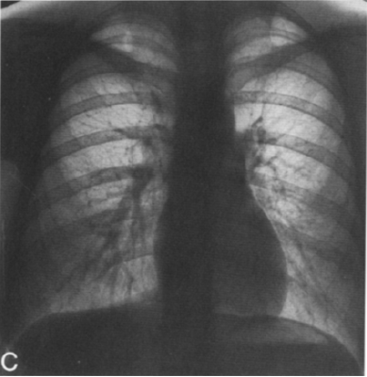

Slide 65
DIGITAL IMAGE PROCESSING

Slide 66
Advantages of CR
No silver based film or chemicals.
Saves time and efforts
Reduced film storage costs because images stored digitally.
Reprinting possible
Reusable phosphor plates
Fewer retakes due to under- or over-exposure which results in lower overall dose to the patient.

Slide 67
Image acquisition is much faster - image previews available < 15 seconds.
Option to change
-Contrast
-Brightness
-Image rotation, flip , inversion
-Image crop
-Image label
-Bone & soft tissue window
-Count distance & angles
Used with PACS

Slide 68
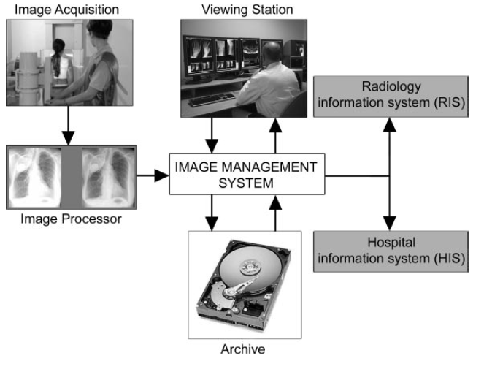

Slide 69
DISADVANTAGES
Resultant lower spatial resolution as compared to film images.
To keep the same SNR, CR needs 20% more radiation exposure as CR is medium speed film.
Imaging plates (IPs) are expensive and can be damaged if the system being used requires manual handling of the IPs.

Slide 70
TO SUMMARIZE
PHOTOSTIMULABLE PHOSPHOR PLATE
Exposed to X-rays
Electrons in europium traps- LATENT IMAGE
On exposure to laser light – emit light with higher energy
Directed to photomultiplier tube converted to electrical signal & amplified

Slide 71
Converted to digital signal
Stored in computer
Image is divided into matrix of individual cells—
PIXELS
Value stored in each pixel in binary format
Image is processed to :
Optimize contrast , reduce image noise , edge enhancement

Slide 72
CR :
Saves time, efforts.
Better quality images.
Post- exposure image processing.
Storage facility.
BUT--- LESS SPATIAL RESOLUTION.

Slide 74
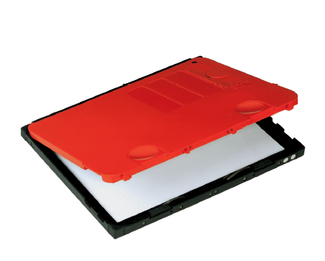
Thank you

