Slide 1
CONGENITAL MALFORMATIONS OF BRAIN AND SKULL PART-1
Dr. MONICA PATIL

Slide 2
EMBRYOLOGY OF HEMISPHERE FORMATION

Slide 3
MAJOR EVENTS
NEURULATION
PROLIFERATION
NEURONAL MIGRATION

Slide 4
NEURULATION

Slide 5
3RD WEEK-neurulation begins as thickening of ectoderm on either side of midline.
4th WEEK- neural folds and tube
25th DAY-anterior neuropore fuses
27th DAY-posterior neuropore fuses

Slide 6
FORMATION OF BRAIN VESICLES
4TH WEEK-division into the 3 major vesicles
5TH WEEK-further division

Slide 7
NEURULATION ERRORS
ANENCEPHALY- failure of closure of anterior neuropore
SPINA BIFIDA- failure of closure of posterior neuropore
CHIARI II MALFORMATION-abnormal neurulation of hindbrain
CEPHALOCELES

Slide 8
NEURONAL PROLIFERATION

Slide 9
Stem cells around the primitive ventricular ependyma form the germinal matrix
These neural stem cells (NSCs) are multipotent ,i.e., generate CNS phenotypes-neurons, astrocytes and oligodendrocytes
Neurons migrate through developing telencephalon to form cortical mantle zone.

Slide 10
Axons of migrating neurons lie in the intermediate zone between germinal matrix and the cortical mantle and gives rise to cerebral WM.
Some NSCs form radial glial cells extending from ependyma to pia
It serves as rope ladder to guide migrating neurons
ERROR in histogenesis leads PNETs.

Slide 11
NEURONAL MIGRATION
Peak migration at 11 to 15 weeks
Along the RGCs fron inside out
Deepest layer of cortex formed first f/b superficial layers
ERROR- leads to malformation of cortical development like microcephaly, megalencephaly, heterotopia, cortical dysplasia and lissencephaly

Slide 12
OPERCULATION, SULCATION AND GYRATION
4TH TO 5TH MONTH
Sylvian fissure first to develop f/b calcerine sulcus
ERROR- leads to microcepahly and microlissencephaly

Slide 13
MYELINATION
Begins at 20 weeks
From inferior to superior, back to front and central to periphery.
Myelination completed by 2 yrs of age

Slide 14
POSTERIOR FOSSA MALFORMATIONS

Slide 15
CHIARI MALFORMATIONS
Chiari I malformation
most common
peg-like cerebellar tonsils displaced into the upper cervical canal through the foramen magnum
Chiari 1.5 malformation
caudal descent of cerebellar tonsils and brain stem
Chiari II malformation
displacement of the medulla, fourth ventricle and cerebellar vermis through the foramen magnum
usually with associated with a lumbosacral spinal myelomeningocoele
Chiari 0 malformation
syrinx
no cerebellar tonsil or brain stem descent

Slide 16
Chiari III malformation
features similar to Chiari II but with an occipital and/or high cervical encephalocoele
Chiari IV malformation
severe cerebellar hypoplasia without displacement of the cerebellum through the foramen magnum
probably a variation of cerebellar hypoplasia
Chiari V malformation
absent cerebellum
herniation of the occipital lobe through the foramen magnum

Slide 17
CHIARI 1 MALFORMATION
Asymptomatic until adulthood.
Symptoms may include headache and those associated with syrinx or scoliosis.
The likelihood of becoming symptomatic is proportional to the degree of descent of the tonsils.
All patients who have greater than 12 mm of descent were symptomatic

Slide 18
ETIOLOGY
Altered bone anatomy and abnormal CSF hydrodynamics is most widely accepted concept
Primary paraxial mesoderm insufficiency
Normal sized hind brain housed in a too small bony envelope

Slide 19
IMAGING
Peg like tonsils instead of gently rounded
Tonsillar herniation(> 5mm)
Retrocerebellar CSF space at FM/C1 levela re effaced
Cerebellar folia are angled obliquely or inferiorly(instead of horizontally)
Bone-small posterior fossa, short clivus, CVJ assimilation
Associated findings-CCD, absent septum pellucidum and hydrocephalus
Displays a normal fastigium(dorsal point)

Slide 20
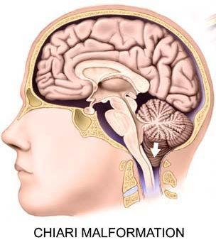
CHIARI 1 MALFORMATION

Slide 21
CHIARI I

Slide 22
TREATMENT
Treatment is usually reserved only for symptomatic patients or those with a syrinx.
It consists of decompressing the posterior fossa, by removing part of the occipital bone, and posterior arch of C1 as well as performing a duroplasty.
With or without tonsillar resection

Slide 23
D/D
TONSILLAR ECTOPIA
INTRACRANIAL HYPOTENSION
RAISED INTRACRANIAL PRESSURE
IDIOPATHIC INTRACRANIAL HYPERTENSION
CRANIAL CONSTRICTION

Slide 24
CHIARI II MALFORMATION
Cerebral
dysgenesis of corpus callosum
absent septum pellucidum
obstructive hydrocephalus, aqueductal stenosis
Prominent massa intermedia
fenestration of the falx with interdigitated gyri or absent falx; heart shape incisura
Creeping or climbing cerebellum
stenogyria/polymicrogyria/heterotopia
tectal beaking and kinking of medulla
Cascade of tissue

Slide 25
spinal
syringohydromyelia
scoliosis
segmentational anomalies:
Klippel-Feil syndrome
atlanto-axial assimilation
Diastematomyelia
cranial vault
small posterior fossa
enlarged foramen magnum
Luckenschadel skull
scalloping of petrous temporal bone
skeletal
clubfoot

Slide 26
CHIARI 2

Slide 27
CHIARI II

Slide 28
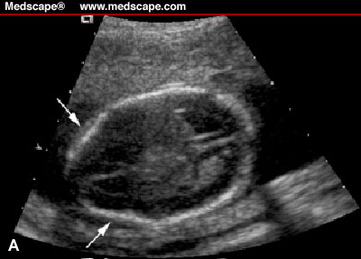
BANANA AND LEMON SIGN

Slide 29
CHIARI II

Slide 30
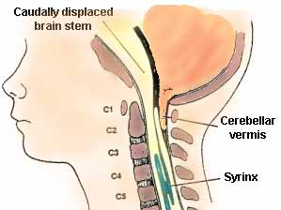
CHIARI 2

Slide 31
TREATMENT
Surgical repair of the meningomyelocele within 72 hrs decreases mortality
Folate supplements during pregnancy prevents it

Slide 32
DANDY WALKER SYNDROME

Slide 33
CLINICAL FAETURES
Most common posterior fossa malformation
More common in females
Patients usually manifest in the first year of life with symptoms of hydrocephalus and associated neurological symptoms.
Macrocephaly is the most common manifestation
Despite severe cerebellar abnormalities, cerebellar signs are not common.

Slide 34
TRIAD OF DWS
hypoplasia of the vermis and cephalad rotation of the vermian remnant
cystic dilatation of the fourth ventricle extending posteriorly
enlarged posterior fossa with torcular-lambdoid inversion (torcular lying above the level of the lambdoid due to abnormally high tentorium)

Slide 35
OTHER FINDINGS
Absent fastigium
Occipital bone may be scalloped, focally thinned and remodelled
Brainstem, cerebellum is somewhat small in moderate to severe forms

Slide 36
DANDY WALKER

Slide 37
DANDY WALKER

Slide 38
PATHOLOGY AND TREATMENT
Delayed opening of foramen of Magendie
This causes 4th ventricle to balloon out posteriorly and form CSF filled cisterna magna cyst
Treatment is by VP shunting with or without cyst shunting or marsupialisation

Slide 39
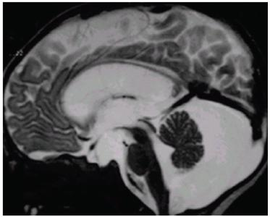
BLAKE’S POUCH CYST
Blake's pouch cyst is a cystic ependyma lined protrusion from the fourth ventricle into the cisterna magna, below and posterior to the vermis .
It is caused by a failure of regression of Blake's pouch secondary to the non-perforation of the foramen of Magendie.

Slide 40
MEGA CISTERNA MAGNA
Large PF
Enlarged cistern magna
May scallop or remodel occiput
Crossed by veins, falx cerebelli
4th ventricle and vermis normal
No supratentorial abnormalities

Slide 41
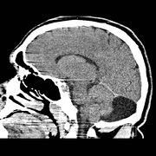
MEGA CISTERNA MAGNA

Slide 42
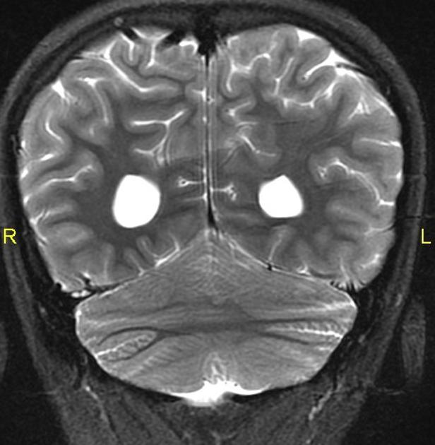
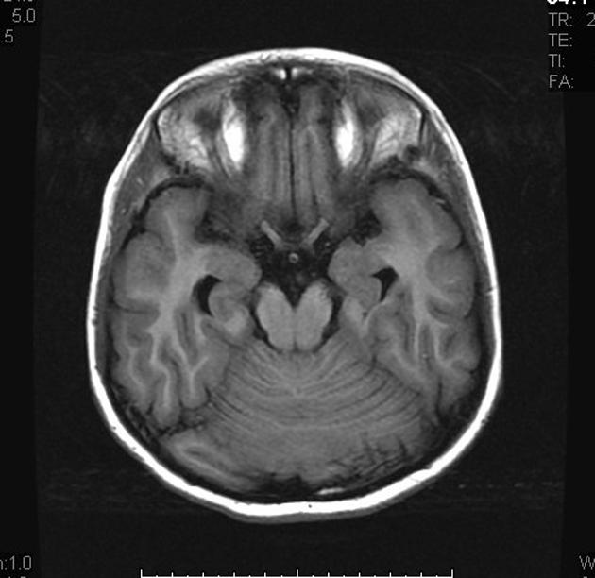
RHOMBENCEPHALOSYNAPSIS
characterised by the vermis absence and continuity of the cerebellar hemispheres, dentate nuclei, and superior cerebellar peduncles.
Associated with VACTERL

Slide 43
JOUBERT SYNDROME
Also known as vermian aplasia or molar tooth midbrain-hindbrain malformation
An autosomal recessive disorder where there is a variable degree of cerebellar vermal ageneis
When associated with anomalies of the kidneys, liver and/or eyes then the term Joubert syndrome and related disorders (JSRD) is used.

Slide 44
Affected individuals usually present with ataxia and have dysmorphic facies, global developmental delay, hypotonia, rapid breathing and oculomotor apraxia.
CORS-cerebello oculo renal syndrome
COACH syndrome-cerebellar hypoplasia, oligophrenia, ataxia, coloboma and hepatic fibrosis

Slide 45
IMAGING
Foreshortened midbrain with deep interpeduncular fossa, a diamond shaped 4th ventricle and prominent thickened elongated superior cerebellar peduncles giving characteristic molar tooth sign like appearance.
small dysplastic or aplastic cerebellar vermis
absence of fibre decussation in the superior cerebellar peduncles and pyramidal tracts , which can be assessed by diffusion tensor imaging

Slide 46
The posterior fossa typically shows a bat wing 4th ventricle
dysplasia and heterotopia of cerebellar nuclei
In a minority of cases minor lateral ventriculomegaly and corpus callosal dysgenesis is also present .

Slide 47
MOLAR TOOTH SIGN

Slide 48
CALLOSAL DYSGENESIS

Slide 49
EMBRYOLOGY
Most common CNS malformation.
Development of the corpus callosum occurs between the 12th and 16-20th weeks of gestation. It begins with the genu and then continues posteriorly along the body to the splenium. The rostrum is the last part to be formed.
Myelination of the corpus callosum occurs in the opposite direction, from the splenium forwards.
In primary agenesis parts of the corpus callosum which form before the insult will be present whereas later parts will be absent.
Presence of the rostrum essentially excludes primary agenesis
One apparent exception to this rule is holoprosencephaly in which it is the anterior parts of the corpus callosum which are absent . This has been termed atypical callosal dysgenesis.

Slide 50
NORMAL CC

Slide 51
IMAGING
ventricles
Ventricles run parallel rather than the normal "bow-tie" configuration giving a racing car appearance on axial imaging
Colpocephaly (dilatation of the trigones and occipital horns) gives a characteristic "longhorn"/moose head/viking helmet appearance on cor imaging
Dilated high-riding 3rd ventricle appears to communicate with the interhemispheric cistern or projecting superiorly as a dorsal cyst
cortex
Bundles of Probst
Radial gyri (absent cingulate gyrus)
Absent /Everted cingulate gyrus
limbic system
hypoplastic fornices
hypoplastic hippocampi

Slide 53
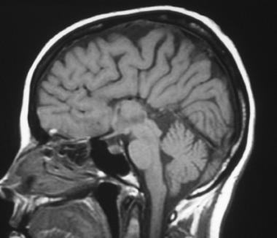
CCA

Slide 54
CCA

Slide 55
Angiography
Angiography no longer has a role in diagnosis, however if performed for other reasons may demonstrate an abnormal course of the anterior cerebral artery, passing directly postero-superiorly with widely spaced pericallosal arteries, and absent pericallosal moustache. The azygos ACA is commonly present in most of cases.

Slide 56
Associated anomalies can be frequent and broad which includes:
aneuploidy syndrome-trisomy 18, trisomy 13
non-aneuploidy syndrome
Aicardi syndrome
Apert syndrome
fetal alcohol syndrome
Zellweger syndrome
Fragile x
CRASH syndrome
Di George syndrome
Williams syndrome
Morning glory syndrome

Slide 57
Other CNS associations:
Chiari II malformation
Dandy-Walker spectrum
grey matter heterotopia
holoprosencephaly
interhemispheric cysts
intracranial lipoma
polymicrogyria
porencephaly

Slide 58
MALFORMATIONS WITH ABNORMAL CELL NUMBER/TYPES

Slide 59
MICROCEPHALY
fetal head measurements (e.g. head circumference) three standard deviations below mean for age.
Craniofacial ratio decreased (<1.5:1)
D/D
MICROLISSENCEPHALY- brain is small, cortex is usually thickened more than 4 mm.

Slide 60
MEGALENCEPHALY
Congenital disorder of cortical formation with hamartomatous overgrowth all or a part of a cerebral hemisphere. This results from either increased proliferation or decreased apoptosis (or both) of developing neurons .
3 SUBTYPES
-isolated
-syndromic
-total hemimegalencephaly- hemihypertrophy also involves the brainstem and cerebellum

Slide 61
SYNDROMES ASSOCIATED
epidermal nevus syndrome
Klippel-Trenaunay Syndrome
McCune-Albright syndrome
Proteus syndrome
unilateral hypomelanosis of Ito
neurofibromatosis type 1 (NF1)
tuberous sclerosis

Slide 62
THANK YOU…

