Slide 1
COMPUTED RADIOGRAPHY -Dr.SHEFALI MESHRAM

Slide 2
Conventional radiography uses an x ray intensifying
screen ,x ray film or both.
The information from the x rays is first stored in the
screens which emits light spontaneously and exposes
the x ray film.
The x ray film is then developed by using developing
solution in a dark room and x ray film is produced.

Slide 3
Nowadays a new process called computed
radiography has been introduced.
In this new process a photostimulable phosphor
is used.
The image is stored in a phosphor containing plate
and is then extracted by means of a reader and
viewed by means of a computer in digital format.
It is the most common method of producing digital
radiographic images and the first technology that was
commercialy available.

Slide 4
PRINCIPLE
Phosphorscence is emission of light that is delayed
for 10⁻⁸ seconds or more.
CR is based on the principle of phosphorescence.
Florescence is emission of light within 10⁻⁸ seconds of
exposure.
Intensifying screens are based on the principle of
florescence .

Slide 5
PHOSPHOR IN CR
The phosphor that is currently used is composed of
europium activated barium fluorohalide.
The halide is a combination of bromide and iodide
typically 85% and 15% respectively.
Europium is added as a impurity or activator. It creates positive energy traps where electrons can bind on excitation.

Slide 6
The phosphor in a powdered form is mixed with a
Binder or adhesive material and laid down as a base
With a thickness of about 0.3mm.
A surface coat protects the phosphor from
physical damage

Slide 7
CASSETTE IN CR
The imaging plate formed is similar in appearance to
intensifying screen used in conventional radiography.
The plate is inserted into a light tight cassette.
It is similar in appearance and of similar dimensions
As that used in film screen radiography.
Hence in CR the radiographic exposure is made using
conventional x ray equipment but here the similarity
to conventional radiography ends.

Slide 8
STEPS OF CR IMAGING
1]PHOSPHOR PRIOR TO EXPOSURE
The plate is first flooded with light from high intensity sodium discharge lamps
This erases any latent image remaining from previous exposure.

Slide 9
2] Formation of latent image
The plate is now exposed to x rays using standard
radiographic equipment.
On exposure the electrons in the phosphor are excited to high energy state.
About half of these electrons return to normal energy state instantly and are no longer available for image formation.
The remaining electrons are trapped in the traps formed by europium and form the latent image.

Slide 10
These traps are positively charged regions in the
crystalline structure formed due to europium.
The trapped electrons are thermally removed on a
statistical basis and will return to their normal energy
State.
This will lead to degradation of the latent image.
Hence the image should be retrieved as soon as possible to prevent degradation due to thermal agitation.
The image is readable upto 8 hours at room temperature.

Slide 11
3] DETECTING THE IMAGE
The image is retrieved by means of a reader. In the reader the plate is scanned by a small dot of light
(100 microns) from a helium neon laser.
First the plate is removed from the cassette and scanned using laser beam.
Scanning is achieved using rotating mirror.
The trapped electrons exposed to the laser light will absorb the light energy.

Slide 12
This addition of energy will free the electrons from
their traps and they become free to return to their
lower energy state.
When the electrons return to this lower energy level
they will emit a light photon.
The energy level of crystalline structure is lower
Than the activator energy level.
The light emitted on return to lower energy level will have more energy than the laser beam, hence it’s wavelength will be shorter than laser beam.
.

Slide 13
The laser light is red in colour. The emitted light is feeble greenish in colour.
The two lights are of different wavelength is critical for image retrieval.
This is because both these lights are in same vicinity and we want to detect the greenish light.
We use initially a filter which absorbs the red light and
allows the green light to pass through.

Slide 14
After the filter an optical fibre is used to direct the light
to photomultiplier tube.
The photomultiplier tube is kept at a remote distance
so that the laser beam does not interact with it.
The photomultiplier tube converts the light signal into
electric signal.
The entire plate can be scanned by moving the image
plate perpendicular to the scan line of the laser beam.

Slide 15
In the output of the photomultiplier tube we have a
continuous point by point scan of the image.
The output of photomultiplier tube is in the form of
electric analog signal corresponding to absorbed
x rays.
The signal from the photomultiplier tube is then
amplified, converted to a digital signal and stored
in a computer by means of a analog to digital
converter.

Slide 17
Following the read cycle the residual signal from the plate is erased by exposing it to a bright light source.
The time for a CR reader to extract the image from the plate is generally between about 30 and 45s.

Slide 18
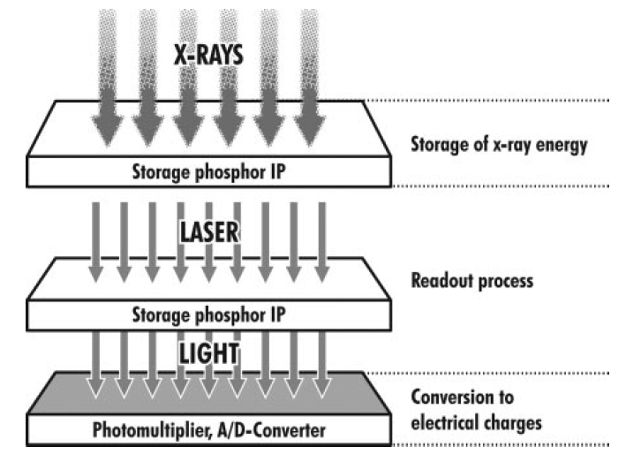
time.

Slide 19
DYNAMIC RANGE
The dynamic range of CR is very large compared to the film.
The dynamic range is graph of light emitted from the plate to dose of x ray produced.
The dynamic range for
CR=10000:1
CONVENTIONAL=100:1

Slide 20
In addition the dynamic range of CR is linear while
that of conventional is S shaped.
It implies that CR will accept a wider range of exposure factors as compared to conventional.

Slide 22
As films have a S shaped curve a low exposure and a
High exposure will lead to insufficient image quality
and failed exposure.
Hence in CR there will be more latitude in choice of
exposure factors viz kvp and mAs as it will accept
Wider range of exposure.
As a result the need of repeated exposures due to
incorrect choice of exposure factors will be decreased.

Slide 23
Spatial resolution
It is the minimum resolvable separation between high
contrast subjects.
In digital imaging each image is divided into a matrix of
individual cells called as pixels.
The spatial resolution is limited by pixel size .
The spatial resolution with CR is less than with
conventional radiography.

Slide 24
Another factor limiting spatial resolution is scattering
of laser beam in the phosphor layer leading to
spreading of area over which light is emitted.
This effect increases with the thickness of the phosphor
layer.
The diameter of scanning laser beam and size of
phosphor grains are also limiting factors in spatial
resolution.

Slide 25
NEWER ADVANCES
Newer phosphor materials are available which are crystals of needle shape and are coated on a glass or aluminium substrate without any binding material
between them .
This technique reduces pixel size

Slide 26
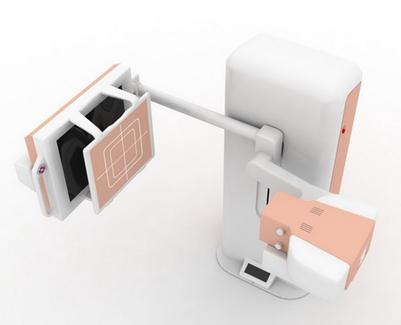
DIRECT RADIOGRAPHY
- Dr. SHEFALI MESHRAM

Slide 27
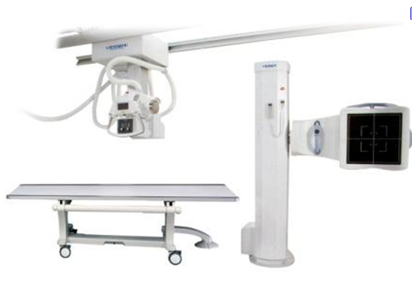
DIRECT RADIOGRAPHY
DR is essentially filmless X-ray image capture.
In place of X-ray film, a digital image capture device is used to record the X-ray image and make it available as a digital file.

Slide 28
Disadvantage of conventional imaging & CR-
Production of final image requires-
Removing cassette from X-ray set - taking plate to reader - waiting for scan time.
In contrast to it-
DR uses imaging DEVICES THAT REMAIN IN SITU and produce an image instantaneously.

Slide 30
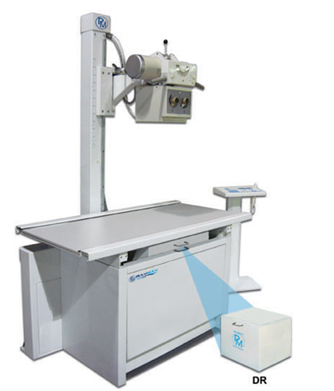
The advantages of DR over film :
Immediate image preview and availability
Wider dynamic range
Ability to apply special image processing techniques that enhance overall display of the image

Slide 31
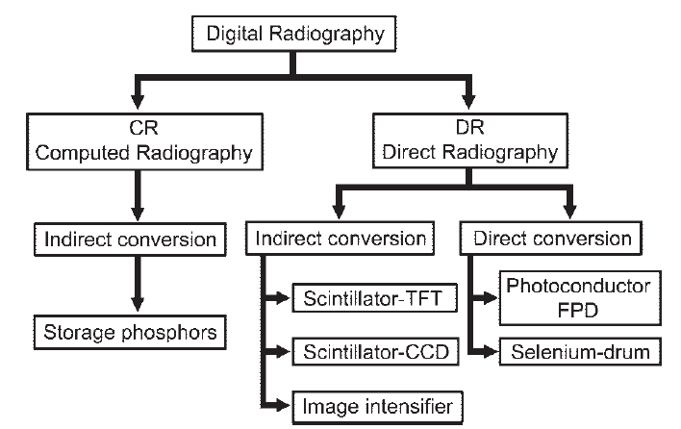

Slide 32
DIRECT DR: PHOTOCONDUCTORS used
which convert:
X-ray photons > Electric signal directly
2. INDIRECT DR: SCINTILLATORS used
which convert:
X-ray photons > LIGHT > Electric signal

Slide 33
DIRECT DR
1. Selenium drum
2. Photoconductor FPD
Photoconductor converts
X-RAY PHOTONS DIRECTLY TO ELECTRICAL CHARGE

Slide 34
INDIRECT DR
1. Scintillator - TFT
2. Scintillator – CCD
-Lens coupled
-Slot scanning
Scintillator converts X-RAY PHOTONS TO LIGHT

Slide 35
Direct dr
Here X-ray photons are converted directly to charge.
The outer layer of the flat panel in this design is a high voltage bias electrode.
It accelerates the captured energy from an X-ray exposure through the AMORPHOUS SELENIUM LAYER.
Electric field is applied across A- selenium layer through electrode on top of selenium
After X-ray exposure, x-rays are absorbed in detector

Slide 36
Electric charge produced collects along charge storage capacitor electrode
This collected electric charge is amplified
Converted to digital code.
The image data file is sent to a computer for display

Slide 37
PHOTOCONDUCTORS
Amorphous selenium : Most common
Lead iodide
Lead oxide
Thallium bromide
Gadolinium compounds
Have high intrinsic spatial resolution- Better image quality.

Slide 38
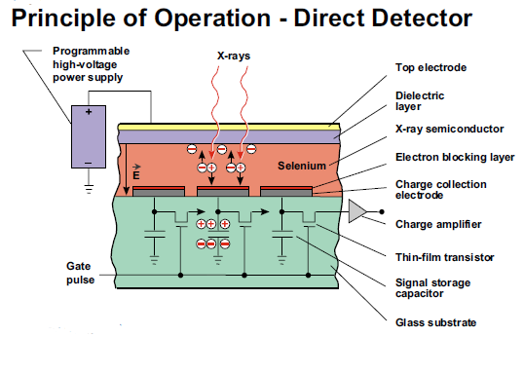

Slide 39
Direct dr
1. Selenium drum
Rotating selenium-dotted drum having a positive electrical surface charge is exposed to x-rays.
Charge pattern proportional to that of the incident x-rays is generated on the drum surface
Recorded during rotation by ADC
(analog to digital converter)
Because of their mechanical design, selenium drum detectors are dedicated thorax stand systems with no mobility at all.

Slide 40
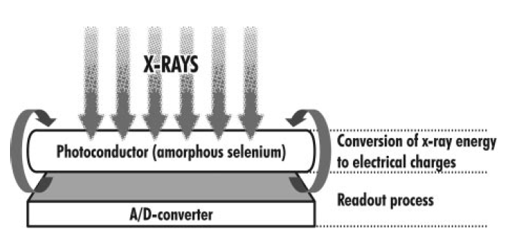
1. Selenium drum

Slide 41
1. Selenium drum
Has better image quality than conventional and CR system due to high intrinsic spatial resolution.
Can be used in mammography.

Slide 42
Direct dr
2. Photoconductor FPD
(flat panel detector)
Consists of layer of selenium with a corresponding underlying array of thin-film transistors (TFTs).
Principle of converting x-rays into electrical charges is similar to that with the selenium drum
Except that

Slide 43
Charge pattern is recorded by the TFT array, which accumulates and stores the energy of the electrons
The transistors amplify the electrical signal and in TFT the amplified signal is stored as an electrical charge which can be released by applying a high potential.

Slide 44
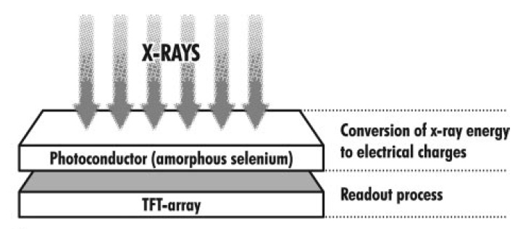
2. Photoconductor FPD

Slide 45
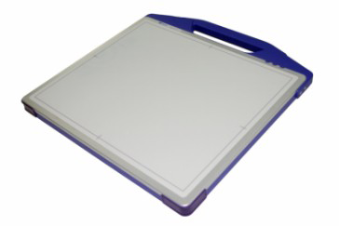
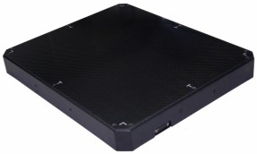
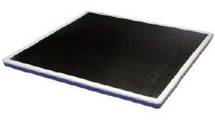
FPDS

Slide 46
INDIRECT DR
1. Scintillator - TFT
2. Scintillator – CCD
(charge coupled devide)
-Lens coupled
-Slot scanning
Scintillator converts X-RAY PHOTONS TO LIGHT

Slide 47
1. Scintillator - TFT
Consists of :
SCINTILLATOR LAYER
AMORPHOUS SILICON PHOTODIODE LAYER
TFT ARRAY

Slide 48
1. Scintillator - TFT
When x-ray photons reach the scintillator
Visible light proportional to the incident energy is emitted
Recorded by an array of photodiodes and converted
to electrical charges.
Charges read out by a TFT array

Slide 49
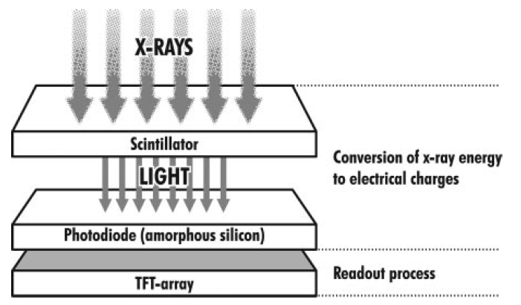
1. Scintillator - TFT

Slide 50
Scintillator
1. Cesium iodide
2. Gado oxysulfide

Slide 51
1. Cesium iodide
Better optical properties and higher quantum efficiency
due to special crystal structure
Highly vulnerable to mechanical load because of their fine structure
Cannot be used outside of fixed installations and therefore lack mobility

Slide 52
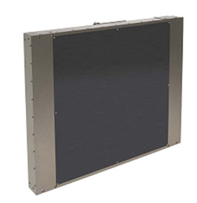
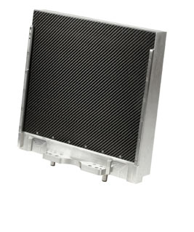
cSi DETECTORS

Slide 53
2. Gado oxysulfide
Resistant to mechanical stress
Hence
Portable flat-panel detector systems make use of Gd2O2S based scintillators

Slide 54
2. Scintillator – CCD
(Charge coupled device)
CCD is a light-sensitive sensor consisting of an integrated circuit containing an array of linked or coupled capacitors.
X-ray energy converted into light by a scintillator such as
cesium iodide
The amount of light emitted is recorded by the CCD
Light is converted into electrical charges
Because the detector area cannot be larger than the CCD chip, it is necessary to combine several chips to create larger detector areas.

Slide 55
2. Scintillator – CCD
-Lens coupled
-Slot scanning

Slide 56
2. Scintillator – CCD
Lens coupled
Array consisting of several CCD chips forms a detector area
Optical lenses are needed to reduce the area of the projected light to fit the CCD array
Drawback is a decrease in the number of photons reaching the CCD
Resulting in a lower signal-to-noise ratio and relatively low quantum efficiency

Slide 57
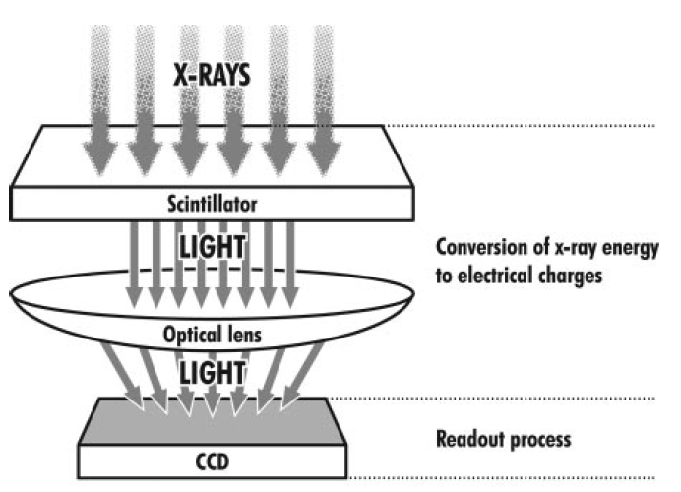
2. Scintillator – CCD
Lens coupled

Slide 58
2. Scintillator – CCD
Slot scanning
Special x-ray tube with a tungsten anode.
Patient scanned with a collimated fan-shaped beam linked to a simultaneously moving CCD detector array having a matching detector width
This combination reduces the impact of scattered radiation in the image

Slide 59
2. Scintillator – CCD
Slot scanning
Because of the need for fixed installation, slot scan CCD systems are dedicated to –
Chest radiography
Mammography
Dental radiography

Slide 60
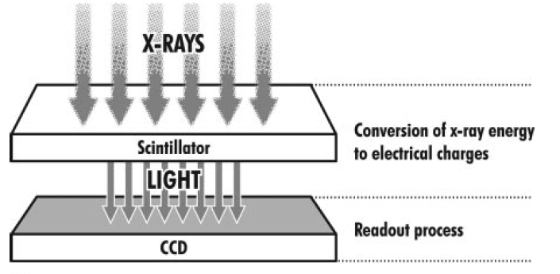
2. Scintillator – CCD
Slot scanning

Slide 61
DIRECT Vs INDIRECT DR
INDIRECT DR
DIRECT DR
X-ray photons > light > electric charge
Scintillator- CsI or Gado compounds
Less spatial resolution
X-ray photons > electric charge
Photoconductor- selenium
More spatial resolution

Slide 62
Detective quantum efficiency [DQE].
The efficiency with which a detector captures the information present in X-ray exposure.
Best measure of detector image quality performance.
If every X ray photon is recorded in the image with no
additional noise then DQE =100%

Slide 63
DQE for DR system = 65%
CR and film screen system is closer to 30%.
DQE is also a measure of efficiency with which SNR of incident exposure is preserved in an image.

Slide 64
ADVANTAGES
Superior image quality
Immediate image retrieval
Image processing - to improve image
quality by reducing noise, making measurements,
and optimizing contrast for viewing.
Reduced exposure.
Storage options
Used with PACS (picture archiving and communicating system)

Slide 65
DIsADVANTAGEs
Lack of mobility.
The flat plate detectors have to be kept at a fixed place.
Very costly
Needs regular upgrade

Slide 67
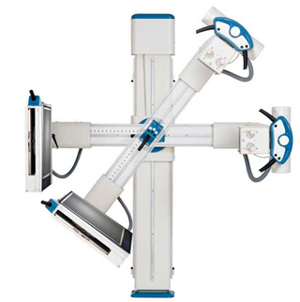
THANK YOU.

