Slide 1
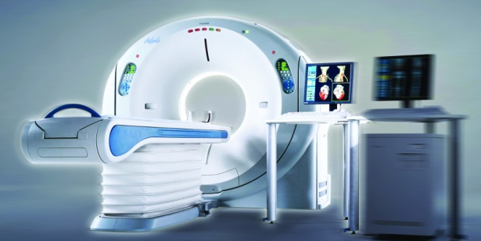

Slide 2
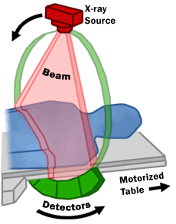
Z axis
The internal structure of an object can be reconstructed from multiple projections of that object taken from multiple direcctions.

Slide 3
Represent gradual evolution of CT technology.
Refers to the betterment of the mechanical construction of the scanner.
Main aim of improvisation was Reducing scan time.
Four generations are known with an arbitrary 5th generation/Recent advancements.

Slide 4
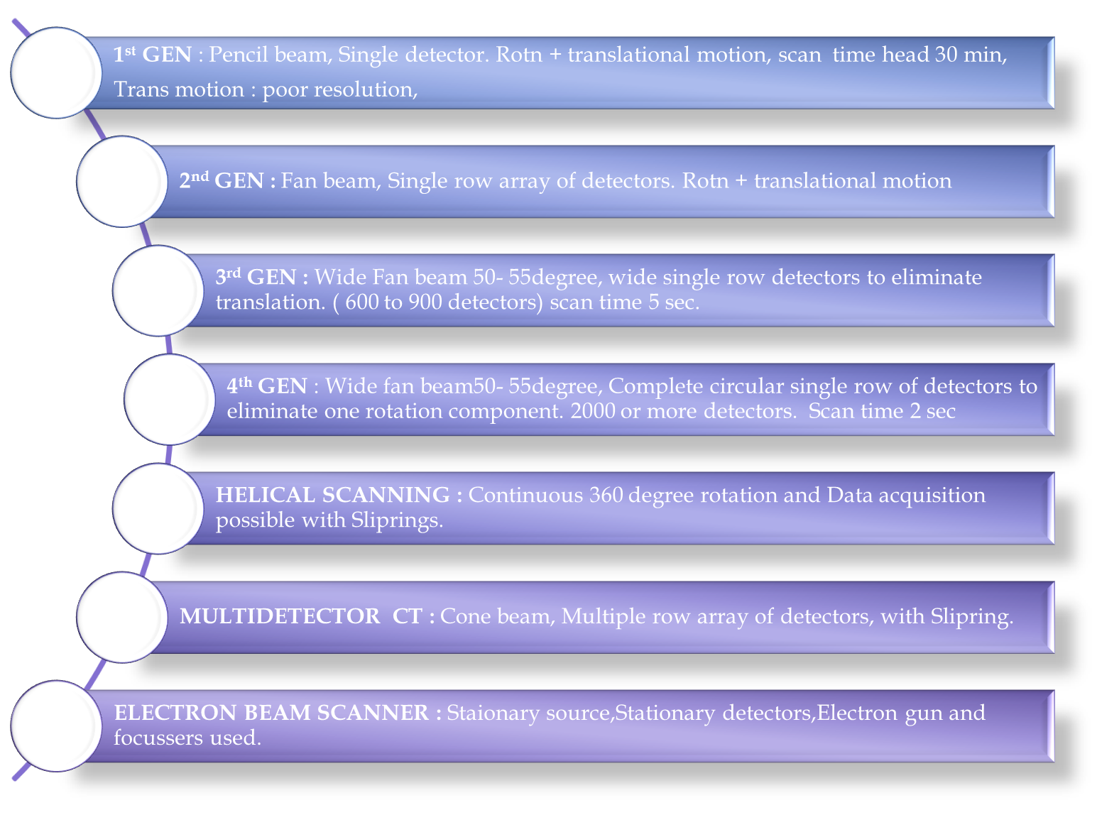

Slide 5
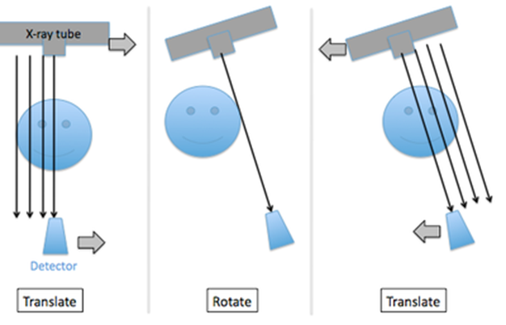
FIRST GENERATION:-
Rotate/Translate, Pencil beam principle
The xray tube detector movements were both linear and rotatory .
The linear motion was repeated over and over 180 times.
Between each of these 180 linear movements ganry rotatedby 1 degree.
The transmitted radiation was measured180 times during each linear movement.
The CT image was reconstructed and then displayed on an 80x80 matrix.
The water bath was used around the head, head was kept closed in a water bath.
DISADVANTAGE:-
LONG SCANNING TIME ( 25-30mins)
IMAGE QUALITY AFFECTED DUE TO PATIENT MOTION

Slide 6
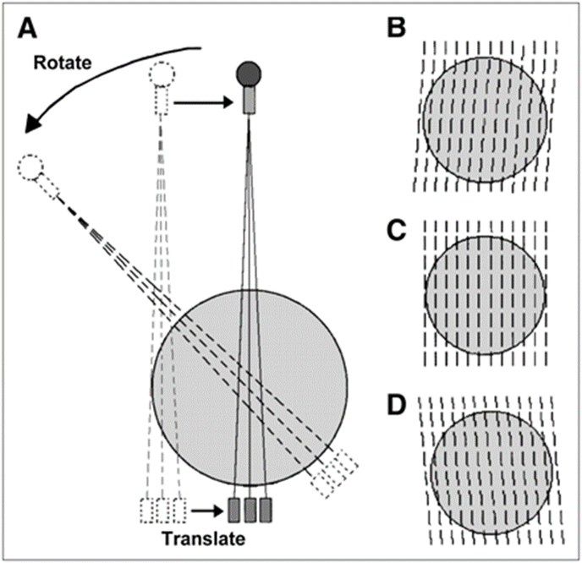
SECOND GENERATION
Rotate/Translate type.
A fan shaped beam and multiple detectors.
Movements of xray tube – detector array areboth linear and rotatory.
The rotation movement is through a greater arc upto 30 degrees.
Linear movements are repeated only 6 times.
Scan time reduced to 3-5 minutes.

Slide 7
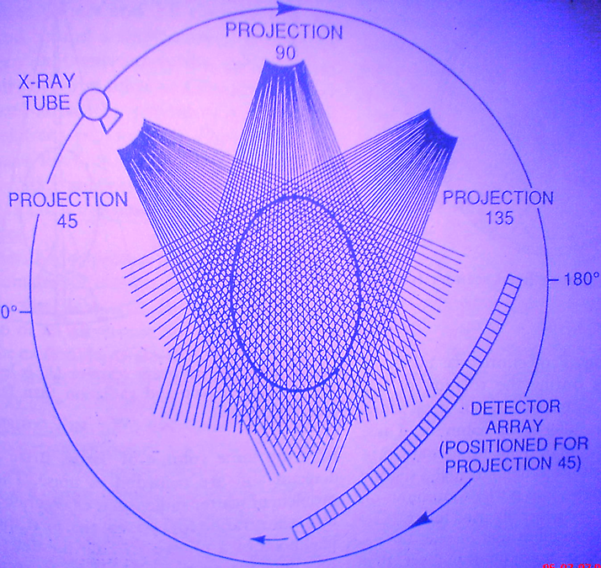
THIRD GENERATION:-
Rotate/rotate.
Use wide angle fan beam.
An arc of detectors and x-ray tube rotate continuously around patient for 360 degree.
Spatial resolution,a key image parameter of ct,depends on how closely spaced are detectors ( i.e. no. of detectors in an arc ).
No. of detectors in arc ranges from, 600 to more than 900,limiting spatial resolution to 5 to 10 line pairs per centimeter.

Slide 8
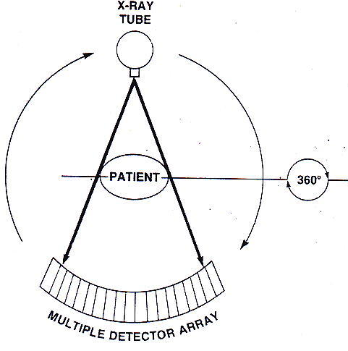
Rotate(tube)-Rotate(detectors) Translatory motion is completely eliminated.
Pulsed wide fan beam(50⁰-55⁰) completely surrounds the patient.
Arc of detectors(600-900)
Detectors are perfectly aligned with the X-Ray tube.
Both x ray tube and detectors rotate around the patient in circles whose centre coincides with centre of patient .
Scan time 4.9 Secs per tomographic scan
Xray tube is pulsed, each pulse producing one projection and the no. of scan lines in each projection was equal to no. of detectors.
Used in multislice scanners.

Slide 9
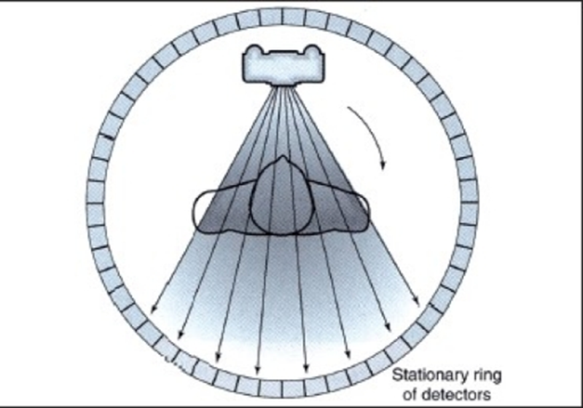
FOURH GENERATION:-
Rotate/stationary…
Use wide angle fan beam geometry(50 to 55 degree)
Only x-ray tube rotates, with fixed detector arc
This geometry permits very high spatial resolution.

Slide 10
FIFTH GENERATION:-
Stationary/Stationary principle
Electron Beam CT
The latest foray of technology in CT is the electron beam CT (EBCT) scanner.
In EBCT, an electron beam is electro-magnetically steered towards an array of tungsten anodes that are positioned circularly around the patient
The anode that was hit emits X-rays that are collimated and detected as in conventional CT.
The use of an electron beam allows for very quick scanning because there are no moving parts. An entire scan can be completed in 50 to 100 milliseconds.
This quick scan time makes this the only CT method which can scan the beating heart….hence for cardiac imaging
At the present time, these machines are installed in only a few sites world-wide.

Slide 11
The latest foray of technology in CT is the electron beam CT (EBCT) scanner.
In EBCT an electron beam is electro-magnetically steered towards an array of tungsten X-ray anodes that are positioned circularly around the patient. The anode that was hit emits X-rays that are collimated and detected as in conventional CT.
The use of an electron beam allows for very quick scanning because there are no moving parts.
An entire scan can be completed in 50 to 100 ms.
This quick scan time makes this the only CT method which can scan the beating heart.
But some technical difficulties and so not so many EBCT centres in world.

Slide 12
Electron gun with focusing and deflecting coils.
High voltage tungsten target ring covering a 210 degree arc below the patient.
Xrays are produced and after passing through patient and collimation, are detected on a 216 degree arc of detectors above.
No mechanical moving parts. What moves is electron beam under influence of its deflector.
TIME – 50 ms for sweeping the electron beam across the arc.- Used predominantly for cardiac imaging.

Slide 13
Spiral CT
Volume (spiral / helical) ct.
Instead of obtaining data sequentially during individual exposure; a block of data in the form of cork-screw or helix is obtained.
If the table movement occurs at such a speed that during one revolution of tube patient is moved by distance equal to slice thickness complete volume of tissue is examined hence the term spiral volumetric ct.

Slide 14
GANTRY CONTAINS
1.Slip rings
2.Generators
3.X-ray tube
4.Collimators
5.Adaptive array detectors
6.Data acquistion system

Slide 15
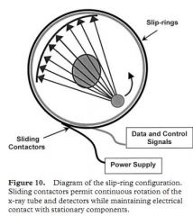
SLIP RINGS
SLIP-RING TECHNOLOGY
In conventional CT systems -inherent delay of 3-5 sec between each exposure
This arose from physical need to have cables connecting stationary gantry & rotating tube- detector assembly-to wind & rewind the tube-detector system.

Slide 16
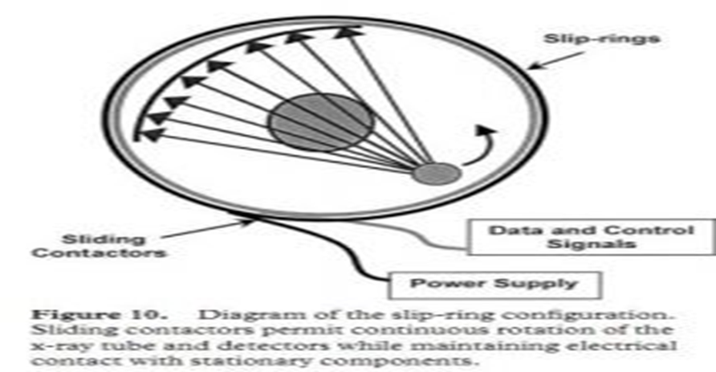
Slip-ring technology abolished the physical need for presence of electric cable between generator & moving tube-detector assembly.
In this power from generator is connected to large stationary ring.
Other large ring that house the x-ray-detector assembly moves around within stationary ring
Power is transmitted between stationary & moving ring by means of brushes,
Hence scene is set for continuous x-ray tube rotation (rather than back & forth) and hence continuous data acquisition

Slide 19
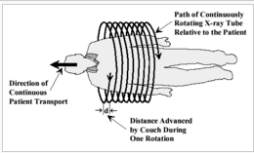
Pitch Factor : Tabletop movement per rotation
Slice thickness or collimation
Eg : Gantry rotation time = 2 sec (for 360⁰ gantry rotation)
Table movement = 5 mm /1sec
Pitch = table movement in one gantry rotation time.
= table movement in 2 sec
= 10 mm.
Suppose we need to acquire, slice width of 10mm,
Pitch factor= pitch / slice thickness = 10 /10= 1.
For slice thickness 2 mm; pitch factor= 10/2 = 5.

Slide 20
Disadvantages :
Increased pitch factor leads to loss of resolution due to need for greater interpolation .
If pitch factor <1 more time required-susceptible to motion artefacts, dose is also more, but image quality is good.
Hence pitch factor > 2 is considered highly unsatisfactory and
maximum pitch factor used is usually 1.5.
Usually, the pitch ranges from 0.2 to 0.4 for cardiac CT protocols. This is quite different from routine body CT protocols, which are typically performed with pitch values of 0.75–1.50.

Slide 21
Faster scan time.
Continuous acquisition of data while table moves the patient through the scan plane.
Minimized motion artefacts : As a result of faster scan times.
Decreased misregistration between adjacent slices.(single breath hold).
Reduced patient dose.
Decreased scan time increases patient compliance.
Improved resolution on along z axis .
Enhanced multiplanar or three dimensional rendering :

Slide 22
Key to three dimensional imaging lies with multislice scanners.
They use solid state detectors with multiple row of detectors along z axis

Slide 23
Two new modifications are made to the existing system:
Instead of a fan beam which is flat along the z axis, a divergence is added to the fan beam along the z axis creating a cone shaped beam.
Instead of a single row of detectors, multiple rows of detectors (along the z axis) are used.
These modifications overcome the shortcomings of the single slice helical detector for 3D imaging.

Slide 24
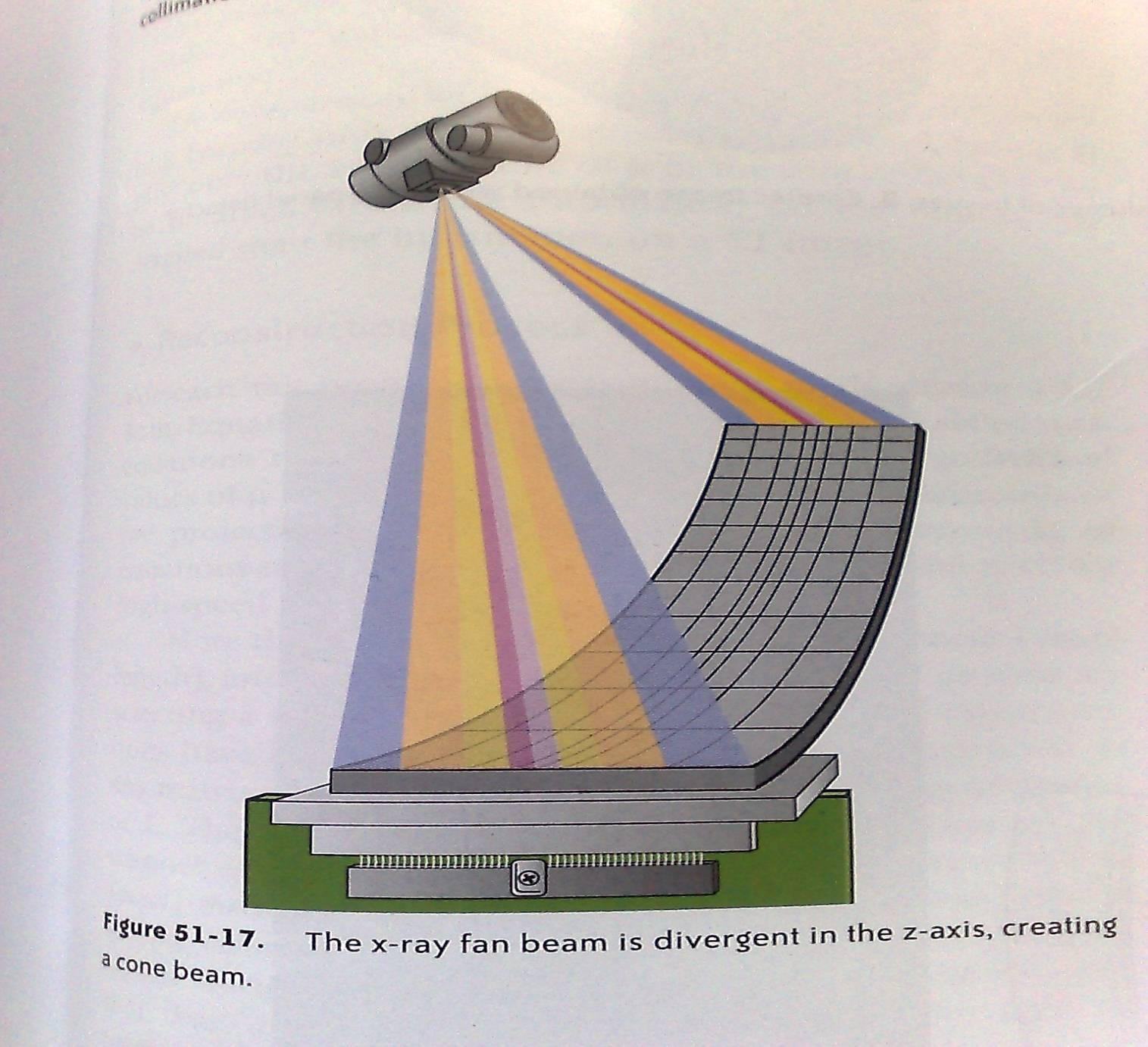
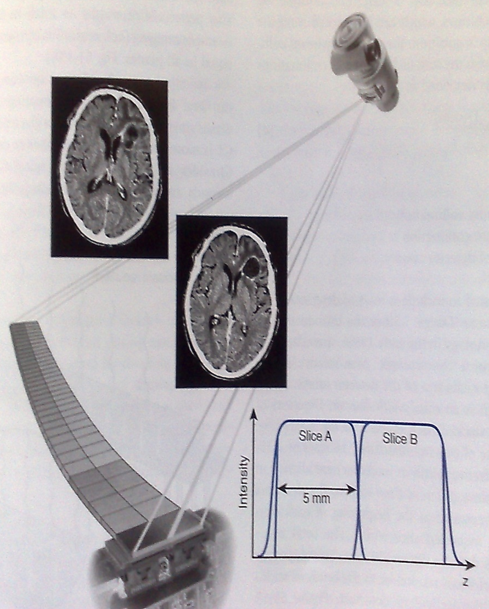
Multiple detectors along
Z axis 16 slice means 16 detectors
Cone beam not fan beam
Increased number of detectors along z axis improves resolution along z axis

Slide 25
Multiple detector CT: Multiple detectors along z axis.
For ex, 16 slice CT contains 16 rows of detectors with 16 data acquisition system channels in the z direction.
Using a multiple-row detector CT scanner capable of obtaining 16 axial sections (16 rows of detectors with 16 data acquisition system channels in the z direction) and with each detector width of 0.625 mm, one can scan a 10 mm (16x 0.625-mm) length per gantry rotation.
Similarly, with a 64-section multiple-row detector CT scanner (64 rows of detectors with 64 data acquisition system channels) and each detector 0.625 mm wide, one can scan about 40 mm per gantry rotation. Typically, the cardiac region ranges from 120 to 150 mm, which can be covered in three to four gantry rotations with a 64-row detector CT scanner. This has a major advantage in terms of the decreased time required for breath holding to minimize motion artefacts.

Slide 26
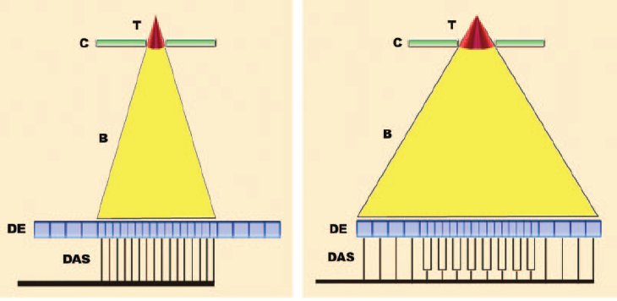
Beam collimation: in 16-section CT. B beam, C collimator, DAS data acquisition system, DE detector elements, T tube. (a) Narrow collimation exposes only the small central detector elements. (b) Wide collimation exposes all of the detector elements. The small central elements are paired or “binned” so that each pair acts as one larger element.

Slide 27
Equal width detector :
Detectors of equal width are stacked back to back along the z axis.
Usually central are thin or 0.6 mm thick,
Variable width detector :
Combines fewer detectors of variable widths and a postpatient collimator to define slice width. (More important in 4 slice CT, In newer 64 slice CT machines the data acquisition system coordination is imp)
More efficient as less unused space in the z-axis.
Permits slice widths as less as 0.5 mm enabling isotropic imaging.

Slide 28
PITCH=Tabletop movement per rotation
collimator length
Collimator length is equal to total detector length used for the scan.
The length of the detector along the z-axis determines the reconstructed slice width and not the collimated width of the fan beam.
PITCH MORE THAN 1 implies gap in the data collection and less than 1 implies an overlap good data collection but more time is required. Pitch max allowed is 1.5
The length of the detector along the z-axis determines the reconstructed slice width and not the collimated width of the fan beam.

Slide 29
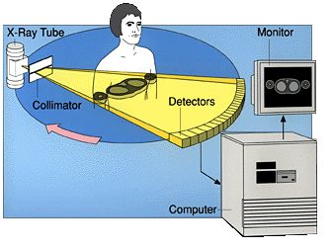
Table

Slide 30
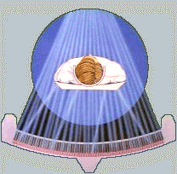
The scanning process begins with data acquisition.
Data Acquisition refers to a method by which the patient is systematically scanned by the X ray tube and detectors to collect enough information for image reconstruction.
A basic data acquisition scheme consists of :
X ray tube
Filters
Collimators
Detectors

Slide 31
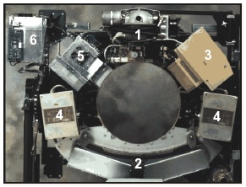
1.X-ray tube & prepatient collimator
2.Detector assembly
3.Tube controller
4.High freq. generator
5.Onboard computer
6.Stationary computer

Slide 32
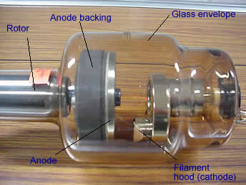
Radiation source for CT is monochromatic x-ray beam .
Provide energy at 120kv and 30 mA.
Rotating anode type
More heat loading and heat dissipation capabilities
Small focal spot size (0.6mm) to improve spatial resolution

Slide 33
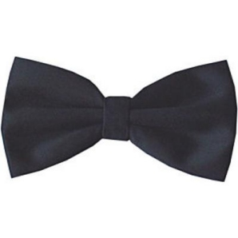
May be used to filter out low energy photons to make the beam uniform (Minimize beam hardening)
BOW TIE Filters: To less of central beam that is uniform and more of peripheral beam which is heterogeneous
Made of ??? Al
Functions:
To absorb low energy x rays
To reduce patient dose
To provide a more uniform beam almost monochromatic.
Notes:
Focal spots: sizes: usually 1 mm,
for magnification radiography: 0.1 mm,
For CT machines: 0.6 mm,
microfocus technique: 50 micrometer

Slide 34
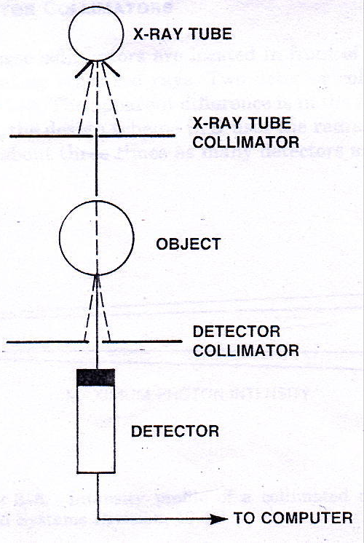
Types: prepatient, postpatient.
Mounted on the Xray tube.
Width : 50 cm at the axis of rotation – sufficient to cover the full cross-section of patient.
Uses of prepatient collimator:
To decrease scatter radiation
To reduce patient dose
To improve image quality
Uses Postpatient predetector Collimator: Its width determines the slice thickness.
Both should be in perfect alignment.

Slide 35
IDEAL DETECTOR
Small in size - For better spatial resolution
Have high detection efficiency.
Have a fast response
Negligible afterglow.
Have a wide dynamic range – must respond to a wide range of X-ray beam intensity.
Have a stable noise free response.
Good detector quantum efficiency.

Slide 36
The detectors gather information by measuring the x-ray transmission through the patient.
Two types:
Scintillation crystal detector
Can be used in third and fourth generation scanners
Xenon gas ionization chamber
Can be used till third generation scanners only

Slide 37
Solid state detectors. (Overall efficiency: 80%)
Crystals that produce light (scintillate) when ionizing radiations pass through them.
Energy of x-ray photon is converted to light
photons: some are promptly emitted and some are delayed producing what is called as afterglow.
Made up of two parts: scintillation crystal and light detector.
Electrical signal output of detectors is proportional to the incident photon.

Slide 38
Crystals used: Cesium iodode (CsI)
Bismuth germinate (BGO)
Cadmium tungstate (CdWO4)
CdWO4 is the most commonly used.
All these have short decay times – Afterglow is not a problem.
Stopping power for X rays is almost 100 %.

Slide 39
Silicon photodiodes (Solid state photodiodes).
Converts light signal into electric current that is proportional to intensity of light signal.
Smaller size
Greater stability
Lower cost.

Slide 40
Notes:
Na I is replaced with Cd WO4 / Cs I / BGO Most commonly CdWO4 is used
PMT is replaced with silicon photodiodes

Slide 41
Detector cross talk occurs when a photon strikes a detector, is partially absorbed and then enters the adjacent detector and is detected again.
Crosstalk produces two weak and signals coming from two different detectors.
Crosstalk is bad because it decreases resolution.
Crosstalk is minimized by using a crystal that is highly efficient in absorbing X-rays (high stopping power).

Slide 42
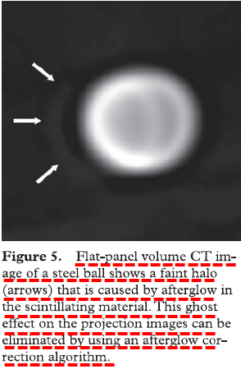
AFTERGLOW
Afterglow in a crystal can degradde image quality.
CsI is a slow scintillator.
Goes on emitting light even after stimulating radiation is gone.
If in immediate next time, next X ray falls it will not form image or will form blurred image with ghost artefact.
To correct In flat pannel CT: the processor subtracts previus image from next one.

Slide 43
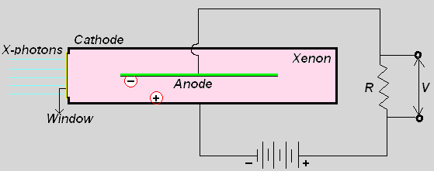
All gas filled detectors must have
Anode and cathode
Inert gas (that ionizes on exposure to radiation),
Window for photon to enter the detector.

Slide 44
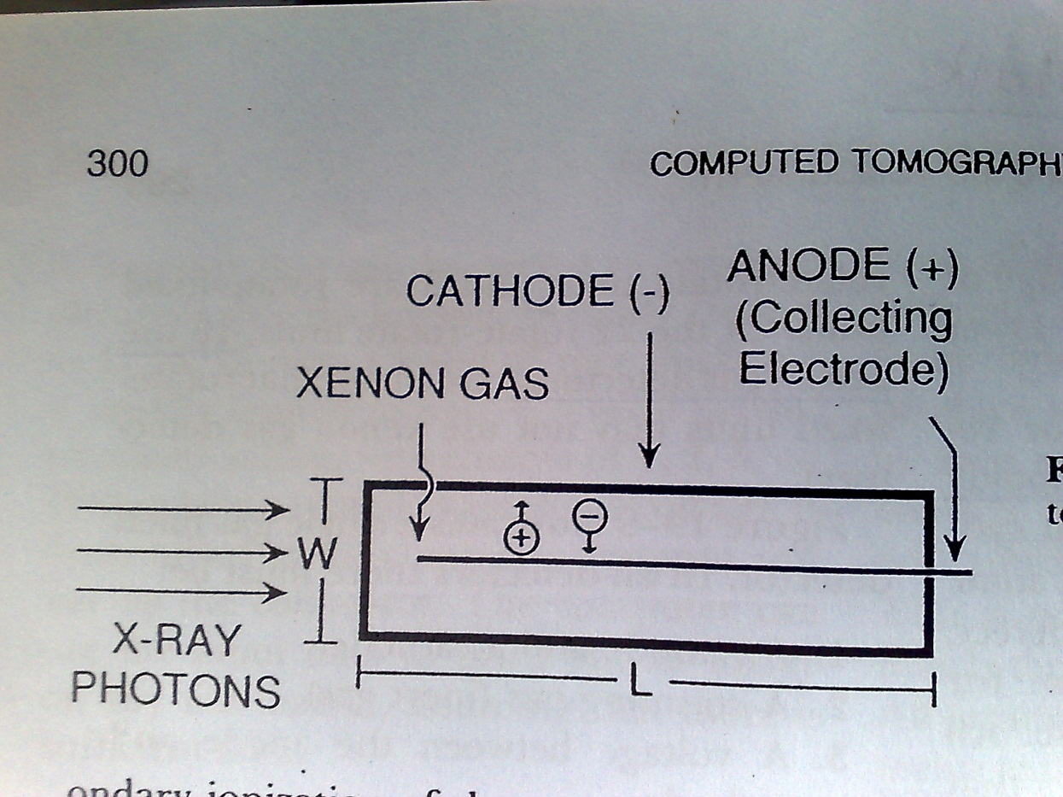

Slide 45
Efficiency - 50 to 60%
This low efficiency is caused by two factors.
Low density of the absorbing material,
So most of the x-ray photons pass undetected through the chamber,
Significant cross talk,
Loss of information.

Slide 46
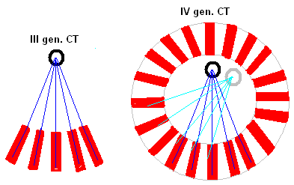
Typical size of a chamber is 1-2 mm wide, 10mm high and 8-10cm deep.
These 10mm long side plates are the reason why Xenon detectors are not in IV generation CT scanners.
Notes:
In III generation CT scanners, the X-ray tube and detectors maintain a fixed relationship, so the beam is always aligned with the long axis of each detector.
In IV generation CT scanner, angle at which X-rays hit the detector changes constantly. Obliquely entering X-rays would pass through only a short distance of gas before they hit the wall of the detector. In such a case, the X-rays are absorbed in the detector walls and the information they carry in lost for all time.

Slide 47
Core physics

Slide 48
Basic concepts
Algorithms for image reconstruction :
Back projection
Filtered back projection
Iterative methods
Analytical methods.
Various components of Image display.

Slide 49
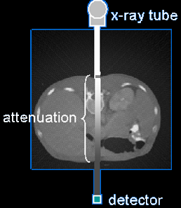
What are we measuring?
The average linear attenuation coefficient (µ), between tube and detectors.
Attenuation coefficient reflects the degree to which the X-ray intensity is reduced by a material.

Slide 51
Linear attenuation coefficient
The linear attenuation coefficient (μ) of each pixel is determined by :
Composition of the voxel
Thickness of the voxel
Quality of the radiation beam
µ

Slide 52
X-ray beam is exponentially attenuated as it passes through a tissue slice.
-µL
I = Io e
I= The transmitted intensity
Io = The incident intensity of an
x-ray beam on the surface of an object of thickness L
e = Eulers costant (2.718)
Base of natural log.
µ = Linear attenuation coefficient
L= thickness of object through which x rays are passing.

Slide 53
We know I0 and I
Thus we calculate, µ for a voxel from formula
Then we calculate CT number using formula
CT Number=…………
Give it a shade of gray dep upon CT number
Show it in image pixel corr to that voxel.

Slide 54
Process of generating an image from the raw data or set of unprocessed measurements made by the imaging system.
Image reconstruction algorithms.
Back projection
Iterative methods
Analytic methods : 2D Fourier analysis Filtered Back Projection

Slide 55
Oldest method. Not used in any present scanners.
The image profiles look like steps. The height of the steps is proportional to the amount of radiation that passed through the block.
The steps are then assigned to a gray scale density that is proportional to their height. These densities are arranged in rows called as RAYS.
When the rays from the two projections are super imposed, or back projected, they produce a crude reproduction of original object.

Slide 56
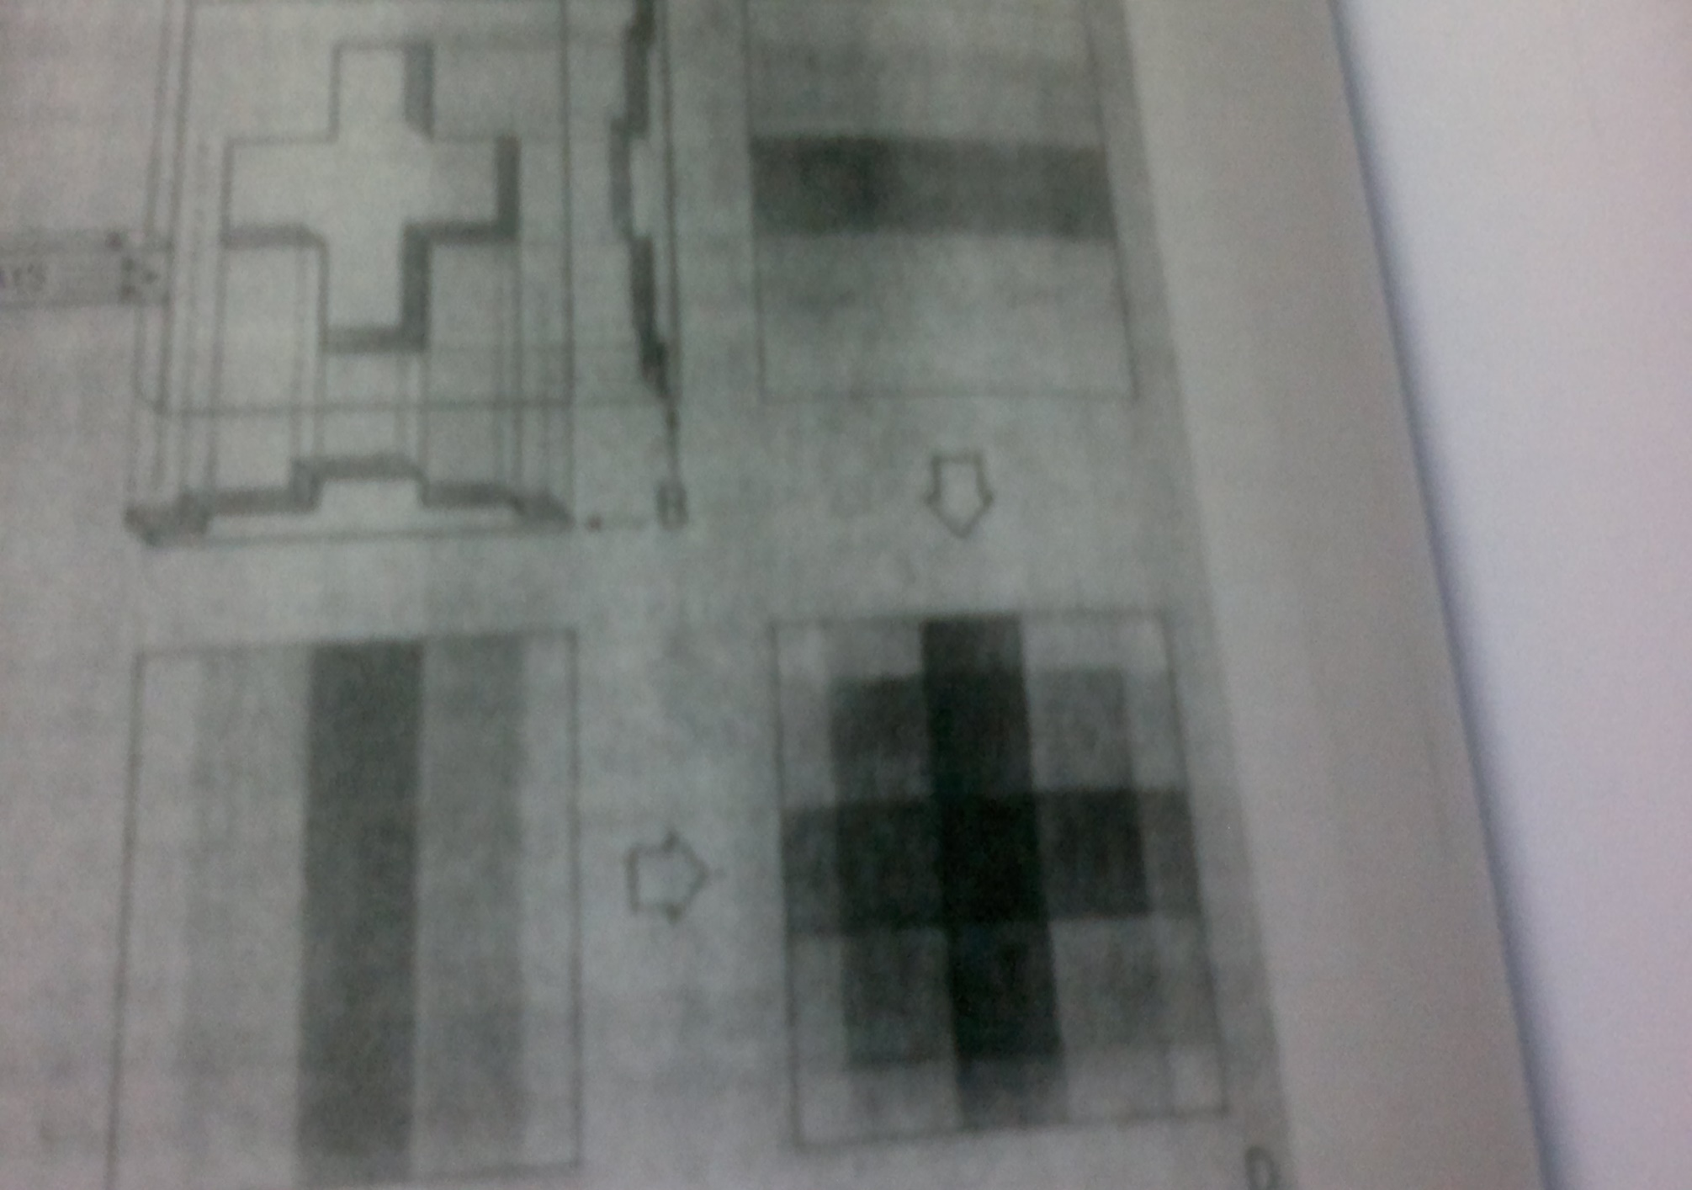

Slide 57
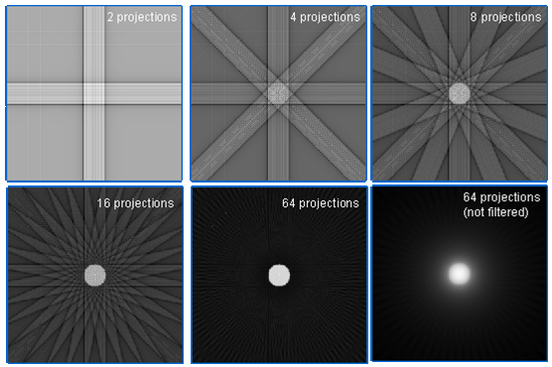

Slide 58
Assumption (for eg. all points in the matrix have same value)
Comparison (with the measured values)
Correction (to bring the two into agreement)
Repetition (of the process until the assumed and measured values are the same or within acceptable limits)

Slide 59
Simultaneous reconstruction
All projections for the entire matrix are calculated at the beginning of the iteration, and all corrections are made simultaneously for each iteration.
Ray by Ray correction
One ray sum is calculated and corrected and these corrections are incorporated into future ray sums, with the process being repeated for every ray in each iteration.
Point – by – point correction
The calculations and corrections are made for all rays passing through one point, and these corrections are used in ensuring calculations, again with the process being repeated for every point.

Slide 60
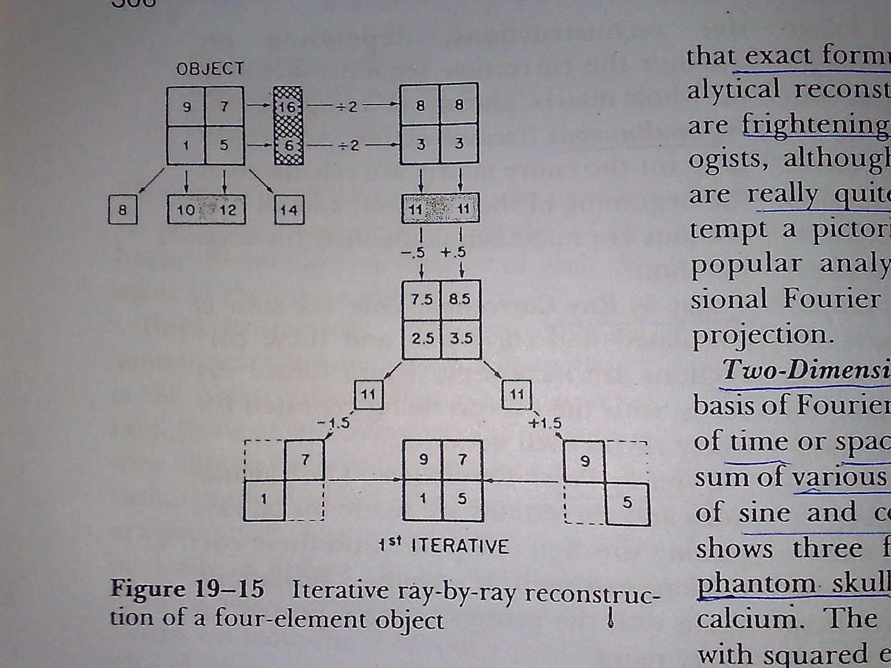

Slide 61
Used in almost all X-ray CT units today.
Differ from Iterative methods in that Exact formulas are used instead of assumptions for analytical reconstruction.
Too complex formulae as such and hence need to be processed by special computers.
TWO POPULAR ANALYTICAL METHODS :
Two dimensional Fourier analysis
Filtered back projection.

Slide 62
Basis: Any function of time [f(t)] or space [f(x)] can be represented by the sum of various frequencies and amplitudes of sine and cosine waves.
A single cosine wave of appropriate height and length makes the first approximation of the wave and each subsequent addition improves the reproduction.

Slide 63
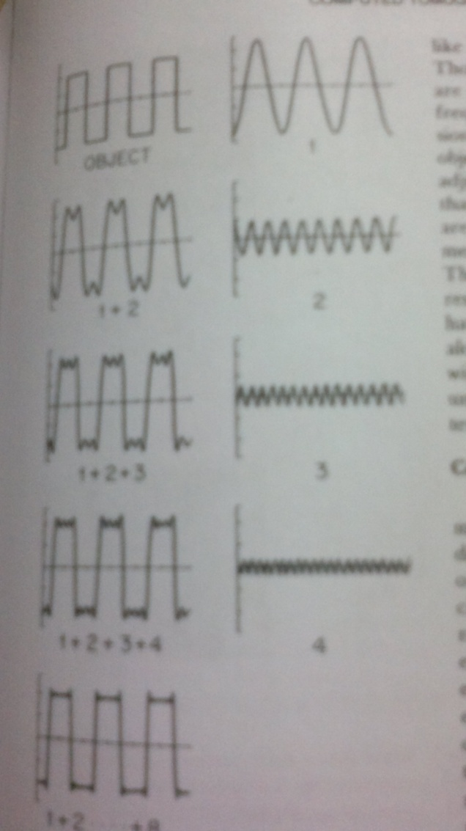

Slide 64
Most common method used for image reconstruction in earlier as well as recent scanners .
It is actually a analytical method.
Overcomes the shortcomings of Simple back projection and improves the resolution.
For each Xray beam measurement, the values that are projected back into the overlying voxels use the data not just from that beam but also from the neighbouring beams.
Data from neighbouring Xray beams can be Added to or Substracted from the projection, closest beam having the greatest effect.

Slide 65
Similar to simple back projection.
The image is filtered or modified to counter balance the effect of sudden density changes, which causes blurring (star – pattern). Those frequencies responsible for blurring are eliminated to enhance more desirable frequencies.
The density of the projected rays is adjusted that is, the inside margins of dense areas are enhanced while the immediately adjacent areas are repressed. The net effect is an image more closely resembling the original object.
Most commonly used nowadays.

Slide 66
In terms of speed, Analytical methods are faster than iterative methods. Because iterative methods involve 4 steps and 4th is repeatation and analytical methods directly use complex formulae.
But with incomplete data(Insufficient to determine the image fully) iterative methods are faster than analytical methods.
Analytical methods does time – consuming interpolations to fill in missing data, whereas iterative methods simply average adjacent points.

Slide 67
CT scanner calculates ,from the collected data ,the linear attenuation coefficient (µ) for each pixel.
The computer calculates a relationship between the linear attenuation coefficients of the pixel and water which is given as CT number.
Density < water : negative CT number(AIR)
Density>water : positive CT number(BONE)

Slide 68
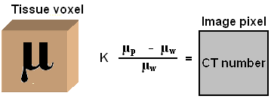
K = Constant (1000 in currently available units)
µ p = Pixel linear attenuation coefficient
µ w = Water linear attenuation coefficient.

Slide 69
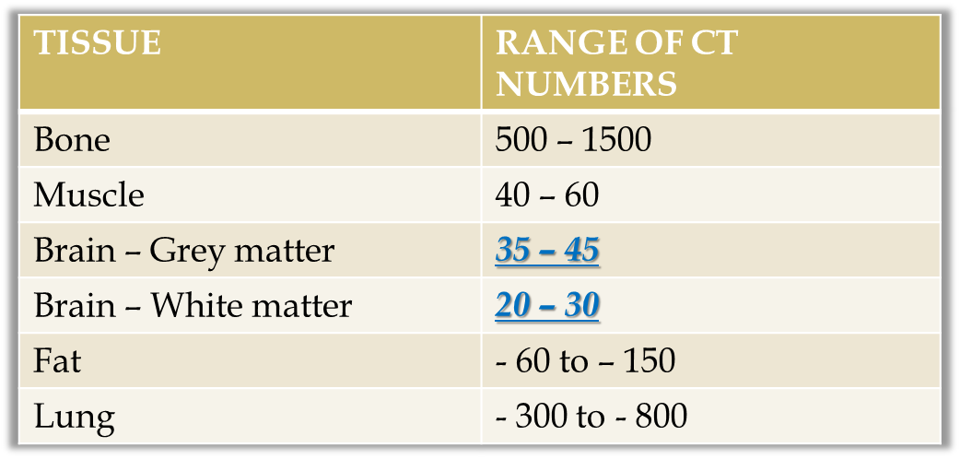
Thus the range CT values for common entities is :

Slide 70
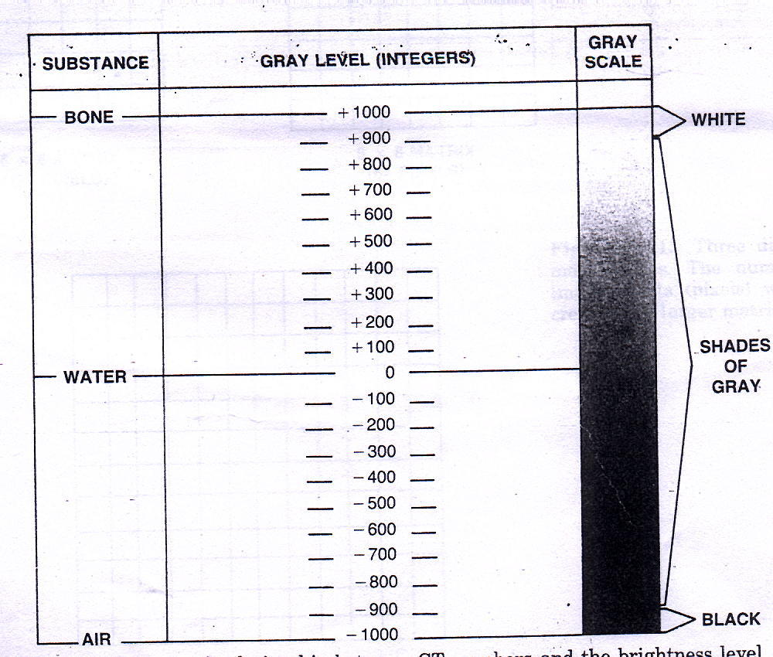
8 bit image 2⁸ = 256 shades of gray,
16 bit image 2¹⁶ shades of gray,
And so on

Slide 71
CT image will have pixels with CT values ranging from – 1000 to + 1000.
If all these are displayed by distinct graded shades of grey, it will result in the image appearing too flat due to the limited ability of human eye to distinguish the shades.
Hence windowing is applied in digital imaging to bring out the most relevant detail in the image.

Slide 72
Human eye cannot appreciate contrast differences <10% whereas CT can differentiate as less as 1%.
So user is enabled to select a small range of gray levels from the entire CT number scale and reset the black and white limits.
For eg. CT numbers of liver lie in range of 40-90 HU on a scale of 1000 HU, So if 40HU and less is set at black and 90 HU or greater is set at white ,the scale of visualisation is 50HU and entire range of liver tissues covers a contrast range of 100%.

Slide 73
A CT number is selected – which is about the average CT number of the body tissue being examined.
A range of CT numbers is then selected –appropriate for that tissue which is then distributed into two halves on either side of the above selected CT number. The range of CT values is known as Window Width.
The previously selected CT number now comes to lie in the center of the window width and is known as Window Level.

Slide 74
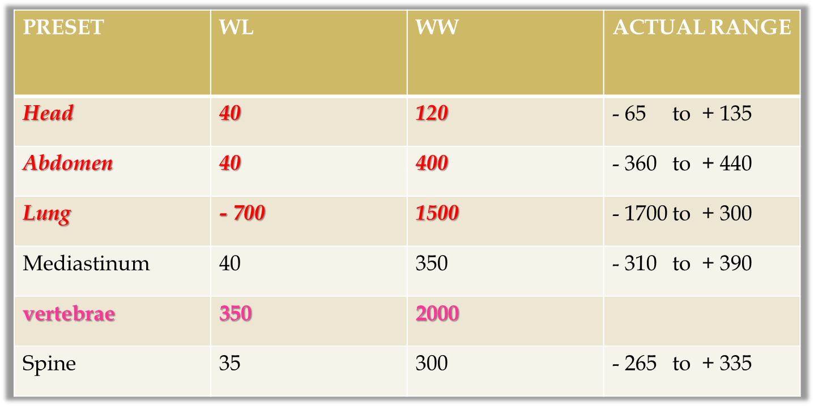

Slide 75
Image quality is the visibility of diagnostically
important structures in the CT image.
The factors that affect CT image quality are
Quantum mottle (noise)
Resolution : Spatial and contrast, temporal
Patient exposure.
The factors are all interrelated

Slide 76
Quantum mottle is the statistical fluctuations of X-photons absorbed by the detector.
The only way to decrease noise is to increase the number of photons absorbed by the detector.
The way to increase the number of photons absorbed is to increase x-ray dose to the patient.
In fact mottle becomes more visible as the accuracy of the reconstruction improves.
Most of the noise in current CT images is the result of statistical fluctuations and not related to mathematical reconstruction.

Slide 77
mAmp : Noise ↓ with ↑ in mAmp.
Scan time : Noise ↓ with ↑ in scan time(scan time also increases mAs)
Slice width : Noise ↓ with ↑ in Slice width.(spatial resolution of the image is reduced)
kVp : ↑ kVp, ↓Noise.(More kVp ,more is the penetration and more is the no. of photons are detected).
FOV and MATRIX size: Decreased FOV and increased matrix size, smaller detector per pixel and so fewer photons and so noise increased.
Noise increases as window width decreases.

Slide 79
Spatial resolution is the ability of the CT scanner to display separate images of two objects placed close together.
High contrast spatial resolution is determined by :
Scanner design
Computer reconstruction
Display
Spatial resolution in MDCT:
Z axis: reqd for 3D recons, 7 to 15 line pairs.
X, Y axis: 10 to 20 line pairs.

Slide 80
Scanner design :
Focal spot size : Smaller the better.
Detector size : Smaller the better.
Magnification: More the better.
No. of projections sampled in each rotation : More the better.
Computer reconstruction:
Reconstruction interval: Overlap 30 % for routine CT,
50 % for cardiac CT.
Does not directly influence resolution.
The reconstruction matrix must be large enough to reconstruct all available information, otherwise information will be lost
Patient motion,
Detector size along z axis Usually 0.625 cm in newer MDCT.
DISPLAY:
Increasing the matrix size increases the spatial resolution. (as pixel size decreases)
Decreasing the pixel size improves the spatial resolution.(due to reduced partial volume averaging).
Notes:
Calcualted linear attenuation coefficient for a pixel is a weighted average of all materials in the pixel.with even small amount of calcium whole picture appears white k/s partial volume averaging.

Slide 81
Contrast resolution is the ability of the CT scanner to display an image of a relatively large (2 or 3mm) object that is only slightly different in density from its surroundings.
More homogenous the background, better is the visibility of low contrast structures.
Homogeneity of the background is the function of noise.

Slide 82
Resolution pertaining to time.
Depends upon: Reconstruction protocol,
Gantry rotation time: which in turn depends upon: rotating mass which is often in tons,
Pitch factor
Most imp in moving structure imaging: cardiac CT.
To create an image data acquired over 180 degree of gantry rotation is sufficient.
Gantry rotation time: 320 msec for newer MDCTs,
This is difficult parameter to reduce beccause minimal decrease in gantry rotation will take lot of engineering efforts, cost. The
Rotating mass in gantry is in tons.
MDCT: Dual source: 320/ 4 = 80 to 120 msec
Single source: 320/ 2 = 160 to 200 msec,
EBCT: 30 ms,

Slide 83
Even distribution of radiation dose to the tissues as exposures are from almost all angles.
No overlapping of scan fields takes place.
Exposure factors used are higher to improve spatial and contrast resolutions and to reduce noise.

Slide 84
kV :
Commonly set to 120 kV.
Increased kVp decreases dose exposure.
mA :
Constant mA technique: more dose.
mA modulation technique : 10 – 40 % dose reduction is possible.
Helical or Axial Acquisition :
Slight greater in helical due to small amount of over-scanning at start and end.
Pitch : Inversely proportional to pitch.
Use of pitch 1.5 rather than 1.0 leads to a 33 % dose reduction.

Slide 85
Perspex phantoms have diameter of 16 and 32 cm respectively to represent head and body scans.
CTDIw:
Weighted value for a complete cross section obtained from measurements from centre and various peripheral locations within the phantom.
It is an approximation for the average dose.
CTDI vol :
Dividing the CTDIw by beam pitch (in case of multislice scanners).
Better parameter,
Represents the average dose absorbed within the scanned volume.

Slide 87
Thank You……..

