Slide 1
CHEST X RAY ANATOMY AND PROJECTIONS

Slide 2
EVALUATING CHEST RADIOGRAPH FOR TECHNICAL ADEQUACY
Five factors important for an adequate chest x ray are
Penetration
Inspiration
Rotation
Magnification
Angulation

Slide 3
Penetration
Penetration is determined by the voltage setting on the x ray tube.
Normally used is 80-120 kVp.
In a well-penetrated chest radiograph the vertebral bodies will be just discernable through the heart on the frontal film.

Slide 4
Low to intermediate kVp technique (60-80kvp) gives good contrast, miliary shadowing and calcification can be seen well.
High kvp technique(120-150kvp) enables better visualization of lung fields and mediastinum .
Overexposure produces too dark films while underexposure causes the film to be too pale.

Slide 5
Under-exposure
Over-exposure

Slide 6
Depth of Inspiration
The level of inspiration can be estimated by counting ribs.
Visualization of ten posterior ribs, or six anterior ribs on an upright PA radiograph projecting above the diaphragm would indicate a satisfactory inspiration.
Shallow inspiration will cause the heart to appear enlarged and crowding of vessels at the lung bases mimicking basal lung infection or segmental collapse.

Slide 7
--
Inspiratory film
Expiratory film

Slide 8
Rotation
Ideally the clavicle heads should be equidistant from the spinous process.
Rotation of the radiograph is assessed by judging the position of the clavicle heads and the thoracic spinous process.
Rotation Of patient distorts mediastinal anatomy and makes assessment of cardiac chambers and the hilar structures especially difficult.

Slide 9
Well centered
rotation

Slide 10
Magnification
AP films cause a false impression of cardiac, mediastinal and aortic enlargement as compared to the standard PA chest radiograph .

Slide 11
Angulation
If the X-ray beam is angled towards the head, the film is called an “Apical Lordotic” view.
Anterior structures (like the clavicle) will be projected higher on the film than the posterior structures.
Angulation might cause an unusual shaped heart shadow and ill defined left dome of diaphragm.

Slide 12
Different CXR Views
PA VIEW
AP VIEW
LATERAL VIEW
LATERAL DECUBITUS VIEW
OBLIQUE VIEW
LORDOTIC VIEW-For middle lobe pathology and lung apices
APICAL VIEW

Slide 13
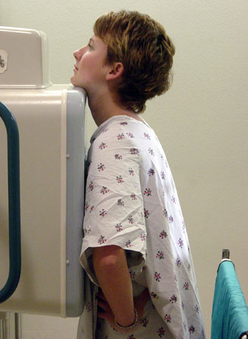
PA VIEW
It is the most frequently used view.
It enables easy comparison of current film with old films.
Position: Patient facing the
cassette, chin extended and centered to the middle of top of the cassette with the shoulders rotated forwards and pressed downwards in contact with the cassette to displace the scapulae from the lungs. This is done by placing the dorsal aspect of hands below and behind the hips, with elbows brought forward, or by allowing the arms to encircle the cassette.
Exposure : is made on full
inspiration. X ray may be taken in full expiration to confirm pneumothorax.

Slide 14
Centering : The horizontal central beam is directed at right angles to the cassette at the level of T8 vertebra i.e. spinous process of T7.
Essential image characteristics :
Full lung fields with scapulae projected laterally and away from the lung fields.
The clavicles should be equidistant from the spinous processes and not obscuring the lung apices.
Lungs must be well inflated.
Mediastinum and heart placed centrally.
Costophrenic angles and diaphragm outlined clearly.
Lung vessels seen from hilum to the periphery.

Slide 15
Imaging parameters :
Focal spot size : <1.3mm
FFD : 180cm (140-200cm)
Voltage : 100-150 kVp
Exposure time : < 20ms
Film screen combination : speed class 200-400
Total filtration : >3mm

Slide 16
AP VIEW
AP view can be taken in erect, semi- erect or supine position.
Position : patient’s back against the cassette with upper edge of cassette above the lung apices. The mid sagittal plane should be at right angles to the cassette.
Centering : the central ray is directed at right angles and towards the sternal notch.

Slide 17
Why is PA preferred over AP
Reduces magnification of heart therefore preventing appearance of cardiomegaly.
Reduces radiation dose to radiation sensitive organs such as thyroid, eyes, breasts.
Visualized maximum areas of lung.
Moves scapula away from the lung fields
More stable positioning for the patient as they can hold onto the unit – this reduces patient movement.
Compression of breast tissue against the film cassette reduces the density of tissue around the CP bases therefore visualizing them more clearly.

Slide 18
LATERAL VIEW
Position : Patient turned to bring the side in contact with the cassette so that mid sagittal plane is parallel to the cassette. The arms are folded over the head or raised above the head to rest on a horizontal bar.
Centering : The central ray is directed at right angles to the middle of the cassette at the mid- axillary line.

Slide 19
Comparison with PA view :
Advantages :
Anterior mediastinal masses
Encysted pleural fluids
Posterior basal consolidation
Disadvantages : Lung collapse
Large pleural effusion.

Slide 20
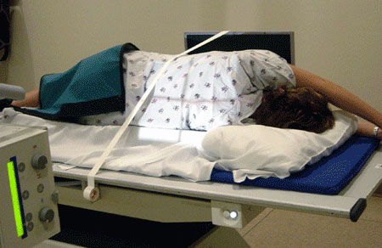
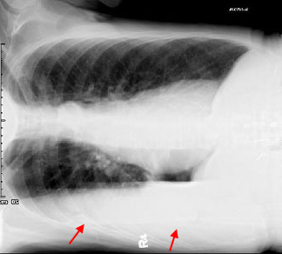
Lateral Decubitus View
It is helpful to assess the volume of pleural effusion and demonstrate whether a pleural effusion is mobile or loculated.

Slide 21
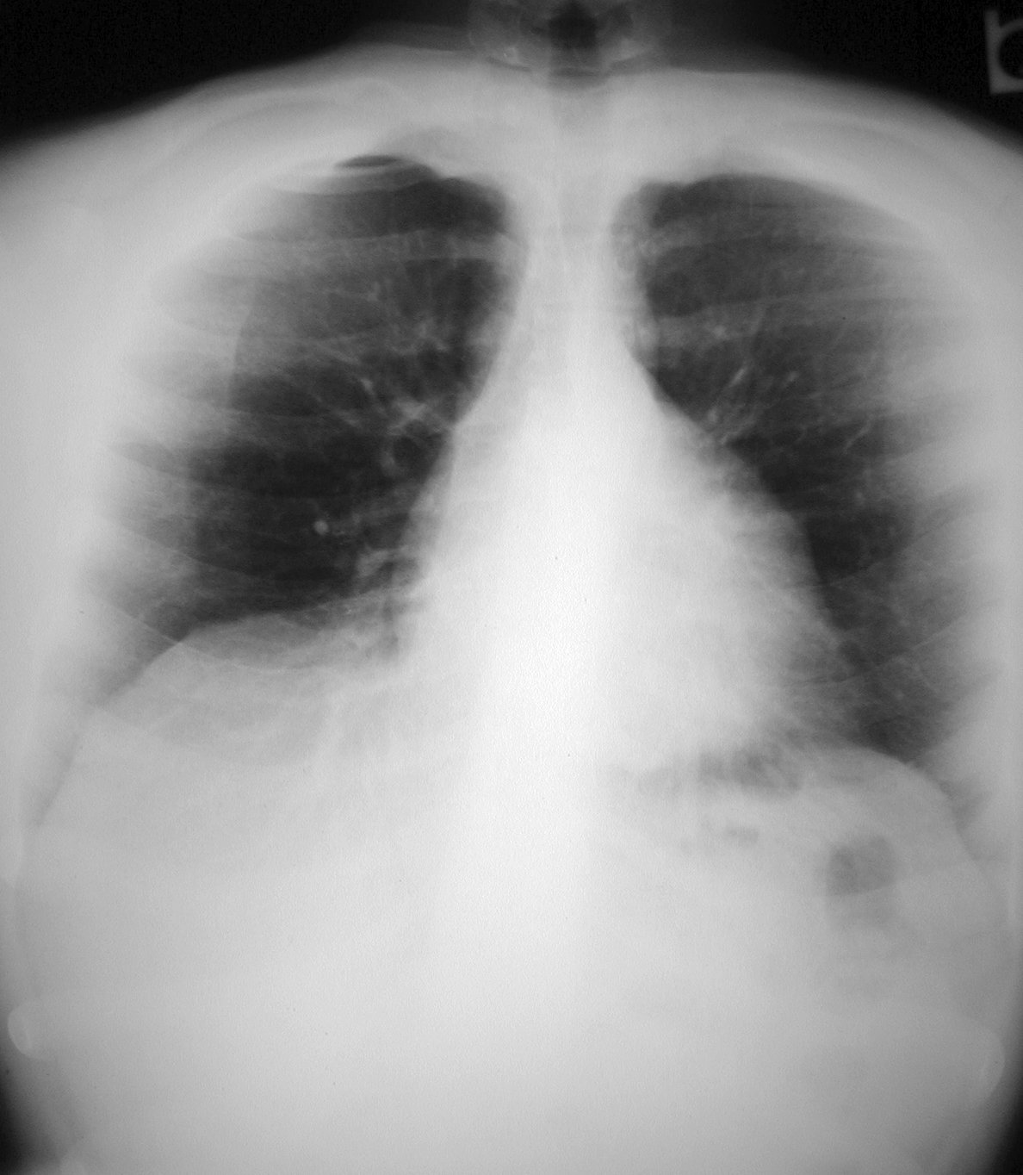
Apical View
In PA projection, the central ray is angled 30 degrees caudal towards the C7 spinous process coincident with sternal angle.
In AP projection, central ray is angled 30 degrees cephalad towards the sternal angle.
Lordotic View
In PA projection, the patient bends at the waist about 30-40 degrees to bring the middle lobe fissure horizontal.
This view is used for right middle lobe collapse and inter-lobar pleural effusion.

Slide 22
Chest x ray Anatomy
Mediastinum
Heart
Lungs
Hila
Diaphragm
Bony Thorax

Slide 23
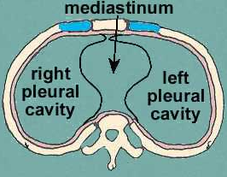
Mediastinum
It is the space between the right and left pleurae in and near the median sagittal plane of the chest.
Mediastinal Boundaries are as follows-
Superior : thoracic inlet
Inferior : diaphragm
Laterally : parietal pleura
Anteriorly : sternum
Posteriorly: thoracic spine

Slide 24
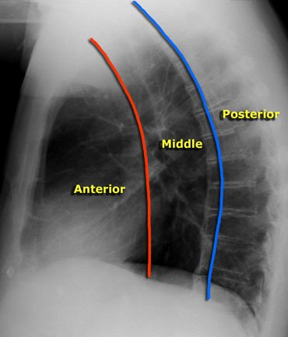
Felson divided the mediastinum into anterior, middle and posterior compartments based on ﬁndings on a lateral chest xray.
A line extending from the diaphragm to the thoracic inlet along the back of the heart and anterior to the trachea separates the anterior and middle mediastinal compartments.
Whereas a line that connects points 1 cm behind the anterior margins of the vertebral bodies separates the middle and posterior mediastinal compartments.

Slide 25
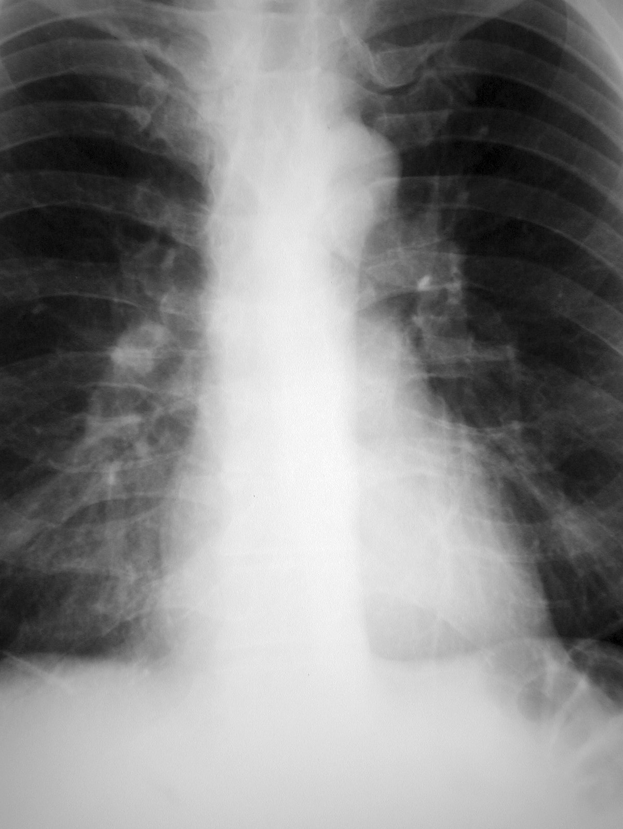
P.A. CARDIAC VIEW
Superior Vena Cava
Aortic Arch
Ascending Aorta
Pulmonary Artery
Left Atrium
Right Atrium
Left Ventricle
INFERIOR VENA CAVA

Slide 26
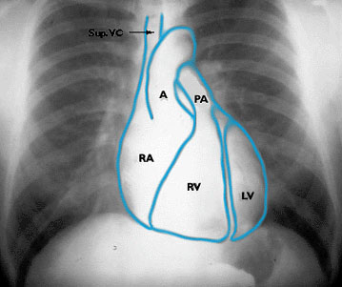
P.A. CARDIAC VIEW

Slide 27
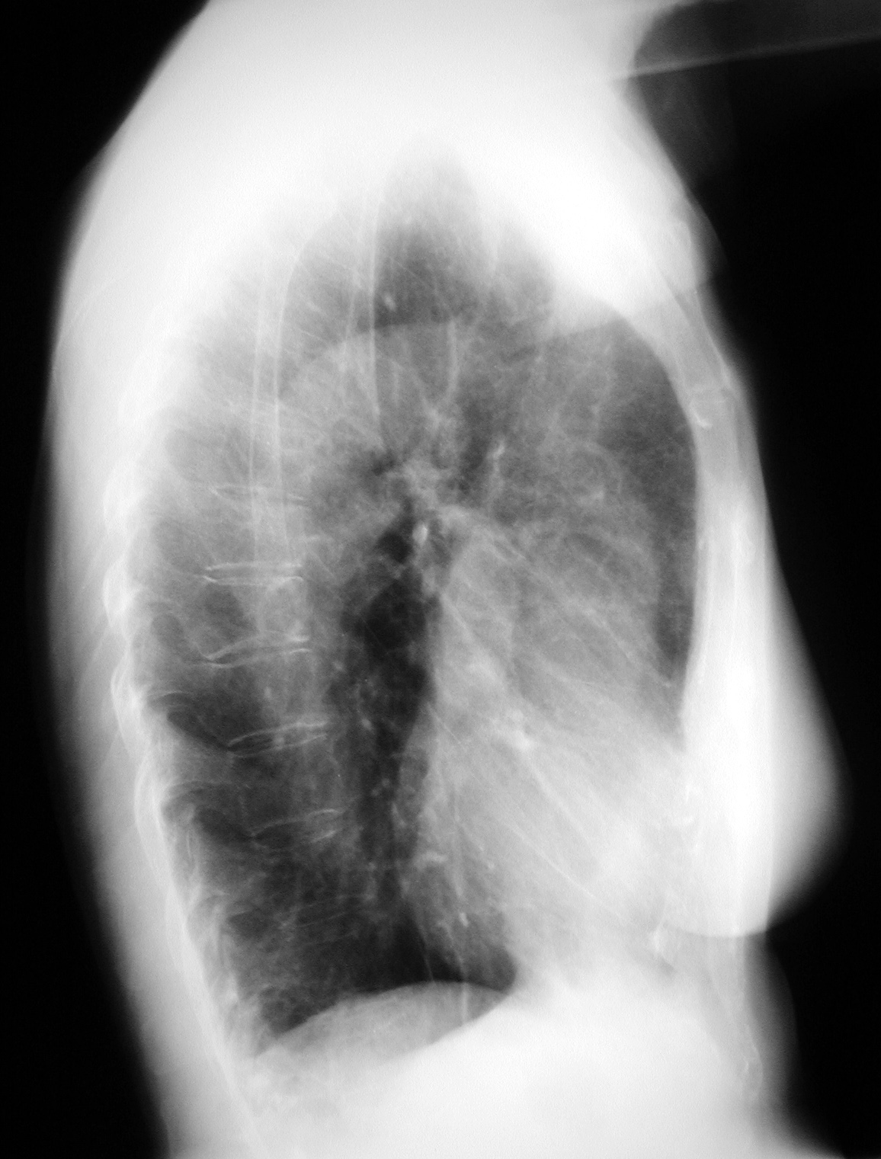
LATERAL CARDIAC VIEW
Aortic Knob/Arch
Descending Aorta
Ascending Aorta
Left Atrium
Right Ventricle
Left Ventricle
Inferior Vena Cava

Slide 28
Cardio thoracic Ratio(CTR)
With good centering two-thirds of cardiac shadow lies to the left of midline and one-third to the right.
NORMAL VALUES for CTR –
On PA view-below 50%
AP films - <55%
Infants - <55%

Slide 29
LUNG FIELDS
UPPER ZONE
(above anterior end of 2nd rib)
MIDDLE ZONE
(between 2nd- 4th ribs anteriorly)
LOWER ZONE
(below 4th rib)

Slide 30
Pulmonary Fissures and Lobes
Pulmonary fissures are formed by the visceral pulmonary pleura and divide the lungs into different lobes.

Slide 31
Oblique fissure is more clearly seen on Lateral view extending from T4-T5 vertebrae to reach the diaphragm and 5 cm behind the costo-phrenic angle on the left and just behind the angle on the right.
Horizontal fissure is more clearly seen on P.A view extending from right hilum to the 6th rib in the axillary line.

Slide 32
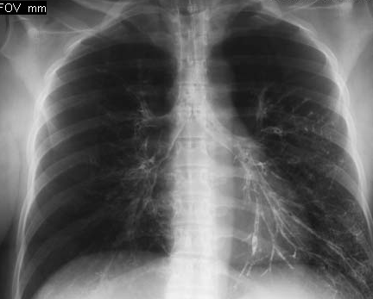
RT. MAIN BRONCHUS
LT. MAIN BRONCHUS
6TH
RIB
CARINA
HORIZONTAL FISSURE
minor
OBLIQUE FISSURE
(major)
OBLIQUE FISSURE
major

Slide 33
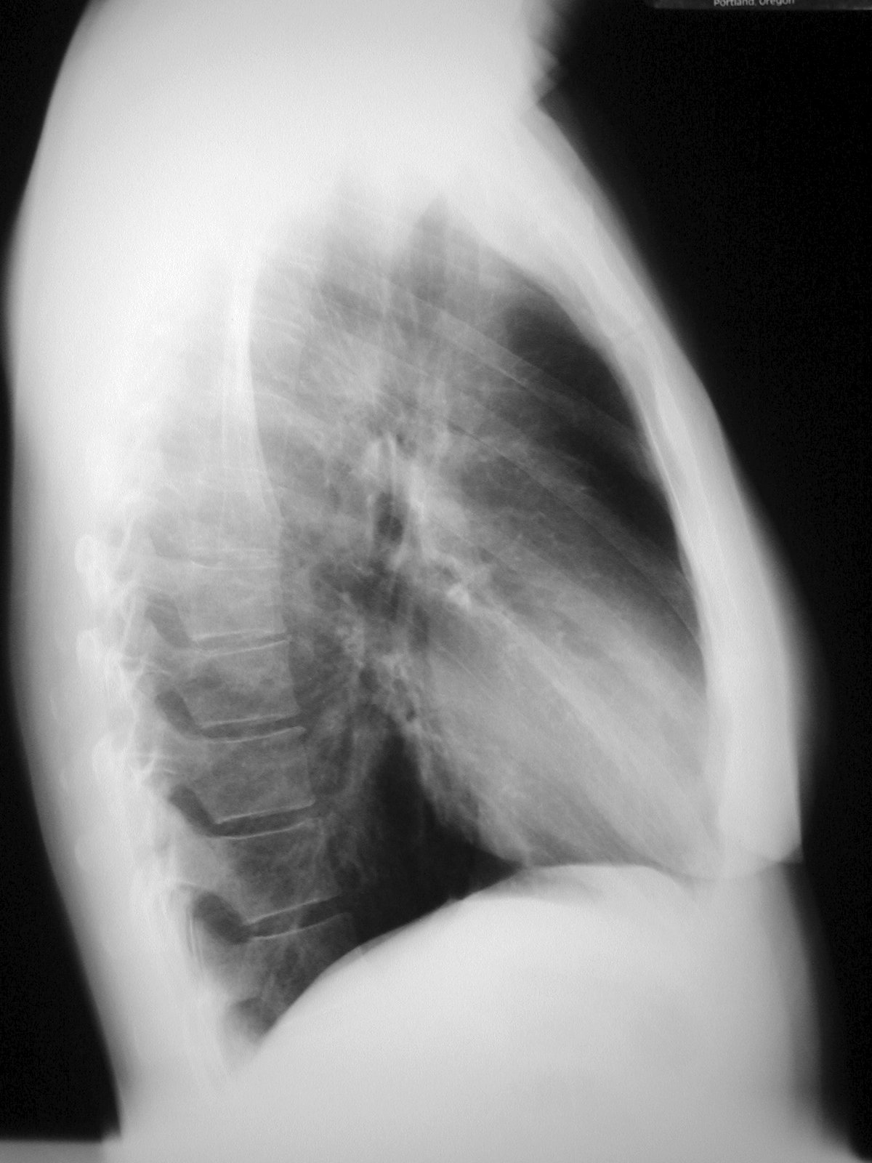
Horizontal Fissure
Left Oblique Fissure
Right Oblique Fissure

Slide 34
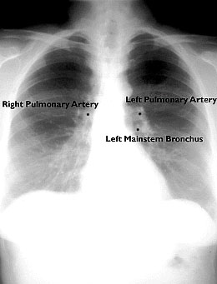
HILA
Most of the hilar shadow is formed by vessels, mainly pulmonary artery and to a lesser extent pulmonary veins.
Left hilum is normally higher than the right because the left main pulmonary artery passes posterior to and hooks over the left main bronchus while the right main pulmonary artery passes anterior to right main bronchus.

Slide 35
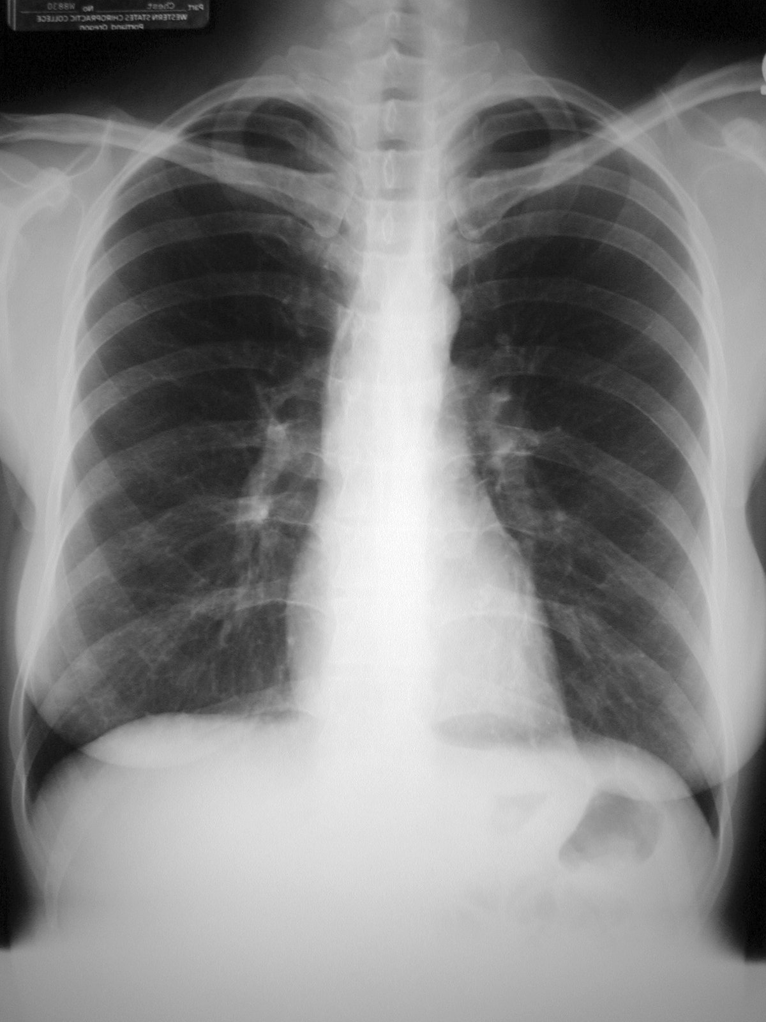
Cardiophrenic Sulci
(Recesses, Angles)
Lateral Costophrenic Sulci
(Recesses, Angles)

Slide 36
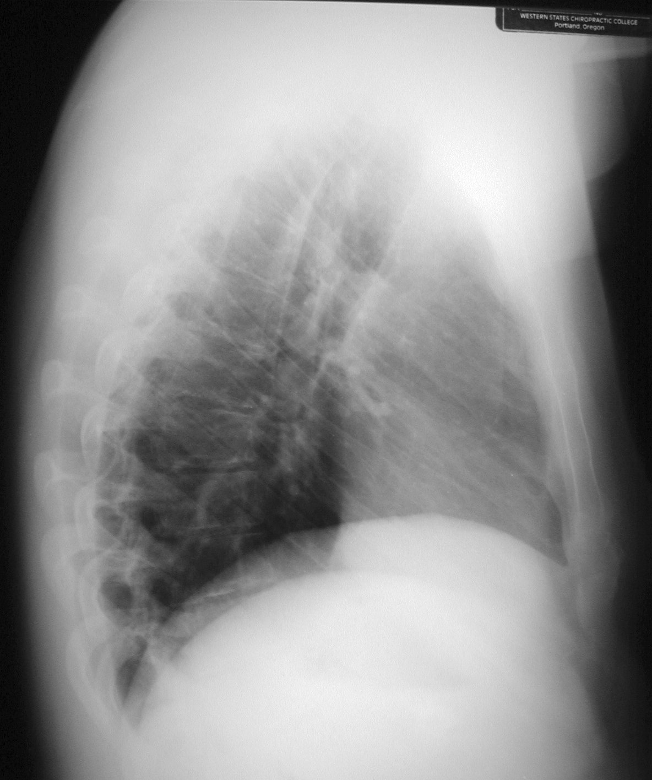
Posterior Costophrenic Sulci
(Recesses, Angles)

Slide 37
DIAPHRAGM
The left and right diaphragm appear as sharply marginated domes.
The peripheral margins of the diaphragm define the costophrenic angles.
The right diaphragm is normally higher than the left.
On lateral view, the right dome is visualised entirely from front to back whereas the left dome is seen only in the posterior part because the heart obliterates it anteriorly.

Slide 38
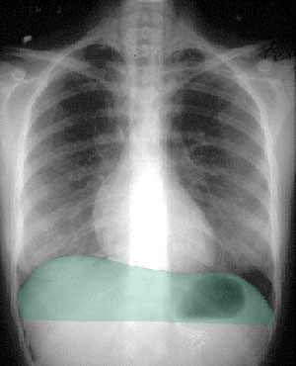
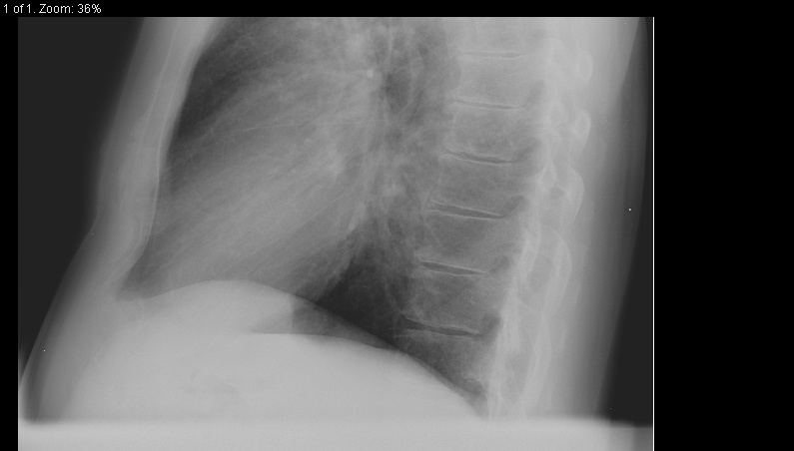
RT
LT

Slide 39
BONY THORAX
Chest x-ray primarily visualizes intra-thoracic structures but also outlines the shoulder girdle, ribs, cervical and thoracic vertebrae.
Sternum is often well outlined .
Inter-costal spaces are numbered according to the rib above them.
The costal cartilages are not visible except when calcified which then assume characteristic mottled appearance (periphery in male but central in female).

Slide 40
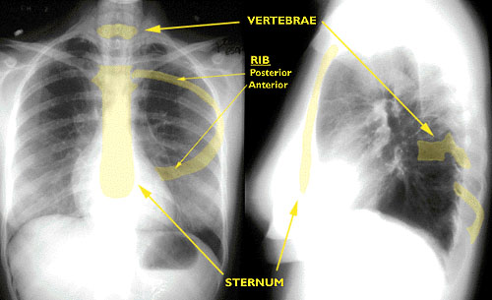

Slide 41
THANK
YOU!

