Slide 1
DEVELOPMENTAL NECK MASSES
DR. Kavita Makasare
JR III

Slide 2
IMAGING MODALITIES : USG
Usually the 1st investigation.
Relationship to the surrounding structures.
Confirms the cystic nature of lesion.

Slide 3
CT
For evaluation of soft tissue planes adjacent to large masses that cannot be visualized on USG.
Superior for detection of calcification.
When contrast is used, tells us about the vascularity of the lesion.

Slide 4
MRI
Multiplanar capability
Superior contrast resolution.
Especially useful in cases with extension into mediastinum or deep spaces of the neck.
Superior resolution for masses located in anatomically complex areas such as the floor of mouth.

Slide 5
THYROGLOSSAL DUCT CYST
Notes:
Relevant embyrology:
Development of thyroid strats in the 3rd wk of foetal life at the foramen caecum which is situated at the junction of the anterior 2/3rd and posterior 1/3rd of tongue.
Then descends and penetrates the underlying mesoderm of the floor of mouth and tongue musculature, runs anterior to the hyoid bone and laryngeal cartilage at bt 7th wk of foetal life after descending anterior to the thyrohyoid membrane and strap muscles of the neck.

Slide 6
Relevant embyrology
Development : in the 3rd wk of foetal life : foramen caecum : the junction of the anterior 2/3rd and posterior 1/3rd of tongue.
Descends and penetrates floor of mouth and tongue musculature
Anterior to hyoid bone and laryngeal cartilage
Final position :7th wk : descending anterior to the thyrohyoid membrane and strap muscles of the neck.

Slide 7
During its migration : the tract forms the thyroglossal duct : involutes by 8th-10th week.
If any part persists : secretions from the lining epithelium forms the thyroglossal cyst.
Site of original opening :
At tongue : foramen caecum
Inferior end : pyramidal lobe of thyroid.

Slide 8
EPIDEMIOLOGY
MC congenital neck mass (70%).
2nd MC neck mass (second to benign cervical lymphadenopathy).
M=F (no gender predilection).
Rarely hereditary : AD : prepubertal females.

Slide 9
CLINICAL FEATURES
MC located in midline (75%) or within 2cms of midline (25%).
If off midline, mostly on left for reasons not understood.
80% are seen at or below the level of hyoid bone.
Enlarging painless mass which moves upwards with protrusion of tongue in a young pt.

Slide 10
INCIDENCE OF MALIGNANCY
In 1% cases, from the ectopic rests of thyroid tissue within it and not from the duct itself.
MC : papillary type (80%), but virtually all types have been reported.
Nodal spread is less common as compared to primary carcinoma arising in the thyroid gland itself.

Slide 11
IMAGING :
CHARACTERISTIC location : cyst like mass in the anterior neck in the midline at the level of hyoid bone or within the strap muscles.
Anechoic mass in the characteristic location : CLASSIC APPEARANCE : less common.
More common : hypoechoic lesion (homogenous/ heterogenous) with increased through transmission : with internal echos.

Slide 12
Presence/ absence of internal echos does not correlate with the pathological presence of inflammation.
Mostly due to the presence of proteinaceous material within the cyst.
Preoperative visualization of the normal thyroid tissue excludes the presence of ectopic thyroid tissue.

Slide 13
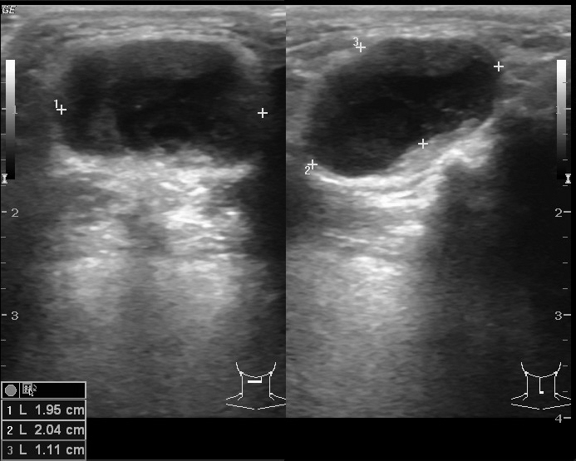

Slide 14
CT
Smooth well circumscribed mass anywhere along the course of the duct.
Thin walled, with peripheral rim enhancement on post contrast study.
Homogenous attenuation (10-18HU).
Increased attenuation suggest increased protein content and correlated with prior history of infection.
Usually unilocular, occasionally septations+
Beaking of strap muscles over the surface of cyst.

Slide 15
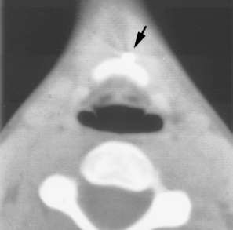
Notes:
Axial ct sections after injecting ethidized oil into the fistulous tract
Fig 1 : shows focal collection of the contrast at the foramen caecum.
Fig 2 : axial ct section at a lower level shows contrast enhanced path of the fistula along the anterior surface of the hyoid bone.
Fig 3 : lower down opening at the skin surface.

Slide 16
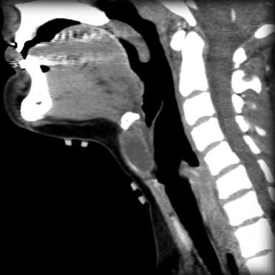

Slide 17
Thyroglossal cyst
CECT shows a cystic lesion in the right strap muscles.

Slide 18
Thyroglossal cyst in left strap muscles

Slide 19
MRI
UNCOMPLICATED CYST :
hypo on T1W and hyper on T2WI with smooth non enhancing wall.
INFECTED/HAEMORRHAGIC CYST:
thick irregular wall with enhancement.
variable signal intensities depending on the protein content.

Slide 20
Notes:
Fig 1 & 2 : showing a peripherally enhancing cystic lesion in the anterior midline at the level of hyoid bone suggestive of a thyroglossal duct cyst.
Fig 3 : axial t1W MR image at the level of thyrohyoid membrane shows a hyperintense mass suggestive of proteinaceous content or haemorrhage.

Slide 21
TREATMENT
Simple incision and drainage or partial resection almost always gives rise to recurrence.
Complete excision: SISTRUNK PROCEDURE : involves excision of a central portion of the hyoid bone and a core of tissue following the expected course of thyroglossal duct to the foramen caecum.
Recurrence rate : 2.6%

Slide 22
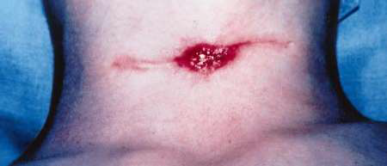
Notes:
Persistent sinus tract in a young boy who had undergone 2 partial resections in the past.
Surgical specimen of the entire fibrous tract.

Slide 23
BRANCHIAL CLEFT ANOMALIES
Notes:
Endodermallining of foregut is separated from the surface ectoderm by a layer of mesoderm.
Soon the mesoderm becomes arrangedd in the form of 6 bars that run dorsoventrallyin the side walls of the foregut.
Each of these bars fuse with that of the opposite side to form pharyngeal/ branchial arches.in The interval between any two adjoining arches the endoderm extends outwards in the form of a pouch (endodermal pouch) to meet the ectoderm which dips into this interval as an ectodermal cleft.

Slide 24
1st arch : Mandibular arch.
2nd arch : Hyoid arch
3rd, 4th and 6th arches donot have special names.
5th arch disappears soon after its formation.

Slide 25
FATE OF THE ECTODERMAL CLEFTS
1ST cleft : dorsal part : develops into the epithelial lining of the EAC.
Ventral part – obliterates.
2nd, 3rd and 4th clefts form a part of the ectodermally lined depression known as the Cervical Sinus of His.

Slide 26
FATE OF THE ENDODERMAL POUCHES
1ST pouch : ventral part- tongue
Dorsal part – with dorsal part of 2nd forms a diverticulum called as tubotympanic recess
Forms the eustachian tube, middle ear cavity and tympanic antrum.
2nd pouch : ventral part : tonsils
3rd pouch: inferior parathyroid gland and thymus.
4th pouch : superior parathyroid gland and part of thyroid.

Slide 27
Branchial cleft anomalies arise from incomplete obliteration of the Cervical Sinus of His or from epithelial cell rests.
Manifest as sinus, fistula or cysts.
Patients presenting as cyst : older children or young adults.
fistulas: infants or young children.
Bilateral in 2-3%

Slide 28
1st BRANCHIAL CLEFT CYST
Also known as parotid lymphoepithelial cyst.
Uncommon cyst
Arise in the 1st branchial arch tract from the EAC through the parotid gland into the submandibular triangle.
MC in middle aged women.
C/F : recurrent abscess or sinus around the ear or angle of mandible.
Facial nerve palsy may occur.

Slide 29
IMAGING :
On CT : cystic lesion either within, superficial or deep to the parotid gland.
Wall thickness and enhancement is variable and increases with repeated infections.

Slide 30
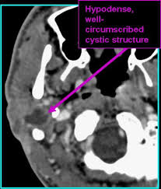

Slide 31
2nd BRANCHIAL CLEFT CYST
95% of the branchial cleft anomalies arise from the 2nd arch.
3/4th of these are cysts (manifest between 10-40yrs) in contrast to sinus or fistulas (manifest in 1st decade).
No gender prediliction.

Slide 32
CLINICAL FEATURES
Usually occur in the submandibular space.
Present as a painless, fluctuating mass in the lateral portion of the neck at the anteromedial border of the SCM at the mandibular angle.
Slowly grows
Painful and tender : if recurrent infection.

Slide 33
Notes:
2nd arch tract : begins in the supraclavicular fossa to the oropharyngeal mucosa.
Path travels lateral to the CCA then between the ECA and ICA under the IX nerve and above the XII nerve.
If the tract prgresses further it enters the parapharyngeal space, pierces the middle constrictor muscle and ends int ot he tonsillar fossa.

Slide 34
BAILEY’S CLASSIFICATION
TYPE I : most superficial
Lies along the anterior surface of the SCM just deep to the platysma muscle.
TYPE II : MC and found in the MC location of these cysts
Along the anterior border of the SCM lateral to the carotid space and posterior to the submandibular gland.

Slide 35
TYPE III : extends medially between the bifurcation of the internal and external carotid artery upto the lateral pharyngeal wall.
TYPE IV : lies in the pharyngeal mucosal space and is lined by columnar epithelium.

Slide 36
IMAGING
USG : sharply marginated rounded anechoic mass with a thin wall displacing the surrounding structures with posterior acoustic enhancement.
Occasional internal echos due to debris.
CT : uniform homogenous hypodense lesion with a uniform thin wall.
Mural thickness may increase after infection.

Slide 37
CHARACTERISTIC LOCATION :
Along the anterior border of the SCM lateral to the carotid space and posterior to the submandibular gland.
Displaces the carotid vessels : medially\
SCM : posteriorly or posterolaterally
Submandibular gland : anteriorly
May extend into the parapharyngeal space after extending through the stylomandibular tunnel and middle constrictor muscle.

Slide 38
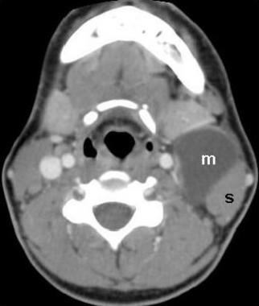

Slide 39
MRI better depicts the deep tissue extent.
Cyst fluid hypo/hyper on T1W and hyperintense on T2WI.
Occasionally, BEAK SIGN : on axial CT/MRI image : pathognomic of a 2nd branchial cleft cyst especially bailey’s type III cyst
It represents a curved rim of tissue or a beak pointing medially between the ECA and ICA.

Slide 40
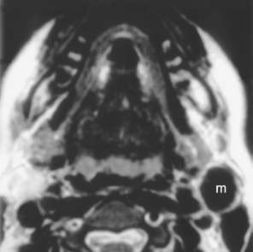
Notes:
Axial T1W : well defined hhyperintense mass present at theanaterior border of the SCM muscle, lateral to the carotid space and posterior to the submandibulargland. Hyperintensity may be due to proteinaceous content or prior haemorrhage.
Fig 2 : hypointense lesion : consistent with to proteinaceous content or prior haemorrhage.
Fig 3 : cor PC T1W I thin peripheral rim of enhancemnet.

Slide 41
Intraoperative photo showing the mass and SCM outlined with a gross specimen of the mass.

Slide 42
Notes:
FIG 1 : axial PC T1WI ; hypointense mass in the classic location of a 2nd branchial cleft cyst, irregular walls may be due to repeated infections.
Fig 2 : cor T1W I shows the mass is inferior to the right parotid gland and lateral to the carotid vessels.
Fig 3 : gross specimen of a lesion with thick capsule and filled with keratinaceous debris.

Slide 43
3rd & 4th BRANCHIAL CLEFT CYST
Extremely rare.
3rd cyst is the 2nd MC lesion in the posterior cervical space after cystic hygroma.
Majority of the 4th cleft anomalies manifest as fistulas rather than cyst or sinus.

Slide 44
3rd cleft cyst :
Posterior to the common or the internal carotid artery
If fistula : pierce the thyrohyoid membrane and reach the pyriform sinus.
Most are located in the posterior cervical space, posterior to the SCM.
4th cleft sinus tract :
Arise from the pyriform sinus, pierce the thyrohyoid membrane and begins to descend in the mediastinum in the tracheo-oesophageal groove.

Slide 45
IMAGING :
3rd cyst : appears as a unilocular cystic mass in the posterior cervical space.
Signal intensity varies according to the fluid content.
4th cleft cyst which connect to the pyriform sinus : appear similar to a external or a mixed laryngocele.

Slide 46
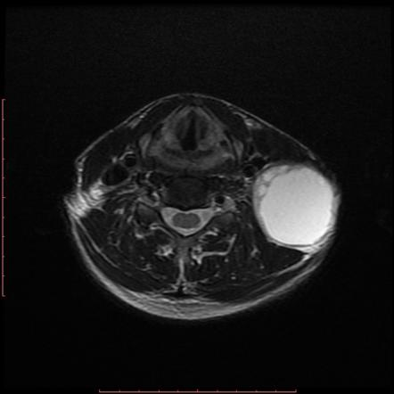

Slide 47
CYSTIC HYGROMA
Most common form of lymphangioma of infancy and childhood
Age : 2 years (80-90%)
Gender : No predilection
Pathogenesis : Early sequestration of embryonic lymphatic channels, more commonly from developing jugular lymph sac pair.

Slide 48
Site : 75-80% in neck and lower face
Children : posterior cervical space> oral cavity
Adults : Sublingual, subamandibular, parotid spaces
Less common- Axilla, mediastinum, abdominal cavity, retroperitoneum, scrotum, skeleton
Infiltrative lesions, do not respect fascial planes

Slide 49
Cystic hygroma
Clinical features.
Majority painless masses in neck
Large masses – pressure
Sudden increase- hemorrhage/trauma/viral infection
Facial nerve palsy, dysphagia, feeding problems
Chylothorax/ chylomediastinum – mediastinal involvement

Slide 50
Imaging :
US- multilocular, predominantly cystic with variably thick septae.
Echogenic areas- cluster of abnormal lymphatic channels.
Fluid-fluid levels – hemorrhage

Slide 51
Notes:
ANC usg showing a large multiseptated cystic lesion in the posterior neck.

Slide 52
USG
May present as nuchal cyst with or without septation
Presence of septation indicate poor prognosis
Associated anomalies can be seen
Turner syndrome: Most frequent aneuplody association
Downs syndrome
Congenital cardiac anomalies

Slide 53
Cystic Hygroma Imaging
CT
Poorly circumscribed, multiloculated, hypoattenuated masses.
Homogenous fluid attenuation, higher if infected

Slide 54
Imaging
MRI
Relationship to adjacent soft tissue best demonstrated
T1WI- low to intermediate
Hyper on T1WI if blood/chyle
T2WI- hyperintense predominantly
On contrast: No enhancement

Slide 55
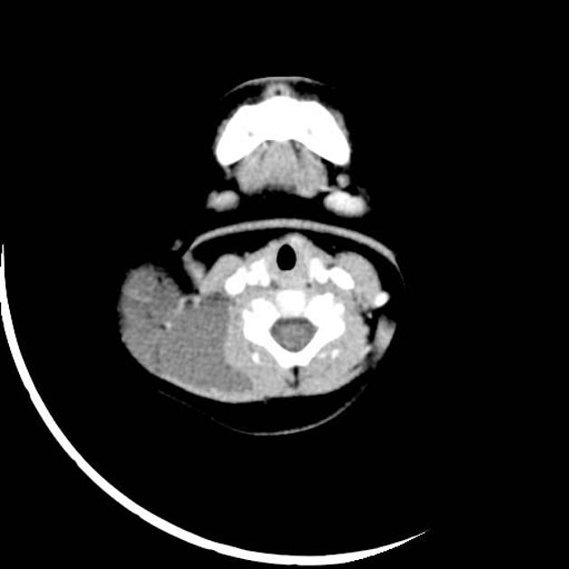
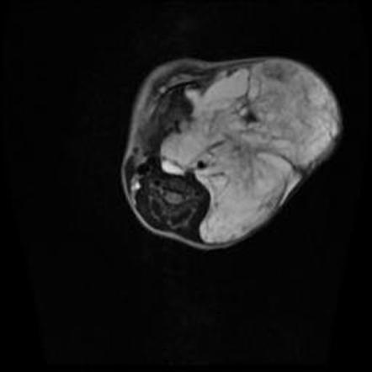

Slide 56
DERMOID AND EPIDERMOID CYSTS
Three types:
True dermoid cyst
Epidermoid cyst
Teratoid cyst
Presence of skin appendages: in dermoid cyst.
Tissues of other major organ: in teratoid cyst.
All three have cheesy keratinaceous material within.

Slide 57
2nd to 3rd decade of life
Only 7% in head and neck
Most common location: lateral eyebrow > floor of mouth.
Epidermoid cysts are rare
Mostly occur in infancy

Slide 58
Epidermoid cyst
Hypoattenuating on CT
Hypo on T1W and hyper on T2W.
Cysts located sublingually difficult to distinguish from ranulas on imaging.

Slide 59
Dermoid cyst
In neck: suprahyoid, midline, slowly growing mass.
Rapid growth: due to pregnancy, sinus tract, or desquamation
Not attached to hyoid so no movement with tongue protrusion.
Size: few mms- 12 cm
m/c cervical location: floor of mouth.

Slide 60
RADIOLOGICAL FEATURES
Moderately thin walled, unilocular masses.
Located in submandibular/ sub lingual space.
CT: central cavity filled with hypoattenuating (0-18 HU) fluid.
“Sack of marbles”- pathognomic
May be heterogenous, fluid –fluid levels.
Rim enhances following contrast administration.
Notes:
Well defined mass in the submandibular- submental loaction with multiple foci of hypoattenuation in the non dependent portion of the cyst.
Coronal images how that the cyst is inferior to the mylohyoid msucle.

Slide 62
Notes:
Mass in the submandibular location with sac of marble appearance.

Slide 63
Dermoid
MR imaging: helps determining topographic relationship to mylohyoid.
Mass above the mylohyoid : intraoral approach
Below it : external neck approach
Coronal plane is optimal.
Hyper or iso to muscle on T1W
Hyper on T2W
Clearly demarcated rim with heterogenous appearance.

Slide 64
Thymic Cyst
Two theories –
Congenital - Persistence of thymopharyngeal duct remnants.
Acquired – Progressive cystic degeneration of Hassall’s corpuscles and epithelium reticulum of thymus

Slide 65
Thymic Cyst
Very rare
2/3rd in 1st decade
Majority asymptomatic, discovered incidentally
Found anywhere along the path of thymopharyngeal duct, i.e. adjacent to carotid sheath from angle of mandible to thoracic inlet
Presents with slowly enlarging painless mass in lateral portion of neck near thoracic inlet
Connection with mediastinal thymic tissue in 50%

Slide 66
Thymic Cyst : imaging
USG – Large cystic mass, usually unilocular
CT – Imaging modality of choice
Uni or multiloculated hypoattenuated cystic mass adjacent to carotid space
MRI – Hypo on T1, Hyper on T2

Slide 67
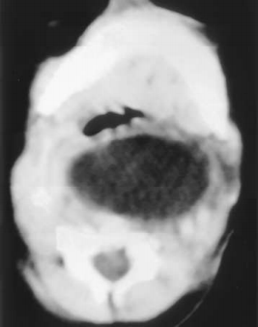
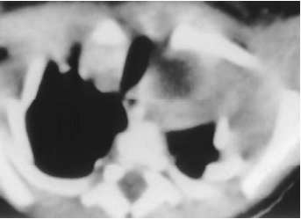
Thymic Cyst
Notes:
Ct section at the level of mandible : hypodemse retropharyngeal mass causing airway obstruction.
Lower section at the level of thoracic inlet shows inferior extent of the elsion with expansion of the left hemithorax.

Slide 68
Cervical Bronchogenic Cysts
Extremely rare
Results from anomalous foregut development
Males 3 times more often
Presents as swelling or draining sinus
Located in suprasternal notch or supraclavicular region
CT – Tubular configuration anterior to trachea
Notes:
3 out of 4 reported cases occurred before advent of CT ☺

Slide 69
Thank you

