Slide 1
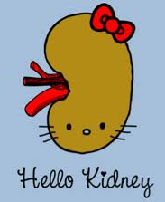
Development of urinary system and congenital anomalies of kidney
Dr Monica Patil

Slide 2
Functionally, the urogenital system can be divided into two entirely different components: the urinary system and the genital system.
Embryologically and anatomically, however, they are intimately interwoven.
Both develop from a common mesodermal ridge (intermediate mesoderm) and open into a common channel the cloaca.
Notes:
vertebrae and ribs
musculature for the body wall (external and internal oblique and transversus abdominis muscles) ,the limb muscles
dermis for the skin of the back and muscles for the back, body wall (intercostal muscles)
Lateral plate: surround the organs

Slide 3
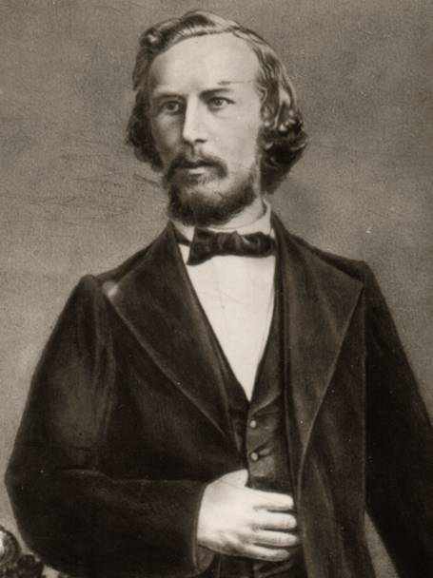
“Ontogeny Recapitulates Phylogeny” Ernst Haeckel 1860
Ontogeny is the development of the individual
Phylogeny is the evolution of the species
So this is the idea that during development an organism (or an organ) goes through the same stages as during their evolution. The kidneys are a perfect example.
Notes:
Ex...frog..

Slide 4
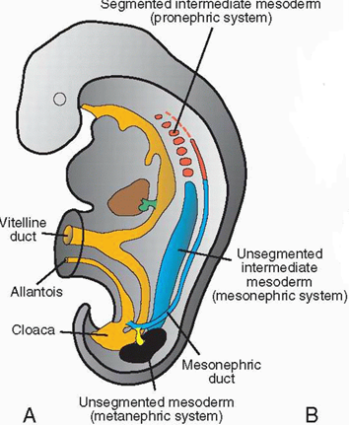
URINARY SYSTEM : Kidney Systems
Three slightly overlapping kidney systems are formed in a cranial-to-caudal sequence during intrauterine life in humans: the pronephros, mesonephros, and metanephros.
PRONEPHROS
Beginning of the 4th wk (21days).
The pronephros is represented by 7 to 10 solid cell groups in the cervical region .
Their excretory units: are called nephrotomes.
By the end of the fourth week, all indications of the pronephric system regress.

Slide 5
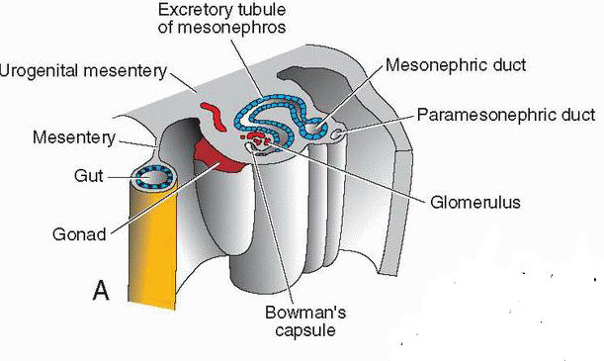
MESONEPHROS
Appear late in the 4th wk
From the thoracic and lumbar seg of intermediate mesoderm.
They function as interim kidneys for approximately 4 wks.
Excretory tubules form their basic unit which open into mesonephric ducts.
The mesonephric ducts open into the cloaca.
Notes:
An excretory tubule is formed from the mesonephros which lengthens rapidly, forms an S-shaped loop and acquire a tuft of capillaries that will form a glomerulus at their medial extremity and open into the mesonephric or wollfian duct at their lateral extrimity, which were originally the pronephric ducts.
In the male, a few of the caudal tubules and the mesonephric duct persist and participate in formation of the genital system, but they disappear in the female

Slide 6
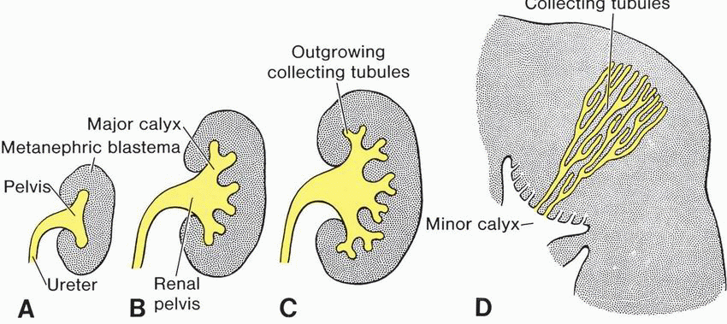
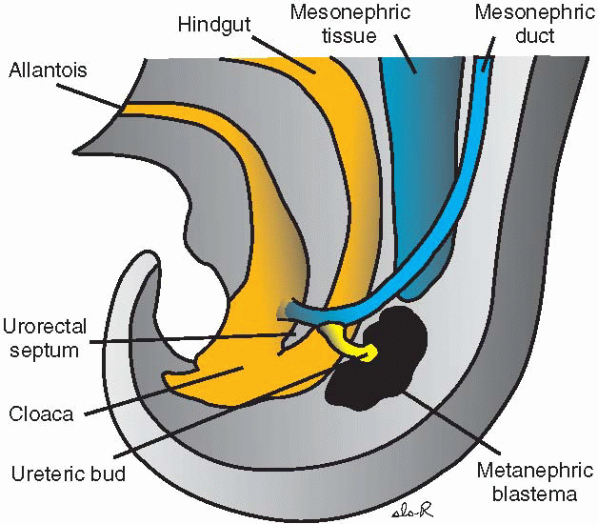
METANEPHROS: THE DEFINITIVE KIDNEY
Appears in the 5th wk.
Develops from sacral segments of the intermediate mesoderm .
However, the development of the duct system differs from that of the other kidney systems.
COLLECTING SYSTEM
Collecting ducts of the permanent kidney develop from the URETERIC BUD, an outgrowth of the mesonephric duct close to its entrance to the cloaca .
The bud penetrates the metanephric tissue, which is moulded over its distal end as a cap .
Subsequently, the bud dilates, forming the primitive renal pelvis, and splits and subsequently divides and sub divides to finally give rise to approximately 1 to 3 million collecting tubules.

Slide 7
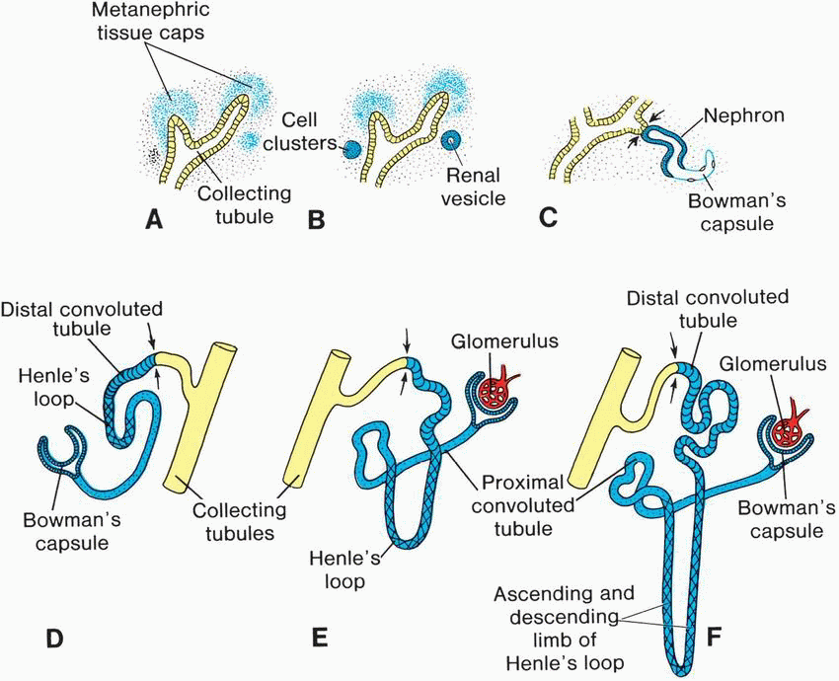
Hence, the kidney develops from two sources: (a) metanephric mesoderm, which provides excretory units and (b) the ureteric bud, which gives rise to the collecting system. At birth, the kidneys have a lobulated appearance, but the lobulation disappears during infancy .
Notes:
Each newly formed collecting tubule is covered at its distal end by a metanephric tissue cap. Under the inductive influence of the tubule, cells of the metanephric tissue cap form small vesicles, the renal vesicles, which in turn give rise to small S-shaped tubules. Capillaries grow into the pocket at one end of the S and differentiate into glomeruli to form the Bowman’s capsule. The distal end forms a connection with one of the collecting tubules. Continuous lengthening of the excretory tubule results in formation of the proximal convoluted tubule, loop of Henle, and distal convoluted tubule . Hence, the kidney develops from two sources: (a) metanephric mesoderm, which provides excretory units and (b) the ureteric bud, which gives rise to the collecting system.

Slide 8
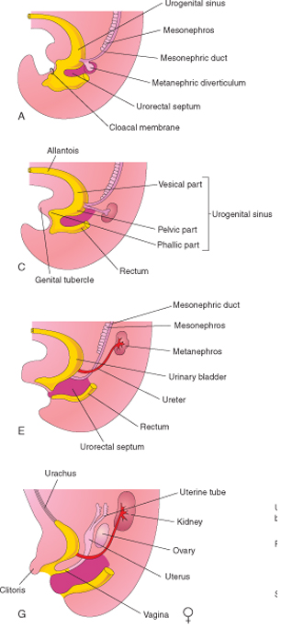
Development of Bladder and Urethra
CLOACA
urogenital sinus anteriorly
anal canal posteriorly
During the 4th to 7th weeks of development,
TIP OF UROGENITAL SEPTUM
PERINEAL BODY
UROGENITAL SINUS
CRANIAL VESICAL PART
MIDDLE PELVIC PART
CAUDAL PHALLIC PART
* THE BLADDER NECK
* THE PROSTATIC PART OF URETHRA IN MALES
* THE ENTIRE URETHRA IN FEMALES
REST OF THE MALE URETHRA
MOST OF THE BLADDER

Slide 9
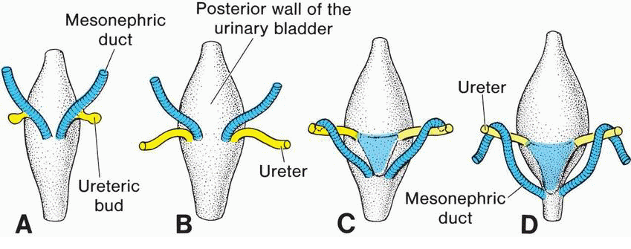
FORMATION OF THE TRIGONE OF THE BLADDER
CAUDAL PORTIONS OF THE MESONEPHRIC DUCTS
ABSORBED INTO THE WALL OF THE URINARY BLADDER
Notes:
As they are absorbed the ureteric orifices move apart by the pull by the ascending kidneys also contributes to the lateral movement of the ureters. The orifices of the mesonephric ducts, however, move close together and enter the prostatic part of the urethra forming the ejaculatory ducts. In females, the distal ends of the mesonephric ducts degenerate.

Slide 10
CONGENITAL ANOMALIES OF THE KIDNEY

Slide 11
ANOMALIES OF FORM
Renal Agenesis
Renal Hypoplasia
Supernumerary kidney and duplex system

Slide 12
RENAL AGENESIS

Slide 13
RENAL AGENESIS
Kidney is absent
It can be unilateral or bilateral
It usually causes no symptoms and is found
incidental
It is due to failure of ureteric bud formation or mesenchymal blastoma differentiation or final mesenchymal condensation.
1:500 – 1:3200 live births
More commonly affects left side and first born male child
More prone for injury so should avoid contact sports
More prone for infection and reflux nephropathy

Slide 14
ETIOLOGY
There is no family history, but in 20-36% of cases, there is a genetic cause.
The risk of recurrence in future pregnancies is 3% unless one parent has unilateral renal agenesis, in which case the risk is about 15%.
Women with uncontrolled diabetes in pregnancy may deliver a baby with bilateral renal agenesis.
Bilateral renal agenesis is incompatible with life due to lack of transmitted pulsations from the amniotic fluid which is necessary for tracheobronchial tree development

Slide 15
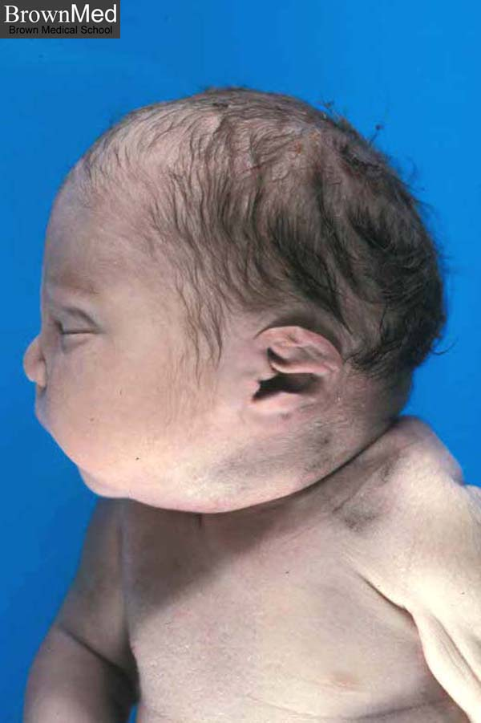
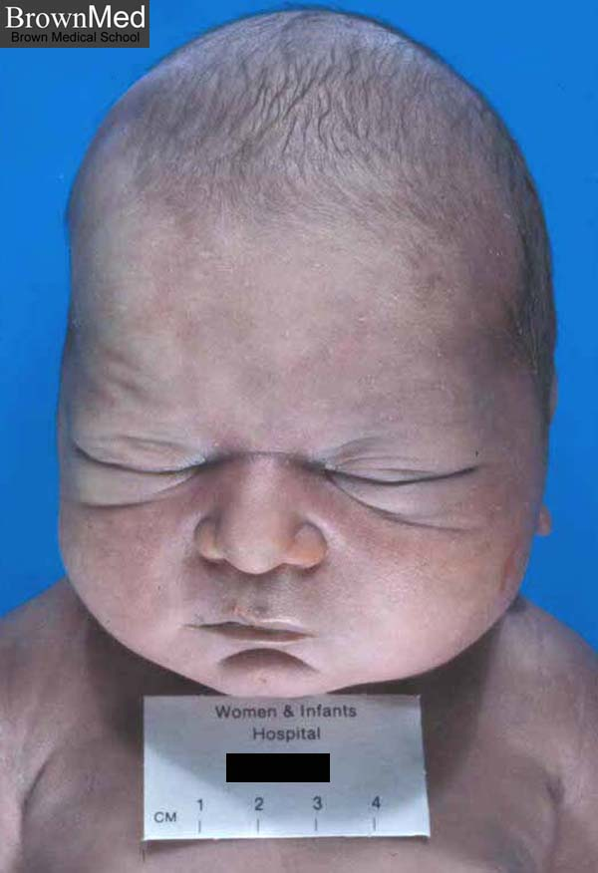
POTTER FACIES
Flattened nose, brachycephaly, recession of chin, epicanthal fold, low set ears, hypertelorism.
POTTER’S SYNDROME
. This absence of kidneys causes oligohydramnios, which can place extra pressure on the developing baby and cause further malformations like clubfoot.

Slide 16
ASSOCIATED GENITOURINARY ABNORMALITIES
Females- uterovaginal atresia and duplication
Males- absent seminal vesicle and seminal vesicle cyst
ABNORMALITIES OF REMAINING KIDNEY
VUR(most common)
Renal ectopia and malrotation
PUJ obstruction
Multicystic dysplasia
ASSOCIATED SYNDROMES
VACTERl association
Fanconi’s pancytopenia
Kallman’s syndrome
Fraser syndrome

Slide 17
IMAGING MODALITIES
ANTENATAL ULTRASOUND
Absent kidney with drooping adrenal sign
Compensatory hypertrophy of contralateral kidney
Oligohydramnios may be present
Doppler shows absence of corresponding renal artery
SCINTIGRAPHY
Help to differentiate ectopic kidney and hypoplastic kidney from true agenesis
Tc 99 DMSA scan done
Reveal uptake by a hypoplastic kidney lying medially over tranverse process of lumbar vertebra and an ectopic functioning kidney

Slide 18
ULTRASOUND
Incidental finding
IVP
Will show absent nephrogram and pelvicalyceal and ureteral opacification
CT
Will give definite diagnosis especially when USG fails to demonstrate a hypoplastic kidney
CYSTOSCOPY
Absence of ipsilateral ureterovesical opening

Slide 19
ANTENATAL ULTRASOUND

Slide 20
IVP

Slide 21
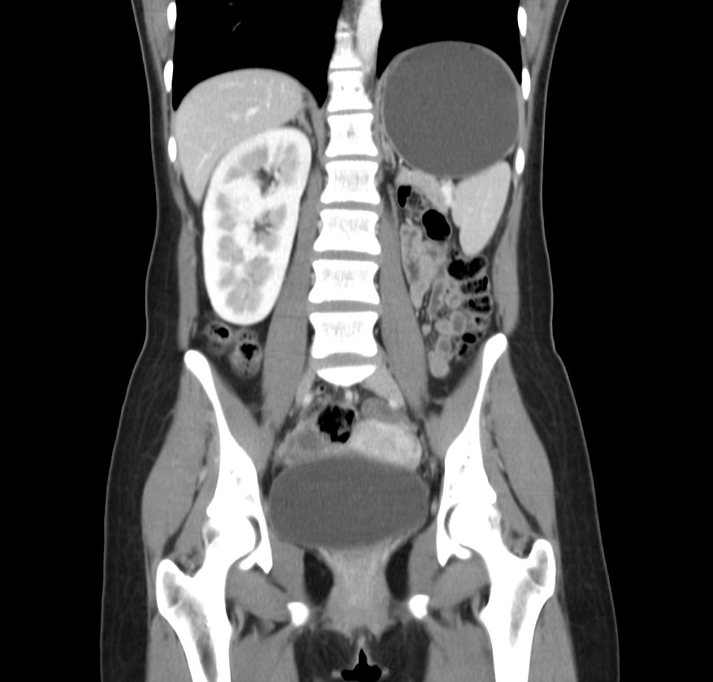
Renal agenesis and agenesis with seminal vesicle cyst

Slide 22
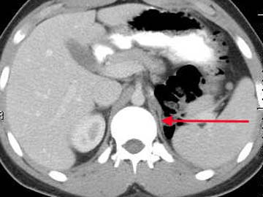
Unilateral renal agenesis :
1 in 1000
Males / left kidney
Unilateral renal agenesis should be suspected in infants with a single umbilical artery
The term
LYING DOWN ADRENAL SIGN as been ascribed to the elongated appearance of the adrenal not normally molded by the adjacent kidney

Slide 23
RENAL HYPOPLASIA

Slide 24
This appears as one small kidney
with the other one larger. It occurs due to the partial development of kidney.
Small kidneys also have small arteries and are associated with hypertension rarely requiring nephrectomy.
also called miniature or dwarf kidney

Slide 25
IMAGING
USG
Shows small kidney with normal appearance and outline with compensatory hypertrophy of contralateral kidney
May be detected incidentally
IVP
Small kidney with fewer than normal calyces(less than 7) which has smooth outline and normal appearance

Slide 26
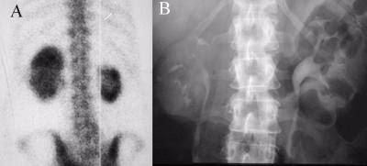
NUCLEAR SCAN AND IVP SOWING RENAL HYPOPLASIA

Slide 27
CT –RT RENAL HYPOPLASIA

Slide 28
URETEROPELVIC DUPLICATION OR DUPLEX KIDNEY

Slide 29
PARTIAL DUPLICATION OR BIFID URETER
Two draining ureters may join before emptying into the bladder
COMPLETE DUPLICATION
Both the ureters enter separately
WEIGERT MEYER RULE
Upper ureter inserts into a position more inferior and medial to the ureter of the lower moiety

Slide 30
Upper moiety ureter- more prone for obstruction and ureterocoele
Lower moiety ureter- more prone for reflux
Lower moiety is functional

Slide 31
IMAGING
USG
Calyces form 2 distinct echo complexes with intervening renal parenchyma
Faceless kidney sign
IVP/ CT UROGRAPHY
Duplex kidney with two ureters leading to two jets of contrast
Lower moiety is displaced by the non filling of obstructed upper pole moiety leading to drooping lily sign
MCU
Ureterocoele in lower end of upper pole moiety and reflux in lower end of lower pole moiety.

Slide 32
Yo yo reflux and saddle relux- seen in partial duplication
Refluxed contrast first enters one moiety, drains it and then enters the other moiety ureter
NUCLEAR SCAN
Will demonstarte duplicated system
MR UROGRAPHY
coronal thick slab sequences most useful

Slide 33
USG

Slide 34
IVP-DUPLEX KIDNEY AND DOUBLE URETER

Slide 35
IVP- SUPERNUMERARY KIDNEY

Slide 36
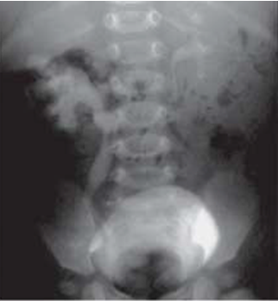
Drooping Lily Sign
Notes:
downward and lateral displacement of the opacified lower pole moiety of a duplicated
system (the drooping lily appearance) caused by the dilated, obstructed collecting system
and ureter of the nonfunctional upper pole moiety.

Slide 37
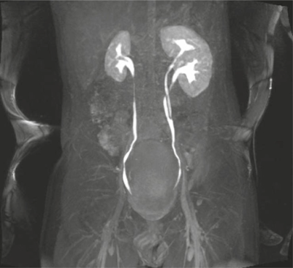
CT AND MR UROGRAPHY

Slide 38
ANOMALIES OF POSITION
Malrotated kidneys
Ectopic kidneys

Slide 39
MALROTATED KIDNEY

Slide 40
During ascent from pelvis to final position opposite second lumbar vertebra , kidney undergoes 90 degree inward rotation so that hilum is directed medially and slightly forward.
ANOMALIES
Non rotation or incomplete rotation- most common
Excessive rotation-hilum faces posteriorly or posteromedially and renal vessels lie posterior to the kidney
Reversed rotation-kidney rotates outward, renal hilum faces laterally and renal vessels lie anterior to the kidney

Slide 41
IMAGING
USG, IVP ,CT UROGRAPHY
All will demonstrate abnormally oriented calyces
Oblique films in IVP are important to demonstrate that the malrotated kidneys are otherwise normal

Slide 43
IVP- SUPERNUMERARY KIDNEY WITH MALROTATION OF LOWERE KIDNEY

Slide 44
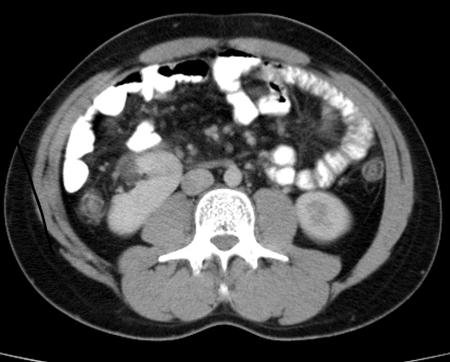
CT- MALROTATED RT KIDNEY
If a kidney fails to rotate, the hilum faces anteriorly, that is, the fetal kidney retains its embryonic position . If the hilum faces posteriorly, rotation of the kidney proceeded too far; if it faces laterally, lateral instead of medial rotation occurred. Abnormal rotation of the kidneys is often associated with ectopic kidneys.
Notes:
Hilum : anterolaterally

Slide 45
ECTOPIC KIDNEY
Uncrossed-ectopic kidney on the same side as the draining ureteral opening
Crossed-ectopic kidney on the opposite side as the draining ureteral opening

Slide 46
UNCROSSED RENAL ECTOPIA
CRANIAL
Intrathoracic kidney- due to a diaphragmatic hernia
Upward displacement of kidney with eventration of diaphragm
CAUDAL
Abdominal-above the level of iliac fossa
Iliac-in the iliac fossa
True pelvic-in the pelvis

Slide 47
IMAGING
PLAIN RADIOGRAPH
A)CXR-well defined posteroinferior mediastinal mass(thoracic kidney)
B)X RAY KUB-Absence of renal shadow on affected side with bowel gases occupying it.
USG
Kidney not seen in renal fossa and most commonly demonstrated in the pelvis
IVP
Tightly coned view may miss the ectopic kidney

Slide 48
CT
It will demonstrate the hernial defect with kidney in intrathoracic compartment
Can distinguish ectopic kidney from abdominal and pelvic masses
Angiography demonstrates aberrant supply from thoracic aorta(thoracic kidney) and from the aortic bifurcation(pelvic kidney)
DMSA
Detect ectopic kidney by outlining shape
d/d for an ectopic kidney is a ptotic kidney(renal artery arises from normal site and ureter is redundant)

Slide 49
INTRATHORACIC KIDNEY

Slide 50
USG-PELVIC KIDNEY

Slide 51
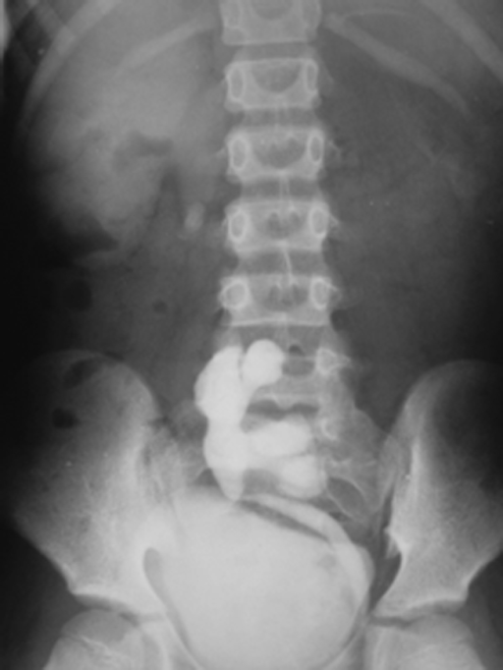
IVP-ECTOPIC KIDNEY

Slide 52
CT-ECTOPIC KIDNEY WITH ABERRANT SUPPLY

Slide 53
ANOMALIES OF FUSION
These anomalies are thought to result because of an abnormally situated umbilical artery that prevents normal cephalic migration from occurring.
In all fused kidneys, the arterial supply and venous drainage are grossly abnormal.

Slide 54
CROSSED RENAL ECTOPIA

Slide 55
May occur with fusion(most common)
Without fusion(15%)
Solitary kidney(least common)
More common in males and on right side
Fusion is between lower pole of orthoptic kidney and upper pole of ectopic kidney
Sigmoid or S shaped fusion and L shaped fusion
Unilateral lump kidney or pancake kidney
c/f- abdominal lump , obstructive uropathy with PUJ obstruction, increased VUR

Slide 56
IMAGING
ULTRASOUND
Large kidney on the affected side with absent kidney on the opposite
Renal sinuses in different planes
IVP/CT
Dilineates morphology of crossed kidney with insertion of ureter into trigone on the side of origin
CT ANGIOGRAPHY
Demonstrates anomalous vasculature

Slide 57
USG

Slide 58
IVP

Slide 59
CT-CROSSED FUSED ECTOPIA

Slide 60
HORSE SHOE KIDNEY

Slide 61
It develops when the lower poles of the kidneys are fused in the midline due to fusion of ureteric buds during fetal development.
They are joined by an isthmus which can be renal parenchyma or fibrous
These kidneys are more prone to develop wilms tumour than general.
Also more prone for VUR, PUJ obstruction, urolithiasis and infection.
Surgery is indicated when uncontrolled urinary infections result in pyelonephritis.

Slide 62
URINARY ANOMALIES ASSOCIATED
PUJ obstruction, duplicated collecting system, ureterocoele, megaureter and renal dysplasia.
ASSOCIATED SYNDROMES
Turner’s syndrome, trisomy 18, Fanconi’s anaemia, VACTERL and Laurence Moon Biedl syndrome

Slide 63
IMAGING
PLAIN RADIOGRAPH
Lower poles of the kidney may be seen close to the spine and isthmus may be seen.
USG
IVP
U shaped nephrogram
Lower calyces descend towards midline near isthmus resulting in hand holding calyces
Lower calyces are often medial to ureter on same side. Ureter curves laterally and then assumes a normal medial course giving rise to flower vase appearance.
Renal pelvis is large and extrarenal with high insertion of ureter

Slide 64
Delayed clearing of contrast can be due to PUJ or VUJ obstruction
MCU
Demonstrates VUR
CT
To show if isthmus is fibrous or has functioning parenchyma
Other urinary anomalies will also be picked up
ANGIOGRAPHY
Aberrant supply from aorta, internal iliac, external iliac,common iliac and inferior mesenteric arteries

Slide 65
PLAIN RADIOGRAPH

Slide 66
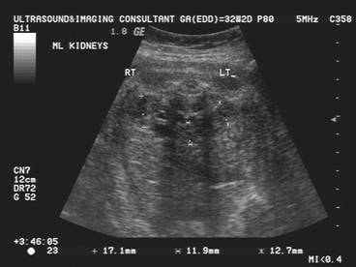
ANTENATAL USG

Slide 67
IVP

Slide 68
CT

Slide 69
CONGENITAL CYSTIC RENAL DISEASES(CYSTIC RENAL DYSPLASIA)
TYPE I-infantile or ARPKD
TYPE II-multicystic dysplastic kidney
TYPE III-ADPKD
TYPE IV-cystic renal dysplasia due to early urinary obstruction

Slide 70
AUTOSOMAL RECESSIVE POLYCYSTIC KIDNEY DISEASE

Slide 71
Bilateral and symmetric involving distal convoluted tubule and collecting ducts
25% recurrence in future pregnancy
Saccular dilatation of renal collecting tubules with hundreds of 1-2 mm cysts.
Liver is always involved- cysts, bile duct ectasia, periportal fibrosis
4 categories-perinatal, neonatal, infantile and juvenile
As the age increases hepatic involvement increases and renal involvement decreases.
These infants at risk for pulmonary hypoplasia

Slide 72
IMAGING
PLAIN RADIOGRAPH
Large flank masses with displacement of bowel gases
USG
Small non communicating cysts(0.5-1mm)
Enlarges kidneys with preservation of reniform shape
Poor or absent CMD
Perirenal halo representing the peripheral compressed hypoechoic normal cortex around the hyperechoic medulla.
Punctate calcification with ring down artifacts

Slide 73
IVP
Streaked nephrogram at 6 to 24 hrs
CT
Bilateral symmetrical enlarged kidneys with punctate calcification
Striated nephrogram due to trapping of contrast in the medulla
Poorly functioning kidneys
NUCLEAR SCAN
Loss of kidney outline with patchy tracer uptake and focal defects throughout renal parenchyma.

Slide 74
RENAL ENLARGEMENT WITH MICROCYSTS

Slide 75
MULTICYSTIC DYSPLASTIC KIDNEY

Slide 76
Second most common cause of abdominal mass in neonate(most common is HN)
Affected kidney is non functioning and replaced by cysts and dysplastic tissue
Unilateral
Bilateral and that associated with contralateral renal agenesis is lethal

Slide 77
Two types
A)pelviinfundibular- most common; atresia of renal pelvis and proximal ureter in early fetal life; cysts represent dilated calyces
B)hydronephrotic-less frequent; atresis of proximal segment of ureter(sometimes entire ureter) cysts represent entire pelvicalyceal system
Postnatally, progressive involution of cystic spaces within first 2 yrs of life

Slide 78
IMAGING
USG
Lobulated kidney , multiple variable sized non communicating cysts separated by echogenic areas throughout
DOPPLER
Minimal vascularity in parenchyma and small central hilar vessels
CECT
Multiple low attenuating cysts with minimal or non enhancement and no excretion on delayed images

Slide 79
d/d is PUJ obstruction
However in PUJ obstruction, reniform shape is maintaines, dilated pelvis is centrally located with multiple peripheral calyces seen to extend from it.
On nuclear imaging demonstration of function indicates PUJ obstruction as initial images demonstrate perfusion but there is lack of excretion

Slide 80
SMALL MALFORMED KIDNEY WITH MULTIPLE CYSTS

Slide 81
AUTOSOMAL DOMINANT POLYCYSTIC KIDNEY DISEASE

Slide 82
Multiple bilateral renal macrocysts
Other organs involved-liver, spleen, pancreas, brain, testis and ovaries
Usually manifests after 3rd decade of life
High degree of penetrance
c/f- hypertension, proteinuria and hyperlipidemia
Rarely diagnosed antenatally

Slide 83
IMAGING
USG
Renal contour normal in early life, becomes bosselated as more cysts develop
IVP
Enlarged kidneys with dystrophic calcification of cyst wall and renal calculi
Smooth marginated radiolucent defects seen in nephrographic phase leading to swiss cheese appearance
CECT
Non enhancing hypodense cysts
Complicated cysts
MRI
Can easily demonstrate hemorrhage in the cyst

Slide 84
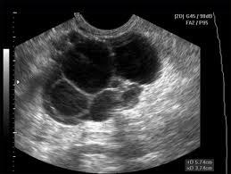
USG

Slide 85
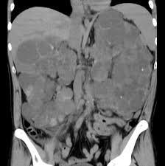
CT

Slide 86
ANOMALIES OF COLLECTING SYSTEM
PUJ OBSTRUCTION
CONGENITAL MEGACALYCES

Slide 87
PUJ OBSTRUCTION

Slide 88
Most common cause of neonatal HN
Functional obstruction more common
Infolding of local mucosa, aberrant artery, adhesion and overlying fibrosis are other causes
In u/l PUJ obstruction opposite kidney is absent, duplicated or cystic dysplastic
More common in males and on left side
If not diagnosed antenatally present with abdominal lump later, intermittent abd pain, hematuria and UTI.

Slide 89
IMAGING
USG
COLOR DOPPLER
RI > 0.7 or increase in RI by >0.1 in post frusemide study
IVP
Delayed opacification of collecting system, marked pyelocaliectasis, narrowing at PUJ and incomplete visualisation of normal ureter
Retention of contrast in collecting system on delayed films
If intrarenal pelvis-then caliectasis>pyelectasis

Slide 90
DIURETIC RENOGRAPHY
0.5 mg/kg frusemide used
MCU
To exclude VUR
CT
Best to evaluate isthmus anatomy when PUJ obstruction in horseshoe kidney

Slide 91
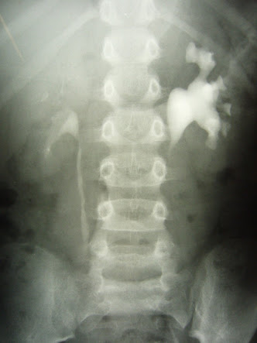
IVP

Slide 92
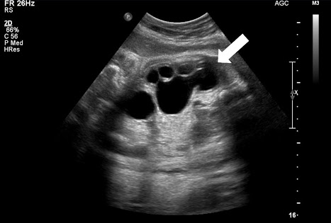
USG

Slide 93
CT

Slide 94
CONGENITAL MEGACALYCES/ PUIGVERT'S DISEASE
Calyces are asymmetrically dilated. Renal pelvis is normal. Some doubt its congenital nature.

Slide 95
THANK YOU

