Slide 1
DIFFUSION WEIGHTED MR IMAGING
DR POOJA DESHPANDE

Slide 2
DIFFUSION WEIGHTED IMAGING
INTRODUCTION
DIFFUSION PHYSICS
TECHNIQUE & INTERPRETATION
CLINICAL APPLICATIONS
WHOLE BODY DIFFUSION
LIMITATIONS & PITFALLS
DIFFUSION TENSOR IMAGING
TRACTOGRAPHY
SUMMARY

Slide 3
INTRODUCTION
DWI obtained by incorporating diffusion gradient pulses within conventional MR sequences
Based on random/Brownian movement of water molecules within tissues.
The pulse gradient technique developed by Stejskal & Tanner in 1965 forms the basis of today’s diffusion-weighted imaging methods.
In 1984 Le Bihan introduced ‘b’ factor & concept of ‘Apparent Diffusion Coefficient’.

Slide 4
Principle of dwi
Based on random movement of water molecules.
unrestricted environment-
water movement completely random- BROWNIAN
MOTION
Within biologic tissues-
-not completely random,
-impeded by interaction with tissue compartments, cell membranes, and intracellular organelles.

Slide 5
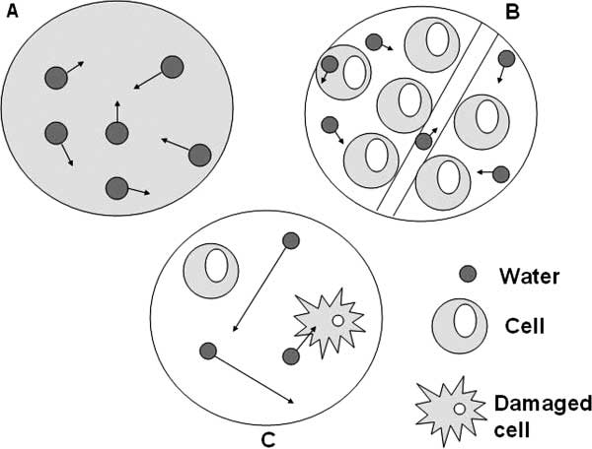
PRINCIPLES OF DWI
Extent of tissue cellularity and presence of intact cell membranes help determine the impedance of water molecule diffusion
Tissues with impeded diffusion include tumor, cytotoxic edema, abscess, and fibrosis.
Notes:
In A, water molecules in a container alone move randomly (Brownian motion). In B, highly cellular tissue impedes the movement of water molecules.
Their movement can be categorized as intravascular,intracellular, or extracellular. In C, tissue of low cellularity or with defective cells permits greater water
molecule movement.

Slide 6
DWI PHYSICS
DW sequence is adaptation of T2 weighted spin echo sequence
spin-echo T2-weighted sequence consists of a 90° radiofrequency (RF) pulse followed by a 180° RF pulse
2 strong motion probing gradients applied on either side of the 180° refocusing pulse- gradient fields applied along x,y,z axes.- imaging is sensitized to water diffusion in 3 directions
Before 180° RF pulse: Dephasing gradient
After 180° RF pulse: Rephasing gradient

Slide 7
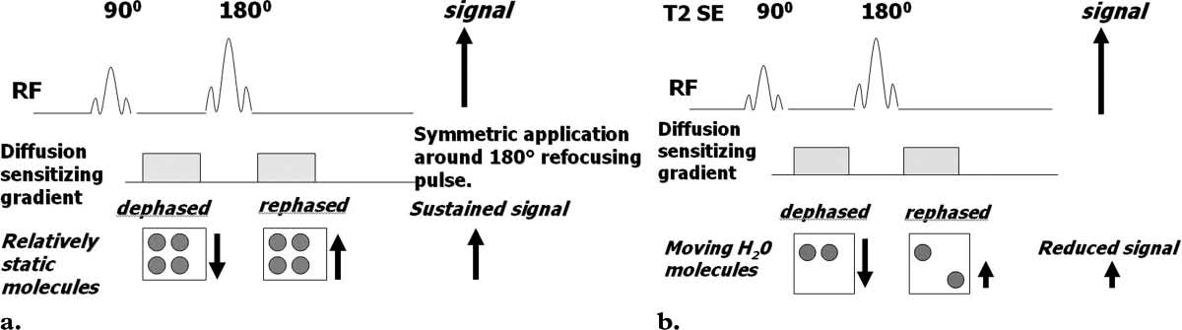
Dephasing gradient is cancelled out by the rephasing gradient in tissues with impeded water movement i.e.highly cellular tissues- HIGH SIGNAL
In low cellularity tissue, water molecules may move a considerable distance between the dephasing and rephasing gradient applications.
So not fully rephased , resulting in a REDUCTION IN OVERALL T2 SIGNAL INTENSITY.
SIGNAL ATTENUATION IS PROP TO WATER DIFFUSION

Slide 8
B-VALUE
B- value : Strength of diffusion sensitizing gradient.
Sensitivity of diffusion sequence is adjusted by changing b value.
The b value is proportional to the
Gradient amplitude
The duration of the applied gradient.
The time interval between paired gradients .
Measured in seconds per square millimeter(s/mm2)
Notes:
As TR, TE are important parameters in case of T1, T2 imaging. B value is an imp parameter in DWI.

Slide 9
B-VALUE
The diffusion sensitivity factor b
B= γ²G²δ²(Δ − δ/3).
γ - The gyromagnetic ratio(physical constant)
G - amplitude of diffusion gradient(miliT/meter)
δ - Duration of each diffusion gradient (ms).
Δ - The time between the two balanced DW gradient pulses.

Slide 10
B-VALUE
At b value =0 sec/mm2 (ie, no diffusion sensitizing gradient), free water molecules have high signal intensity, the signal intensity being based on T2 weighting.
Small b values (50–100 sec/mm2) - result in signal loss in highly mobile water molecules such as within vessels.
Since water movement in highly cellular tissues is restricted, the water molecules within such tissue retain their signal even at high b values. (500–1000 sec/mm2).
Thus, performing DW MR imaging measurements by using two or more b values, tumor detection and characterization are possible based on the differences in water diffusivity

Slide 11
APPARENT DIFFUSION COEFFICIENT
With MR imaging, molecular motion due to concentration gradients cannot be differentiated from molecular motion due to pressure gradients, thermal gradients, or ionic interactions.
Therefore, when measuring molecular motion with DW imaging, only the apparent diffusion coefficient (ADC) can be calculated.
ADC is independent of magnetic field strength
Devoid of T2 shine through

Slide 12
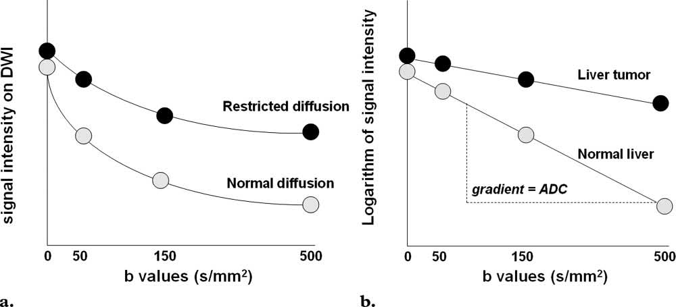
APPARENT DIFFUSION COEFFICIENT
The ADC represents the slope (gradient) of a line that is produced when
logarithm of relative signal intensity of tissue is plotted along the y-axis versus b values plotted along x-axis.
The calculated ADC values for all voxels are displayed as a parametric map, and by drawing a region of interest onto this map, the mean or median ADC value in the region of interest that reflects water diffusivity can be recorded.

Slide 14
technique
FAST IMAGING required to avoid motion artefacts
Echoplanar imaging:
  Series of fast gradient oscillations applied for readout
  Less SPR
or fast/ turbo spin echo
  180 degree refocussing pulses applied during each readout
BREATH HOLD:
Or FREE BREATHING
B value is inverse of expected ADC value.
Increase b value : hyperintensity due to T2 effect decreases & that due to true diffusion restriction is retained.

Slide 15
ASSESSMENT OF DWI
QUALITATIVE |  | QUANTITATIVE
DIFFERENT b VALUES | DWI & ADC IMAGE | ADC VALUES
Atleast 2 ‘b’ values | Low cellularity- hyper on both | At least 2 ‘b’ values used.
Relative attenuation of signal intensity on different b values | High cellularity- Hyper on DWI & hypo on ADC | The analysis of ADC is an automated process
Low b value- for lesion detection |  | ADC can then be displayed as a parametric map
High b value- hyperintensity retained by tissues with restricted diffusion |  | ADC measurements then recorded for a given region by drawing ROIs on the ADC map

Slide 17
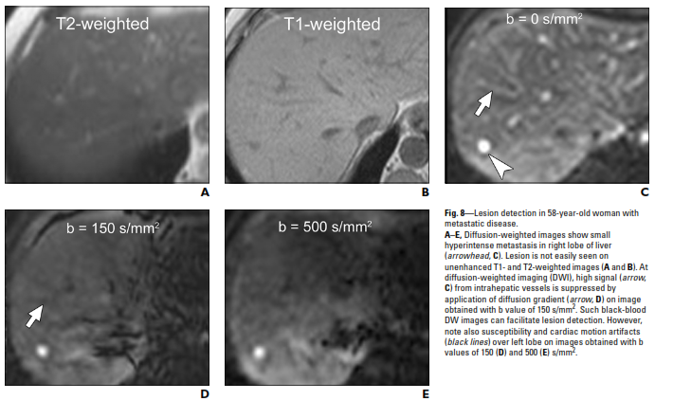

Slide 18
HIGH CELLULARITY LOW CELLULARITY
HYPER ON DWI HYPER ON DWI
HYPO ON ADC HYPER ON ADC
LOW ADC VALUE HIGH ADC VALUE
Restricted diffusion facilitated diffusion

Slide 19
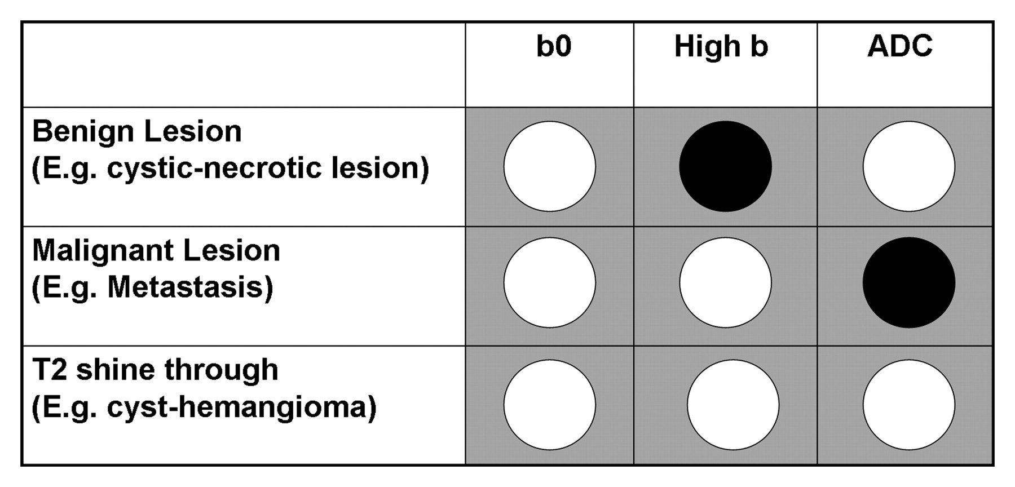

Slide 20
USES OF DWI
Lesion detection- Better at low b values
Lesion characterization- at multiple b values
Differentiates benign & malignant lesions
Differentiates abscess(low ADC) from cystic & necrotic mets(high ADC).
Tumor grading
Guide biopsy to avoid necrotic area
Predict whether tumor will respond to chemotherapy- high ADC pretreatment means low cellularity- less response to chemo
Response to treatment- increase in ADC value post-treatment- sign of response
Detection of residual/ recurrent lesion.

Slide 21
CLINICAL APPLICATIONS IN CNS
Acute infarction
Extra axial masses : Arachnoid cyst Vs Epidermoid cyst
Intra-axial masses : Gliomas- Solid gliomas with low ADC are higher grade
Intracranial infection-
Pyogenic infecton
Herpes encephalitis

Slide 22
CLINICAL APPLICATIONS IN CNS
Creutzfeldt Jacob Disease
Demyelination :
Multiple Sclerosis
Acute disseminated encephalomyelitis
Hemorrhage

Slide 23
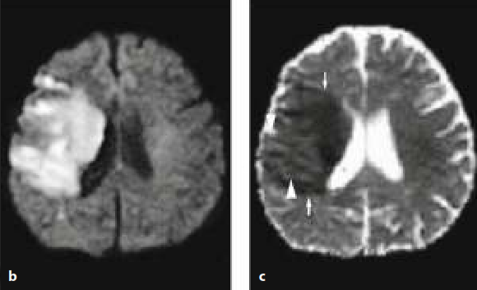
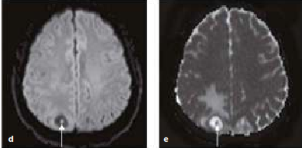

Slide 24
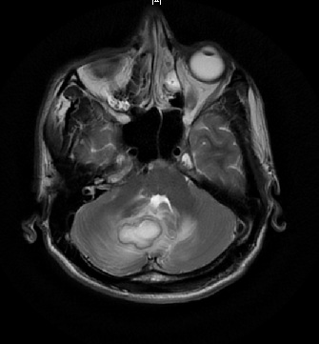
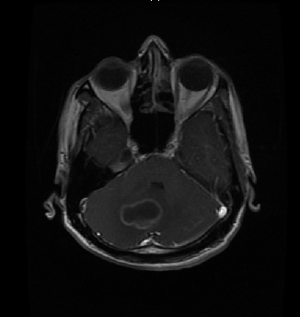
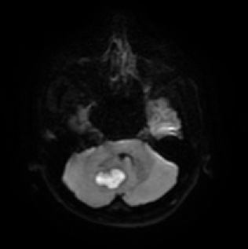
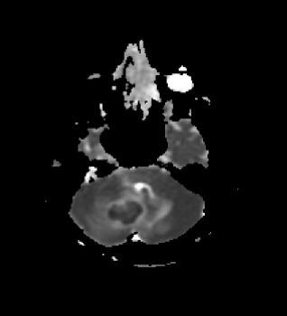
Notes:
t2W- hyperintense lesion in right cerebellar hemisphere , T1 post contrast- peripheral rim enhancement dwi- hyperintense adc- hypo abscess

Slide 25
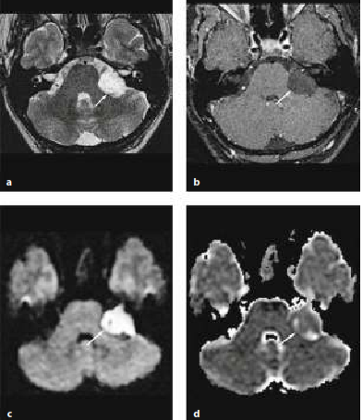
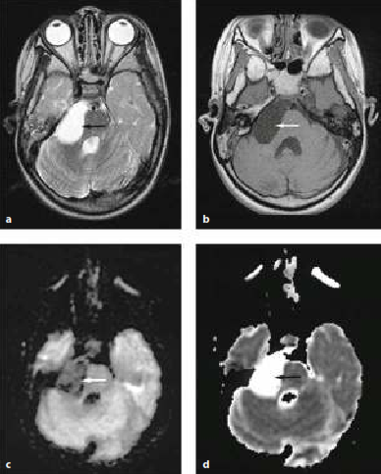

Slide 26
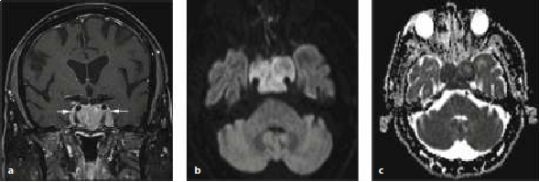
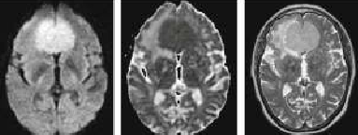
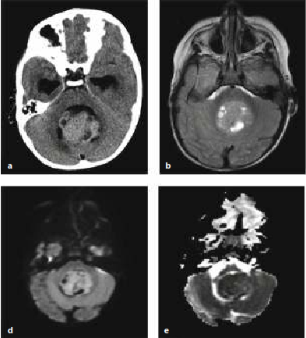

Slide 27
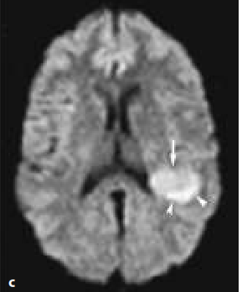
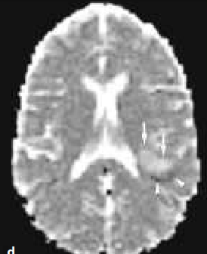
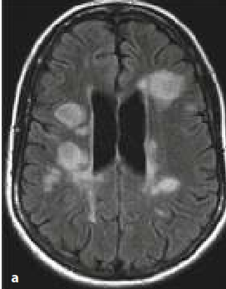
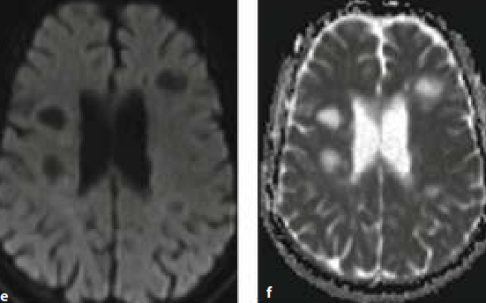

Slide 28
CLINICAL APPLICATIONS IN OTHER SYSTEMS
LIVER:
Detection of focal lesions
Characterization
Differentiate benign from malignant lesions
Response to treatment
Higher ADC values indicate tumor necrosis- s/o reduced perfusion and therefore reduced response to chemotherapy.
Response to chemotherapy is detected by increase in ADC value.
ADC threshold of 1.63 × 10-3 mm2/sec could be used to correctly characterize 88% of lesions as either benign or malignant.
Fibrosis & cirrhosis show low ADC values.

Slide 32
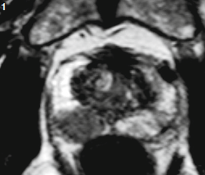
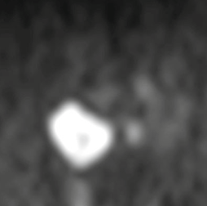
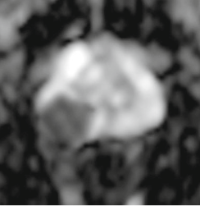

Slide 33
Clinical applications of dwi
HEAD & NECK:
Differentiates benign & malignant
Lymphoma shows lower ADC values than SCC
Pleomorphic adenoma shows higher ADC values than warthins tumour
High grade lesions- low ADC
Assess tm response to therapy in early stage- better than PET to differentiate inflammation ( high ADC) from residual tm ( low ADC)
Differentiate necrosis within tm(high ADC) from abscess formation (low ADC)

Slide 34
Clinical applications of dwi
THORAX:
Small cell lung ca has lower ADC than Non small cell ca.
Delineate tumour from collapsed lung
Characterize mediastinal nodes
BREAST:
Benign vs malignant ( however lesions with fibrotic component show low ADC- fibroadenoma)
Grade tumour
Guide biopsy
Response to treatment

Slide 35
Clinical applications of dwi
GB, pancreas, kidneys
Cervix: SCC has lower ADC values than adenocarcinoma
Spine:
Whole body diffusion: lymphoma & other malignancies

Slide 36
Whole body dwi
Skull base till mid thigh
Acquisition in multiple stations with multiple thin slices
Free breathing
Echoplanar sequence with STIR
B values- 0 & 1000 sec/mm2- background suppression
Large number of signals collected & averaged
Longer time
Interpreted with source images- reversed black & white grey scale display - MIP
Areas showing restricted diffusion—for example, highly cellular lymph nodes—are strikingly depicted .
Used to evaluate lymphadenopathy in patients
with lymphoma and other cancers

Slide 37
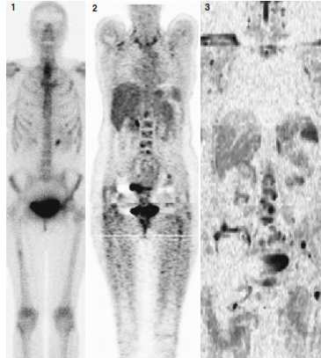
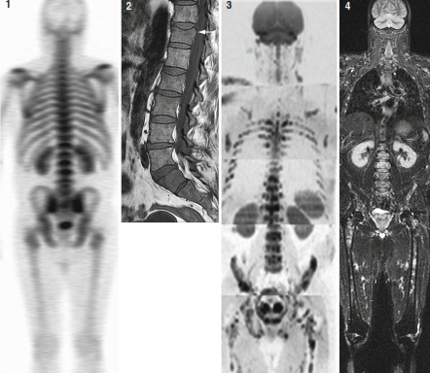

Slide 38
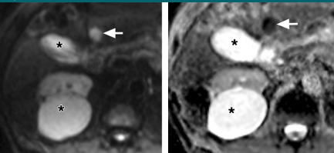
Limitations &PITFALLS IN DWI
T2 Shine-through :
tissues with long T2 relaxation time like cysts show high signal even on high b values even if signal due to water diffusion is attenuated. ADC map should be used as it eliminates T2 effect.

Slide 39
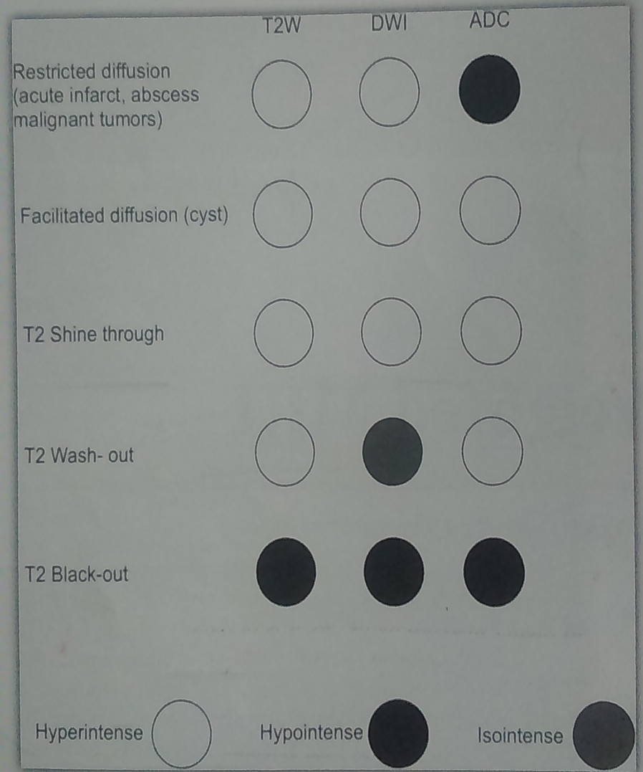
Limitations & PITFALLS IN DWI
Slow-flowing Blood: hemangioma may appear hyper on DWI- should be interpreted with other MR sequences
T2 blackout: hypo on T2 as well as DWI - hematoma
T2 washout: in vasogenic oedema. Increase in ADC because of increased diffusivity.
Eddy currents: due to echoplanar
Sensitive to Motion artifacts
Low SNR
As there is overlap between ADC values of benign and malignant lesions, DW images should be interpreted with other conventional MR sequences

Slide 40
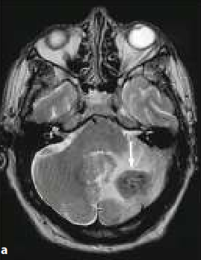
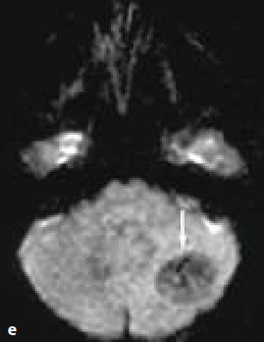
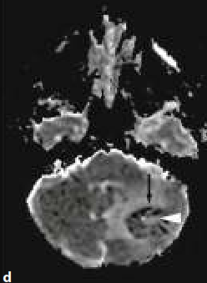
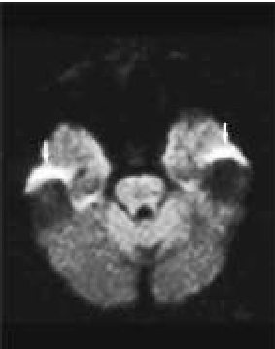

Slide 41
DIFFUSION TENSOR IMAGING
&
TRACTOGRAPHY

Slide 42
INTRODUCTION
This method offers in vivo localisation of neuronal fibre tracts.
As the diffusion in white matter of brain is anisotropic due to axonal orientation, scalar ADC is not sufficient. The required directional component is provided by DTI.

Slide 43
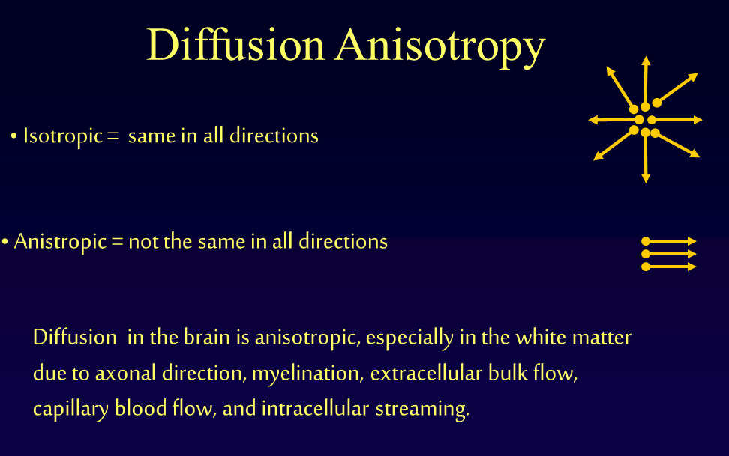

Slide 44
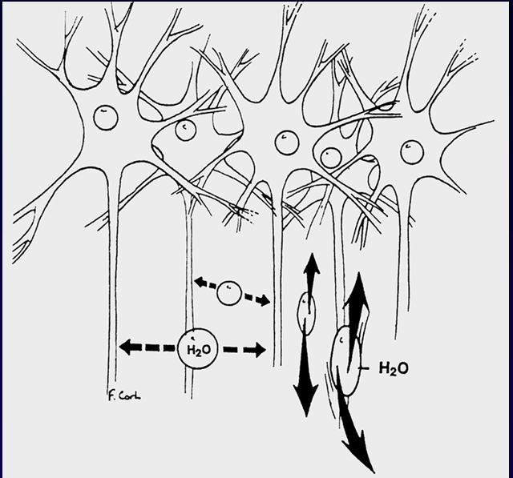

Slide 45
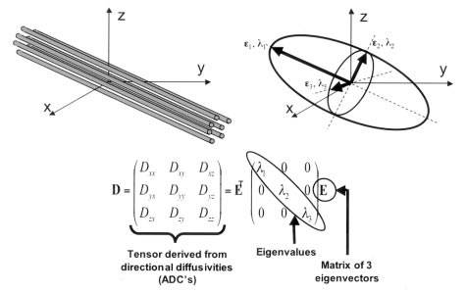
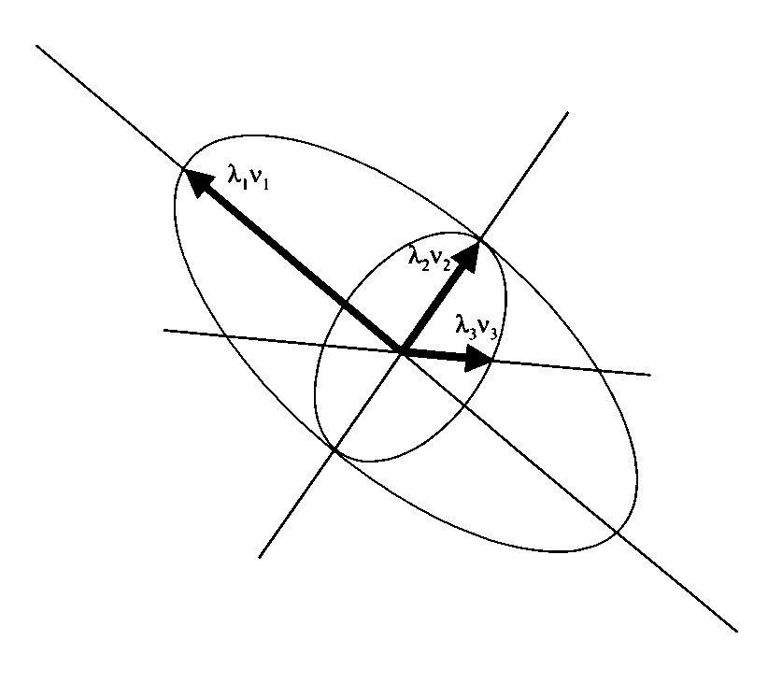
DIFFUSION TENSOR
Notes:
λ is avg diffusivity. λ1,λ2, λ3 are 3 eigenvalues. The order (also degree or rank) of a tensor is the dimensionality of the array needed to represent it, or equivalently, the number of indices needed to label a component of that array.

Slide 46
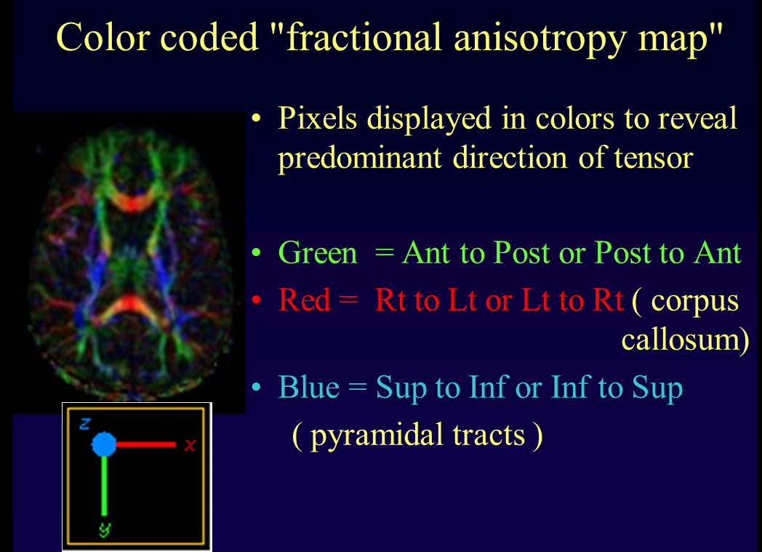
FRACTIONAL ANISOTROPY(FA)
Using these mean diffusivity values, FA maps are created which provide the degree of anisotropy and the local fiber direction.

Slide 47
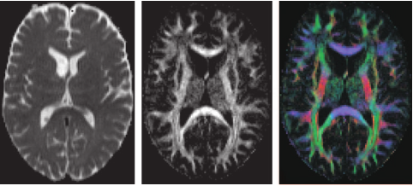

Slide 48
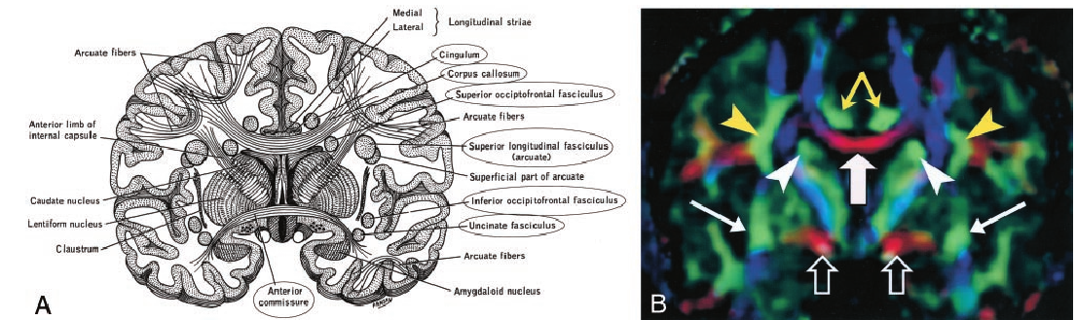

Slide 49
DTI APPLICATIONS
Tractography
Aberrent fibre connections
Neoplasms and peritumoral edema
Traumatic brain injury
Hypoxic-ischaemic Encephalopathy
Epilepsy

Slide 50
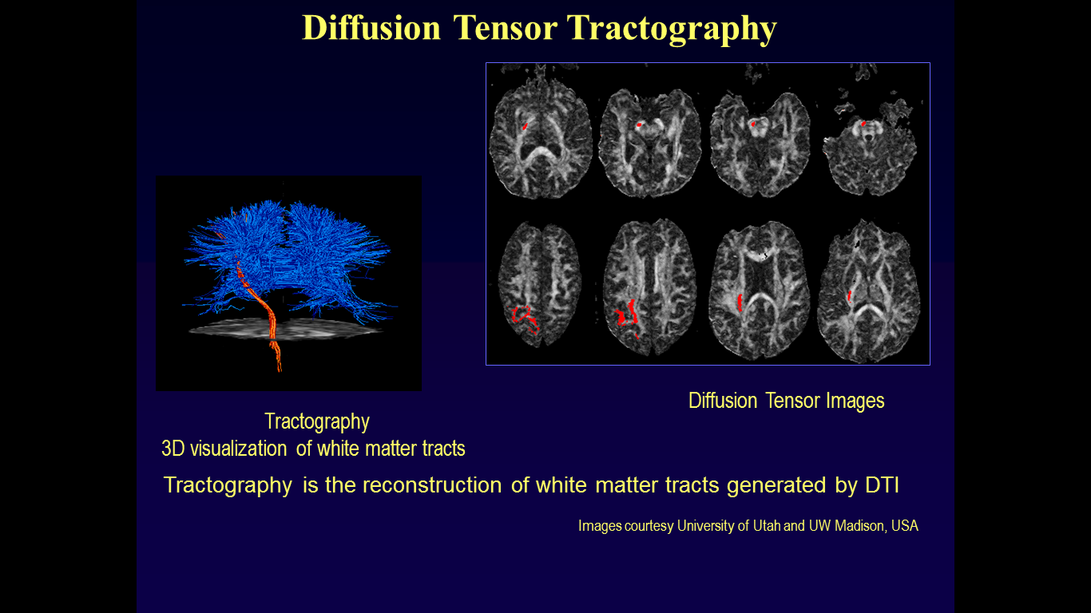
TRACTOGRAPHY
It is reconstruction of white matter tracts generated by DTI
Fractional anisotropy thresholds help to exclude gray matter and to segment white matter tracts that are separated by gray matter .

Slide 51
TRACTOGRAPHY
Tracking is launched from a seed voxel from which a line is propagated in both retrograde and antegrade directions according to the principal eigenvector at each voxel.
Tracking propagates on the basis of the orientation of the eigenvector that is associated with the largest eigenvalue.
Tracking is terminated when it reaches a voxel with fractional anisotropy lower than a threshold of 0.25–0.35 and when the angle between the two principal eigenvectors is greater than 35–40°.
Notes:
0.18

Slide 52
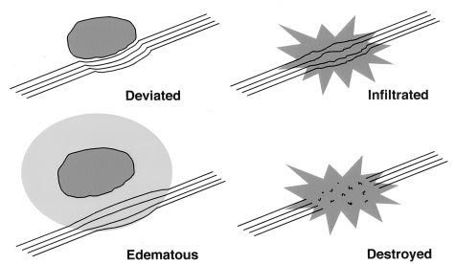
DTI IN NEOPLASM
White matter tracts are characterized as follows
Displaced : If they maintained normal anisotropy relative to the corresponding tract in the contralateral hemisphere but were situated in an abnormal location or with an abnormal orientation on color-coded orientation map.
Edematous : if they maintained normal anisotropy and orientation but demonstrated high signal intensity on T2-weighted MR images.
Infiltrated : if they showed reduced anisotropy but remained identifiable on orientation maps.
Disrupted : if anisotropy was markedly reduced such that the tract could not be identified on orientation maps.

Slide 53
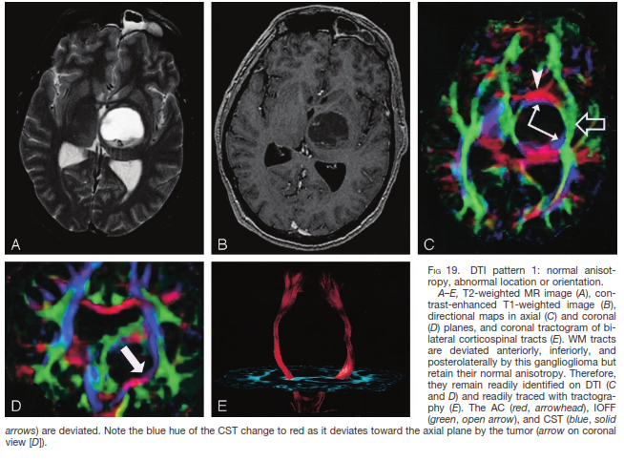

Slide 54
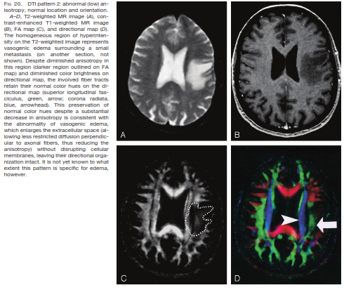

Slide 55
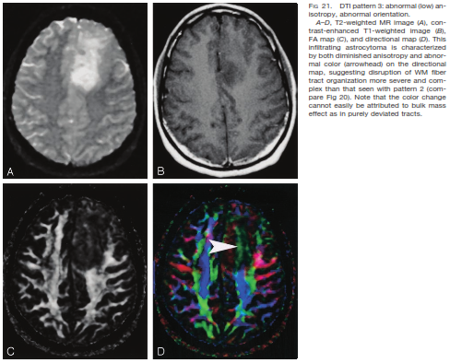

Slide 56
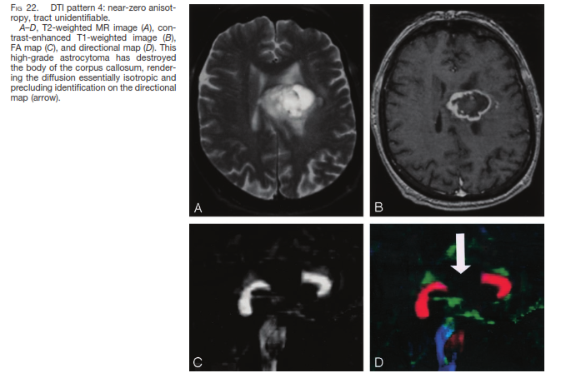

Slide 57
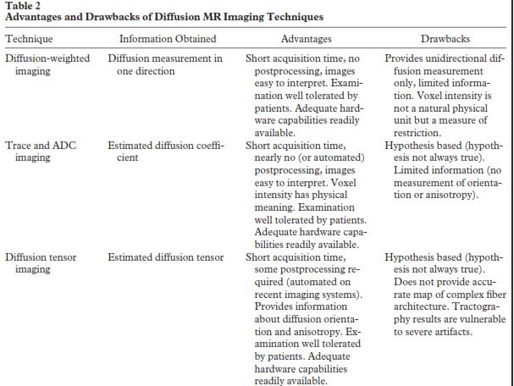

Slide 58
summary
DWI is based on brownian motion of water molecules.
Imaging is sensitized to water diffusion.
Both qualitative & quantitative assessment
Tissues with low cellularity show facilitated diffusion & those with high cellularity show restricted diffusion
Used for lesion detection , characterization & differentiation
Fast, no radiation, no contrast
As there is overlap between ADC values of benign and malignant lesions, DW images should be interpreted with other conventional MR sequences.
DW images should always be studied in conjunction with ADC maps to avoid any misinterpretation due to T2 shine through effect

Slide 59

MRI PHYSICS……..
Let me take the liberty of offering you some advice: keep reading about MRI.
Each time you reread the story you‟ll learn something new. And there will be a day that all the pieces come together.
When this happens you are invited to read the story again and you will discover that there is still more to learn.
Evert Blink
Author – MRI PHYSICS

Slide 60
THANK YOU

