Slide 1
ENTEROCLYSIS
Dr. Suchita B. ,JR-II

Slide 2
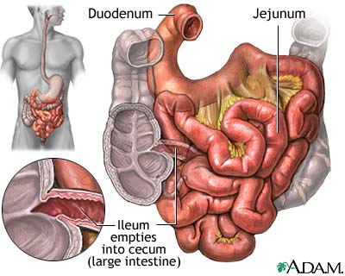

Slide 3
Small intestine proper starts from duodenal jejunal flexure to ileocaecal ligament and measures about 5 m and consist of:-
Jejunum.
Ileum.
Jejunum
ileum
Distal 3/5th
Lies in upper LUQ and LLQ
Proximal 2/5th
Max. diameter 4 cm.
4-7 folds per cm
Valvulae conniventies :-2mm
Feathery mucosal pattern on BMFT.
Lies in RIF and lower abdomen.
max.diiameter 3cm
Folds 3-5 per cm
1mm
Less feathery or absent.

Slide 4
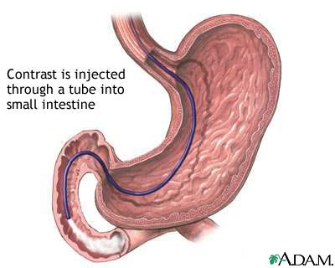
Enteroclysis……????
Radiological study of small bowel fr jejunum to i-c jn
By intubation of jejunum
Instillation of cont thro’ tube

Slide 5
WHY…..???
Overlapping of bowel loops
Poor distension of bowel loops
SBFT- Time consuming
Not accesible for scopes

Slide 6
Indications
1)Partial small bowel obstruction
2)Crohns disease
3) Suspected meckels diverticulum.
4) malabsorpion.
5)Tumours of small intestine
6) Occult git bleeding
7) Equivocal BMFT but strong clinical suspicion.

Slide 7
Contraindication
1)Complete colonic obstruction.
2)Suspected perforation.
3) Massive dilatation of small bowel
4)Duodenal obstruction and gastrojejunostomy.
5) Paralytic ileus.

Slide 8
Advantages
The material does not have to be held up by normal pyloric activity.
Less time
Increase in the distention of the lumen;
Distention of the lumen is controlled by the rate of infusion.
Sinuses or fistulous tracts

Slide 9
Disadvantages
The placement of the enteroclysis catheter
higher doses of radiation
Nausea & vomiting d/t inadequate placement of cath
Rapid colonic emptying
Operator dependent
Failure to demonstrate extra-intestinal changes

Slide 10
Patient Preparations
Liquid diet and overnight NBM.
Bowel preparation
No rectal enemas.
Infants.
4hrs fasting
Sedation
decreased peristasis-3-5ml of metaclopromide

Slide 11
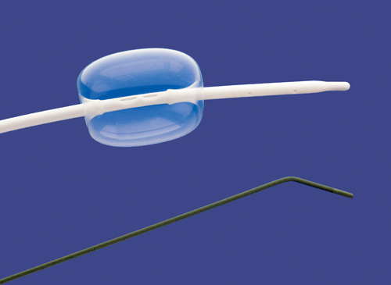
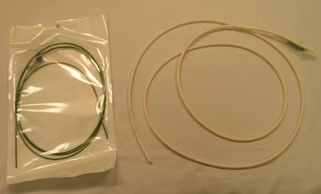
Technique
Bilbao dotter tube and guidewire
Plain radiograph of abdomen
Single contrast examination.(20%)
Double contrast examination
Methlycellulose
10 gm + 2lit water

Slide 12
Procedure
Explain the procedure
Sedation, usually not recommended
Administer Xylocaine lubricate to the nostril, on the enteroclysis catheter tip
The patient may sit up or lie down for the initial placement of the catheter.
B-D Tube(without guidewire) advanced thro one of the nostrils

Slide 13
The Radiologist will advance the catheter until slight resistance is felt; this usually indicates the tip of the catheter is in the fundus of the stomach.
the patient should lie back on the fluoroscopy table The Radiologist will then check the position of the catheter with fluoroscopy.
Fluoroscopy may also be utilized during the entire placement of the catheter

Slide 14
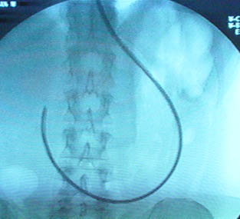
Common difficulties
1. The catheter coils in the fundus of the stomach.
rolling the patient onto their right side ,
gravity to point the catheter into the body of the stomach

Slide 15
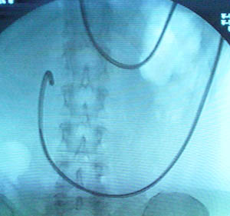
The catheter doubles back into the antrum of the stomach.
The Radiologist will then pull the catheter back slowly cause the tip of the catheter to straighten slightly and point to the pylorus.
,

Slide 16
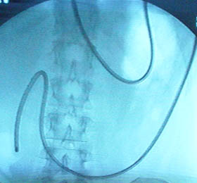
The catheter is being held up at the pylorus.
rolling the patient to the left (LPO) will widen the bulb,

Slide 17
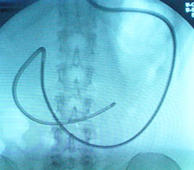
catheter stops at the inferior duodenal flex
apply pressure from a lead glove or compression paddle

Slide 18
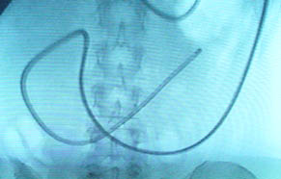
catheter has difficulties passing through the duodenojejunal junction.
Rolling the patient laterally (left) and then into a slight posterior oblique posi

Slide 19
Proper position
The balloon on the catheter should be inflated.
Placed beyond the ligament of Treitz.
Reassure the patient that the catheter is correctly positioned

Slide 20
INFUSION OF Ba
rate of 70 to 75 ccs per minute.
The infusion rate should be fast enough to distend the small bowel.
usually done by hand. .
barium advance through the small bowel in an uninterrupted column
monitor the fluoroscopy image during the inj of cont
If inadequate distention of the small bowel, an increase of 10 ccs per minute
if there is reflux of barium into the duodenum , slow the infusion rate by 10 ccs per minute.

Slide 21
the amount of barium injected can be from 180 ccs up to 500 ccs on average.
Monitor the leading edge of barium as it progresses through the small intestine
injected until the leading edge reaches the distal ileum.

Slide 22
Methylcellulose
form of polysacharide cellulose
nonirritating to the mucosal lining,
unable to be absorbed,
no toxic effects on the body.
to retain water in the lumen, which promotes peristalsis and prevents lumen collapse.

Slide 23
Why CMC?
It propels the barium into the distal ileum and the colon.
It distends the lumen, straightens the circular folds, and distends each segment. It has low diffusivity with compatible barium suspensions and thus, preserves an interface between the dense barium coating the mucosa and the water density of the distended lumen. Intestinal surface detail can be studied methylcellulose promotes evacuation of the barium.

Slide 24
Infusion of the Methylcellulose
infused at a rate of 70 to 120 ccs per minute;
with 1,500 to 2,000 ccs
The infusion rate is related to the rate at which the barium moved through the patient.
watch the fluoroscopy image for reflux
This rate of infusion of the methylcellulose is continued until there is sufficient distention of the distal and terminal ileum.

Slide 25
Filming
Upper abdo- jejunum seen in double cont
Full abdo- entire small bowel in double cont
I-C junction spot in single/double cont
Spot films as required

Slide 26
Aftercare
Diarrhea – large volume of fluid

Slide 27
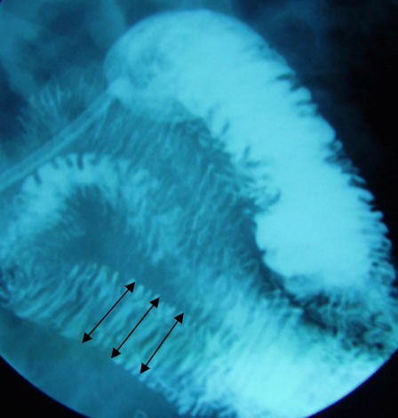
Fold shape:
less pronounced or possible absent in the ileum.
The folds run fairly straight and parallel, joining the bowel wall in the form of rounded corners.
in the ileum, creating a triangular fold pattern.

Slide 28
Fold thickness
1.8 mm thick in the jejunum,
1.5 mm thick in the ileum.
>2.5 mm in the jejunum
> 2.0 in the ileum, it is considered a pathologic finding.

Slide 29
Number of folds
: 4 to 7 folds per inch are normal for the proximal jejunum
2 to 5 folds per inch is normal for the distal ileum.

Slide 30
Fold Height.
3 to 7 mm in the jejunum and 1.5 to 3.5 mm in the ileum.
the height of the folds may vary considerably within the same segment of the bowel,

Slide 31
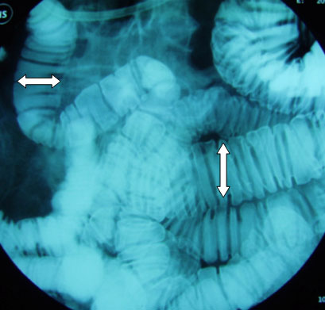
 | NORMAL (CM) | ABNORMAL (CM)
upper jejunum | 3.0 to 4.0 | >4.5
lower jejunum, | 2.5 to 3.5 | >4.0
ileum | 2.0 to 2.8 | >3.0

Slide 32
Single contrast enteroclysis

Slide 33
High grade partial small bowel obstruction
Ba suspension (20%)
At rate of 75-120cc/min
1-1.5 lit of Ba
Follow the head of the Ba column
Fims- jejunal loops
Entire small bowel loops
I-C jn

Slide 34
Air double contrast enteroclysis

Slide 35
50-70% Barium sulphate
At rate of 60ml/min
150-200 ml
Head of barium reaches the distal ileum, inj air
At rate of 100ml/min
600-1000ml of air
Adv -superior mucosal detail
Disadv- uncomfortable for the patient,difficult to produce

Slide 36
CT ENTEROCLYSIS

Slide 37
hybrid technique that combines the methods of fluoroscopic intubation-infusion
small-bowel examinations with that of abdominal CT.

Slide 38
Limitations conventional small bowel enema
evaluates only the lumen of the small bowel, not provide any information about the wall or extraluminal pathology.
significant overlap of small bowel loops.
These loops need to be separated by manual compression, loops which are deep in the pelvis are difficult to compress due to the bony pelvis.
differentiating a stricture from a peristalsis ,as the bowel wall is not seen on a conventional small bowel enema.
the radiation dose, not only to the patient but the operator also, especially if a lot of manual compression of bowel loops is required.

Slide 39
WHY CT…..?
a cross sectional imaging technique so every loop can be seen.
With thin collimation available, the bowel can be imaged in multiple planes.
visualizes not only the lumen but also the wall of the bowel as well as the structures external to the bowel.
The only disadvantage of MDCT - inadequate distension of the bowel lumen, as a result mucosal abnormalities are not well visualized. To counter this disadvantage, when MDCT is used to study the small bowel a CT enteroclysis technique is added to the examination.

Slide 40
CT ENTEROGRAPHY
patients object to insertion of a naso jejunal tube,
No NJ tube is used
450 ml/15min of contrast is administered orally
At the end of an hour CT is performed.
- Disadvantage - the distension is not as adequate as the invasive technique, as a result there may be false positive results for bowel wall thickening.

Slide 41
Enteral contrast agents
Neutral - isodense such as water
good delineation of contrast enhanced mucosa
Opacified mesenteric vessels can be seen well through the isodense neutral contrast.
Water - inexpensive and readily available.
suboptimal distension of the small bowel as it is absorbed by the intestinal mucosa.
contraindicated -cardiac and renal failure ,( increases the preload

Slide 42
Methylcellulose- ideal neutral cont

Slide 43
Negative - air.- evaluating the stomach, duodenum and colon
technical difficulties in insufflation of air, patients experience significant discomfort
Positive - hyperdense contrast agents like iodinated contrast medium
enhancement of bowel wall/mucosa cannot be visualized with positive contrast agents
useful - an enteral leak/fistula as even a small quantity of extra luminal contrast can be easily detected.

Slide 44
Methods
1)Positive enteral contrast without i.v.contrast material
detection of low-grade small-bowel obstruction
or enteric leak/fistula
2) Neutral enteral contrast material with intravenous contrast material.
Primary method of investigation

Slide 45
CT Enteroclysis with Neutral Enteral and Intravenous Contrast Material
The nasojejunal tube is placed beyond the ligament of treitz under fluoroscopy.
150 to 200ml of contrast is injected via the tube/ min total contrast quantity of 1500-2000 ml.
20 mg of buscopan just prior to doing the CT exam helps to reduce artifacts from small bowel peristalsis.
An additional 500 mL of contrast was administered while the patient was lying on CT table.

Slide 46
IV contrast - at a rate of 4ml/sec,(Total dose-75ml)
three phases, an early arterial phase at 20 sec to obtain a arteriogram,
late arterial phase at 35 sec -any hypervascular hepatic lesions and assess vascularity of bowel wall
portal venous phase approx 70 sec after onset of administration of contrast. to assess bowel wall vascularity as well as provides a CT Venogram of the mesenteric circulation.

Slide 47
CT Enteroclysis with Positive Enteral Contrast Material
Jejunal intubation of the patient with catheter
12% water soluble cont material is inj
At the rate of 55-150ml/min
Total dose- 2 lit
On CT table., 500 ml of cont is given

Slide 48
Small-Bowel Obstruction
Routine CT is very useful in high-grade small-bowel obstruction
Performance of CT enteroclysis with positive enteral contrast material is better in low grade
Patients with sympt of proxi jejunal obstruction, findings of conventional CT may be negative particularly if a nasogastric tube was used to decompress the stomach or if the patient vomited prior to the scan

Slide 49
(a) conventional CT image shows no evidence of distended
small bowel and unremarkable. (b) Transverse CT enteroclysis image with positive enteral contrast material shows distended proximal bowel loop with abrupt tapering (arrowhead) of caliber adjacent to anterior parietal peritoneum. Distal small bowel contains enteral contrast material (arrow) but is nondistended.

Slide 50
Cause-Adhesions (60%–80%)
classified
1) parietal or
2) visceral.
parietal adhesions cause abdominal pain and interloop adhesions are associated with bowel obstruction

Slide 51
Parietal adhesion-
Deformity and fixation of the small bowel to the peritoneal lining,
with obliteration of the fat plane
Visceral adhesion-
kinking or sharp angulation of bowel loops
asymmetric wall thickening

Slide 52
(a) Parietal adhesions. flattening (black arrowheads) of the anterior wall of small bowel and loss of fat plane between the posterior wall of rectus sheath and bowel wall. Anterior parietal peritoneum was thickened(arrow). (b) Visceral adhesions. dilated loops of small bowel in lt hemiabdomen. On the rt side,small-bowel loop showed variable caliber (arrow), sharp angulations (white arrowhead), and asymmetric wall thickening (black arrowhead) sugges

Slide 53
therapeutic & diagnostic
Early ( 7 days) postoperative obstruction,
Crohn disease
carcinomatosis
history of radiation therapy

Slide 54
CT examination performed 3 hours later
enteral contrast has passedbeyond the site of obstruction
conservative bowel decompression,
resolves without surgery

Slide 55
no enteral contrast material is seen in the colon
high grade obstruction
complete
at a second CT examination performed
12 hours after infusion,
surgery

Slide 56
Mural hyperenhancement
Segmental hyperattenuation of distended small bowel loops
relative to nearby normal-appearing loops
jejunum enhances > the ileum
Collapsed bowel loops have higher attenuation than distended ones
compare small bowel loops with increased attenuation ,with normal-appearing distended loops in the same bowel segment.

Slide 57
Active jejunal Crohn disease in a 19-year-old woman. CT enterogram shows
mural hyperenhancement (arrows). Compare the normal enhancement of the unaffected small
bowel (arrowhead).

Slide 58
Mural stratification
Visualization of layers of the bowel wall at contrast material–enhanced CT.
In mural stratification, the mucosa and serosa enhance strongly
Intervening bowel wall can have any of various degrees of attenuation, depending on what pathologic process

Slide 59
CT enterogram shows disease in the neoterminal ileum with bilaminar mural stratification (arrows) and intramural
soft-tissue attenuation

Slide 60
BOWEL THICKENING
Small bowel mural thickness > 3mm
is abnormal
Asymmetrically involvement predominantly the mesenteric border
Inflammation along the mesenteric
border will often result in pseudosacculations or
redundancy along the antimesenteric border

Slide 61
shows thickening of the ileal wall with intermediate attenuation (arrowhead), a finding
that suggests inflammatory infiltrate. Mucosal hyperenhancement (arrow) and perienteric fat stranding are also seen. (b) shows asymmetric
thickening of the medial wall of the cecum (arrows), along with the “comb sign” (arrowheads).

Slide 62
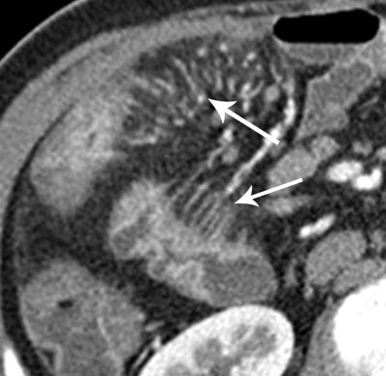
comb sign
Engorged vasa recta, vessels that penetrate the bowel wall perpendicular to the bowel lumen .
Engorged vasa recta indicate active inflammation

Slide 63
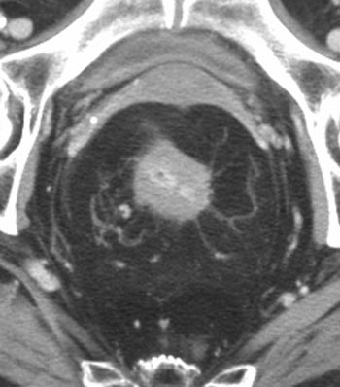
Fibrofatty proliferation
along the mesenteric border of bowel segments
CT enterogram shows diffuse fibrofatty
proliferation surrounding the rectum
and displacing the uterus anteriorly.

Slide 64
hyperenhancement of terminal ileal mucosa (arrowhead) and mural thickening.

Slide 65
Complications
Obstruction
Fistulae
Refractoriness to drugs
fibrostenotic
active inflammation.

Slide 66
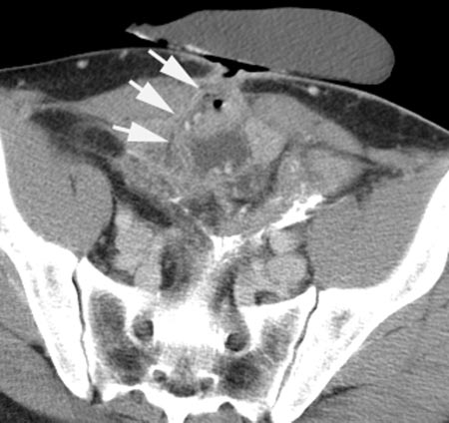
Fistulas
Extraenteric compli. of Crohn disease
Hyperenhancing tracts, usually originating from
bowel loops that exhibit signs of active inflammation
Large enterocutaneous fistula (arrows) arising from matted
loops of the distal ileum.

Slide 67
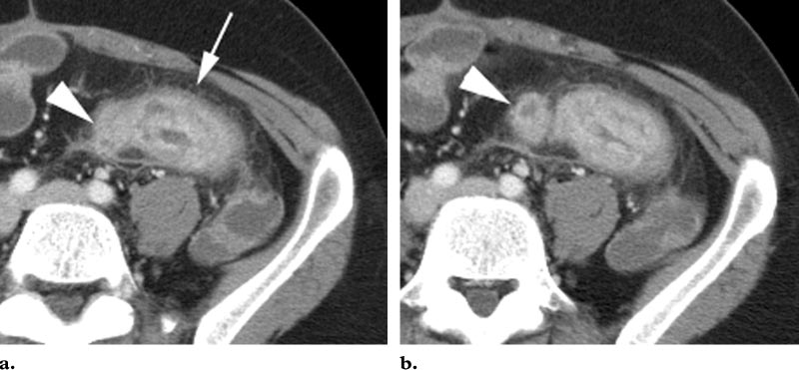
Abscesses
usually either within the mesentery or in a retroperitoneal location,
often being connected to inflamed bowel by a sinus
tract

Slide 68
Small-Bowel Neoplasms
Ability to characterize the small-bowel wall, its mesentery, and the liver,
CT enteroclysis with neutral enteral
and intravenous contrast material

Slide 69
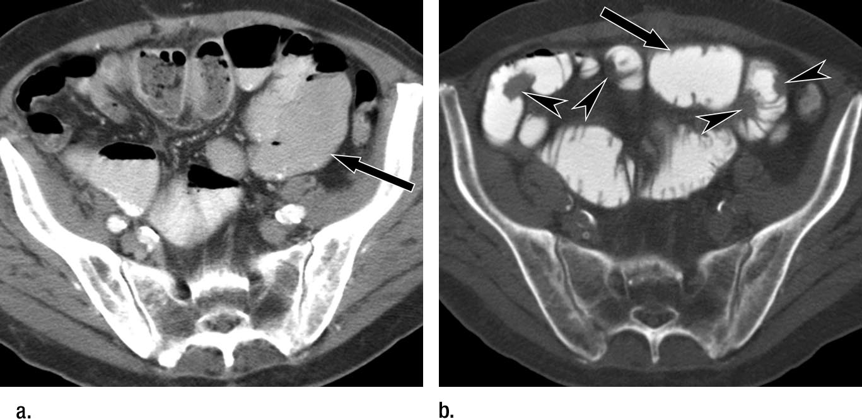
a) conventional CT image with oral and intravenous contrast material
shows distended small-bowel loops (arrow), but no bowel mass is seen.
(b)CT enteroclysis image with positive contrast material obtained 2 weeks later shows multiple masses (arrowheads) in small-bowel
wall consistent with serosal metastases and distended small-bowel loop (arrow)

Slide 70
Adenocarcinoma of the jejunum
demonstrates a bulky, heterogeneously enhancing
mass (arrow) arising from the
proximal jejunum (arrowhead).

Slide 71
Carcinoid tumor
mesenteric metastases from an ileal carcinoid tumor. Note the enhancing, star-shaped mesenteric nodule (arrowhead),
with stranding of the mesentery and thickening of the adjacent small bowel wall (arrows). The segmental wall
thickening may indicate either a carcinoid carpet lesion or segmental edema.

Slide 72
Hamartomatous polyps
multiple juvenile hamartomatous polyps
(arrows) are visible within the ileum

Slide 73
Celiac Disease
Fold reversal.
Note the prominent mucosal
pattern in the ileal loops within the pelvis
Classic appearance
But not seen usually
Dilatation of multiple loops
of jejunum with absence of valvulae conniventes
Most common finding

Slide 74
Gastrointestinal Bleeding
submucosal tumors or
Meckel diverticulitis.
second-line role in the investigation

Slide 75
unexplained gastrointestinal bleeding shows
3-cm hypervascular submucosal mass (arrow)
arising from mid small bowel, which was proved at
surgery to be gastrointestinal stromal tumor.

Slide 76
Disadvantages of CT Enteroclysis
Discomfort associated with nasoenteric tube placement
$$$
Radiation exposure
Bowel perforation,
Enteral contrast material aspiration
Respiratory depression from sedation

Slide 77
THANK YOU

