Slide 1
CONGENITAL HEART DISEASES
Dr MONICA PATIL
PG Guide-Dr SACHIN BAGALE

Slide 2
MORPHOLOGICAL RIGHT VENTRICLE
Rhomboid
Wraps around the LV
Trabeculated esp at apex
Septal attachment of papillary muscle

Slide 3
MORPHOLOGICAL lefT VENTRICLE
Cylindrical or ovoid
Basal half of IV septum is smooth
2 papillary muscles with no septal attachment

Slide 4
MORPHOLOGICAL lefT and right atrium
RA
Appendage is broad and triangular
Contains pectinate muscles
IVC opens in RA
LA
Long and narrow appendage curling around left side of heart

Slide 5
MODALITIES
Antenatal USG
Chest radiograph
2D ECHO
Cardiac CT
Cardiac MRI
Catheter angiography
a) 65 degree LAO with 20-25 degree cranial tilt
b) 30 degree RAO
Additional views
a) 55 degree LAO with 10-15 degree caudal tilt
b) 40 degree RAO with 15 degree caudal tilt

Slide 6
Descriptive steps
Situs
Cardiac connections
Looping
Positions
Malformations

Slide 7
Viceroatrial and bronchial situs

Slide 8
situs
Incidence of CHD-0.5-1%
Situs solitus with levocardia-1%
Situs solitus with isolated dextrocardia-98%
Situs inversus and dextrocardia (mirror image anatomy)-4%
Situs inversus with isolated levocardia-100%

Slide 9
Fetal situs on usg
Right hand rule
Fist-head of fetus.
Palm- face
Dorsal aspect-back
Thumb-left side

Slide 10
4 chambered view

Slide 11
3 vessel view

Slide 12
connections
Atrioventricular discordance
Ventriculoarterial discordance

Slide 13
Looping/topology

Slide 14
looping

Slide 15
Right sided aortic arch

Slide 16
malformation

Slide 17
asd
SECUNDUM ASD
60-90% of all ASDs
usually an isolated abnormality
PRIMUM ASD
5-20%
associated with cleft anterior mitral valve leaflet (partial atrioventricular septal defect)
SINUS VENOSUS
5%
associated with anomalous right pulmonary venous return to the superior vena cava or right atrium
CORONARY SINUS TYPE ASD ("UNROOFED CORONARY SINUS")
<1%

Slide 18
asd

Slide 19
ASD
The second most common congenital heart defect after ventricular septal defects
Most common to become symptomatic in adulthood.
They are characterised by an abnormal opening in the atrial septum allowing communication between the right and left atria.
Due to the low pressures of the atria, the lesion is typically asymptomatic until adulthood despite 2-4 times the normal pulmonary blood flow.
Gradual (high output) congestive cardiac failure eventually develops, usually becoming symptomatic by the age of 30.

Slide 20
ASD
Usually tend to be isolated anomalies.
Associations include:
Down syndrome (ostium primum defect)
Holt-Oram syndrome
Ellis-van Creveld syndrome
mitral valve prolapse
Lutembacher syndrome (ASD with MS)
Anomalous pulmonary venous return (especially with sinus venosus defects)
a)total anomalous pulmonary venous return (TAPVR)
b)partial anomalous pulmonary venous return (PAPVR)
A patent foramen ovale (PFO) is a form of atrial septal defect.

Slide 21
asd
Radiograph
Cardiomegaly with pulmonary plethora
2 D ECHO
Dilated RA and paradoxical motion of IV septum

Slide 22
asd

Slide 23
asd

Slide 24
asd

Slide 25
asd

Slide 26
complications
Pulmonary hypertension
Eisenmenger syndrome
Paradoxical emboli
Cardiac conduction defects, e.g. atrial fibrillation, flutter

Slide 27
treatment
The defect can be closed surgically or percutaneously (e.g. using an Amplatzer closure device).

Slide 28
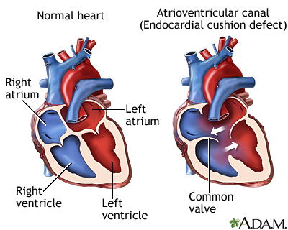
Endocardial cushion defects
Also called atrioventricular septal defects
Include septum primum, medial portions of mitral and tricuspid valves and inlet portion of interventricular septum
Associated with mitral regurgitation
So LA enlargement also seen.

Slide 29
VENTRICULAR SEPTAL DEFECT
Most common congenital cardiac abnormality diagnosed in children.
Second most common diagnosed in adults.
Classification according to location
MEMBRANOUS/PERIMEMBRANOUS (most common: 80-90%)
MUSCULAR
A-inlet/inflow
B-outlet/subarterial
C-muscular/trabecular

Slide 30
vsd

Slide 31
VSD
tetralogy of Fallot
truncus arteriosus
double outlet right ventricle: including Taussig-Bing malformation
aortic coarctation
tricuspid atresia
aortic regurgitation
pulmonary stenosis

Slide 32
vsd
A)Plain radiograph
Normal with a small VSD.
Larger VSDs may show cardiomegaly (particularly left atrial enlargement).
A large VSD may also show features of pulmonary arterial hypertension, pulmonary oedema, pleural effusion and increased pulmonary vascular markings.
B)Ultrasound: echocardiography
seen in the four chamber view.
A perimembranous VSD can be seen as a septal dropout in the area adjacent to the tricuspid septal leaflet and below the right border of the aortic annulus.

Slide 33
vsd

Slide 34
vsd

Slide 35
vsd

Slide 36
VSD
C)CT
CTA with ECG-gating allows direct visualisation of the defect. Large VSDs may be seen on non-gated studies.
D)MRI
May also show added functional information (e.g. quantification/shunt severity). Some muscular defects can give a "Swiss cheese" appearance owing to their complexity

Slide 37
vsd

Slide 38
vsd

Slide 39
vsd

Slide 40
VSD
Small VSDs which show a high spontaneous intrauterine or postnatal closure rate.
VSDs usually do not cause any haemodynamic compromise in utero due to the right and left ventricular pressures being very similar during that period.
Complications
Eisenmenger phenomenon with shunt reversal (i.e. left-to-right becomes right-to-left)
cardiac failure

Slide 41
Scimitar syndrome
Synonyms
Partial anomalous pulmonary venous return (L to R shunt)
Congenital pulmonary venolobar syndrome
Hypogenetic lung syndrome
Triad
Hypoplastic right lung
Anomalous vein draining into the RA, IVC, portal vein
dextrocardia

Slide 42
Scimitar syndrome

Slide 43
PDA
Normal connection of the fetal circulation between the aorta and the pulmonary arterial system (descending aorta and left pulmonary artery) that develops from the 6th aortic arch.
Functional closure 48 hours after birth.
Patency of the ductus may be isolated or associated with other cardiac anomalies (triad of PDA, coarctation and VSD)
continuous machine-like murmur (D/D-congenital sinus of valsalva aneurysm/fistula, coronary arteriovenous fistula)

Slide 44
PDA
tetralogy of Fallot
Eisenmenger syndrome
hypoplastic left heart
pulmonary atresia

Slide 45
pda
LA enlargement-VSD
LA enlargement with prominent aortic knuckle –PDA
Exception is premature infant in whom PDA is statistically most common and who will neither show cardiomegaly or prominent aortic knuckle

Slide 46
PDA
Treatment and prognosis
Medical
-prostaglandin E1: to keep ductus open
-indomethacin: to close the ductus
Endovascular
-various closure devices
Surgical
-clipping or ligation to close

Slide 47
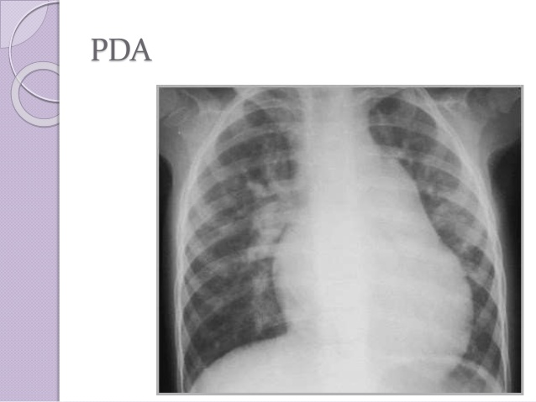
PDA

Slide 48
pda

Slide 49
pda

Slide 50
APW
The term "aortopulmonary window" can also refer to a rare form of congenital heart disease, where there is an opening between the aorta and the main pulmonary trunk.

Slide 51
Coarctation of aorta
Refers to a narrowing of the aortic lumen, more frequent in males
A)Infantile (pre-ductal) form:
Distal to the brachiocephalic artery to the level of ductus arteriosus, typically
With a more discrete area of constriction just distal to the origin of the left subclavian artery.
Therefore, the blood supply to the descending aorta is via the patent ductus arteriosus.
B)Adult (juxta-ductal, post-ductal or middle aortic) form:
Short segment abrupt stenosis of the post-ductal aorta, occurs just distal to the ligamentum arteriosum (a remnant of the ductus arteriosus.
Due to thickening of the aortic media and typically).

Slide 52
Coarctation of aorta

Slide 53
Coarctation of aorta
Clinical
Children and adults can present with angina pectoris and leg claudication. On clinical examination- diminished femoral pulses and differential blood pressure between upper and lower extremities may be noted.
Associations
Cardiac:
Bicuspid aortic valve: most common associated defect and seen in 75-80%
VSD
cyanotic congenital lesions including truncus arteriosus,TGA, sub-pulmonic VSD and overriding pulmonary artery (Taussig-Bing), mitral valve defects including hypoplastic mitral valve, parachute mitral valve and abnormal papillary muscles

Slide 54
Coarctation of aorta
Non cardiac associations
intracranial berry aneurysms
spinal scoliosis
Turner syndrome: a coarctation can be seen in 15-20% of those with Turner syndrome

Slide 55
Coarctation of aorta
Plain radiograph
Figure of 3 sign: contour abnormality of the aorta
Inferior rib notching: Roesler sign
Secondary to dilated intercostal collateral vessels which form as a way to bypass the coarctation , erode the inferior margins of the ribs, resulting in notching
Seen only in long standing cases (unusual in patients <5 years of age)
If the coarctation is distal to either subclavian artery, then increased flow occurs through the subclavian artery, forming a collateral pathway via the internal thoracic artery, anterior intercostal artery, posterior intercostal artery and then into the descending thoracic aorta
4th to 8th ribs are involved; occasionally involves the 3rd to 9th ribs
May also show left ventricular hypertrophy

Slide 56
Coarctation of aorta
1st and 2nd posterior intercostal arteries arise from the costocervical trunk (a branch of the subclavian artery) and do not communicate with the aorta, these are not involved in collateral formation, and the 1st and 2nd ribs do not become notched
If bilateral rib notching: the coarctation must be distal to the origin of both subclavian arteries, to enable bilateral collaterals to form
If unilateral right rib notching, then the coarctation lies distal to the brachiocephalic trunk, but proximal to the origin of the left subclavian artery. Collaterals cannot form on the left, as the left subclavian is distal to the coarctation.
If unilateral left rib notching, then this suggests an associated aberrant right subclavian artery arising after the coarctation. The coarctation is distal to the origin of the left subclavian artery, therefore collaterals form on the left. Collaterals cannot form on the right, as the aberrant right subclavian artery arises after the coarctation

Slide 57
Coarctation of aorta
Antenatal ultrasound
Useful in assessing for infantile coarctation. The suprasternal notch-long axis views are particularly considered helpful. Occasionally an aortic arch view may directly show a narrowing.
Angiography: CTA/MRA/DSA
Delineating the coarctation as well as collateral vessels, most common collateral pathway being subclavian artery to internal mammary artery to intercostal arteries (resulting in inferior rib notching) to post-coarctation part of descending thoracic aorta.

Slide 58
Coarctation of aorta

Slide 59
Coarctation of aorta

Slide 60
Coarctation of aorta

Slide 61
Coarctation of aorta
Complications
Neonatal heart failure
Subarachnoid haemorrhage from a ruptured berry aneurysm
Aortic dissection
Infective endocarditis: in the context of an added infective insult
Mycotic aneurysm: in the context of an added infective insult
Differential diagnosis
Pseudo-coarctation of the aorta: elongation, narrowing or kinking with no pressure gradient or collateral formation, no rib notching
Chronic large vessel arteritis, e.g. chronic phase of Takayasu arteritis

Slide 62
Coarctation of aorta
Treatment and prognosis
The urgency of treatment depends on the presence of congestive cardiac failure in severe coarctations found in infancy.
In less severe cases, elective treatment when the child is older (typically ~2 years of age) is preferred.
Treatment can be either primary surgical repair with excision of the coarctation and end-to-end anastomosis, or balloon angioplasty. Subclavian flap repair is a common surgical technique used, where the origin and proximal left subclavian artery is excised, opened up and sutured onto the aorta.

Slide 63
Bicuspid aortic valve

Slide 64
TOF
Tetralogy of Fallot (TOF) is the second most common cyanotic congenital heart condition
Characterised by
Ventricular septal defect (VSD)- may be multiple
Right ventricular outflow tract obstruction (RVOTO)
Overriding aorta
Late right ventricular hypertrophy-only develops after birth, a result of the VSD and right ventricular outlet obstruction, both contributing to elevated resistance to right heart emptying
Right sided aortic arch in 20% patients of TOF
Most common coronary artery variant is LAD from RCA
PINK TETRALOGY -resulting in delayed presentation, even into adulthood, although this is rare

Slide 65
tof

Slide 66
tof

Slide 67
tof

Slide 68
tof

Slide 69
tof

Slide 70
tof

Slide 71
tof
Notes:
Reduction in pulmonary artery calibre

Slide 72
tof
Treatment
A)Palliative
If child is too small for definitive surgery
Blalock Tausig shunt(end to side anastomosis of subclavian a. to pulmonary a.)
Modified BT shunt-use of a prosthetic graft
Complications- narrowing of the pulmonary artery into which it is inserted and seroma formation which may show wall calcification
Balloon dilatation of pulmonary valve ad outflow tract
Adv- no stenosis of pulmonary artery which can happen in BT shunt

Slide 73
tof
Notes:
Bt and modified bt shunt

Slide 74
tof
Notes:
Post operative seroma formation

Slide 75
MAPCAS
Major aortopulmonary collateral arteries (MAPCA's) are persistent tortuous fetal arteries that arise from the descending aorta and supply blood to pulmonary arteries in the lungs usually at the posterior aspect of hilum.
Embryologically, the intersegmental arteries regress with the normal development of pulmonary arteries.
They may persist to supply the pulmonary arteries when there is no flow or very little flow into the pulmonary arteries from the right ventricle.
If there is an alternate supply to the pulmonary arteries (e.g. patent ductus arteriosus), then the fetal arteries regress and such patient does not have MAPCAs.

Slide 76
MAPCAS
Association
pulmonary atresia
Tetralogy of fallot
Location
They usually arise from the descending aorta. Less commonly, they may arise from ascending aorta, IMAs, intercostal arteries, bronchial arteries, or subclavian arteries

Slide 77
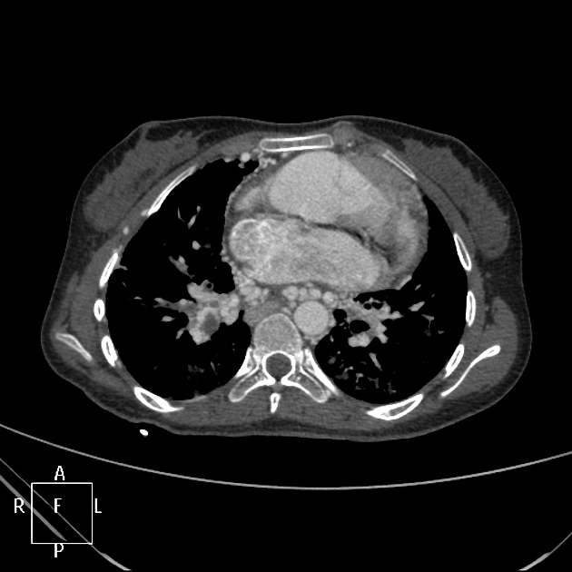
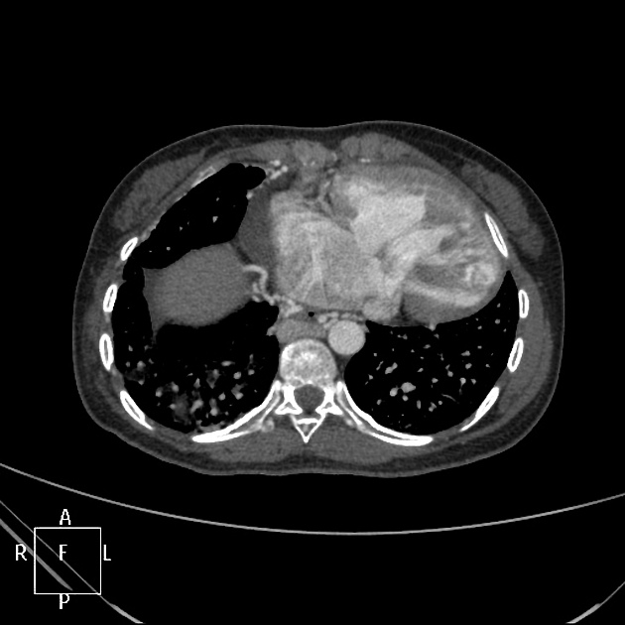
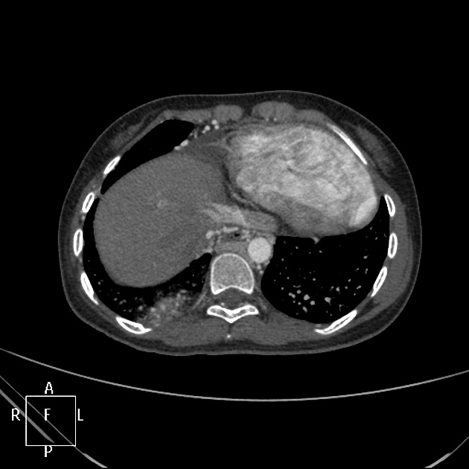
mapcas

Slide 78
TGA
Transposition of the great arteries (TGA) is the most common cyanotic congenital cardiac anomaly with cyanosis in the first 24 hours of life.
Most common in infants of diabetic mothers.

Slide 79
TGA
L-loop transposition of the great arteries: congenitally corrected TGA
D-loop transposition of the great arteries
An isolated TGA is incompatible with life at birth without one of the following additional anomalies (which are a common occurrence ):
a)atrial septal defect (ASD): uncommon
b)ventricular septal defect (VSD): ~35%
c)patent ductus arteriosus (PDA): unstable due closure following birth
d)patent foramen ovale (PFO): unstable

Slide 80
L loop tga

Slide 81
tga
Radiograph
-EGG ON STRING- There is often an apparent narrowing of the superior mediastinum as the result of the aortic and pulmonary arterial configuration, i.e. parallel in D-loop transposition, with the main pulmonary artery posterior to the aorta.
Echocardiography
-Allows direct visualisation of abnormal anatomy with the aorta and-pulmonary trunk lying in parallel with an absence of crossing (best seen in the base view of the fetal heart).

Slide 82
tga
CT/CTA
-Allows direct visualisation of abnormal great vessel anatomy. Cardiac-gated cine CT can additionally assess function.
Treatment and prognosis
-Initial Rashkind septoplasty is usually done as a palliative procedure in neonates.
Definitive surgical correction
-Previously TGAs were treated with atrial switch operations, such as a Mustard repair or Senning repair, which have been superseded by arterial switch procedures.

Slide 83
Normal crossing

Slide 84
tga

Slide 85
tga

Slide 86
tga

Slide 87
PS
Morphologically categorised depending on the relationship to the pulmonary valve
a)supra valvular: distal to the valve: commonest ~60%
b)valvular
c)subvalvular: infundibular
A pulmonary arterial stenosis can be classified into several types:
type I: involving main pulmonary artery
type II: involving bifurcation
type III: multiple peripheral stenoses
type IV: central and peripheral stenoses

Slide 88
Infundibular ps

Slide 89
Valvular ps

Slide 90
TRICUSPID ATRESIA
Agenesis of the tricuspid valve and right ventricular inlet.
There is almost always an obligatory intra-atrial connection through either an ASD or patent foramen ovale (PFO) in order for circulation to be complete.
A small VSD is often also present. In a proportion of cases they may also be associated with transposition of great arteries (TGA).
Pathology
It results from an unequal atrio-ventricular canal division and the right ventricle is typically very hypoplastic.

Slide 91
TRICUSPid atresia
Plain radiograph
Chest radiographic features may vary depending on the presence and extent of a VSD or TGA.

Slide 92
TRICUSPID ATRESIA

Slide 93
TRICUSPID ATRESIA

Slide 94
TRICUSPID ATRESIA

Slide 95
TRICUSPID ATRESIA

Slide 96
double outlet right ventricle (DORV)
Both the aorta and pulmonary trunk arise from the morphologically right ventricle. It is usually classed as a conotruncal anomaly. There is almost always a concurrent VSD.
Types
According to the position of the great vessels :
side by side positioning of great vessels
right sided malpositioning of great vessels
left sided malpositioning of great vessels

Slide 97
dorv

Slide 98
dorv
According to where the VSD is located about the great vessels:
DORV with subaortic VSD-VSD is located just below the aorta
DORV with subpulmonary VSD (also called Taussig-Bing anomaly)-VSD is located below the pulmonary artery
DORV with doubly committed VSD-VSD under both of the great arteries
DORV with non-committed (or remote) VSD-VSD is not located near the aorta or the pulmonary artery

Slide 99
DOLV
Extremely rare congenital cardiac anomaly where both the aorta and pulmonary trunk arise from the anatomical left ventricle.
It is usually classified as a conotruncal anomaly and is often associated with aventricular septal defect with normal continuity between the aortic valve and anterior mitral valve.
Associated conditions
-ventricular septal defect
-subpulmonic and subaortic obstruction

Slide 100
Plain radiograph
Chest radiographic features relate to the presence or absence of pulmonic valvular stenosis.
in the presence of pulmonic stenosis, findings are similar to tetralogy of Fallot with a normal heart size and decreased pulmonary flow.
without pulmonic stenosis, moderate cardiomegaly and increased pulmonary blood flow are evident.

Slide 101
TAPVC
Abnormal drainage anatomy of the entire pulmonary venous system. This contrasts with partial anomalous pulmonary venous return (PAPVR) where only part of the pulmonary venous anatomy is abnormal.
In TAPVR, all systemic and pulmonary venous blood enters the right atrium and nothing drains into the left atrium.
A right-to-left shunt is required for survival and is usually via a large patent foramen ovale (PFO) or less commonly (ASD).

Slide 102
TAPVC
Affected infants develop cyanosis and congestive heart failure in the early neonatal period.
associated with heterotaxy syndrome, particularly asplenia.
Type III (infra cardiac) is also associated with thoracic lymphangiectasia and pulmonary congestion.

Slide 103
TAPVC
Type I: supra cardiac
most common type (over 50% of cases)
anomalous pulmonary veins terminate at the supra cardiac level
pulmonary veins converge to form a left vertical vein which then drains to either brachiocephalic vein, SVC or azygous vein
Type II: cardiac
second most common (~30% of cases)
pulmonary venous connection at the cardiac level
drainage is into the coronary sinus and then the right atrium

Slide 104
tAPVC
Type III: Infra cardiac
the pulmonary veins join behind the left atrium to form a common vertical descending vein
the common descending vein courses anterior to the oesophagus passes through the diaphragm at the oesophageal hiatus and then usually joins the portal system
drainage is usually into the ductus venosus, hepatic veins, portal vein or IVC
Type IV: Mixed pattern
least common type
anomalous venous connections at two or more levels

Slide 105
Tapvc

Slide 106
TAPVC
Plain radiograph
The right heart is prominent because of the increased flow volume
Left atrium remains normal in size.
Types I and II -cardiomegaly.
The supra cardiac variant (type I) can classically depict a snowman appearance on a frontal chest radiograph, also known as figure of 8 heart or cottage loaf heart.
The dilated vertical vein on the left, brachiocephalic vein on top, and the superior vena cava on the right form the head of the snowman;
the body of the snowman is formed by the enlarged right atrium.

Slide 107
tapvc

Slide 108
tapvc

Slide 109
tapvc
Echocardiography
May show blind ended left atrium with no connecting veins.
CT/MRA
Direct visualisation of anomalous venous return.

Slide 110
tapvc

Slide 111
TRUNCUS ARTERIOSUS
There is a lack of normal separation of the embryological truncus arteriosus into a separate aorta and pulmonary trunk. This results in a single arterial vessel that originates from the heart that supplies the systemic, pulmonary and coronary circulations. It may also result in a common truncal valve which can contain 2 to 4 cusps.
Is usually classified as a conotruncal anomaly.
Almost always associated with a ventricular septal defect (VSD) to allow circulatory flow circuit completion.

Slide 112
TRUNCUS ARTERIOSUS
Classifications
Collett and Edwards system
type I: (most common) both aorta and main pulmonary artery arise from a common trunk
type II: pulmonary arteries arise separately from the posterior aspect of trunk, close to each other just above the truncal valve (negligible main pulmonary artery segment)
type III: (least common) pulmonary arteries arise independently from either side of the trunk
type IV: neither pulmonary arterial branch arising from the common trunk (pseudotruncus), currently considered a form of pulmonary atresia with a VSD

Slide 113
Truncus arteriosus
Van Praagh system
type A1: identical to the type I of Collett and Edwards
type A2: separate origins of the branch pulmonary arteries from the common trunk
type A3: origin of one branch pulmonary artery (usually the right) from the common trunk, with other lung supplied either by collaterals or a pulmonary artery arising from the aortic arch
type A4: presence of an associated interrupted aortic arch

Slide 114
Truncus arteriosus

Slide 115
Truncus arteriosus

Slide 116
TRUNCUS ARTERIOSUS

Slide 117
TRUNCUS ARTERIOSUS
Associations
right sided aortic arch
interrupted aortic arch
persistence of primitive aortic arches
DiGeorge syndrome
CHARGE syndrome

Slide 118
TRUNCUS ARTERIOSUS
Plain radiograph
moderate cardiomegaly with pulmonary plethora(mainly as a result of collateral formation) and widened mediastinum.
However, the main pulmonary artery (arising from common trunk) may be small/unusual in position which may result in a narrow mediastinum. This along with moderate cardiomegaly and pulmonary plethora gives an appearance that is similar to D-loop transposition of great arteries.
Right-sided aortic arch may be seen in ~40%.
Antenatal ultrasound/Echocardiography
Allows direct visualisation of a single trunk. Outflow tract views are the most useful. Colour Doppler may show associated VSD.

Slide 119
TRUNCUS ARTERIOSUS
CT/CTA
Allows direct visualisation of abnormal anatomy.
MRI
Allows direct display of anomalous anatomy. SSFP cine sequences can offer an additional functional assessment.
Treatment and prognosis
If left untreated, approximately 80% of infants die within the first year.

Slide 120
EBSTEIN ANOMALY
Developmental anomaly of the tricuspid valve.
Rare CHD, but most common cause of congenital tricuspid regurgitation.
The main abnormality is an abnormal tricuspid valve (particularly septal and posterior leaflets), which is displaced apically into the right ventricle, resulting in atrialisation of the parts of the ventricle above the valve.
This results from the tricuspid valve leaflets inadequately separating from each other, or from the chorda tendinae from the inferior portion of the ventricle, during embryologic development.
There can be concurrent tricuspid regurgitation +/- stenosis.

Slide 121
EBSTEIN ANOMALY
No recognised gender predilection, and almost all cases seem to be sporadic.
Although an association with maternal lithium carbonate injection has been postulated.
The presentation is often antenatal, with the development of hydrops fetalis and fetal tachyarrhythmias.
Depending on the degree of atrial right-to-left shunting, the infant may or may not be cyanotic.

Slide 122
EBSTEIN ANOMALY
Associations-trisomy 13, trisomy 21, Turner syndrome
Multiple other congenital heart lesions (ASD is quite common)
Conduction abnormalities leading to arrhythmia (common), e.g. Wolf-Parkinson-White syndrome
Maternal lithium carbonate ingestion: possible

Slide 123
EBSTEIN ANOMALY
Plain radiograph
Findings on chest radiographs largely depend on the severity of the abnormality and the degree to which the tricuspid valve is displaced downwards.
There is often severe right-sided cardiomegaly due to an elongated and enlarged right atrium which may result in an elevated apex. Classically, the heart is described as having a "box shape" on a frontal chest radiograph

Slide 124
EBSTEIN ANOMALY

Slide 125
EBSTEIN ANOMALY

Slide 126
EBSTEIN ANOMALY
Echocardiography/ultrasound
Typically shows right heart enlargement. Colour Doppler may show tricuspid regurgitation, an abnormally downward displaced tricuspid valve, and a small right ventricle. May also show evidence of concomitant tricuspid valve regurgitation.
CT/MRI
Allows direct visualisation of anatomical detail. Cine MRI can be used akin to echocardiography for functional assessment.
Apical displacement of the septal and posterior leaflets of the tricuspid valve

Slide 127
EBSTEIN ANOMALY
As a rule of thumb: if the tricuspid septal attachment lies more than 1.5 cm "beneath" (i.e. towards the apex) than mitral septal attachment, this can be considered Ebstein anomaly (in adults, the measurement is 2 cm)
"atrialisation" of the right ventricle
tricuspid regurgitation
If you find Ebstein anomaly, also look for other associated defects: RVOT abnormalities,ASD (especially ostium secundum type), VSD and tetralogy of Fallot.

Slide 128
Thank you

