Slide 1
TECHNICAL ASPECT OF HRCT & INTERSTITIAL LUNG DISEASES
DR. SHWETA SHENDEY

Slide 2
HRCT
Resolution : Means ability to resolve small object that are close together ,as separate form.
Actual meaning
A scan performed using high- spatial frequency algorithm to accentuate the contrast between tissue of widely differing densities, eg.,
- air & vessels (lung)
- air & bone (temporal & paranasal sinus)

Slide 3
INTRODUCTION
HRCT -- Use of thin section CT images (0.625 to 2 mm slice thickness) often with a high-spatial-frequency reconstruction algorithm to detect and characterize disease affecting the pulmonary parenchyma and airways.
Superior to chest radiography for detection of lung disease, points a specific diagnosis and helps in identification of reversible disease.

Slide 4
TECHNICAL ASPECT
Parameters
Slice thickness
Kvp
mAs
FoV
Interslice gap (collimation)
Scan time

Slide 5
SLICE THICKNESS
Thin sections 0.5 – 1.5 mm is essential for optimal spatial resolution
Thicker slices are prone for volume averaging and reduces ability to resolve smaller structure
Better for delineation of bronchi, wall thickness and diameter

Slide 6
Kilovolts (Peak), Milliamperes, and Scan Time
In HRCT image, noise is more apparent than standard CT.
Noise – 1/√ mAs X Kvp X scan time
As increasing scan time is not feasible, mAs and Kvp are altered to reduce noise
Noise decreases with increase in Kvp and mAs.

Slide 7
For routine technique –
Kvp -- 120-140
mAs -- 200- 300
Increased patient and chest wall thickness are associated with increase image noise, may be reduced by increasing mAs and Kvp
Scan Time : As low as possible (1-2 sec) to minimize motion artifact.

Slide 8
WINDOW SETTINGS
Lung window
Window level setting ranging from – 600 to – 700 HU and window widths of 1000 to 1500 HU are appropriate for a routine lung window.
Soft tissue window
Window level of 40-50
Window width of 350-450 HU are best for evaluation of the mediastinum, hila, and pleura.

Slide 9
Matrix size, Field of View, and Target reconstruction
Matrix size : Largest available matrix s/b used – 512 x 512
Field of view : smallest FOV that will encompass the patient is used as it will reduce the pixel size. (commonly 35 to 40)
Retrospectively targeting image reconstruction to a single lung instead of the entire thorax significantly reduces the FOV and image pixel size, and thus increases spatial resolution.

Slide 10
INTERSLICE GAP – varies from examination to examination, but is usually 10- 20 mm
INSPIRATORY LEVEL : Routine HRCT is obtained in suspended full inspiration, which
optimizes contrast between normal structures, various abnormalities and normal aerated lung parenchyma; and
reduces transient atelectasis, a finding that may mimic or obscure significant abnormalities.
EXPIRATORY SCAN : valuable in obstructive lung disease or airway abnormality

Slide 11
Patient Position and the Use of Prone Scanning
Supine adequate in most instances.
Prone for diagnosing subtle lung abnormalities.
e.g., asbestosis, suspected early lung fibrosis
Prone scan is useful in differentiating dependent lung atelectasis from early lung fibrosis

Slide 12
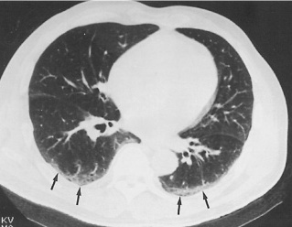
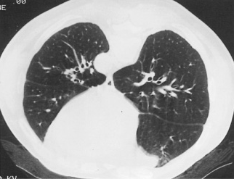
Axial CT image shows opacity in the posterior part of the lung which could represent dependent opacity or pulmonary inflammation. The prone images shows complete resolution of the opacity suggesting dependent atelectasis.

Slide 13
TECHNIQUE OF SCAN ACQUISITION:
Spaced axial scans :
Obtained at 1cm intervals from lung apices to bases. In this manner, HRCT is intended to “sample” lung anatomy
It is assumed that the findings seen at the levels scanned will be representative of what is present throughout the lungs
Results in low radiation dose as the individual scans are widely placed
Notes:
Sequential HRCT

Slide 14
2. Volumetric HRCT -
MDCT scanner are capable of rapid scanning and thin slice acquisition.(slice interval 0.8mm)
Advantages :
1. Viewing of contagious slice for better delineation of lung abnormality
2. Complete imaging of lung and thorax
3. Reconstruction of scan data in any plane using MIPs or MPR
4. diagnosis of other lung abnormalities
Disadvantage : greater radiation dose. It delivers 3-5 times greater radiation.

Slide 15
LOW DOSE HRCT
Low dose HRCT uses Kvp of 80 and mA of 30-20 at 2 sec scan time.
Equivalent to conventional HRCT in 97 % of cases
Disadvantage : Fails to identify Ground glass opacities in few cases and have more prominent streak artifact.
Not recommended for initial evaluation of patients with lung disease.
Indicated in following up patients with a known lung abnormality or in screening large populations at risk for lung diseases.

Slide 16
Multidetector Helical HRCT
Multidetector CT is equipped with a multiple row detector array
Multiple images are acquired due to presence of multiple detectors
Advantages : - shorter acquisition times and retrospective creation of both thinner and thicker sections from the same raw data
Acquisition time is so short that whole-lung HRCT can be performed in one breath-hold.

Slide 17
MODIFICATION OF SCAN PROTOCOL
Scan protocol can be modified in relation to disease or patients comfort.
If a disease has basal predominance, it may be wise to begin scanning near the diaphragm and proceed cephalic .
Caudad for disease with an upper-lobe predominance (e.g., sarcoidosis)
An alternative approach - cephalad in all patients.

Slide 18
REVIEW OF RELEVANT ANATOMY
PART 2

Slide 19
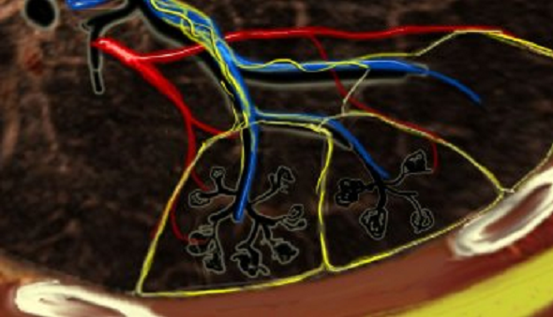
SECONDARY PULMONARY LOBULE
Smallest lung unit that is surrounded by connective tissue septa
The basic anatomic unit
Irregular polyhedral in shape.
Measures 1 to 2.5 cm

Slide 20
Interlobular septa and contiguous subpleural interstitium
The secondary pulmonary lobule is marginated by septa which extends from the pleural surface.
They measure 0.1 mm in thickness.
They are less well defined in central lung
Lobular core :
The secondary lobule is supplied by arteries and bronchioles that measures approximately 1 mm in diameter.
It consists of functioning lung parenchyma namely the alveoli, alveolar duct and vessels. The parenchyma is supported by network of central and peripheral fibers of interstitium.

Slide 21
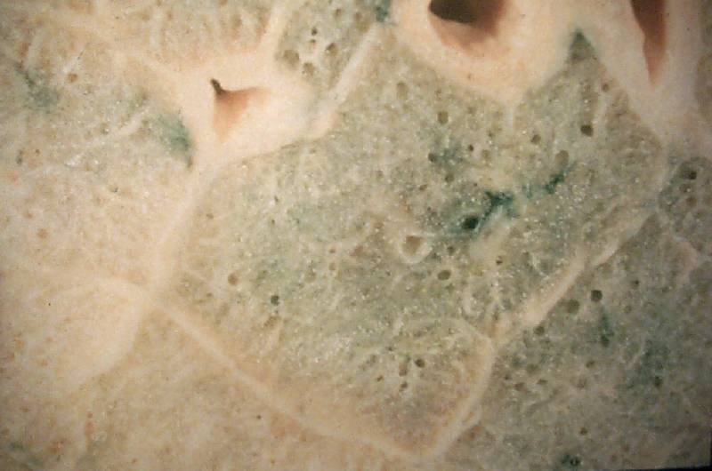
Notes:
Unit of lung (0.5-3 cm)
Irregularly polyhedral متعدد السطوح
Supplied by a group of terminal bronchioles and accompanying pulmonary arterioles surrounded by lymph vessels
Demarcated by “interlobular septa”
pulmonary veins
pulmonary lymphatics
connective tissue stroma

Slide 22
A group of terminal bronchioles
Notes:
Unit of lung (0.5-3 cm)
Irregularly polyhedral متعدد السطوح
Supplied by a group of terminal bronchioles and accompanying pulmonary arterioles surrounded by lymph vessels
Demarcated by “interlobular septa”
pulmonary veins
pulmonary lymphatics
connective tissue stroma

Slide 23
Accompanying pulmonary arterioles
Notes:
Unit of lung (0.5-3 cm)
Irregularly polyhedral متعدد السطوح
Supplied by a group of terminal bronchioles and accompanying pulmonary arterioles surrounded by lymph vessels
Demarcated by “interlobular septa”
pulmonary veins
pulmonary lymphatics
connective tissue stroma

Slide 24
Surrounded by lymph vessels
Notes:
Unit of lung (0.5-3 cm)
Irregularly polyhedral متعدد السطوح
Supplied by a group of terminal bronchioles and accompanying pulmonary arterioles surrounded by lymph vessels
Demarcated by “interlobular septa”
pulmonary veins
pulmonary lymphatics
connective tissue stroma

Slide 25
  Pulmonary veins
Notes:
Unit of lung (0.5-3 cm)
Irregularly polyhedral متعدد السطوح
Supplied by a group of terminal bronchioles and accompanying pulmonary arterioles surrounded by lymph vessels
Demarcated by “interlobular septa”
pulmonary veins
pulmonary lymphatics
connective tissue stroma

Slide 26
  Pulmonary lymphatics
Notes:
Unit of lung (0.5-3 cm)
Irregularly polyhedral متعدد السطوح
Supplied by a group of terminal bronchioles and accompanying pulmonary arterioles surrounded by lymph vessels
Demarcated by “interlobular septa”
pulmonary veins
pulmonary lymphatics
connective tissue stroma

Slide 27
  Connective Tissue Stroma
Notes:
Unit of lung (1 cm to 1 inch)
Irregularly polyhedral
Supplied by a group of terminal bronchioles and accompanying pulmonary arterioles surrounded by lymph vessels
Demarcated by “interlobular septa”
pulmonary veins
pulmonary lymphatics
connective tissue stroma

Slide 28
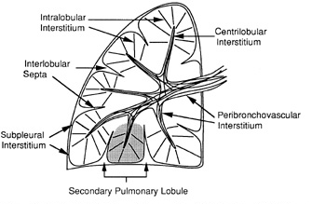
LUNG INTERSTITIUM
Peribronchovascular interstitium
Centrilobular interstitium
Peripheral fibre system
Subpleural interstitium
Lung interstitium
Interlobular septa
Axial fibre system
Notes:
The lung parenchyma is supported by a network of connective tissue , called lung interstitum.

Slide 29
LUNG INTERSTITUM
The peribronchovascular interstitum invests the bronchi and pulmonary artery in the perihilar region.
The centrilobular interstitium are associated with small centrilobular bronchioles and arteries
The subpleural interstitium is located beneath the visceral pleura; envelops the lung into fibrous sac and sends connective tissue septa into lung parenchyma.
Interlobular septa constitute the septas arising from the subpleural interstitium.
Notes:
The abnormalities of subpleural interstitium is recognized over the costal surface and along fissures
Normal fissure is less than 1 mm thick, smooth and very thin opacities

Slide 30
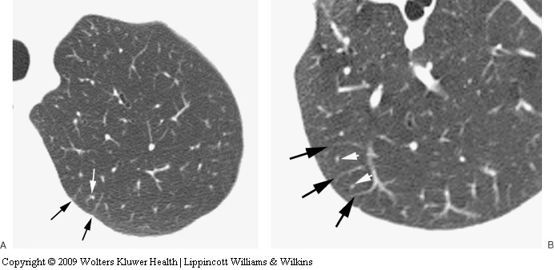
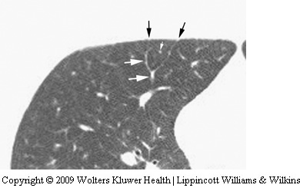
The normal pulmonary vein branches are seen marginating pulmonary lobules. The centrilobular artery branches are visible as a rounded dot

Slide 31
PATTERN OF LUNG DISEASE IN HRCT
PART 3

Slide 32
HRCT PATTERN
INCREASED LUNG ATTENUATION
DECREASED LUNG ATTENUATION
LINEAR AND RETICULAR OPACITIES
NODULES AND NODULAR OPACITIES
PARENCHYMAL OPACIFICATION
CYSTIC LESIONS, EMPHYSEMA, AND BRONCHIEACTASIS
MOSAIC ATTENUATION AND PERFUSION
AIR TRAPPING ON EXPIRATORY SCANS
Ground glass
consolidation

Slide 33
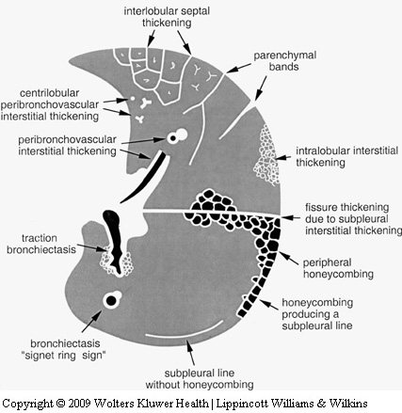
LINEAR AND RETICULAR OPACITIES
Represents thickening of interstitial fibers of lung by
- fluid or
- fibrous tissue or
- infiltration by cells
Notes:
Manifested by the interface sign, peribronchovascular interstitial thickening, interlobular septal thickening, Parenchymal band, subpleural interstitial thickening, intralobular interstitial thickening , honeycombing, irregular opacities and subpleural lines.

Slide 34
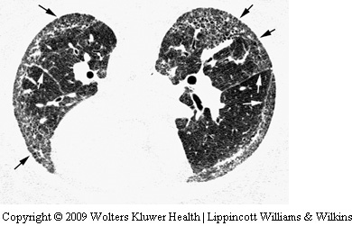
Interface sign
Irregular interfaces between the aerated lung parenchyma and bronchi, vessels, or visceral pleural surfaces.
Represent thickened interlobular septa, intralobular lines, or irregular scars.
Nonspecific.
Common in patients with an interstitial abnormality, fibrotic lung disease.
Notes:
Described by Zerhouni et al. present in patients with interstitial abnormality regardless of cause. Associated with increased lung reticulation.

Slide 35
Peribronchovascular Interstitial Thickening
PBIT
Smooth
Nodular
Irregular
Pulmonary edema/ hemorrhage
Lymphoma / leukemia
Lymphangitic spread of carcinoma
Sarcoidosis
Lymphangitic spread of carcinoma
Due to adjacent lung fibrosis
Sarcoidosis, silicosis, TB and talcosis
Venous, lymphatic or infiltrative disease
lymphatic or infiltrative diseases
Notes:
It is strong connective tissue sheath that envelops central bronchi and pulmonary arteries. This abnormality is perceived in HRCT as an increase in bronchial wall thickening (similar to peribronchial cuffing on chest X ray) and an increase in the diameter of pulmonary artery branches.
The smooth PBIT are appreciated as kerley B lines in x ray.

Slide 36
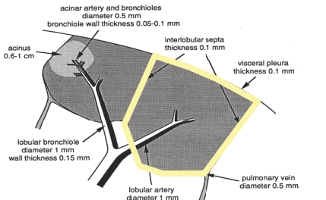
INTERLOBULAR SEPTAL THICKENING
Normally, only a few septa seen
On HRCT, if numerous interlobular septas are seen, it almost always indicate abnormality.
Septal thickening d/t -interstitial fluid, cellular infiltration or fibrosis.
The thickened interstitium outline the secondary pulmonary lobules and are perpendicular to the pleura.
D/D are similar to that of PBIT.

Slide 37
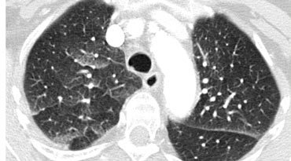
Smooth Septal thickening
Septal thickening and ground-glass opacity with a gravitational distribution in a patient with cardiogenic pulmonary edema.

Slide 38
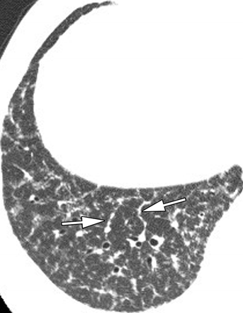
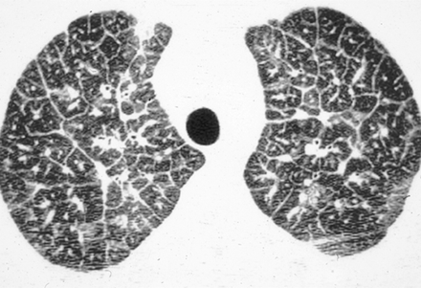
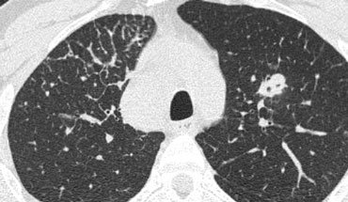
Nodular Septal thickening
Lymphangitic carcinomatosis : show diffuse smooth and nodular septal thickening.
Sarcoidosis :
right lung base shows interlobular septal thickening associated with several septal nodules giving beaded appearance
Focal septal thickening in lymphangitic carcinomatosis
Notes:
Beaded or noular septal thickening

Slide 39
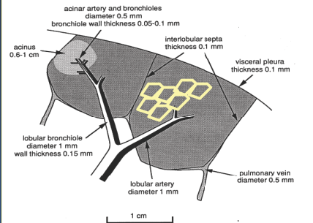
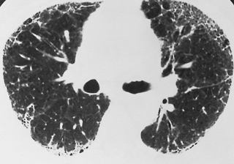
Intralobular interstitial thickening (Intralobular lines)
Results in a fine reticular pattern on HRCT, with the visible lines separated by a few millimeters
Fine lace- or netlike appearance
Causes : Pulmonary fibrosis
Asbestosis
Chronic Eosinophilic pneumonitis.
Notes:
Intralobular interstitial thickening reflects thickening of distal peribronchovascular interstitial tissue and the intralobular interstitium.
Most commonly associated with lung fibrosis, like UIP or asbestosis.

Slide 40
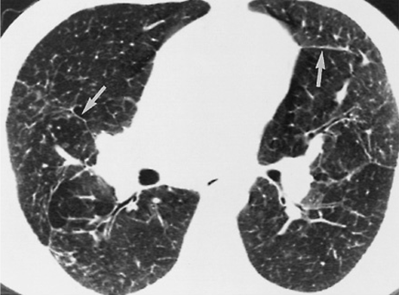
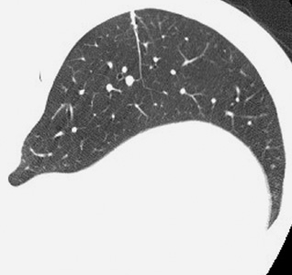
PARENCHYMAL BANDS
Non tapering , reticular opacity usually 1 to 3 mm in thickness and from 2 to 5 cm in length.
Is often peripheral and generally contracts the pleural surface
D/D : 1. Asbestosis
2. Sarcoidosis
3. Silicosis/ coal worker pneumoconiosis
4. Tuberculosis with associated scarring.
Notes:
Parenchymal bands represents areas of peribronchovascular fibrosis, coarse scars or atelectasis associated with lung infiltration or pleural fibrosis.

Slide 41
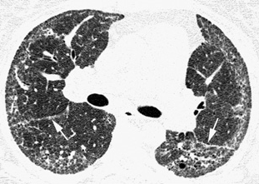
Subpleural Interstitial Thickening
Mimic thickening of fissure.
Appear similar to that of interlobular septal thickening.
more common than septal thickening in IPF or UIP of any cause.

Slide 42
HONEYCOMBING
Defined as - small cystic spaces with irregularly thickened walls composed of fibrous tissue.
Predominate in the peripheral and subpleural lung regions
Subpleural honeycomb cysts typically occur in several contiguous layers. D/D- paraseptal emphysema in which subpleural cysts usually occur in a single layer.
Indicates the presence of “END stage” disease regardless of the cause.

Slide 43
Nodules and Nodular Opacities
Size, Distribution, Appearance
Small Nodules: <10 mm Miliary - <3 mm
Size
Large Nodules: >10 mm Masses - >3 cms
Interstitial opacity:
Well-defined, homogenous,
Soft-tissue density
Obscures the edges of vessels or adjacent structure
Appearance
Air space:
Ill-defined, inhomogeneous.
Less dense than adjacent vessel – GGO
small nodule is difficult to identify

Slide 44
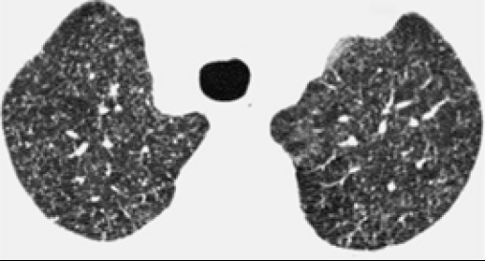
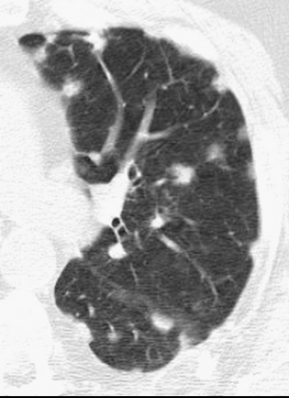
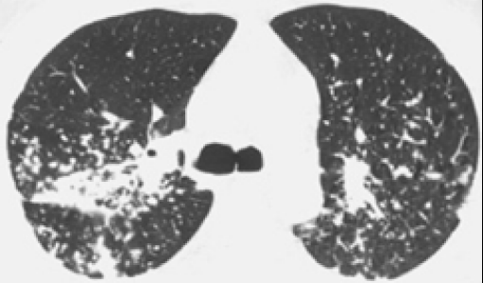
Interstitial nodules
Air space opacity
Miliary tuberculosis
in a lung transplant patient with
bronchopneumonia
sarcoidosis

Slide 45
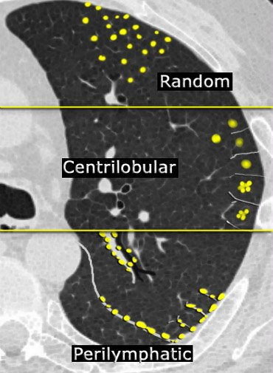
RANDOM: no consistent relationship to any structures
Distribution
CENTRILOBULAR: related to centrilobular structures
PERILYMPHATIC: corresponds to distribution of lymphatics

Slide 46
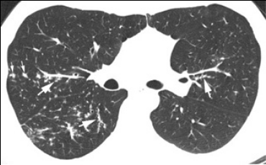
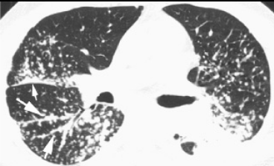
Perilymphatic nodules: D/D
Sarcoidosis
Lymphangitic carcinomatosis
Lymphocytic interstitial pneumonia (LIP)
Lymphoproliferative disorders
Amyloidosis

Slide 47
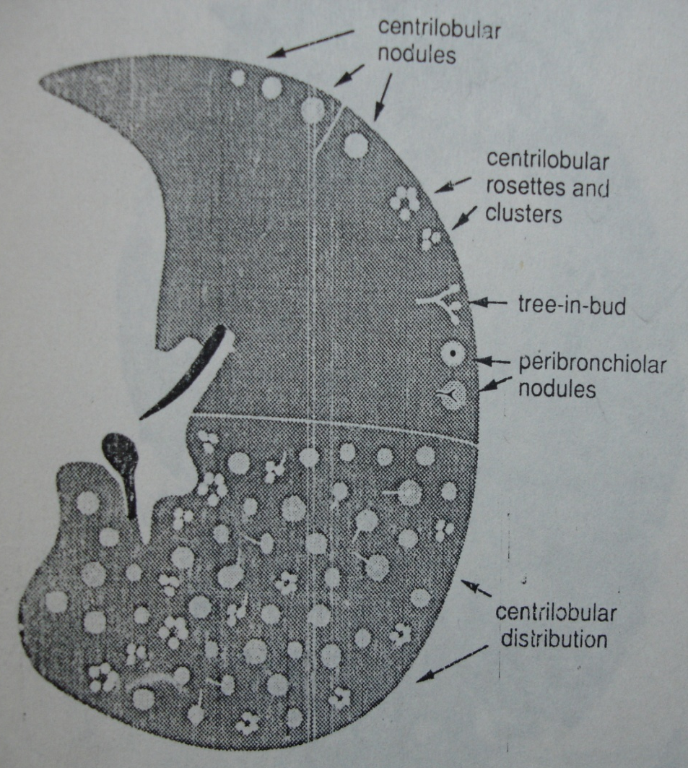
Centrilobular nodules
Distributed primarily within the centre of the secondary pulmonary lobule
Reflect the presence of either interstitial or airspace abnormalities
Dense or ground-glass opacity
Subpleural lung is typically spared- distinguishes from
diffuse random nodules.

Slide 48
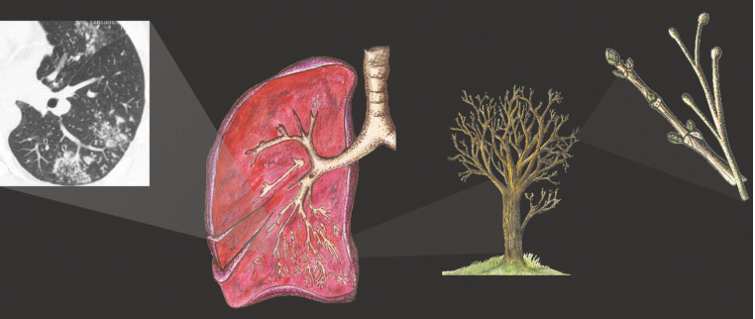
Tree-in-bud
Centrilobular nodules are further characterized by presence or absence of ‘‘tree-in-bud.’’
Tree-in-bud -- Impaction of centrilobular bronchus with mucous, pus, or fluid, resulting in dilation of the bronchus, with associated peribronchiolar inflammation .
Dilated, impacted bronchi produce Y- or V-shaped structures
This finding is almost always seen with pulmonary infections.

Slide 49
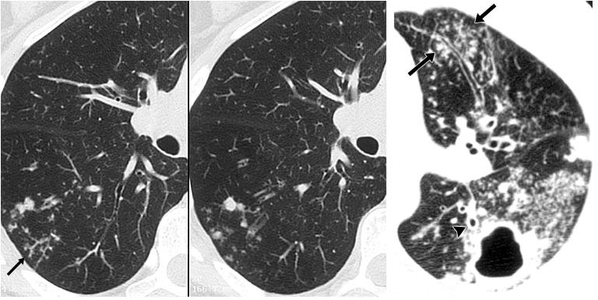
Notes:
High-resolution CT scans of the right lung show peripheral, poorly deﬁned, small centrilobular nodules and branching linear opacities of similar caliber
originating from a single stalk (the tree-in-bud pattern) in the lower lobe. These ﬁndings represent endobronchial spread of tuberculosis.
Postprimary active tuberculosis in a 34-year-old man with weight loss and a chronic cough. (a) High-resolution CT scan of the left lung shows a thick-walled cavity and multiple peripheral small nodules and branching linear structures

Slide 50
Centrilobular nodules with or without tree-in-bud opacity: D/D :
With tree-in-bud opacity
Bacterial pneumonia
Typical and atypical mycobacteria infections
Bronchiolitis
Diffuse panbronchiolitis
Aspiration
Allergic bronchopulmonary aspergillosis
Cystic fibrosis
Endobronchial-neoplasms (particularly
Bronchioloalveolar carcinoma)
Without tree-in-bud opacity
All causes of centrilobular nodules with tree-in-bud opacity
Hypersensitivity pneumonitis
Respiratory bronchiolitis
Cryptogenic organizing pneumonia
Pneumoconioses
Langerhans’ cell histiocytosis
Pulmonary edema
Vasculitis
Pulmonary hypertension

Slide 51
Random nodules
Random nodules – No definable distribution
Are usually distributed uniformly throughout the lung parenchyma in a bilaterally symmetric distribution.
Random nodules: Miliary tuberculosis.
Axial HRCT image shows multiple nodules scattered uniformly throughout the lung parenchyma.

Slide 52
Random nodules: D/D
Haematogenous metastases
Miliary tuberculosis
Miliary fungal infection
Disseminated viral infection
Silicosis or coal-worker’s pneumoconiosis
Langerhans’ cell histiocytosis

Slide 53
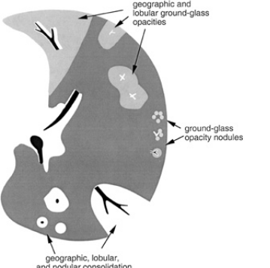
Parenchymal Opacification
Ground-glass opacity
Consolidation
Lung calcification & high attenuation opacities.

Slide 54
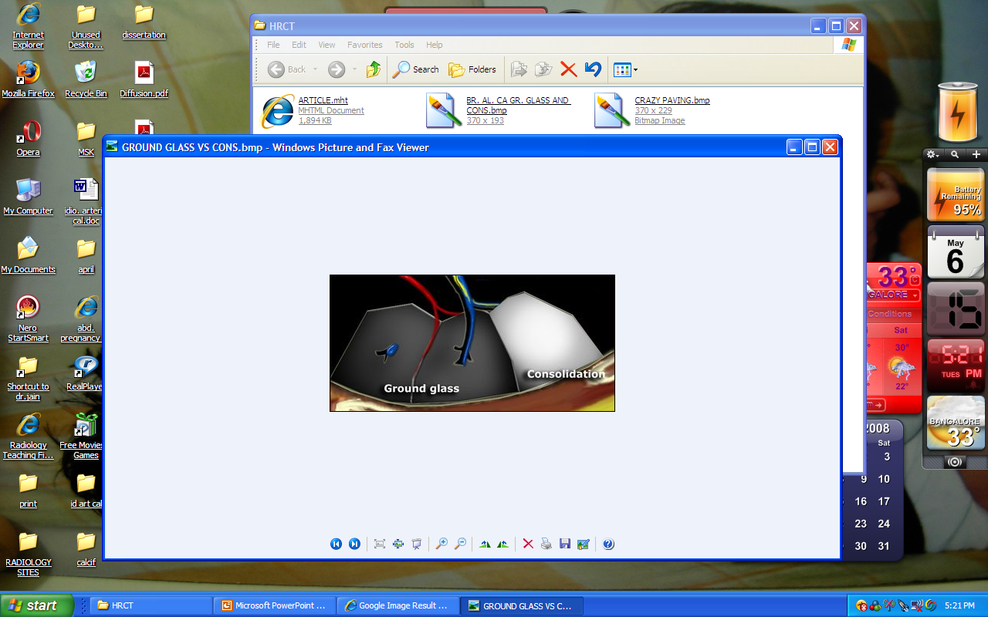
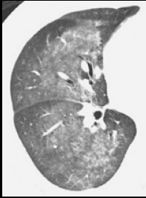
GROUND GLASS OPACITIES
Hazy increased attenuation of lung, with preservation of bronchial and vascular margins
Pathology : it is caused by
# partial filling of air spaces,
# interstitial thickening,
# partial collapse of alveoli,
# normal expiration, or
# increased capillary blood volume

Slide 55
IMPORTANCE OF GGO
Can represent - microscopic interstitial disease
(alveolar interstitium)
- microscopic alveolar space disease
- combination of both
In the absence of fibrosis, mostly indicates the presence of an ongoing, active, potentially treatable process
Ground Glass opacity should be diagnosed only on scans obtained with thin sections : with thicker sections volume averaging is more - leading to spurious GGO, regardless of the nature of abnormality

Slide 56
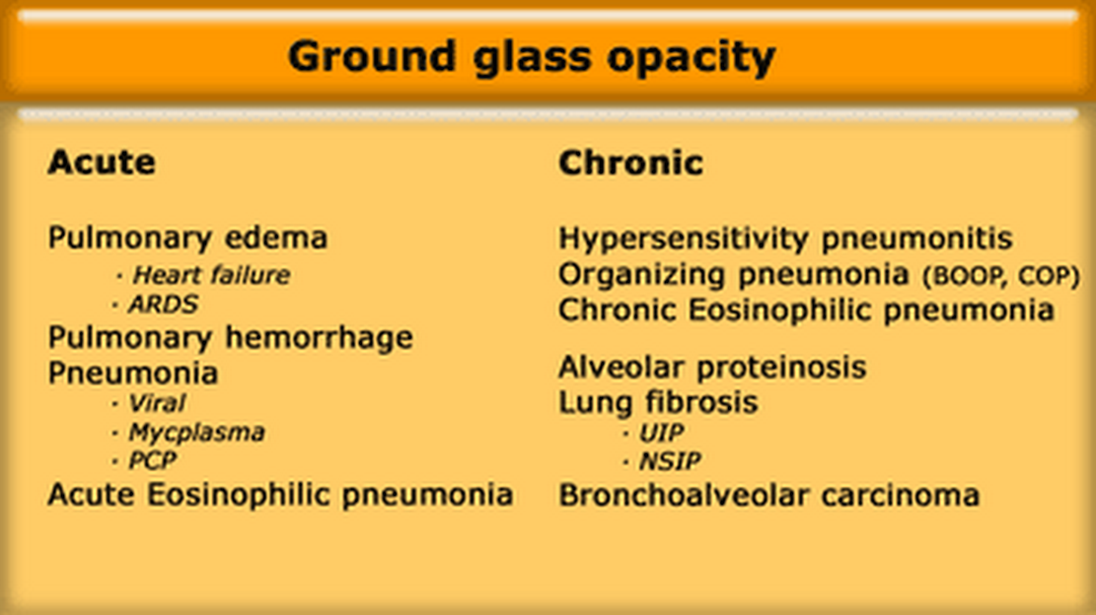
DIFFERNTIAL DIAGNOSIS : GGO
Notes:
THE PATIENTS SYMPTOM IS IMPORTANT WHILE CONSIDERING THE DIFFERNETIAL OF GGO.

Slide 57
The location of the abnormalities in ground glass pattern can be helpful:
Upper zone predominance:
Respiratory bronchiolitis
PCP.
Lower zone predominance: UIP, NSIP, DIP.
Centrilobular distribution:
Hypersensitivity pneumonitis,
Respiratory bronchiolitis

Slide 58
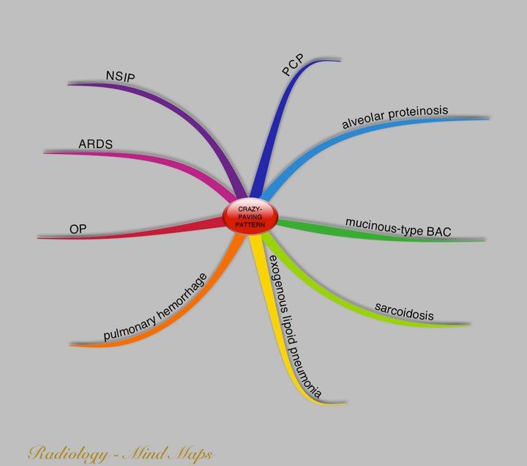
CRAZY PAVING PATTERN
It is scattered or diffuse ground-glass attenuation with superimposed interlobular septal thickening and intralobular lines.
Causes:
Notes:
In general terms, the D/D of crazy paving is similar to GGO.

Slide 59
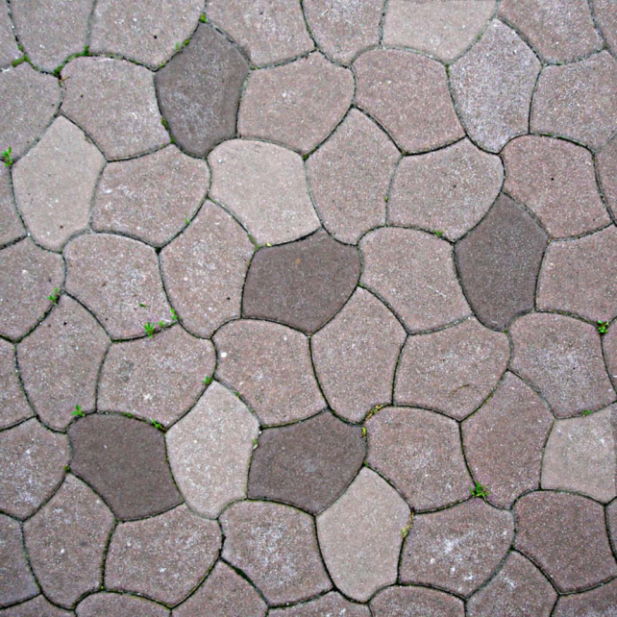
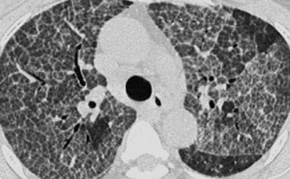
Combination of ground glass opacity and septal thickening : Alveolar proteinosis.

Slide 60
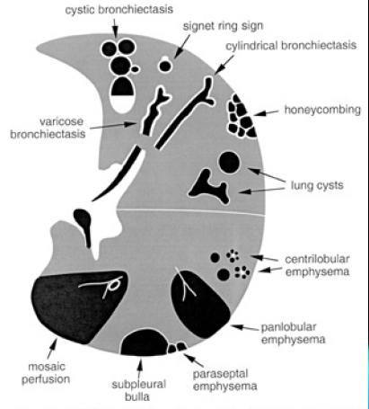
HRCT findings manifesting as decreased lung opacity
Lung Cysts,
Emphysema,
and
Bronchiectasis

Slide 61
Lung cysts
Thin walled (less than 3mm) , well defined and circumscribed air containing lesions
They are lined by cellular epithelium, usually fibrous or epithelial in nature.
Common cause are : 1. Lymphangiomyomatosis
2. Langerhans Histiocytosis
3. Lymphoid interstitial pneumonia
.

Slide 62
BRONCHIEACTASIS
Bronchiectasis is defined as localized, irreversible dilation of the bronchial tree.
HRCT findings of the bronchiectasis include
# Bronchial dilatation
# Lack of bronchial tapering
# Visualization of peripheral airways.

Slide 63
Mosaic attenuation & perfusion
Lung density and attenuation depends partially on amount of blood in lung tissue.
The term 'mosaic attenuation' is used to describe density differences between affected and non-affected lung areas.
It is seen as inhomogeneous attenuation of lung parenchyma with focal region of lucency which show smaller size of vessels
May be due to vascular obstruction, abnormal ventilation or airway disease/
Notes:
Pulmonary tissue density is in part determined by the blood volume present within lung tissue. Any pathologic process that disturbs the distribution of pulmonary blood volume may alter pulmonary parenchymal attenuation.
Alterations in pulmonary parenchymal attenuation that are seen on HRCT imaging that either result from infiltration of the lung parenchyma or from disturbances in pulmonary blood volume may be collectively referred to as ‘‘inhomogeneous lung opacity.’’

Slide 64
Head cheese sign
It refers to mixed densities which includes presence of-
# consolidation
# ground glass opacities
# normal lung
# Mosaic perfusion
Signifies mixed infiltrative and obstructive disease
Common cause are : Hypersensitive pneumonitis
Sarcoidosis
DIP

Slide 65
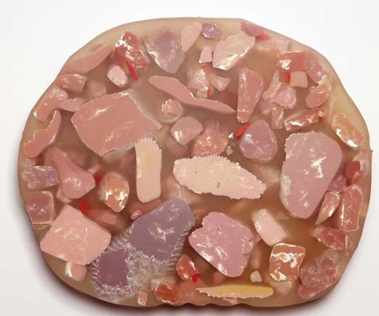
Axial HRCT image in a patient with hypersensitivity pneumonitis shows a combination of ground-glass opacity, normal lung, and mosaic perfusion (arrow) on the same inspiratory image.

Slide 66
Hilar and mediastinal lymphadenopathy
# In sarcoidosis the common pattern is right paratracheal and bilateral hilar adenopathy .
# In lung carcinoma and lymphangitic carcinomatosis adenopathy is usually unilateral.
#'Eggshell calcification' in lymph nodes occurs in ----Silicosis and coal-worker's pneumoconiosis and is sometimes seen in sarcoidosis, post irradiation Hodgkin disease, blastomycosis and scleroderma .

Slide 67
ATS –ERS classification of IIPs (idiopathic interstitial pneumonia)
This is a clinical , radiological , pathological classification.
1.UIP
2.NSIP
3.COP
4.RB-ILD
5.DIP
6.LIP
7.AIP

Slide 68
IDIOPATHIC PULMONARY FIBROSIS(UIP)
It is the term for the clinical syndrome associated with morphologic pattern of UIP and specifically excludes entities like NSIP and DIP.
Usually more than 50 years of age
Men >women
Worsening dyspnoea and nonproductive cough.
CXR:
Classic chest radiographic features include bilateral asymmetric peripheral reticular opacities most profuse at the lung bases associated with lung volume loss.

Slide 69
CHARACTERISTICS HRCT FINDINGS
Subpleural basal honeycombing
Ground glass opacity is not a predominant feature, if present then a/w traction bronchiectasis
Mediastinal lymphadenopathy is a frequent accompaniment
Subpleural disease in upper lobe if present tends to be anterior.
As the disease progresses, it often appears to ‘creep’ around the periphery of the lung to involve the anterior aspects of the upper lobes.
The rapid development of a diffuse increase in the attenuation of lung parenchyma in patients with IPF should raise the possibility of an opportunistic infection

Slide 70
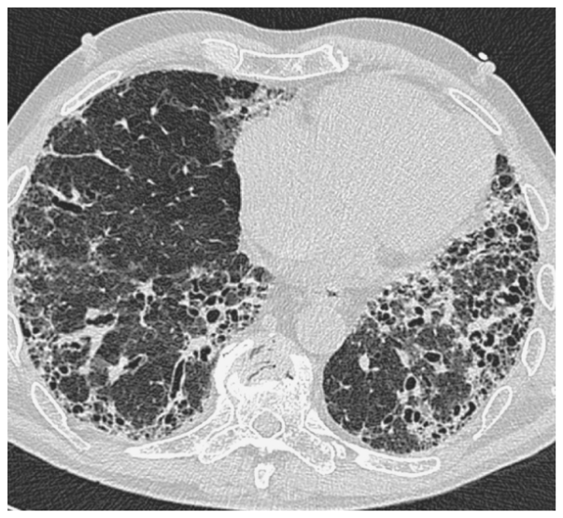
Usual interstitial pneumonia. HRCT abnormalities predominate in the posterior, subpleural regions of the lower lobes and comprise honeycombing and traction bronchiectasis within the abnormal lung.

Slide 71
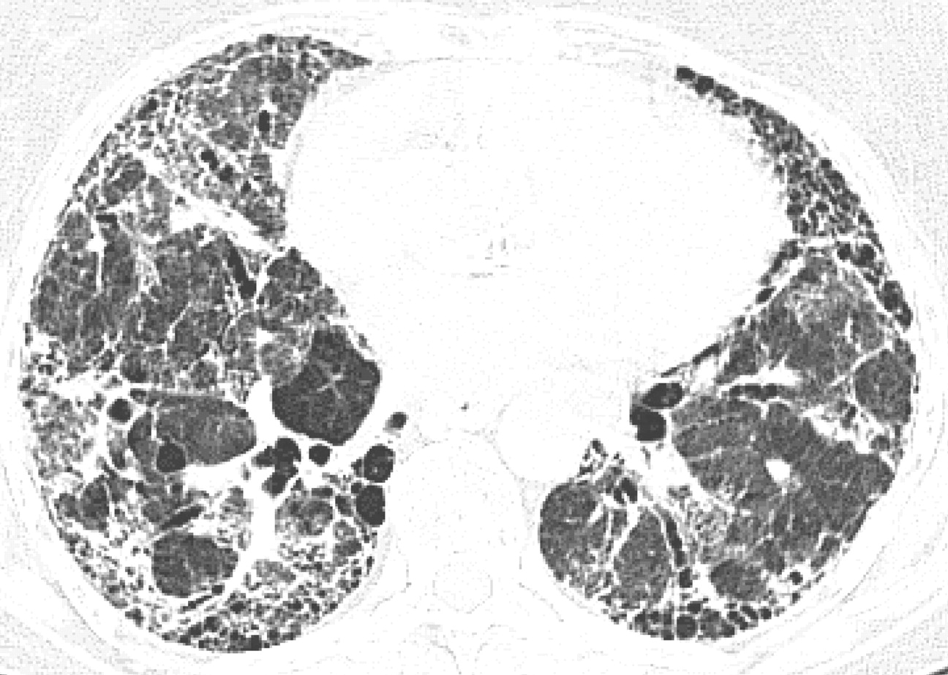
Coarse reticular opacities, subpleural honeycombing and traction bronchiectasis

Slide 72
Non-specific interstitial pneumonia
NSIP is characterized by varying degrees of interstitial inflammation and fibrosis without the specific features that allow a diagnosis of UIP or DIP.
NSIP may have significant fibrosis, it is usually of uniform temporality (in comparison to UIP)
Better prognosis.
On HRCT, NSIP is characterized by a predominant pattern of ground-glass opacification in a predominantly basal and subpleural distribution with or without associated distortion of airways.

Slide 73
A reticular pattern is common but honeycombing is sparse or absent.
NSIP may be distinguished from UIP on CT by a more prominent component of ground-glass attenuation and a finer reticular pattern in the absence of honeycombing.
Predominently peripheral but also patchy and band like.
Traction bronchiectasis and bronchiolectasis.

Slide 74
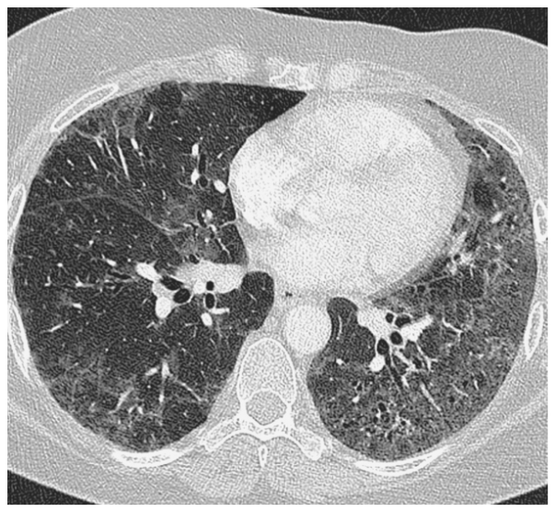
Non-specific interstitial pneumonia. The predominant abnormality is patchy, bilateral ground-glass opacification, mild reticulation and traction bronchiectasis. There is no frank honeycombing destruction.

Slide 75
Cryptogenic organizing pneumonia
It is identifiable in a variety of different contexts, including infection, malignancy, drug-related lung injury.
On a chest radiograph the most frequent feature of COP is patchy, often subpleural and basal, areas of consolidation with preservation of lung volumes.
The areas of airspace consolidation have a propensity to progress and change location over time.

Slide 76
HRCT findings in OP
Bilateral peripheral consolidations, sharply demarcated.
Consolidations may be migratory.
Bronchial wall thickening and dilatation are seen in most patients and are usually restricted to areas of consolidation or ground glass opacifications.
Additional findings are pleural thickening, small pleural effusions and parenchymal bands.

Slide 77
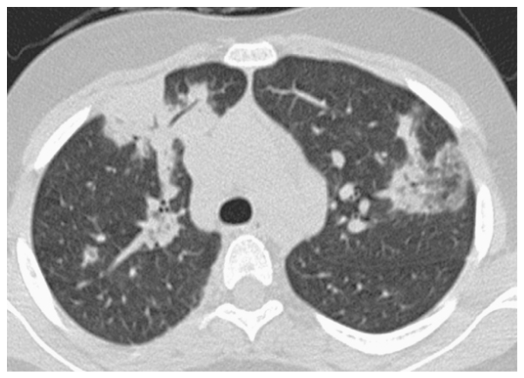
Cryptogenic organizing pneumonia. HRCT through the upper lobes demonstrates areas of consolidation in a subpleural and peribronchial distribution in association with areas of ground-glass opacification (left upper lobe).

Slide 78
Respiratory bronchiolitis–interstitial lung disease and desquamative interstitial pneumonia
Respiratory bronchiolitis (RB), respiratory bronchiolitis-associated interstitial lung disease (RB-ILD), and desquamative interstitial pneumonia (DIP) represent different degrees of severity of small airway and parenchymal reaction to cigarette smoke
The term RB-ILD was proposed to describe the bronchocentric (or centrilobular) lung disease in these patients and the term DIP was used to describe the more diffuse disorder.
insiduous onset of dyspnoea and cough.
chest radiograph is relatively insensitive
.

Slide 79
On HRCT,in RB–ILD = areas of patchy ground-glass opacification
and poorly defined low attenuation centrilobular nodules .
In addition, upper lobe centrilobular emphysema.
DIP = Ground-glass opacification is typically lower zone, peripheral and may be patchy.
Some features of interstitial fibrosis(reticulations) may be seen.
Smoking cessation is an important part of the management.
global term smoking related-interstitial lung disease (SR-ILD) has been proposed

Slide 80
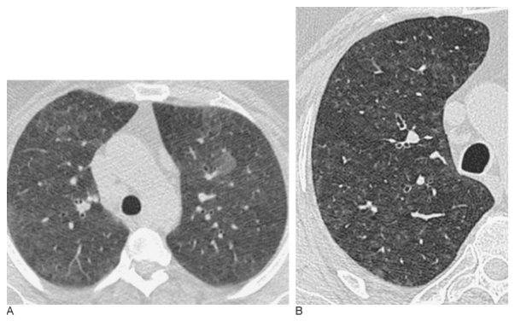
Respiratory bronchiolitis–interstitial lung disease. HRCT shows (A) subtle areas of ground-glass opacification and (B) ill-defined centrilobular nodules

Slide 81
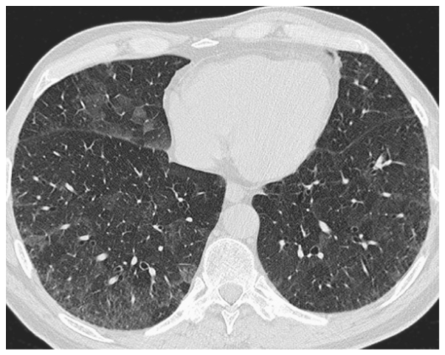
Several areas of non-specific ground-glass opacification in the right middle lobe and both lower lobes

Slide 82
ACUTE INTERSTITIAL PNEUMONIA
Only interstitial pneumonia presenting as rapidly progressive severe dyspnoea with need for mechanical ventilation.
idiopathic form of the ARDS
histological pattern seen in AIP is that of diffuse alveolar damage (DAD), which is also found in infection, connective tissue disease, drug toxicity, toxic inhalation, uraemia and sepsis.
DAD has an acute exudative phase and a subsequent organizing and fibrotic phase.

Slide 83
Diffuse, symmetric and bilateral involvement
Costophrenic angles are spared
chest radiograph shows bilateral patchy airspace opacification.
HRCT demonstrates a combination of ground-glass opacification, consolidation, bronchial dilatation and architectural distortion.

Slide 84
Lymphoid interstitial pneumonia
characterized by a widespread interstitial lymphoid infiltrate of the lung.
association with autoimmune diseases, most often Sjögren's syndrome. Other diseases include dysproteinaemias, autologous bone marrow transplantation and viral, mycobacterial and human immunodeficiency virus (HIV) infections.
Female > male

Slide 85
progressive cough and dyspnoea usually predominate.
HRCT findings are patchy areas of ground-glass opacification, indistinct nodules and thin-walled cysts (1–30 mm).
The cysts in LIP are usually discrete, are not found in clusters and are found deep within the lung parenchyma.

Slide 86
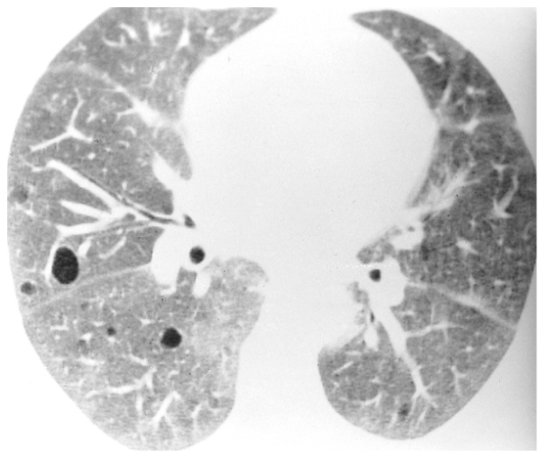
Lymphocytic interstitial pneumonitis. There is a background of ground-glass opacification and a few thin-walled cystic airspaces.

Slide 87
SARCOIDOSIS
Sarcoidosis is a systemic disorder of unknown origin.
It is characterized by non-caseating granulomas in multiple organs.
Pulmonary manifestations are present in 90% of patients.
Systemic symptoms such as fatigue, night sweats and weight loss are common.
Loefgren's syndrome, an acute presentation of sarcoidosis, consists of arthritis, erythema nodosum, bilateral hilar adenopathy and occurs in 9-34% of patients.
Erythema nodosum is seen predominantly in women and arthritis is more common in men.

Slide 88
Stages
Chest films in sarcoidosis have been classified into four stages:
Bilateral hilar lymphadenopathy
Bilateral hilar lymphadenopath + pulmonary disease
Only pulmonary disease
Irreversible fibrosis
These stages do not indicate disease chronicity or correlate with changes in pulmonary function.

Slide 89
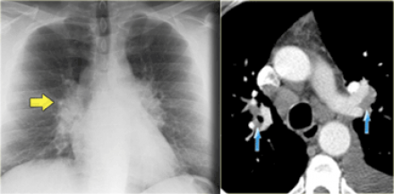
Sarcoidosis stage I: left and right hilar and paratracheal adenopathy (1-2-3 sign)
There is hilar and paratracheal adenopathy and no sign of pulmonary involvement.

Slide 90

HRCT findings in Sarcoidosis.
Common findings:
  Small nodules in a perilymphatic distribution (i.e. along subpleural surface and fissures, along interlobular septa and the peribronchovascular bundle).
  Upper and middle zone predominance.
  Lymphadenopathy in left hilus, right hilus and paratracheal (1-2-3 sign). Often with calcifications.
Uncommon findings:
  Conglomerate masses in a perihilar location.
  Larger nodules (> 1cm in diameter, in Grouped nodules or coalescent nodlues surrounded by multiple satellite nodules (Galaxy sign)
  Nodules so small and dense that they appear as ground glass or even as consolidations (alveolar sarcoidosis)

Slide 91
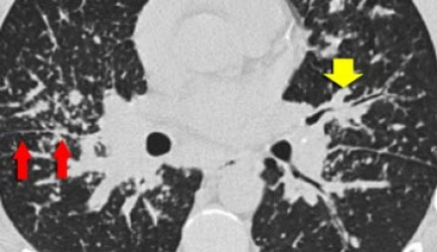
pulmonary involvement.
a typical presentation of sarcoidosis with hilar lymphadenopathy and small nodules along bronchovascular bundles (yellow arrow) and along fissures (red arrows)

Slide 92
LANGERHANS CELL HISTIOCYTOSIS
is a granulomatous disorder characterized histologically by the presence of large histiocytes containing rod- or racket-shaped organelles.
male-to-female ratio is about 4:1, and the vast majority of adult patients are cigarette smokers.
present with dyspnoea, cough, constitutional symptoms or a spontaneous pneumothorax.

Slide 93
Pulmonary involvement is widespread, bilateral and usually symmetrical.
Typical appearances are of reticulonodular shadowing in the mid and upper zones of the lungs that are of normal or increased volume.
On HRCT ,there are nodules (ranges from a few mm to 2 cm), several of which show cavitation (this feature often clinches the diagnosis)leading to formation of thick wall cyst->thin walled cyst and have bizarre shapes.

Slide 94
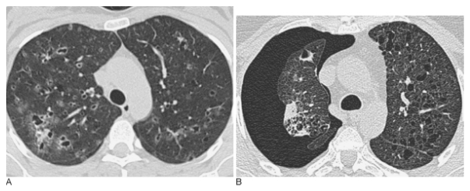
Langerhans cell histiocytosis. (A) Shows the characteristic combination of thin-walled cysts and poorly defined nodules, some of which are just beginning to cavitate. (B) Image from a patient with more advanced disease. There are numerous irregularly-shaped cysts bilaterally and a pneumothorax on the right.

Slide 95
LYMPHANGIOLEIOMYOMATOSIS
characterized histologically by two key features: cysts and proliferation of atypical smooth muscle cells of the pulmonary interstitium, particularly in the bronchioles, pulmonary vessels and lymphatics.
LAM is a rare disease seen almost exclusively in women.
approximately 1% of patients with tuberous sclerosis.

Slide 96
pattern of generalized, symmetrical, reticular, or reticulonodular opacities with normal or increased lung volumes.
Pleural effusions occur in 10–40% of patients and pneumothoraces in approximately 50% of cases. The effusions are chylous and result from involvement of the thoracic duct by the leiomyomatous tissue.
characterized by numerous thin-walled cysts randomly distributed throughout the lungs with no zonal predilection.

Slide 97
LAM Vs LCH
Imaging features that help distinguish LAM from LCH include a more diffuse distribution of cysts typically with no sparing of the bases, more regularly shaped cysts and normal intervening lung parenchyma.

Slide 98
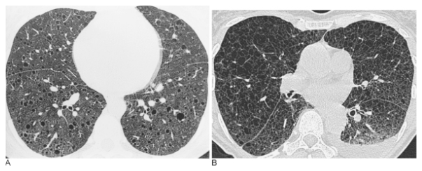
Lymphangioleiomyomatosis. (A) There is a profusion of thin-walled cystic airspaces scattered evenly throughout the lungs. The cysts are relatively uniform in size. (B) In a more advanced case of LAM, note the small left-sided pleural effusion.

Slide 99
ALVEOLAR PROTEINOSIS
Alveolar proteinosis
Alveolar proteinosis is a rare disease characterized by filling of the alveolar spaces with PAS positive material due to an abnormality in surfactant metabolism.
The diagnosis is based on the suggestive HRCT pattern (crazy paving) and the characteristic features of BAL fluid (Broncho Alveolar Lavage)
Usually between 30 and 50 years old.
Nonproductive cough, fever, and mild dyspnea.
Prognosis has improved since the advent of treatment using bronchoalveolar lavage.

Slide 100
Key findings in alveolar proteinosis
Crazy paving pattern: reticular pattern superimposed on ground glass opacification.
Opacifications range from ground glass to consolidation.
.

Slide 101
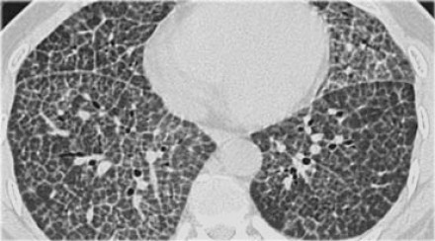
using bronchoalveolar lavage.
Alveolar proteinosis with crazy pavement sign

Slide 102
HYPERSENSITIVITY PNEUMONITIS
Hypersensitivity pneumonitis (HP) is also known as extrinsic allergic alveolitis (EAA).
HP is an allergic lung disease caused by the inhalation of a variety of antigens (farmer's lung, bird fancier's lung, 'hot tub' lung, humidifier lung).
The radiographic and pathologic abnormalities in patients can be classified into acute, subacute, and chronic stages.
Mostly HRCT is performed in the subacute stage of HP, weeks to months following the first exposure to the antigen or in the chronic phase.

Slide 103
Subacute hypersensitivity pneumonitis
The key findings in the subacute hypersensitivity pneumonitis are:
ill-defined centrilobular nodules of ground-glass opacity (80% of cases) or
mosaic pattern of a combination of patchy ground-glass opacity due to lung infiltration and patchy lucency due to bronchiolitis with air trapping

Slide 104
THANK YOU

