Slide 1
MR ANATOMY OF KNEE JT.

Slide 2
► MENISCI ► CRUCIATE LIG. ► COLATERAL LIG. ► BONE AND BONE MARROW ► MUSCLE AND TENDONS ► BURSAE ►JOINT CAPSULES

Slide 3
Planes
Menisci - sagittal & coronal
cruciate lig - sagittal, cor & ax for secondary confirmation
collateral ligs - coronal & axial
articular cartilage - coronal & sagittal
patellofemoral joint - sagittal & axial
patellar & quadriceps tendon - sagittal & axial

Slide 4
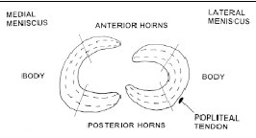
MENISCI :- •’C’ shaped structures, fixed to central portion of tibial articular surface. • Anteriorly connected to each other . • 3 parts :Ant. Horn Body Post. Horn

Slide 5
• Triangular in cross section taken in coronal & sag. planes with apex pointing towards center of knee.

Slide 6
Medial meniscus | Lateral meniscus
1. Open & wide C shape , Half circle. | 1. Tight C shape , ¾ circle.
2. Post. horn twice to thrice as large as ant. horn | 2. Symmetric horns.
3.Attached to jt. capsule in entire circumference & to tibia by coronary ligaments | 3. Loosely attached to jt. capsule esp along posterolateral aspect.
4.Hence less mobile & more prone to injury. | 4. Hence more mobile & less prone to injury.
 | 5. Post. horn of lat. meni. is linked to med. fem. condyle via menisco-fem. ligaments of Humphery (ant. to PCL) and Wrisberg (post to PCL).

Slide 7
MR APPEARANCE:-
Both menisci appear dark , without signal on all sequences.
Sag. images – ant. & post. horn of MM & LM .
Cor. images- meniscal bodies.
MM – On extreme edge of ant. tibia, trans. lig. joins it superiorly & postly : Arrowhead appearance pointing postly.
Lower portion – ant. horn. Attachment &
upper portion – trans. lig. junction.

Slide 9
LM –
Ant. horn may show striated or speckled, increase SI pattern on Proton density images due to interwining of dense collaginous fibres of ACL with fibrocarti. of LM.

Slide 10
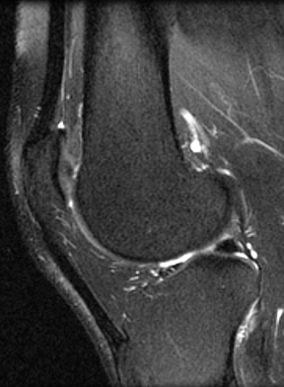
Speckled anterior horn of lateral meniscus

Slide 11
Ant & post horns of LM are equal in size – both resemble isosceles triangle.
Lig. of Wrisberg seen at its ori. at sup. margin of post horn – may appear as round dot adjacent to sup. aspect of post horn & may mimic tear.
Due to smaller radius of curvature of LM.: Bow tie configuration is seen.

Slide 13
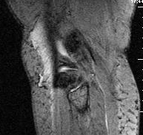
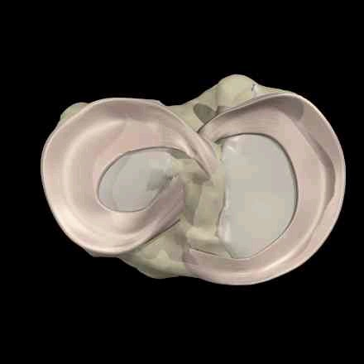
menisci

Slide 14
Cor. cross sections at mid portion of knee : bodies of both menisci seen.
Trianguler in shape.
Postly cor. cross sections – post horns seen as flat bands.

Slide 18
On lat. side, popli tandon courses upwards & lat. at 45⁰.
Synovium extends suply & infly about tendon through opening in capsule.
Syno. appears increase SI & linear: cor. & sag. images.
Med. SI on T1W & spin density images
High SI on T2W images.

Slide 19
Popliteus tendon

Slide 20
Transverse lig.
Connects ant. horns of both menisci.
Thickness : 1 to 4 mm.
Arise at ant. sup. portion of ant horn of LM & may appear as small dot ant to meniscus.

Slide 22
ACL
Extends from post aspect of med surface of
lat.fem. condyle to ant. intercondylar region of tibia.
Central support to knee jt.
Prevents excessive anterior translation of tibia.
Fan shaped – tight femoral attachment & wide at tibial attachment
11 mm wide & 38 mm long.
ACL is most commonly torn knee lig.

Slide 24
ACL – MR APPERARANCE –
T2 Sag images.
Straight taut fibres that run parallel to roof of intercondylar notch.
Striated appearance with somewhat high signal near insertion.
Axial images proximally show ACL as a low SI band flattened against med. surface of lat. femoral condyle.
Distally, lig. is not well seen.
All imaging sequences demonstrate fat at intercondylar notch, adjacent to ACL origin.

Slide 26
ACL – straight and taut

Slide 28
PCL :
• Lat. surface of med. fem. condyle to post surface of inter condylar region below level of arti. tibial plateau.
• Lies in sagittal plane & can be seen entirely on a single sag. MR slice.
• Central support to knee jt.
• Major stabilizer of the knee.
• Prevents excessive post translation of tibia,excessive varus & valgus stress & restricts ext. rotation of tibia.
• 13 mm wide & 38 mm long.

Slide 30
PCL is twice as strong as ACL.
Higher tensile strength & so less prone to injury.
It is arcuate in shape when knee is extended or slightly flexed & becomes taut with increasing flexion.
On MRI – sag. images best show PCL: Band like structure of low SI , Arcuate in shape.
Nearly horizontal take off at femoral origin & abrupt descent at 45⁰ to tibia.

Slide 32
PCL – arcuate band

Slide 34
MEDIAL COLLATERAL LIGAMENT :-
MCL consist of 3 functional units.
Superficial / tibial collateral lig.
Deep fibers.
Post. oblique fibres.
SUPERFICIAL / TIBIAL C L
Broad, flat band, 2 cm wide & 2 to 4 mm in thickness.
Extend from med. epicondyle of femur to tibia, attaching about 2 cm below jt. line.

Slide 35
DEEP FIBRES=>
Function as jt. capsule, attach loosely to periphery of body of med. meniscus.
Superior portion constitutes meniscofemoral lig.
Firmer attachment to tibia just below jt. line forms coronary lig.
POST. OBLIQUE FIBRES=>
Blend into post. capsule of knee.

Slide 36
MR APPEARANCE=>
TIBIAL COLLATERAL LIG.
Best seen on coronal images: homogenously low SI structure on all pulse sequences.
Moderately increase SI between superficial & deep fibres.

Slide 38
LATERAL / FIBULAR COLLATERAL LIG.
Tubular cord arising from lat. epicondyle of femur to fibular head, where it joins which biceps femoris insertion as conjoined tendon.
MR APPEARANCE =>
Best seen on coronal images: uniformly low SI cord on all pulse sequences.

Slide 40
BONE & BONE MARROW:-
Cortical bone of distal femur, proxi tibia & patella : low SI on all pulse sequences.
SI of medullary canal reflects changing amounts of haematopoitic & fatty bone marrow with age.
Fatty marrow increases with age.
Epiphyseal portions of distal F & proxi. T and epiphysoid patella contain fatty marrow.
Sensitivity of MRI to bone marrow alterations makes it ideal for detecting traum. injuries.

Slide 41
MUSCLES & TENDONS :-
10 ms & their tendons cross knee jt.
Ant.: Quadriceps => Rectus femoris
Vastus medialis
V. Intermedius
V. Lateralis
Quadriceps insert on proxi. pole of patella.
Anterolat: Tensor fascia lata & its iliotibial band insert at Gerdy’s tubercle at anterolat tibia.
Post lat.: biceps femoris inserts with fibular CL as conjoined tendon at fibular head.
Post med.: sartorius, gracilis & semitendinosus insert at post med. tibia. Semimemdranosus inserts seperately slightly more posteriorly.

Slide 42
Med. & lat. Heads of gastrocnemius arise at post. Supracondy region of F.
Popliteal MS belly rests at post. proxi. tibia. Its tendon courses intra-articularly through post horn of LM to popli groove of F.
Plantaris ms ori. at postlat. supracondy F & its tendon (longest in body) courses toward ankle.

Slide 43
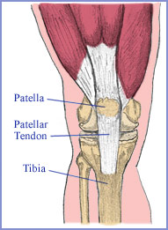
EXTENSOR MECHANISM=>
Quadriceps ms & tendon
Patellar lig.
Components of patellofemoral jt.

Slide 44
QUADRICEPS TENDON=>
Rectus F, V intermedius, V med. & V lat. ms. converge to insert as Q tendon at sup. pole of patella.
Fasciae of 4 ms combine to varying degrees to form a multilayered str.
Usually V. med. & V. lat. Merge: 3 layered Q tendon with fascia from R. fem. ant. & F from V . int. postly.
Also F. of V. med. & lat. combine with each other & with F of either R. fem. or V. int. ms: 2 layered tendon
Laminar str. Seen on axial & sag. MRI scans.
Partial ruptures of Q tendon involve one of these fascial groups.

Slide 46
PATELLAR LIG. =>
Extends from distal pole of patella to ant. tibial tubercle.
Uniformly low SI best seen on sag. images.

Slide 48
PATELLOFEMORAL JOINT=>
Patellar tracking abnormalities imaged with MR P-F joints during incremental knee flexion.

Slide 49
ARTICULAR CARTILAGE :-
MRI best suited for evaluation of articular cartilage, different pulse sequences required.
Low to intermediate SI on T₁W, spin density & T₂W images.
T1WI – intermediate SI compared to low SI of cortex and menisci.

Slide 52
T2WI - intermediate SI surrounded by bright SI of synovial fluid (arthogram like effect) useful when effusion is present
STIR – intermediate SI like T2WI, but subchondral changes can be demonstrated

Slide 54
3D GRE high spatial resolution High SI like synovial fluid

Slide 56
BURSAE :-
Numerous bursae present about knee jt.
Ant . – 2 superficial bursae ant. to ext. mechanism.
1) Pre-patellar b ant. to pat. lig.
2) 1 or 2 deep pat. bursae post. to pat. lig.
Post . – A bursa beneath both med. & lat. Heads of gastroenemius.
B beneath med. Head is adjacent to & usually connected with semimembr b.
This gastrocnemius – semimembr b. commonly commu. with jt. : Popliteal cyst.

Slide 57
Lat. – b. between LCL & jt. Capsule.
b. betn biceps femoris & LCL.
b. beneath iliotibial tract.
Med. – Bursae beneath MCL & pes anserinus
A b. may be present between supf &
deep fibres of MCL.

Slide 58
JOINT CAPSULE:-
Fibrous capsule of knee joint is complex.
ANT. – aponeurosis of v. med. & lat. extends from med. & lat. margins of Q tendon, patella & pat. lig., postly to respective tibial & fibu. CLs and tibial plateau.
This ant. portion of cap. is med. & lat. patellar retinacula: Jt capsular thickenings.
Provide rotatory stability to PF jt.
Med ret: med pole of patella to med fem condyle
Lat ret: lat pole of patella to lat fem condyle.

Slide 60
MED. – Cap. attached at fem. condyle just above arti. carti. & at tibia just below plateau.
MM attaches to cap. & tibial CL complex.
Coronary lig. - portion of cap. that attaches inf. margin of peripheral MM to tibia.
LAT. – Cap. attaches at fem. condyle just above popli. tendon groove & at tibia just below plateau.
LM attaches to lat. cap.(loosely than MM) along its periphery, except postly, where popli. ms & tendon interpose.

Slide 61
Thank You

