Slide 1
Benign vs malignant collapse
Dr. Sagar Kadam

Slide 2
Introduction
Vertebral collapse is a frequently encountered entity in clinical practice.
While diagnosing acute, benign traumatic types is usually not complicated, difficulties arise in determining the etiology of vertebral collapse when there is no history of significant trauma, especially in older populations.
Considering up to one-third of vertebral collapse in patients with a known primary malignancy are benign the diagnosis becomes even more difficult when there is a history of malignancy. Additionally, because primary cancer patients may be immunocompromised, the possibility of infectious vertebral collapse should also be entertained.
The purpose of this presentation is to review all recent magnetic resonance imaging aspects of differentiating osteoporotic, malignant vertebral collapse.

Slide 3
OSTEOPOROTIC COLLAPSE
In osteoporotic collapse, edema and fluid replace the fatty marrow within the vertebral body, appearing hypointense on T1- weighted images and isointense to hyperintense on T2- weighted images.
Most benign collapses have some amount of normal fatty marrow in the vertebral body on T1-weighted images.
The areas of normal, preserved fatty marrow are opposite of the fractured endplate and the band-like hypointensity seen adjacent to the preserved marrow on T1-weighted images is considered specific for osteoporotic collapse .
Signal is similer to other vertebral body.(high-T1,low-T2)

Slide 4
On T2-weighted images, benign collapse has a variety of appearances, ranging from normal to heterogeneous to homogeneously abnormal signal.
chronic benign fractures, normal conversion back to fatty marrow is expected.
Within 3 months of injury, there is almost always some restoration of fatty marrow,
Return of signal intensity from hyperintense to isointense on T2-weighted images is strong evidence of a nonmalignant collapse.

Slide 5
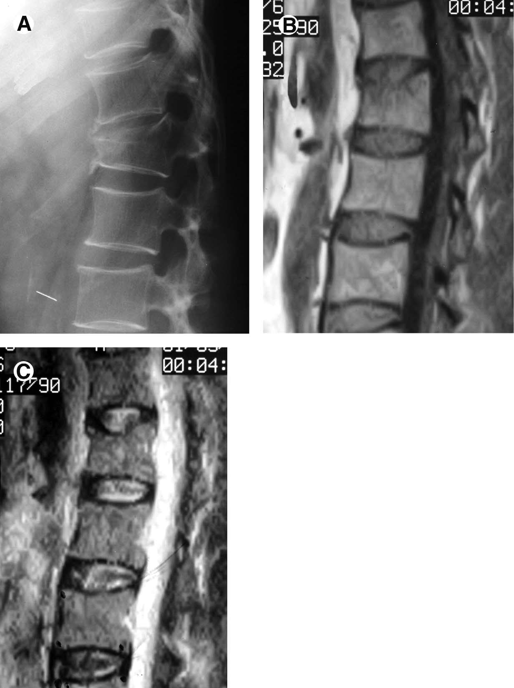

Slide 6
Preservation of normal concave posterior cortex and pedicles.
Retropulsion into the spinal canal, - a posterior-angulated fragment of the posterosuperior or posteroinferior vertebral body is highly characteristic of benign collapse,
The linear intravertebral vacuum sign of Kümmell’s disease, dignosing benign osteoporotic collapse due to osteonecrosis on MR imaging.(fluid sign)
Fragmentation - the higher force required to fracture normal vertebrae and osteoporotic vertebrae than in vertebrae affected by malignancy.
Paraspinal soft tissue edema is more readily seen in traumatic collapse and malignant collapse
Disk involvement is rarely seen but is more common in traumatic and osteoporotic collapse than with malignant collapse.

Slide 7
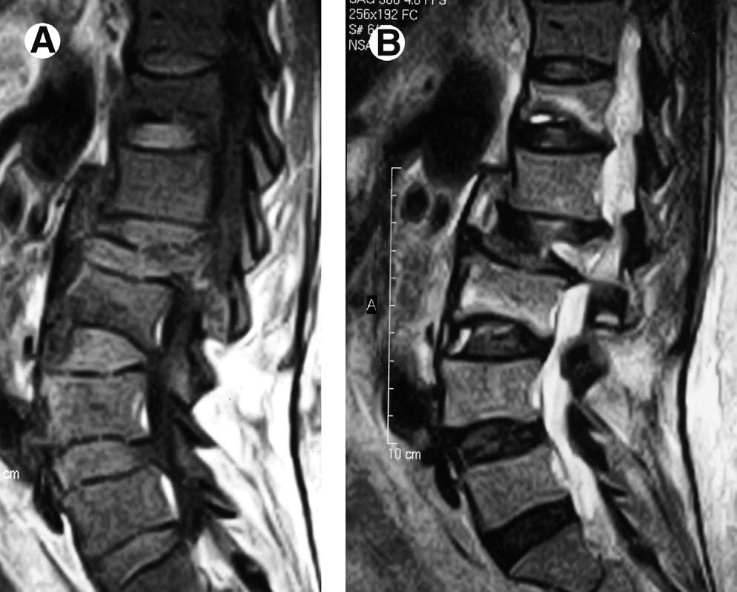

Slide 8
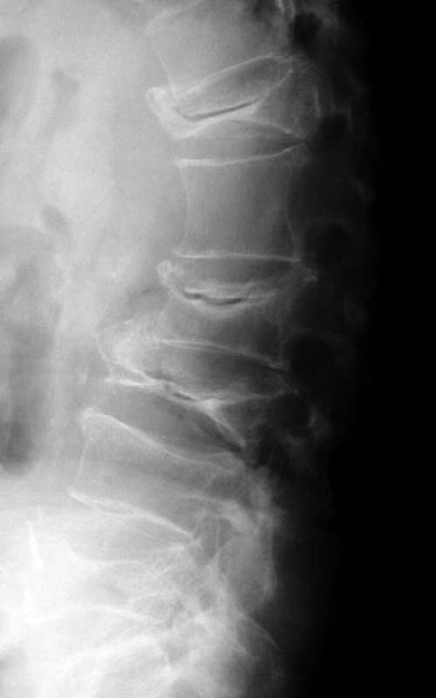

Slide 9
CONTRAST STUDY
Intense enhancement of benign, osteoporotic collapse is a feature of acute cases while mild enhancement is a feature of subacute or chronic
Using time-intensity curves, intravenous contrast-enhanced dynamic magnetic resonance imaging (MRI) has shown some value in the evaluation of benign collapse.
A pattern of early rapid contrast wash-in (at 20-30 seconds) with a second rising slope (after 30 seconds) is more likely to occur in benign collapse (acute or chronic),

Slide 11
Malignant Collapse
The most common cause of malignant collapse is metastatic disease, usually from breast carcinoma, bronchogenic carcinoma, prostatic carcinoma, or renal carcinoma.Multiplmyeloma or solitary plasmacytoma and lymphoma are less common.
Like osteoporotic collapse, malignant collapse possesses the same signal characteristics of hypointensity on T1- weighted images, hyperintensity on T2-weighted images and enhancement on postcontrast images.

Slide 12
There is complete marrow replacement because the vast majority of vertebral metastases will not fracture until there is complete tumor infiltration
Multiple lesions
Restoration of normal fatty marrow does not occur in malignant collapse
signal abnormalities in adjacent vertebrae, usually representing metastatic foci
Anterior and posterior vertebral body bulging or convexity
The posterior-angulated fragment is not a feature of malignant collapse
Unilateral or bilateral pedicle involvement-pedicle expansion
Paraspinal and/or epidural soft tissue masses
absence of involvement of the avascular regions of the cartilaginous end plate and disks

Slide 14
The “return to normal” signal intensity- not usually seen in malignant collapse
A pattern of rapid contrast wash-in (20-30 seconds) followed by early washout (up to 180 seconds) is specific for differentiating metastatic disease from benign collapse

Slide 15
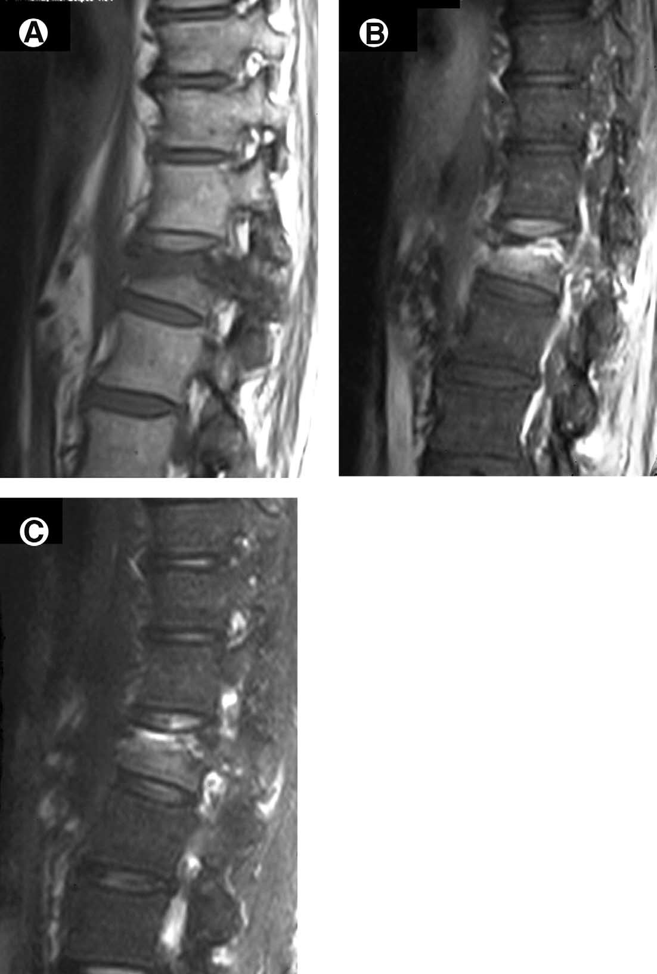
pedpicle

Slide 16
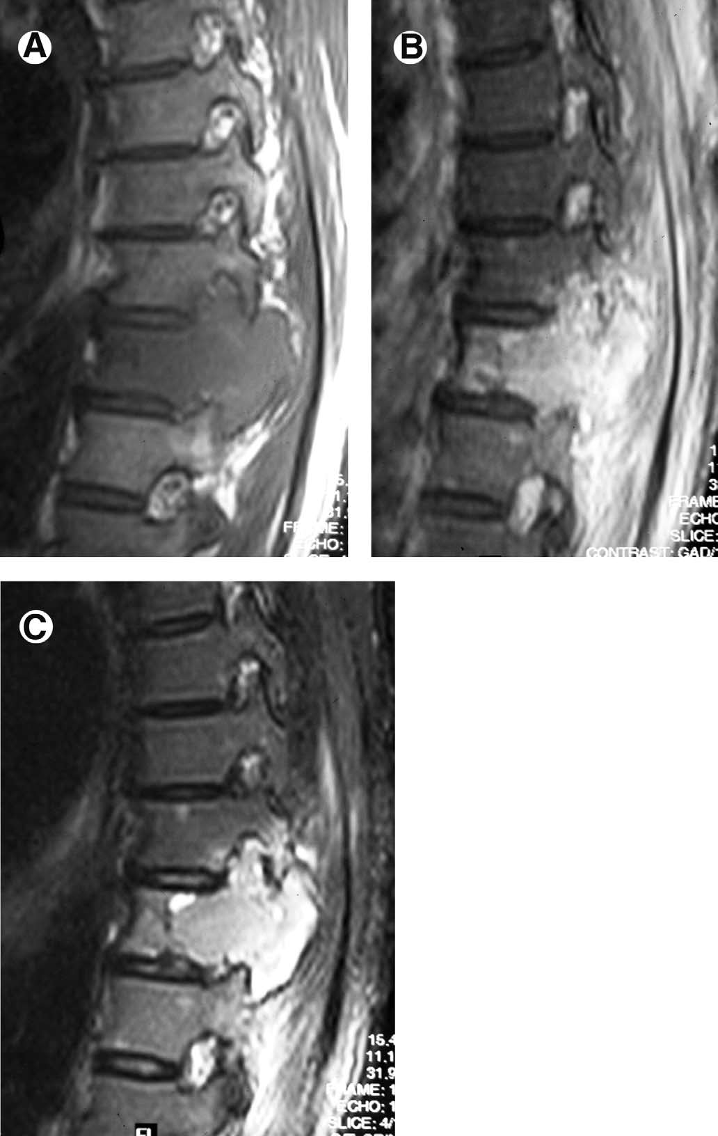

Slide 17
`

Slide 18
THANKS

