Slide 1
Dr Monica Patil JR III, Dept of Radiology Guide-Dr Sagar Kadam
STROKE

Slide 2
STROKE
“Acute onset focal neurological deficit of presumed vascular origin and of more than 24 hours”
TIA - recovery is complete within 24 hours. 10% of patients will go on to have a stroke.

Slide 3
TYPES OF STROKE
Cerebral infarction
Venous occlusion
Primary intracerebral hemorrhage
Subarachnoid hemorrhage

Slide 4
STROKE
Ischemic stroke
Pathophysiology
Imaging of acute, subacute & chronic stroke
Strokes in specific vascular distributions, lacunar infarcts
Treatment

Slide 5
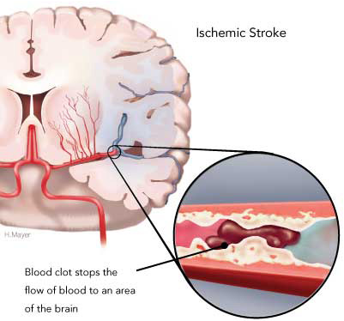
ISCHAEMIC STROKE
CAUSES:
Large vessel occlusions
Small vessel ( Lacunar ) infarcts
Cardiac emboli: IHD, Valvular HD, Cardiomyopathy, AF
Blood disorders, vasculitis.

Slide 6
PATHOPHYSIOLOGY OF STROKE
Stroke progresses in stages from ischemia to actual infarction.
Ischemia produces energy depletion in affected cells- loss of cell membrane function & cytoskeletal integrity- cell death.
Central infarcted core & surrounding penumbra.
Notes:
Loss of ion homeostasis, accumultn of calcium, na, cl , metabolic acidosis, extracellular glutamate and free radicles.

Slide 7
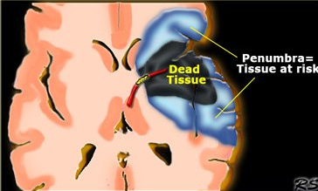
PATHOPHYSIOLOGY OF STROKE
Salvage therapies are directed towards saving this area.
Neuroimaging is imp for detecting this area.
Notes:
Neurons may be injured but supporting cell types preserved

Slide 8
NEUROPATHOLOGY OF STROKE
Most vulnerable: NEURONS
Astrocytes
Oligodendroglia
Microglia
Endothelial cells

Slide 9
NEUROPATHOLOGY OF STROKE
Most vulnerable regions:
Thalamus
Basal ganglia
Centrum semiovale
Relatively spared: dual supply
Extreme and external capsule
Subcortical white matter U fibres
Claustrum

Slide 10
IMAGING OF STROKE
CT :
Quick
To identify early signs of stroke
To rule out hemorrhage
CT ANGIOGRAPHY AND CT PERFUSION IMAGING:
To detect intravascular thrombi and salvageable tissue
MRI:
More sensitive and specific than CT within the first few hours after the onset of stroke.

Slide 11
IMAGING OF STROKE
Diffusion-weighted MR:
Sensitive for hyperacute infarct.
Gradient- echo MR sequences :
For haemorrhage.
MR angiography:
Status of neck and intracranial vessels
Diffusion and perfusion mismatch:
Presence of a penumbra.

Slide 12
IMAGING OF STROKE
Acute
Subacute
Chronic

Slide 13
ACUTE INFARCT

Slide 14
ACUTE INFARCT
Early CT is required to :
Localize the site of infarct
Exclude ICH – as management differs in ischemia and ICH.
Identify underlying structural lesion like tumor, vascular malformation.

Slide 15
CT In ACUTE INFARCT
Hyperacute (<6 hrs)
Normal (50-60%)
Dense MCA
obscuration of lentiform nucleus

Slide 16
CT In ACUTE INFARCT
Acute (6-48hrs)
Low density BG
Loss of G-W interfaces
Sulcal effacement

Slide 17
Named signs
Hyperdense MCA sign
Hyperdense dot sign
Disappearing basal ganglia sign
Insular ribbon sign

Slide 18
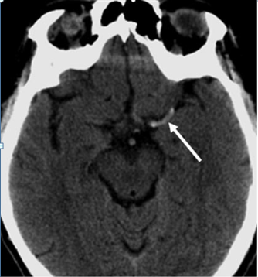
DENSE MCA
Due to acute intraluminal thrombus.
Present in 25-50 % cases.
MCA is normally mildly hyperdense

Slide 19
DISAPPEARING BASAL GANGLIA

Slide 21
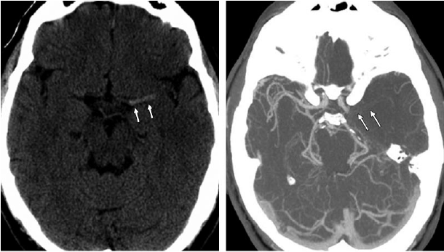
CT ANGIO IN ACUTE INFARCT
Useful for evaluating the intracranial and extracranial vessels and guiding appropriate therapy.

Slide 22
MRI in Acute Infarct
Absence of normal flow void
Intravascular contrast enhancement
Low ADC
Perfusion alteration
Immediate
Notes:
MRI is more accurate than CT for identification and localization of infarct.

Slide 24
INTRAVASCULAR ENHANCEMENT

Slide 25
MRI in Acute Infarct
Sulcal effacement
Gyral edema
Loss of grey- white interfaces
< 12 hrs
On T1WI

Slide 26
MRI in Acute Infarct
Hyperintensity on T2WI &FLAIR
Meningeal enhancement adjacent to infarct
Mass effect
12 to 24 hrs
Notes:
T2 hyperintensity is generally not observed before 8 hrs.

Slide 27
MR ANGIO IN ACUTE INFARCT
For detecting cerebral
And neck vessel thrombus
Flow gap in left proximal MCA

Slide 28
Diffusion Imaging in Acute Infarct
Mainly for detection of acute ischemic stroke and differentiation of acute stroke from other processes that manifest with sudden neurologic deficit.
Acute infarcts have lower ADCs compared to non-infarcted areas- so sensitive indicator of early cytotoxic brain oedema.

Slide 29
Diffusion Imaging in Acute Infarct
Acute ischemia
Lack of ATPs
Failure of Na+, K+ ATPase pump
Cytotoxic oedema due to IC water shift
RESTRICTED DIFFUSION

Slide 30
Diffusion Imaging in Acute Infarct
Restricted diffusion appears 30 min after stroke
ADC returns to normal after 1-4 weeks

Slide 31
PERFUSION IMAGING IN ACUTE INFARCT
used to identify areas of reversible ischemia as well.
In the acute stroke setting, a region that shows both diffusion and perfusion abnormalities represents irreversibly infarcted tissue.
While a region that shows only perfusion abnormalities and has normal diffusion represents a penumbra.

Slide 32
PERFUSION IMAGING IN ACUTE INFARCT
 | MTT | CBF | CBV
Penumbra |  |  | Normal or slightly increased
Infarct Core

Slide 33
MR PERFUSION
MTT

Slide 34
Crossed cerebellar diaschisis
In a large MCA territory infarct, CBF in the contralateral cerebellum is reduced.

Slide 35
SUBACUTE INFARCT

Slide 36
CT in SUBACUTE INFARCT
Strokes are between 48 hrs to 2 weeks following initial ischaemic event.
Increasing oedema and mass effect within 3 to 4 days-reduces after 7-10 days
Wedge shaped hypodense area involving grey and white matter in typical vascular distribution.
Hemorrhagic transformation of initially ischemic infarct in 20-25% between 2 d to 1 week.
Ischaemia damaged vascular endothelium becomes leahy and BBB permeability increases.

Slide 38
CECT-”2-2-2” rule
Patchy gyriform enhancement appears as early as 2 days, peaks at 2 weeks and disappears by 2 months.

Slide 39
GYRAL ENHANCEMENT

Slide 40
MRI in SUBACUTE INFARCT
Early signs of acute infarct- intravascular enhancement seen in 48 hrs, begins to diminish, disappears by 4 days and replaced by meningeal enhancementcaused by persistent collateral pial flow.
Early parenchymal contrast enhancement.
Hemorrhagic transformation maybe evident. Petechial or gyriform blooming.
Mass effect increases then slowly diminishes.

Slide 41
MRI in SUBACUTE INFARCT
FOGGING EFFECT:
Reduction in oedema and leakage of proteins from cell lysis- decrease in abnormal signal on T2WI reaching isointensity by 1 to 2 weeks.
Early wallerian degeneration:
Hypointense band in from infarcted cortex along the corticospinal tract on T2WI

Slide 42
HEMORRHAGIC TRANSFORMATION

Slide 43
WALLERIAN DEGENERATION

Slide 44
CHRONIC INFARCT
Encephalomalacic changes – volume loss in affected vascular distribution.
Hemorrhagic residua- hemosiderin/ ferritin.

Slide 45
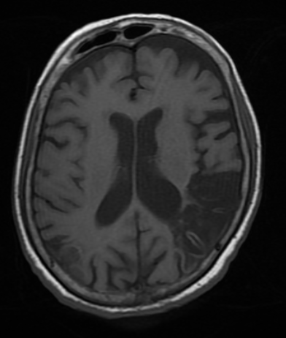
CHRONIC INFARCT
T2W & T1W

Slide 46
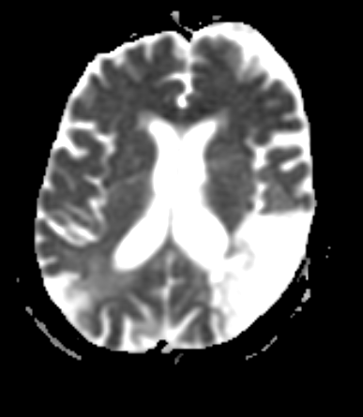
CHRONIC INFARCT
DWI & ADC

Slide 47
STROKES IN
SPECIFIC VASCULAR DISTRIBUTIONS

Slide 49
STROKES IN SPECIFIC VASCULAR DISTRIBUTIONS

Slide 50
Ant 2/3rd of medial hemispheric surfaces
Some of superior & lateral surface of frontal and parietal lobes,
Anterior part of corpus callosum
Anterior basal ganglia and
Anterior limb of internal capsule
Head of caudate nucleus
ANTERIOR CEREBRAL ARTERY

Slide 51
ANTERIOR CEREBRAL ARTERY

Slide 52
Most of lateral surface of hemispheres (motor and sensory cortices)
Wernicke’s &broca’s area
Frontal eye fields, auditory area
Part of internal capsule, Lentiform nucleus, Lenticulostriate
Caudate nucleus Branches
MIDDLE CEREBRAL ARTERY

Slide 53
T2WI and FLAIR- LEFT MCA INFARCT Involvement of the lentiform nucleus and insular cortex.

Slide 54
BASILAR ARTERY & BRANCHES
Pons : LOCKED IN SYNDROME
Branches : PCA, AICA, superior cerebellar A.
Thrombosis causes patchy multifocal lesions involving all these vascular territories.
TOP OF THE BASILAR SYNDROME:
-Only distal BA occluded.
-Lesions mainly in thalami, pons, internal capsule, posterior temporal & occipital lobes

Slide 55
POSTERIOR CEREBRAL ARTERY
Posterior 1/3rd of convexity
Most of inferior temporal lobe
Occipital lobe
Post. Limb of internal capsule
Thalami, midbrain

Slide 56
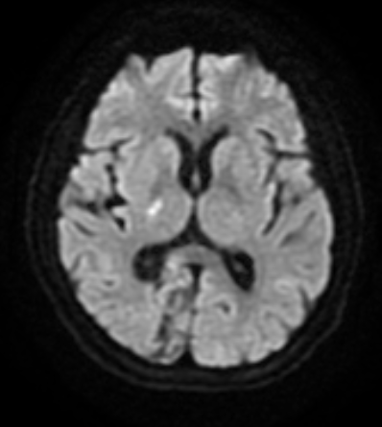
T2W & DWI of acute & subacute PCA territory infarct

Slide 57
- Part of pons & medulla
- Ant surface of cerebellum & vermis
-Superior surface of cerebellum
-Deep cerebellar white matter
-Superior vermis
AICA
SUPERIOR CEREBELLAR A

Slide 58
PICA
Branch of VA
Choroid plexus of 4th ventricle
Posterolateral medulla
Posteroinferior cerebellum
Inferior vermis & cerebellar tonsils

Slide 60
WATERSHED INFARCT

Slide 61
WATERSHED INFARCT
They occur at the border zones between major cerebral arterial territories due to hypoperfusion or microembolisation.
Two types :
Cortical border zone infarctions Infarctions of the cortex and adjacent subcortical white matter ACA/MCA and MCA/PCA
Internal border zone infarctions Infarctions of the deep white matter of the centrum semiovale and corona radiata at the border zone between lenticulostriate perforators and the deep penetrating cortical branches of the MCA.

Slide 63
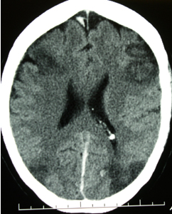
WATERSHED INFARCT

Slide 64
LACUNAR INFARCT

Slide 65
LACUNAR INFARCT
Small (3mm to 15 mm), multiple deep cerebral infarcts.
Involve BG & thalamus.
Due to embolic, thrombotic & atheromatous lesions in penetrating end arterioles supplying deep cerebral grey matter.

Slide 66
LACUNAR INFARCT
MR
– Small hypointense lesions on T1WI
_ Well defined hyperintense areas on T2WI/FLAIR surrounded by a hyperintense rim
Not well seen on CT.

Slide 67
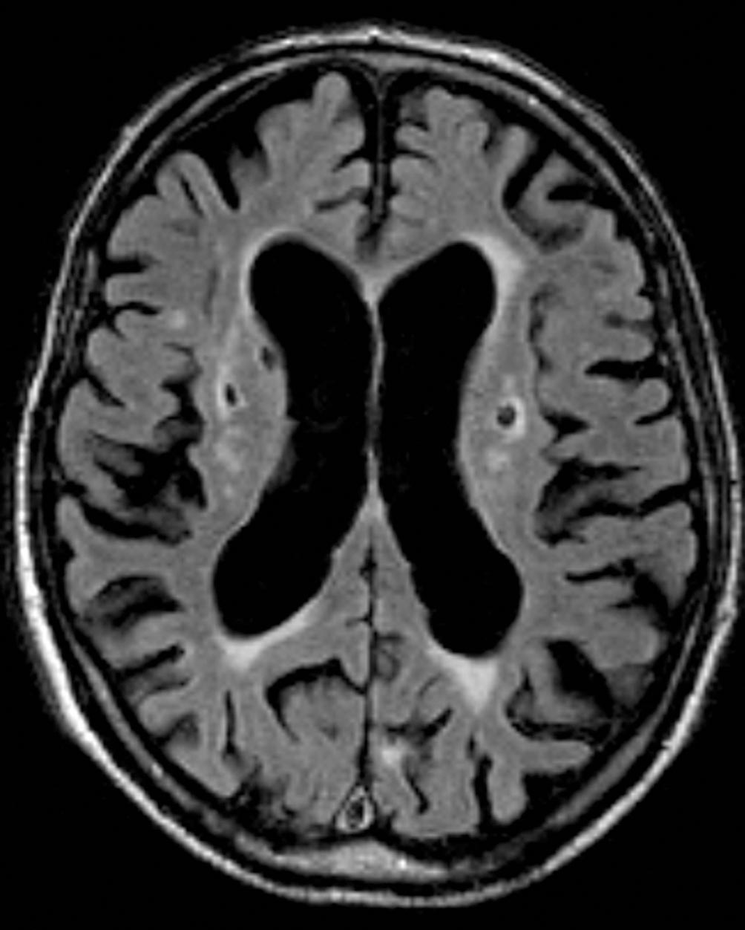
LACUNAR INFARCT

Slide 68
Acute stroke
NECT or MRI
Hemorrhage
No hemorrhage
No therapy
0-3 hrs
3- 6 hrs
IV thrombolysis
CTA+CTP
IC thrombus with penumbra
No penumbra +/-thrombus
IA therapy
IA therapy not useful

Slide 69
EXCEPTIONS
Basilar artery thrombosis
Patients outside the 6 hr window with persistent diffusion-perfusion mismatch

