Slide 1
MR EVALUATION OF PELVIC FLOOR
DR. SHRIKANT

Slide 2
PELVIC FLOOR
ANTERIOR COMPARTMENT:
Bladder & Urethra
MIDDLE COMPARTMENT:
Vagina, Cervix & Uterus
POSTERIOR COMPARTMENT:
Rectum

Slide 3
The support for these structures arises from the attachment of the muscles, fascia, and ligaments to the bony pelvis.
These are the primary supporting structures of the female pelvis.

Slide 4
Endopelvic fascia
The endopelvic fascia covers the levator ani muscles and the pelvic viscera in a continuous sheet.
Laterally, the condensation of the endopelvic fascia forms the arcus tendineus, providing lateral support to and anchoring the levator ani muscles.
The endopelvic fascia also attaches the cervix and vagina to the pelvic side wall via the elastic condensations known as the parametrium and paracolpium, respectively.

Slide 5
The parametrium is made up of the cardinal and utero-sacral ligaments and provides support to the body of the uterus.
The paracolpium stretches the vagina transversely between the urinary bladder and the rectum.

Slide 6
Anteriorly the endopelvic fascia forms the pubocervical fascia, between the pubis, the urinary bladder, and the anterior vaginal wall.
Similarly, posteriorly the endopelvic fascia forms the rectovaginal fascia, between the posterior vaginal wall and the rectum, that prevents the rectum from protruding forward and the bowel from herniating inferiorly.

Slide 7
The distal vagina is directly attached to its surrounding structures: anteriorly to the urethra, posteriorly to the perineal body, and laterally with the levator ani muscles.

Slide 8
Notes:
The levator ani muscles lie deep in relation to the endopelvic fascia.
The two components of the levator ani that provide the major support to the pelvic organs are the puborectalis and the iliococcygeus muscles.

Slide 9
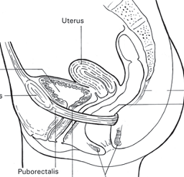
The pubo-rectalis forms a sling around the rectum and plays an important role in apposing the orifices of the pelvic floor as well as elevating the bladder neck and compressing it against the pubic symphysis.

Slide 10
The iliococcygeus has a horizontal orientation, arises from the external anal sphincter, and fans out laterally, attaching to the arcus tendineus.
Posteriorly and in the midline, the iliococcygeus condenses to form a firm raphe anterior to the coccyx known as the levator plate.
The iliococcygeus muscle acts as an important physical barrier, preventing posterior compartment prolapse.

Slide 11
Iliococcygeus & Levator plate

Slide 12
PELVIC FLOOR RELAXATION
Weakness of supporting muscles, fascia, and ligaments that results in pelvic floor relaxation.
This weakness progresses with age and may be related to menopause and hypoestrogenic states.

Slide 13
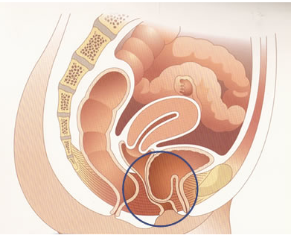
Loss of support to the urinary bladder and the urethra results in prolapse of the urinary bladder and protrusion of the anterior vaginal wall, forming a cystocele, which may result in urinary incontinence.

Slide 14
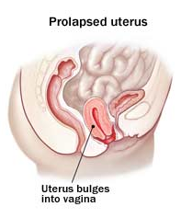
Weakness of the parametrium and paracolpium causes prolapse of the cervix and uterus.

Slide 15
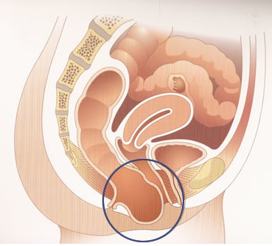
Weakness of the rectovaginal fascia results in prolapse of the rectum and protrusion of the posterior vaginal wall, forming a rectocele, and may result in fecal incontinence.

Slide 16
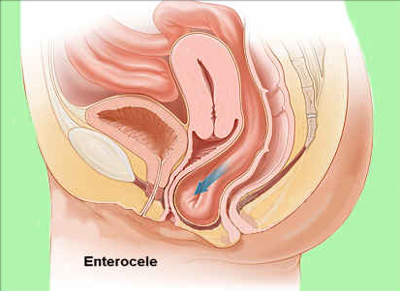
Prolapse of the small bowel through the rectovaginal fascia results in an enterocele.

Slide 17
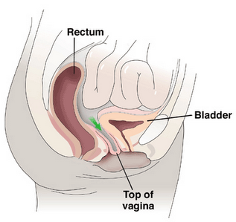
In patients who have undergone a hysterectomy, prolapse of the vaginal apex can arise because of weakness of the paracolpium, resulting in apical prolapse.

Slide 18
Several studies have also shown that patients with urinary incontinence have coexistent pelvic organ prolapse in the other two compartments that requires surgical repair.
Accurate assessment of all compartments of the pelvic floor is therefore essential in planning surgical reconstruction in order to minimize the risk of recurrence and repeated surgery.

Slide 19
IMAGING OF PELVIC FLOOR
Traditional imaging methods in assessment of pelvic floor weakness include,
Urodynamics
Voiding cysto-urethrography
Ultrasonography of the bladder neck and anal sphincter
Fluoroscopic cysto-colpo-defecography.
MRI

Slide 20
MRI
MRI is routinely used in preoperative planning before pelvic floor surgery.
It allows concomitant visualization of all three compartments of the pelvic floor and at the same time allows direct visualization of the pelvic support muscles and organs.

Slide 21
In MRI of the pelvis, adequate patient preparation and a good technique with fast acquisition time are required to achieve maximum patient comfort and hence better patient compliance.
The patient will be asked to void partially before the dynamic examination in order to prevent a distended urinary bladder from obscuring the pelvic structures and masking pelvic organ prolapse.
The examination is performed with a torso phased-array coil wrapped around the pelvis.

Slide 22
The pelvic organs may be opacified by instilling ultrasonic gel into the vagina and rectum
Although use of an endo-vaginal coil may improve the spatial resolution of the fine supporting ligaments in the pelvis, it is invasive and may diminish patient acceptance and compliance

Slide 23
Ultrafast, large-field-of-view, T2-weighted sequences such as single-shot fast spin-echo (SSFSE) or half-Fourier acquisition turbo spin-echo (HASTE) are frequently used.
The patient should be given instructions as to the proper performance of straining before the examination.
Specifcally, she should be told to keep her sacrum on the table and strain using only the internal organs.

Slide 24
For patients with a rectocele, these images should be repeated after the patient evacuates the rectal contents.
In patients with pelvic organ prolapse, static images may be acquired in the coronal plane.

Slide 25
After the dynamic examination is completed, small-field-of-view (20–24 cm) T2-weighted axial fast spin-echo (FSE) or axial turbo spin-echo (TSE) sequences are acquired to obtain high-resolution images of the pelvic floor.
Fat saturation is generally not applied to these sequences because the hyperintense signal of fat in the pelvis provides good contrast to the hypointense signal of the adjacent muscles, fascia, and pubic bones.

Slide 26
Interpretation of MRI Findings
H line: 5 cm
M line: 2 cm
Notes:
PCL: This line extends from the most inferior portion of the pubic symphysis to the last horizontal sacrococcygeal joint.
The H line measures the distance from the inferior symphysis pubis to the posterior anorectal junction on the
midsagittal image and is indicative of the anteroposterior width of the levator hiatus.
The M line is drawn perpendicular from the pubococcygeal line to the most distal aspect of the H line and is indicative of the descent of the levator hiatus from the pubococcygeal line.

Slide 27
The presence of significant pelvic floor prolapse will result in sloping of the levator plate and increasing length of the H and M lines, indicating widening and descent of the levator hiatus.
Elongation of the H and M lines is a useful indication of pelvic floor dysfunction and pelvic organ prolapse.

Slide 28
The high-resolution T2-weighted axial images of the pelvic floor should be analyzed for signal intensity, symmetry, thickness, and fraying of the pelvic floor muscles.
The vagina is suspended between the urethra and the rectum by the paracolpium and should maintain a normal butterfly configuration and be well centred in the pelvis in women with normal anatomy.

Slide 29
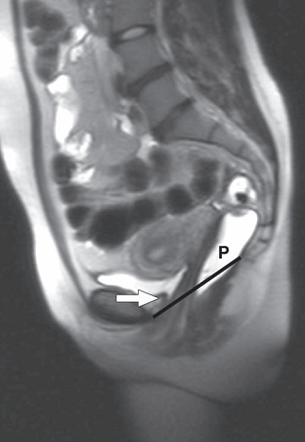
NORMAL
STRAINING

Slide 30
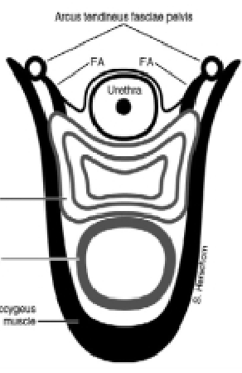
T2W AXIAL SHORT FIELD OF VIEW

Slide 31
CORONAL T2W
BOWED ILIOCOCCYGEUS
THICK INTERNAL ANAL SPHICTER

Slide 32
PATHOLOGY

Slide 33
Urinary Incontinence and Anterior Compartment Prolapse
Urinary incontinence in women is divided into,
Stress urinary incontinence
Urge urinary incontinence,
Overflow urinary incontinence.
Notes:
Stress urinary incontinence is the involuntary loss of urine due to an increase in intraabdominal pressure such as coughing and sneezing; it is related to urethral sphincter deficiency.
Urge and overfow urinary incontinence are related to bladder abnormalities.
In urge incontinence, there is detrusor instability or damage to the nervous system supplying the urinary bladder, such as in multiple sclerosis, stroke, or pelvic injury, and a large amount of urine leaks when the patient experiences a sudden urge to urinate.
In overfow incontinence, a small amount of urine leaks when the urinary bladder is overdistended because of weakness of the bladder muscles in a neurogenic bladder or in chronic bladder outlet obstruction.
Overfow incontinence is less common in women than in men.

Slide 34
The normal vertical distance of the bladder neck at strain should be less than 1 cm from the pubococcygeal line.
The distal two thirds of the urethra is inseparable from the anterior vaginal wall.
In patients with stress urinary incontinence, the support from the anterior vaginal wall is diminished; increased intra abdominal pressure results in descent of the bladder neck below the pubococcygeal line and prolapse of the urinary bladder through the anterior vaginal wall, resulting in a cystocele.

Slide 35
The normal butterfly shape of the vagina may also be altered by weakening of the paravaginal ligaments.
The vagina may have a fattened appearance because the vaginal wall will be displaced posteriorly as a result of loss of paravaginal attachments.
The disruption to the paravaginal ligaments will weaken support to the urethra because the middle and distal thirds of the urethra are closely related to and supported by the anterior vaginal wall.
The loss of the normal shape of the vagina is therefore a good indication of paravaginal tears in patients with urinary incontinence.
This information will be relevant to the surgeon because repair of the cystocele alone will not be sufficient, and fascial repair may also be necessary

Slide 37
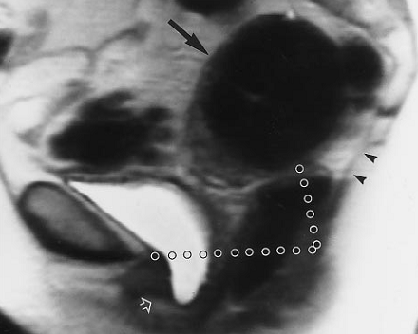
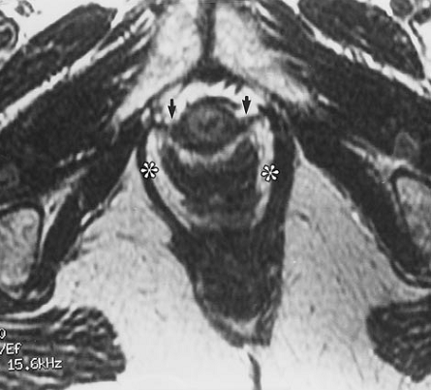
Notes:
Stress incontinence in a 42-year-old woman
signiﬁcant descent of the bladder below the pubococcygeal line, forming a cystocele
A large ﬁbroid (black arrow) likely prevents descent of the uterus.
On the strain image, the H and M lines are elongated and the levator plate is almost vertical (arrowheads), indicating loss of anterior and posterior support.
Axial T2-weighted image (4,200/112) shows intact pubovesical ligaments (arrows) and mild widening of the levator hiatus (distance between asterisks)

Slide 38
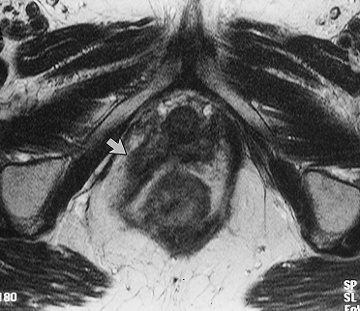
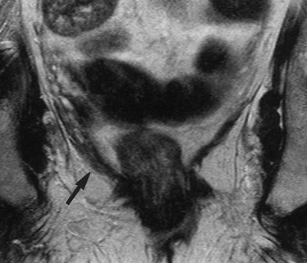
Notes:
Figure 5. Firm, painful mass lateral to the left wall of the vagina in a 62-year-old woman. (a) Sagittal T2-weighted image (2,200/96) of the patient during pelvic strain shows only minimal descent of the pelvic organs below the pubococcygeal line (arrows). (b) Axial T2-weighted image (4,400/112) of the patient at rest shows detachment of the right aspect of the puborectal muscle from the parasymphyseal area and deformation of the right vaginal fornix (arrow). (c) Coronal T2-weighted image shows mild convex downward deformity of the iliococcygeal muscle (arrow). The intact, left aspect of the levator ani muscle was in spasm and responded well to biofeedback therapy.

Slide 39
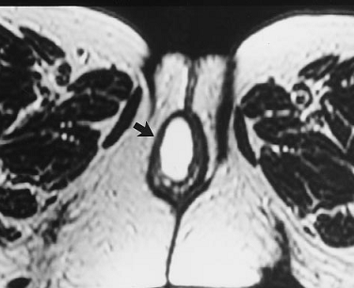
Notes:
Pelvic pressure and protrusion of tissue through the pelvic ﬂoor in a 68-year-old woman. (a) Sagittal T2-
weighted image (2,200/96) of the patient during pelvic strain shows global pelvic ﬂoor weakness with a severe cysto-
cele and more moderate descent of the uterus and rectum. (b) Axial T2-weighted image (4,400/112) shows the blad-
der protruding through the labia (arrow).

Slide 40
Middle Compartment Prolapse

Slide 41
Vaginal support in the pelvis
Three levels of support:
Level 1: The cephalic 2- to 3-cm portion of the vagina, is suspended from the pelvic side wall by the parametrium and paracolpium, which are condensations of the endopelvic fascia.
Level 2: In-between. Attached to the arcus tendineus
Level 3: Starts at the hymen ring and extends 2–3 cm cephalad to it., Directly fused anteriorly to the urethra, laterally to the levator ani muscles, and posteriorly to the perineal body.

Slide 42
Prolapse of the middle compartment in patients who have undergone hysterectomy is also termed “apical prolapse” because of the prolapse of the vaginal apex.
When the patient has had a hysterectomy, support to the vaginal apex is provided by the paracolpium, and the vaginal apex should remain at least 1 cm above the pubococcygeal line at strain.
Damage to the paracolpium can then result in apical prolapse.

Slide 43
Although loss of the normal butterfly shape of the vagina is widely described as a sign of disruption of the paravaginal ligaments, loss of the normal shape of the vagina on MRI can also be seen in nulliparous asymptomatic women and in the absence of relevant clinical symptoms; therefore, the diagnosis of weakening of vaginal support should not be made based on vaginal shape alone.

Slide 44
The parametrium, consisting of the uterosacral and cardinal ligaments, suspends the uterus and cervix from the pelvic side walls.
On midsagittal MR images, descent of the uterus in addition to descent of the cervix and vagina usually suggests disruption of the uterosacral or cardinal ligaments.
The H and M lines may be elongated.
On axial images, the transverse dimension of the levator hiatus may be widened.
The levator muscles may be asymmetric and assume a convex morphology.
The vagina may also be flattened or lose the symmetric butterfly shape.

Slide 45
Notes:
Note complete tear of right puborectalis muscle (arrow) and loss of normal butterfly shape of vagina

Slide 46
Notes:
Note asymmetric appearance of puborectalis muscles. Right puborectalis muscle (arrow) shows slight
ballooning, has convex morphology, and is torn anteriorly at insertion to pubis

Slide 47
A fibroid in the uterus may prevent descent of the uterus and cause underestimation of the true degree of pelvic floor dysfunction and supporting fascial damage.
In severe cases, procidentia results and the entire uterus prolapses and lies outside the introitus.

Slide 48
Posterior Compartment Prolapse

Slide 49
The perineal body is an important anchoring structure for the muscles and ligaments of the urogenital diaphragm.
The rectovaginal fascia, condensation of the endopelvic fascia that attaches to the perineal body, also provides a support diaphragm, preventing posterior prolapse.
One of the muscles of the levator ani, the iliococcygeus muscle, is a horizontally oriented sheet of muscle that, together with the rectovaginal fascia, forms a diaphragm that provides support to the pelvic organs, especially those in the posterior compartment.

Slide 50
The pubo-rectalis muscle, by forming a U-shaped sling between the pubis and the anus, acts to tighten the urogenital hiatus and keep the pelvic organs in position.

Slide 51
The levator plate, the midline raphe of the iliococcygeus muscle, is easily identified on the midsagittal image of the dynamic MR examination; it should remain parallel to the pubococcygeal line in normal individuals.
Caudal angulation of the levator plate on the midsagittal MR image by more than 10° with respect to the pubococcygeal line is a sign of pelvic floor weakness.

Slide 52
The most common cause of posterior vaginal bulge is anterior rectocele, caused by herniation of the anterior wall of the rectum into the posterior vaginal wall as a result of weakness in the rectovaginal fascia.
On the midsagittal image of the dynamic MR examination, rectocele is identifed by a rectal bulge of more than 3 cm, which is the distance measured between the anal canal and the tip of the rectocele.

Slide 53
The superior soft-tissue contrast of MRI allows the posterior compartment to be seen in great detail, such as the hyper intense T2 signal of peritoneal fat in peritoneoceles, the hyper intense fluid-filled small-bowel loops in enteroceles, and the hyper intense gel-filled rectum or sigmoid colon in rectoceles or sigmoidoceles.

Slide 54
Prolapse of peritoneal contents is due to deficiency of the supporting ligaments and iliococcygeus muscle, resulting in widening of the rectovaginal space.
In normal individuals, the rectovaginal space caudal to the upper third of the vagina is closely apposed.
Widening of this space will allow inferior herniation of the peritoneal fat, small bowel, sigmoid colon, and fluid into the pouch of Douglas.
Prior hysterectomy may cause disruption of the rectovaginal fascia and increase the risk of enterocele formation .

Slide 55
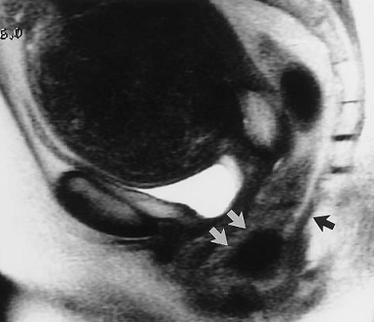
Notes:
descent and anterior bulging of the rectum
consistent with a rectocele (white arrows). The levator plate is nearly vertical (black arrow). The large uterine ﬁbroid
likely prevents descent of the middle and anterior compartments.

Slide 56
Notes:
Sagittal HASTE
MR image of pelvis at strain shows large rectocele (arrow) and abnormal caudal
angulation of levator plate (arrowhead), indicating signifcant weakness of
posterior compartment of pelvic foor.

Slide 58
SUMMARY
Pelvic ﬂoor weakness is common in middle-aged and elderly parous women and is often associated with stress incontinence, uterine prolapse, constipation, and incomplete defecation.
Most patients with incontinence and minimal pelvic ﬂoor weakness can be treated based on physical examination and basic urodynamic ﬁndings.
However, in women with symptoms of multicompartment involvement for whom a complex repair is planned or who have undergone previous repairs, magnetic resonance (MR) imaging can be a useful preoperative planning tool.

Slide 59
THANK YOU !

