Slide 1
MRI ARTEFACTS
PG Student : Dr Aditi Shah
PG Guide: Dr Rajendra Chavan
AK

Slide 2
Artefact is a feature appearing in an image that is not present in the original object.
Artefacts –
-reduce the image’s aesthetic quality
-mask pathology leading to a missed diagnosis (false negative)
-mimic pathology leading to overdiagnosis (false positive)

Slide 3
Some artefacts are irreversible, some can be completely eliminated, some can be reduced
These can be classified as
1.patient related
2.machine related
3.signal processing dependant

Slide 4
GHOSTS / PHASE MISMAPPING
Replication of something in the image.
Motion is the important cause.
Can arise from any structure that moves during acquisition for e.g.
-chest wall during respiration
-pulsatile movement of vessels
-swallowing
-eye movement
occurs along phase encoding axis.

Slide 5
Remedy-
Gating – ECG, pulse or respiratory gating
Respiratory motion - breath holding, respiratory gating, ROPE - respiratory ordered phase recording.
phase encoding axis swap- phase encoding direction is changed.
presaturation-area producing motion artifacts is saturated with RF pulses before start of proper pulse sequence such that all signals from this area are eliminated.
Gradient moment nulling-reduces ghosts caused by flowing nuclei moving along gradients by adjusting the gradient.

Slide 6
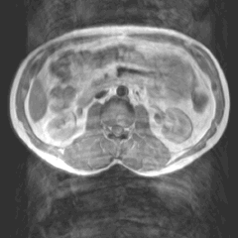

Slide 7
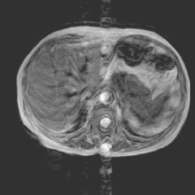

Slide 8
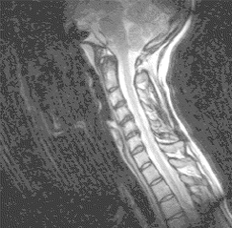

Slide 9
CHEMICAL SHIFT ARTEFACT
Different chemical environment of protons in fat and water
Artefact Appears at the interfaces of water and fat as a dark edge because frequency of precession is slightly different in these substances. Always occurs in frequency encoding direction.
At 1T-147Hz, at .5-insignificant, at 1.5T-220Hz i.e. fat precesses 220 Hz less than water.

Slide 10
The amount of chemical shift is expressed in units known as ppm.of the main magnetic field strength.
The actual dimention of this artefact depend on the FOV as this determines the size of each pixel.
axis - frequency encoding axis.

Slide 11
Remedy-
-using lower field strengths
-reduce FOV
-increase bandwidth
-use fat saturation
Advantage-
chemical shift along frequency encoding axis forms the basis of MR spectroscopy.

Slide 12
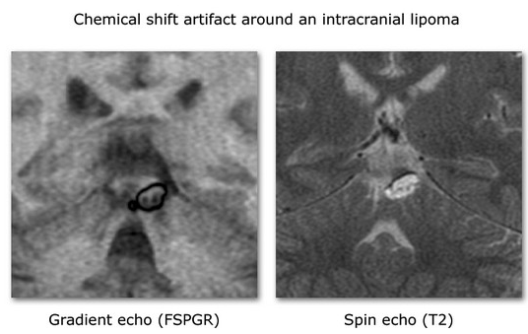

Slide 13
CHEMICAL MISREGISTRATION
This is due to precessional frequency difference between fat and water however, here, the fat and water are in phase at certain times and out of phase at others.
So when fat and water are in phase their signals add constructively and when they are out of phase their signals cancel each other. This cancellation effect is known as chemical misregistration artefact,which cause a ring of dark signal around certain organs where fat and water interfaces occur within the same voxel.

Slide 14
More in GRE sequences than spin echo
Remedy-
Use a spin echo sequence
Select a TE that generates an echo when fat and water are in phase.
Advantage-
In phase and out phase imaging

Slide 15
ALIASING / WRAPAROUND ARTEFACTS / BACK FOLDING
It is artefact when anatomy that exists outside the FOV is mapped inside the FOV, if it is in close proximity to the receiver coil.
It can occur in any axis
-frequency wrap
-phase wrap

Slide 16
Frequency wrap- is easier to correct. Low pass-filters are used to cut off the frequencies originating from outside FOV.
Phase wrap- corrected by increasing FOV along phase encoding direction.

Slide 17
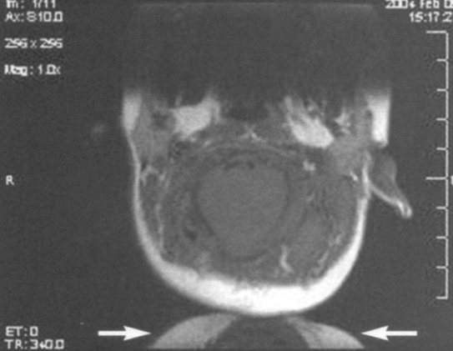

Slide 18
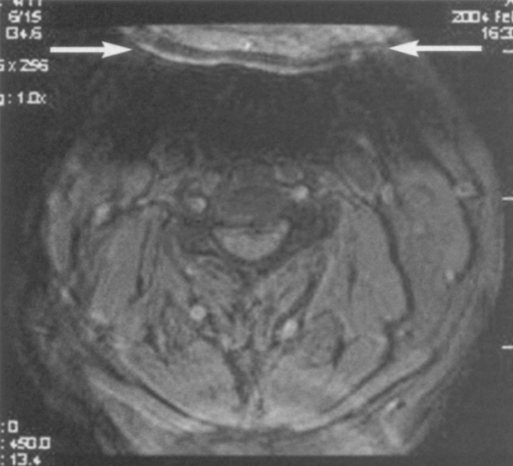

Slide 19
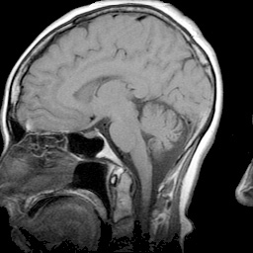

Slide 20
CROSS EXCITATION AND CROSS TALK
CROSS EXCITATION –
RF excitation pulse is not exactly square hence nuclei in slices adjacent to the RF pulse may be excited by it and receive energy. This energy flips NMV of these nuclei into transverse plane so that they are saturated when they are excited by their own RF pulse. This phenomenon is called cross excitation.

Slide 21
CROSS TALK-
The same effect is produced when energy is dissipated to nuclei from neighboring slice (due to spin lattice relaxation) as nuclei within selected slice relax after RF pulse is switched off. This is called as cross talk.
REMEDY-
Cross talk can never be eliminated.
Cross excitation can be reduced by
Increase interslice gap-At least 30% gap between the slices.
Interleaved slices scanning- so that nuclei have time to relax.
Using softwares to square off the RF pulses.

Slide 22
SHADING ARTEFACTS
Image has uneven contrast with loss of signal intensity in one part of the image.
Causes-
-uneven excitation of nuclei within the patient due to RF pulses applied at flip angles other than 90 and 180 degree
-abnormal loading of coil
-coupling of coil
-inhomogeneity of magnetic field

Slide 23
Remedy-
-shimming to reduce the inhomogeneity of the magnetic field
-load the coil correctly

Slide 24
MAGNETIC SUSCEPTIBILITY ATREFACT
Magnetic susceptibility is ability of a substance to become magnetised.
Normally most of the tissues has susceptibility value which fall in a fairly narrow range.
Presence of paramagnetic material like Hb degradation products or metallic objects or tissue-air interphase causes MS differences. This causes dephasing at the interface of these tissues and signal loss.
It is more prominent in GRE sequence than SE sequence because 180 degree pulse refocus the dephasing by reducing magnetic field inhomogeneities.
axis - frequency and phase encoding.

Slide 25
Remedy-
-use of SE sequence
-remove all metals whenever possible
Good effects-
-used to diagnose haemorrhage
-used to quantify liver and myocardial iron overload
-forms basis of post-contrast T2* w MR perfusion studies.

Slide 26
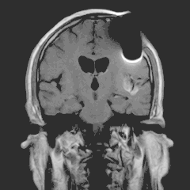

Slide 27
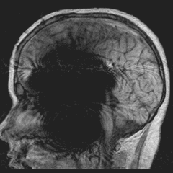

Slide 28
STRAIGHT LINES AND ZIPPER LIKE ARTEFACT
Zipper like artefact is a line with alternating bright and dark pixels propagating along the frequency encoding direction.
Radiowaves from sources outside the MR machine (from inside or outside the shielded MR room) can cause pattern of straight lines.
Door opened during imaging can cause this by interfering with inherently weak signal coming from the patient.
Stimulated echo and spike in K-space can also cause this.
axis - frequency encoding

Slide 29
Remedies-
-RF leak should be located and corrected.
-sources of RF inside the room should be removed
-zipper artefacts can be eliminated by spoiler gradients.

Slide 30
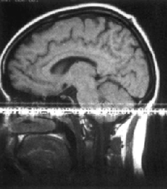
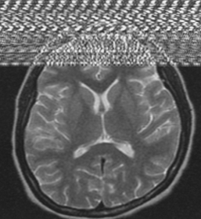

Slide 31
TRUNCATION ARTEFACTS
Also called edge, Gibbs and ringing artefacts.
It is due to undersampling of the data so that interfaces of high and low signal are incorrectly represented on the image
Seen as low intensity band running through high intensity area.
Seen in phase encoding direction

Slide 32
Gibbs’ artefact
Remedy-
-increase the no. of phase encoding steps.

Slide 33
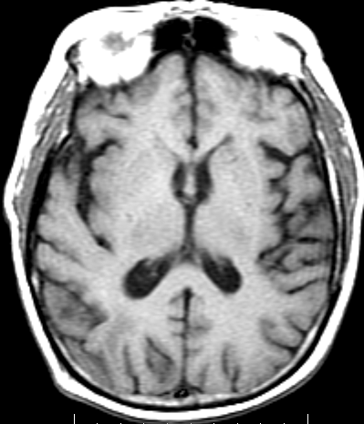

Slide 34
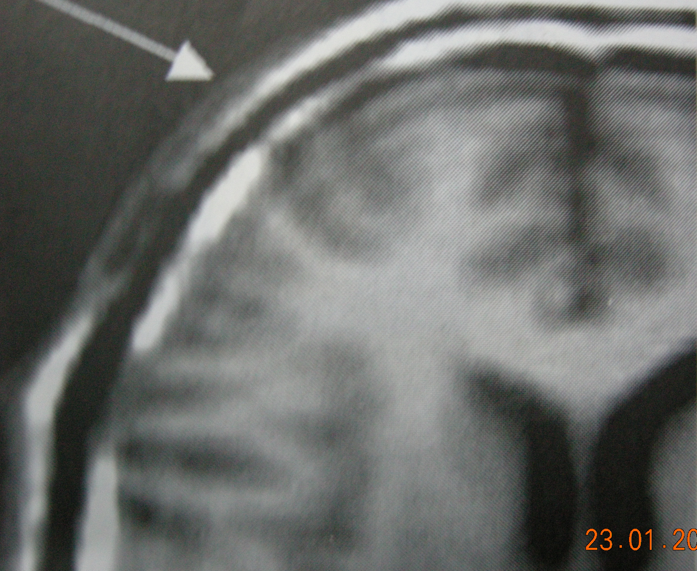

Slide 35
Shading artifact
Produces difference in signal intensity across the imaging volume like loss of signal intensity in one part of the image.
It is produced due to uneven excitation of nuclei due to RF pulses applied at flip angles other than 90^{0 ,} Inhomogeneities in the main magnetic field, overflow of analog to digital converter.
axis - phase and frequency encoding.

Slide 36
Point artefact-
a bright spot of increased signal intensity in the center of the image. This is due to constant offset of DC voltage in the receiver coil which after Fourier transformation appear as a bright spot in the center of the image.

Slide 37
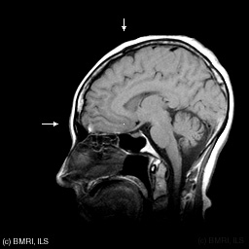

Slide 38
*CLASSIFICATION OF ARTEFACTS-
PATIENT RELATED- MOTION artefacts, FLOW artefacts, magnetic SUSCEPTIBILITY ARTEFACTS.
SIGNAL PROCESSING DEPENDANT- CHEMICAL shift ARTEFACTS, WRAP AROUND, GIBBS artefacts.
MACHINE / HARDWARE RELATED- SHADING ARTEFACTS, STRAIGHT LINES.

Slide 39
THANK YOU

