Slide 1
MRI CASES REVIEW MRI TEAM

Slide 2
case 1
14 yr female came with complaint of pain and swelling in left popliteal fossa near the proximal end of tibia since 4-5 month.
No H/O trauma, RTA, operative history

Slide 3
X RAY

Slide 4
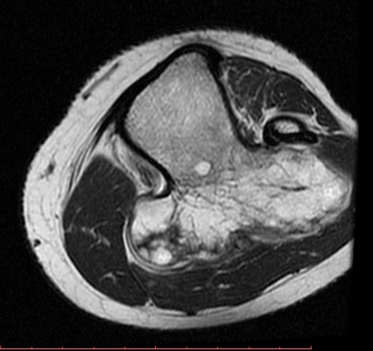
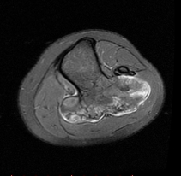
AXIAL T2W AXIAL PDFS

Slide 5
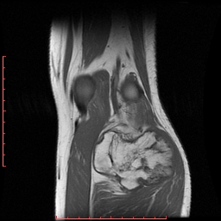
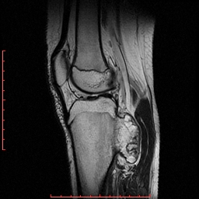
CORONAL T1W SAGGITAL T2W

Slide 6
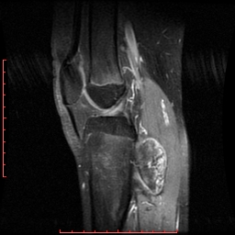
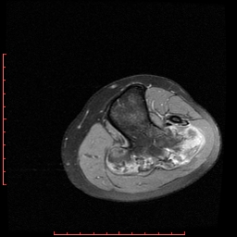
SAGGITAL GRE SAGGITAL POSTC+ T1W AXIAL POST C+ T1W

Slide 7
DIAGNOSIS ???

Slide 8
case 2
40 year old female came to the casulaty with complaints of severe headache since 2 days. There was h/o one episode of convulsion 8 days back.
No h/o trauma, fever or any other known medical and surgical illness.

Slide 9
CT BRAIN PLAIN

Slide 10
POSTCONTRAST CT BRAIN

Slide 12
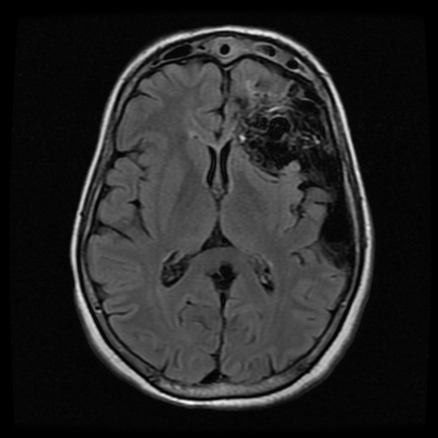
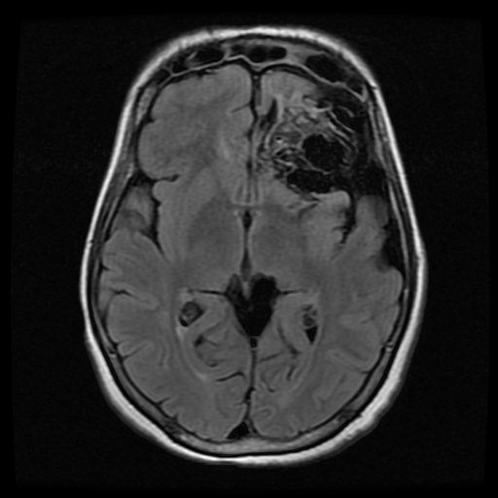
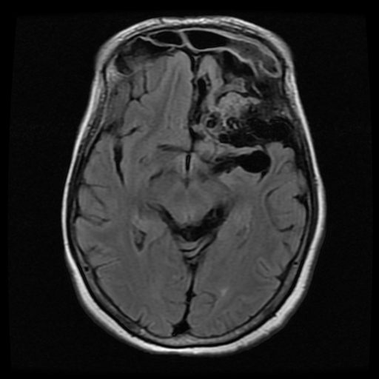
MRI BRAIN FLAIR IMAGES

Slide 13
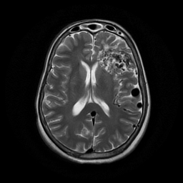
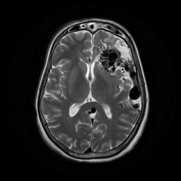
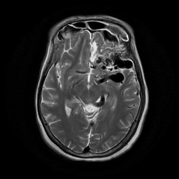
T2W IMAGES

Slide 14
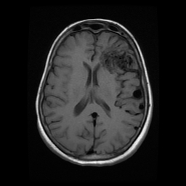
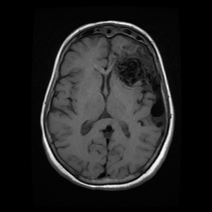
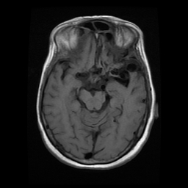
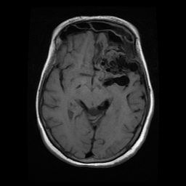
MRI BRAIN T1W IMAGES

Slide 15
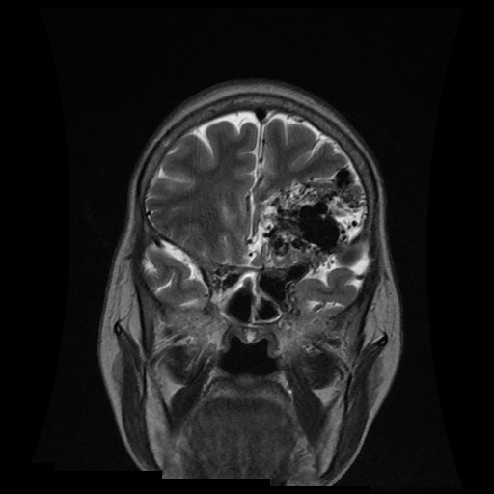
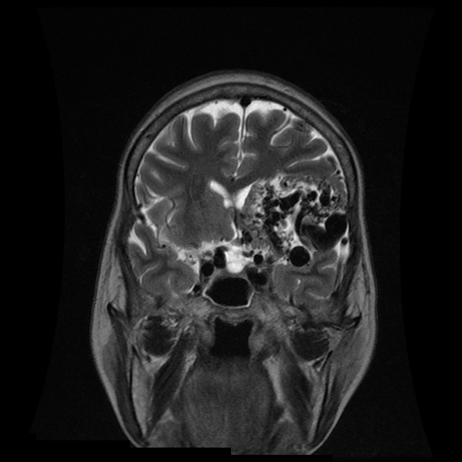
CORONAL T2W IMAGES

Slide 16
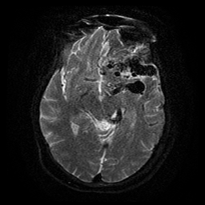
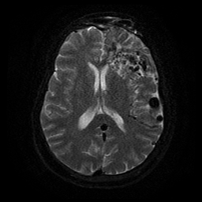
DWI IMAGES

Slide 17
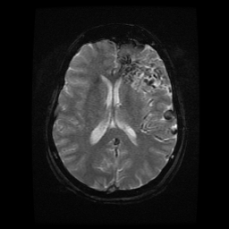
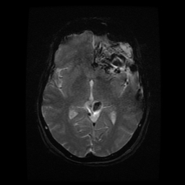
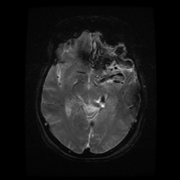
GRE IMAGES

Slide 18
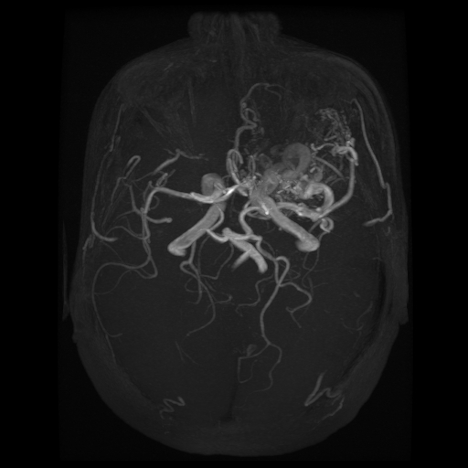
MR ANGIOGRAPHY

Slide 19
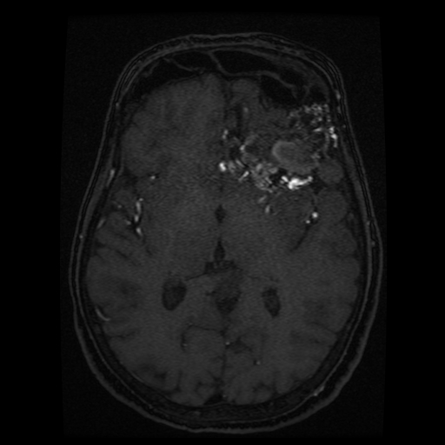
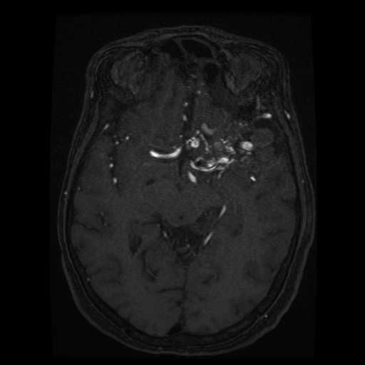
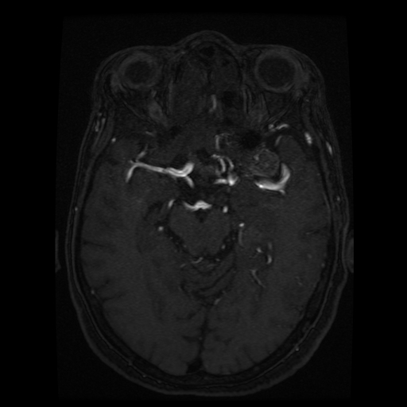
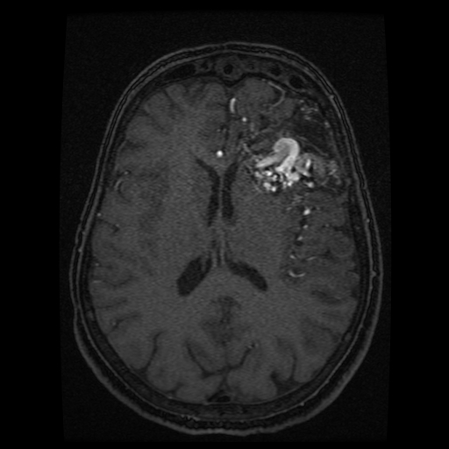

Slide 20
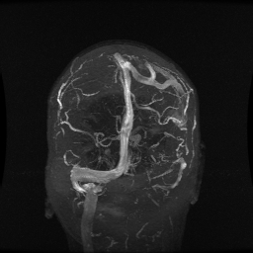
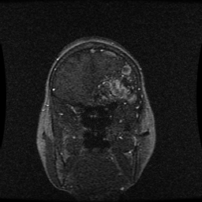
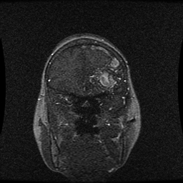
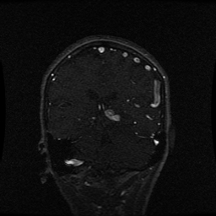

Slide 21
DIAGNOSIS??

Slide 22
Case 3
42 yr female presented with 1st degree infertility and endometriosis with multiple fibroid with right renal stone came with complaint lower pain abdomen, burning micturation, backache and weakness since 1month.
Patient give past H/O uterine fibroid 8 year back. In 2010 I/V/O hematuria cystoscopy diagnosed endometrosis of UB.
CT pelvis 16/12/11- diffuse nodular enhancing UB wall thickness posteriorly with focal loss of fat plane between anterior wall of uterus s/o endometriosis.
USG 28/8/16- Bulky uterus with fibroid and right renal calculus.
Not a k/c/o any major medical or surgical illness in the past.

Slide 23
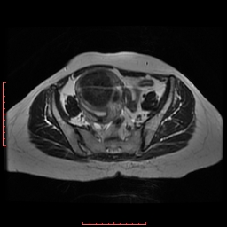
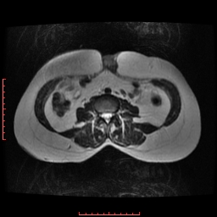
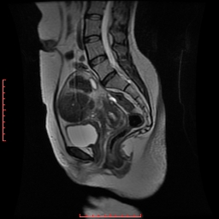
AXIAL T2W AXIAL T2W SAG T2W

Slide 24
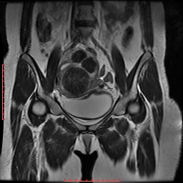
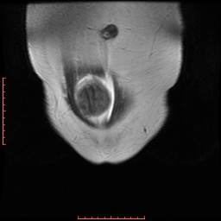
COR T2W

Slide 25
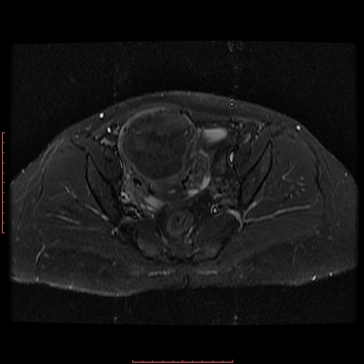
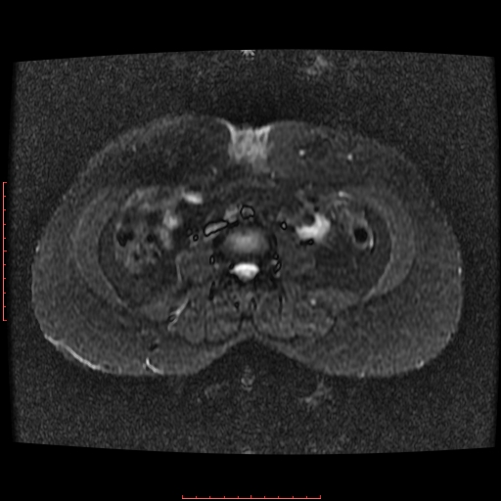
AXIAL STIR

Slide 26
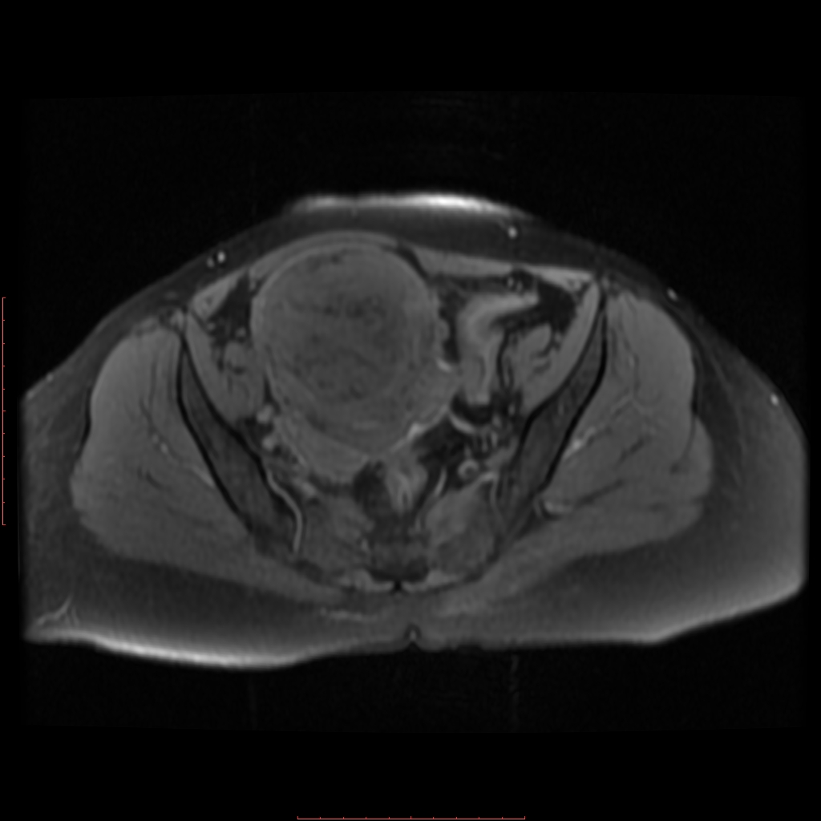
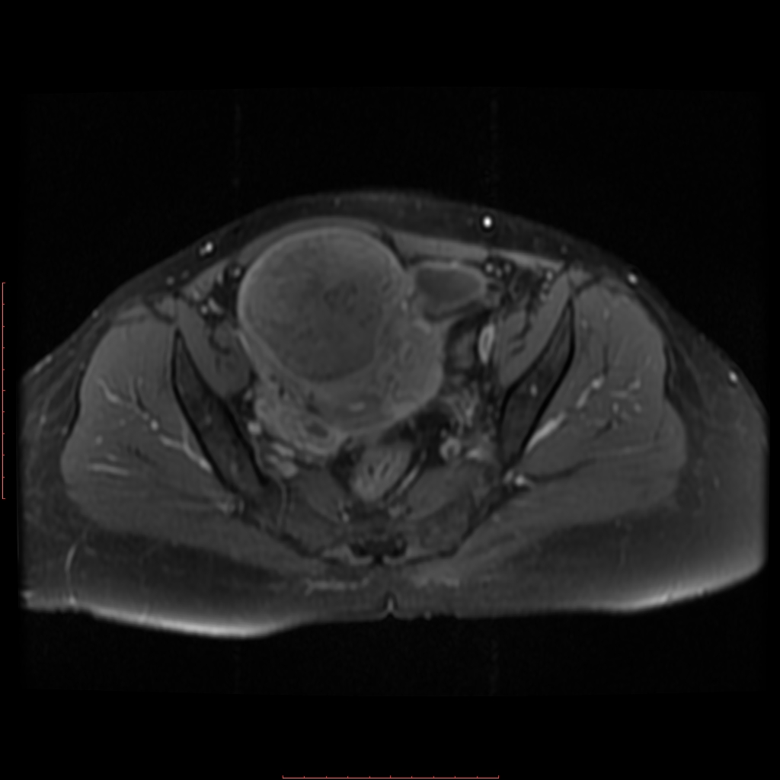
AXIAL GRE AXIAL T1W PRE C AXIAL T1W POS C

Slide 27
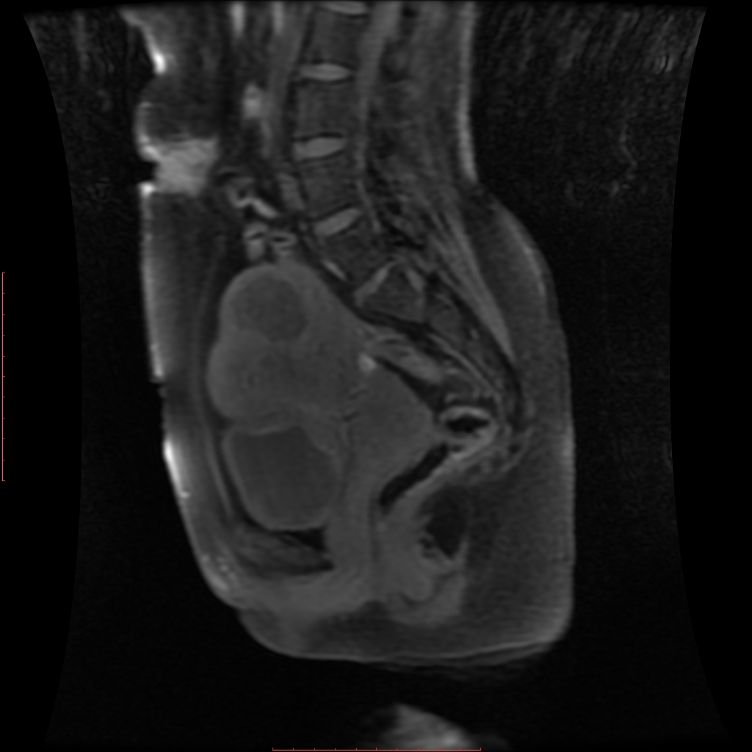
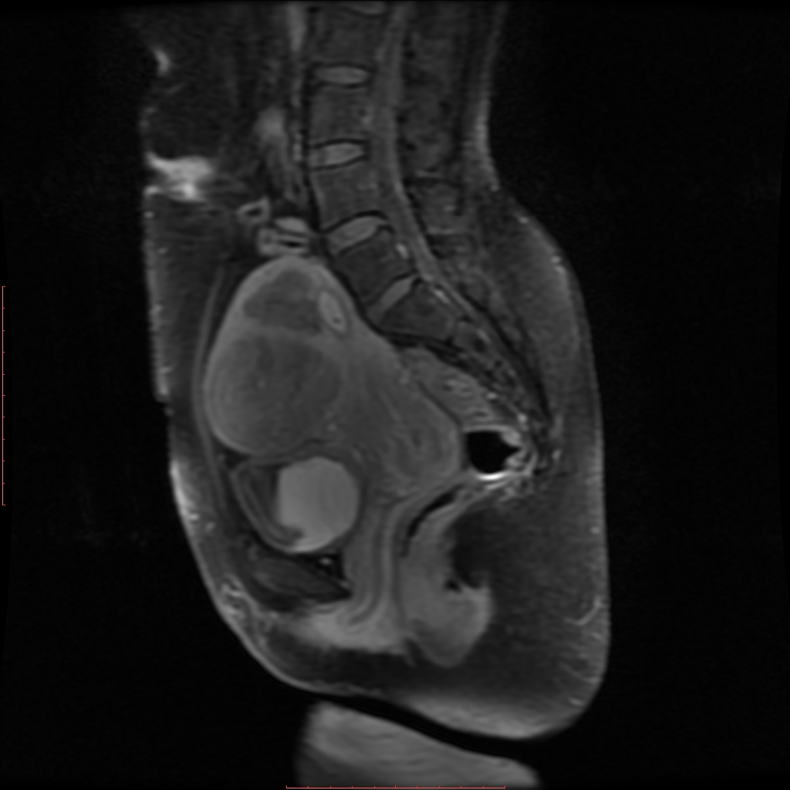
SAG TI PRE CON SAG TI POST CON

Slide 28
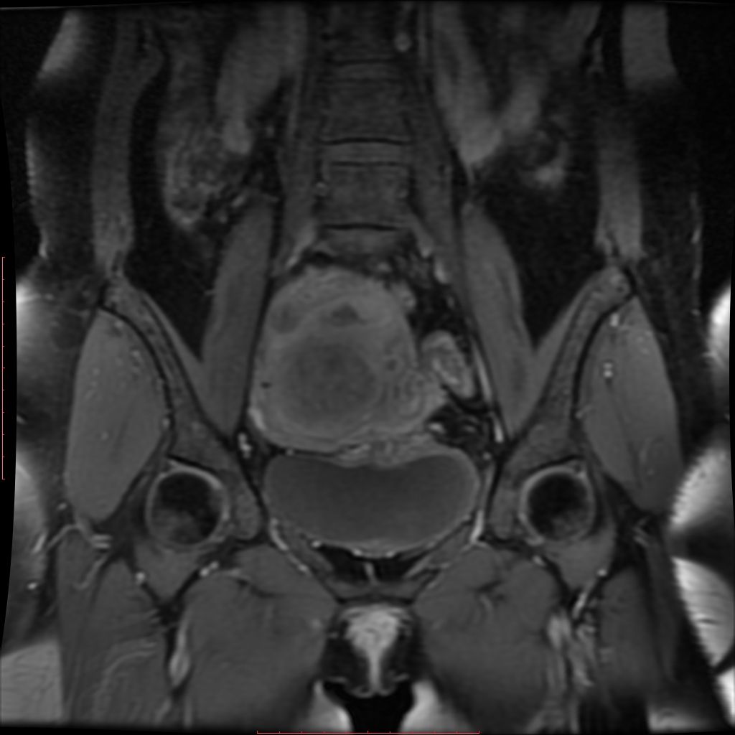
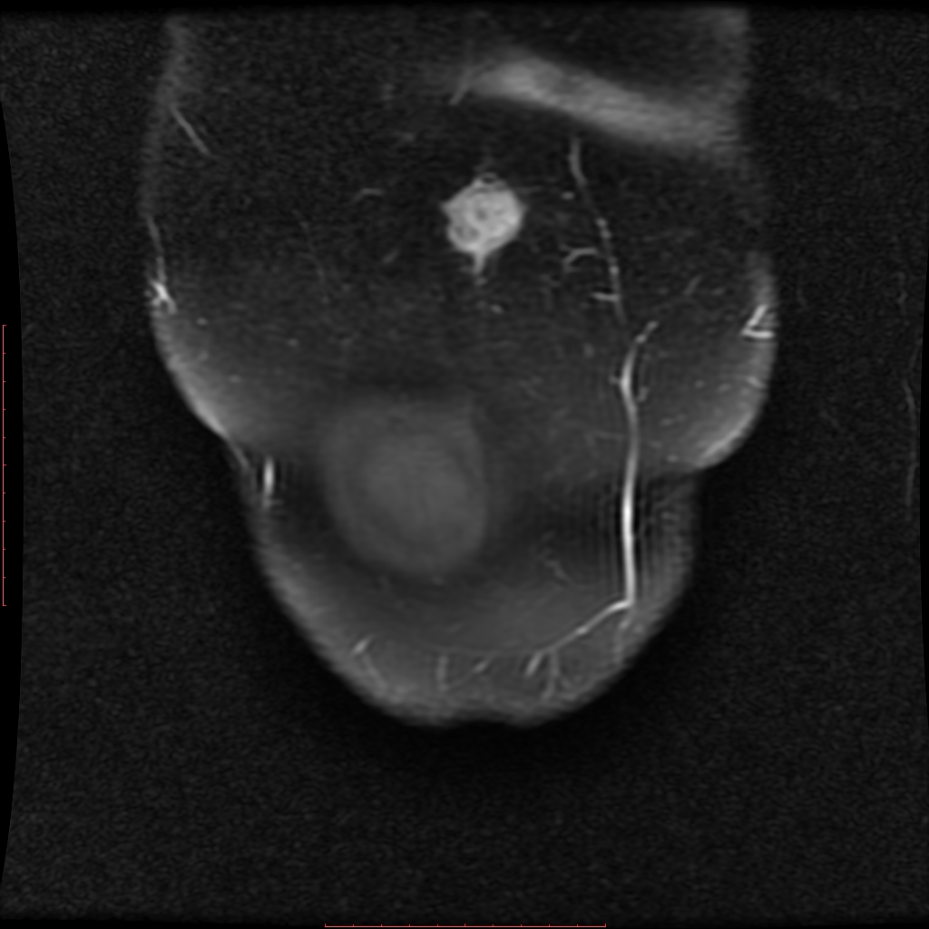
COR T1W PRE C CORT2W POST CON

Slide 29
DIAGNOSIS???

Slide 30
Case 4
3 yr male child came with complaint of reddish small lesion over face which progressed to scalp along with exfoliation and itching since 3 month.
These lesions are on and off type. H/O oral candidiasis and on and off mild fever is present.
X rays skull shows multiple well defined radiolucent lesion.
USG abdomen showed mesenteric lymphadenopathy.
Montoux test is negative.

Slide 31
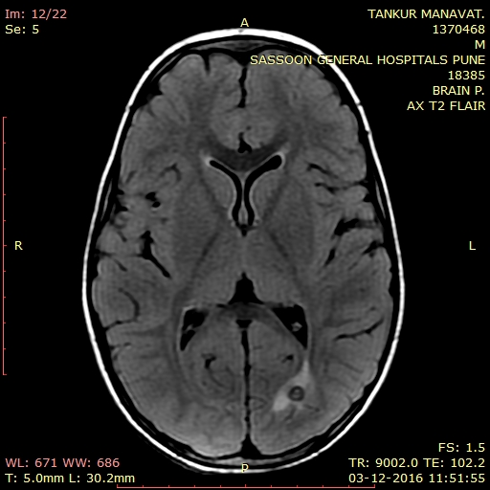
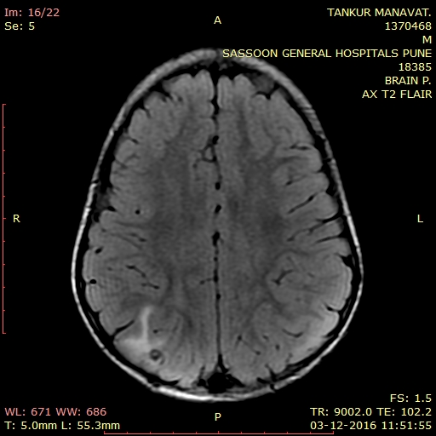
AXIAL T2W FLAIR

Slide 33
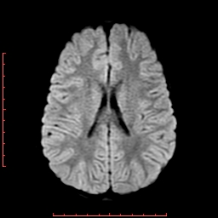
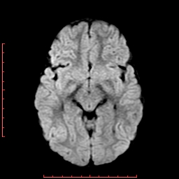
DWI

Slide 34
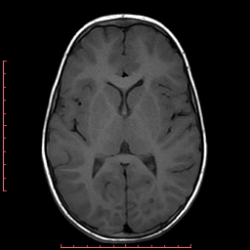
T1W

Slide 35
T2W PROP

Slide 36
GRE

Slide 37
AXIAL POST C

Slide 38
AXIAL POST C

Slide 39
DIAGNOSIS ???

Slide 40
CASE 5
37 yr old female presented with complaint of pain and swelling in left popliteal fossa since 2 years.
Pain and swelling was progressive in nature.
Local USG suggested chronic popliteal bursitis with suprapatellar effusion
No h/o trauma or other major surgical illness.
Rest of the blood parameters were normal.

Slide 41
X-RAY

Slide 42
T2W

Slide 43
SAG PDFS

Slide 44
SAG T1W IMAGES

Slide 45
GRE

Slide 46
PRECONTRAST T1W
POSTCONTRAST T1W

Slide 47
SAG T1W POSTCONTRAST

Slide 48
DIAGNOSIS???

Slide 49
CASE 6
2 yr old girl presented with complaint of episode of focal convulsion involving left lower limb followed by left sided weakness since 2 days which was followed by a single spike of fever relieved with antibiotics.
There is h/o hydronephrosis of right kidney at birth with absent left kidney.
Patient is hypertensive currently on amlodipine treatment.
No h/o trauma or other major surgical illness.
On lab investigations sr creat is 0.5. rest of the blood parameters are normal.

Slide 51
FLAIR

Slide 52
GRE

Slide 54
POSTCONTRAST T1W

Slide 55
THANK YOU

