Slide 1
RENOVASCULAR HYPERTENSION
DR.SHWETA SHENDEY

Slide 2
HYPERTENSION
Defined as blood pressure more than 140/90 mm/hg.
Idiopathic hypertension forms the major group
Other less common causes are:
Renovascular hypertension(most common)
Renal parenchymal
Endocrine
neurological

Slide 3
RENOVASCULAR HYPERTENSION
Renovascular HTN (RVHTN) is HTN mediated by high levels of renin and angiotensin II, produced by an underperfused kidney behind a stenosed renal artery.
Denoted casual relationship between renal artery stenosis and its clinical consequences.
Diagnosis is imp as treatment of renal artery stenosis may cure patients HTN.
Renal artery stenosis is narrowing or complete occlusion of one or both renal arteries,
defined by radiograph imaging at
greater than 60 % stenosis on renal Doppler
or
greater than 50 % on angiography

Slide 4
PATHOPHYSIOLOGY
When the stenosis exceeds 50% reduction in vessel diameter ➔ underperfusion of the kidney and decreased GFR ➔ the regulatory mechanism (renin-angiotensin system) triggered➔ angiotensin mediated increased vascular resistance & aldosterone induced sodium and water retention ➔ worsening kidney function & difficult-to-control HTN
RAS ➔
Atrophy of tubular cells
Fibrosis of the capillary tuft
Intra-renal arterial medial thickening.

Slide 5
PRESENTATION
Very high or sudden increase in blood pressure in the child or adult.
hypertension that is difficult to control with medication
Epigastric or flank bruit
Unexplained impairment of renal function
presence of coronary and peripheral arterial disease, and flash pulmonary edema.

Slide 6
ETIOLOGY OF RENAL ARTERY STNEOSIS
Atherosclerotic RAS(8%)
Diabetes mellitus
Dyslipidemia
Smoking
Fibromuscular dysplasia(28%)
Medial fibroplasia (histological finding in 90% of cases)
Intimal and adventitial fibroplasia (less common)
Smoking
Other causes:
Takayasu's arteritis (61%)
Vasculitis
dissection
Vasospasm
Neurofibromatosis
Spontaneous renal artery dissection
Arteriovenous malformations
Arteriovenous fistulas
Trauma
Abdominal radiotherapy
Retroperitoneal fibrosis.
Coarctation syndrome
Congenital rubella
Syphilitic arteritis
Tuberous sclerosis

Slide 7
ATHEROSCLEROSIS
More common in people aged older than 50 years
Found more commonly in women than in men.
Obstruction is more commonly due to aortic plaque engulfing renal ostium.
Both renal arteriesare frequently involved
Often circumferential but can be assymetric
Commonly associated with calcification.

Slide 9
FIBROMUSCULAR DYSPLASIA
Typically occur in young women, occur in visceral and peripheral arteries but spares intracranial arteries.
Involve any layer of artery:
INTIMAL FIBROPLASIA:
Common in children, progressive, Concentric collagen accumulation beneath internal elastic membrane causing focal smooth stenosis in midportion of artery.
MEDIAL DYSPALSIA:
Most common type
Affect 20-50 yrs of age
Progressive
Medial fibroplasia is the most common type, with replacement of smooth muscle with collagen alternating with small areas of dilatation due to aneurysm formation with classic STRING OF BEADS appearance,
ADVENTITIAL DYSPLASIA:
Collagen deposition surrounding adventitia leading to tubular smooth narrowing on angiogram.

Slide 10
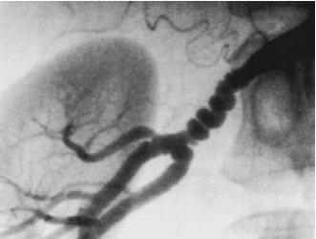

Slide 11
NONSPECIFIC AORTOARTERITIS/TAKAYASU’S ARTERITIS
It is granulomatous arteritis commonly involves aorta and its major branches.
Young female (less than 35 yrs of age)
Can present with fever and raised ESR levels.
Progressive adventitial fibrosis leads to luminal narrowing , occlusion, dilatation or aneurysm formation
Type 1:narrowing of aortic arch and great vessels arising from aortic arch
Type 2:descending thoracic and upper abdominal aortic involvement
Type 3:aortic arch vessels, abdominal aorta and major branches.
Type 4:pulmonatry artery involvement

Slide 12
SCREENING FOR RENOVASCULAR HYPERTENSION
Preserved for patients with moderate to high risk of RVH.
CLINICAL
Patients presenting with accelerated and malignant HTN
HTN uncontrolled by triple drug therapy
Onset of HTN in less than 20yrs or more than 50 yrs of age
Unilateral small kidney
Impairment of renal function on treatment with ACE inhibitors
Long history of smoking
H/o PVD
PHYSICAL SIGN : Abdominal or flank brui.
LAB TESTS : Blood urea nitrogen >20mg/dl
serum potassium <3.4 mEq /L
Proteinuria.

Slide 13
IVU
The affected kidney small and smooth
The reduced perfusion on the affected side produces a late nephrogram giving rise to a hyperdense nephrogram.
Similarly there is late appearance of contrast into the pelvicalyceal system and again this becomes hyperdense.
Notching of the ureter due to compensatory hypertrophy of the ureteric artery .
Notes:
Hyper dense nephrogram due to more concentrated urine on the affected side compared to opposite side

Slide 14
RADIONUCLIDE RENAL SCINTIGRAPHY
Captopril Renography is a nuclear study which takes advantage of the fact that ACEI can abruptly reduce renal function in an ischemic kidney.
Patients are given radio-labeled agents that are either exclusively filtered (Tc⁹⁹-DTPA), thus estimating GFR, or agents that are filtered and secreted (Tc⁹⁹-MAG or I¹³¹-hippurate), thus estimating RBF.
A baseline study is done on day 1 and 25 mg of captopril is given 1 hr prior to the second study on day 2.
The difference between the left and right kidney with regard to uptake, excretion, kidney size and asymmetry can be determined by this study.
Either a slowing of the excretion of Tc⁹⁹-DTPA or a reduction of the uptake of the Tc⁹⁹⁻MAG can be used to identify the effect of the ACEI in removing the protective actions of high levels of ATII on the autoregulation of GFR and on the maintenance of renal blood flow.
Notes:
Diethylene triamine penta acetic acid, mercaptoacetic triglyceride

Slide 15
CAPTOPRIL SCINTIGRAPHY
The mean transit time is prolonged
Diminished uptake
Flattened peak and delayed Tmax.
In severe cases the clearance may be so slow that the curve continues rising
throughout the period of observation.
Grade I Mild delay in Tmax (6-11 min) with a falling excretion phase
Grade 2a More prolonged delay in T max (greater than 1 1 min) but still with an excretion phase
Grade 2b Continually rising or flat curve
Grade 3 As grade 2b, with marked reduction in function of the affected kidney.

Slide 16
Advantage of study include low cost, reliability and non invasive nature.
Notes:
Disadvanatage is low sensitivity in pts with azotemia and or underlying renal dysfunction and bilateral renal artery stensois.

Slide 17
ULTRASOUND
first step in the investigation
It is a simple non-invasive
And exclude an obvious structural abnormality or coexistent condition that may relate to the hypertension (renal scarring, hydronephrosis, calculus disease and rarely renal or adrenal tumours )
Obvious size disparity b/w the two kidneys (2cm)
One kidney is abnormally small – s/o unilateral RAS

Slide 18
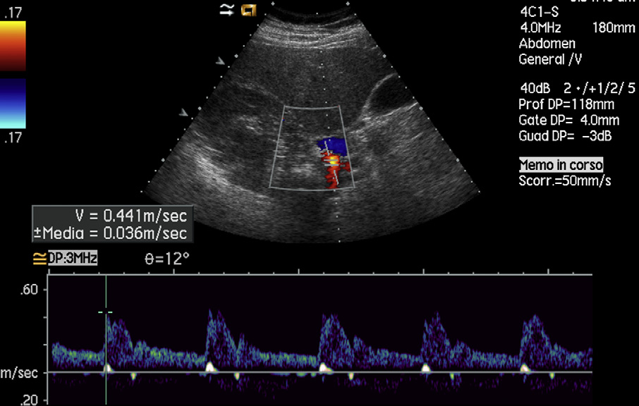
DOPPLER CRITERIA FOR DIAGNOSIS OF RAS
Doppler US criteria of RAS can be divided into two groups based on
Direct findings obtained at the level of the stenosis (proximal criteria)
Flow changes observed in the renal vasculature distal to the site of stenosis (distal criteria).
Notes:
Normal renal artery wave form

Slide 19
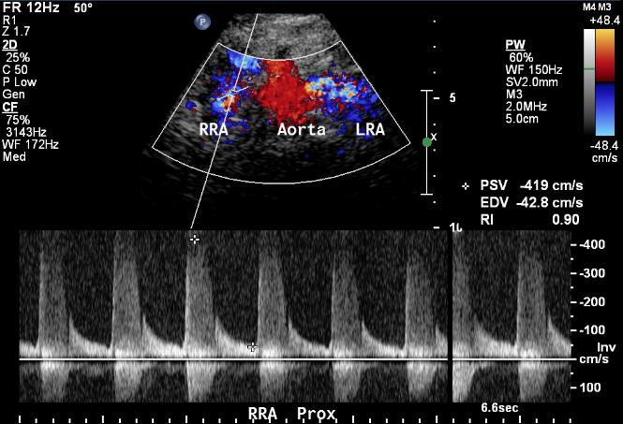
PROXIMAL CRITERIA (DIRECT EVALUATION OF THE STENOSIS)
Four criteria are used to diagnose significant proximal stenosis or occlusion of the RA.
The first and most important sign is the increase in PSV.
Velocities higher than 180 cm/s suggest the presence of a stenosis of more than 60%
End-diastolic velocity greater than 150 cm/s suggests a degree of stenosis greater than 80%.

Slide 20
The second criterion is the comparison of PSV values obtained in the prerenal abdominal aorta with those measured in the RAs, the so-called renal/aortic ratio (RAR)
In normal conditions, RAR is lower than 3.5.
If PSV obtained in the prerenal abdominal aorta is abnormally low (less than 40 cm/s), RAR cannot be used.
The third criterion is identification of RAs with no detectable Doppler signal, a finding that indicates occlusion.
The fourth criterion is the visualization of color artifacts such as aliasing at the site of the stenosis and the presence of turbulence at Doppler evaluation indicating the presence of a significant stenosis.

Slide 21
DISTAL CRITERIA (INDIRECT EVALUATION OF THE STENOSIS)
Waveform alterations distal to the stenosis in arterial segments (hilar or interlobar arteries).
loss of early systolic peak/loss of steep systolic upstroke
acceleration index (AI) it is the slope of systolic upstroke lower than 3 m/s²;
acceleration time (AT) it is time from start of systole to peak of systole. > 0.07 s
a difference between the kidneys in RI > 5% or
“tardus–parvus” effect: Tardus refers to low systolic acceleration and parvus refers to low amplitude of systolic peak.
A great difference in RI values obtained on the 2 kidneys (>0.05–0.07) is another criterion for diagnosis of RAS .
Notes:
Tardus means slow and late and parvus means small and little. Slow rise of systolic wave or delay in the rise of systolic wave.it cana lso be produced by coarecttaion of aorta

Slide 22
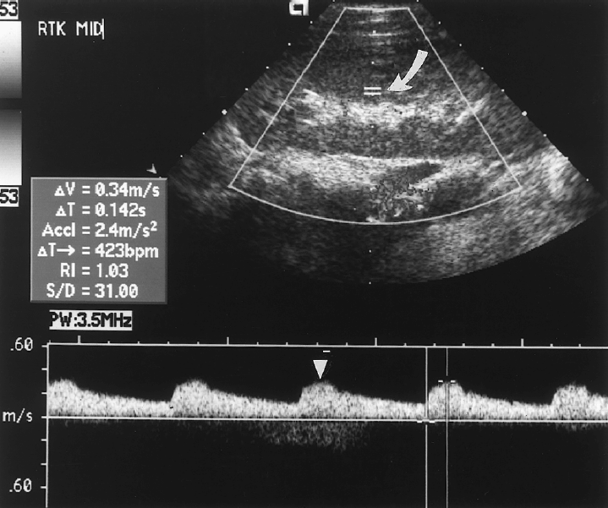

Slide 23
CT ANGIOGRAPHY
It is nonivasive technique for angiographic images.
Data on CTA is obtained craniocaudally with section thickness of 1 mm and pitch of 1.5 after an intravenous injection of 90-150 ml of contrast medium (300mg/ml) at the rate of 3-6 ml/sec using bolus tracking technique.
Axial images can be reconstructed using MPR, MIP, VRT for morphological evaluation of kidney and main renal artrey
CTA is useful in demonstrating wall of aorta unlike angiography which visualizes lumen only

Slide 24
It is also useful in demonstrating extent of plaque projecing into the vessel lumen thus helps in determining the form of intervention planned such as angioplasty and primary stent placement
High efficacy in diagnosing osteal stenosis, differentiate between osteal stenosis and truncal stenosis.
To detct collaterals in presence of renal artery stenosis
To examine patency of vessel dilated by intravascular stents.

Slide 25
Computerized Tomographic Angiography

Slide 26
MAGNETIC RESONANCE ANGIOGRAPHY
Renal arteries can be visualized noninvasively with or without contrast.
CE-MRA is preferred technique for detection RAS.
However risk of nephrogenic systemic fibrosis with gadolinium based contrast is there hence use of gadolinium is restricted for patients with derranged renal function. In CE-MRA gadolinium is given in dose of 0.1-0.3 mmol/kg with bolus tracking and entire acquisition is performed during single breath hold.
Long time parallel imaging technology provides images with shorter acqusition time in pts unable to hold breath.

Slide 27
Magnetic Resonance Angiogram

Slide 28
ADVANTAGE OF MRA
Absence of ionizing radiation
Production of arteriographic images that unlike CTA are not affected by calcified plaques
Images can be viewed in multiple planes with facilities for temporal processing as well.
Phase contrast studies provide information about the blood flow velocities.
DRAWBACKS :
High cost, limited availibility and artifacts caused by motion and bowel peristalsis.

Slide 29
RENAL ANGIOGRAPHY
It is the gold standard technique against which all other modalities for diagnosing renal artery stenosis are compared.
Limited role as sceening tool because of its invasive nature.
Flush aortography is often adequate to demonstrate main renal arteries and any proximal renal stenosis.
When intrarenal branch artery stenosis are suspected selective angiography is essential.
Bcoz of origin of right renal is anerolateral and left renal is posterolateral sometimes ostial lesions may be missed on AP aortogram hence oblique and lateral view required to delineate stenosis.

Slide 30
FEATURES OF RAS ON ARTERIOGRAPHY
ATHEROSCLEROSIS produces irregular circumferential or eccentric narrowing of ostium or proximal 3rd of the renal artries, bilateral disease is common and infrarenal aortic involvement is seen.
FMD typically involves middle to distal renal arteries and less commonly intrarenal branches, but aorta is disease free.
Bilateral disease is seen in about 2/3 rd of cases.(right>left) with the classic appearance of medial fibroplasia is string of beads appearance.
AORTOARTERITIS in asian countries abdominal aorta is most commonly affected particularly renal and subclavian arteries, pulmonary artery involvement is less frequently seen in indian population. With steno-occlusive lesions being more common than dilating lesions .

Slide 31
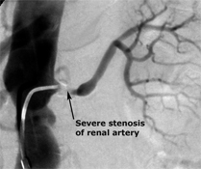
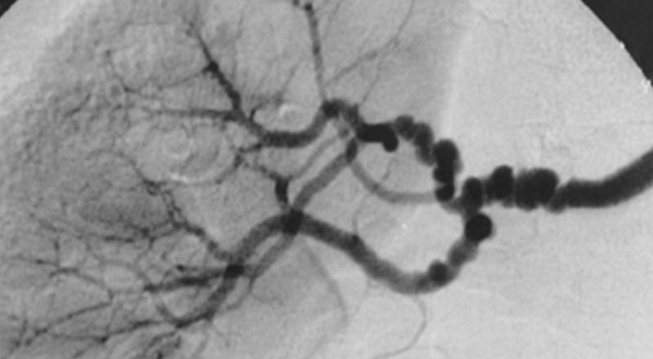

Slide 32
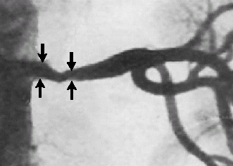

Slide 33
After identification of stenosis hemodynamic significance is established by following criterias :
Reduction in luminal diameter by > 75%
Systolic pressure gradient across the stenosis > 15-25 mm of hg or > 20% of aortic systolic pressure( most accurate indicator)..
E/o collateral circulation in distal vessels
ADVANTAGE: High resolution of technique making it a only modality capable of adequetly visualizing branch renal artery stenosis.
Pressure gradient can be measured
Selective renal catheterization may be followed by appropriate intervention in the same sitting.
DISADVANTAGE: Expensive, invasive, risk of iodinated contrast materials, risk of procedural complications like haematoma, pseudoaneurysm , vessel dissection.

Slide 34
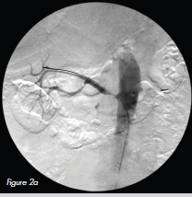
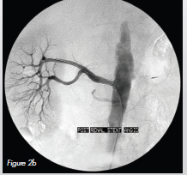
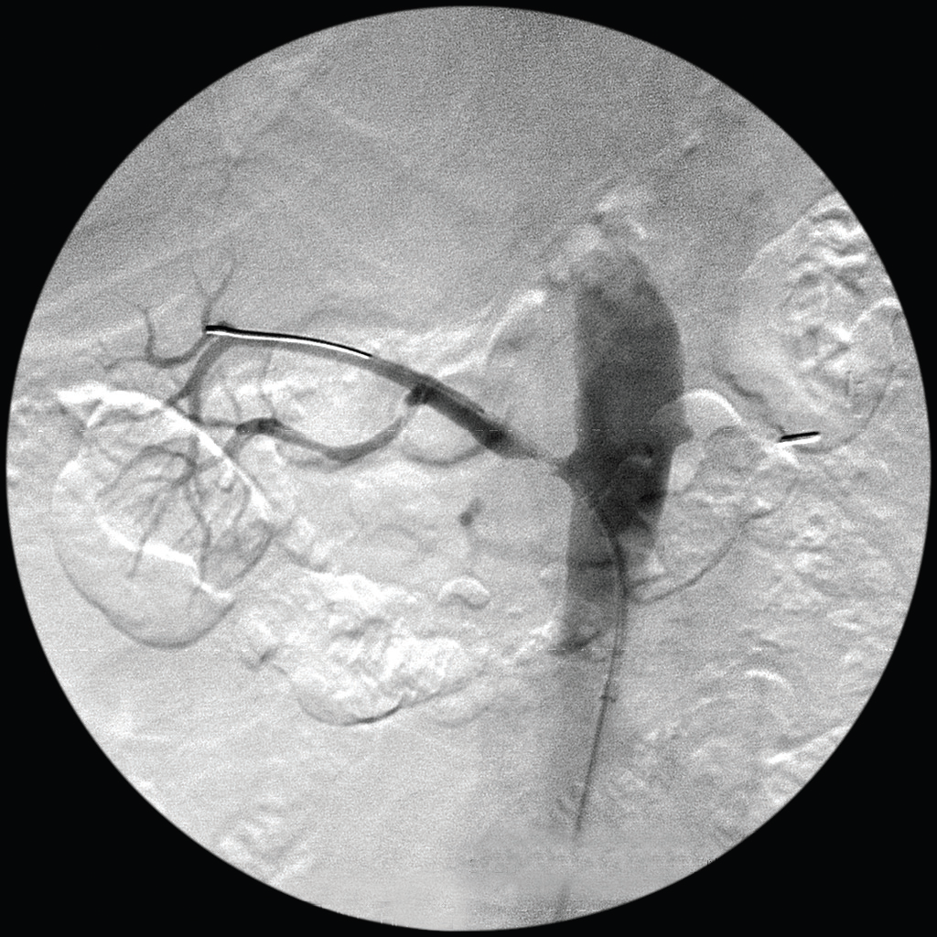
Interventional radiology in the treatment of renal artery stenosis
Percutaneous transluminal renal angioplasty (PTRA) alone or in combination with stent implantation .
Minimally inavasive alternative to surgery.
Notes:
used as an alternative technique to surgical revascularization

Slide 35
SELECTING PATIENTS FOR RENAL REVASCULARISATION
Refractory hypertension on multidrug regimen.
Progressive azotemia.
ARF on ACE inhibitors in patients with CHF
Bilateral renal artery stenosis or stenosis of renal artery supplying single functioning kidney.
Salvage therapy in recent onset end stage renal failure (preserved renal size and parenchymal thickness), it is not beneficial in patients with severe renal failure (sr creatinine >4mg/dl)
Angioplasty failure is an absolute indication for stenting .
Stenting is the procedure of choice for osteal atherosclerosis RAS.

Slide 36
Success of renal revascularization is judged by:
If residual stenosis < 30%
Atleast 50% enlargement in arterial diameter
Aortorenal pressure gradient of <20 mm of Hg or reduction in pressure gradient by 15 mm of HG as compared to pretreatment gradient.
Pt is considered cured when diastolic blood pressure <90 mm of Hg without medication.
Considered failed when there is no change in blood pressure after procedure.

Slide 37
THANK YOU

