Slide 1
RADIATION PROTECTION
Dr. ANAND HATGAONKAR,
Associate Professor,
Dept. of Radiodiagnosis,
B.J.Govt. Medical College,
Pune

Slide 2
History
Evolution of Radiation protection

Slide 3
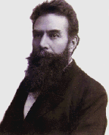
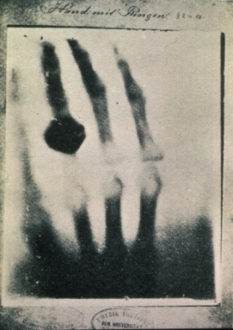
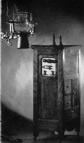
X-Rays – Chronology
Early days
Discovery of X rays -
Sir William Conrad Roentgen
8Th Nov 1895.
Dec 1895 – Roentgen published Paper.
Feb 1896 – x-ray accepted as evidence in court case.
March 1896 – Diagnostic labs started
1897 - 1st x-ray machine in USA at Lenox HilI Hospital, New York
First X-ray: hand of his wife Anna
Early X-Ray Machine
Notes:
Many important milestones in the advancement of medical knowledge have been made at Lenox Hill Hospital, including:
Introduction of antiseptic methods in obstetrics
Installation of one of the first X-ray machines in America in 1897
First tuberculosis pavilion in any American hospital
First hemophilia center
Introduction of the technique for bone marrow examination in 1931
Development of the specialty of thoracic surgery
First successful esophagectomy for carcinoma
First surgical treatment of undescended testicles
First angiocardiogram in the United States
First coronary angioplasty in the United States
Implantation of the first drug-eluting stent in the United States

Slide 4
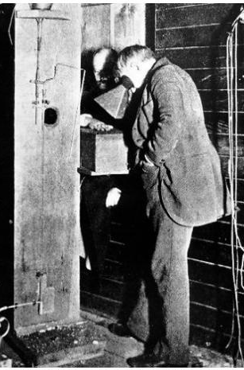
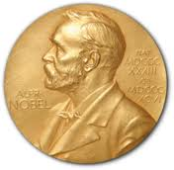
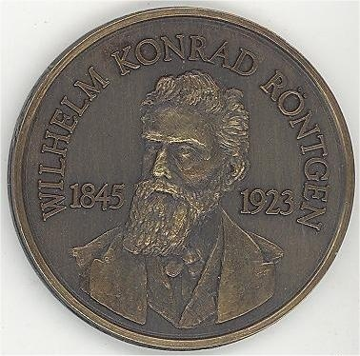
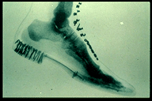
X-Rays – Chronology
Early days
X-ray slot machines installed in Chicago & Lawrence Kansas.
Thomas Alva Edison developed working Fluroscopy model.
Roentgen received the first Nobel Prize in physics in 1901
Notes:
In short order Edison and his team had developed a working fluoroscopy model (Figure) which he proudly displayed at the Electrical Exhibition in New York City‘s Grand Central Station in April of 1896.
Edison‘s involvement with the new ray had the additional effect of lending scientific credence and popular excitement to the endeavour. By the next year, Edison was marketing fluoroscopy kits for the home hobbyist (Caufield, 1989, p. 6).
X-ray slot machines – radiograph your hand for a coin.

Slide 5
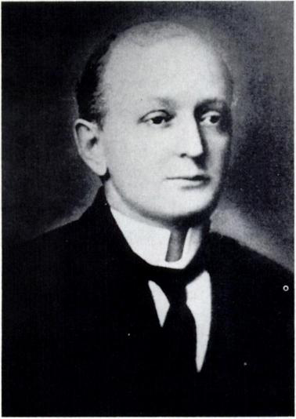
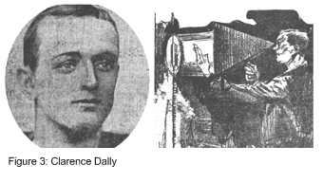
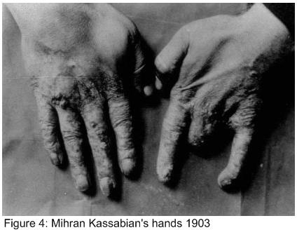
X-Rays – Chronology
Early days
First to die with X ray – Clarence Dally 1904
By the early 1900‘s amputated limbs became the unofficial badge of the x-ray worker.
Notes:
In 1904, x-rays claimed its first victim. Clarence Dally was Edison‘s main assistant who helped with the development of fluoroscopy. He was in the habit, as were many experimenters of the time, of holding objects being x-rayed with his bare hands. Dally first noticed burns on his face, followed by the loss of all his hair and lesions that would not heal on his left hand. He continued to work with Edison using his right hand to hold objects. Soon the condition spread to his right hand as well.
It was too late for Dally, who continued to suffer from oozing ulcers, tried skin grafts to no avail and eventually had both arms amputated. Pained by watching his friend die by inches with increasing and unrelenting pain, Edison consulted doctor upon doctor. ―The strangest part of all,‖ lamented Edison, ―Is that all this is the result of work with the X-ray five or six years ago and now comes this result‖ (Kevles, 1998, p. 48).

Slide 6
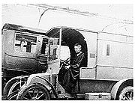
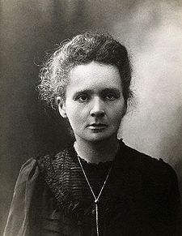
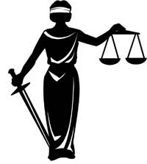
Curie in a World War I
mobile X-ray vehicle
X-Rays – Chronology
Early days
1 st World War 1914
Marie Curie
petites Curies ("Little Curies"),
These vehicles and their wondrous machines, christened Petite Curies by the soldiers, served to save innumerable lives by quickly allowing doctors to locate and remove bullets and shrapnel as well as diagnose and set broken bones
(De Burgh, 1989, p. 2178)
1 st Law suit 1920
Mr. and Mrs. Goodrum Vs St. Luke’s
Hospital in Little Rock Arkansas
Notes:
Although the phenomenon was discovered by Henri Becquerel, the term radioactivity was coined by Marie.
These vehicles and their wondrous machines, christened Petite Curies by the soldiers, served to save innumerable lives by quickly allowing doctors to locate and remove bullets and shrapnel as well as diagnose and set broken bones (De Burgh, 1989, p. 2178)

Slide 7
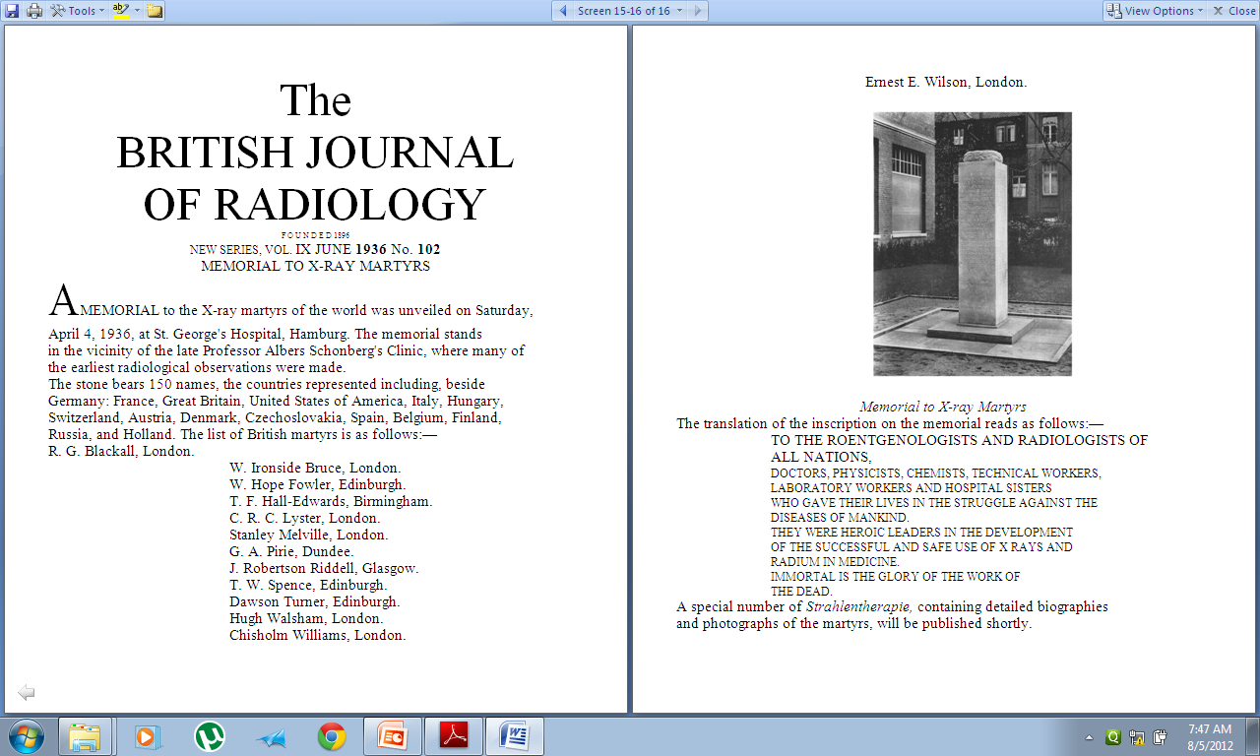
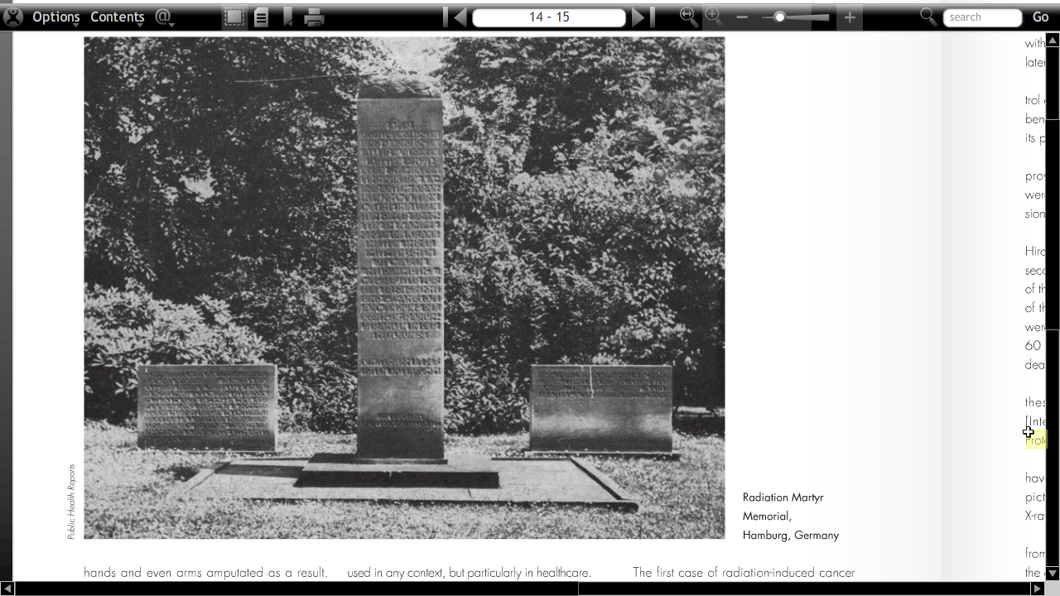
Monument to the x-ray martyrs
Hamburg - Germany
To the Roentgenologists and Radiologists of all nations,
doctors, physicists, chemists, technical workers, laboratory workers and hospital sisters who gave their lives in the struggle against the diseases of mankind.
They were heroic leaders in the development of the successful and safe use of x rays and radium in medicine.
Immortal is the glory of the work of the dead.
April 4, 1936, at St. George's Hospital, Hamburg - Germany
Notes:
One hundred and sixty-nine names were engraved on the stone at that time. By 1959 this number had escalated to 352.
Walter James Dodd, Caldwel, Clarence Madison Daily, Elizabeth Fleischman Ascheim, R. G. Blackall, W. Ironside Bruce, Hope Fowler, T. F. Hall-Edwards, C. R. C. Lyster, Stanley Melville, G. A. Pirie, J. Robertson Riddell, T. W. Spence, Hugh Walsham, Chisholm Williams, Ernest E. Wilson.

Slide 8
Basic radiation physics

Slide 9
Ionizing vs. Non-Ionizing
Radiations
Ionizing Radiation
A radiation that has sufficient energy to remove electrons from atoms or molecules as it passes through matter.
Examples: x-rays, gamma rays, beta particles, and alpha particles
Non-Ionizing Radiation
A radiation that is not as energetic as ionizing radiation and cannot remove electrons from atoms or molecules.
Examples: light, lasers, heat, microwaves, and radar

Slide 10
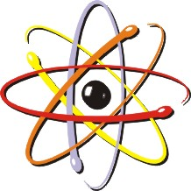
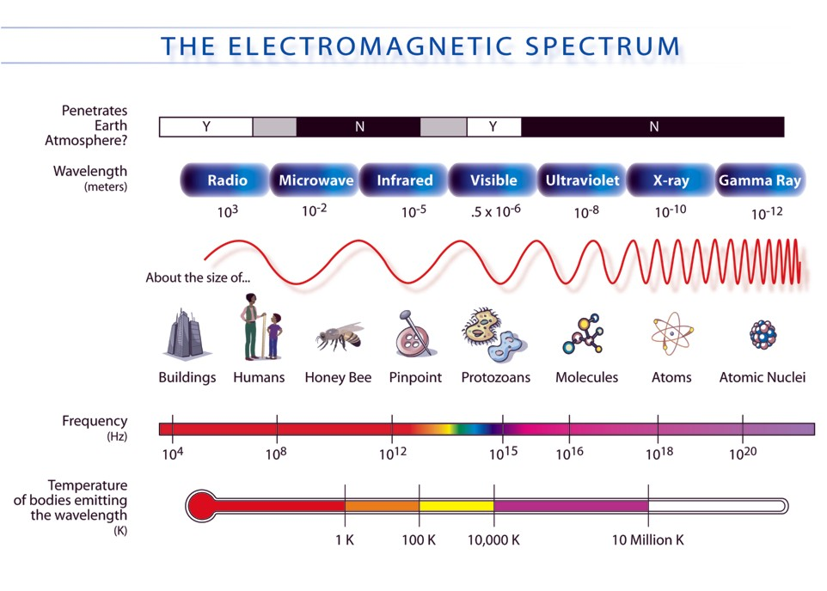
Radiation spectrum
Notes:
Electromagnetic radiation (EM radiation or EMR) is a form of energy emitted and absorbed by charged particles, which exhibits wave-like behavior as it travels through space. EMR has both electric and magnetic field components, which stand in a fixed ratio of intensity to each other, and which oscillate in phase perpendicular to each other and perpendicular to the direction of energy and wave propagation. In vacuum, electromagnetic radiation propagates at a characteristic speed, the speed of light.

Slide 11
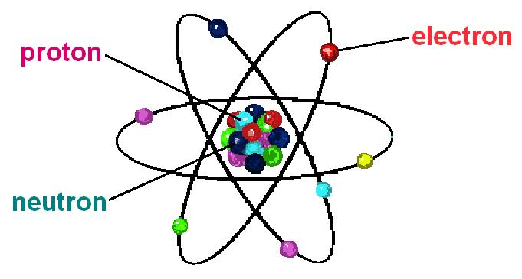
Atom
Whether we talk about ionizing or non-ionizing radiation, its genesis is either within or very close to the exterior of the atom. The following is a brief review the atomic structure.
The atom is comprised of a nucleus, which is made up of positively charged protons and electrically neutral (no charge) neutrons, surrounded by negatively charged electrons.
In an electrically neutral atom, the number of positively charged protons and negatively charged electrons are equal.

Slide 12
Radiation Origins
Ionizing radiation (hereafter, referred only as “radiation”) can be generated by electronic means (x-ray units) or radioactive materials.
When electronic-product radiation is produced, the source is turned on and off like a light switch. Once the unit is off, the radiation exposure is over. The x-ray unit does not continue to radiate or become radioactive.
With radioactive materials, there is a little more involved. The source is always on until it decays away.
Next: A review of both types of ionizing radiation generators – X-rays and Radioactive Materials.

Slide 13
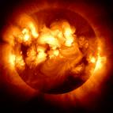
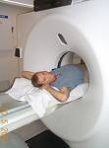
Sources Of Radiation
NATURAL BACKGROUND
ARTIFICIAL BACKGROUND
NATURAL BACKGROUND RADIATION
a) EXTERNAL - COSMIC & TERRESTRIAL
b) INTERNAL
ARTIFICIAL BACKGROUND RADIATION :
MEDICAL DIAGNOSTIC
THERAPEUTIC RADIATION
Natural radiation ~82%
Man-Made~18%

Slide 14
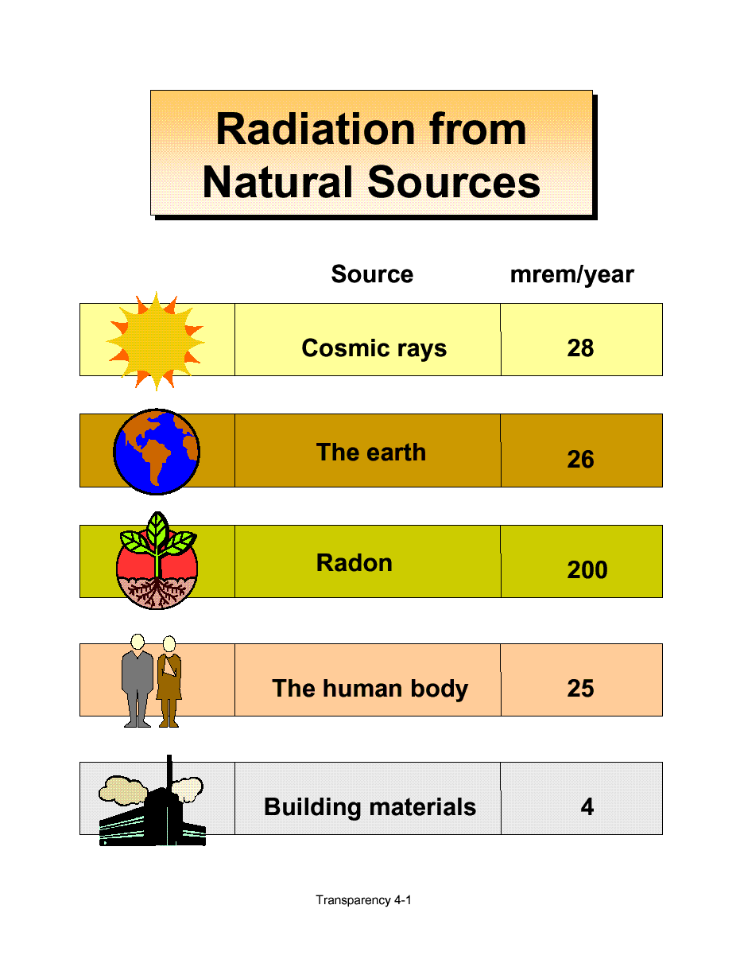
Total – 3.6 msev/year

Slide 15
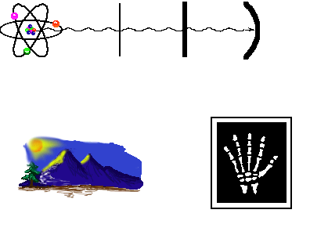
Radioactive Material
Types of Radiations
GAMMA AND X-RADIATION
Gamma rays and X-rays are essentially the same, except for where they originate. Gamma rays originate from the nucleus, and X-rays originate outside the nucleus of an atom.
These rays have no mass or no charge, and are very penetrating.
These rays are the same as light (electromagnetic radiation), only much more energetic.
Considered more of an external hazard than internal.
Both rays are great for imaging patients.
Generally, stopped by lead.
Sources include naturally occurring radioactive materials and cosmic radiation.
Medical imaging
FYI: As discussed earlier, x-rays can be produced by radioactive decay or electronic production. Both originate outside the nucleus of the atom.

Slide 16
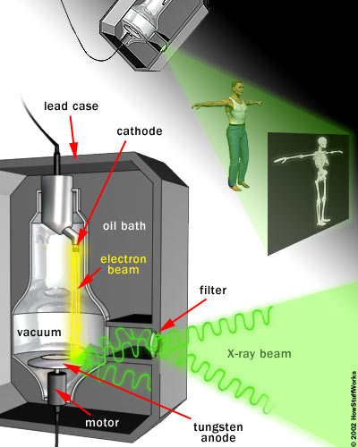
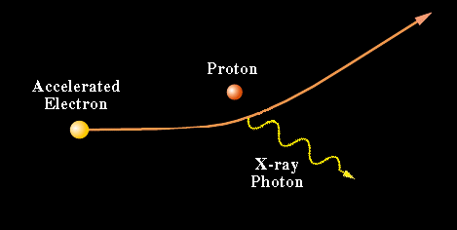
Production of X-ray

Slide 17
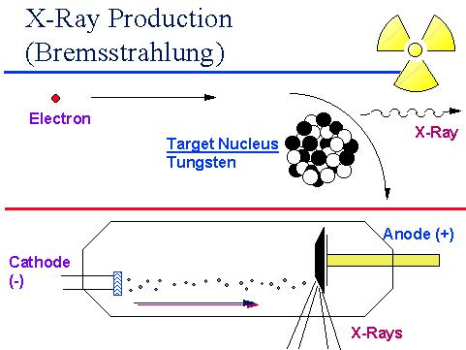
X-ray Generation
Review
X-rays as produced by an x-ray unit are also know as “Bremsstrahlung.” It is a German word for “braking radiation.”
As depicted in the diagram, when the electron slows very fast (brakes) as it gets close to the atom of the target nucleus, x-rays (radiation) are formed.
X-rays are emitted in all directions; therefore, the structure housing the x-ray tube is shielded except for a port where the x-rays escape and can be used for diagnostic purposes.
FYI: If you’ve ever had an x-ray, when the x-ray technologists takes your “picture,” it is over. The x-ray unit does not continue to produce radiation after the exposure is complete.

Slide 18
Radiation units

Slide 19
Radiation Units
Now that you have a little understanding of the physics behind ionizing radiation, how do we measure or quantify radiation? Here are a few units of measure that are used (often interchangeably) in radiation protection:
Exposure
A measure of ionization produced in air by X or gamma radiation.
Highly specific in that the unit specifies the matter being exposed and radiation producing the ionizations.
Unit: roentgen (R)
1 R = 1000 mR
Absorbed Dose
A measure of energy deposition per unit mass irradiated.
Considers all radiations imparting energy to all types of matter.
Unit: rad
1 rad = 1000 mrad
SI Units: gray (Gy)
1 Gy = 100 rad
Dose Equivalent
It is numerically equal to the absorbed dose by a quality factor
Dose equivalent is needed because the biological effect from a given absorbed dose is dependent upon the type of radiation producing the absorbed dose.
Unit: rem
1 rem = 1000 mrem
SI Units: sievert (Sv)
1 Sv = 100 rem

Slide 20
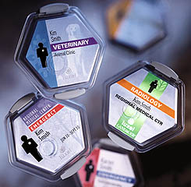
Radiation Units
Dose Equivalent
The unit of measure, dose equivalent, was instituted to take into account the relative biological effectiveness of the differing types of radiations.
Some radiations like alpha particles are densely ionizing; therefore, as they pass through tissue, they are able to strip more electrons than beta particles or x-rays or gamma rays…20 times greater. In short, alpha particles are better at producing damage.
Absorbed dose merely documents how much energy is being deposited per unit mass, it does not consider how effective each radiation is at producing damage in a biological system.
The more densely ionizing, the more damage is done.
FYI: If you wear a badge, your dose in reported in “mrem.”

Slide 21
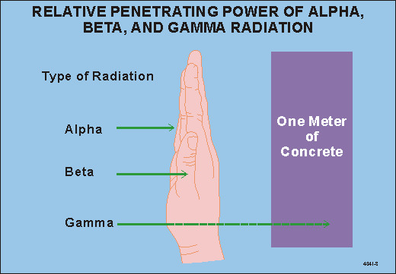
,
X Rays,

Slide 22
Biological Effects and
Radiological Risk

Slide 23
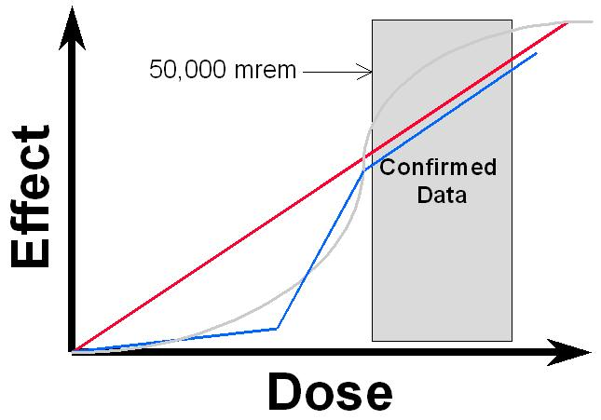
Dose versus Effect
≈
Nobody knows for sure what radiation dose does to us below the shaded region. There may be a threshold where there is no effect from radiation below a certain dose.
In Radiation Protection, as a protective measure, it is assumed that all dose carries some risk, this is represented by the straight red line on the diagram.
FYI: There are other theories regarding the effects of radiation dose (as represented by the other lines – blue and gray), to include radiation hormesis. Radiation hormesis is a theory that chronic low doses of radiation is good for the body.

Slide 24


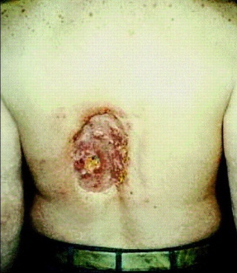
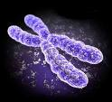
Radiation responses
The series of events which occurs as follows
Radiation
Energy deposition
Molecular changes
Morphological changes
Biological effects

Slide 25
Radiation health effects
TYPE
OF
EFFECTS
CELL DEATH
CELL TRANSFORMATION
BOTH
DETERMINISTIC
Somatic
Clinically attributable in the exposed individual
STOCHASTIC
somatic & hereditary
epidemiologically attributable in large populations
ANTENATAL
somatic and hereditary expressed in the foetus, in the live born or descendants

Slide 26
Biological effects of ionizing radiation
Deterministic
  e.g. Lens opacities, skin injuries,
  infertility, epilation, etc
Stochastic
  Cancer, genetic effects.

Slide 27
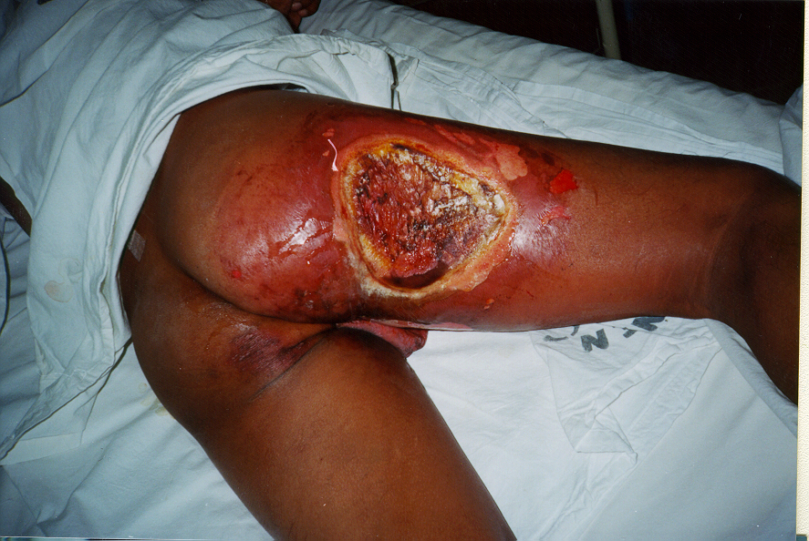
Deterministic effects
Deterministic (Threshold or non-stochastic)
  Existence of a dose threshold value (below this dose, the effect is not observable)
  Severity of the effect increases with dose
  A large number of cells are involved
Radiation injury from an industrial source

Slide 28
Threshold Doses for Deterministic Effects
Cataracts of the lens of the eye 2-10 Gy
Permanent sterility
  males 3.5-6 Gy
  females 2.5-6 Gy
Temporary sterility
  males 0.15 Gy
  females 0.6 Gy
Severity of
effect
dose
threshold

Slide 29
Stochastic Effects
Stochastic(Non-Threshold)
  No threshold
  Probability of the effect increases with dose
  Generally occurs with a single cell
  e.g., cancer, genetic effects

Slide 30
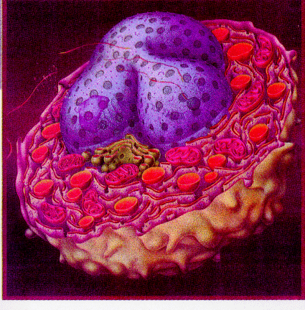
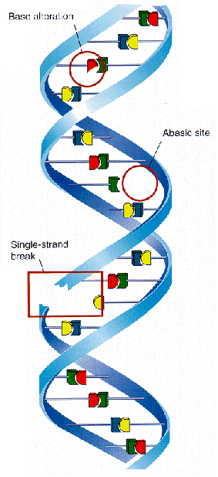
No change
DNA mutation
radiation hit cell nucleus!

Slide 31
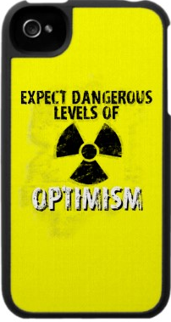
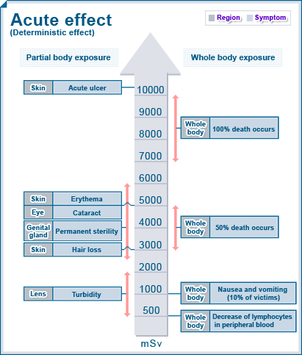
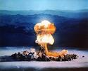
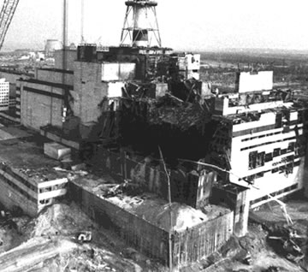
(Hiroshima, Nagasaki)
(Chernobyl Tragedy)
SUB- LETHAL DOSE
(Kaiga nuclear plant
heavy water contamination)

Slide 32
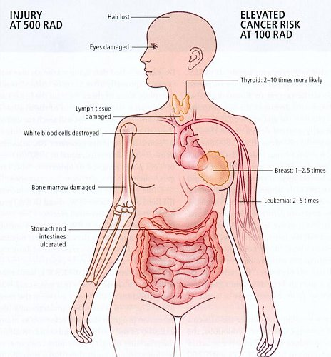
Chronic effects
Elevated cancer risk
Sensitive Organs
Gonads
Breast
Red Bone
Marrow
4. Lung
5. Thyroid
6. Bone
Notes:
Sensitive Organs
In order of greatest sensitivity
•Gonads •Breast •Red Bone Marrow •Lung •Thyroid •Bone

Slide 33
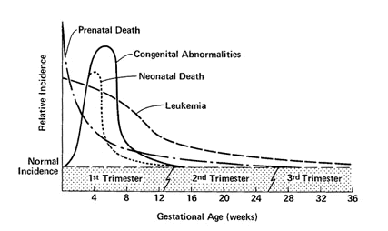
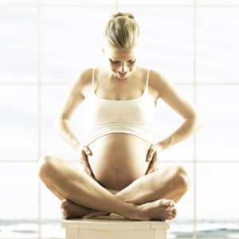
Effects During Pregnancy
10 day rule - high dose examinations
28 day rule - low dose examinations
Notes:
female patient of childbearing age can only be examined within the first 10 days from the START of her last period. After that date the patient can only be x-rayed if a pregnancy test is negative or if a medical doctor over-rules the 10 day rule on medical grounds. 10 day rule is for high dose examinations such as CT pelvis and Barium Enemas. The 28 day rule states that a female patient of childbearing age can only be examined in the first 28 days from the start of her last period. 28 day rule is for low dose examinations

Slide 34
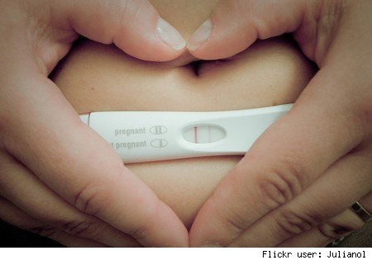
Exposure of the pregnant/expectant female for Diagnostic Radiation.
Before 4 weeks of gestations there is all or none effect of radiation, so there will be either abortion or normal baby.
2. Single diagnostic examination with dose below 5 Rad (50 msev) will not lead to any harm.
Guidelines for diagnostic imagingduring pregnancy. ACOG Committee Opinion No. 299. American College of Obstetricians and Gynecologists.Obstet Gynecol 2004;104:647–51.
Notes:
Guidelines for diagnostic imagingduring pregnancy. ACOG CommitteeOpinion No. 299. American Collegeof Obstetricians and Gynecologists.Obstet Gynecol 2004;104:647–51.

Slide 35
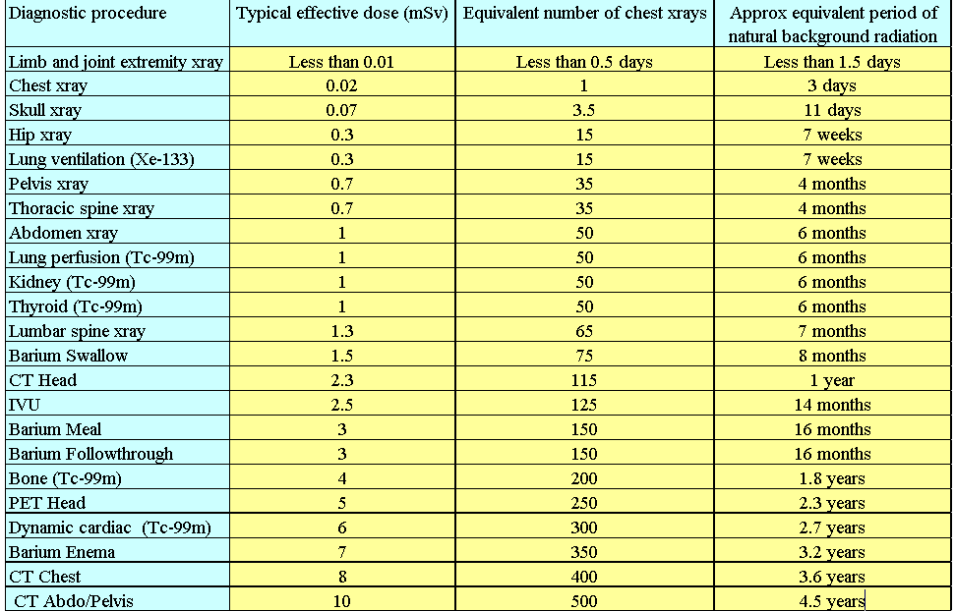
Typical effective doses from diagnostic medical exposures in the1990s (taken from ’Making the best use of a Department of Clinical Radiology –Guidelines for Doctors’. Distributed by The Royal College of Radiologists

Slide 36
Practical
Radiation Safety

Slide 37
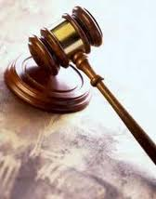

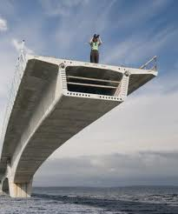
Principles of radiation protection
The current radiation protection standards are based on three general principles :-
a) Justification of a practice.
b) Optimized Protection.
(ALARA & TDS)
c) Dose limitation.
(MPD)
Notes:
a) Justification of a practice i.e. no practice involving exposures to radiation should be adopted unless it provides sufficient benefit to offset the detrimental effects of radiation.
b) Protection should be optimized in relation to the magnitude of doses, number of people exposed and also to optimize it for all social and economic strata of patients.
c) Dose limitation, on the other hand, deals with the idea of establishing annual dose limits for occupational exposures, public exposures, and exposures to the embryo and fetus

Slide 38
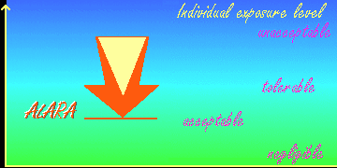
ALARA Principle
(As Low As Reasonably Achievable )
Optimization of protection and the ALARA Principle

Slide 39
Protecting Ourselves from External Exposure
Adhere to the three cardinal rules of external radiation protection:
  TIME
  DISTANCE
  SHIELDING
TIME
Less Time = Less Exposure
DISTANCE
Greater Distance = Less Exposure
SHIELDING
More Shielding = Less Exposure

Slide 40
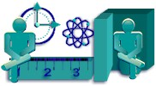


T.D.S. principle of Radiation Safety
Factors affecting Radiation Exposure are
1) Time: Less exposure time means a lower dose.
2) Distance: More the distance from a radiation
source means less exposure.
3) Shielding: The use of appropriate shielding
greatly reduces the dose rate

Slide 41
External Radiation Protection
Exposure to a source of ionizing radiation is very similar to the exposure from a light bulb (i.e. light and heat).
The closer you are to the source, the more intense the light and heat are. Likewise, if you move away, the intensity decreases.
The longer you are close to the light bulb, you begin to feel the warming effects of the light. If however, you move quickly to and from the light, you’ll not likely feel the warming effect.
If you put something opaque between you and the light bulb, you effectively eliminate the light.

Slide 42
Exposure and Contamination
A difficult concept to understand is the difference between exposure and contamination when we talk about radioactive materials.
To illustrate the difference, consider a burning candle.
If you stand away from the candle, you are being exposed to the candle’s light. If you leave the room, your are no longer exposed to the candle’s light.
If you walk up to the candle, you are being exposed to the candle’s light. If you then reached out and grabbed the candle, you would get hot wax on your hand. If you left the room, you are no longer exposed to the light, but the wax on your hand (i.e. contamination) remains. If the wax were radioactive, the “contamination” would continue to expose your hand until you washed it off.
Remember: Being exposed by a radioactive source does not contaminate you. You must have interacted with the source to get some of the source on you. Once on you, the contamination will expose you until it is removed.

Slide 43
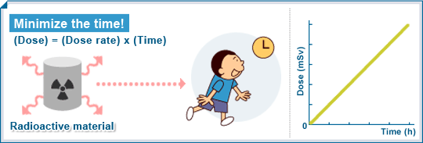
Time
Since accumulated dose is directly proportional to exposure time, the less time one spends around a radiation source, the less radiation exposure one receives.

Slide 44


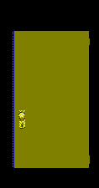
Do’s
  Intermittent Fluoroscopy
  Limiting Number of Radiation related procedures
  Pre-plan the experiment/procedure
  Enhance the skill to operate fast
Don’t
  Unnecessarily peep / stay in procedure rooms
  Take long cine loops for records.
  do unnecessary procedures on patients request

Slide 45
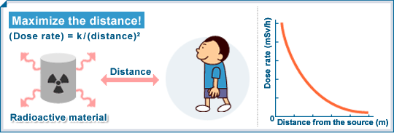
Distance
The rate of radiation exposure is inversely proportional to the square of the distance from the source. More the distance from a radiation source means less exposure.

Slide 46
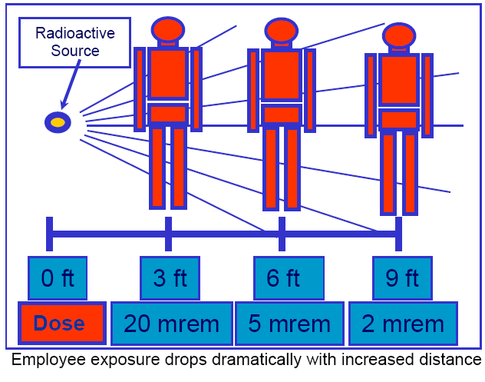
Distance
20 msev
5 msev
2 msev
Notes:
Doubling the distance from a radiation source means one-fourth the dose rate.
Tripling the distance gives one-ninth the dose rate.

Slide 47

Distance
Do’s
Keep appropriate distance with radiation source
Move to lower dose areas during work delays.
Move the item being worked on away from the radiation area if possible.
one step behind will reduce significant radiation
Dont’s
Stand on end of tables prefer sides as radiation is less.

Slide 48

One Step Behind

Slide 49


Shielding
The use of appropriate shielding greatly reduces the dose rate.

Slide 50






Personnel protective apparels

Slide 51



Do’s
Protect yourself as a loaded cassette.
Use personnel protective apparels
Dont’s
Expose a person for demonstration purpose.
Hold a patient for radiography without shielding.

Slide 52
General Safety Guides for Use of Radiation Producing Equipment
X-ray equipment should not be left unattended while in operating mode.
When in fixed radiographic rooms, operators shall remain behind the protective barrier.
If required to be in a room during a diagnostic x-ray exposure (e.g. fluoroscopy), wear a lead apron or stand behind a protective barrier.
Wear your dosimetry.
Follow established procedures; when unsure, stop and notify your supervisor or the RSO.
Keys MUST not be left in portable x-ray equipment.

Slide 53


Slide 54
Radiation monitoring and survey

Slide 55



Detection of Radiation
Roentgen‘s rays were invisible, tasteless and odourless; just another kind of light.

Slide 56




Radiation monitoring
- Personal Monitoring instruments
Thermo luminescent dosimeter.
CaSO₄
Optical dosimeter
Al2O3:C , BaFCl:Eu
Notes:
A TLD badge based on CaSO₄: Dy Teflon discs has been designed and is in regular Personnel Monitoring use since 1975. The TLD badge has shown satisfactory performance for monitoring beta and gamma doses of radiation workers.
The complete Personnel Monitoring TLD badge consists of a TLD card and a plastic cassette for holding the TLD card. The badge is affixed to the clothing of a person with the help of a crocodile clip attached to the badge.
Avanttec signed up a Technology Transfer Agreement with BARC(Bhabha Atomic Research Centre) to manufacture Thermo Luminescence Dosimeter(TLD) Phosphor and TLD Badges.
Thermoluminescence (TL)–Optically Stimulated Luminescence (OSL)•TL–Stored energy from the radiation released from the dosimetry material by thermal stimulation. Energy release in form of luminescence
•OSL–Stored energy from the radiation released from the dosimetry material by optical stimulation. Energy release in form of luminescence. Material is Al2O3:C , BaFCl:Eu

Slide 57


Personnel Monitoring Methods
(Dosimetry)
Monitoring Required Monitoring Method
Whole Body TLD or OSL Badge
Extremity Finger Ring TLD
Internal Contamination Urinalysis or Bioassay
Ring Badge
Whole Body Badge
Thyroid Bioassay

Slide 58
Personnel Dosimetry - FYI
Dosimetry does not protect you from radiation.
Dosimetry is not a warning device (i.e. it will not alarm, beep or change color)
Dosimetry documents the radiation dose an individual receives when working with radiation sources.
It is ILLEGAL to intentionally expose an individual’s dosimeter.

Slide 59
General Rules for Use of Dosimetry
Wear your own badge.
Wear your whole body (WB) badge whenever working with radiation sources
Notify the RSO immediately when a badge is lost.
Wear ring badges under gloves.
Store badges in designated areas at the end of each day of work.

Slide 60
Personnel Dosimetry Review
Each monitoring period dose report is reviewed by the Radiation Safety Officer
The report is compared against the institution’s investigational levels:
  >200 mrem/monitoring period to whole body
  > 2000 mrem/monitoring period to extremities
  > 800 mrem/monitoring period to the skin
  Action Required: Written notification from RSO to worker and investigation

Slide 61
Dose Equivalent to an Embryo/fetus
Occupational exposure to the fetus of a declared pregnant woman shall not exceed 500 millirem during the 9 month pregnancy.
Declare pregnancy as soon as possible

Slide 62
Declared Pregnant Workers
Available for those radiation workers who are pregnant or planning a pregnancy.
Purely VOLUNTARY!
To be apart of the program, you must DECLARE your pregnancy in writing to your supervisor and provide the estimated date of conception. The RSO must be notified immediately upon declaration.
The declared pregnant worker may be provided with a dosimeter that will be worn at the waist level. If lead is worn, the “fetal badge” shall always be worn under the lead.

Slide 63



What eyes don’t see;
Mind does not believe
is the most dangerous

Slide 64

Geiger Mueller Detector
Geiger counters are portable devices that detect and measure radioactivity.
Can be used to detect beta, gamma and X-ray radiation.
Geiger-Muller tube is filled with an inert gas that will conduct electricity when ionized. “The tube amplifies this conduction by a cascade effect and outputs a current pulse, which is displayed by a needle or audible clicks.”

Slide 65


Radiation survey monitoring
Geiger-Muller (G-M) Detector
NAI Detectors
Pressurised ionisation chembers

Slide 66
Permissible dose

Slide 67

Radiation Dose Limits over the Past Century
1924 - 700 mSi
1934 - 300 mSi
1949 - 150 mSi
1958 - 50 mSi
1990 - 20 mSi
Notes:
The whole body maximum permissible exposure, which had been set at 70 REM (700 mSi) per year in 1924, was reduced to 30 REM (300 mSi) per year in 1934, 15 REM (150 mSi) in 1949 and 5 (50 mSi) REM per year in 1958.
1REM = 10 miliseivert
100 mREM = 1 miliseivert.

Slide 68

Maximum Permissible Dose
 | OCCUPATIONAL WORKERS |  | PUBLIC
 | Limit | Annual equivalent | Limit | Annual equivalent
ICRP | 20mSv /yr over 5 years | 20mSv | 1mSv/yr over 5 years | 1mSv
NCRP | Cumulative dose = age(Yrs) × 10mSv | 50mSv | 5mSv for 5 years | 1mSv
AERB | 100mSv over 5 years | 30mSv | 1mSv/yr for 5 yrs | 1mSv
1.Seeram E and Travis EC, Radiation protection, Philadelphia, New York : Lippincott. 1997.
2.AERB Safety Code, (Code No. AERB/SE/MED-2), Mumbai 2001:1-20.
Notes:
The Regulatory Bodies
ICRP is International Commission for radiation protection, In America the counterpart is the NCRP or The National Commission for Radiological Protection and in India it is the AERB or the Atomic Energy Regulatory Board.
Setting limits on radiation dosages, scientifically researched and internationally verified, gave a sense of security to the industry.

Slide 69


PREGNANT WOMEN
 | Limits
ICRP | supplementary equivalent dose limit of 2mSv applied to the surface of her lower abdomen for the remainder of her pregnancy
NCRP | 0.5 mSv per month for the embryo/fetus
AERB | equivalent to surface of pregnant woman's abdomen should not exceed 2 mSv for the remainder of the pregnancy
1.Seeram E and Travis EC, Radiation protection, Philadelphia, New York : Lippincott. 1997.
2.AERB Safety Code, (Code No. AERB/SE/MED-2), Mumbai 2001:1-20.
Notes:
During pregnancy the specific dose equivalent limit applies to the conceptus & not to the mother
Setting limits on radiation dosages, scientifically researched and internationally verified, gave a sense of security to the industry
ICRP - International Commission on Radiological Protection.
NCRP-National Council on Radiation Protection and Measurements.

Slide 70







Slide 71



Radiation Symbol
The 3-blade radiation symbol to alert you to the presence of radiation and/or radioactive material.

Slide 72


Slide 73
Risk versus Benefit
Taken from ‘Essential Physics for Radiographers’ by John Ball and Adrian D. Moore
Radiation is hazardous but not deadlier than these day to activities..
Activity | Probability of Dying | Time Period | Odds against
Motorcycling | 0.02 | Per year | 50:1
Smoking | 0.05 | Per year | 200:1
Air travel | 0.003 | 100 hr Flying time | 330:1
Pregnancy | 0.00023 | Per year | 4350:1
Housekeeping | 0.0002 | Per year | 5000:1
RTA – driver | 0.00017 | Per year | 5900:1
RTA –Passenger | 0.00006 | Per year | 16,600:1
Jogging | 0.00015 | Per year | 6700:1
Struck by lightening | 0.0000001 | Per year | 10000000:1
Exposure to radiation –
At 0.3 mSv per year | 0.00001 | Per year | 100,000:1
At 20 mSv per year | 0.001 | Per year | 1000:1

Slide 74




Radiation Misconceptions and Misuse
Radiation does not give you super human powers
Radiation will not make you glow in the dark

Slide 75






Slide 76
Take Home Message
a) Justification of a practice.
b) Optimized Protection. -- (ALARA & TDS)
c) Dose limitation. ------ (MPD)
Notes:
a) Justification of a practice i.e. no practice involving exposures to radiation should be adopted unless it provides sufficient benefit to offset the detrimental effects of radiation.
b) Protection should be optimized in relation to the magnitude of doses, number of people exposed and also to optimize it for all social and economic strata of patients.
c) Dose limitation, on the other hand, deals with the idea of establishing annual dose limits for occupational exposures, public exposures, and exposures to the embryo and fetus

Slide 77


Slide 78
Nobel Laurels Radiology
1901 - Wilhelm Conrad Röntgen receives the Nobel Prize in Physics for discovery of X-rays.
1903 - Henri Becquerel, Pierre Curie, Marie Curie receives the Nobel Prize in Physics forn discovering Radioactivity
1914 - Von Laue receives the Nobel Prize in Physics for x-ray diffraction from crystals.
1915 - Bragg and Bragg receive the Nobel Prize in Physics for crystal structure derived from x-ray diffraction.

Slide 79
Nobel Laurels Radiology
1917 - Barkla receives the Nobel Prize in Physics for characteristic radiation of elements.
1924 - Siegbahn receives the Nobel Prize in Physics for x-ray spectroscopy.
1927 - Compton receives the Nobel Prize in Physics for scattering of x-rays by electrons.
1936 - Debye receives the Nobel Prize in Chemistry for diffraction of x-rays and electrons in gases.

Slide 80
Nobel Laurels Radiology
1946 - Hermann J. Muller receives the Nobel Prize in Physiology or Medicine "for the discovery of the production of mutations by means of X-ray irradiation".
1979 - Comack and Hounsfield receive the Nobel Prize in Medicine for computed axial tomography.
1981 - Siegbahn receives the Nobel Prize in Physics for high resolution electron spectroscopy.
2003 - Paul C. Lauterbur, Sir Peter Mansfield receives the Nobel Prize in Physiology or Medicine "for the discovery of MRI

Slide 81


