Slide 1
Shoulder ultrasound: What you need to know
DR Jatinder Pal Singh Department of Radiology, Medanta-The Medicity Gurgaon, Haryana, India

Slide 2
Shoulder ultrasound is consistently used in the assessment of rotator cuff and is as accurate as magnetic resonance imaging in the detection of rotator cuff tear
Notes:
Advantage of usg over mri cost , time, dynamic , comparision with oppsite side claustrophobic , pacemaker, implant

Slide 3
Technique
Face the patient
Stand behind patient
The probe should be held at its end with the edge of the hand resting on the patient's shoulder, in order to reduce stress and allow fine motor control
High-frequency (12-15 MHz) linear-array (with a flat surface) probe is required.

Slide 6
Biceps tendon
The tendon can be readily identified in the intertubercular groove on the anterolateral aspect of the humerus with the arm in a neutral position

Slide 7
Small amounts of fluid can normally be seen surrounding the tendon.
This can easily be differentiated from tenosynovitis where there are internal echoes within the fluid with areas of increased Doppler flow

Slide 8
Long head of biceps tendon (arrows) in longitudinal (C) and transverse plane (E) appears hypoechoic (D and F) (arrows) due to anisotrophy when not imaged perpendicular to the sound beam. Hypoechoic appearance (G) of biceps tendon with areas of increased Doppler signal as a result of tendinopathy.

Slide 9
PATHOLOGY
Acute rupture
Chronic rupture
Subluxation

Slide 10
Acute rupture
non-visualization of the tendon within the bicipital groove.
biceps muscle contraction with bulbous appearance/popeye sign.
Chronic rupture there is partial non-visualization of the upper portion of the tendon.

Slide 11
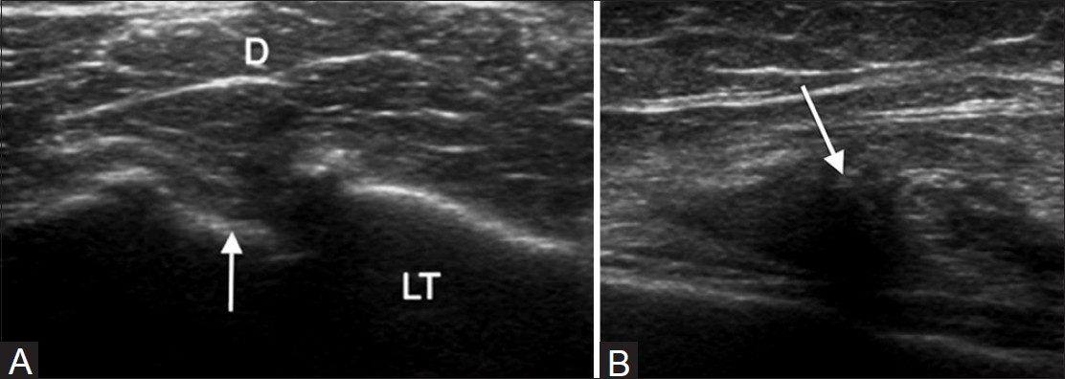
(A) Transverse scan of torn long head of biceps tendon with an empty bicipital groove (arrow). (B) Longitudinal scan shows the convex superior margin (arrow) of the retracted muscle belly (popeye sign).

Slide 12
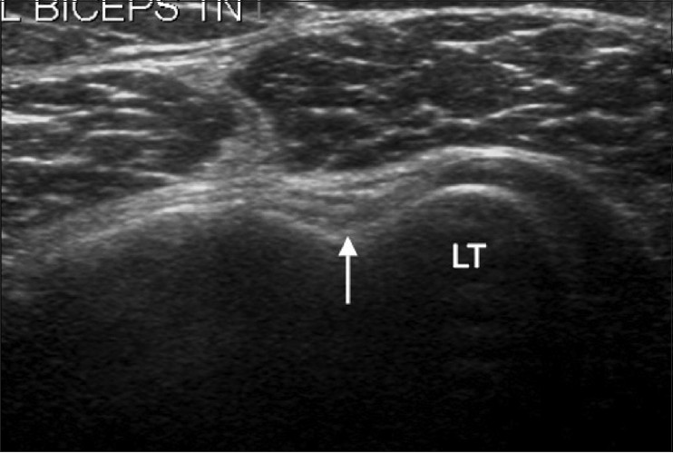
Short-axis view of the long head of the biceps tendon with bicipital groove (arrow) filled with scar tissue simulating an attenuated biceps tendon.

Slide 13
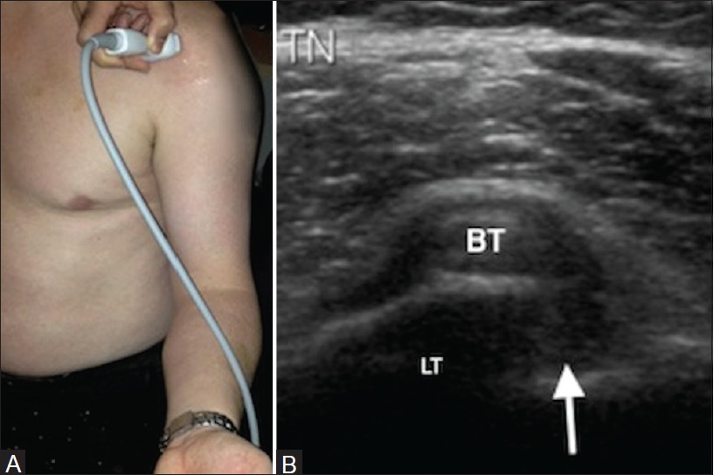
(A) Transducer position for evaluating long head of biceps tendon stability and in a longitudinal plane. Note the arm externally rotated and elbow flexed at 90°. (B) Medial subluxation of the biceps tendon with an empty intertubercular groove (arrow) suggestive of biceps instability.

Slide 14
Subscapularis tendon
While the arm is passively externally rotated the subscapularis can be examined in orthogonal planes from its insertion into the lesser tuberosity to the point at which it becomes hidden to ultrasound by the coracoid process medially.
Notes:
Origin and insertion

Slide 15
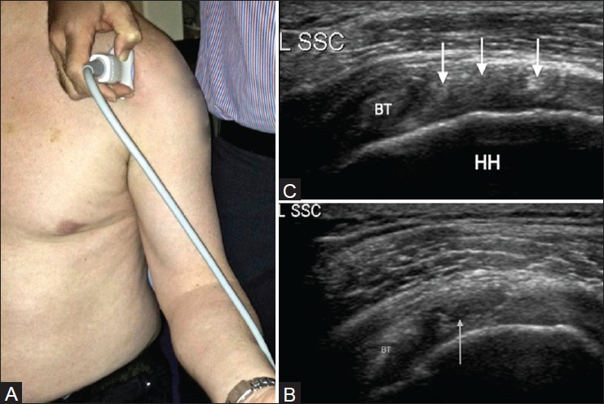
(A) Transducer position for a transverse image of the subscapularis tendon. (B) Corresponding transverse image of the subcapularis tendon. Note the hyperechoic tendon slips (arrows) between the hypoechoic muscle fibers. (C) Short-axis view of the subscapularis tendon with a partial-thickness articular surface tear in its superior part (arrow). Biceps tendon seen on the left of the image

Slide 16
Supraspinatus tendon (SST)
To visualize the SST the patients are asked to place their hand on their back pocket.
In the longitudinal plane – beak shaped configuration.
It is important to be able to see the anterior border of the supraspinatus, a common site for tear, in the short axis/transverse plane and this may sometimes require scanning with the elbow drawn backward

Slide 17
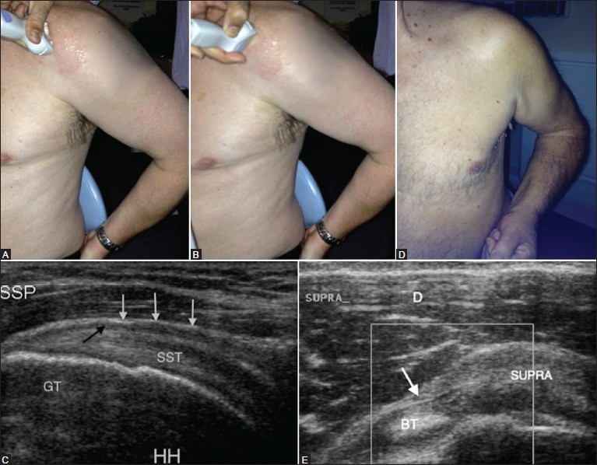
Longitudinal view of the SST (C) with overlying thin hypoechoic line (black arrow) representing subacromial subdeltoid bursa and the overlying subdeltoid fat (white arrows). Elbow backward position (F) to see the anterior border of supraspinatus tendon in transverse plane (E) with the echogenic component of biceps tendon sling, coracohumeral ligament (arrow)

Slide 18
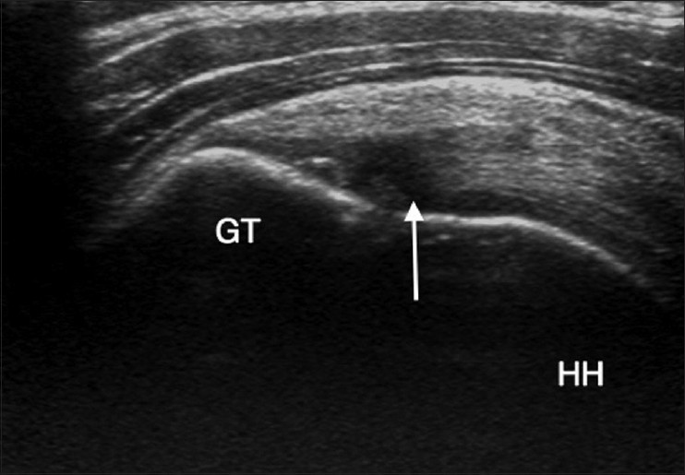
Longitudinal view of the supraspinatus tendon with an area of reduced echogenicity due to anisotrophy, at the site of tendon insertion over the greater tuberosity, which is not to be confused with a tear. HH: Humeral head

Slide 20
Full-thickness tear
A full-thickness rotator cuff tear is a defect in the tendon that reaches from the bursal to the articular margin.
Typically, these tears occur at the footprint of the greater tuberosity where the tendon fibers insert, and then propagate proximally

Slide 21
DeOrio and Cofield classification
Full-thickness rotator cuff tears are quantified
small (<1 cm)
medium (1-3 cm)
large (3-5 cm)
massive (>5 cm)

Slide 22
Secondary or indirect signs are reliable criteria for the detection of rotator cuff tears.
Fluid is present in the subacromial/subdeltoid bursa and in the glenohumeral joint
Sagging of bursa
Bright aspect of the humeral cartilage (cartilage interface sign or uncovered cartilage sign)

Slide 23
Longitudinal view(SSP). Full-thickness tear of the tendon (long arrow) reaches from the bursal to the articular margin with sagging of the overlying bursa (short arrow).
(B) Long-axis view SSP. Partial thickness articular surface tear (black arrow) and a bright anterior aspect of humeral cartilage (white arrow) - Cartilage interface sign

Slide 24
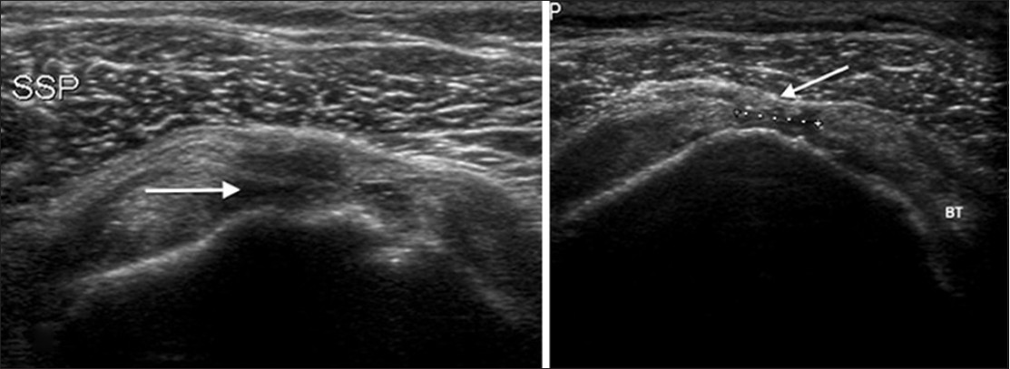
(A) Full-thickness tear (arrow) in anterior free edge of supraspinatus tendon. Note irregularity over the greater tuberosity (arrowhead). (B) Short-axis view of left supraspinatus tendon. There is a full-thickness tear in the mid-portion of the tendon (between the markers) with sagging of the overlying bursa (arrow).

Slide 25
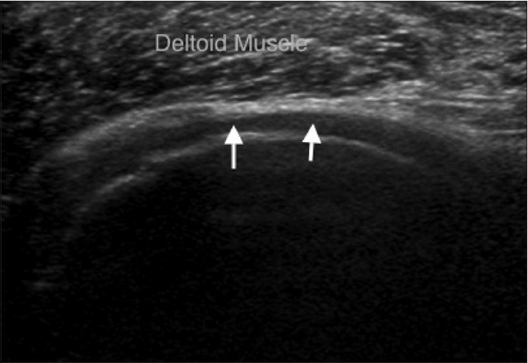
Figure 10: Short-axis view of supraspinatus tendon. There is a massive tear of the tendon with the deltoid muscle lying directly on the humeral head cartilage (arrows)

Slide 26
Partial-thickness cuff tear
Partial-thickness tear is a focal discontinuation, which is limited to tears affecting either
Articular surface (common)
Bursal surface (uncommon)

Slide 27
Partial-thickness tears have been classified by Ellman by the depth of the tear
Grade 1 for tears less than 3 mm
Grade 2 for tears 3-6 mm
Grade 3 for those greater than 6 mm

Slide 28
"high-grade" (greater than 50% thickness)
"low-grade" (less than 50% thickness).

Slide 29
Occasionally, a partial tear may propagate proximally within the tendon substance causing a "de-laminating tear.“
A rim rent tear is an articular surface tear near the footplate of the tendon.

Slide 30
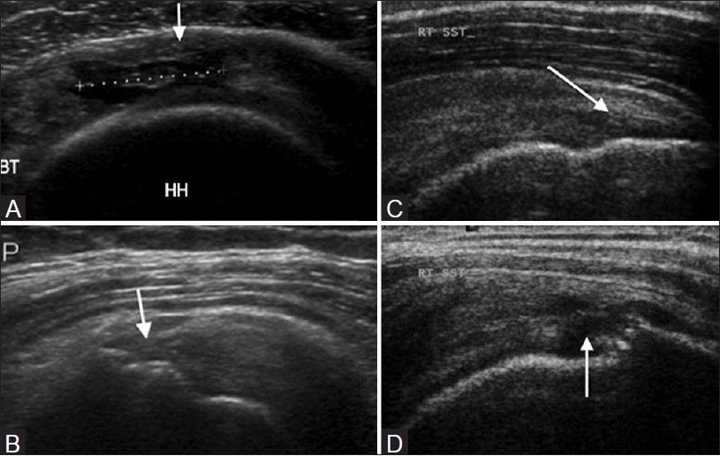
(A) Short-axis view. Partial-thickness articular surface tear in the mid-substance of the tendon (between markers) with a few intact fibers overlying (arrow). (B) Partial-thickness bursal surface tear (arrow) of the supraspinatus tendon. (C)” de-laminating tear.“ Partial-thickness intrasubstance tear (arrow). (D) Partial tear (rim rent) of supraspinatus tendon at greater tuberosity (arrow).

Slide 31
Infraspinatous (IST) and teres minor tendons
The IST and teres minor tendons lies more posteriorly and can be well visualized with the arm in a flexed and adducted position
The IST is demonstrated in longitudinal section as a beak-shaped soft-tissue structure
The teres minor tendon may be visualized as a trapezoid structure and can be differentiated from the IST by its oblique internal echoes.

Slide 32
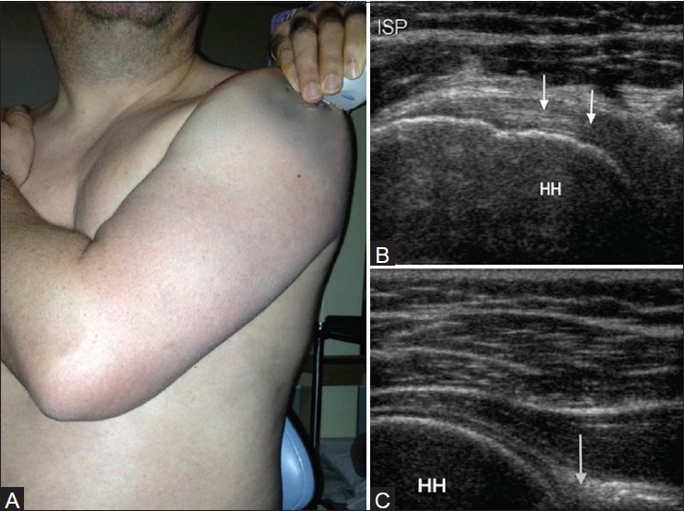
Infraspinatous . (B) Corresponding US image shows characteristic contour of the humeral head with adjacent infraspinatous tendon (arrow). (C) US image showing glenoid labrum ( arrow) and the posterior aspect of the glenohumeral joint

Slide 33
Non-rotator cuff abnormalities
Subacromial impingement syndrome is the result of chronic irritation of the SST against the undersurface of the anterior one-third of the acromion, the coracoacromial ligament, and the acromioclavicular joint.
Evaluating the superior aspect of the acromio-clavicular joint
Sonographic assessment of fatty atrophy is by calculating the occupation ratio, measured by dividing the cross-sectional surface area of the supraspinatus muscle by that of its fossa

Slide 34
Conclusion
The ultrasound image quality has substantially improved with technological advancement, producing spatial resolution exceeding that obtained with MRI
Ultrasound gives the ability to provide direct correlation of the imaging findings with the symptoms of the patient, and helps with guided interventional procedures.

Slide 35
THANK YOU
DR Mayur Mahadule JRII
Under guidance of DR Sagar Maheshwari
BJGMC, PUNE

