Slide 1
VASCULAR INTERVENTIONS IN GIT
DR. SHWETA SHENDEY

Slide 2
ROLE OF VASCULAR INTERVENTIONS
T/T GASTROINTESTINAL HAEMORRHAGE
T/T PORTAL HYPERTENSION
T/T LIVER TUMOURS

Slide 3
GI HAEMORRHAGE
Upper GIH
Peptic ulcers,
erosive gastritis,
Varices
esophagogastric mucosal tear
Less common causes include ca esophagus, stomach/deudenum/haemobilia, av malformations splenic arterial aneurysm

Slide 4
Lower GI haemorrhages
Lower GI haemorrhages
Enteric ulcers
Diverticulosis
TB
Neoplasms
colitis
angiodysplasia

Slide 5
IMAGING MODALITIES
Endoscopy is the initial diagnostic procedure in any GI bleeding
Provides prognostic information
Access to therapeutic interventions

Slide 6
ANGIOGRAPHY
Significant role in diagnosis and management
Localize the actual site of active bleed
Help in management of transcatheter embolization of bleeding vessel
Role is diminished d/t wider availability of endoscopy
Helpful in pts with recurrent gih where barium studies or endoscopy has failed

Slide 7
TECHNICAL CONSIDERATION OF ANGIOGRAPHY
Diagnostic if bleeding exceeds 0.5 ml/min(blood loss exceeds 4 units within 24 hrs)
Often not useful in mesentric studies because of bowel gas and peristalsis .
Renal function should be normal otherwise alternative contrast media like CO2 can be used as contrast
Notes:
Bcoz motion artifacts are interpretated as contrast extravasation hence antispamodics are used to reduce bowel peristaklsis

Slide 8
PROCEDURE
Initially flush aortogram is done f/b selective and superselective arteriography
Tip of pigtail catheter placed above celiac axis
40 ml of contrast is injected with pressure injector at the rate of 18-22ml/sec
Depending on initial findings further selective and superselective studies done using various visceral angiographic catheters
Flush aortogram is useful in cases if suspected aortoenteric fistula

Slide 9
In mesentric studies flow rate of contrast
Coeliac -10ml/sec
SMA-8ml/sec
IMA 3ml/sec
-Imaging rapid during arterial phase (1-2 frames/sec)
-Reduced to 1 frame/2-5 sec for for capillary and venous phase
-carried out for atleast 30 secs to look for extravasation, venous occlusion,vascular malformations
-suspected bleeding vessel should be injected first
-selective arteriograhy may reveal bleeding as low as 0.5-1 ml/min
In apprx 70% of pts with gastric mucosal haemorrhage bleeding occurs frm left gastric artery hence essential that LGA be well opacified during selective angiography
Notes:
In bleeding deud ulcers contrast extravasation noted frm supradeudenal branch of gastrodeus artery
In variceal bleeding contrast extravassation is rarely demonstarted as contrast med gets diluted by the time it reaches bleeding veins

Slide 10
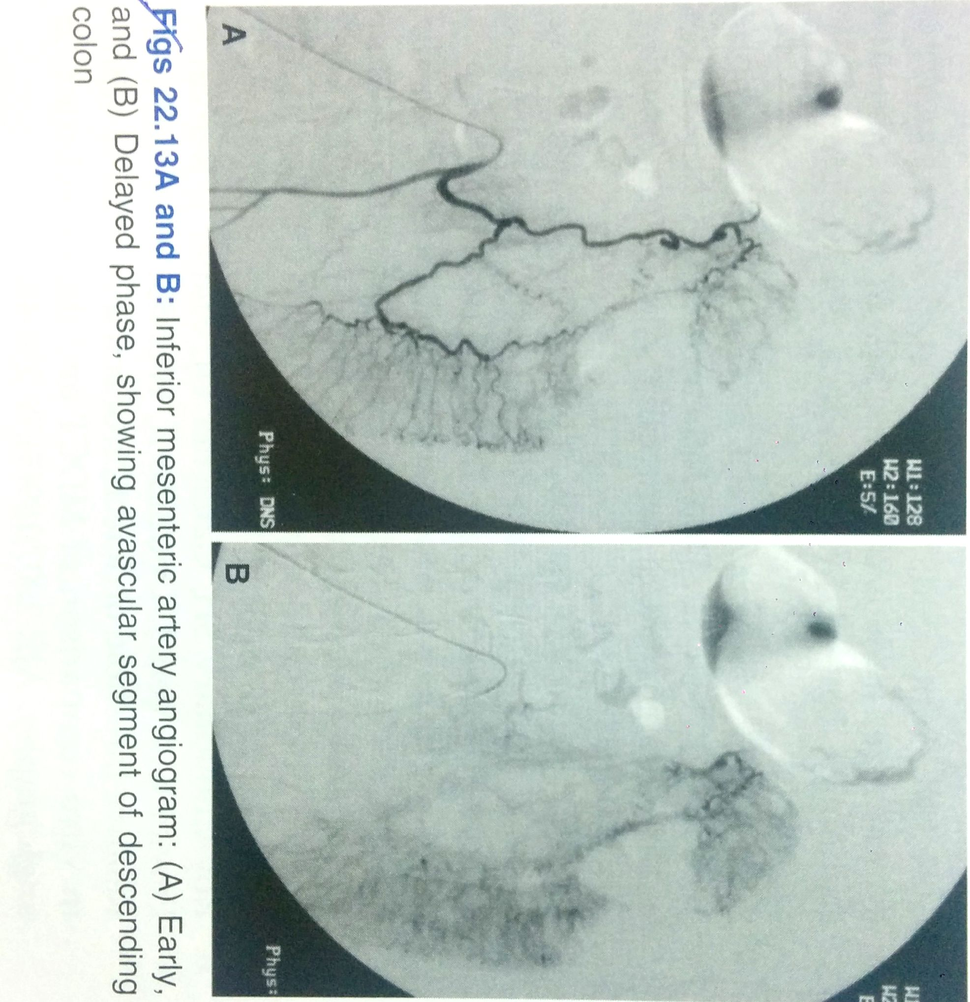

Slide 12
ANGIOGRAPHIC FINDINGS IN GIH
Extravasation of contrast : seen as puddling or staining that persists beyond capillary and venous phases
Delayed films may show opacified intestinal folds d/t luminal extravasation of contrast material
If lumen of GIT is filled with clotted blood “pseudovein ” appearance is seen as(as extravasated contrast flows through the clot to the most dependant part but unlike venous phase it persists much longer)

Slide 13
RADIONUCLIDE STUDIES
Minimal risk and invasiveness to pt
Used in pts where bleeding has stopped or is intermittent in nature
Not useful in massively bleeding patients
Commonly used are
Tc 99m sulphur colloids:cleared frm blood pool by RE system

Slide 14
RADIONUCLIDE STUDIES
Tc 99m sulphur colloids:cleared frm blood pool by RE system
Half life 2.5-3 min
As tracer extravasate in bowel hence only active bleeding can be diagnosed
Can detect blood loss of as low as 0.1 ml/min
Drawback is bleeding into hepatic or splenic flexure of colon and ugih will be obscured
Tc 99m labelled RBCs:RBCs in circulation extravasate during bleeding and can be detected
Images can be obtained upto 2 hrs after initial injection hence useful in intermittent bleeding
Tc 99m pertechnate scanning:in cases of bleeding from meckels diverticulum ,the tracer accumulates in ectopic gastric mucosa
Notes:
Because of overlap by normal accumulation of tracer in liver and spleen in re cells
Major limitation is activity can be seen In lower git whwn it has occuerd in more proximal bowel loops thence source of bleeding is missed eif frequent images are nt onatined

Slide 16
CT
Acute localization is possible on arterial phase of CT
Arterial phase ct demonstrates extravasated contrast in the bowel lumen greater than 90 HU.
In some cases it may detect parenchymal abnormalities such as hepatic artery aneurysms,arterioportal fistulae,tumours etc

Slide 17
CONTROL OF GI HAEMORRHAGES
Endoscopic coagulation and mucosal injection of sclerosing agent can control bleeding in ulcers and variceal bleed
TRANSCATHETER EMBOLIZATION:
For lesion of stomach colon and small bowel
Especially useful in t/t of bleeding pancreatic and hepatic artery pseudoaneurysm
Advantages are
Control is immediate
Risk of visceral ischemia is minimum if embolization is superselective and collaterals are preserved.
The most commonly used materials include gelatin sponge(a temporary occluding agent) or steel coils for permanent embolization.
Polyvinyl alcohol particles have shown good results
Notes:
Min amount of embolicvc material sshld be used and it shld be selective as mvh as possible

Slide 18
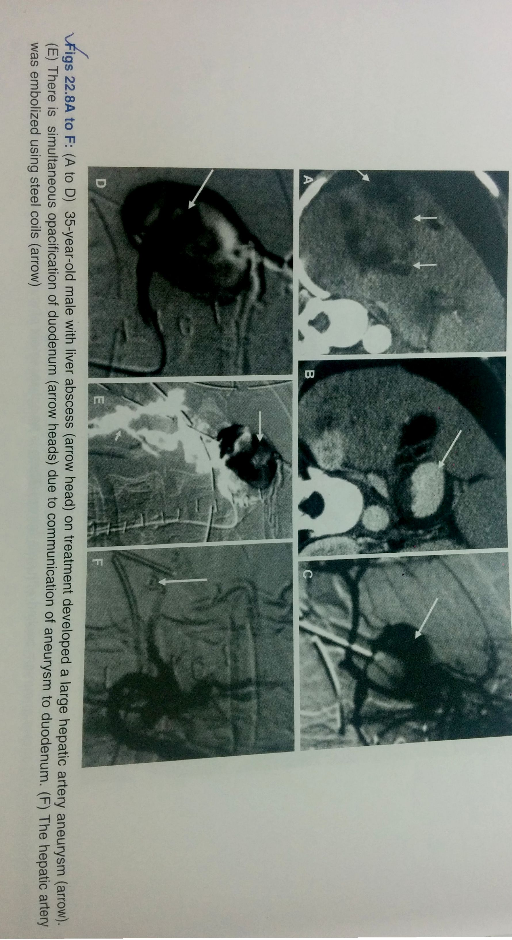

Slide 19
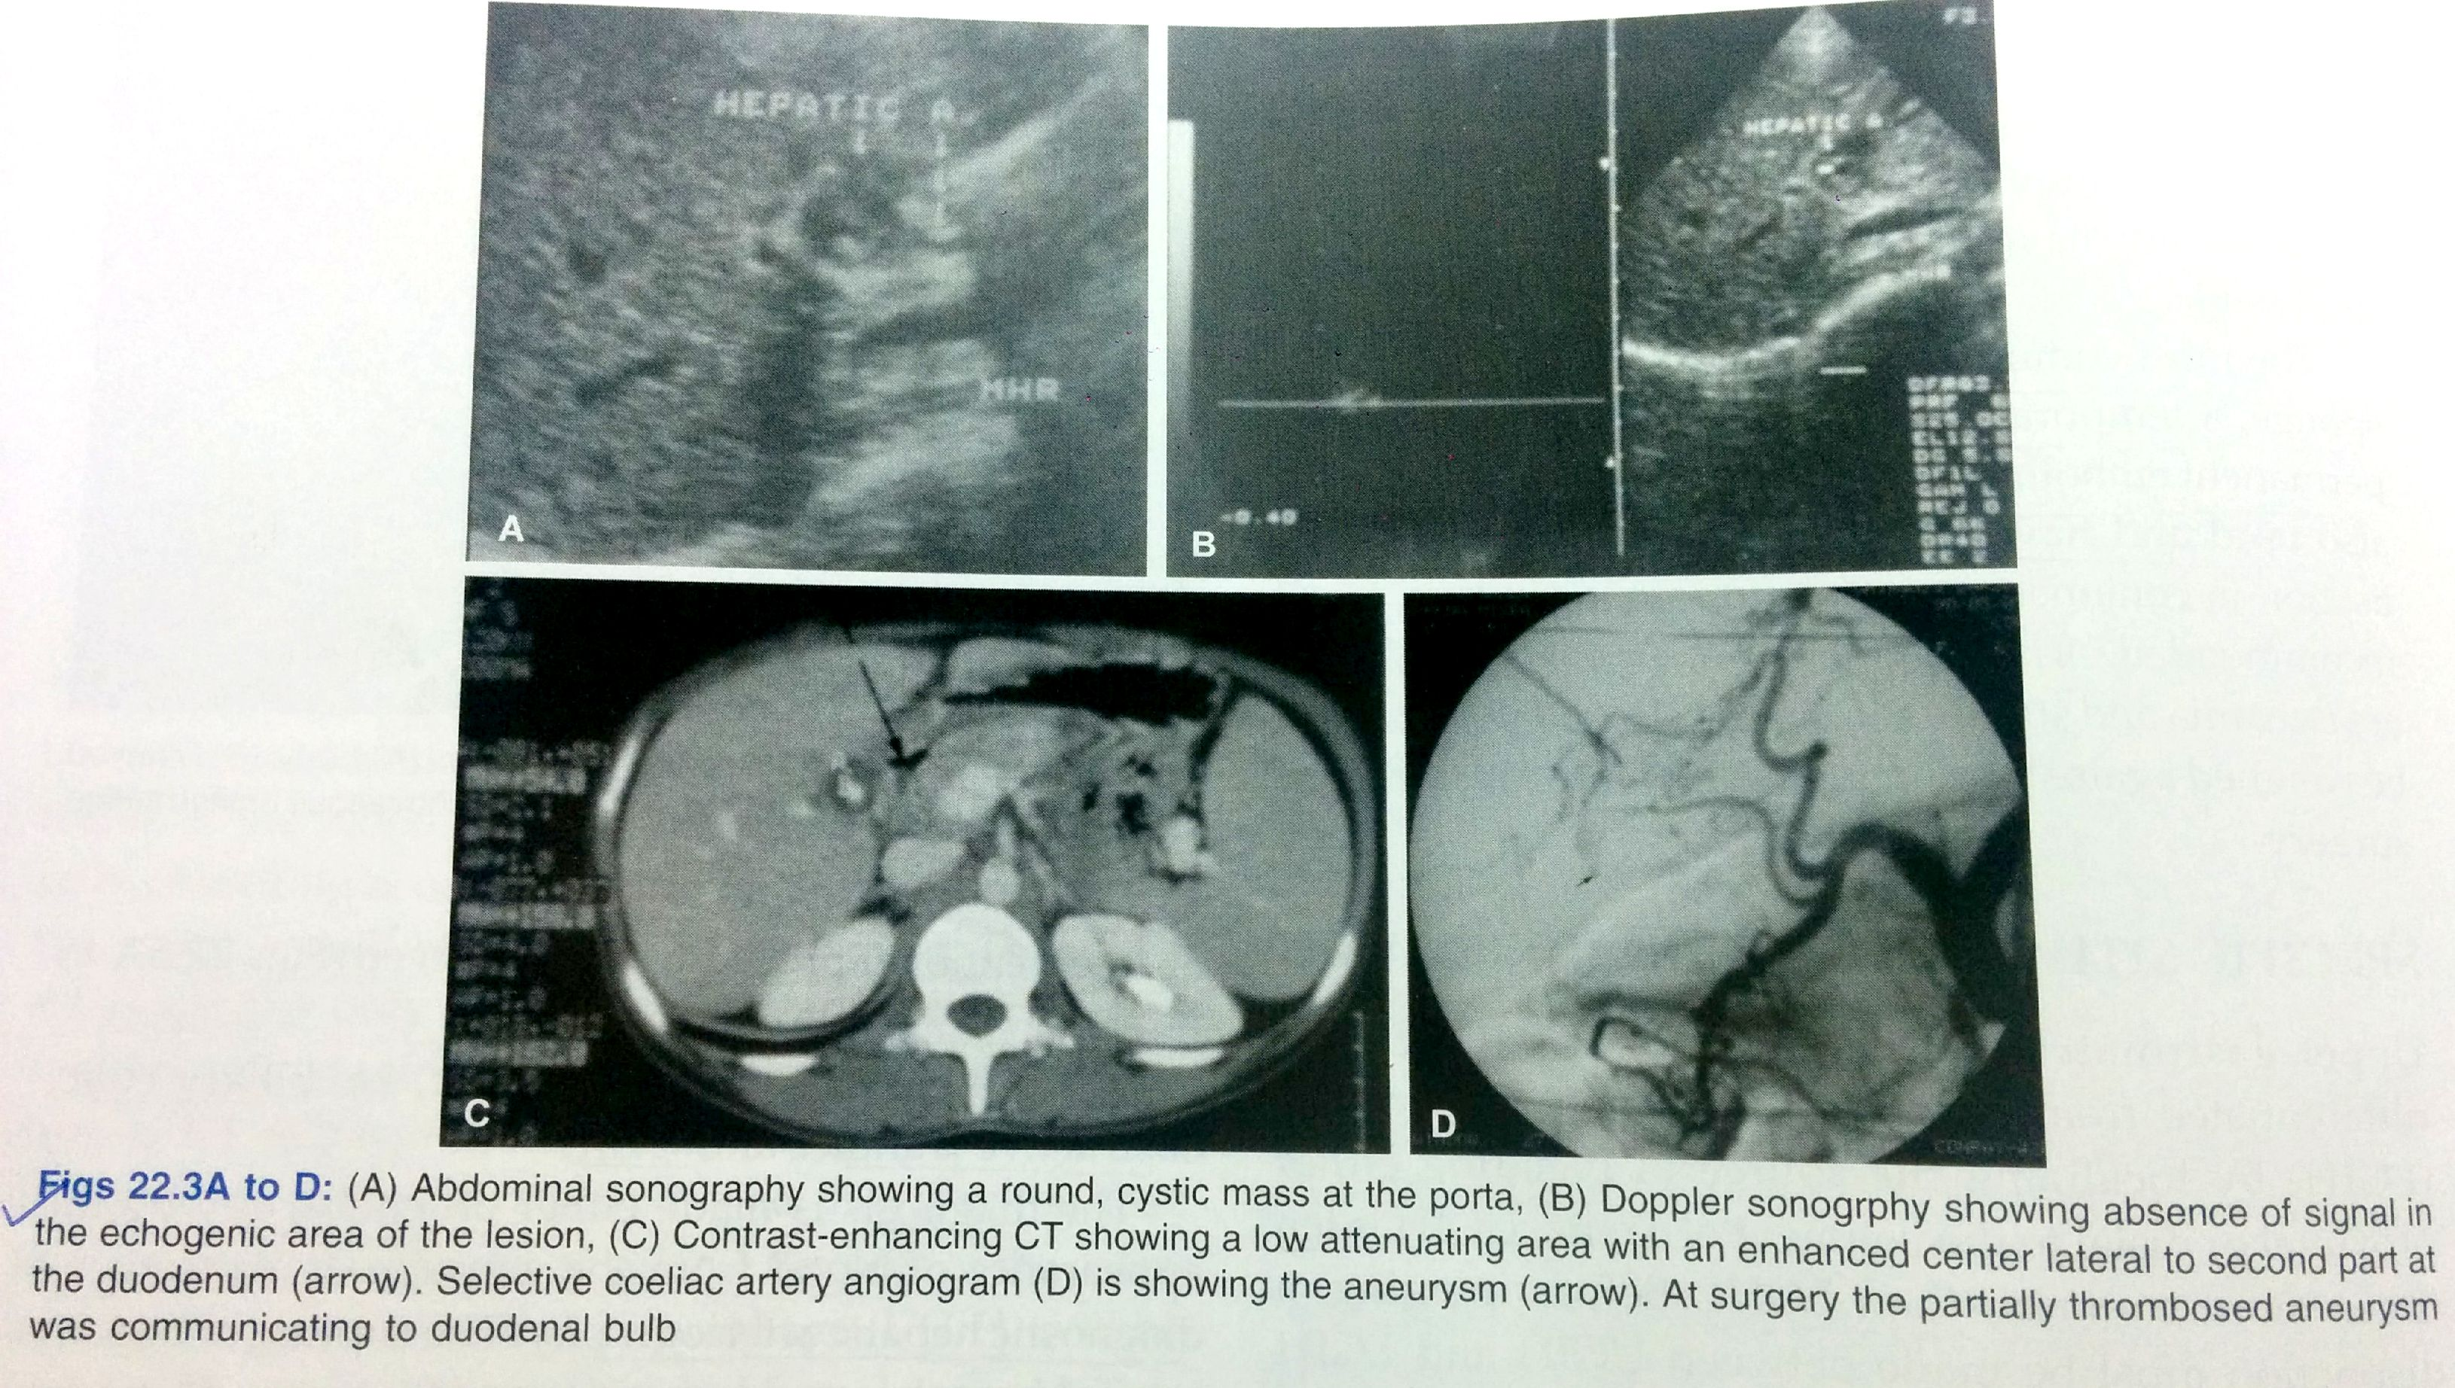

Slide 20
HAEMOBILIA
Presentation is billiary colic,obstructive jaundice and upper GI haemorrhage.
Diagnosis is made on endoscopy(by appearnce of blood at ampulla of vater
By diagnostic hepatic arteriography
Can be treated by angioembolization or surgical ligation of hepatic artery

Slide 21
TUMOURS
They bleed spontaneously but blood loss is characteristically chronic and intermittent.
On angiography some tumors like leiomyoma and leiomyosarcoma, adenoma and kaposi’s sarcoma are hypervascular and shows intense capillary stain
Notes:
eieio

Slide 22
PANCREATITIS AND UGIH
Pseudocyst and pseudoaneurysm are the complications d/t extension of pancreatic inflammation to nearby splenic artery
Other complications are haemorrhage within cyst ,gi haemorrhage d/t fistula formation,rupture of cyst into peritoneum,haemorrhage into deudenum via pancreatic duct.
Superior mesentric angiography is the investigation of choice for diagnosis and selective arterial embolization may control haemorrhage.

Slide 23
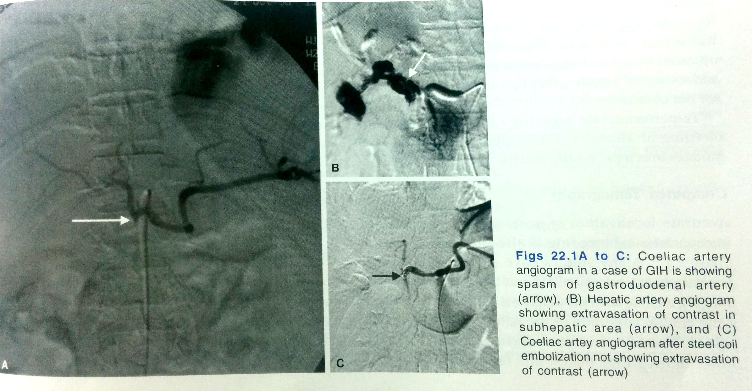

Slide 24
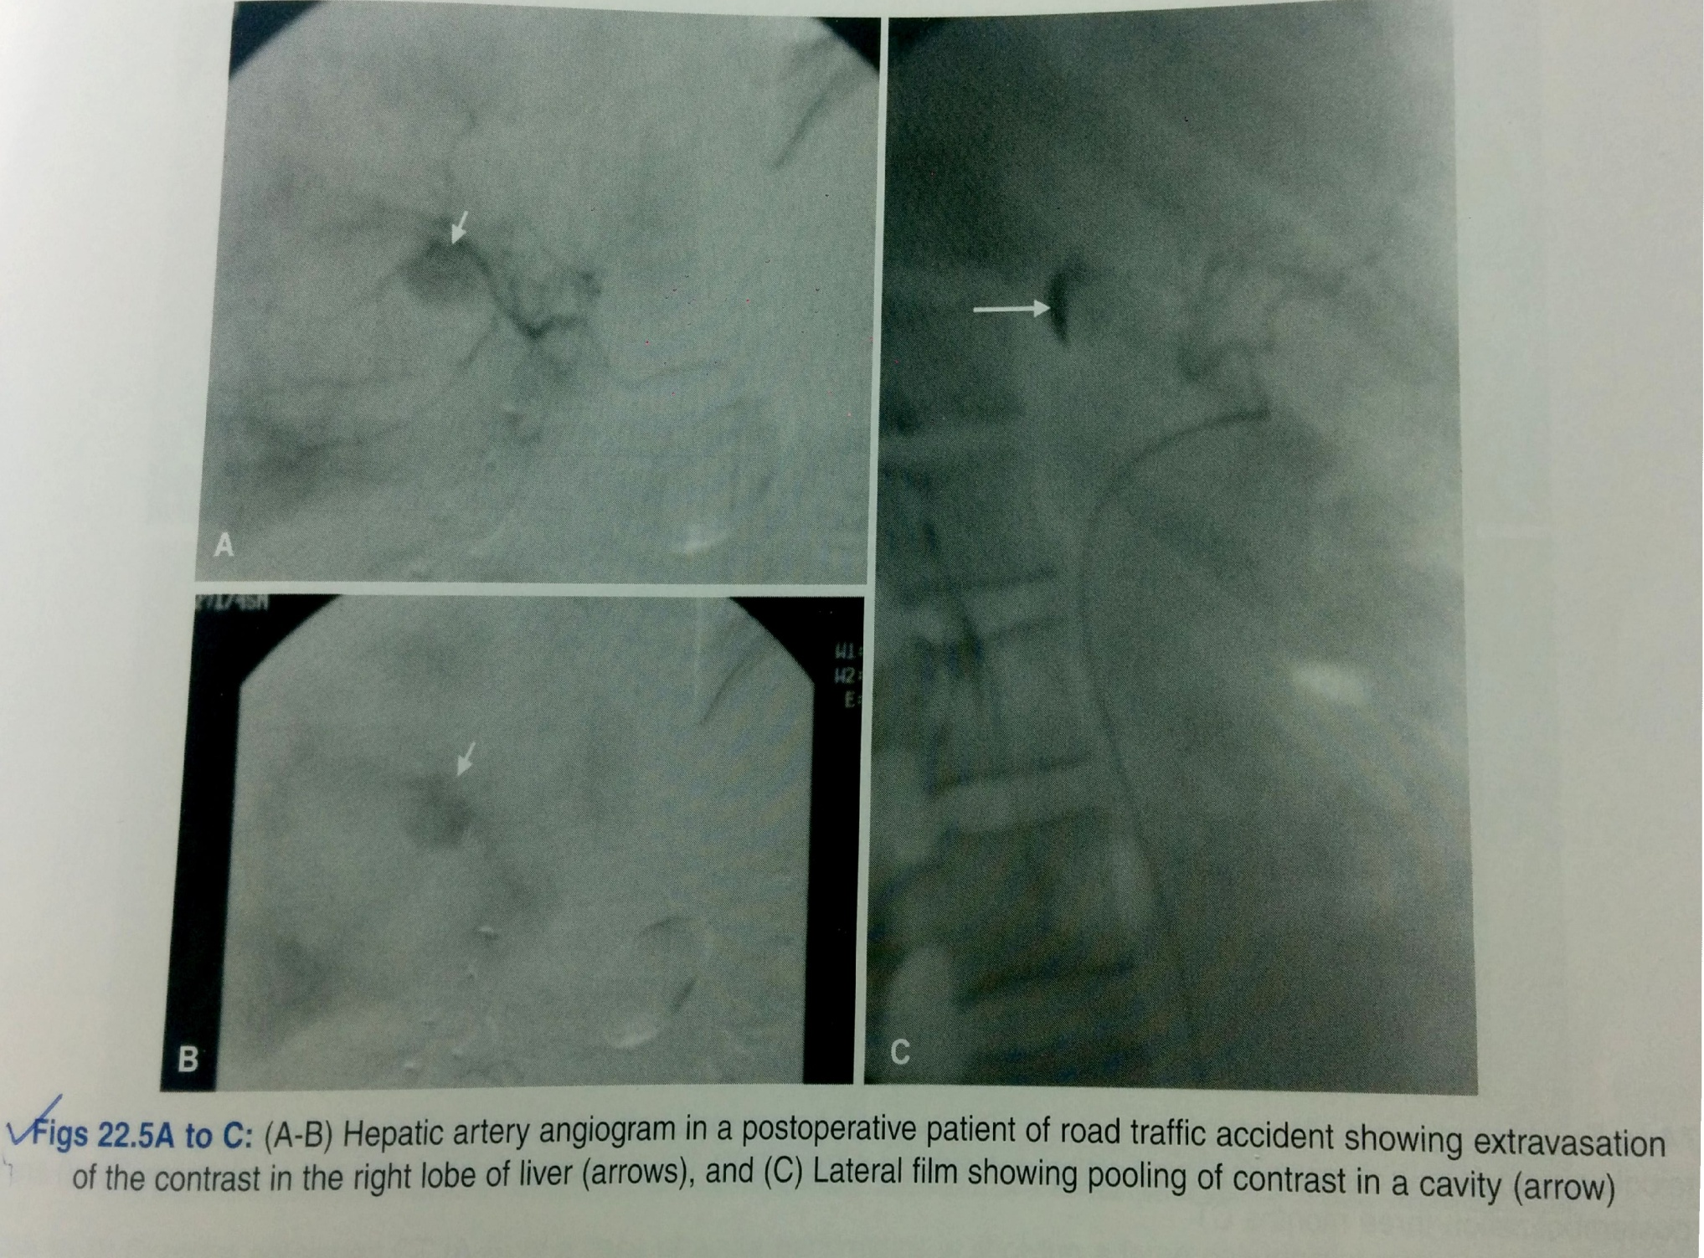

Slide 25
LOWER GI HAEMORRHAGE
COLONIC DIVERTICULA
most common in left colon
Bleeding is abrupt massive and often painless.
Bleeding demonstrated by direct endoscopic visualization or by filling the bleeding diverticulum with contrast medium at the time of angiography.

Slide 26
MECKEL’S DIVERTICULUM
Congenital anomaly
Cause of acute hemorrhage in children and young adults
Acid secretion from gastric mucosa results in peptic ulceration most often in ileal mucosa and lead to gi bleeding
Tc 99m pertechnate radionuclide scanning detect bleeding diverticula
Angiography shows vessel supplying area of abnormality and increased contrast medium accumulation in distal ileum

Slide 27
ANGIODYSPLASIA
It is a mucosal telangiectasia often multiple,involve cecum and ascending colon
Represent dilated preexisting vascular structures
On angiography it is seen as vascular tuft appearing in arterial phase -> early opacification of draining veins -> delayed emptying of a dilated tortuous intramural vein.
Notes:
To diagose bleedng frm angiodyspalsia actual extravasation of contrast mst be demonstrated if axtracvasation is nt detected then ca or some other lesion shld be considered

Slide 28
TUMOURS
They bleed spontaneously but blood loss is characteristically chronic and intermittent.
On angiography some tumors like leiomyoma and leiomyosarcoma, adenoma and kaposi’s sarcoma are hypervascular and shows intense capillary stain
Notes:
eieio

Slide 29
INTERVENTION RADIOLOGY IN PORTAL HYPERTENSION

Slide 30
PORTAL HYPERTENSION
Primary goal in treating portal hypertension is reducing the portal venous pressure and thus treating its complications like variceal,refractory ascites, hydrothorax and hypersplenism
INTERVENTIONS THAT REDUCE PORTAL PRESSURE
Transjugular intrahepatic portosystemic shunts.(TIPS)
Revision of occluded surgical and radiological portosystemic shunts
Embolization of arterioportal fistulas
Recanalization of occluded portal vein
Partial splenic embolization
Recanalization of hepatic venous outflow
INTERVENTIONS TO PALLIATE SYMPTOMS OF PORTAL HYPERTENSION
Percutaneous transhepatic variceal embolization
Balloon occluded retrograde transvenous obliteration of gastric varices

Slide 31
TIPS
Refers to creation of portosystyemic shunt by transjugular insertion of expandable metal stent between hepatic and portal vein under image guidance
Purpose is to decompress portal venous system and prevent its complication including rebleeding from varices
Normally procedure is performrd under conscious sedation ,GA is used in case of haemodynamically unstable patient.

Slide 32
INDICATIONS OF TIPS
Acute variceal bleeding unresponsive to medical treatment
Sec. prevention of variceal bleeding
Refractory ascites
Portal hypertensive gastropathy
Refractory hepatic hydrothorax
Budd chiari syndrome
Veno occlusive disease

Slide 33
ADVANTAGE:
does not need general anaesthesia,postinterventional intensive care,parentral nutrition and immobilization.
Control rebleeding in patients with poor liver function.
DISADVANTAGE:
Like surgery risk of hepatic encephalopathy,
liver failure and
procedural complications.

Slide 34
CONTRAINDICATIONS OF TIPS
ABSOLUTE:
Primary prevention of variceal bleed
Congestive heart failure
Multiple hepatic cyst
Uncontrolled systemic infections and sepsis
Unrelieved billiary obstruction
Severe pulmonary hypertension
RELATIVE:
Hepatoma especially with central obsrtuction of all veins
Portal vein thrombosis
Severe coagulopathy
Thrombocytopenia of less than 20000/cm3
Moderate pulmonary hypertension

Slide 35
STEPS OF TIPS
Cannulation of hepatic vein through transjugular approach which is performed via right transjugular route as it provides straight path to hepatic vein opening
It is important to decide which hepatic vein to use which is done by using USG or fluroscopy
Right hepatic vein is dorsal and cephalad to anterior superior branch of right portal vein
After cannulation of hepatic vein,hepatic venography is performed to ensure that vein is large enough to provide outflow tract of sufficient diameter of 8-10mm
Second step is passage of long needle from hepatic vein through liver parenchyma into the portal vein(the right pv branch typically runs at the level of 11th rib about 0.5-1.5 vertebral width from the lateral border of spine
Subsequently portal vein pressure is measured and base line pressure gradient is measured
A marking pigtail catheter is advanced into main portal vein for venography for determining suitability of portal vein puncture.
Third step involves balloon angioplasty with dilatation of parenchymal tract created by needle
Last step is stent deployment to ensure patency of tract
The ends of stent should project for short distance into hepatic and portal vein to prevent displacement

Slide 36
VIATORR PTFE covered stents are preferred nowadays
Stents of variable sizes are available with chances of shunt stenosis decreasing and encephalopathy increasing with larger size of shunt.
Successful outcome Is determined by decreasing portosystemic gradient to less than 12 mm of hg and resolution of complication of portal hypertension
At the end of procedure portal venogram is performed to document shunt patency and nonvisualization of gastro esophageal varices.
Notes:
Reduction of gradient by 50% of baseline is required fr control of varicela bleeding and a portal pressure gradient of less than 8 mm of hg required fr control of refractory ascites

Slide 37
COMPLICATIONS OF TIPS
Thrombosis ,occlusion,stenosis,transcapsular puncture,intraperitoneal bleed,hepatic infarction,fistulae,hemobilia,sepsis,haemolysis,encephalopathy.
Recurrence of symptoms should be managed by shunt venography and interventions.
use of PTFE(polytetrafluoroethylene) film minimizes transmural permeation of bile and mucin thus prevent hyperplastic tissue ingrowth
Another complication is hepatic encephalopathy for which most patients respond to medical conservative therapy or constraining stents and constraining grafts have been used to reduce shunt diameter

Slide 38
REVISION OF OCCLUDED SURGICAL STENTS:
Shunt stenosis is most common cause of rebleeding
Percutaneous transluminal angioplasty is alternative method of therapy for shunt stenosis
ARTERIPORTAL FISTULAS:
Radiological intervention is the therapy of first choice
Between portal vein and systemic arteris occur intraabdominally
Are not readily accesible
Presents with f/o portal hypertension ,cardiac failure, intestinal ischemia
May be congenital;may be multiple sec to hereditary telangiectatic diseases,av malformation and aneurysms
May be acquired; sec to blunt or penetrating abdominal trauma or iatrogenic
Hepatic artery is the most common artery involved followed by splenic artery
Arteriography confirms by definitve demonstration of fistula feeding vessel,location and size of shunt,portal vein flow and collaterals
Selective and superselective catheterization is done and various embolizing materials like coils and wires ,isobutyl-2-acrylate gelfoam and balloons have been used to occlude fistula

Slide 39
RECANALIZATION OF OCCLUDED PORTAL VEIN AND ITS BRANCHES:
5-10% of portal hypertension cases are d/t extrahepatic portal vein obstruction and ¼ th of them are d/t neoplasms
Portal venous stents may be placed in all these carcinomas to resolve blockage of portal vein and alleviate the related symptoms
BUDD CHIARI SYNDROME:
Percutaneous radiological management is becoming procedure of choice
Thrombolysis is the first line therapy and locoregional thrombolysis by selective catheterization as well as mechanical and hydrodynamic techniques are used for removal of obstructing thrombus.
If thrombolysis is unsuccessful then TIPS may be done
Notes:
Through percutaneous approach and using cholangiographuic needle a sheath is placed in portal vein and catheter is advanced beyond stenotic site which is subsequenntly dilated using a balloon
A stent of appropriate size is then placed across the stenotic segment

Slide 40
PARTIAL SPLENIC VEIN EMBOLOZATION
Hypersplenism is a common complication of portal hypertension and can be treated with splenectomy, splenic artery ligation and splenic artery embolization.
In partial splenic embolization supply is occluded more peripherally in the splenic parenchyma
Splenic artery is selectively cannulated through transfemoral route using 4F catheter
Tip should lie distal to last pancreatic artery.
Gelfoam is then injected to induce splenic infarction and induce fibrosis in 45-70% splenic parenchyma
Embolizing agent such as gelfoam or PVA particle are soaked in antibiotic solution penicillin and gentamycin
Procedure treats hypersplenism in convenient and noninvasive way and also reduces portal flow resulting in decreased portal pressure.

Slide 41
PERCUTANEOUS TRANSHEPATIC VARICEAL EMBOLIZATION
Used to control variceal bleeding after failure of sclerotherapy or in cases of recurrent bleeding after sclerotherapy.
Portal vein thrombosis is the major complication of this procedure
ANGIOGRAPHIC VASOPRESSIN INFUSION:
Intravenous systemic vasopressin has been used to control bleeding and vasopressin is infused through SMA at the rate of 0.1 mg /min for 24 hrs.
This causes reduced mesentric blood flow with drop in portal pressure resulting in decompression of varices and subsequent thrombosis of bleeding site.
Notes:
Somatostain can be used instead of vasopressin hich has got lesser fewew complications

Slide 42
INTERVENTIONAL TREATMENT OF LIVER TUMOURS
Interventional techniques have been developed employing angiographic and percutaneous route, these are:
Chemical ablation with ethanol(PEI) or acetic acid(PAI)
Radiofrequency ablation
Transcatheter arterial chemoembolization
Transcatheter arterial embolization
Transcatheter arterial radionuclide therapy
Right portal vein embolization
Hepatic vein stenting

Slide 43
TRETMENT OF LIVER TUMOURS HCC
Used in patients with extensive lesions or with concurrent cirrhosis or with intrahepatic mets who cant undergo surgical resection of HCC
CHEMICAL ABLATION:
Direct percutaneous injection of ethanol or acetic acid into a liver tumour under USG or CT guidance
Percutaneous acetic acid/ethanol result in coagulative necrosis and fibrosis of tumour.
95% ethanol is most commonly used and highly effective method this technique is particularly useful for lesion less than 3 cm in diameter
It is contraindicated in surafce lesions, tumours with ascites or coagulopathy
Notes:
Features of hcc which rationalize ethanol therapy are its hypervasularity and difference in consistency between neoplaastic and cirrhotic liver
Technique is nt useful in larger lesion bcoz alcohol diffusion is often incomplete and residual viable neoplastic tissue can persist along peripherry of nodule

Slide 44
Alcohol is injected in multiple sessions under radiological guidance using long needle
Alcohol injection is started from deepest to superficial portion of tumour avoiding direct injection into hepatic vein,
Multiple sessions are required (ie once or twice a week)
In PAI 50% of acetic acid is used, amount in ml required to achieve complete response is equal to three times the diameter of lesion in cms
It is done on outdoor basis under aseptic condition and local anesthesia
At a time 1-8 ml at different site is injected by one or more injections
Perfused area usually spreads within a radius of2 -3 cms and is seen as a patch of hyperechogenecity on USG
Notes:
Direct injection into hepatic vein may lead to cardiopulmonary collpase and a shouldbe avoided
Needle is slowly withdrawn after 10-30sec of alcohol or acetic acid injection to avoid teflux into adjacent tissue

Slide 45
RADIOFREQUENCY ABLATION
New technique for small HCC and hepatic mets
It induced necrosis of tumour by deposition of thermal energy around the tip of electrode inserted in the tumour
RFA is ideally suited for smaller lesions less than 3 cms as well as for multiple lesions. even tumours upto 5cms can be ablated (chances of complete ablation diminish with increase in size of tumour)
Notes:
Lesions whivh are closer to liver capsule are gall bladder are c/I as they increase chances of peritonitis and cholecystitis hence lesion that do not have atleast 1 cm of liver parenchymal margin seperating it frm liver capsule gall bladder and porta hepatis or major vessels are connsidered insitable RFA.

Slide 46
TECHNIQUE OF RFA
Radiofrequency probe is inserted into the lesion under USG or CT guidance
AC current is passed through the probe with energies ranging from 60-100 watts for a period of 6-12 mins, rapid change in polarity of electric current results in fast oscillation of intracellular molecules which causes friction and heat generation
Local temperature of more than 60 degrees is maintained for more than 5 minutes.
Complications:
less common
Include severe pain after procedure,haemorrhage,peritonitis,cholecystitis,colitis,vascular injury and thrombosis.
Folllow up:to asses degree of necrosis and completeness of ablation.
-f/u CT shows low density nonenhancing area which corrospend to necrosis
-tumour response rate to RFA is inversely proportional to size of tumour
Notes:
There are two basic types of electrodes cooled or noncooled tip and nonexpandable/expandable arrayselectrodes in .in cooled tip type of electrodes there is continuos cooling of needle tip by circuilating saline allows tissue necrosis far from the electrode without tissue charring

Slide 47
TRANSCATHETER ARTERIAL CHEMOEMBOLIZATION
Is mainstay of t/t for unresectable HCC
It involves intrarterial delivery of high concentration of chemotheurapetic agent emulsified in lipiodal(iodine containing lipid) combined with embolic agent directly to tumour under angiographic guidance
Commonly used chemotherapeutic agents are adriamycin,epirubucin,mitomycin c, and cisplatin.
It results in selective tumour necrosis d/t ischemia and is a/w preservation of most of the normal liver (as drug concentrates in maligant cells d/t tumour vacscularity and lack of lymphatics but is cleared from nonmalignant cells of liver)
So it allows chemotherapeutic agent to remain in contact with tumour cells for prolonged period
Large exophytic masses and surface lesions may get extrahepatic arterial supply which are chemoembolized to prevent tumour recurrence .
f/u is taken with CT or MRI to look for reduction in size,amount of necrosis and lipiodal retention.
As the procedure targets tumours specificallly while preserving normal liver it delays progression to liver failure.
Notes:
(principle is different blood supply to the liver and tumour,whereas normal liver receives most of its blood supply from portal vein,hepatic arteries primarily feed the liver tumours

Slide 48
TRANSCATHETER ARTERIAL EMBOLIZATION
In this tumour is embolized with intrarterial temporary or permanent embolizing material in single or multiple sessions.
It is less effective for large and peripherally located HCC d/t development of collaterals.
It can be done as an emergency procedure to reduce gastrointestinal haemorrhage from HCC which can be d/t varices or direct invasion of deudenum,tranverse colon or stomach

Slide 49
TRANSARTERIAL RADIONUCLIDE THERAPY:
Internal radiotherapy by injection of isotopes iodine 131 lipiodal,yttrium90 into hepatic artery have shown usefullness.
Can be used in HCC with portal vein thrombosis.
RIGHT PORTAL VEIN EMBOLIZATION:
Imp preoperative t/t in pts who are undergoing extensive liver resection d/t hepatic maligancy.
It reduces post op hepatic failure in major hepatectomy.
Procedure is done percutaneousy using both ultrasound and angiography guidance usually 3 wks before surgery,
Technique is useful in cirrhotic liver with malignant tumour confined to segment of right lobe.
Notes:
Aim is to occlude branches of right lobe of liver which is to be resected and preserve left lobe branches which causes compensatory hypertrophy of left lobe

Slide 50
HEPATIC VEIN STENTING
HCC is most common in patients with membranous obstruction of vena cava
Pts are managed with hepatic vein stenting or IVC dilatation to relieve venous obstruction combined with transarterial chemoembolization.

Slide 51
BENIGN LIVER TUMOURS
Hepatic artery embolization using both temporary or permanent occludinng material can be used in the management of symptomatic haemangioma,haemangioma with high risk of bleeding and for preoperative embolization.
Preoparative embolization of focal nodular hyperplasia,hepatic adenoma or other vascular tumours may help in surgical removal of tumour.

Slide 52
ISCHEMIC BOWEL DISEASE
causes
Arterial occlusion(more common)
Thromboembolic occlusion is the most common cause of acute mesentric ischemia
Venous occlusion
Low flow states
Types
Acute
chronic(it results from atherosclerosis of mesentric arteries)
Notes:
THE DISOREDER OCCUR WEN BLOOD FLOW TO INTESTINES IS COMPROMISED

Slide 53
investigations
DUPLEX DOPPLER SONOGRAPHY:
It is preferred noninvasive modality for evaluation of stenosis of mesentric arteries.
SMA peak systolic velocity of 275cm/sec or no flow signals are reliable indicators of 70% or greater stenosis.
CT
It detects ischemic changes in affected bowel loops and mesentry as well as determine cause of ischemia by allowing evaluation of mesentric vasculature

Slide 54
MRI
It is comparable to CT in detecting bowel changes and mesentric vascular abnormalities
Intraluminal thrombus and collateral vessels can be readily identified
It shows bowel wall thickening and increased in signal intensity from compropmised bowel on T2WI.
DSA:
Most accurate modality to evaluate degree of stenosis
Allows diagnosis as well as interventional therapy .
Percutaneous transluminal angioplasty with or without stent placement can be done.
Invasive and time consuming.

Slide 55
ACUTE ISCHEMIA
Most common CT finding is circumferential thickening of bowel wall which demonstrate low attenuating reflecting submucosal edema and inflammation or high attenuation d/t submucosal haemorrhage.may show halo appearance)
It may demonstrate luminal dilatation and mesentric stranding
After administartion of IV contrast material affected loops demonstrate decreased enhancement compared to normal bowel loops d/t compromised blood flow.
In cases of infarction pneumatosis may be present which indicate damage.
CT is more sensitive than plain radiography in detection of pneumatosis.

Slide 56
IN LOW FLOW STATES:
Mesentric arteries appear narrowed with limited opacification of branches d/t hypovolumia and spasm
CT shows diifuse thickening of bowel wall with or without mucosal enhancement and increased intraluminal fluid.
CHRONIC MESENTRIC ISCHEMIA:
Devlop collateral pathways
CT detects calcified plaques in aorta and mesentric arteries

Slide 57
BARIUN STUDIES;
c/I In presence of suspected acute mesentric ischemia.
In clinically unsuspected patients barium findings are:
-bowel dilatation
-thumb printing
-thickened folds
-submucosal edema
-ulceration
There is uniform thickening of bowel folds which produce symmetric spike like configuration simulating “stack of coins” or “picket fence” appearance.
In chronic cases there may be formation of strictures with smooth outlines.

Slide 59
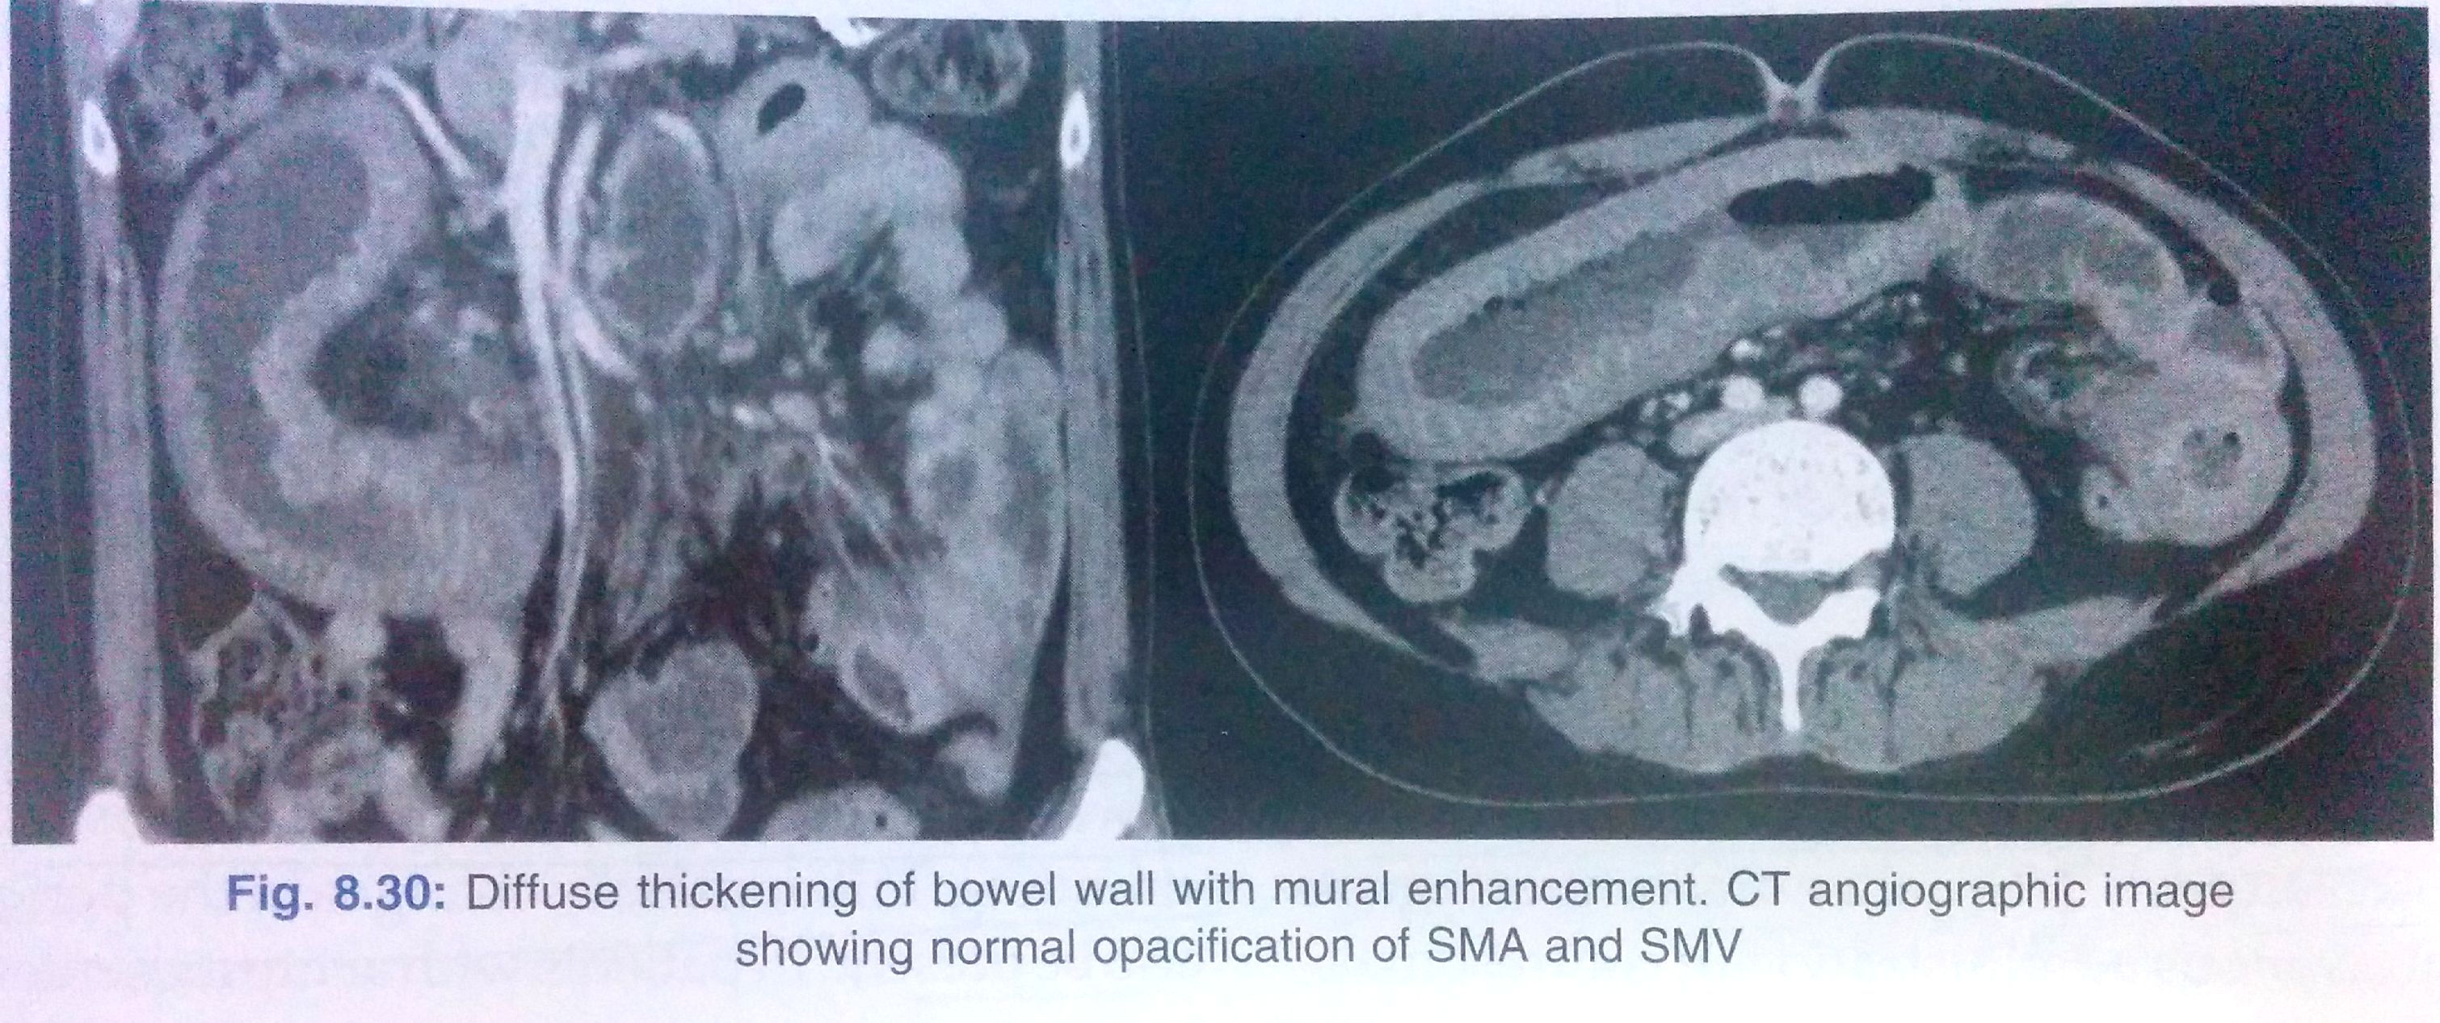

Slide 61
THANK YOU!!

