Slide 1
CEREBRAL VENOUS ANATOMY AND
VENOUS INFARCTS
Dr MONICA PATIL

Slide 2
Venous anatomy
Causes of venous infarct
Imaging of venous infarct

Slide 3
VENOUS ANATOMY

Slide 4
VENOUS ANATOMY
DURAL SINUSES
CEREBRAL VEINS:
- DEEP CEREBRAL
- SUPERFICIAL CORTICAL

Slide 5
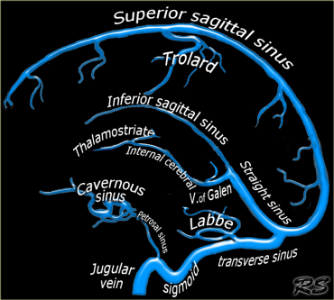
DURAL VENOUS SINUSES
Posterosuperior group
Superior Sagittal Sinus
Inferior Sagittal Sinus
Straight Sinus
Transverse sinus
Sigmoid sinus & jugular bulb
Confluence(torcular herophili)

Slide 6
Anteroinferior group
Cavernous sinus
Superior and inferior petrosal sinus
Clival plexus
Sphenoparietal sinus

Slide 8
SUPERIOR SAGITTAL SINUS(SSS)
Originates from ascending frontal veins anteriorly
Runs in midline at the union of calvaria and falx cerebri
Tributaries from superficial cortical veins, vein of Trolard and venous lakes in diploic space

Slide 9
On cor-seen as a triangular channel between dural leaves of falx cerebri
On sag-sickle shaped
Normal variants-absence of anterior segment(sinus begins at coronal suture) and off midline position

Slide 12
INFERIOR SAGITTAL SINUS(ISS)
Smaller and inconstant
Lies at the bottom of falx cerebri and above corpus callosum and cingulate gyrus
Terminates at falcotentorial junction where it joins vein of galen to form straight sinus

Slide 14
STRAIGHT SINUS
Formed by junction of ISS and VOG at the falcotentorial apex
Numerous small tributaries from falx cerebri, tentorium cerebelli and adjacent brain
Terminates by joining at the confluence which is often asymmetric with septations and intersinus channels
SS variant- persistent falcine sinus which connects ISS or VOG directly to SSS. 2/3 of these patients have absent or rudimentary SS

Slide 15
TRANSVERSE SINUS
Contained between attachments of tentorium cerebelli to the inner table of skull
Anatomic variations are the rule rather than the exception
Asymmetrical with R>L
Hypoplastic and atretic segments

Slide 16
SIGMOID SINUSES AND JUGULAR BULB
Inferior continuation of the TS descending behind the petrous temporal bone and becoming jugular bulbs
Jugular bulb is focal dilatation between sigmoid sinus and extracranial portion of IJV
Jugular bulb pseudolesions with flow asymmetry should not be mistaken for real masses(schwannoma, paraganglioma). Jugular foramen is intact, not eroded or remodelled

Slide 17
CAVERNOUS SINUS
Irregularly shaped and heavily trabeculated venous sinuses that lie along sides of sella turcica extending from superior orbital fissure anteriorly to clivus and petrous apex posteriorly
Contain ICA and VI n.
III, IV, V1 and V2 are within lateral dural wall
Tributaries-superior and inferior ophthalmic veins, sphenoparietal sinuses

Slide 18
Communicate with each other via intercavernous venous plexus
Drains inferiorly through foramen ovale into clival plexus and superior and inferior petrosal sinuses
Lateral walls are straight or concave(not convex) and venous blood enhances uniformly

Slide 20
SUPERIOR AND INFERIOR PETROSAL SINUS
Superior petrosal sinus courses posteriorly along top of petrous temporal bone from CS to sigmoid sinus
Inferior petrosal sinus courses above petrooccipital fissure from inferior aspect of clival venous plexus to jugular bulb

Slide 21
CLIVAL PLEXUS
Extends along clivus to foramen magnum
Connects cavernous and petrosal sinuses with each other and with suboccipital veins around foramen magnum.

Slide 22
SPHENOPARIETAL SINUS
Courses around lesser wing of sphenoid at rim of middle cranial fossa
It receives superficial veins from the anterior temporal lobe and drains CS or inferior petrosal sinus

Slide 23
SUPERFICIAL CORTICAL VEINS
SUPERIOR CORTICAL VEINS-
-8-12 unnamed, drain into SSS
- Vein of Trolard (Sylvian fissure to SSS)
MIDDLE CORTICAL VEINS-
-Begins over the Sylvian fissure and collects small tributaries from frontal, parietal and temporal opercula that overhang lateral cerebral fissure.
-Superficial middle cerebral vein.
-Drain into CS or sphenoparietal sinus.
INFERIOR CORTICAL VEINS-
-Vein of Labbe (sylvian fissure to TS)
Notes:
Superficial middle cerebral vein- along sylvian fissure vein of trolard- from sylvian fissure to sss vein of labbe- sylvian fissure to transverse sinus

Slide 24
DEEP CEREBRAL VEINS
Medullary veins
Subependymal v – thalamostriate & septal veins
Deep paramedian v.(Internal cerebral veins)
Brainstem/ Posterior Fossa veins
Notes:
Medullary veins drain subcortical and deep white matter subependymal veins surround lateral ventricles join behind foramen of monroe icv paramedian and run in velum interpositum basal veins drain medial temporal lobes and course in ambient cisterns

Slide 25
MEDULLARY VEINS
Unnamed veins, begin 1-2 cm below the cortex course straight through the white matter towards the ventricle
Terminate into the subependymal veins
Inapparent until they converge near the ventricle
SWI best depicts the vessels as the deoxygenated blood is paramagnetic

Slide 26
SUBEPENDYMAL VEINS
Most important named veins are the septal veins and the thalamostriate veins
Course under the ventricular ependyma and collect blood from the basal ganglia and deep white matter(via the medullary veins)
Septal veins curve around the frontal horns of lateral ventricles, then course posteriorly along septum pellucidi.
Thalamostriate veins receive tributaries from caudate nuclei and thalami curving medially to unite with septal veins near foramen of Monro to form 2 internal cerebral veins.

Slide 27
BRAINSTEM/POSTERIOR FOSSA VEINS
SUPERIOR/GALENIC GROUP-
-Drain into vein of galen.
-Precentral cerebellar v-single midline v.
-Superior Vermian v.
-Anterior pontomesencephalic v.
ANTERIOR/PETROSAL GROUP-
-Petrosal v.-large venous trunk lying in the CP angle cistern, receives tributaries from cerebellum, medulla and pons.
POSTERIOR/ TENTORIAL GROUP-
-Inferior vermian v-paired paramedian v.

Slide 30
VENOUS DRAINAGE
Peripheral or brain surface pattern (drain centrifugally)- cortical veins and SSS
Deep or central pattern (drain centripetally)-VOG and internal cerebral v.
Inferolateral or perisylvian pattern-superficial middle cerebral v.=>sphenoparietal sinus=>CS
Posterolateral or temporoparietal pattern-superior petrosal sinus and anastomotic v. of labbe into transverse sinus.

Slide 32
ETIOPATHOGENESIS

Slide 33
PREDISPOSING FACTORS
Pregnancy, peurperium
Infection: Sinusititis, mastoiditis, otitis media, meningitis
Trauma
Prothrombotic conditions
Dehydration
Oral contraceptives
Coagulopathies
Trauma
AVM
IBD
PNH
Paraneoplastic syndrome

Slide 34
VENOUS INFARCT
Cerebral venous thrombosis is an important cause of stroke especially in children and young adults.
Clinically patients with cerebral venous thrombosis present with variable symptoms ranging from headache to seizure and coma in severe cases.

Slide 35
PATHOLOGY
Venous thrombosis
High venous pressure due to restricted flow
Vasogenic edema in the white matter of the affected area due to hydrostatic displacement of fluid from capillaries to extracellular spaces as a result of breakdown of BBB.
May lead to infarction
Cytotoxic oedema develops

Slide 36
VENOUS INFARCT
Venous thrombosis begins in dural sinus.
Then progresses to bridging veins.
Petechial perivascular hemorrhages & cortical venous infarctions occur.

Slide 37
VENOUS INFARCT
Most commonly involved sinus:
tranverse
Then
-SSS
-Sigmoid
-Cavernous
Most commonly involved veins:
Superficial cortical veins that drain SSS.

Slide 38
VENOUS INFARCT
Internal cerebral vein thrombosis is less common but devastating.
Involves vein of Galen or straight sinus.
May lead to bilateral venous infarcts in deep grey matter nuclei & upper midbrain.

Slide 39
IMAGING IN VENOUS INFARCT

Slide 40
IMAGING IN VENOUS INFARCT

Slide 41
IMAGING IN VENOUS INFARCT
Empty delta sign
Dense clot sign
Cord sign
MR & veno findings
Pseudo-delta sign

Slide 42
CT IMAGING IN VENOUS INFARCT
EMPTY DELTA SIGN:
-Seen on contrast study
- Hypodense sinus due to thrombus.
- Surrounding cavernous spaces, meningeal venous tributaries, venous channels enhance on CECT.

Slide 44
CT IMAGING IN VENOUS INFARCT
DENSE CLOT SIGN
Seen on plain scan
Hyperdense thrombus in dural sinus
It is also called as delta sign

Slide 46
CT IMAGING IN VENOUS INFARCT
CORD SIGN:
Thrombosed cortical veins seen as linear high density areas.

Slide 47
CT IMAGING IN VENOUS INFARCT
Hemorrhagic infarction in the temporal lobe.
Dense transverse sinus due to thrombosis.

Slide 48
CT IMAGING IN VENOUS INFARCT
Deep cerebral vein thrombosis seen as-
Hyperdense thrombus in deep veins, vein of Galen or straight sinus.
Secondary changes seen are bilateral low density basal ganglia with or without associated petechial hemorrhages.

Slide 50
MR IMAGING IN VENOUS INFARCT
Infarct that does not follow the distribution of an expected arterial occlusion.
MRI is more sensitive for detection of venous thrombi than CT.
The absence of a flow void & presence of altered signal intensity in the sinus is a primary finding of sinus thrombosis on MR images.

Slide 51
MR IMAGING IN VENOUS INFARCT
ACUTE THROMBUS : Isointense with cortex on T1WI
LATE ACUTE : Hyper on T1WI
Hypo on T2WI
SUBACUTE : Hyper on both T1 and T2WI
CHRONIC:-T1 iso
-T2 hyper
-Chronically thrombosed sinuses undergo fibrosis, develop significant vascularity and enhances strongly on T1 C.
-Frayed or shaggy appearance

Slide 52
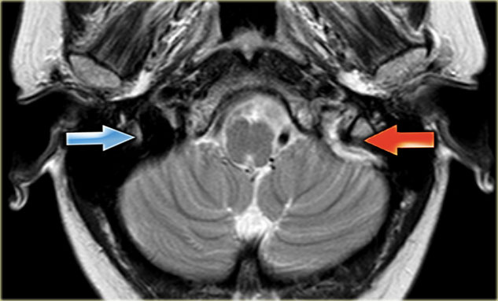
MR IMAGING IN VENOUS INFARCT
T2-weighted image with normal flow void in the right sigmoid sinus.
On the left there is abnormal high signal as a result of thrombosis.

Slide 53
MR IMAGING IN VENOUS INFARCT
GRE - Thrombus hypointense, "blooms"
Tl C+ - Acute-Peripheral enhancement
MRV
- Absence of flow in occluded sinus on 2D TOF MRV
-"Frayed" or "shaggy" appearance of venous sinus

Slide 54
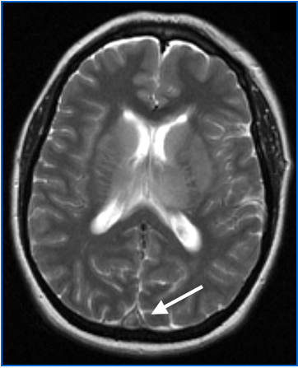
MR IMAGING IN VENOUS INFARCT
Axial T2WI shows replacement of signal void by thrombus in superior sagittal sinus.

Slide 55
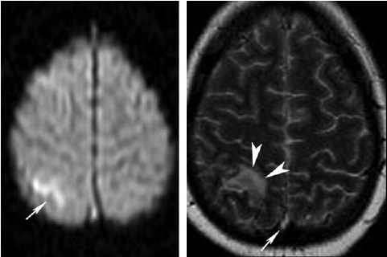
MR IMAGING IN VENOUS INFARCT
T2WI showing an area of increased signal intensity consistent with diffusion restriction along the cortex of the right parietal lobe.
High-signal-intensity thrombus in the superior sagittal sinus

Slide 56
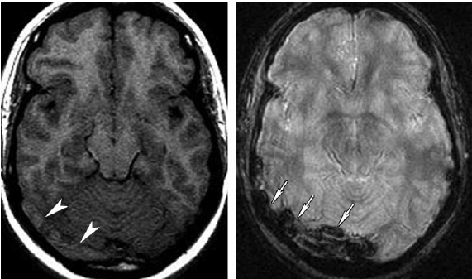
MR IMAGING IN VENOUS INFARCT
T1WI shows an area of isointense signal s/o thrombus in the right transverse sinus.
GRE image shows blooming in that area.

Slide 57
MR VENO IN VENOUS INFARCT
TOF MR venography is most commonly used for the diagnosis of cerebral venous thrombosis.
2D TOF techniques are used to evaluate the intracranial venous system because of their excellent sensitivity to slow flow.

Slide 58
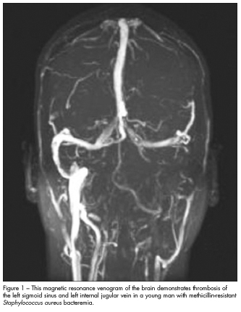
MR VENO IN VENOUS INFARCT
The left sigmoid sinus and left IJV has no signal due to thrombosis.

Slide 59
CAVERNOUS SINUS THROMBOSIS
Communicate with veins of orbit, face and neck so infection from here can easily spread to CS.
When thrombosis is accompanied by infection –thrombophlebitis
S. aureus is most imp pathogen
C/F-headache, fever and orbital symptoms(dirty orbital fat, periorbital oedema, chemosis)

Slide 60
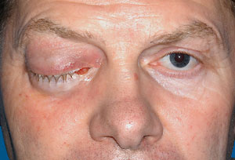

Slide 61
IMAGING
CT
Lateral CS margins are convex and not flat or convex
Proptosis, dirty orbital fat, periorbital swelling and sinusitis
MRI
Non enhancing filling defects within the enhancing dural walls of CS and thrombosed orbital veins on T1C
Rare- inflammation of the ICA can cause stenosis or pseudoaneurysm formation

Slide 63
VENOUS OCCLUSION MIMICS
SINUS VARIANTS
FLOW ARTIFACTS
ARACHNOID GRANULATIONS
SDH
POLYCYTHEMIA AND LEFT TO RT SHUNT
UNMYELINATED BRAIN
DIFFUSE CEREBRAL OEDEMA

Slide 64
CONDITIONS MIMICKING VENOUS INFARCT
PSEUDODELTA SIGN:
In infants -hypointensity of the unmyelinated brain and the physiologic polycythemia resulting in high density of the blood in the sagittal sinus.
MIMIC OF EMPTY DELTA SIGN (CT in head trauma)
Unclotted blood in SSS creates low density area surrounded by hyperdense SAH or SDH

Slide 65
THANK YOU

