Slide 1
X –RAY TUBES
BY
DR. MONICA PATIL

Slide 2
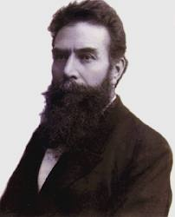
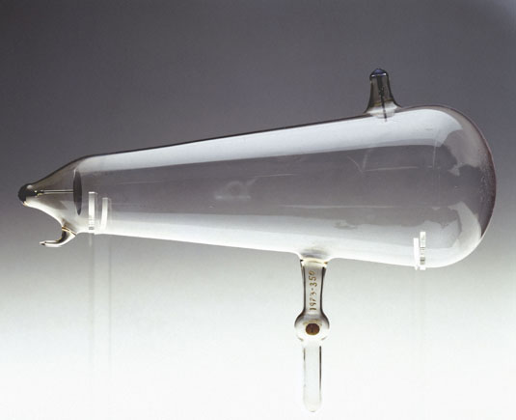
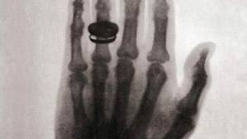

Slide 3
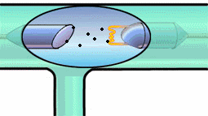
INTRODUCTION
X-Rays are electromagnetic radiation produced when a fast moving stream of electrons is suddenly decelerated at the target anode.

Slide 4
STRUCTURE OF AN ATOM
Atom has a central nucleus which has nucleons:
Protons(+very charged)
Neutrons(no charge)
Notes:
To understand x-rays we must first understand the structure of an atom.
Atomic model given by bhor.

Slide 5
This is surrounded by electrons in different shells.
These shells are labelled as K , L & M from inside out.
These shells hav sub shells within them
(2n-1)
K : no subshell
L: 3 subshells-lowest
-middle
-highest

Slide 6
Nucleus : positive charge
Electrons : negative charge
Thus there exists a force of attraction between the two which keeps them together termed as
BINDING FORCE OF AN ELECTRON.
It is inversely proportional to square of distance between electron and nucleus.

Slide 7
Binding energy is defined as the energy given to raise the energy of an electron to zero. For tungsten (most common anode material used) : K shell binding energy is 70 kev L shell binding energy is 11 kev L shell electron has 59kev more energy than K electron.
Notes:
i.E 70 kev of energy would b required to remove an electron from the k shell
& 11 kev energy required to remove electron from L shell
This diff in energies occur as v saw previously that the binding force is inversely related to the square of the distance from the nucleus , thus as the distance increases energy required decreases.

Slide 8
Transition of electrons:
To a lower energy shell :
Ex: L to K shell
- loss of energy occurs
To a higher energy shell :
Ex: K to L shell
- absorption of energy occurs
This loss or absorption of energy is equal to the difference in the binding energies of the two shells.
Notes:
Energy of the electrons & not the binding energy.

Slide 9
Lowest sub shell of L shell to K shell not possible known as FORBIDDEN TRANSITION.
Other L sub-shells to K shell : K-alpha
M shell to K shell : K-beta
Notes:
L has 3 subshells

Slide 10
PROCESS OF X-RAY GENERATION

Slide 11
2 PROCESSES
General Radiation/
Bremsstrahlung
(reaction of electrons with nucleus)
Characteristic radiation
(reactions of electrons with shell electrons)

Slide 12
GENERAL/BREMSSTAHLUNG RADIATION:
From German : breaking radiation
Original path of incident electrons (from cathode)
Deflection in original path due to positively charge nucleus (of anode)
Loss of kinetic energy
Emission of x-ray photon.
Notes:
Energy can neither be created nor destroyed.

Slide 13
Electrons gives up only a part of its energy in one time , thus they penetrate through multiple layers before giving up all of its energy. Rarely there will be head on collision with the nucleus: all energy lost as a single photon of energy. Thus, only few x-rays are produced, 99% lost as heat. Energy of the photon is inversely related to its wavelength , since different energy photons are emitted, wavelength varies in general radiation.

Slide 14
CHARACTERISTIC RADIATION:
Ejection of K electron
Creation of Vacancy
Jump of electron from L shell.
Release of x ray photon.
Notes:
Since transition is from high to low energy loss of energy as photon occurs.

Slide 15
In routine practice most of radiations are due to General Radiation except when Molybdenum target is used as in mammography characteristic radiation
forms the main part.

Slide 16
Quantity - atomic no.
- square of Kvp.
- x-ray tube current.
Quality/energy - tube potential(Kvp)

Slide 17
At lower atomic no. general radiation becomes less efficient & characteristic radiation assumes greater importance.
Combination of low atomic no. & low voltage is used in breast imaging by using molybdenum as the target material.

Slide 18
X-RAY MACHINE
It has the following part:
- x-ray tube
- operating console
-high voltage section
-film holder, grid cabinet/ table

Slide 19
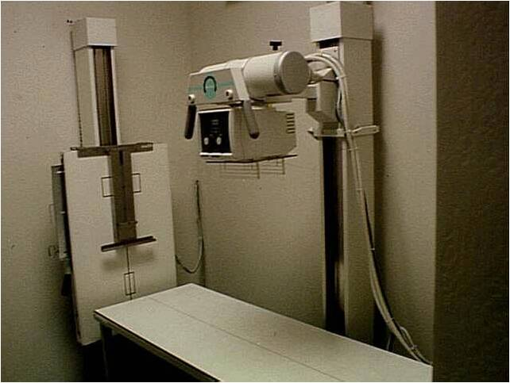

Slide 20
Operating console:

Slide 21
generator

Slide 22
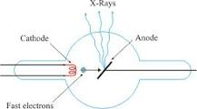
STRUCTURE OF AN X-RAY TUBE
3 basic components:
- Glass enclosure
- Cathode
- Anode

Slide 23
Glass enclosure:
It is made of pyrex glass.
The 2 electrodes are placed in vaccum, this is necessary as:
-collision of the electrons with the gas molecules would cause secondary electrons to be prod, causing wide variation in the energy of the x-rays produced.

Slide 24
cathode:
Source of electrons.
-ve terminal.
Cathode = filament.
Components :
- Tungsten filament
- Connecting wires
- Focusing cup
Newer tubes have 2 filament mounted side by , one usually longer than the other , only 1 fil. Is used for a given exposure.

Slide 25
TUNGSTEN FILAMENT:
0.2 mm in diameter.
Coiled to form vertical spiral
- 0.2 cm in diameter
- <1 cm in length.
Chosen as the filament material as:
-high atomic no.
-high melting point(3370oC)
-little tendency to vaporize, hence long life.
-strong & can be drawn into thin wires.

Slide 26
FOCUSING CUP:
Made of Nickel.
Maintained at the same –ve potential as the filament
Causes the electrons to converge on the target anode in required size & shape

Slide 27
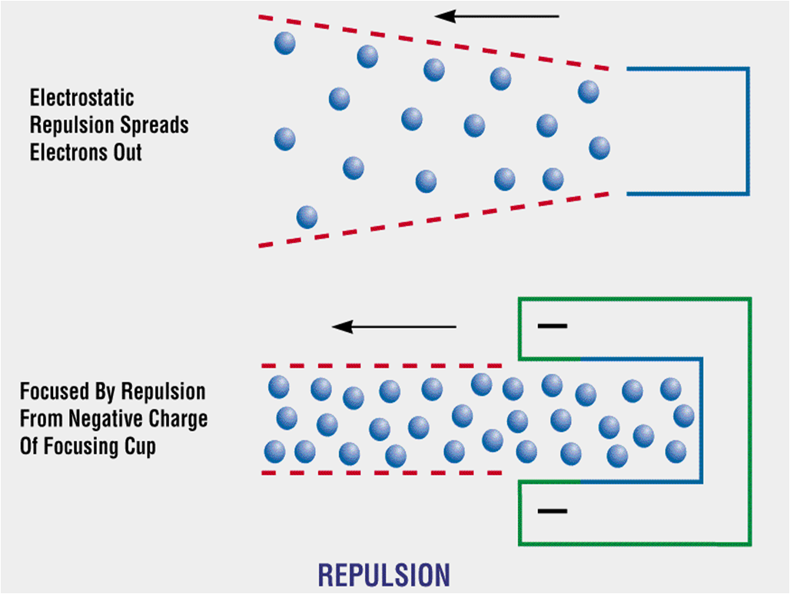
Notes:
Force of mutual repulsion in the electron stream : e beam spreads out & bombards large area of the anode in an irregular fashion: prevented by the focusing cup

Slide 28
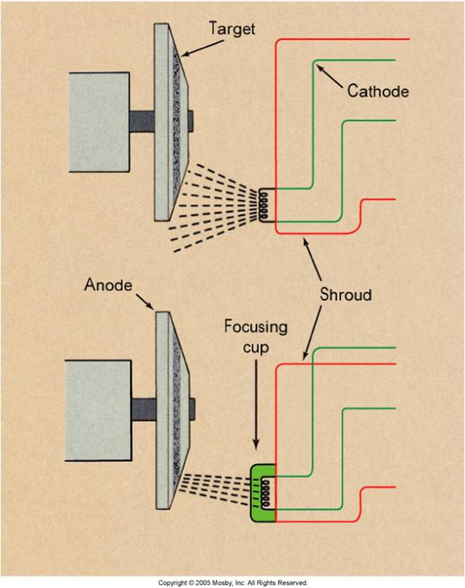

Slide 29
CONNECTING WIRES:
Supplies the voltage & amperage i.e the current needed to heat the filament.
Tube Current is defined as the no. of elec. Flowing per second from the filament to the target (measured in milliamperes, mA).
Electron current across the tube is in one direction only.

Slide 30
THERMIONIC EMISSION:
When current flows the filament becoms heated, some atoms absorb sufficient thermal energy to allow them to move from the surface of the metal.
This emission of electrons resulting from the absorbtion of thermal energy is called THERMIONIC EMISSION.

Slide 31
SPACE CHARGE:
As a result of thermionic emission small cloud of electrons around the filament , this is called as the SPACE CHARGE.
As it is made of negatively charged elec. It prevents other electrons from being emitted from the filament , this is called as the SPACE CHARGE EFFECT.

Slide 32
SATURATION VOLTAGE:
Notes:
If potential applied across the tube is insufficient to cause all the electrons to be pulled away from the filament , residual space charge exists around the filament : this limits the no. of electrons available thus limmits the tube current , hence the initial part of the tube current is space charge limited.
Beyond the saturation voltage : no more space charge is left & all the electrons thaqt are produced by the cathode are pulled away , hence in this region current is limited by the no. of electrons made available by the heated filament : EMISSION/TEMPERATURE limited.
The voltage of demarcation betweeen the space charge limited & emission limited current is called as the Saturation voltage.

Slide 33
Tungsten vaporized from the filament gets deposited on the inner side of the glass wall :becomes bronze coloured SUN BURN
This has two effects:
-filter the x-ray beam, gradually changing the quality of the beam.
-presense of metal on the glass surface causes arcing at high peak voltage.
Notes:
Arcing: when tungsten is deposited on the inside of the x-ray tube between the cathode aaa7 anode it itself starts acting like an electrode & hence cause problems.

Slide 34
ANODE:
It is the +ve electrode.
2 types
Stationary
Rotating

Slide 35
Focal spot:
It is the area of the anode/tungsten which is bombarded by the electrons.
Most of the energy is converted into heat, <1% into X-Rays.
Notes:
Anode is the electrode which is bombarded by the electron stream from the cathode.

Slide 36
Large focal spot allows for accumulation of large amounts of heat before damage to the tungsten target occurs.
Smaller the focal spot, better is the resolution of the resultant image.

Slide 37
LINE FOCUS PRINCIPLE:
It resolved the problem posed by the need of:
-A large focal spot for better heat loading &
-Small focal spot need for good radiographic details

Slide 38
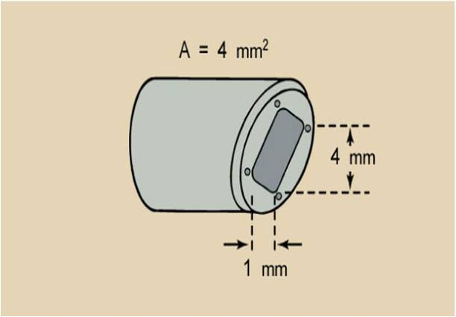
By angling the target, the effective area of the target is much smaller than the actual area of electron interaction

Slide 39
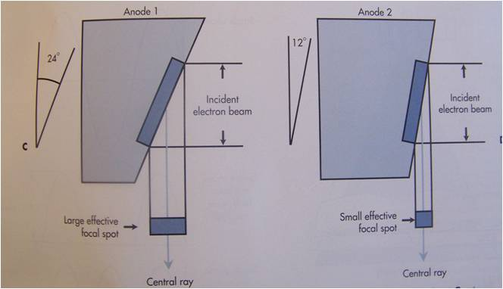
TARGET ANGLE:
The smaller the target angle the smaller the effective focal spot
Angles from 5 degrees to 15 degrees

Slide 40
STATIONARY ANODE:
Made of tungsten , 2-3 mm thick
Embedded in a large mass of copper.
Square or rectangular in shape.
Anode angle : 15-20 degrees.

Slide 41
Tungsten is a good material for absorption & rapid dissipation of heat away from the target area.
Large block of copper is bound to tungsten plate to
increase the total thermal capacity of the anode
Speed its rate of cooling.
As Cu is a better conductor of heat & tungsten cannot withstand heat of repeated exposures.

Slide 42
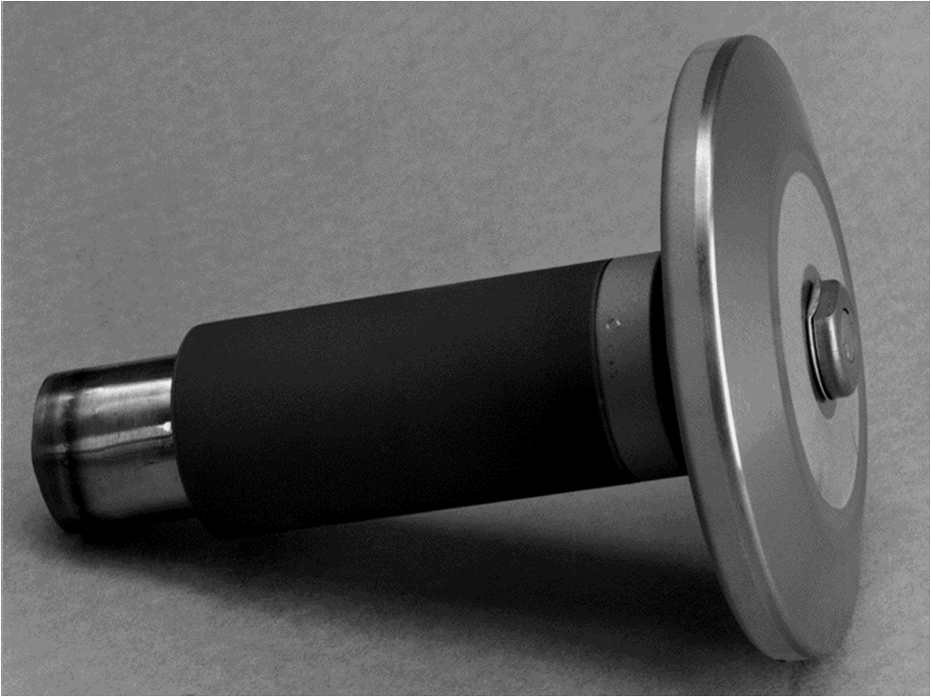
ROTATING ANODE:
Used to produce X-ray tubes capable of withstanding heat generated by large exposures.

Slide 43
Made of large disc of tungsten which rotates at speed of 3600 rpm theoretically when the exposure is being made(in prac. reaches ard 3000rpm).
The disc has beveled edges(to take advantage of the Line Focus Principle)
Power of rotation is provided by magnetic field produced by stator coils that surround the neck of the X-Ray tube outside the envelope ,which induce current in the copper rotor of the induction motor which rotates the anode assembly.

Slide 44
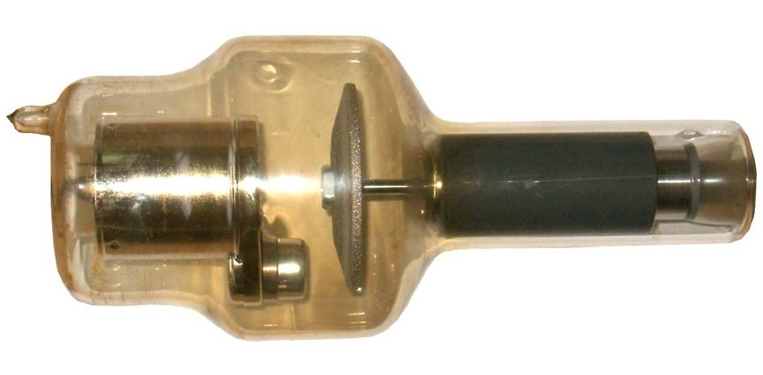
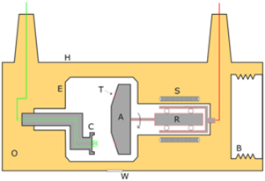

Slide 45
If the target is made to rotate , electrons will bombard constantly changing area of the target.
If it is rotating at the
speed of 3600rpm , then
any given area is found
found opp. the elec.
stream only once every
1/60th sec ,the remainder
time used for heat dissipation.
Notes:
Hence the total heat loading capacity of the anode is increased.

Slide 46
SHORTCOMINGS:
I) Life of the tube reduces coz of lack of durable bearings on which the anode rotates . Because of the friction it is necessary to lubricate : commonly used lubricants cannot be used
-Oil : vaporizes & destroys the vaccum.
- Graphite : wear off as powder & destroy the vaccum.
METALLIC SILVER IS USED

Slide 47
II)Heat dissipation :
- In Statinary : Cu block
-In rotating : absorption of heat by anode assembly undesirable as
heat expand bind , the bearings.
SOLUTION: 1) Molybdenum stem.
-High melting point(2600 deg.)
-poor conductor of heat
Hence , it acts as a barrier of heat.
If length , inertia , load ,hence keep the stem as short as possible.

Slide 49
Another way to dec inertia : dec. the weight of the anode itself.
Larger part of the disc to be made of molybdenum(lighter) : 35% reduction in the inertia.
Graphite can also be used : 50% reduc.
but problem with it – doesn’t conduct heat like molyb. So the anode assembly becomes hotter.
- problem in binding the tungsten disc to graphite.

Slide 50
2) Coating the back of the anode disc with a black substance , such as carbon , to aid in heat dissipation from the anode.
III) Red. life by roughening & pitting of the surface : by thermal stress : decreases output coz of
excess scattering away frm the exit window.
Increased absorption of the x-rays by the target itself.

Slide 51
ANODE HEEL EFFECT:
INTENSITY OF THE X-RAY BEAM THAT LEAVES THE TUBE IS NOT UNIFORM THROUGHOUT ALL THE PORTIONS OF THE BEAM.
It depends on the angle at which the x-rays are emitted from the focal spot ; this variation is called HEEL EFFECT

Slide 52
There is decreased intensity of the beam that is emitted more near parallel to the angled target surface.
Caused by the absorption of some of the photons by the anode itself.

Slide 53
3 clinically imp aspects of Heel Effect:
1)Intensity of film exposure is less on the anode side compared to the cathode side ; used in obtaining balanced densities in radiographs:
- thicker parts: towards cathode side
-thinner parts : towards the anode side
Ex: Thoracic spine –anode towards the upper th. Spine & cathode towards the lower spine where the body structures are thicker.

Slide 54
Anode heel effect

Slide 55
2) Heel Effect is less noticable when a large film-focus distance is used.
At a distance of 40” : anode end –relative exposure of 73%
cathode end – 105%
Hence 30% difference in intensity between the two ends.
At 72cms : anode end-87%
cathode end-104%
Hence, only 17% diff in intensities between the two ends.

Slide 56
3) Heel effect will be less for smaller films :
as intensity of the beam nearer the central ray is more uniform than towards the periphery of the beam.

Slide 57
TUBE HOUSING:
Notes:
X-rays are emitted in all the directions from the target + there is scattering following collision with the various structures in & around the tube.
Tube housing lined with lead serves to absorb these primary as well as secondary x rays that would otherwise produce - high intensity of radiation around the tube &
- film fogging

Slide 58
Protects from the radiation.
Prevents excess film fogging.
Also provides shielding for the high voltage cables required to produce x-rays.
These cables are grounded.
To prevent short circuiting , space between the tube & cables if filled with thick mineral oil.

Slide 59
Oil has – electrical insulating &
- thermal cooling properties.
Convection currents set up in the oil which carry the heat away frm the tube to the metal surface frm where heat is lost by conduction.
Oil expands on heating, metal bellows are present: which allow oil to expand without incresing the pressure , connected to microswitch, which prevent further exposure if max. heating of oil has occurred.

Slide 60
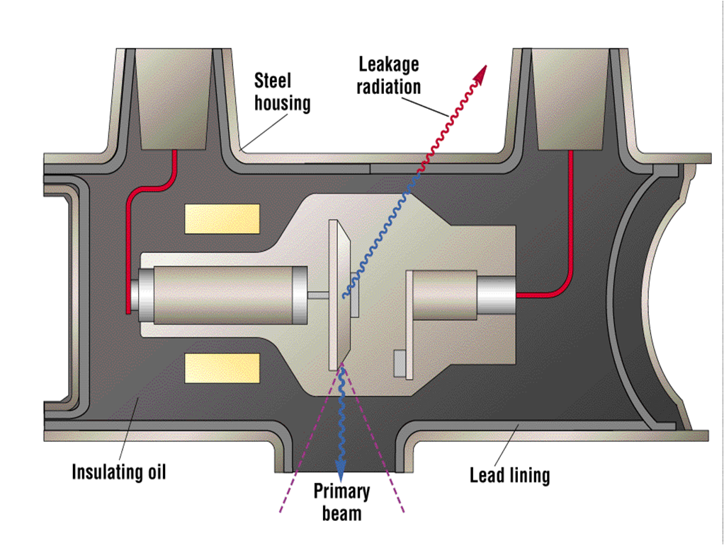

Slide 61
GRID – CONTROLLED X-RAY TUBES:
It’s a tube which contains its own ‘switch’ which allows it to turned on & off rapidly.
A 3rd electrode is used which controls the flow of electrons from the filament to the target.
It is actually the focusing cup.
The focusing cup counteracts the flow of electrons.

Slide 62
If the voltage of cup is made large enough , tube current may be completely pinched off , where no electrons go to the target
The voltage applied between the focusing cup & the filament therefore acts like a SWITCH.

Slide 63
METALLIC/CERAMIC X-RAY TUBES:
Introduced by Philips with a trade name of ceramic super Rolatix.
Difference:
Metal casing instead of usual glass.
Has 3 ceramic insulators(2 for the high vol cables & 1 for anode stem).Aluminum oxide used mostly.
Anode rotates on an axle which has bearings at each end.
Notes:
Allows to use more massive anode(upto 2000gms) as opposed to no more than 700 gms in conventional x-ray tubes.

Slide 64
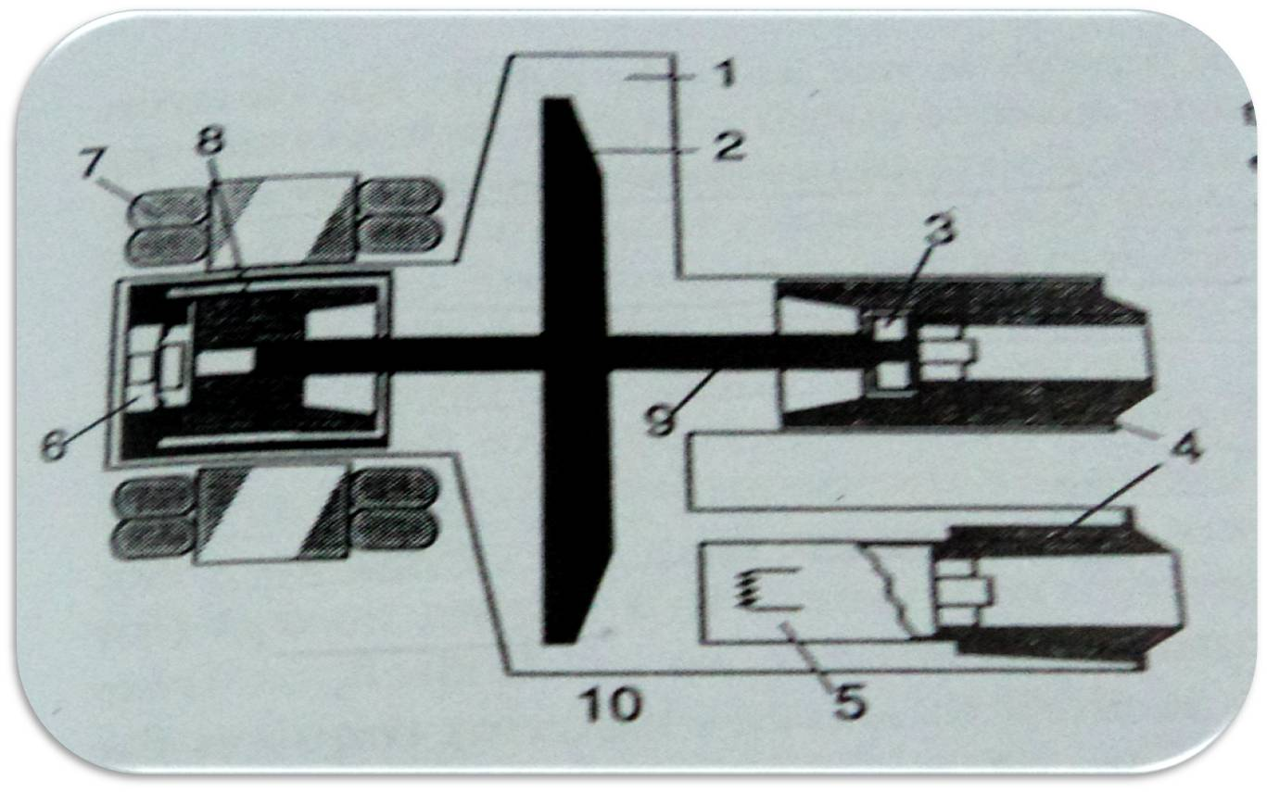
Notes:
1-Metal casing 2 anode disc 3 and 6- ball bearings 4 an 8 are ceramic insulatorsthode
5 Cathode with filament 7 Stator windings 9 Anode Shaft 10 Beryllium window

Slide 65
Advantages:
Less Off-focus radiation.
Longer tube life.
Higher tube loading.

Slide 66
Off-focus radiation:
Produced when electrons interact with metal surfaces other than the focal track of the anode.
Main source is back scatter from anode.
Partly reduced by placing the collimator or a lead diaphragm as close to the tube as possible .

Slide 67
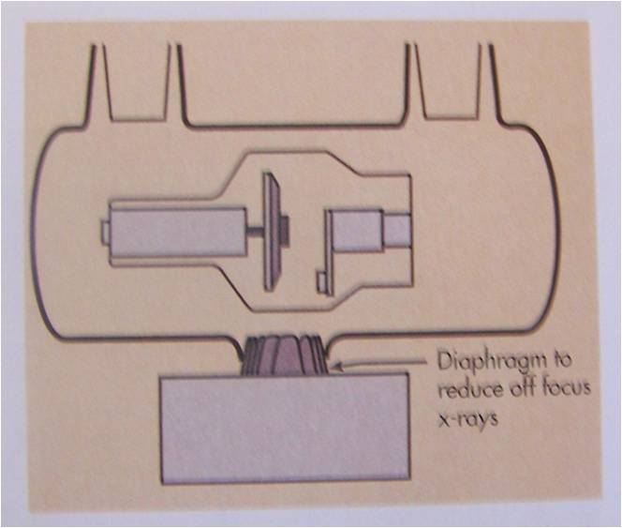

Slide 68
Metal tube decreases off- focal radiations by attracting the –vely charged electrons to the grounded metal wall.
Metal enclosure which is at a zero potential(since it is grounded) ,is relatively +ve as compared to the electrons.
Electrons striking the metal wall may produce x-rays , but the low atomic no. metal wall produces few & low energy x-rays.

Slide 69
Longer tube life:
Deposition of tungsten on the glass wall decreases tube life as it causes arcing between the glass & filament by acting as an anode itself.
Metal enclosure is grounded , hence deposition of tungsten will not alter this grounding.
For this reason tube life will be greater especially when used for high tube currents.

Slide 70
High tube loading:
The more massive anode (coz of extra bearings) allows for higher tube current & increased capacity for serial exposures coz of :
-larger heat storage capacity.
-better cooling.

Slide 71
Tube rating charts:
The limit on the load(in terms of Kv ,mA & exposure time) that can safely
be accepted by an x-ray tube is a function of heat energy produced during the exposure.
This energy is currently expressed in two different systems:
Heat Units (an artificial system)
SI units (the watt-second or joule)

Slide 72
Heat units:
Heat Unit is defined as product of mA and Kvp and time(sec) for a single phase power supplies.
It is expressed as HU.
For single phase generator:
1HU = 1Kvp x 1 mA x 1sec
For modern triple phase generator( which we routinely use)
1HU = 1.4 x 1kVp x 1 mA x 1 sec
Since kvp=1.4x Kv(i.e average voltage)

Slide 73
3 types of tube rating charts:
Radiographic rating charts.
Anode cooling charts.
Housing cooling charts.

Slide 74
Radiographic rating charts:
This is the most important of the three charts
It conveys which radiographic exposures are safe and which are unsafe
The chart shows a family of curves for different mA
For a given mA, any combination of kVp and time that lies below the curve is safe
Any combination that lies above the curve of desired mA is unsafe

Slide 75
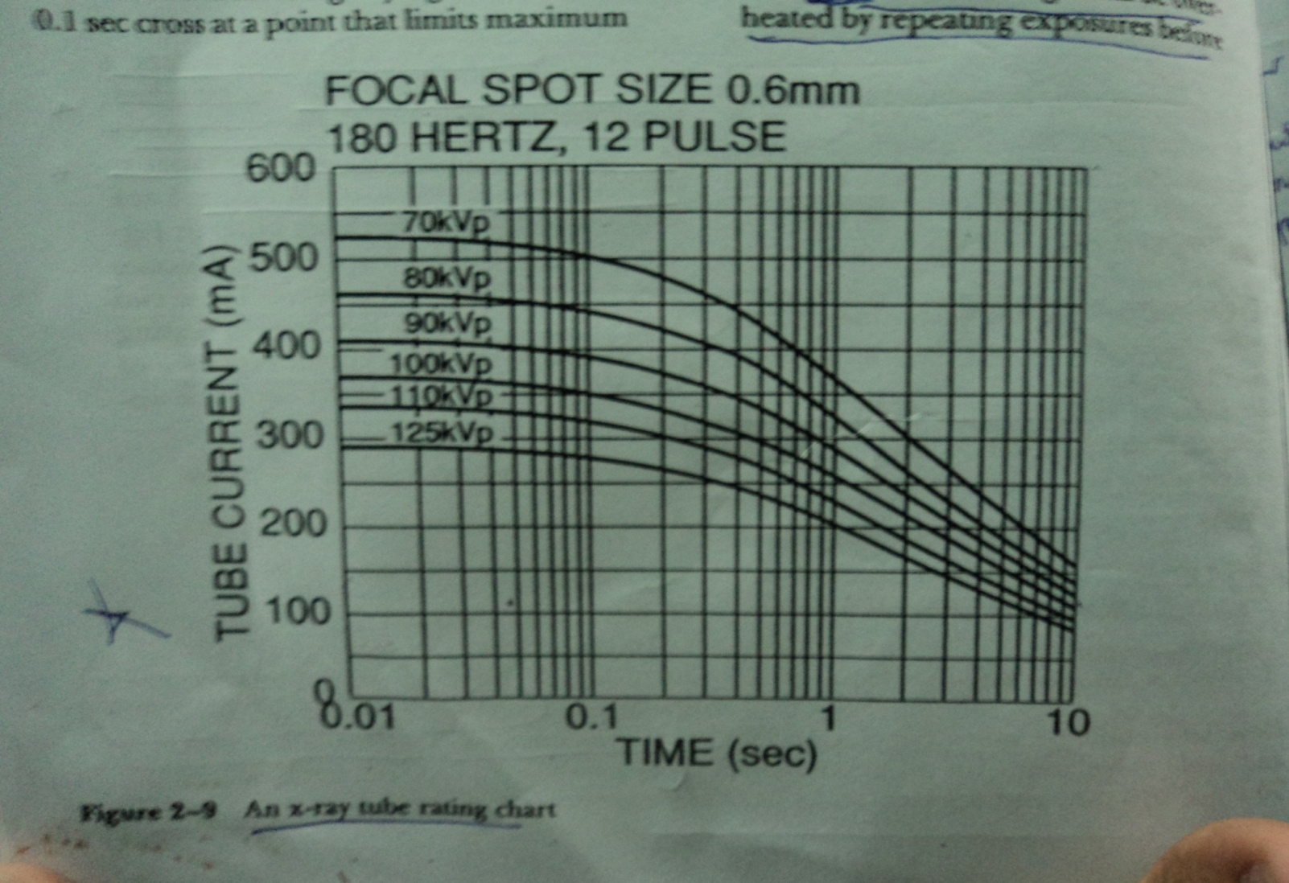
Is used for Single exposure.
Can be used for Multiple rapid exposures ( i.e. angiography) though however special charts are available
Notes:
Ex : if we know that an exposure will require 500mA at 0.1sec , then by using this chart v can c that it limits the max KV to about 70kvp

Slide 76
Three characteristics are to be considered for tube rating charts:-
1) The ability of the tube to withstand single exposure.
2) Multiple rapid exposures( as in
angiography)
3) Multiple exposures during several hours of heavy use (Fluoroscopy)

Slide 77
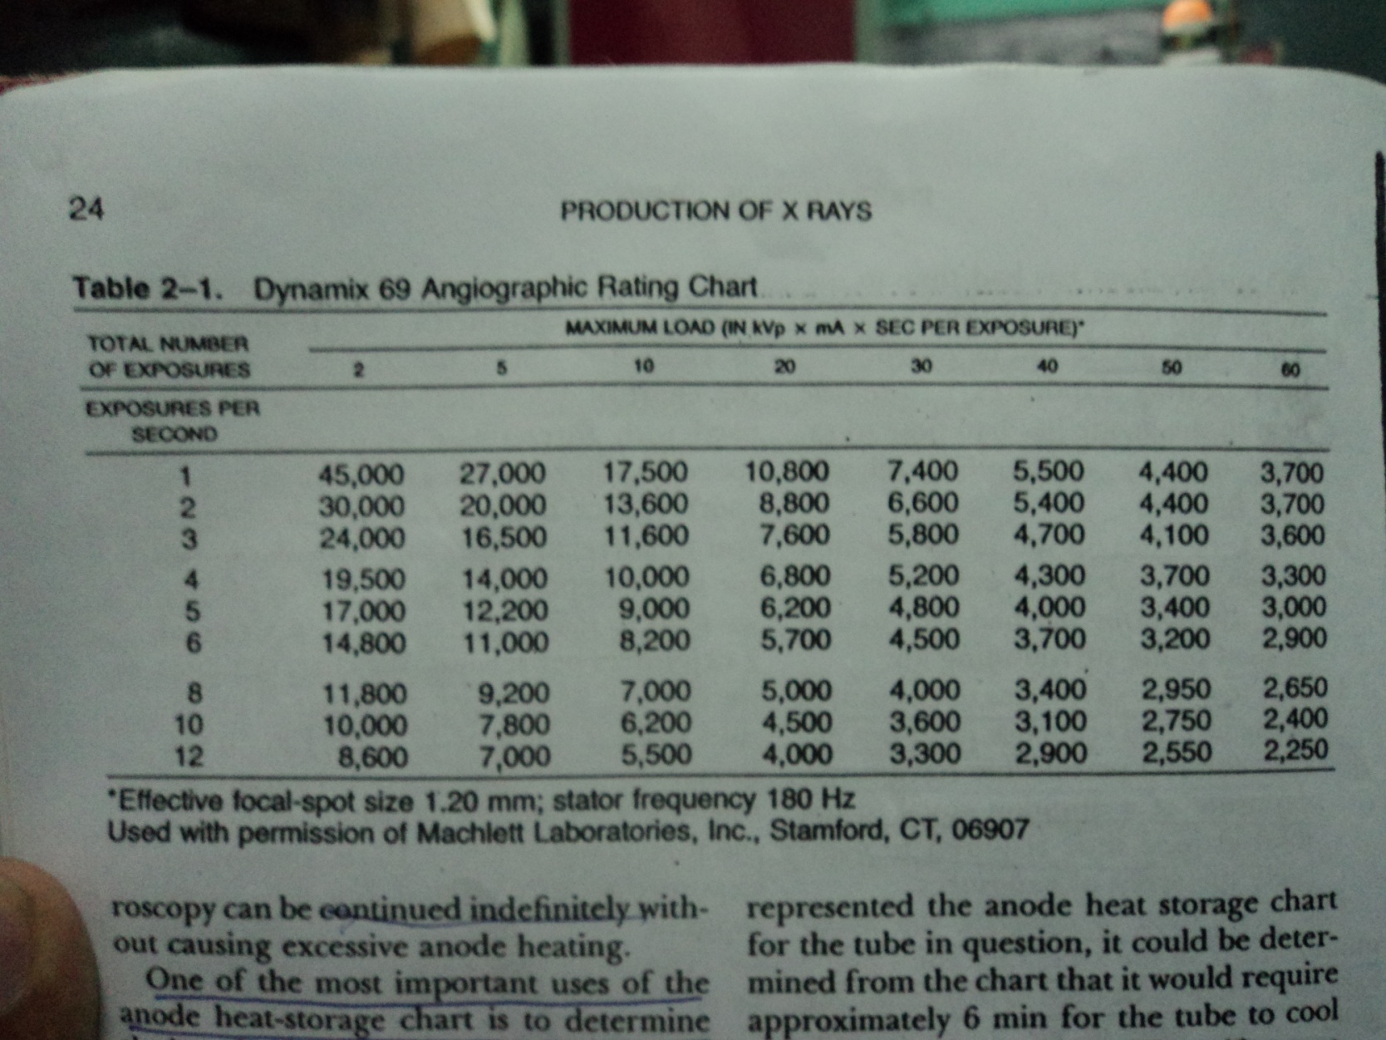
ANGIOGRAPHIC CHART
Notes:
Ex : if we wish to make 20 exposures at the rate of 2 exposures per second , chart indicates that we can use a maximum of 8800J per exposure , i.e we can deliver total of 1,76,000 J of enery in total 20 exposures in 10 seconds.

Slide 78
ANODE COOLING CHARTS:
Anode cooling charts contain the information about the thermal capacity of an anode and its heat dissipation characteristics.
It is used to determine the length of time required for complete cooling after any level of heat input.

Slide 79
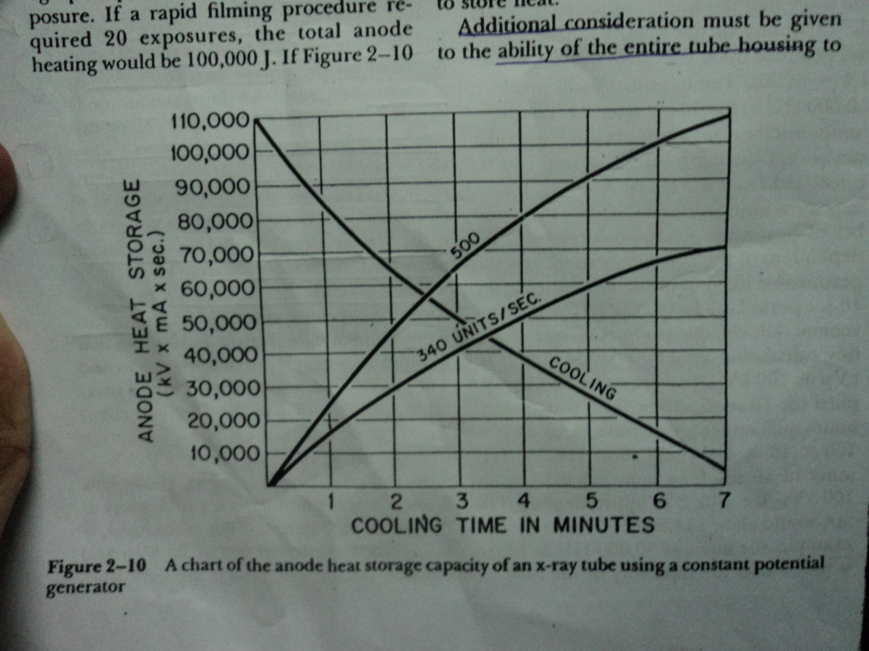

Slide 80
Housing cooling charts:
The cooling chart for the housing of the x-ray tube has a similar shape as the anode cooling chart.
The maximum heat capacity of the housing is in the range of several million heat units.
Complete cooling after maximum heat capacity requires from 1 to 2 hours

Slide 81
Microfocus x-ray tubes:
x-ray tubes that generate very small focal spot size ,upto 50µ , even smaller than 1µm may be produced.
2 types: - Solid anode tube
- Metal jet anode tubes
Solid Anode tube : focuses electron beam into very small spot at the anode.
Major disadv: It operates at a very low power(4-8W) in order to avoid melting of the anode.

Slide 82
Metal Jet Anode Microfocus X-ray tube:
Here the solid metal anode is replaced by a jet of liquid metal which acts as a target.
Advantage : Maximun power density increases(30-60 W).
Used in XRD , XRF(methods of NDT)
Notes:
XRD : x ray diffraction
XRF : x ray flourescence
NDT : non destructive testing

Slide 83
Thank you !!!

