Slide 1
MRI PHYSICS
By Dr. Rahul. Talwade
Moderator : Dr. A. K. shukla

Slide 2
History:
Felix Bloch & Edward Purcell discovered magnetic resonance phenomenon in 1946. Received Nobel Prize in 1952
Used for chemical and physical molecule analysis
Raymond Damadian in 1969 showed magnetic relaxation of tumor and normal tissue differed

Slide 3
MRI principle
MRI is based on the principle of nuclear magnetic resonance (NMR)
Two basic principles of NMR
Atoms with an odd number of protons or neutrons have spin
A moving electric charge, be it positive or negative, produces a magnetic field
Body has many such atoms that can act as good MR nuclei (¹H, ¹³C, ¹⁹F, ²³Na)
Hydrogen nuclei is one of them which is not only positively charged, but also has magnetic spin
MRI utilizes this magnetic spin property of protons of hydrogen to elicit images

Slide 4
Why Hydrogen ions are used in MRI?
Hydrogen nucleus has an unpaired proton which is positively charged.
Every hydrogen nucleus is a tiny magnet which produces small but noticeable magnetic field.
Hydrogen is abundant in the body in the form of water and fat.
Essentially all MRI is hydrogen (proton) imaging.
The average 70 kg adult human body contains approximately 3 x 10²⁷ atoms of which 67% are hydrogen atoms!!!!

Slide 5
Patient (protons) is put in a magnet.
RF signal is sent
RF signal is switched off
Patient emits a signal which is used for
Reconstruction of image

Slide 6
Proton are little magnet
Proton spin around its axis like a planet, has positive changer and electrical field around it, and moving electrical field has a magnetic field like a bar magnet

Slide 7
Precession
Proton moves in like spinning top
In two axis wobbling motion called
Precession, depends on magnetic
field strength

Slide 8
Proton alignment
Protons align to external magnetic field parallel or anti-parallel.
Both have different energy level
Like walking on feet require less energy than on hand, parallel state is preferred to anti-parallel
Difference is 10,000,000/10,000,007

Slide 9
Precession frequency:
Precession frequency is dependent on strength of external magnet field
It is determined by Larmor Equation
Wo = yBo
Wo is precession frequency in Hz or MHz
Bo is magnetic field strength in Tesla
y is gyro-magnetic ratio, for proton is 42.5MHz/Tesla
Stronger the external magnetic field higher the precession frequency

Slide 10
Coordinate system:
Representation of magnetic force in Z axis, Proton vector as red arrow

Slide 11
Net magnetic force
Proton pointing in opposite direction cancels each others magnetic effect
in respective direction.
9 proton align up and 5 down, resulting in 4 proton up force

Slide 12
As there are more protons aligned parallel to the external magnetic filed, there is a net magnetic movement aligned with or longitudinal to the external magnetic field
LONGITUDNAL MAGANETIZATION

Slide 13
In a strong external magnetic field a new magnetic vector is induced in the patient, who becomes a magnet himself.
This new magnetic vector is aligned with the external magnetic field
LONGITUDNAL MAGANETIZATION

Slide 14
Measuring magnetization
Magnetization along an external magnetic field cannot be measured
For this a magnetization transverse to the external magnetic field is
necessary

Slide 15
Transverse magnetization:
After RF pulse , precessing protons pick up some energy from RF pulse.
Some of the protons go to higher energy level and start precessing anti-parallel .
This results in reduction of longitudinal magnetization.
Forces of protons now add up to form a new magnetic vector in the X-Y plane . This is called as transverse magnetization.
And this transverse magnetization can be measured.

Slide 16
Resonance:
For exchange of energy to occur between protons and RF pulse, precession frequency of the protons should be same as RF pulse frequency.
When RF pulse and protons have same frequency , protons can pick up some energy from RF pulse. This phenomenon is called as resonance--- “R” of MRI.
After protons aligned along the external magnetic force, RF pulse is sent for energy exchange. Which is only possible if RF pulse has same frequency as protons precession frequency

Slide 17
Effect of RF pulse:
It lifts some protons to higher energy ( they point down), and it also causes the protons to precess in step, in phase.
The former result in decreasing the magnetization along the Z-axis, the longitudinal magnetization
The later establishes a new magnetization in the x-y-phase (->), a new transversal magnetization, which moves around with the precessing protons- Phase Coherence

Slide 18
Before RF pulse there is only longitudinal magnetization
After the 90dgr RF pulse there is only transversal magnetization and this is spinning around
With time after the removal of RF pulse the transversal magnetization decreases and longitudinal magnetization increases in spiral motion

Slide 19
Free induction decay:
The sum magnetic vector changes constantly in its direction and magnitude, while it performs its spiral motion.
The sum vector induces an electrical current in an antenna, the MR signal.
This is greatest immediately after RF signal is switched off and then decreases
The signal intensity reduces but frequency is constant
This is called free induction decay (FID) signal

Slide 20
Localization of signal:
Three more magnetic fields are superimposed on main magnetic field along X, Y and Z axes to localize the signal.
These are of varying strength – gradients .
The three gradients are :
Slice selection gradient – Z axis.
Phase encoding gradient- Y axis.
Frequency encoding gradient- X axis.
In a usual sequence, slice selection gradient is sent at the time of RF pulse. Phase encoding gradient is turned on for a short time after slice selection gradient . Frequency encoding or readout gradient is sent in the end at the time of signal reception.
Information from all three axes is sent to computers to get the particular point in that slice from which the signal is coming.

Slide 21
TIME TO WAKE UP…☺
REGARDING MRI SAY TRUE/FALSE
The gyro magnetic ratio of a hydrogen atom is 42.57MHz/T
The strength of magnetic field is measured in gauss
The Larmor frequency is defined as sum of the magnetic field and gyromagnetic ratio.
An MR active nucleus spins at its own precessional frequency.
ONLY hydrogen nuclei are said to be MR active
true
true
1 Tesla = 10kG = 10,000 Gauss.
false
true
false

Slide 22
Instrumentation:
Four basic components make MR system.
Magnet to produce external magnetic field.
Gradients to localize the signals.
Transmitter and receiver to coils for RF pulses.
Computer system.

Slide 23
Magnetism and magnets:
Magnetism is fundamental property of matter. Degree of magnetism depends on the magnetic susceptibility of the atoms which make the substance.
Paramagnetism
Diamagnetism.
Ferromagnetism.

Slide 24
Magnetic field strength:
Magnetic field strength is expressed by notation ‘B’, the primary field as ‘Bo’ and secondary field as ‘B1’.
Units of magnetic field strength are Gauss and Tesla ( TESLA was father of alternating current and GAUSS was a german mathematician)
1 Tesla = 10kG = 10,000 Gauss.
Gauss is the measure of low magnetic field strength. Earths magnetic field strength is approximately 0.6 G.
MRI systems used for clinical purpose have strength ranging from 0.2 to 7 Tesla.
Advanced MR applications like spectroscopy, functional MRI, cardiac MRI are possible only on higher field strengths like 1.5 T.

Slide 25
Magnets:
Three types:
Permanent :
Alnico ( alloy of aluminium, nickle and cobalt) ferromagnetic substance.
Low range of strength: 0.2 to 0.5 Tesla.
Electromagnets: low range 0.2 to 0.3 Tesla
Superconducting magnets:
Helium based.
Hot magnets.

Slide 26
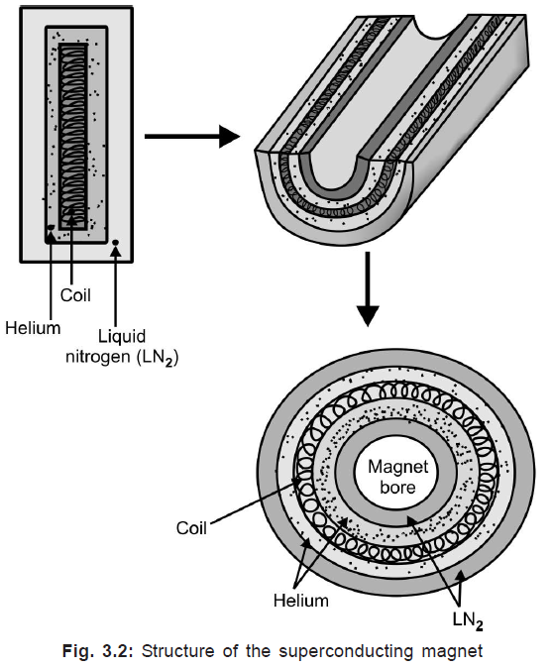
Superconducting magnets:
Mercury or Niobium- Titanium alloy.
Very low temperature- lose their electric resistance
Higher field strength is achieved.
Structure of superconducting magnet

Slide 27
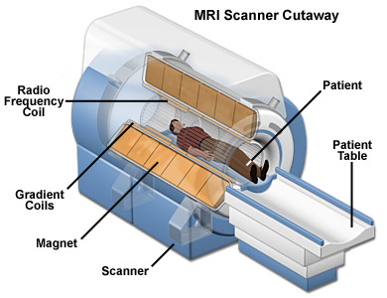

Slide 28
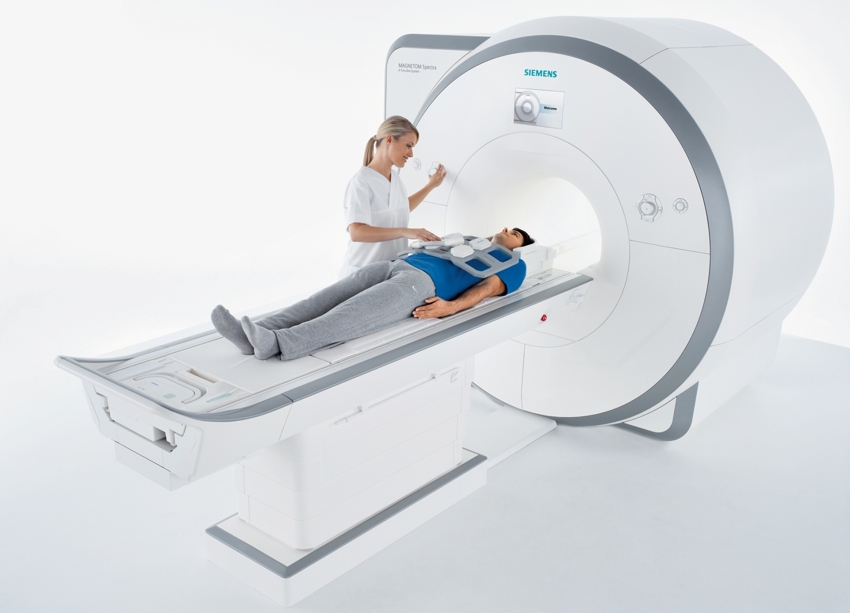

Slide 29
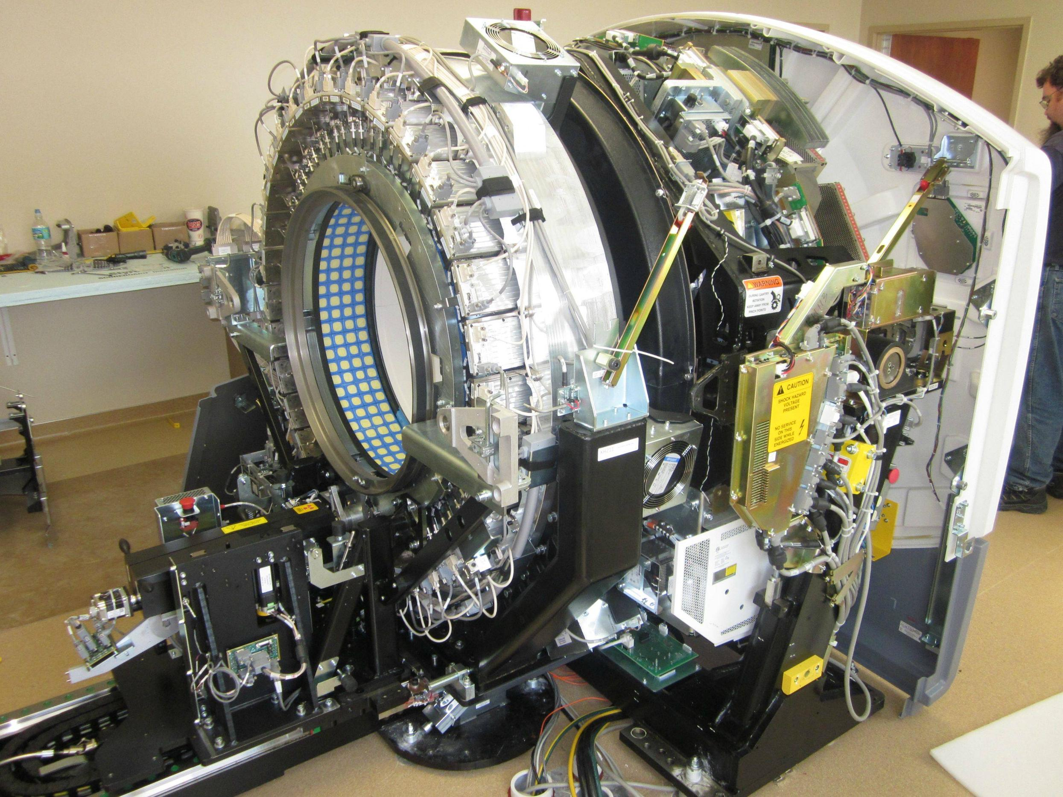

Slide 30
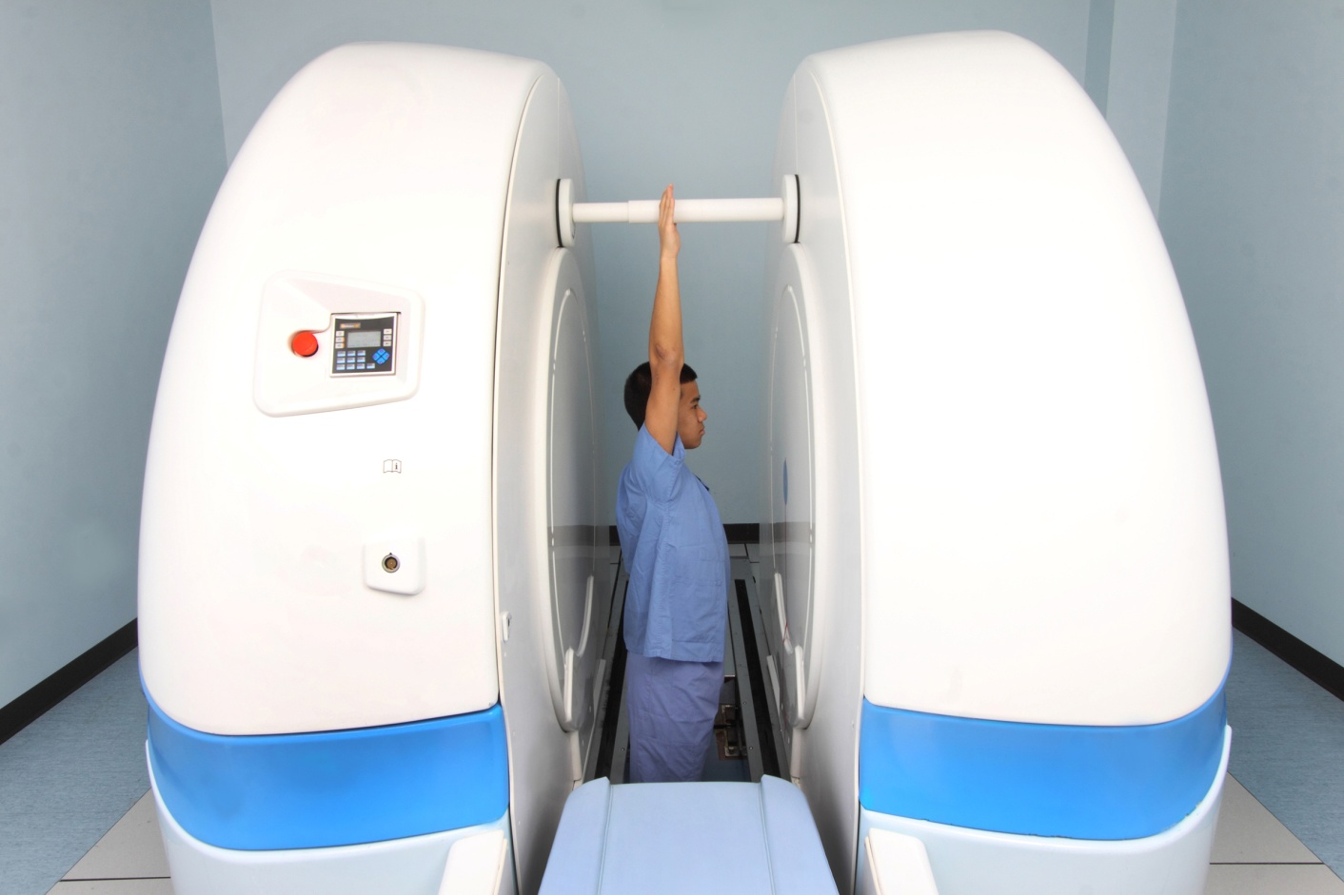
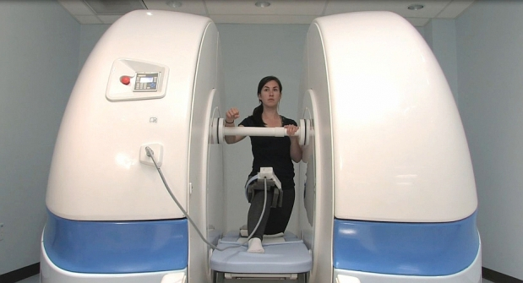
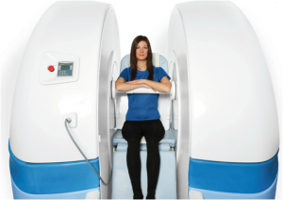
Split magnets

Slide 31
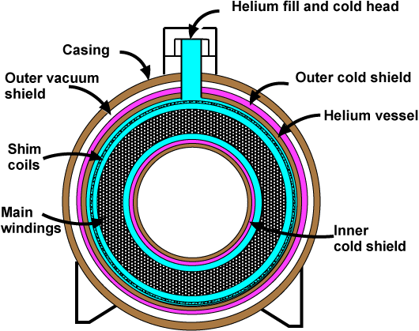

Slide 32
ramping
When magnet is started first time , it is done in a particular way or sequence.
first the superconducting coil is cooled to -269 degree Celsius by helium and liquid nitrogen.
Then magnet is energized by delivering current from external power source to superconducting coil. Once desirable level of current is achieved , power supply is cut off.
The current continues to circulate through the coil.
The current and the magnetic field produced by it remains constant subjected only to minor changes.

Slide 33
Shimming:
Magnetic field should be uniform all over its extent to get correct signals from patient . Even though magnetic field is more or less uniform there might be minor inhomogeneity.
The process of making the magnetic field homogenous is called as shimming.
This process is necessary because of the difficulty of winding a perfect coil , slight changes in the wire and presence of metal within the environmemt, which leads to magnetic field inhomogeneity.
Active shimming- shim coils
Passive shimming – shim plates.

Slide 34
Shielding:
The stray magnetic field outside the bore of the magnet is known as fringe field . This stray field can cross conventional walls, floors or ceilings and can potentially be harmful to the patients with pacemakers, for monitoring devices and other magnetically –activated devices present nearby.
To prevent this MR system is shielded by two processes:
Passive shielding: is done by lining the wall of MR room by steel or copper. This chamber is called as ‘ Faraday’s cage’.
Active shielding : it uses additional solenoid magnet outside the cryogen bath that restricts the B0 lies to acceptable location . It is expensive alternative.

Slide 35
Gradients:
Gradients are used to vary magnetic field strength over the extent of magnetic field. Gradient system consists of three sets of coils that produce field with changing strength in X, Y and Z directions.
Three gradients are used for slice selection, phase encoding and frequency encoding when applied in three directions perpendicular to each other.
How gradient coils are produced?
Magnetic field strength is proportional to the amount of current passed through the loop of wire, number of loops in wire, the size of the loop and how closely the loops are spaced. By changing these parameters coil can be produced, which increases or decreases magnetic field strength in particular direction.

Slide 36
Gradient coils are located coaxially in the room temperature compartment of the magnet bore.
Apart from localization gradients are used for gradient echo sequence. Gradients are used for rewinding transverse magnetization. Gradients are used to rephase the protons when they are going out of phase after RF pulse is switched off. Thus eliminating 180 degree pulse and making the gradient echo sequence much faster.

Slide 38
Gradient strength has effect on slice thickness and FOV that can be used. For a constant bandwidth, weaker gradient will produce thicker slice and stronger gradient will produce thinner slice.
Quality of gradient system depends on gradient linearity and their rise and fall time. In typical spin-echo imaging slice selection gradient is on for 3 ms, the phase encoding gradient for 4 ms and frequency encoding (readout) gradient for 8 ms.

Slide 39
RF coils:
A loop of wire is coil. Radiofrequency (RF) coils are used to transmit RF pulse into the patient and to receive the signals from the patient.
RF coils can be transmitters, receivers or both transmitter and receiver then it is called as transceiver. Energy is transmitted in the form of short intense bursts of radiofrequencies known as radiofrequency pulses. This RF pulses cause phase coherence and flip some of the protons from a low energy states to high energy states.
RF pulse that causes net magnetization vector to flip by 90 degree is called as 90 degree RF pulse. Rotating TM vector induces current in the receiver coil, which forms signal.

Slide 40
Various types of RF coils are:
1. Body coil
2. Head coil
3. Surface or local coil
4. Phased array coil
5. Solenoid coil
6. Helmholtz coil

Slide 41
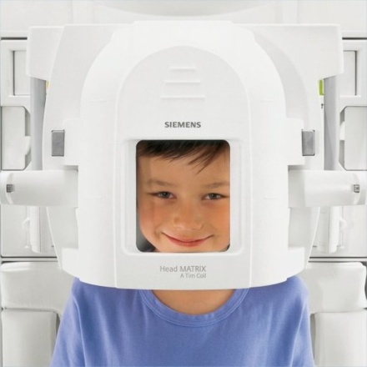
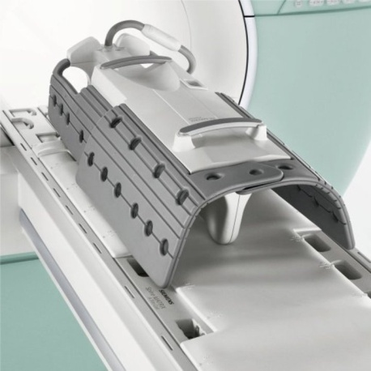
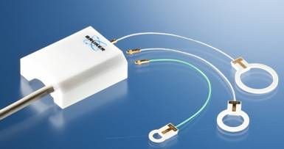
Head and body coils are volume coils and are transceivers. They cover larger area and give uniform SNR over the entire imaging volume. However, SNR is lower than other types of coils. They also act as transmitters for surface or local coils.
Surface coils improve SNR significantly when used to image structures near the surface of the patient. Area covered is sensitive volume covered by the coil. Signal drops as the distance of the structure increased from the coil. Body coil acts as transmitter for surface coil, which are receiver only. Various surface or local coils are designed as per requirement for the particular parts. Examples are flex coils that can be wrapped around knee, shoulder and ankle. There are orbit and carotid coils. Local coils can be endoluminal for example rectal coil for prostate imaging. All these coils give images with high SNR and high resolution.

Slide 42
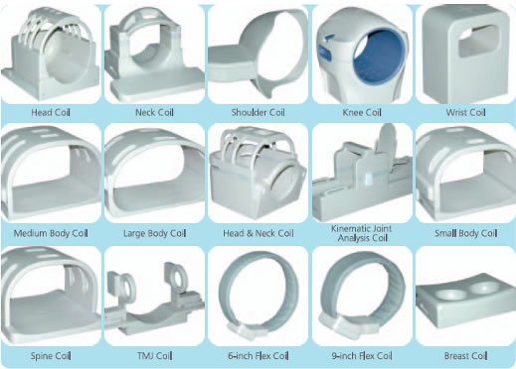

Slide 43
Phased Array coils combine advantages of surface coils (increased SNR and resolution) and volume coils (increased coverage). They consist of multiple small coils. The signal input of each coil is separately received and processed and then combined to form single larger FOV.
There could be four (4 channel) or six (6 channel) small coils in phased array coils. Phased array coils are used in body imaging, spine, pelvis, cardiac, MRCP and other imaging

Slide 44
Computers:
This is the last component of MR system. Computer system control every application. They perform functions of data collection and manipulation, image viewing, storage, retrieval and documentation.

Slide 46
Before RF pulse there is only longitudinal magnetization
After the 90dgr RF pulse there is only transversal magnetization and this is spinning around
With time after the removal of RF pulse the transversal magnetization decreases and longitudinal magnetization increases in spiral motion

Slide 47
Relaxation:
Relaxation means recovery of protons back towards equilibrium after been disturbed by RF excitation. Relaxation times of protons and heterogeneous distribution of tissue-proton densities determine the contrast in an MR image.
We have seen that RF pulse causes LM to reduce and TM to form.
What happens when RF pulse is switched off?
When RF pulse is switched off TM reduces, which is called as Transverse Relaxation and LM increases, which is called as Longitudinal Relaxation.
The net magnetization vector (NMV) is the sum of two vectors in different planes (like LM and TM vector) represented as single vector in a plane midway between the two.

Slide 48
Terminology:
When RF pulse is switched off, protons start losing their energy. This energy is given to surrounding or lattice, hence this is also called as ‘spin-lattice’ relaxation. As protons lose their energy, the magnitude of LM increases.
After RF pulse is switched off, there is gradual decrease in the magnitude of TM and is termed as Transverse relaxation.
LONGITUDINAL RELAXATION.
TRANSVERSE RELAXATION.
T1 CURVE.
T2 CURVE.
T1.
T2.
TR- TIME OF REPETATION.
TE- TIME OF ECHO.
TI- TIME OF INVERSION.
TI WEIGHTED IMAGE.
T2 WEIGHTED IMAGE.
PD – PROTON DENSITY IMAGE.
When curve is plotted of LM magnitude against time, it is called as T1 curve.
When curve is plotted of TM magnitude against time, it is called as T2 curve.

Slide 49
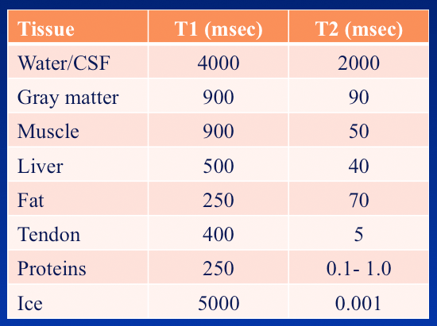
LONGITUDINAL RELAXATION.
TRANSVERSE RELAXATION.
T1 CURVE.
T2 CURVE.
T1.
T2.
TR- TIME OF REPETATION.
TE- TIME OF ECHO.
TI- TIME OF INVERSION.
TI WEIGHTED IMAGE.
T2 WEIGHTED IMAGE.
PD – PROTON DENSITY IMAGE.
T1 is the time when LM reaches back
to 63% of its original value.
T1 depends upon tissue composition, structure and surroundings.
water has long T1.
fat has short T1.
It is the time taken by TM to reduce to 37% of its original value.
T2 depends on inhomogeneity of external magnetic field and inhomogeneity of local magnetic field within tissues.
Water has long T2.
Fat has short T2.

Slide 50
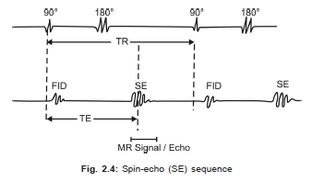
LONGITUDINAL RELAXATION.
TRANSVERSE RELAXATION.
T1 CURVE.
T2 CURVE.
T1.
T2.
TR- TIME OF REPETATION.
TE- TIME OF ECHO.
TI- TIME OF INVERSION.
TI WEIGHTED IMAGE.
T2 WEIGHTED IMAGE.
PD – PROTON DENSITY IMAGE.
TR (Time to Repeat) is the time interval between start
of one RF pulse and start of next RF pulse. Typically in
spin-echo sequence time interval between beginnings of
90 degree pulses is TR.
TE (Time to Echo) is the time interval between start
of RF pulse and reception of the echo (signal).
TI is Time of Inversion. It is the time between inverting
180 degree pulse and 90 degree pulse in Inversion recovery (IR) sequence. TI determines contrast IR sequence.

Slide 51
LONGITUDINAL RELAXATION.
TRANSVERSE RELAXATION.
T1 CURVE.
T2 CURVE.
T1.
T2.
TR- TIME OF REPETATION.
TE- TIME OF ECHO.
TI- TIME OF INVERSION.
TI WEIGHTED IMAGE.
T2 WEIGHTED IMAGE.
PD – PROTON DENSITY IMAGE.
How do we make images T1-weighted?
This is done by keeping TR short. If TR is long the tissues
with long T1 will also regain maximum LM giving stronger
TM with next RF pulse and stronger signal. This will result
in no difference between tissues with different T1. So in
T1-W images differences in signal intensity in tissues is due to their difference in T1
How do we make images T2-weighted?
With short TE, difference between tissue A and B will be less pronounced. With long TE signal difference between A and B, i.e. tissues with long (A) and short (B) T2 will be more. So, image with long TE is T2- weighted since signal difference between tissues (contrast) is determined by T2 of tissues.
Contrast in the image is determined by density of protons
in the tissue. T1 effect is reduced by keeping long TR and
T2 effect is reduced by keeping TE short. Hence long TR
and short TE gives PD-weighted image

Slide 52
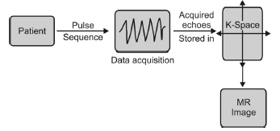
Basic sequences:
A pulse sequence is interplay of various parameters leading to a complex cascade of events with RF pulses and gradients to from a MR image.
So pulse sequence is a time chart of interplay of:
1. Patient’s net longitudinal magnetisation
2. Transmission of RF pulses (90, 180 degree or any degree)
3. X, Y and Z gradient activation for localisation and acquisition of signal (echo)
4. K-space filling with acquired signals or echoes.

Slide 53
k-space is an imaginary space which represents raw data matrix. After acquisition all signals are stored in k-space. This raw data from k-space is then used to reconstruct image by Fourier Transformation.
Center part of k-space represents contrast of the image.
Periphery corresponds with resolution and fine details.

Slide 54
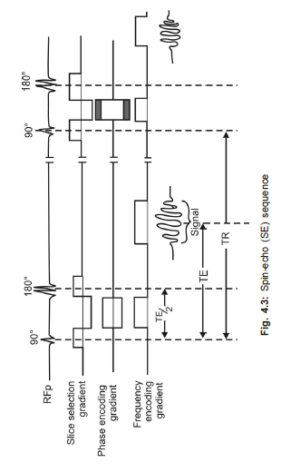
SPIN-ECHO PULSE SEQUENCE (SE)
It consists of 90 and 180 degree pulses. Excitatory 90 degree pulse flips net magnetisation vector by 90 degree from along Z-axis into transverse X-Y plane. When 90 degree pulse is switched off, protons start dephasing and amount of TM magnetisation reduces.
At this stage second pulse of 180 degree is sent. This 180 degree pulse also called as rephasing pulse, brings protons back into phase. This rephasing results into increased magnitude of TM and echo or signal is received by the receiver coil. This is called as spin-echo.

Slide 55
In conventional SE sequence one line of k-space is filled per TR.
SE is mother of all sequences and forms basis for understanding all other sequences. It is used in almost all examinations.
T1-weighted images are useful for demonstrating anatomy. Since tissues that are diseased, are generally more edematous and or vascular, they appear bright on T2-weighted images. Therefore, T2-weighted images demonstrates pathology well.

Slide 56
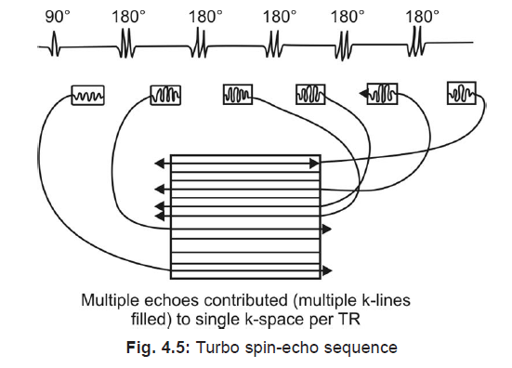
Turbo Spin-Echo Sequence
When multiple 180 degree rephasing pulses are sent after 90 degree pulse, it is called as multi spin-echo or Turbo spin-echo sequence. In this sequence multiple echoes obtained per TR; one echo with each 180 degree pulse.
All the echoes are used to fill single or common k-space. Since k-space is filled much faster with multiple echoes filled in single TR the scanning speed increases considerably.

Slide 58
Turbo factor: Turbo factor is number of 180 degree pulses after each 90 degree pulse. It is also called as echo train length.
USES: Image contrast of TSE is similar to SE sequence. Therefore, these sequences are useful in most clinical applications as SE sequence.
Added advantage is greatly reduced scan time such that acquisition can be completed in single breath-hold.
HASTE and RARE are examples of TSE used in MRCP.

Slide 59
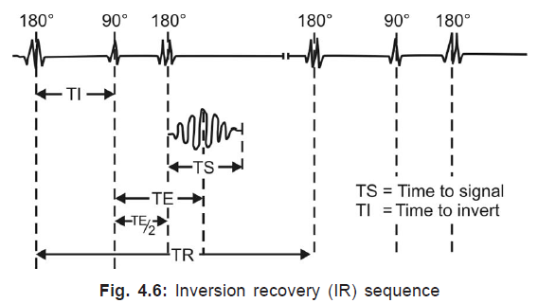
Inversion Recovery (IR) Sequence
IR sequence consists of an inverting 180 degree pulse followed by 90 degree excitation pulse followed by rephasing 180 degree pulse.
The inversion 180 degree pulse flips NMV along negative side of Z-axis. This saturates fat and water completely at the beginning of each 90 degree pulse. When 90 degree excitatory pulse is applied after NMV has relaxed through the transverse plane, contrast in the image depends on the amount of longitudinal recovery, as in SE sequence. Apart from getting heavily T1-weighted images to demonstrate anatomy, IR sequence also used to suppress particular tissue depending on TI. IR sequence also can be used in postcontrast imaging as they enhance signals from tissues taking up contrast.

Slide 60
Tissue Suppression:
If TI corresponds with time the tissue takes to recover after 180 degree inversion pulse from full inversion to transverse plane, there will not be any longitudinal magnetisation. So, when 90 degree pulse is applied there is no TM, i.e. no signal. IR sequences are thus used to suppress certain tissues by changing TI. The TI required to null the signal from a tissue is 0.69 times T1 relaxation time of that tissue.

Slide 61
GRADIENT ECHO SEQUENCE (GRE)
There are basic three differences between SE and GRE sequences.
1. There is no 180 degree pulse in GRE. Rephasing of TM in GRE is done by gradients; particularly by reversal of frequency encoding gradient. Since rephasing by gradient gives signal this sequence is called as Gradient echo sequence.
2. Flip angle in GRE are smaller, usually less than 90 degree. Since flip angle is smaller there will be early recovery of LM such that TR can be reduced hence scanning time.
3. Transverse relaxation in SE sequence is caused by combination of two mechanisms-
A. Irreversible dephasing of TM resulting from nuclear, molecular and macromolecular magnetic interactions with proton.
B. Dephasing caused by magnetic field inhomogeneity.

Slide 62
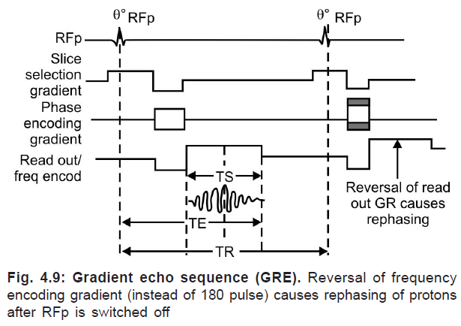
In SE sequence the dephasing caused by inhomogeneity is eliminated by 180 degree pulse. Hence there is ‘true’ relaxation in SE sequence. In GRE sequence dephasing effects of magnetic field inhomogeneity are not compensated as there is no 180 degree pulse. T2 relaxation in GRE is called as T2* (T2 star) relaxation.

Slide 63
Take home message:
MRI utilizes this magnetic spin property of protons of hydrogen to elicit images.
Larmor Equation-- Wo = yBo.
Transverse magnetization is measured.
Resonance.
Free induction decay.
Localization of signal. (Z, Y and X)
1 Tesla = 10kG = 10,000 Gauss.
Superconducting magnets ---Mercury or Niobium- Titanium alloy.
Ramping, shimming and shielding.
TI weighted image.
T2 weighted image.
PD – proton density image.

