Slide 1
JOURNAL CLUB
DR DIMPI SINHA,MDRD

Slide 2
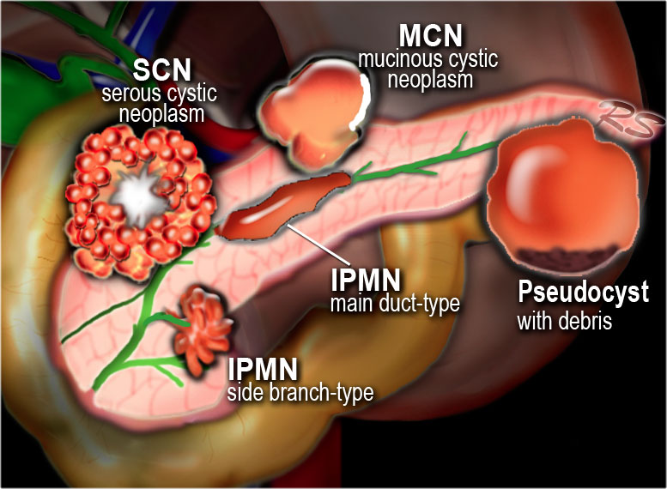
CYSTIC LESIONS OF PANCREAS-DIAGNOSIS AND MANAGEMENT

Slide 3
articles
Pancreas - Cystic Lesions-Diagnosis and management
Marc Engelbrecht, Jennifer Bradshaw and Robin Smithuis
Radiology department of the Academical Medical Centre, Amsterdam and
the Rijnland hospital in Leiderdorp, the Netherlands-published in 2012 in
radiology assistant.
Cystic Pancreatic Lesions: A Simple Imaging-based Classification System for Guiding Management published in Radiographics in 2005.
Dushyant V. Sahani, Rajgopal Kadavigere, Anuradha Saokar, Carlos
Fernandez-del Castillo, William R. Brugge, Peter F. Hahn

Slide 4
Morphologic classification of cysts based on imaging findings.
Roadmap to approach pancreatic cystic lesion.
Mangement of such lesions.

Slide 5
INTRODUCTION
Cystic lesions of the pancreas encompass a variety of neoplastic and nonneoplastic processes that cause a range of clinical symptoms.
With the increasing use of cross-sectional imaging, pancreatic cysts have become a common incidental finding.
The accurate imaging-based characterization of pancreatic cystic lesions is necessary for appropriate patient triage and management, as some lesions require surgical intervention or follow-up imaging, whereas others require no further action.

Slide 6
Clinical presentation
Pseudocysts typically occur with acute pancreatitis or trauma or may develop insidiously in the setting of chronic pancreatitis.
A large number of pancreatic cysts are incidentally detected during imaging work-up for an unrelated medical problem.
The majority of incidentally detected pancreatic cysts turn out to be cystic neoplasms.
Symptomatic cysts are most likely to manifest with abdominal pain. Jaundice or recurrent pancreatitis indicating that the lesion is either in communication with the pancreatic ductal system or obstructing the pancreatic or biliary duct.
Notes:
Symptoms and clinical presentation are variable.
Pseudopancraetic cysts typically occur with acute pancraetitis or taruma or chronic apncraettis.
Most of the cystic neoplasms of pancreas are asymptomatic and incidentally detected during imaging work-up for an unrelated medical problem,
Some of the cystic neoplasms are symptomatic and present with abdominal pain,jaundice and recurent pancreatitis due to obstruction of main pancreatic duct,billiary

Slide 7
MRI VS CT
CT will depict most pancreatic lesions, but is sometimes unable to depict the cystic component.
Currently, Abdominal MRI with MRCP is considered the modality of choice for demonstrating the
1.Cystic nature,
2.Morphologic features of the cyst (including septa and mural nodules),
3.Establishing the presence of communication between the cystic lesion and
the pancreatic duct as is seen in IPMN, and
4.Evaluating the extent of pancreatic ductal dilatation.
There are cases when CT can be helpful, since it better depicts a central calcification in SCN or peripheral calcification in a mucinous cystic neoplasm (MCN).
Notes:
Although MDCT scans detect most of the cystic pancreatic lesions, abdmonial MRI with MRCP is the investigation of choice as sometimes specially in small lesions CT may fail to demonstrate the cystic nature of the lesion.

Slide 8
ROLE OF ENDOSCOPIC USG
Guided aspiration.
FNAC from cystic lesion.

Slide 9
DIFFERENTIALS OF PANCREATIC CYSTIC LESIONS
Notes:
Pseudocysts, serous cystadenoma, mucinous cystic neoplasm and IPMNs account for majority of pancraetic cystic leison (90%).Rest 10% are SPEN,NET with cystic changes,Pancreatic adenocarcinoma with cystic changes and true epithelial cysts.

Slide 10
MORPHOLOGIC CLASSIFICATION
Morphologic Classification of Cystic Pancreatic Lesions
Based on the imaging morphologic features of the cyst, Pancreatic cysts can be classified into four subtypes:
(a) Unilocular cysts,
(b)Microcystic lesions,
(c) Macrocystic lesions, and
(d) Cysts with a solid component
Reference: Cystic Pancreatic Lesions: A Simple Imaging-based Classification System for Guiding Management
Dushyant V. Sahani, Rajgopal Kadavigere, Anuradha Saokar, Carlos Fernandez-del Castillo, William R. Brugge, Peter F. Hahn

Slide 11
UNILOCULAR CYST
Pseudocyst
Branch type IPMN
Unilocular serous cystadenoma
True epithelial cysts
Notes:
Unilocular cysts include pancreatic cysts without internal septa, a solid component, or central–cyst wall calcification. Pseudocyst is the most common and the most frequently encountered cystic lesion in this group. Other less commonly encountered unilocular cysts include IPMNs, unilocular serous cystadenomas, and lymphoepithelial cysts.

Slide 12
PSEUDO CYST
Collection of pancreatic enzymes, blood and necrotic tissue.
Debris within a cystic lesion is a specific MR finding.
History of pancreatitis or abdominal trauma.
The imaging findings -pancreatic inflammation, atrophy or calcification of the pancreatic parenchyma, and dilatation of and calculi in a typically thin-walled pancreatic duct.
Cysts develop in 4-6 weeks - usually decrease in size over time - sometimes enlarge or become infected.
Found in any part of the pancreas or anywhere within the abdomen and sometimes even in the chest.

Slide 14
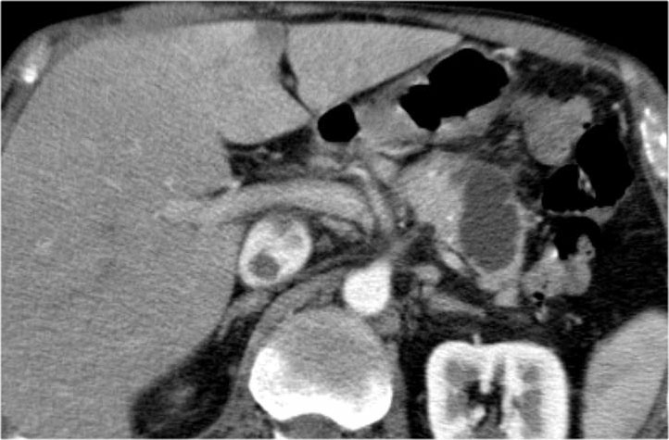

Slide 15
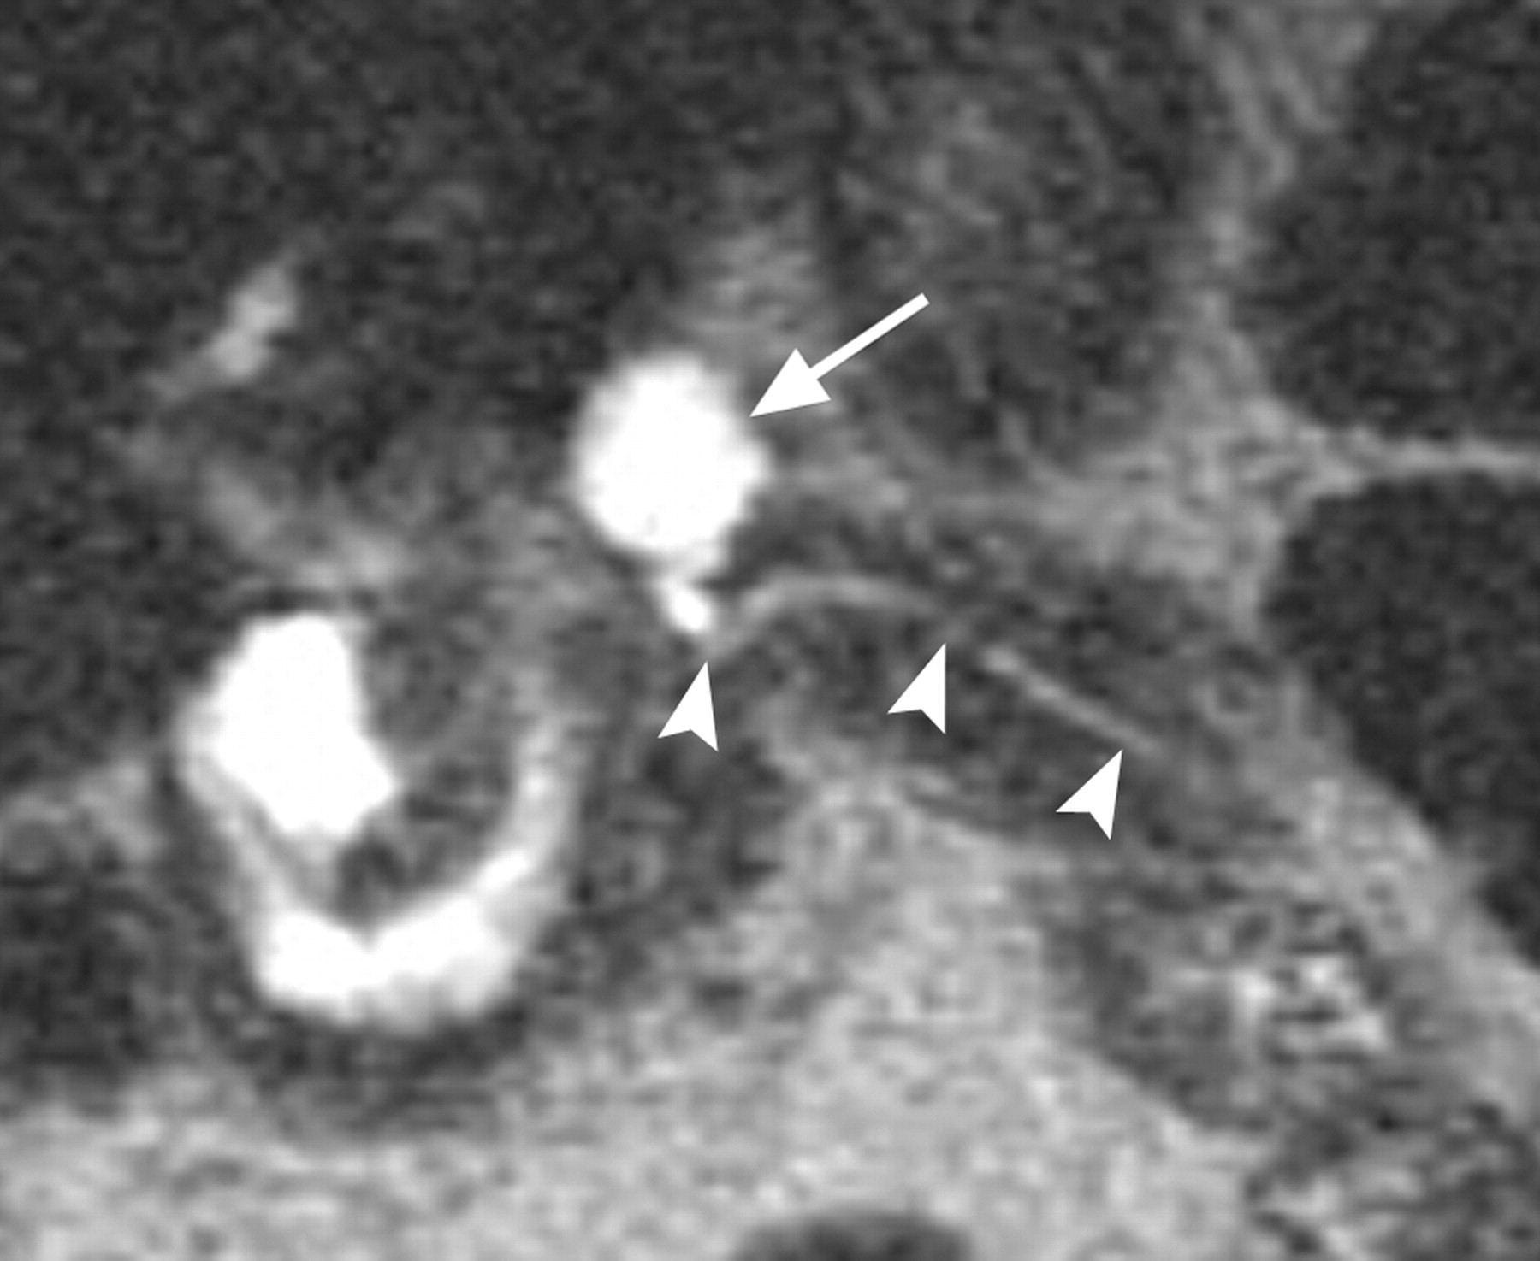

Slide 16
MICROCYSTIC LESION
Notes:
polycystic or microcystic pattern consisting of a collection of cysts (usually more than six) that range from a few millimeters up to 2 cm in size

Slide 17
MICROCYSTIC LESIONS SEROUS CYSTADENOMA
Typically in ’GrandMother' - median age: 60-70 years
In 70% of cases-MICROCYSTIC PATTERN.
External lobulations , enahncing wall and sepattions.
A fibrous central scar with or without a characteristic stellate pattern of calcification at CT or MR imaging is highly specific and is considered to be virtually pathognomonic for serous cystadenoma .
Pancreatic ductal dilatation or communication with main pancraetic duct is not seen.
Only cystic neoplasm with no malignant potential.

Slide 18
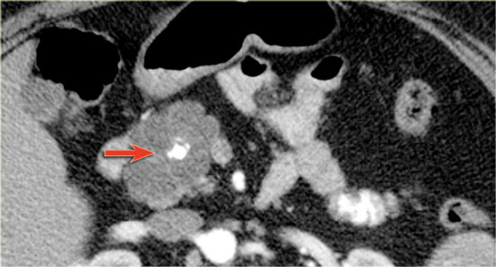
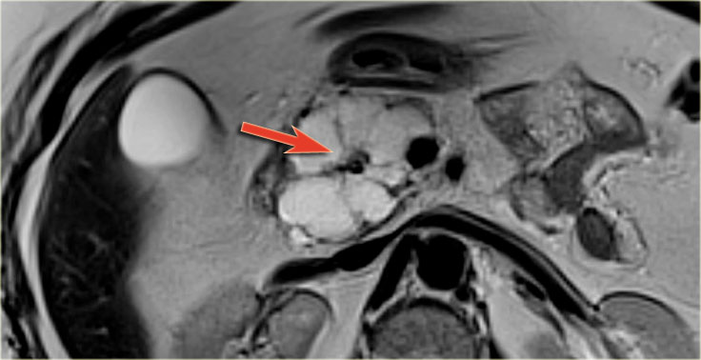

Slide 19
Notes:
10% of cases Macrocystic/unilocular pattern and difficult to differentiate from mucinous cystic neoplasm and pseudocyst.

Slide 20
Branch duct type ipmn
Branch-duct IPMN - This tumor can look like a SCN, but has no scar or calcifications.
Can be multifocal.
Identification of a septated cyst that communicates with the main pancreatic duct is highly suggestive of a side-branch or mixed IPMN.
Location: pancreatic head >> tail and corpus.

Slide 22
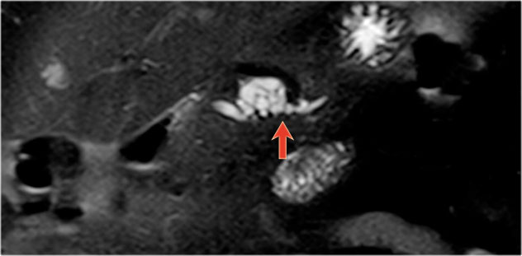

Slide 23
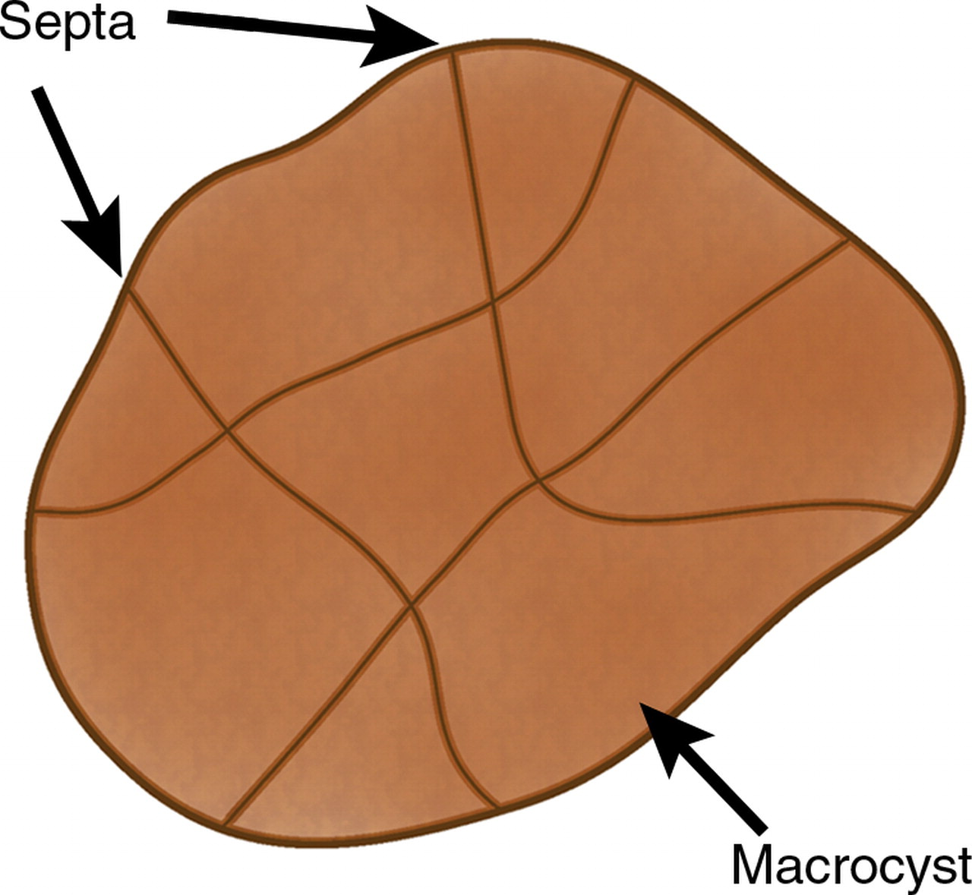
MACROCYSTIC LESION
Notes:
Macrocystic lesions include multilocular cysts with fewer and bigger compartments (>2 cm) with or without wall calcification.

Slide 24
MUCINOUS CYSTIC NEOPLASM
Premalignant tumor - may transform into a mucinous cystadenocarcinoma
Exclusively seen in women - Typically in 'Mother' - median age: 40-50 years
Macrocystic with thickened wall , septations and peripheral calcifications. The cysts may occasionally contain debris or hemorrhage.
The complex internal architecture of the cyst, including septa and an internal wall, is best appreciated at MR imaging and endoscopic US, allowing differentiation from serous cystadenomas
Peripheral calcifications seen in 25%. Peripheral eggshell calcification -specific finding for a mucinous cystic neoplasm and is highly predictive of malignancy.
Location in the tail and body of the pancreas (95%).
These tumors can be asymptomatic in up to 75% of cases .When present, symptoms are caused by the mass effect of these often large neoplasms.
Because mucinous cystic neoplasms have a high potential for malignancy, surgical resection is usually advocated
They do not communicate with the pancreatic duct, they can cause partial pancreatic ductal obstruction.

Slide 25
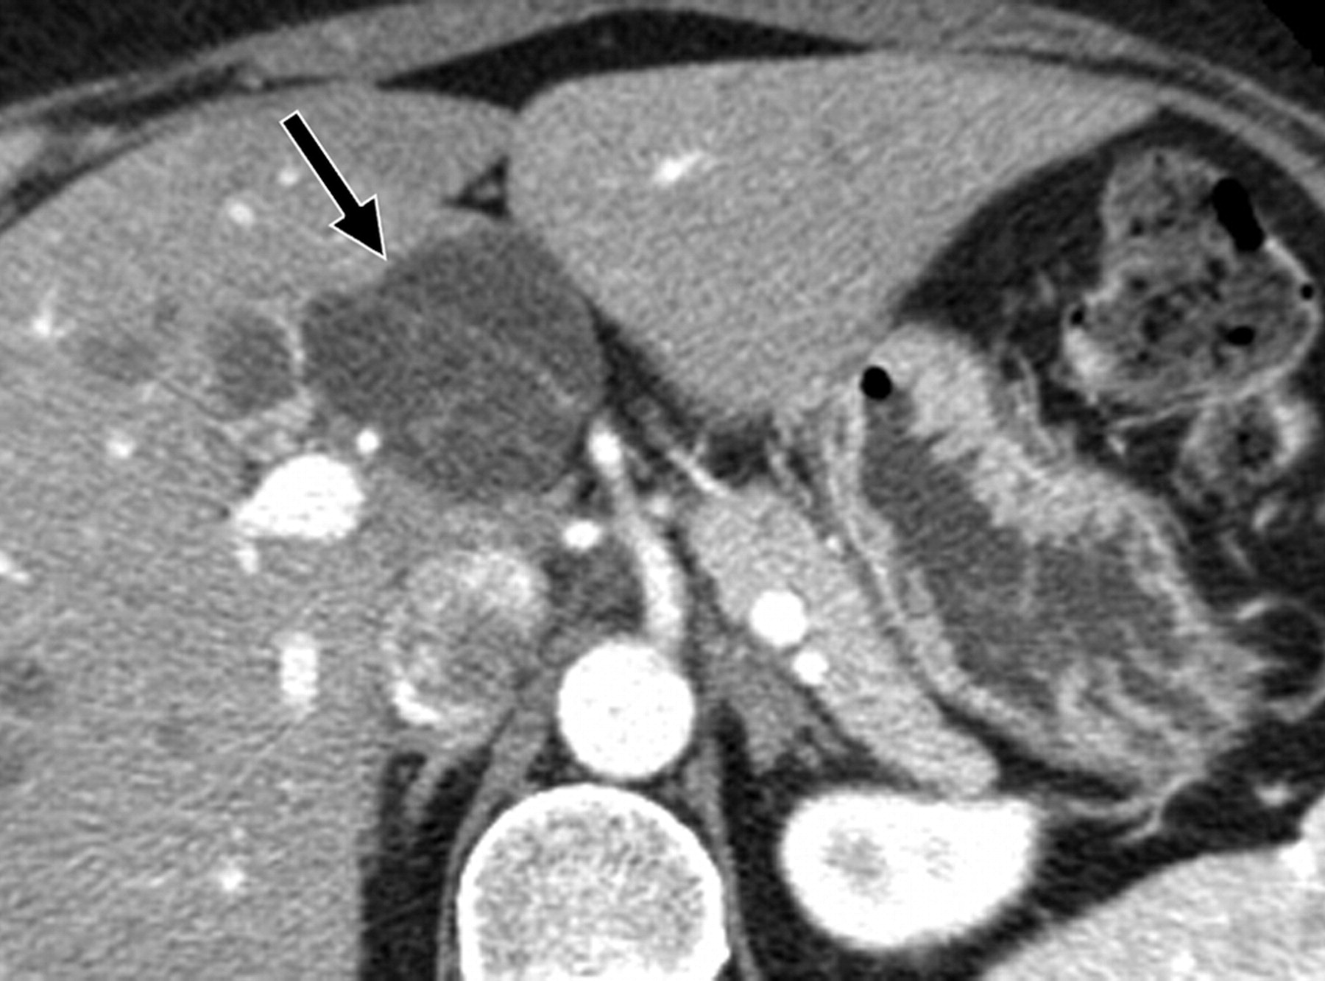
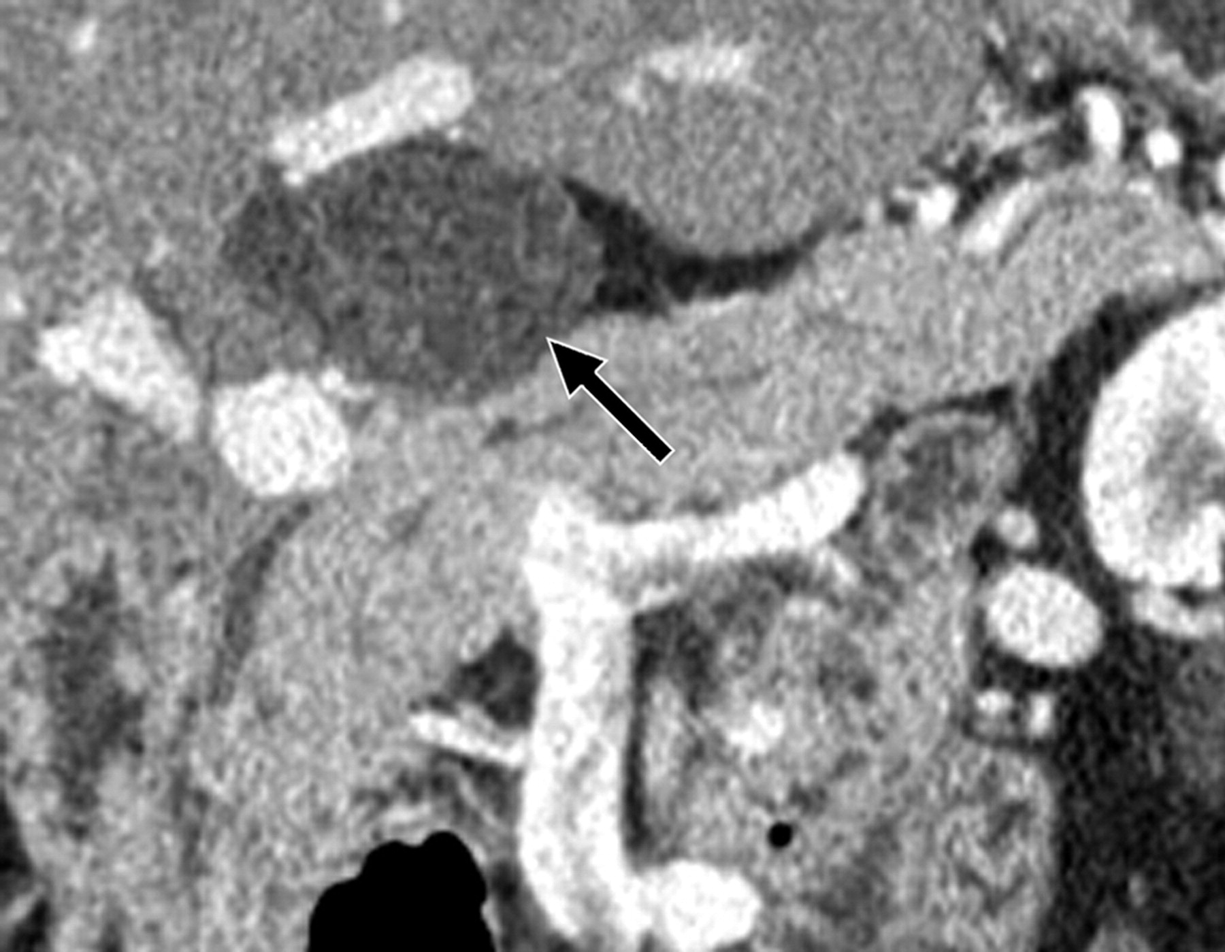
Notes:
There is a large cyst in the pancreatic tail with peripheral calcification. There is subtle septation as seen on the left image and wall thickening.

Slide 26
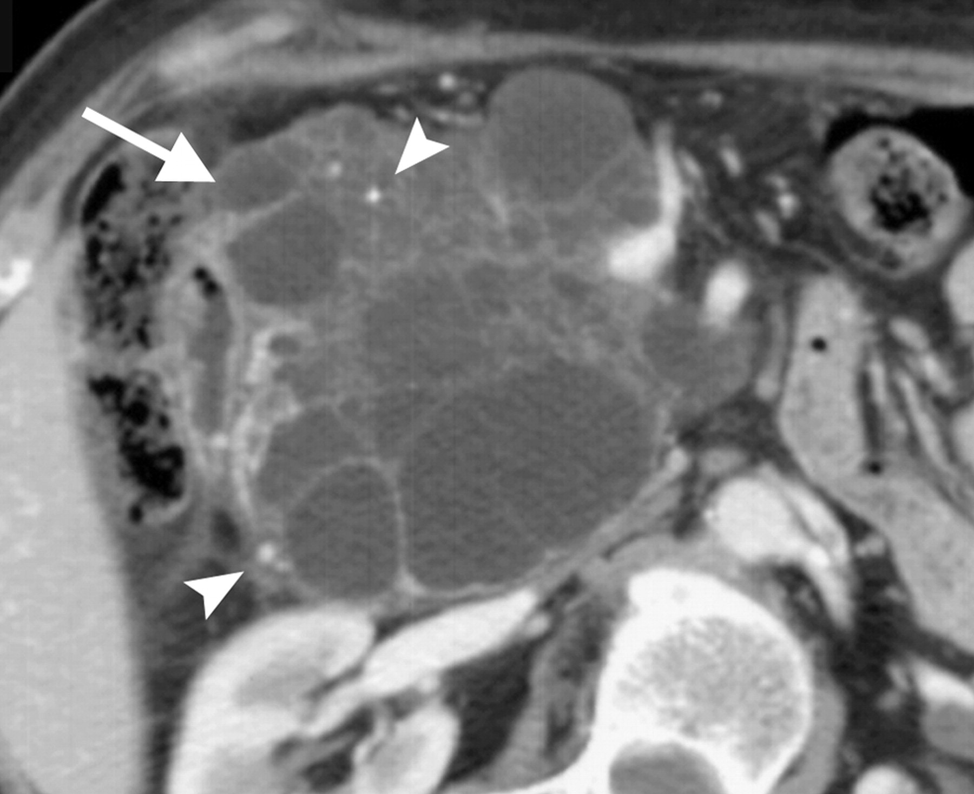

Slide 27
IPMN-MAIN DUCT TYPE
key findings:
Mucine producing tumor in main pancreatic duct.
Abnormal dilatation of main pancraetic duct usually more than 8 mm, best seen on MRCP.
Intraductal solid nodule is highly suggestive of IPMN.
May present with pancreatitis.
IPMN has premalignant potential.
Signs of malignancy are:
Pancreatic duct > 8 mm - as in this case.
Solid node in duct.
Mass around the pancreatic duct.
Enlarged choledochal duct.

Slide 28
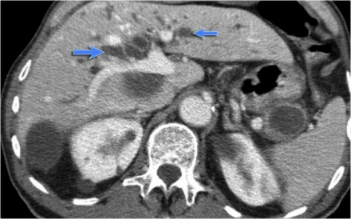
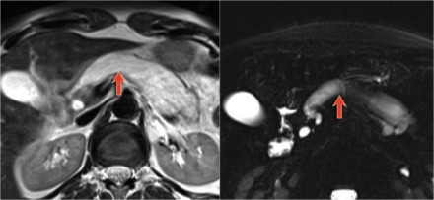
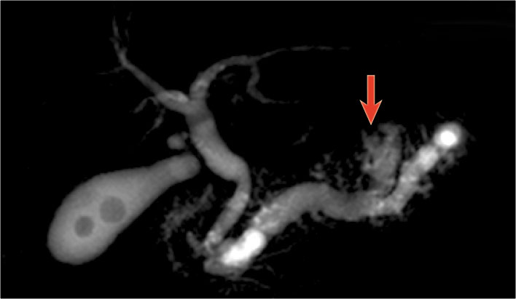

Slide 30
CYST WITH SOLID COMPONENTS
Cysts with a solid component may be either unilocular or multilocular. True cystic tumors (eg, mucinous cystic neoplasms, IPMNs) as well as solid pancreatic neoplasms associated with a cystic component or cystic degeneration are included in this category.
Solid tumors associated with a cystic component include
1.Islet cell tumor
2.solid pseudopapillary tumor
3.adenocarcinoma of the pancreas,
4.Metastasis

Slide 31
SPEN
Solid Pseudopapillary Neoplasm
key findings:
Very uncommon neoplasm seen in women 20-30 years (Daughter).
Commonly located in pancreatic tail.
Solid and cystic neoplasm with capsule and with early 'hemangioma-like' enhancement. Sometimes intratumoral hemorrhage.

Slide 32
Notes:
CT-images of a young woman with a large mass in the pancreatic head and metastases in the liver. In the center there is lack of enhancement due to cystic or necrotic degeneration.

Slide 33
Neuroendocrine tumor with cystic degeneration
key findings:
Non-functioning endocrine neoplasm
Also called islet cell tumor
Hypervascular with ring-enhancement. This is unlike serous cystic neoplasms that enhance from the center and more solid.

Slide 34
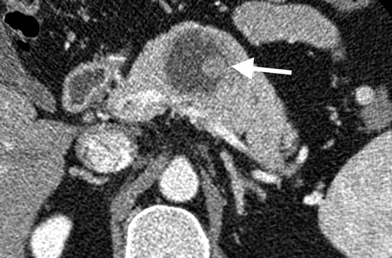
Notes:
CT-image of a neuroendocrine tumor with central necrosis. Sometimes this can simulate a cystic component. Notice the peripheral enhancement.

Slide 35
SYSTEMATIC APPROACH
Notes:
When a cystic pancreatic lesion is detected, the first step is to decide whether the lesion is most likely a pseudocyst or a cystic neoplasm. This scheme is a simplified roadmap for the differentiation of pancreatic cysts.
Pseudocyst - Think pseudocyst when there is a history of pancreatitis, alcohol abuse, stone disease or abdominal trauma and the lesion is unilocular or contains non-enhancing dependent debris.
Cystic neoplasm- Think of the possibility of a cystic neoplasm, when there is no history of pancreatitis or trauma, or when the cyst has internal septa, a solid component, central scar or wall calcification.
Mucinous cystic neoplasm - This is usually a unilocular cyst filled with mucin sometimes with wall calcification, exclusively seen in women.
Serous cystic neoplasm - This is a microcystic lesion, that conaints serous fluid with sometimes a characteristic scar which may calcify. It can look like a branch-duct IPMN, but SCN has no communication with the pancreatic duct. The typical appearance makes a specific diagnosis possible, which is important, because SCN is the only tumor that is not premalignant.
Branch-duct IPMN - This tumor can look like a SCN, but has no scar or calcifications. MRCP or heavily weigted T2WI may show the connection to the pancreatic duct, which is highly specific.

Slide 36
Notes:
Ct image on left side shows two thin walled unilocular cysts with retroperitoneal fat stranding along with history of recent abdominal pain and raised serum amylase-likley diagnosis is pseudocyst,
Image on the right side shows incidenatlly detected cyst in pancreatic tail with thick irregular margins –the most likley diagnosis is cystic neoplasm.

Slide 37
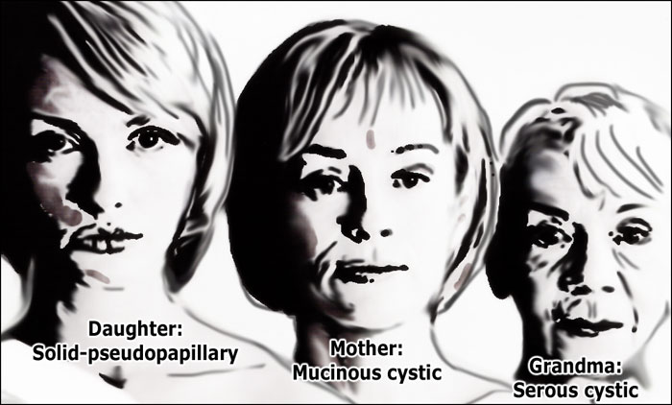
AGE and gender
Grandma - Serous cystic adenoma
Mother - Mucinous cystic neoplasm
Daughter - SPEN
IPMN-Male=female.

Slide 40
MANAGEMENT
Histopathology of tumours,Age, life-expectancy and comorbidity should be considered in the possible surveillance or treatment.
Cysts smaller than 3 cm and no worrisome or high risk-features can be considered for follow-up with either MRI, CT or ultrasound.
Symptomatic cysts and asymptomatic cysts with obvious high risk stigmata should be considered for resection based on other comorbidities or risk factors.
Pancreatic cysts are regarded symptomatic when there is hyperamylasemia, recent-onset diabetes, severe epigastric pain, weight loss, steatorrhea, or jaundice.

Slide 41
THANK YOU

