Slide 1
Mammography :TECHNIQUE , INDICATION AND CONTRAIDICATION
Presenter
Moderator
Dr.Vishwanath Patil
PG Resident
Dr. Sudha Kiran Das
Associate Professor

Slide 2
INTRODUCTION
A mammogram is a x ray exam of breast to detect and evaluate any changes in the breast.
X-ray was first used to examine the breast by German surgeon Albert Salmon.
Modern mammography came into existence since late 1960.

Slide 3
INTRODUCTION
Modern machines are safe and uses the lowest possible dose.
If women has yearly mammogram staring from age 40 and continue until 90.She will get total 20-40 rads.
Benefits pleural effusion mammography outweigh any possible harm from the radiation.

Slide 4
RADIATION DOSE
Mean glandular radiation dose to the breast is approximately 2 mGy (0.2 rad) per exposure.
With present mammographic equipment, there is little or no radiation related risk to the women over 40 years of age.

Slide 5
Types of of Mammogram
Screening mammogram.
Diagnostic mammogram.

Slide 6
American College of Radiology Recommendations for Imaging Screening for Breast Cancer
Women at average risk for breast cancer
∘Annual screening from age 40
Women at increased risk for breast cancer
Women with certain BRCA1 or BRCA2 mutations or who are untested but have first-degree relatives (mothers, sisters, or daughters) who are proved to have BRCA mutations
■Yearly starting by age 30 (but not before age 25)

Slide 7
American College of Radiology Recommendations for Imaging Screening for Breast Cancer
2. Women with ≥20% lifetime risk for breast cancer on the basis of family history (both maternal and paternal) and Women with mothers or sisters with pre-menopausal breast cancer
■Yearly starting by age 30 (but not before age 25), or 10 years earlier than the age of diagnosis of the youngest affected relative, whichever is later

Slide 8
American College of Radiology Recommendations for Imaging Screening for Breast Cancer
3. Women with histories of mantle radiation (usually for Hodgkin's disease) received between the ages of 10 and 30.
■Yearly starting 8 years after the radiation therapy, but not before age 25.

Slide 9
American College of Radiology Recommendations for Imaging Screening for Breast Cancer
4. Women with biopsy-proven lobular neoplasia (lobular carcinoma in situ and atypical lobular hyperplasia), atypical ductal hyperplasia (ADH), ductal carcinoma in situ (DCIS), invasive breast cancer or ovarian cancer
■Yearly from time of diagnosis, regardless of age.

Slide 10
Age at Which Annual Screening With Mammography Should Stop.
When life expectancy is <5 to 7 years on the basis of age or comorbid conditions
•When abnormal results of screening would not be acted on because of age or comorbid conditions

Slide 11
INDICATIONS
Breast Cancer.
Breast Lump.
Nipple Discharge.
Focal Breast Pain.
Follow up for previously evaluated Mammographic findings.
BIRADS ( Breast Imaging Reporting and Detection System).

Slide 12
CONTRAINDICATIONS
Size of cancer relative to Breast Size.
First or Second-trimester pregnancy.
Prior radiation therapy to chest/mediastinal.
Active Collagen Vascular disease.

Slide 13
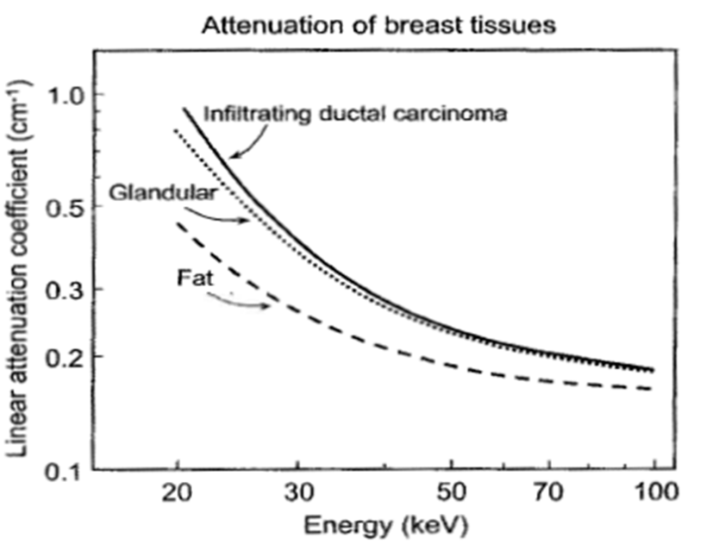
Mammography
Principle: Breast is composed of fatty tissue, glandular tissue, and connective tissue.
Normal and cancerous tissues in the breast have small x-ray attenuation differences between them
Need x-ray equipment specifically designed to optimize breast cancer detection.

Slide 14
Modern Equipment
Dedicated Mammography Equipment
Specialized X-ray Tubes
Optimized Screen/Film detector systems
Breast Compression Devices

Slide 15
X-ray Tube Design
Cathode and Filament Circuit
Low operating voltage
below 35 – 40 kVp
Typically 23 or 24 kVp at the lowest
dual filaments in a focusing cup
0.3 mm (contact) and 0.1 mm (magnification) focal spot sizes
small focal spot
minimizes geometric blurring
maintains spatial resolution
Typical tube currents are
100 mA (+/- 25 mA) for large (0.3 mm) focal spot
25 mA (+/- 10 mA) for small focal spot

Slide 16
X-ray Tube Design
Anode
rotating anode design
Molybdenum (Mo), and dual track molybdenum/rhodium (Mo/Rh) targets are used
Characteristic x-ray production is the major reason for choosing molybdenum and rhodium
For molybdenum, characteristic radiation occurs at 17.5 and 19.6 keV
For rhodium, 20.2 and 22.7 keV

Slide 17
X-ray Tube Design
Heel effect - lower x-ray intensity on the anode side of the field (attenuation through the target)
Thus cathode-anode axis is placed from the chest wall (greater penetration of x-rays) to the nipple in breast imaging
A more uniform exposure is achieved
This orientation also minimizes equipment bulk near the patient’s head for easier positioning

Slide 18
MAMOGRAPHY POSITIONING
Bring the breast back to its true anatomical position.
Use palpable and anatomical landmarks for positioning and clinical image evaluation.
It should be consistent and Reproducible with the goal of maintaining improving quality.

Slide 19
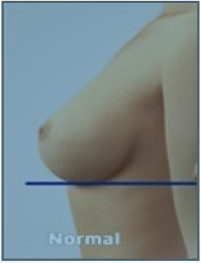
Normal or natural position of the breast is when the nipple is perpendicular to chest wall.

Slide 20
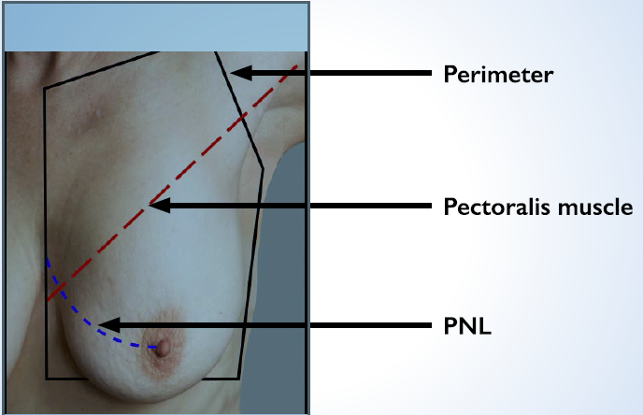
Anatomical landmarks that will be used for positioning and clinical image analysis are
Perimeter.
Pectoralis muscle.
Posterior nipple line (PNL).

Slide 21
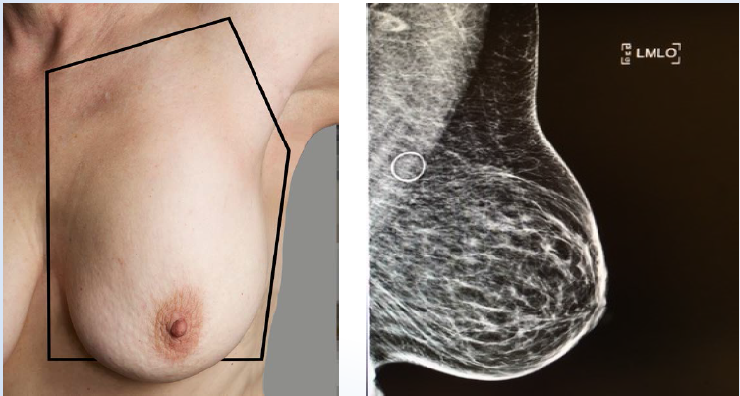
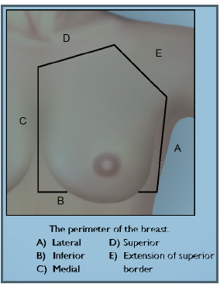
Perimeter used for positioning and clinical image analysis

Slide 22
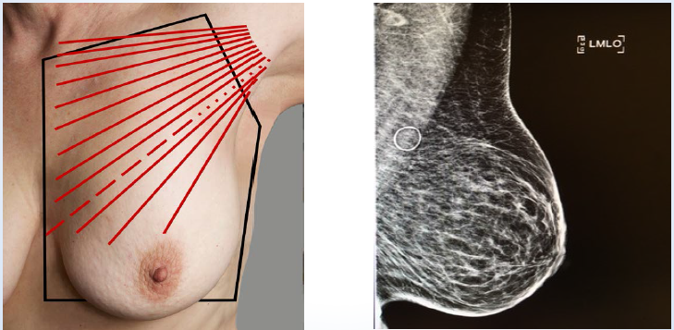
Pectoralis used for positioning and clinical image analysis

Slide 23
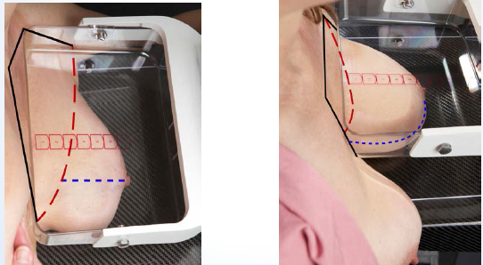
PNL
Elevate the breast so that the PNL is close as possible to perpendicular plane to the chest wall.

Slide 24
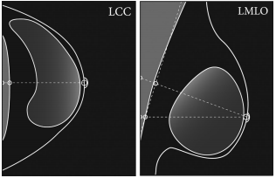
PNL
PNL measurement of CC should be within 1cm of the PNL measurement on the MLO. according to American College of Radiologists, 2017.

Slide 25
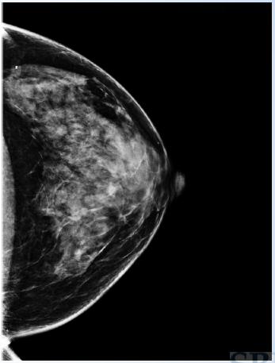
The craniocaudal view
It includes maximum amount of breast tissue in axial plane.
Visualization of medial breast tissue (Cleavage).
Visualization of pectoralis muscle on approximately 30% of all CCs.

Slide 26
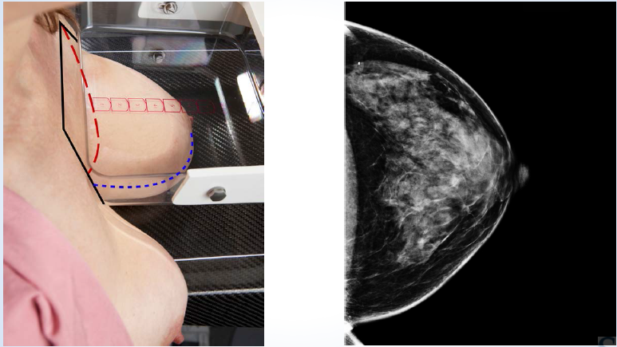
The craniocaudal view

Slide 27
Standard method
Stand on medial side of breast to be imaged.
Elevate the breast so that the PNL is perpendicular to chest wall.
Adjust the height of IR to elevated IMF( Inframammary fold ).
Pull the breasts with both hands.
Anchor the breast
Lift the contralateral breast .
Guide patients head forward.
Pull on lateral breast tissue.

Slide 28
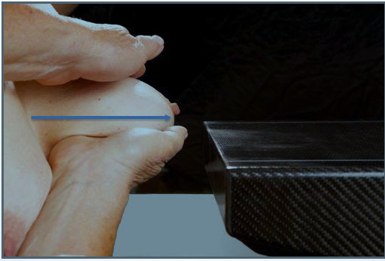
Method
Elevate the breast so the PNL is perpendicular to the chest wall and pull the breast on with both hands.

Slide 29
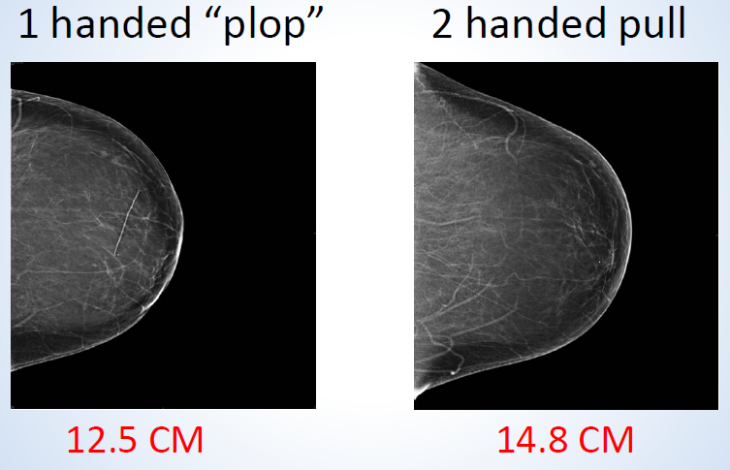
CC View Method

Slide 30
CC View Method

Slide 31
Nipple Centered
Nipple should be centered on CC view, if possible ,and without sacrificing breast.
Nipple may not be centered due to prominent medial or lateral fullness of the breast.

Slide 32
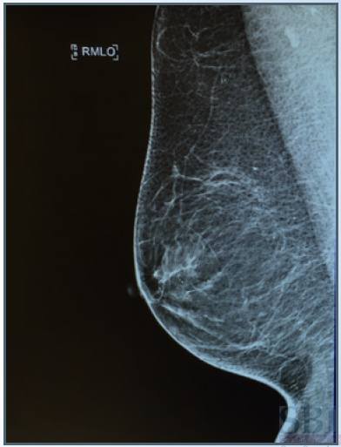
MEDIO LATERAL OBLIQUE
Inclusion of all the breast tissue within perimeter.
Pectoralis muscle fully visualized.
Tissue well separated.
Tissue visualized back to retro-mammary fat space.
IMF.

Slide 33
MLO
POSITION:
C-arm of the unit is rotated to 45 angle, so that the cassette is parallel to pectoral muscle.
The film holder is kept high in axillary fossa.
Arm is abducted at elbow.

Slide 34
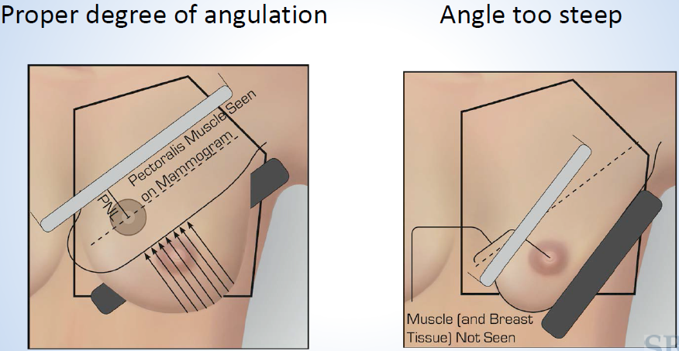
Recommended angulation for MLO
Keep the angulation consistent.
Steeper a angle for patient with longer thorax and small breasts.
Lesser angles for shorter thorax and larger breast.

Slide 36
Some additional View
XCCL –Exaggerated CC lateral.
CV –Cleavage.
LM-90 degree latero-medial view.
ML-90 degree mediolateral view.
TAN –Tangential.

Slide 37
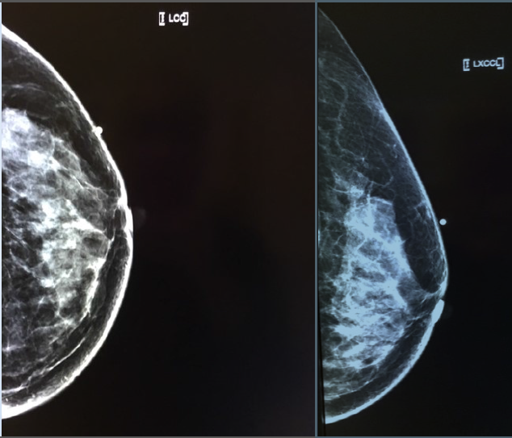
XCCL
Done visualize the lateral breast tissue in CC projection.
Done when lateral posterior breast tissue is excluded on the CC image.

Slide 38
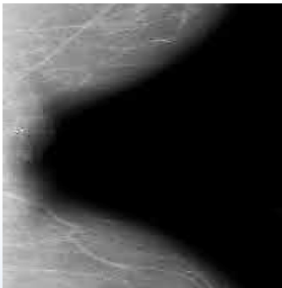
CV View
To visualize the medial breast in CC projection.

Slide 39
LM & ML Views
LM Shows medial breast in better detail.
ML shows lateral breast in better detail.

Slide 40
LM & ML Views

Slide 41
Tangential View.
To prove the existence of dermal calcifications.
Enhanced visualization of palpable masses that may otherwise be superimposed on glandular breast tissue.

Slide 42
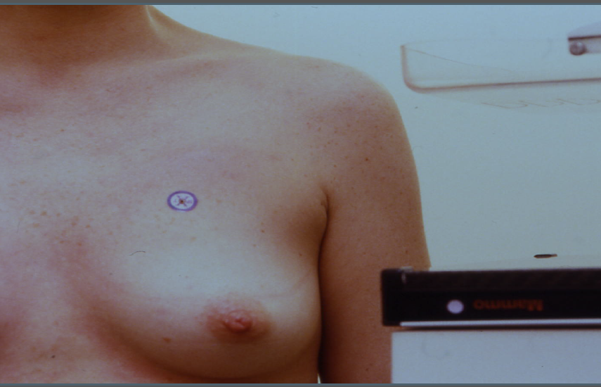
Tangential View.
Mark on the palpable mass or area identified by localizing skin calcification.

Slide 43
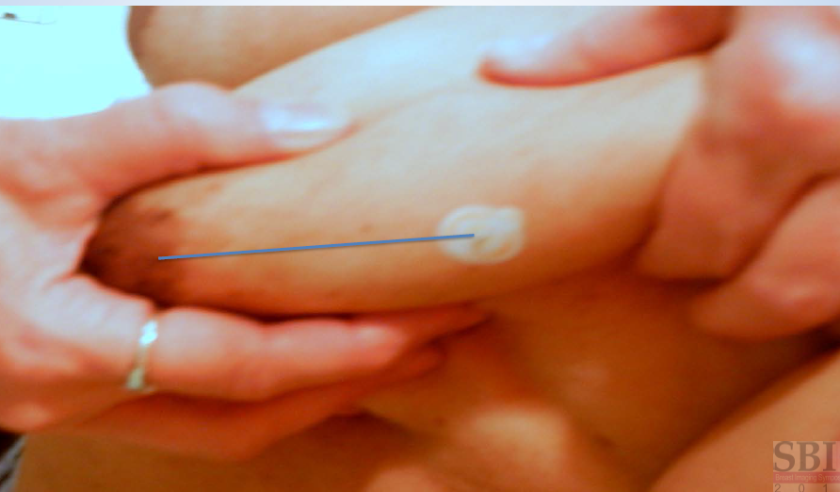
Tangential View.
Draw and imaginary line between the breast and mark.

Slide 44
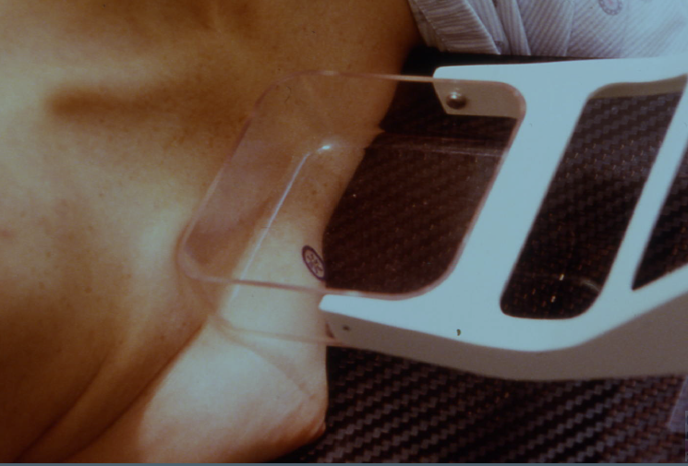
Tangential View.
Position the breast so that lesion in tangent to the beam by angling the tube ,or breast.

Slide 45
Reporting

Slide 46
Reference
Rhonda-Joy I Sweeney, MHSc, PGDip HSc, 1Sarah J Lewis, PhD, MEd, 2,3Peter Hogg, MPhil, BSc and 1Mark F McEntee, PhD, BSc . A review of mammographic positioning image quality criteria for the craniocaudal projection.
Breast Cancer Screening With Imaging: Recommendations From the Society of Breast Imaging and the ACR on the Use of Mammography, Breast MRI, Breast Ultrasound, and Other Technologies for the Detection of Clinically Occult Breast Cancer:AJR

