Slide 1
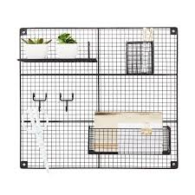
GRIDS
PRESENTER-Dr.Vishwanath patil
PG resident
MODERATOR- Dr.Dimple Bhatia
Senior Resident

Slide 2
Scatter Control

Slide 3
OUTLINE
Filters
2. Beam restrictors
3.Grids

Slide 4
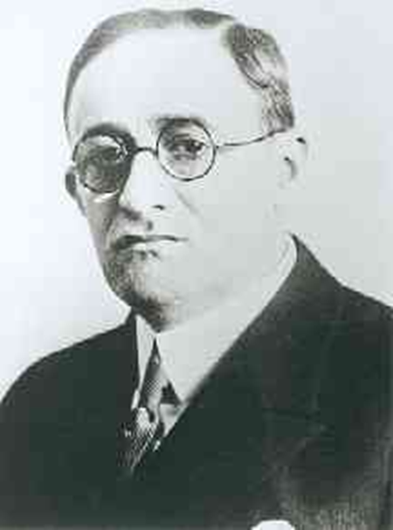
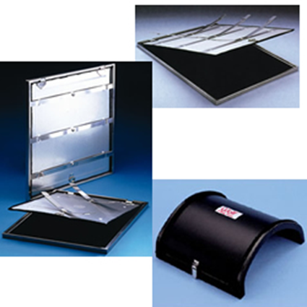
INTRODUCTION
It was invented by Dr. Gustave Bucky in 1913.
It is still the most effective way of removing scatter radiation from large radiographic fields.

Slide 5
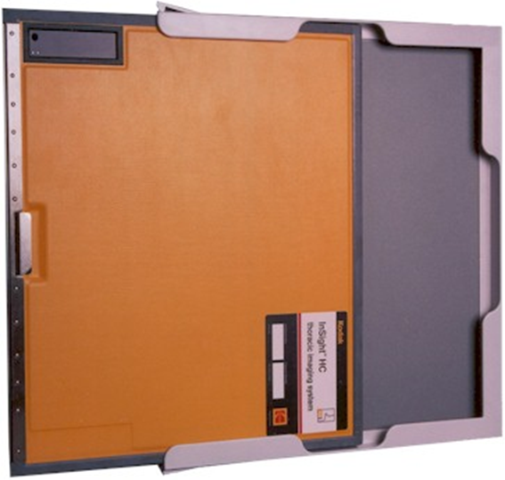
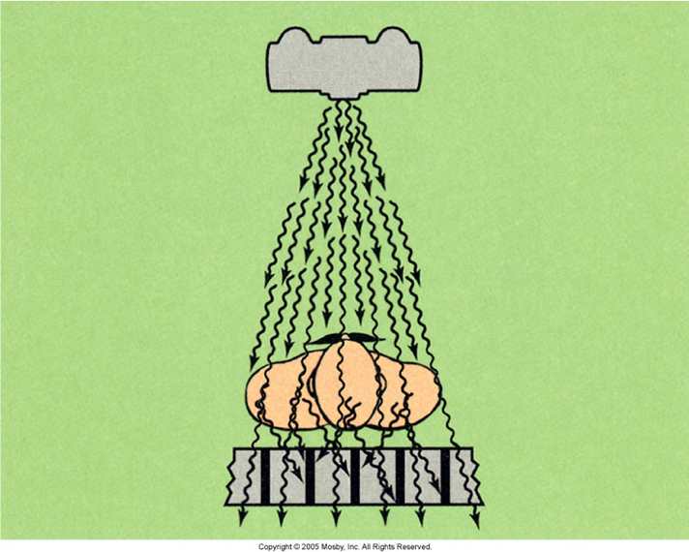
INTRODUCTION
Only rays that travel in a relatively straight line from the source are allowed to reach the film
The others are absorbed by the lead.
A high quality grid can attenuate 80 -90 percent of scatter radiation.

Slide 6
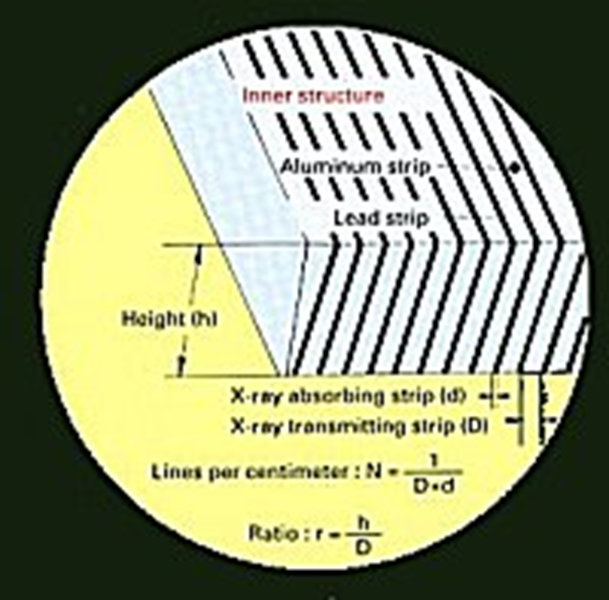
Construction:
Thin lead strips alternate with interspacing material
Interspacing
a)Organic (carbon-based) interspacing
absorbs moisture and can potentially
warp (^{EX:} fiber, paper, cardboard, plastic).
b)Inorganic interspacing is much more
durable and absorbs more radiation
(^{EX:} aluminum and the less-visible lead)

Slide 7
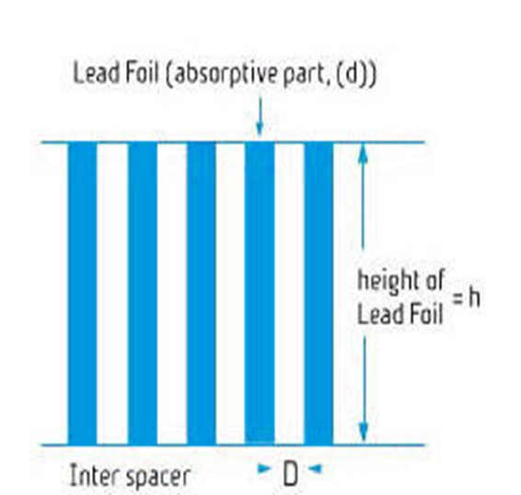
TERMINOLOGY
Grid ratio
Grid ratio = height of lead strips / distance between strips.
-The grid ratio indicates how
well the grid cleans up scatter
(Higher ratios mean higher
absorption of scatter)

Slide 8
Grid Patterns
Orientation of lead strips as seen from above.
Types
Linear
Their major advantage is that they allow us to angle the x-ray tube along the length of the grid without loss of primary radiation from grid "cutoff.“
Cross hatched
2 stacked linear grids
Ratio is sum of ratios of two linear grids
very sensitive to positioning & tilting.
Cannot be used with oblique techniques.

Slide 9
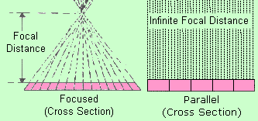
Grid Styles
Parallel
Focused

Slide 10
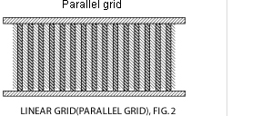
Parallel Grid
lead strips parallel
Have the same focusing distance
useful only for
small field sizes
large source to image distances

Slide 11
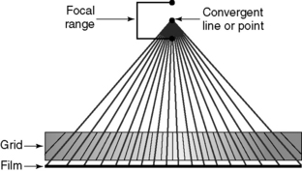
Focused Grid
Slightly angled lead strips
Strip lines converge to a point in space called convergence line
Focal distance
distance from convergence line to grid plane
Focal range
working distance range
width depends on grid ratio
smaller ratio has greater range

Slide 12
EVALUATION OF GRID PERFORMANCE
Ideal Grid
Passes all primary radiation
Reality: lead strips block some primary
Block all scattered radiation
Reality: lead strips permit some scatter to get through to film
several tests have been devised to evaluate grid performance.

Slide 13
THREE METHODS OF EVALUATING PERFORMANCE:
I. primary transmission (Tp)
2. Bucky factor (B)
3 . contrast improvement factor (K)

Slide 14
METHODS OF EVALUATING PERFORMANCE:
PrimaryTransmission:Measurement of the percentage of primary radiation transmitted through a grid.
Ideally 100% (never achieved)
Typical values: 55 - 75%
Theoretic calculation: (fraction of grid that is interspace)
Tp (%)= 100 X W / (W+w)
W = Interspace thickness
w = lead strip thickness

Slide 15
PrimaryTransmission
Actual transmission < theoretical
Primary attenuated by interspace material
Focusing imperfections

Slide 16
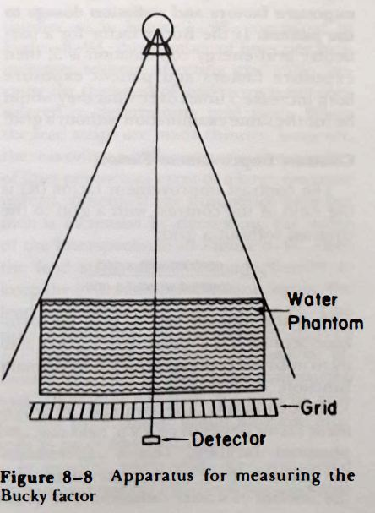
Bucky Factor
The Bucky factor is the ratio of the incident radiation falling on the grid to the transmitted radiation passing through the grid.
One difference: Bucky factor indicates the absorption of both primary and secondary radiation.
Indicates how much we must increase exposure
factors when we change from a nongrid to a grid
technique.
.

Slide 17
Bucky Factor
In part its also measurement of grid’s ability to absorb scattered radiation.
The higher the Bucky factor, the greater the exposure factors and radiation dosage to the patient.
IF the Bucky factor for a particular grid-energy combination is 5, then exposure factors and patient exposure both increase 5 time "s over what hey would be for the same examination without a grid.

Slide 18
Contrast Improvement Factor
K =contrast with a grid/contrast without a grid
This is the ultimate test of grid performance because it is a measure of a grid's ability to improve contrast.
Unfortunately, the contrast improvement factor depends on Kvp, field size and phantom thickness.
These three factors determine the amount of scatter radiation.

Slide 19
GRID CUTOFF
Grid cutoff refers to a decrease in the number of transmitted photons that reach the IR because of some misalignment of the grid.
It is the result of a poor geometric relationship between the primary beam and the lead foil strips of the grid.
Types
Upside-Down Focused.
Off-Level.
Off-Center.
Off-Focus.

Slide 20
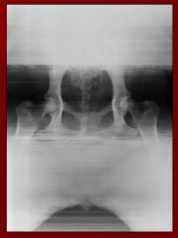
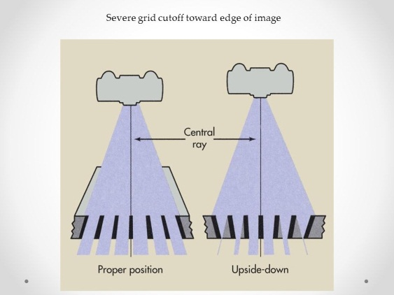
Upside-Down Focused.
Occurs when a focused grid is placed upside-down on the IR, resulting in the grid lines going opposite the angle of divergence of the x-ray beam.
Placing a focused grid upside-down on the IR causes the lateral edges of the radiograph to be very underexposed.

Slide 21
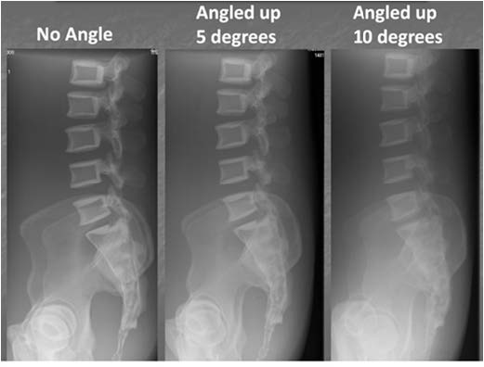
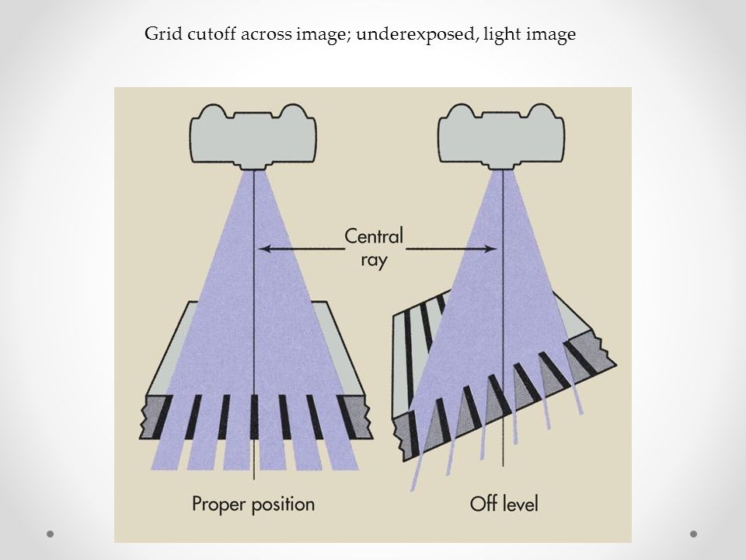
Off-Level.
It is the most common type of cutoff.
Angling the x-ray tube across the grid lines or angling the grid itself during exposure produces .
Either the tube or the grid being angled.
overall decrease in exposure on the radiograph

Slide 22
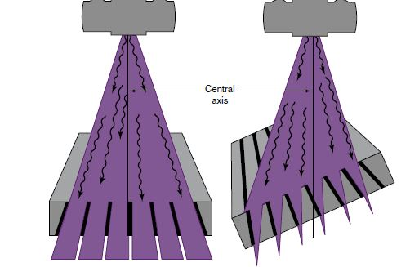
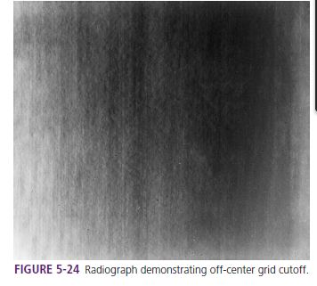
Off-Center(lateral decentering)
If the center of the x-ray beam is not aligned from side to side with the center of a focused grid, grid cutoff occurs.
Off-center grid cutoff appears as an overall loss of density on radiographic film .

Slide 23
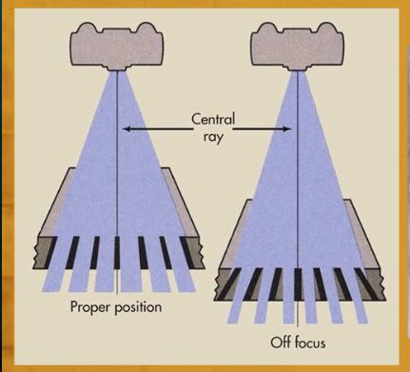
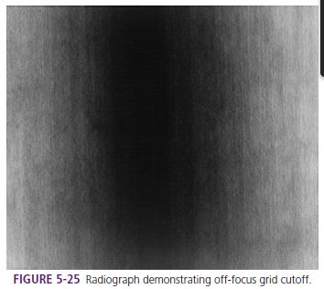
Off-Focus.
Off-focus grid cutoff occurs when using an SID outside of the recommended focal range.
Using an SID outside of the focal range creates a loss of exposure at the periphery of the radiograph.

Slide 24
Moiré Effect
The moiré effect or zebra pattern is an artifact.

Slide 25
Moving Grids
-Motion starts with second trigger
Grids move ~1- 3 cms
must be fast enough not to see grid lines for short exposures
Motion blurs out lead strip shadows

Slide 26
Moving Grid Disadvantages
EXPENSIVE
-May limit minimum exposure time
- Vibration potential
-Increases patient dose
lateral decentering from motion
up to 20% loss of primary
evenly distributes radiation on film
stationary grid makes interspace gaps darker for same amount of radiation

Slide 27
GridS
Advantage
cleanup / scatter rejection
Disadvantage
increased patient dose
increased exposure time
increase tube loading
positioning & centering more critical
EXPENSIVE

Slide 28
Grid Selection
use low ratios for low kVp, high ratios for high kVp
book recommends
8:1 below 90 kVp
12:1 above 90 kVp

Slide 29
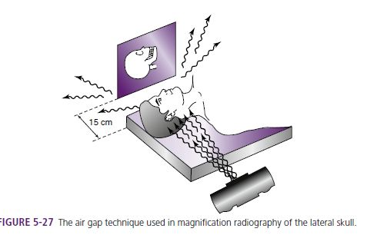
Air Gap
Air gap very effective in removing scatter originating closest to film
much of scatter nearest tube doesn’t reach film
The air gap technique is an alternative to using a grid to control scatter reaching the IR.
By moving the IR away from the patient, more of the scatter radiation will miss the IR

Slide 30
References
Christensen's Physics of Diagnostic Radiology.
Radiographic Imaging and Exposure4th Edition Terri Fauber.

Slide 31
THANK YOU

