Slide 1
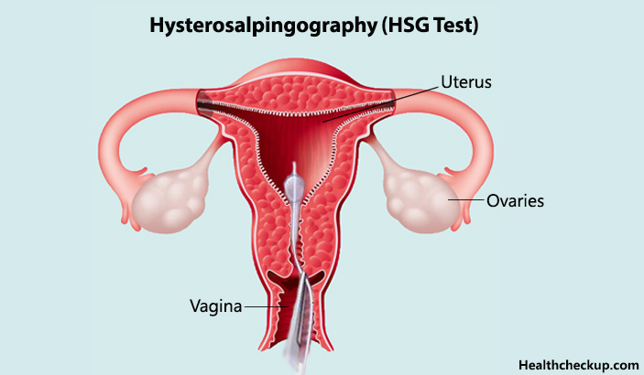
HISTEROSALPHINGOGRAPHY –COVENTIONAL
Presenter
Moderator
Dr.Vishwanath Patil
PG Resident
Dr. Rudresh Hiremath
Professor Dept of Radiology

Slide 2
Defination
Hysterosalpingography is the radiographic evaluation of uterus and fallopian tubes under fluoroscopic guidance.

Slide 3
INDICATION
1. Infertility (main role)
2. Recurrent spontaneous abortions .
3. Congenital anomalies of uterus.
4. Postoperative evaluation following (a)tubal ligation (b) reversal of tubal ligation.
5. Suspected case of genital tuberculosis
6. To prove tubal occlusion after insertion of transcervival sterilization micro insert (essure).
HSG also has a potential therapeutic role in increasing the probability of pregnancy ( especially if oil soluble contrast –lipoid is used)

Slide 4
CONTRAINDICATION
Suspected pregnancy
Acute pelvic infection
Active vaginal bleeding
Recent dilation and curettage
Tubal or uterine surgery within last 6 wks.
Contrast sensitivity

Slide 5
PATIENT PREPARATION
Done in first half of menstrual cycle in proliferative phase between 8th to 12th day .
Patient to avoid unprotected sexual intercourse from the date of her period until investigation is over .
If periods are irregular , do urine B- hcg .
Exclude active pelvic infection .
Prophylactic antibiotics not routinely recommended (considered in case of bacterial endocarditis)

Slide 6
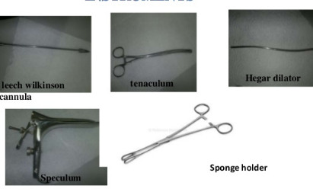
Accessory & Equipments
Disposable HSG tray is used.
Speculum
Cotton balls, cup, gauze, drapes.
Sponge-holding forceps.
10 ml syringes, lubricating jelly extension tube.
Contrast.

Slide 7
CONTRAST MEDIA
Heuser was the first to report on the use of lipiodol in HSGs.
Lipiodol was gradually replaced by water soluble contrast media for several reasons .

Slide 8
CONTRAST MEDIA
LIPID SOLUBLE CONTRAST (lipiodol)
WATER SOLUBLE CONTRAST (iohexol-omnipaque,meglumine diatrizoate-urograffin
Sharp image
Minimal pain
Delayed absorption
Risk of lipogranuloma formation in case of tubal block/hydrosalpynx.
Intravasation of contrast and possible risk of oil embolism
Need of delayed film
Less often used
Ampullary rugae clearly visualised
Gets absorbed within hours, does not leave residue
Granuloma formation rare
Pain persists after procedure
Prompt demonstration of tubal patency, delayed film not needed.
Widely used and preferred

Slide 9
PROCEDURE
Informed consent is taken .
Patient is asked to empty bladder immediately before procedure .
Scot film may be taken.
Patient is placed in lithotomy position.
The perineum is cleaned with antiseptic solution (Betadine)and draped with sterile towel.
The cervix is localized and cleansed with povidine-iodine solution.
A speculum is inserted into the vagina.
Cervix is cannulated with any of available cannulas which is made air free before administration of contrast.

Slide 10
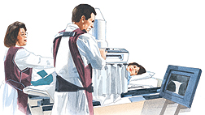
PROCEDURE
Tenaculm is used to hold anterior lip of cervix .
Speculum is removed & Patient is placed in slight trendelenburg position and contrast is slowly given
3 ml contrast to fill uterine cavity and another 3 ml to fill tube. ( up to 10 ml)

Slide 11
PROCEDURE
4 spot films are taken .
1.Early filling -any filling defect
2. uterus fully distended- shape of the uterus.
3. Evaluate the fallopian tubes.
4. free intraperitoneal spillage of contrast material.
Additional oblique views may be taken for optimal visualization of pelvic pathology and tortuous fallopian tubes( to see retroverted or anteverted).
After end of the procedure , antibiotic course is given and patient is informed about vaginal spotting for 1-2 days.

Slide 12
COMPLICATION
Pain (because of dilatation of uterus , spillage into peritoneum).
Infection (pelvic).
Bleeding.
Vascular or lymphatic Intravasation .
Vasovagal episode.
Allergic reaction (to iodinated contrast media).
Uterine perforation.

Slide 13
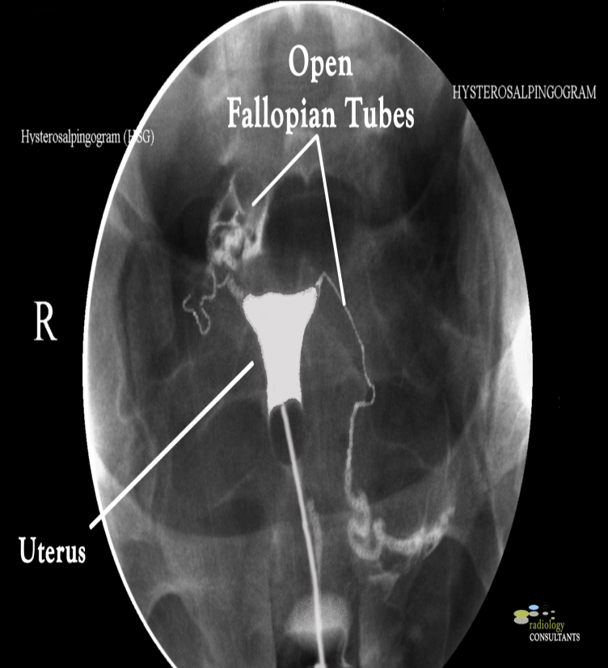
NORMAL HSG
The uterine cavity is shown during HSG as a triangular contrast-filled structure.
The uterine fundus on top, which can be flattened, concave or slightly convex .
Free spillage of the contrast to the peritoneum noted

Slide 14
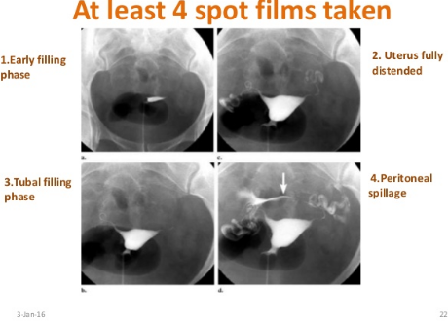
NORMAL HSG

Slide 15
NON PATHOLOGIC FINDINGS
Air bubble- round, often multiple, welldefined mobile filling defect ,usually displaced to fallopian tubes if additional contrasts given.

Slide 16
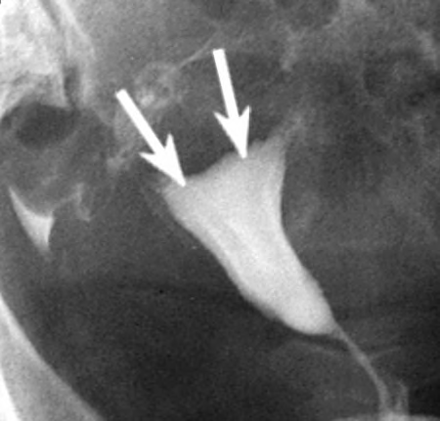
UTERINE FOLDS
Uterine folds.
HSG spot radiograph demonstrates uterine
folds (arrows) as linear filling defects that parallel
the longitudinal axis of the uterus.

Slide 17
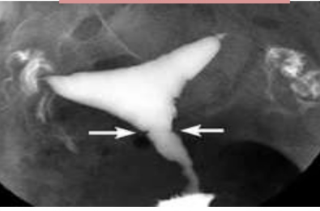
Previous caesarean section scar
Previous caesarean section scar: linear appearance (as in this case) or can occasionally manifest as a wedge-shaped outpouching or diverticulum

Slide 18
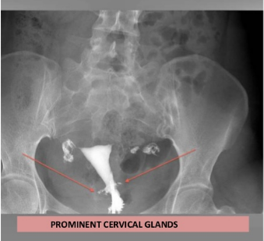
PROMINENT CERVICAL GLANDS
Prominent cervical glands-tubular structure with their origin in both cervical walls.

Slide 19
DETECTABLE PATHOLOGY
UTERINE
TUBAL
1. Uterine anomaly
2. Fibroid (submucosal)
3. Adenomyosis
4.Endometrial polyp
5.Intrauterineadhesions/synaechiae .
6.Endometrial TB
7. Cervical incompetence
1. tubal block
2. Tubal spasm
3. Tubal polyp 4.Hydrosalpinx
5.Salpingitis isthmic nodosum (SIN).
6. Peritubal adhesions.
7. TB salpingitis .

Slide 20
UTERINE ANOMALIES
Any disruption of müllerian duct development during embryogenesis can result in a broad and complex spectrum of congenital abnormalities termed müllerian duct anomalies (MDAs).
First 6 weeks - male fetus and female fetus are indistinguishable .
After 6 weeks gestation- Absence of müllerian-inhibiting factor in the female fetus promotes bidirectional growth of the paired müllerian ducts.
Midline migration and fusion .
9 and 12 weeks gestation- fused müllerian ducts undergo a process of reabsorption of the intervening uterovaginal septum.

Slide 21
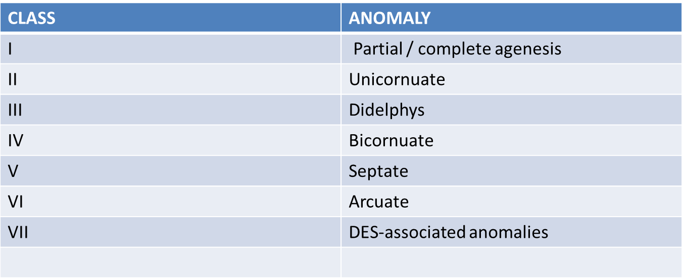
UTERINE ANOMALIES

Slide 22
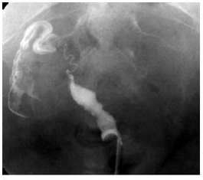
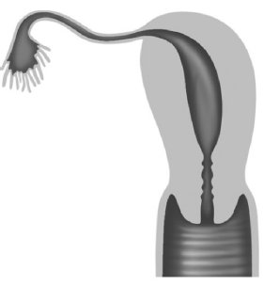
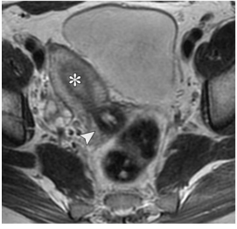
Unicornuate uterus
Spot radiograph demonstrates a single uterine horn with an irregular medial contour.
HSG cannot be used to exclude the presence of a noncommunicating rudimentary horn .
Single right uterine horn with single right fallopian tube.

Slide 23
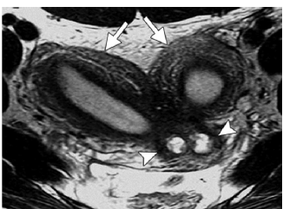
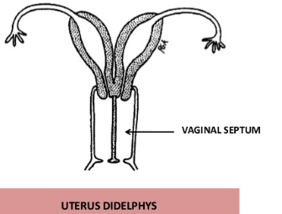
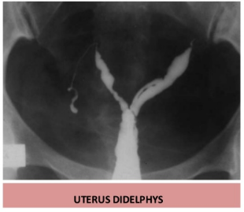
UTERUS DIDELPHYS
2 Uterine cavities, 2 cervical canals, 2 vagina. (nonfusion of the two Müllerian ducts.)
Vaginal obstruction may manifest shortly after menarche, lead to complications, and require intervention.

Slide 24
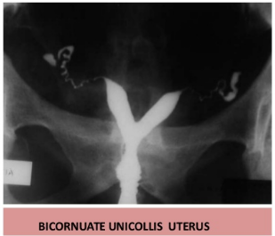
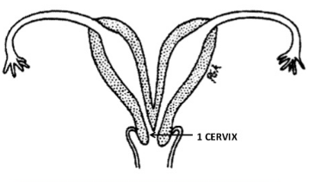
BICORNUATE UNICOLLIS
Widely splayed uterine horns with intercornual angle >100.
2 uterine cavities, 1 cervical canal Incomplete fusion of the cephalad extent of the uterovaginal horns with resorption of the uterovaginal septum.
Often asymptomatic .
Surgery usually not indicated

Slide 25
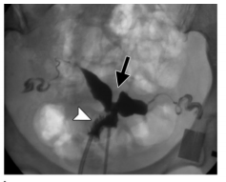
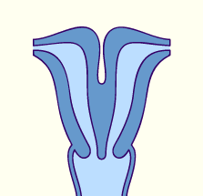
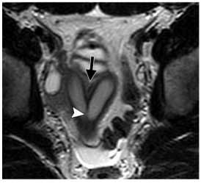
BICORNUATE BICOLLI
Two cervical canals; central myometrium extends to external cervical os

Slide 26
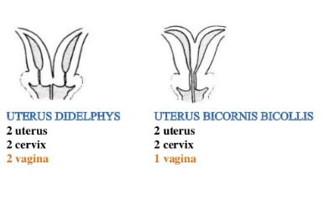

Slide 27
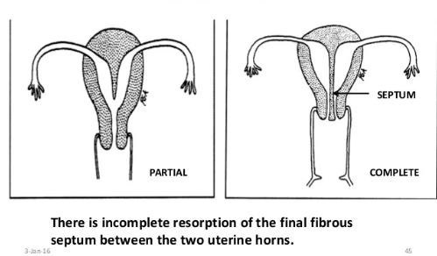
Septate Uterus
History of midtrimester pregnancy loss .
Surgical resection may be considered if recurrent fetal loss occurs

Slide 28
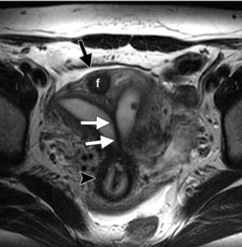
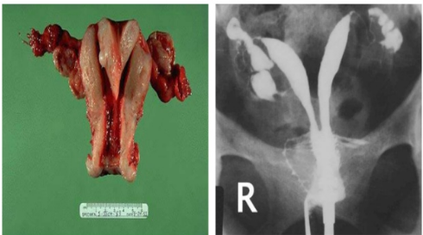
SEPTATE UTERUS
Slight separation forming acute angle.

Slide 29
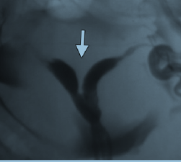
Bicornuate and Septate Uteri
Bicornuate
Septate
Fundus indented – Cavities widely separated( > 100 degree) – Partial fusion of mullerian ducts.
Definite diagnosis by MRI Intervening cleft > 1 cm & intercornual distance > 5cm in bicornuate uterus.
Normal external surface – Cavities are close together – Defect in canalization or resorption of midline septum between mullerian ducts.
Angle of less than 75° between.

Slide 30
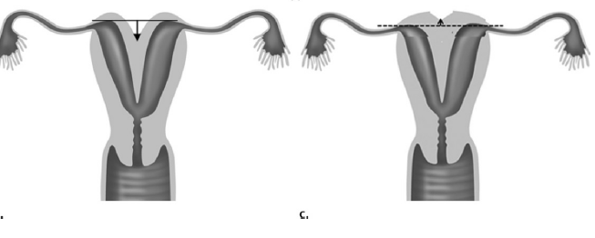
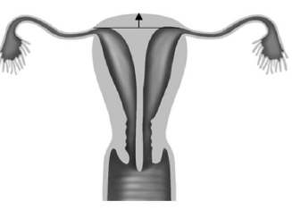
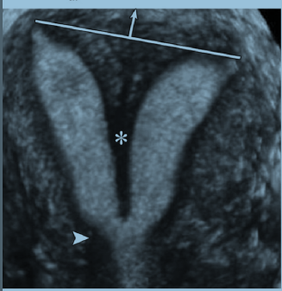
Classification criteria for USG
Bicornuate
Septate
When the apex of the fundal contour is below or less than 5 mm above a line drawn between the tubal ostia, the uterus is bicornuate .
When the apex of the fundal contour is more than 5 mm (arrow) above a line drawn between the tubal ostia, the uterus is septate.

Slide 31
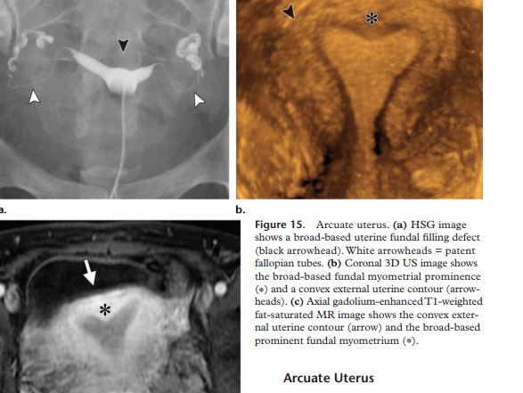
Arcuate Uterus
Near reabsorption of the uterovaginal septum and is characterized at imaging by a mild indentation of the external fundal contour.
HSG: Saddle-shaped indentation at
the uterine fundus is seen.

Slide 32
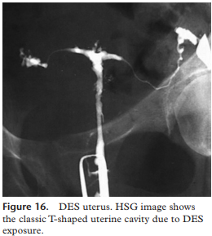
DES Uterus
DES-related anomaly of the uterus involves a hypoplastic or T-shaped uterus.

Slide 33
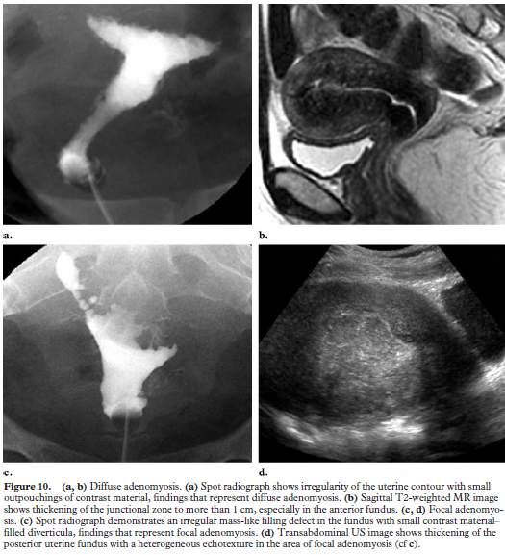
Abnormalities of Uterine Contour
Adenomyosis is a condition in which endometrium extends into the myometrium.
At HSG, adenomyosis appears as small diverticula extending into the myometrium that is irregular outline with multiple diverticulum.

Slide 34
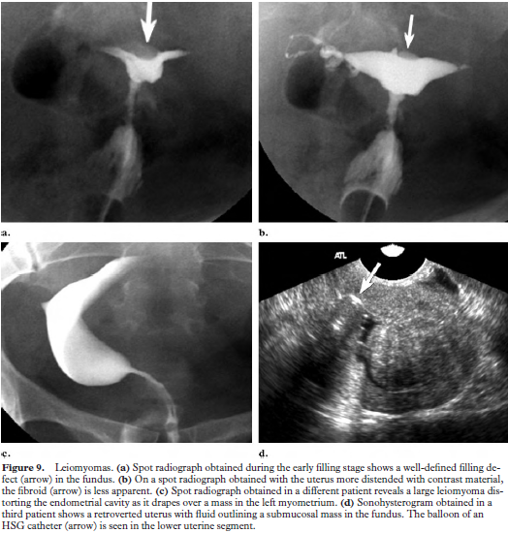
FIBROID UTERUS
Leiomyomas manifest as well-defined filling defects at HSG and can have a variety of appearances depending on their size and their location within the uterus.

Slide 35
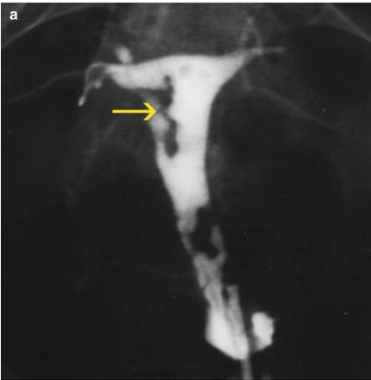
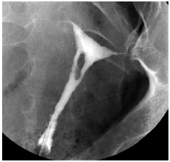
Luminal Filling Defects
Synechiae
Spot radiograph shows a central oval irregular filling defect within the uterus, a finding that represents a synechia.
Multiple synechiae associated with infertility is known as Asherman syndrome.
Multiple filling defects are observed in the uterine cavity with irregular edges.

Slide 36
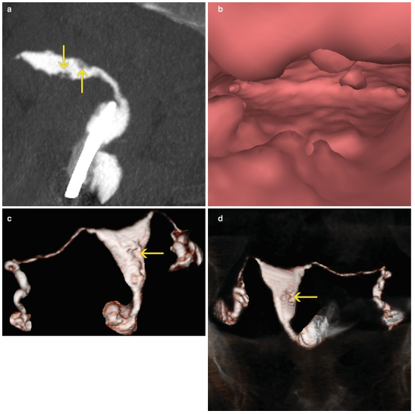
Virtual Hysterosalpingography (VHSG)
Multiplanar reconstructions show irregular elevated lesions with soft tissue density which extend from the uterine walls.
Sagittal maximum intensity projection image that shows an anteverted uterus, which presents multiple filling defects compatible with synechiae.
Virtual endoscopy image which illustrates endoluminal lesions.
(c,d). 3D volume rendering images which exhibit irregularities on the wall corresponding to synechiae.

Slide 37
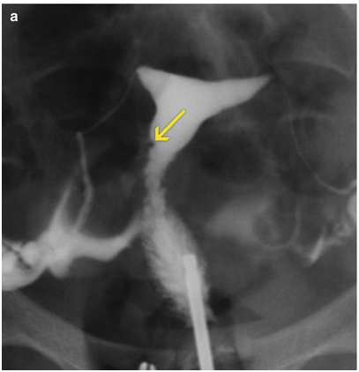
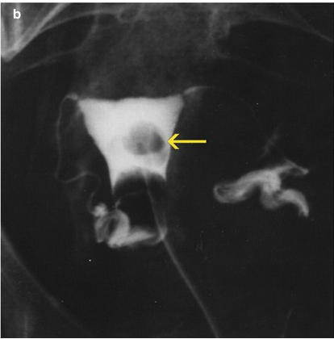
Luminal Filling Defects
Endometrial polyp
They usually manifest as well-definedfilling defects and are best seen during the early filling stage.
Small polyp on the right lateral wall of the uterine silhouette

Slide 38
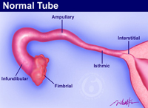
Fallopian Tubes
10–12 cm in length.
Salpingitisisthmicanodosum (SIN).
Cornual spasm.
Tubal occlusion.
Per tubal adhesions
Hydrosalpinx.
Irreversible tubal occlusion with a micro insert.
Tubal polyps.

Slide 39
Salpingitis isthmica nodosum (SIN)
Spot radiograph demonstrate SIN as small outpouchings or diverticulum from the isthmic portion of the fallopian tubes.
Unknown cause.
A/W 1.infertility
2.PID
3.Ectopic pregnancy
SINcan be either unilateral or bilateral.

Slide 40
Cornual spasm
Early filling stage of the uterus, the right fallopian tube does not opacify beyond the cornual portion.
After the instillation of additional contrast material, the right fallopian tube opacified to the ampullary portion.

Slide 41
Tubal occlusion
Spot radiograph demonstrates abrupt cutoff of the left fallopian tube.
Spot radiograph demonstrates cutoff of contrast material in the isthmic portions of both fallopian tubes, with bulbous dilatation.

Slide 42
Hydrosalpinx
(a) Steep right oblique spot radiograph shows dilatation of the ampullary portion of the right fallopian tube (arrow).
(b) Spot radiograph shows dilatation of the ampullary portion of the left fallopian tube, a finding that is consistent with a hydrosalpinx.

Slide 43
Peritubal adhesions
Spot radiograph demonstrates a round collection of contrast material adjacent to the left fallopian tube, a finding that suggests per tubal adhesions.
Note the free contrast material spillage on the right side.

Slide 44
Irreversible tubal occlusion with a microinsert
(a) Scout radiograph obtained prior to the instillation of contrast material shows a micro insert.
(b) Radiograph obtained after instillation shows no contrast material filling of the fallopian tube beyond the micro insert

Slide 45
Tubal polyp.
Small smooth filling defect (arrow) in the proximal left fallopian tube, a finding that typically represents a tubal polyp.
Without concomitant dilatation or tubal occlusion.
Rare.
Asymptomatic

Slide 46
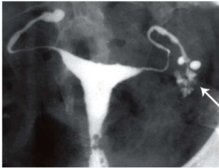
HSG finding in women with TB
Genital tuberculosis (TB) is an important cause of health problem and infertility.
It remains the initial diagnostic procedure in the evaluation of tubal, uterine cavity, and peritoneal factors leading to infertility.
1.Multiple small diverticular like appearance surrounding the ampulla produced by caseous ulceration gives the tubal outline a Rosette-like appearance.

Slide 47
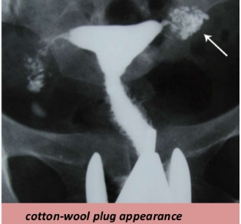
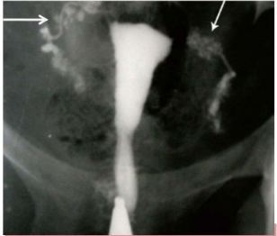
Cotton-wool plug appearance
TB Salphagitis isthemica nodosa
Penetration of contrast medium between the mucosal folds produces small diverticular-like outpouchings with a bizarre pattern.
Distribution of contrast medium in a reticular pattern.

Slide 48
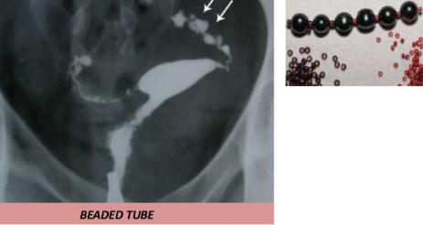
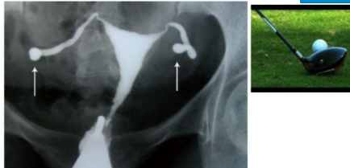
BEADED TUBE
GOLF CLUB TUBE
Multiple constrictions along the fallopian tube giving rise to a " beaded" appearance .
Sacculation of both tubes in distal portion with an associated hydrosalpinx giving a Golf club-like appearance.

Slide 49
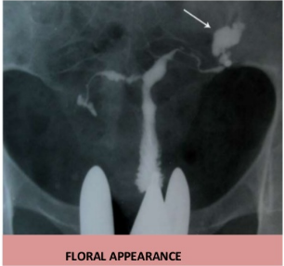
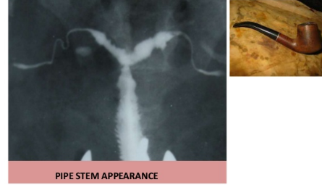
PIPE STEM APPEARANCE
FLORAL APPEARANCE
Absence of normal tortuosity and a curved or straight pipe like appearance show fibrotic stage of tuberculous salpingitis.
Twisted hydrosalpinx resembles a floral appearance of left side tube.

Slide 50
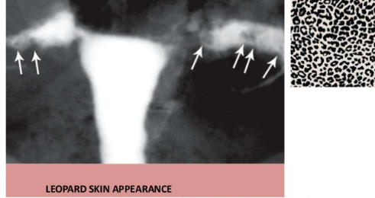
LEOPARD SKIN APPEARANCE
Multiple rounded filling defects following intraluminal granuloma formations within the hydrosalpinx, resembling a " leopard skin" appearance.

Slide 51
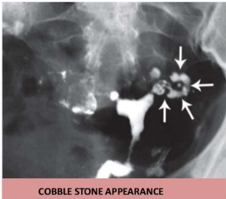
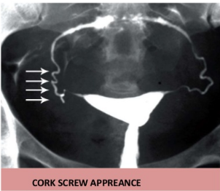
COBBLE STONE APPEARANCE
CORK SCREW APPREANCE
Intraluminal scarring of the tube gives rises a cobblestone like appearance which is an effective radiographic sign of intraluminal adhesions
Vertically fixed tubes secondary to dense peritubal adhesions. Dense connective tissue causes the lack of tubal mobility.
The hyperconvulated right tube and manifests a " cork screw" like appearance

Slide 52
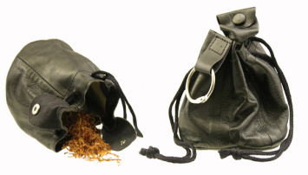
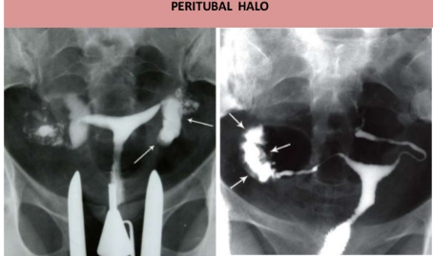

PERITUBAL HALO
TOBACCO POUCH APPREANCE
Thickening of the tubal walls due to peritubal adhesions (arrows) represents a cloudy sign on hysterosalpingograms.
Terminal hydrosalpinx with the conical narrowing is seen in the right tube.
Eversion of the fimbria secondary to adhesions, with a patent orifice produces the tobacco pouch appearance in the left terminal.

Slide 53

Pseudo-unicornuate uterus.
Unilateral scarring of the cavity makes an asymmetric intrauterine obliteration, resembling a unicornuate uterus. the irregular contour and vertical orientation of long axis.
True unicornuate uterus. the smooth contour, more horizontal orientation of long axis and normal ipsilateral fallopian tube.

Slide 54

TRIFOLIATE SHAPED UTERUS
Synechiae formation at the uterine borders and partial obliteration in the fundus produce a trifoliate like appearance. Both tubes are obstructed in the isthmic portion.

Slide 55
Conclusion
HSG remains the front-line imaging modality in the investigation of infertility.
Has a low sensitivity for the diagnosis of pelvic adhesions,
which is why it cannot replace laparoscopy.

Slide 56
References
Pathology of the Uterine Cavity: Clinical key.
Hysterosalpingographic findings in women with genital tuberculosis; Donya Farrokh, Parvaneh Layegh, Monavvar Afzalaghaee, Mohaddeseh Mohammadi, Yalda Fallah Rastegar
Iran J Reprod Med. 2015 May; 13(5): 297–304.
Simpson Jr WL, Beitia LG, Mester J. Hysterosalpingography: a reemerging study. Radiographics. 2006 Mar;26(2):419-31.
Imaging of Müllerian Duct Anomalies Spencer C. Behr, Jesse L. Courtier, Aliya Qayyum Online:Oct 4 2012https://doi.org/10.1148/rg.326125515

Slide 57


Slide 58

?

Slide 59
Answer
The cornua, isthmic and proximal 2/3rd of ampullary part of right fallopian tube are normal in calibre and show normal contrast opacification n. Rest of the distal 1/3rd of ampullary and infundibular parts of the right fallopian tube is dilated.

Slide 60

?

Slide 61

Answer
NON VISUALIZATION OF THE LEFT FALLOPIAN TUBE IN ITS ENTIRE LENGTH BEYOND THE CORNUA - S/O LEFT CORNUAL BLOCK.

Slide 62


?

Slide 63

Answer
There is intravasation of contrast into the myometrial-parametrial vessels extending into paracaval veins occurring immediately – S/O Level 3 intravasation.

