Slide 1
Radioloksabha spotters series- II
Radioloksabha is a free educational website for medical students, residents and doctors to
share knowledge contributing to the world of Radiology
Dr Pavankumar(DMRD, DNB) . Dr Anju (MD). Dr Saarah khan ( MD) . Dr Ashok sharma(MD)
we support FOAMrad - Free open access radiology education

Slide 4
1. Bilateral acute sacroiliitis 2.Enthesitis of the bilateral trochanteric bursa of gluteus, attachment of the right vastus lateralis, bilateral gluteus medius muscles and gluteus minimus tendons with stretching of bilateral gluteus minimus tendons 3. Incomplete sacralisation of L5 vertebra - Castellvi's type IIb

Slide 6
Pelvic brim plate and fixator screws in situ. No break / loosening of implant.
Healed comminuted fracture at the inferolateral aspect of the left iliac bone.
Sub chondral lucencies in the femoral head - suggestive of post-traumatic avascular necrosis of femoral head.

Slide 8
AVASCULAR NECROSIS OF RIGHT HIP JOINT
Evidence of reduction in the acetabular joint space noted with mild sclerosis and multiple lucencies in the femoral head as evidenced by subchondral cysts in the femoral head.
Left hip joint space is normal, no evidence of sclerosis/ subarticular cysts. Bilateral sacroiliac joints are normal, no evidence of sclerosis. Pubic symphsis is normal. Visualized pelvic bones appear normal. Visualized soft tissue planes appear normal.
IMPRESSION:
FEATURES INDICATIVE OF AVASCULAR NECROSIS OF RIGHT HIP JOINT - FICAT AND ARLET CLASSIFICATION - STAGE II

Slide 9
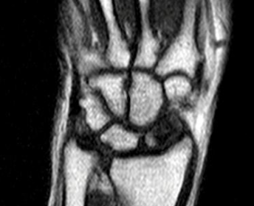

Slide 10
Avascular necrosis of scaphoid.

Slide 11
STIR

Slide 13
T1

Slide 14
MRI features of left avascular necrosis of femoral head (Steinberg's V).

Slide 16
Avascular necrosis of the left head of femur, with secondary osteoarthritic changes - Ficat and Arlet Grade IV.
Flattening and loss of normal contour of the head of left femur, with loss of joint space noted.
Sclerosis around the head of the femur noted.
Loss of neck-shaft angle. Postero-superior displacement of the head of femur.

Slide 19
Dilated right atrium,inferior vena cava with pericardial calcifications- constrictive pericarditis. Contrast in inferior vena cava and hepatic veins on arterial phase images – Right heart failure/tricuspid regurgitation.

Slide 20
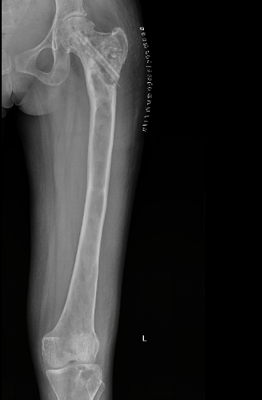

Slide 21
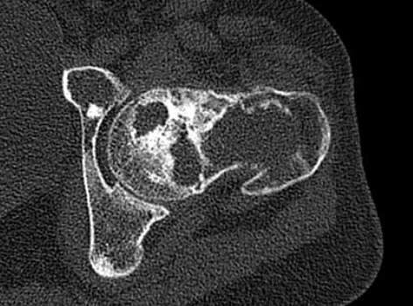
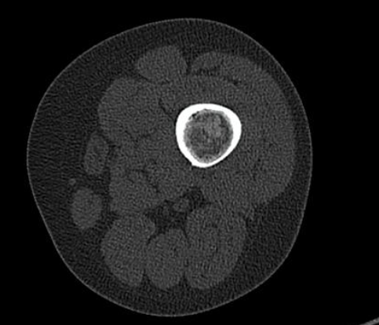

Slide 22
There is evidence of a expansile intramedullary lesion causing mild expansion of the medullary cavity with cortical thinning noted involving head , neck and meta-diaphyseal and proximal diaphysis of the femur
Linear radiolucent area with surrouninding sclerosis noted in the head and neck of femur-Likely post operative screw removal.
The muscles of the hip are normal to the visualized extent.
Intermuscular planes are normal on both sides.
Expansile polyostotic lytic intramedullary lesion with cortical thinning involving left femur and tibia as described- likely Fibrous dysplasia

Slide 23
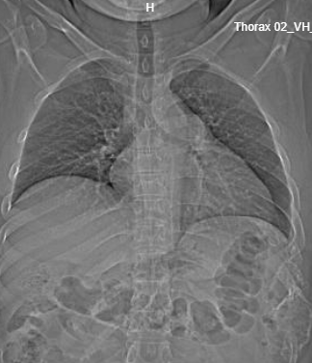

Slide 24
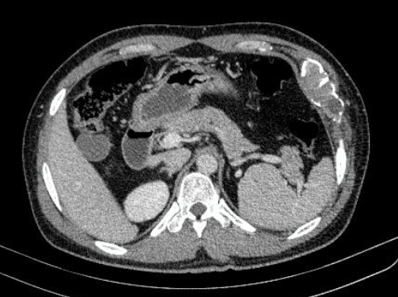
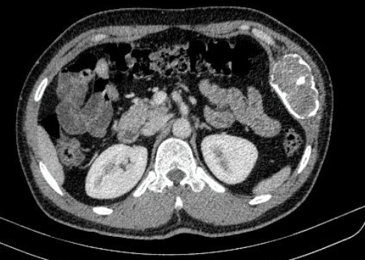

Slide 25
Expansile lytic lesion with enhancing soft tissue component (precontrast HU:34, post contrast HU:52) within noted in anterior end of 7th and 8th rib on left side . Calcification noted within the matrix of the lesion. Expansile lytic lesion in anterior end of 7th and 8th rib on left side. Differentials to be considered: -Fibrous dysplasia -Plasmacytoma

Slide 26
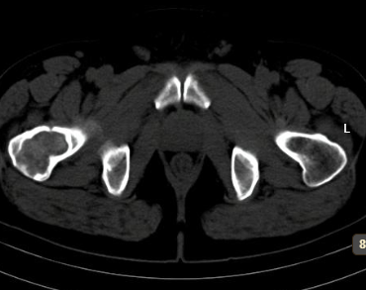
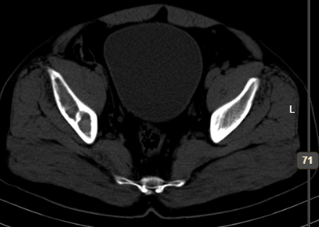

Slide 27
Ill defined intramedullary lesions causing mild expansion of the medullary cavity with sclerotic margins and fibro-osseous ground glass matrix involving the meta-diaphyseal region of the right femur,femoral neck,intertrochanteric and subtrochanteric regions of the femur,acetabulum ,ilium and few focal areas in the ischium bone.-Features suggestive of fibrous dysplasia of the right femur and right hemipelvis.

Slide 28
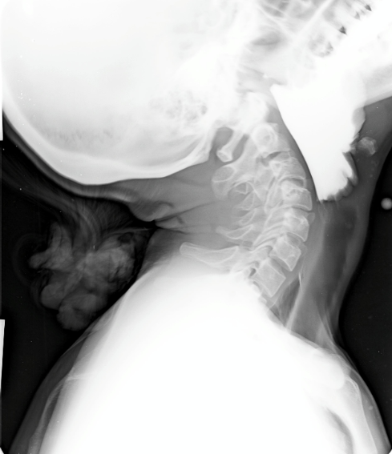
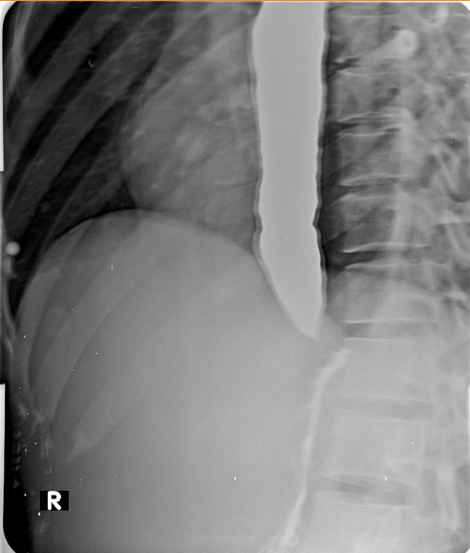

Slide 29
BARIUM SWALLOW
Procedure was done by administering barium sulphate suspension (250% w/v, 100ml) orally and fluoroscopic observation done. Filming done in Erect, AP and RAO, LAO positions and spot films of the upper and lower oesophagus taken.
FINDINGS:
The oesophagus was visualised while swallowing.
Laryngopharynx and upper esophagus is well delineated with barium.
Narrowing noted at gastro esophageal junction with dilatation of proximal part of esophagus.
Thin streak of barium is noted entering stomach.
IMPRESSION:
Features of achalasia cardia .

Slide 30
THANK YOU
You can share presentation, cases, events and articles On Radioloksabha.com
Register at https://www.radioloksabha.com/home.php
Download DNB/MD question papers, presentation and formats.

