Slide 1
Radioloksabha spotters series- III
Radioloksabha is a free educational website for medical students, residents and doctors to
share knowledge contributing to the world of Radiology
Dr Pavankumar(DMRD, DNB) . Dr Anju (MD). Dr Saarah khan ( MD) . Dr Ashok sharma(MD)
we support FOAMrad - Free open access radiology education

Slide 2
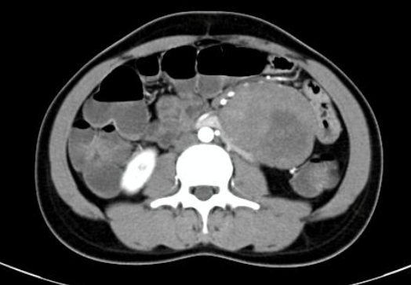

Slide 3
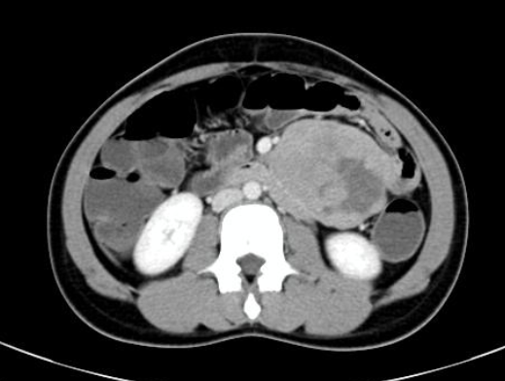
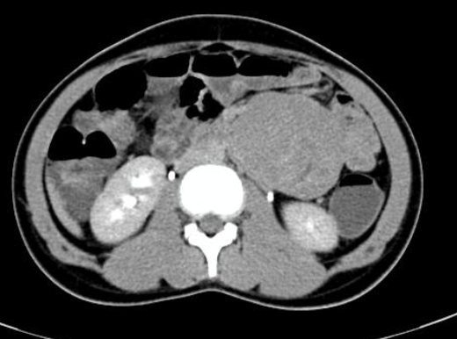

Slide 4
GIST- Gastrointestinal stromal tumor
Well defined homogenously enhancing solid cystic lesion (precontrast HU:38, postcontrast HU:79) with non enhancing hypodense area (s/o necrosis) within approximately measuring x xmm (ApxTrXCc) seen possibly arising jejunal loop with no obvious features of obstruction. The lesion is seen abutting left psoas muscle and left kidney. Craniocaudally the lesion is extending from level of L1 - L4 verebra.

Slide 5
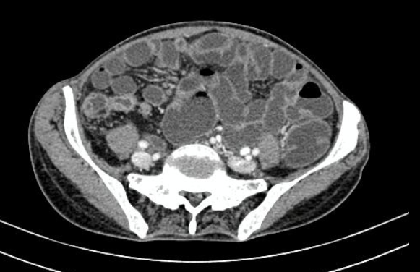

Slide 7
Crohn’s disease with ankylosing spondylitis.
There is evidence of circumferental hetrogenously enhancing(Pre contrast 31, Post contrast 60) short segment wall thickening of the terminal ileum (wall-thickness measuring 12mm) for a length of aprrox. 4.5cm causing mild narrowing of the ileo-caecal junction. Extensive adjacent mesenteric fat stranding noted.
Multiple enhancing enlarged lymph nodes noted in the mesentric region largest measuirng 12x10mm.

Slide 10
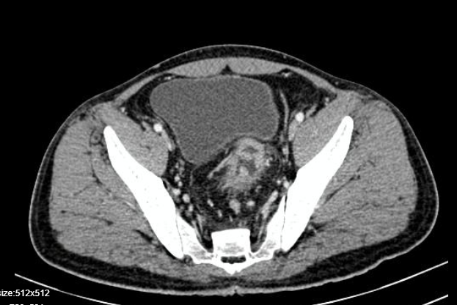

Slide 11
Ulcerative colitis
* Circumferential enhancing wall thickening of sigmoid colon with significant adjacent paracolic fat stranding & minimal mucosal edema in the distal half of the rectum * Multiple enhancing pedunculated intraluminal lesions in the proximal rectum and in the sigmoid – suggestive of Polyps.

Slide 15
Crohn’s disease
There is significant thickening and luminal narrowing involving the cecum and ileocecal junction , wall thickening is also seen involving the adjacent terminal ileum.

Slide 16
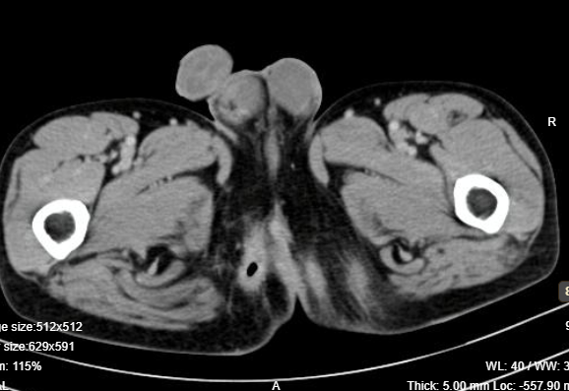

Slide 18
Crohn’s disease
Wall thickening with mural stratification involving the small bowel.
On sinogram ,well defined linear fistulous tract extending from the skin surface in the ischioanal fossa perianal region at 8O clock position in the transphincteric plane ,adjacent fat stranding and air pocket noted, communicating internally with rectum measuring for length of approx. 4 cm and maximum width of 6mm; contrast seen opacifying the rectum, . No extravasation of contrast into the peritoneal cavity.

Slide 19
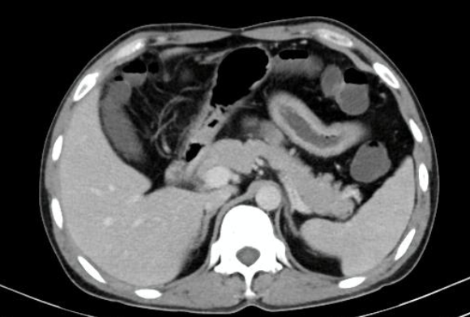
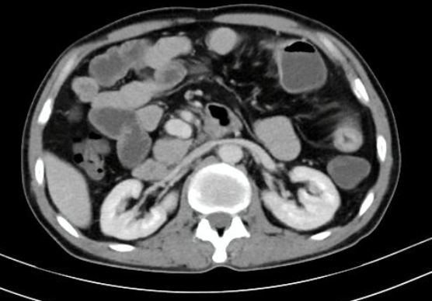
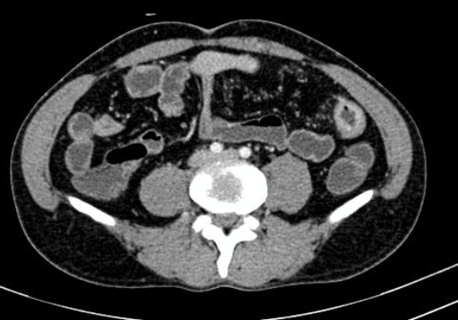
IC junction

Slide 20
Inflammatory bowel disease
A long segment circumferential wall thickening, mural stratification and wall edema noted involving the ileum with maximum wall thickness of 13mm, causing mild luminal narrowing with adjacent fat stranding, with fibrofatty proliferation [creeping fat ] and positive vasa recta sign.
Patulous IC junction.

Slide 21
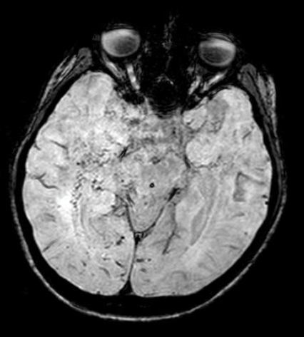
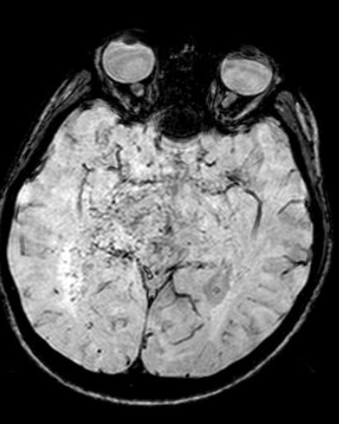

Slide 22
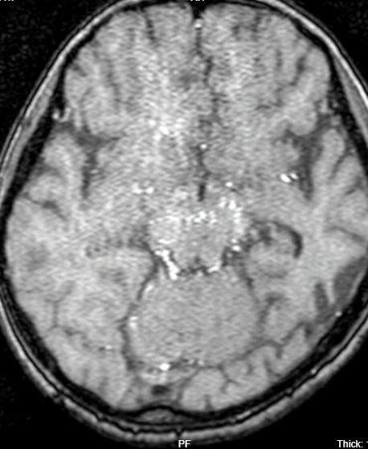
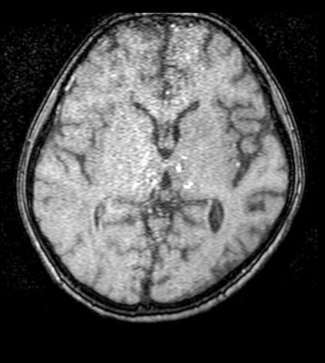

Slide 23
Multiple basal collaterals bilaterally with occlusion of supraclinoid ICA’s( Not shown) --Features suggestive of Moya moya disease- Suzuki stage III to IV. Differentials
Moyamoya syndrome etiologies:CNS vasculitis/ Autoimmune vasculitis.

Slide 24
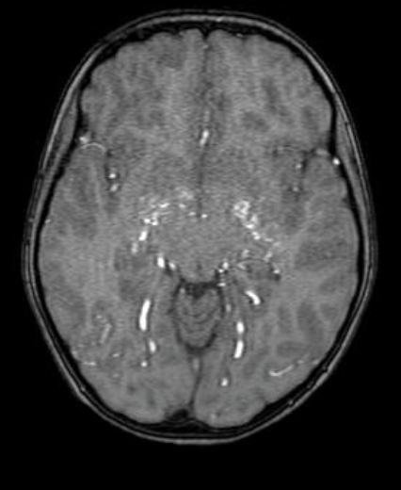
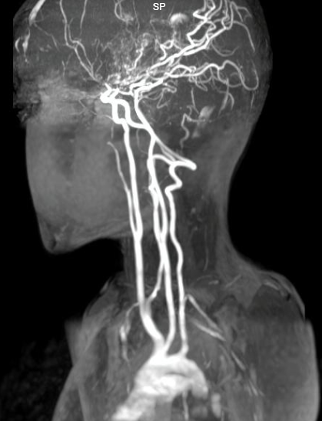

Slide 25
Stenosis of supraclinoid portion of both internal carotid arteries and bilateral anterior and middle cerebral arteries with multiple tortuous flow voids in lenticulostriate, thalamoperforating and dural arteries - s/o abnormal moya moya collaterals giving puff of smoke appearance. Multiple linear FLAIR hyperintensities in the sulcal spaces of frontal, parietal and temporal lobes - s/o leptomeningeal collaterals. -- Features suggestive of grade III moya moya disease (Suzuki staging).
Other close differential diagnosis to be considered are- slowly developing occlusive vasculopathies (sickle cell disease/NF1).

Slide 26
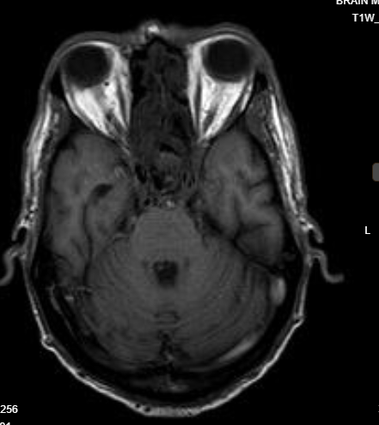
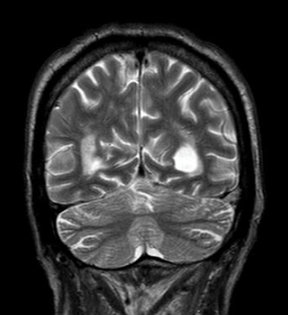

Slide 27
Left transverse and sigmoid sinus thrombosis

Slide 28
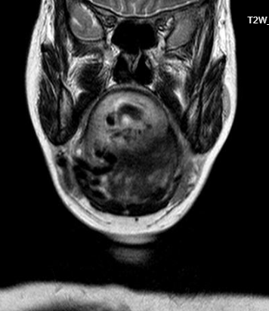
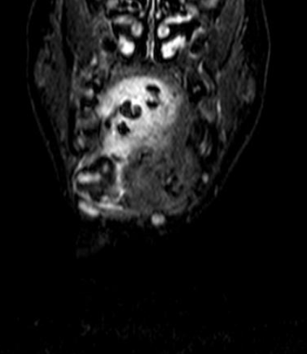

Slide 29
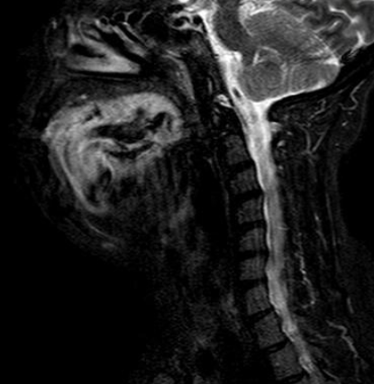
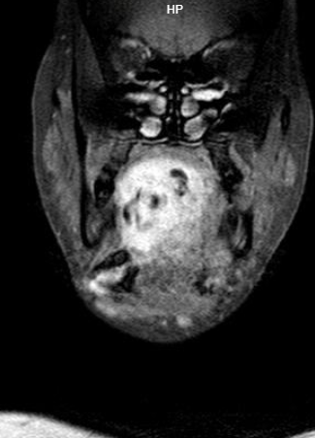

Slide 30
Evidence of a fairly well defined enhancing lesion noted in the floor of the mouth involving the right and left halves of tongue.The lesion is seen involving the superior longitudinal , transverse and genioglossus muscles of tongue. Multiple dilated tortuous flow voids noted within the lesion.
The arterial supply is predominantly from the right lingual artery with few branches from the left lingual artery. Right facial and lingual veins are seen draining the lesion.
(Not shown)
Features suggestive of arteriovenous malformation of tongue

Slide 31
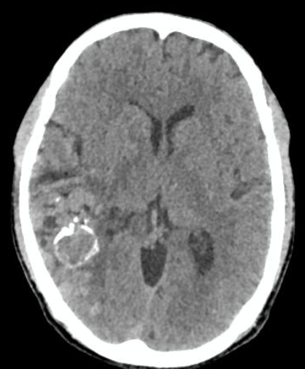

Slide 32
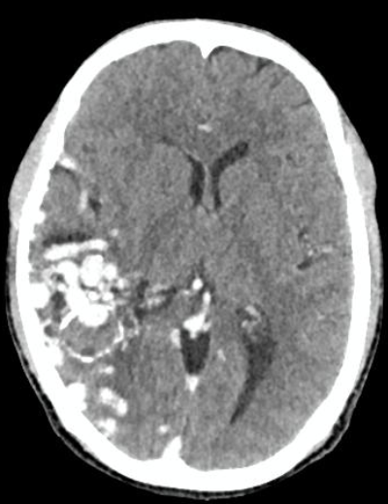
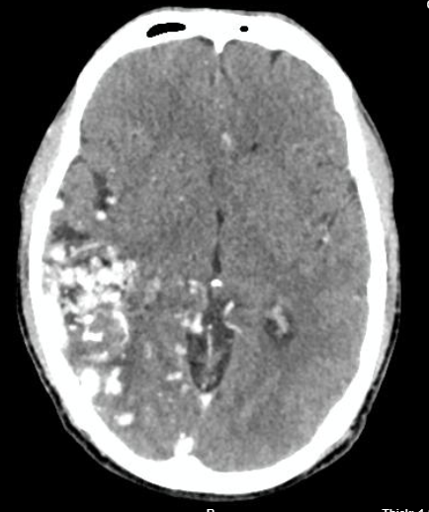

Slide 33
Cerebral arteriovenous malformation

Slide 34
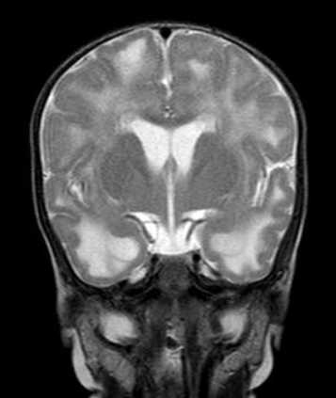
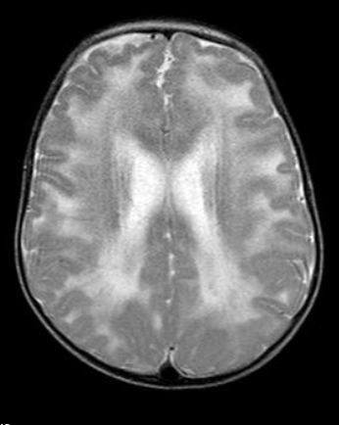

Slide 35
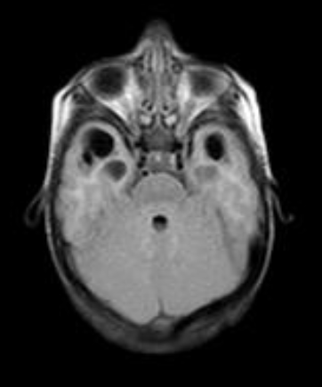
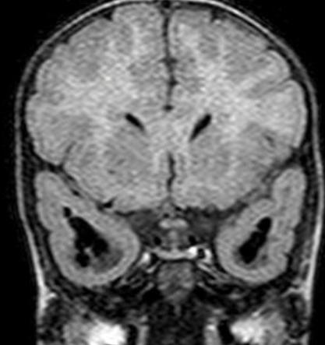

Slide 36
Megalencephalic leucoencephalopathy [Van Der Knaap disease]
*Megalencephaly noted. *Evidence of bilateral symmetrical altered signal intensity noted throughout the deep and sub-cortical white matter of both the cerebral hemispheres, predominantly seen in the frontal, temporal and parietal lobes with relative sparing of cerebellar hemisphere and cortical grey matter. It appears hyperintense on T2/FLAIR, isointense on T1 sequences and restricts on DWI *Evidence of multiple expansie bilateral symmetrical sub-cortical white matter cysts showing CSF signal intensity noted in the anterio-medial aspect of inferior temoral gyrus and lateral aspect of superior temporal gyrus, largest measuring 14x12mm noted in in the right temporal lobe.

Slide 37
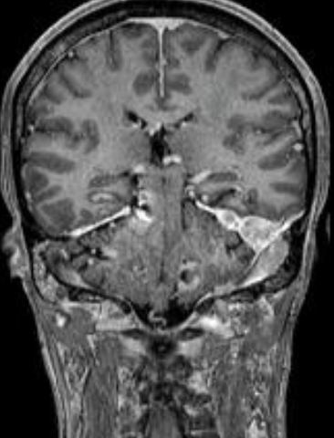
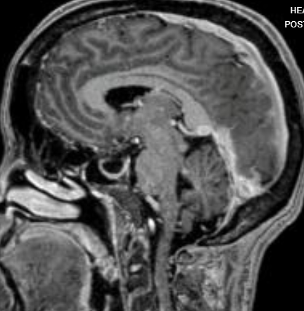

Slide 38
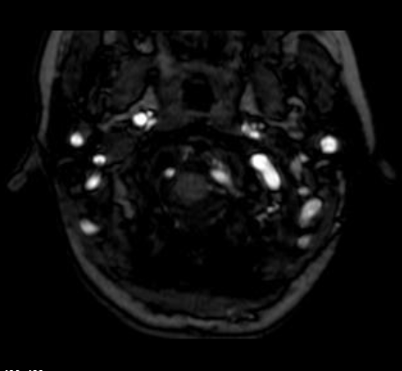
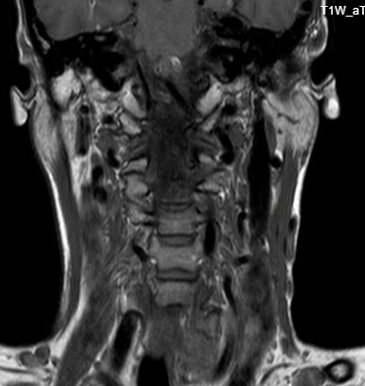

Slide 39
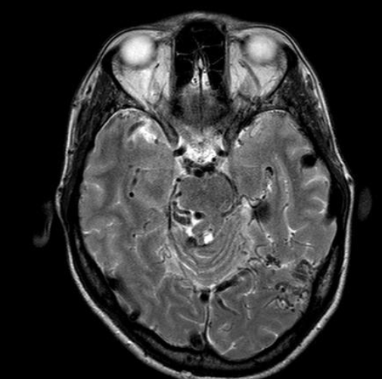
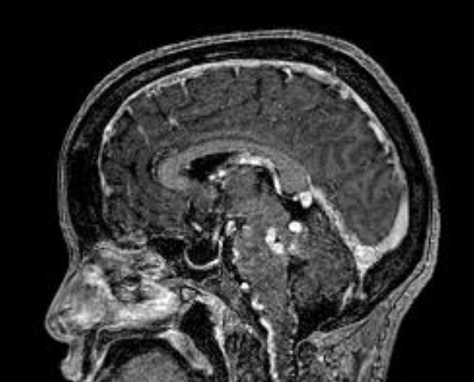

Slide 40
Dural AV fistula
Multiple dilated and tortuous vessels located along the margins of the cerebellar hemisphere, brainstem , peripherally along the temporoparietal and occipital lobes, around the cavernous sinuses. These channels predominantly represent dilated and tortuous veins, bilateral transverse, left sigmoid sinus, internal cerberal veins, vein of galen and straight sinus are significantly dilated and tortuous. Multiple arterial feeders are seen supplying these lesions wih involvement of feeders from bilateral middle cerebral, posterior cerebral , superior cerebellar and choroidal arteries

Slide 41
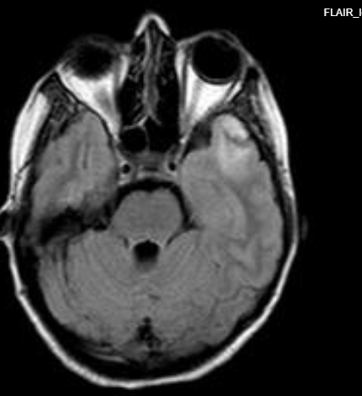
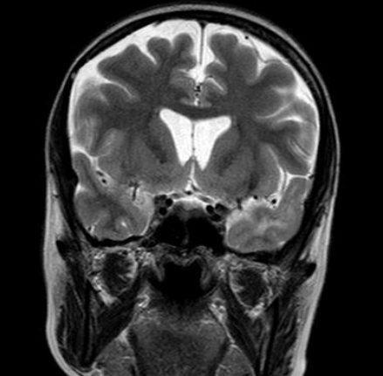

Slide 42
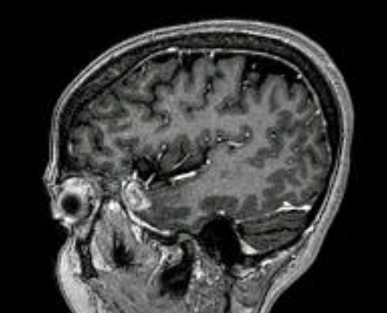

Slide 43
Herpes encephalitis
Evidence of a fairly well defined T1/T2/FLAIR hyperintensity showing diffusion restriction in th left superior temporal gyrus, on contrast images showing enhancement of the lesion with - s/o herpes encephalitis with hemorrhage.

Slide 44
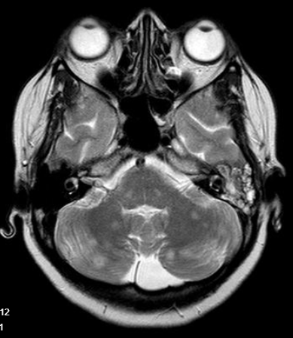
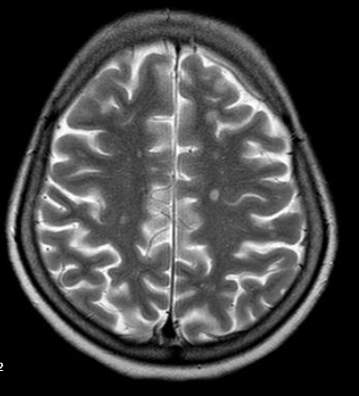

Slide 45
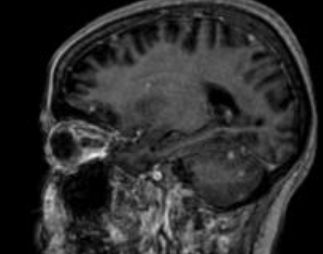

Slide 46
TB Granulomas
Multiple well-defined enhancing lesions noted diffusely spread throughout, involving both the supra and infra-tentorial regions.

Slide 47
THANK YOU
You can share presentation, cases, events and articles On Radioloksabha.com
Register at https://www.radioloksabha.com/home.php
Download DNB/MD question papers, presentation and formats.

