Slide 1
Radioloksabha spotters series- IV
Radioloksabha is a free educational website for medical students, residents and doctors to
share knowledge contributing to the world of Radiology
Dr Pavankumar(DMRD, DNB) . Dr Anju (MD). Dr Saarah khan ( MD) . Dr Ashok sharma(MD)
we support FOAMrad - Free open access radiology education

Slide 2
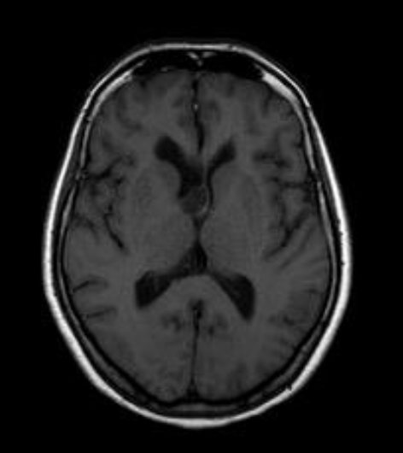

Slide 4
Subependymoma.
Small vessel ischaemic changes (Fazeka's Grade I)

Slide 6
A ill defined soft tissue attenuating midline lesion[mean HU 30] with multiple dicsrete calcific foci of varying sizes noted within, is seen epicentered in the posterior part of third ventricle involving foramen of munro, measuring approximately 27x27x26[ApxTrXC c] mm. Dilatation of lateral ventricle (evan's index 0.4), third ventricle.
Seepage of cerebrospinal fluid noted at the bilateral frontal and bilateral occipital horn of lateral ventricle.
Midline intraventricular lesion with associated hydrocephalus - Ependymoma

Slide 7
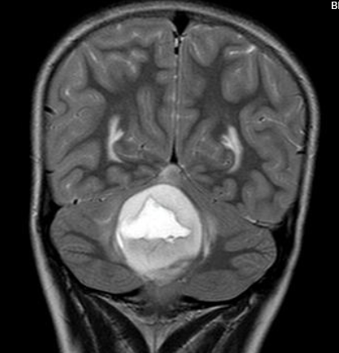

Slide 9
Midline heterogenous lesion in fourth ventricle with obstructive hydrocephalus and tonsillar herniation as described - Medulloblastoma/ Ependymoma

Slide 10
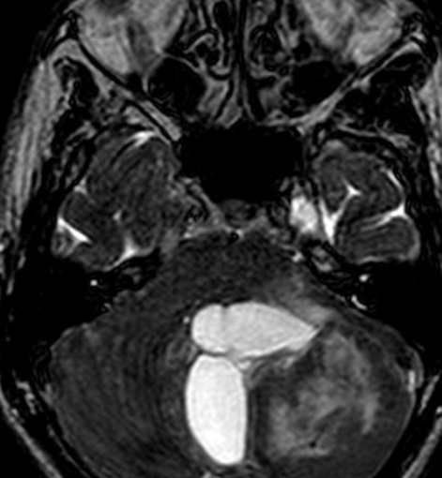

Slide 11
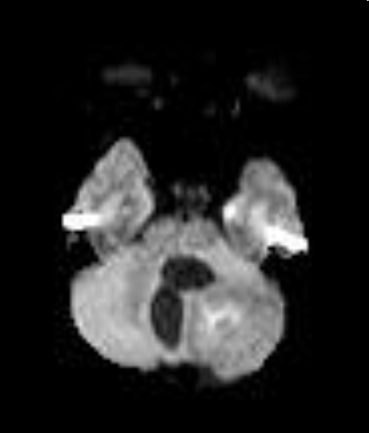

Slide 12
Evidence of intra-axial solid cystic lesion measuring 56x62x48 mm (ApxTrxCc) noted in left cerebellum. The solid component shows post contrast enhancement and minimal diffusion restriction. The lesion is causing compression of right cerebellum and fourth ventricle medially with displacement to the right for 10 mm. The lesion causing compression and displacement of brain stem (mid brain & pons) anteromedio superiorly causing transtentorial herniation and near complete effacement of ambient and prepontine cisterns. Cerebellar tonsillar herniation of below the mc rae line 12mm into foramen magnun.
MR spectroscopy shows choline peak with inverted Cho/NAA peak and evidence of lactate peak at 1.4 ppm. Cerebellar hemangioblastoma

Slide 13
23 year/ male

Slide 14
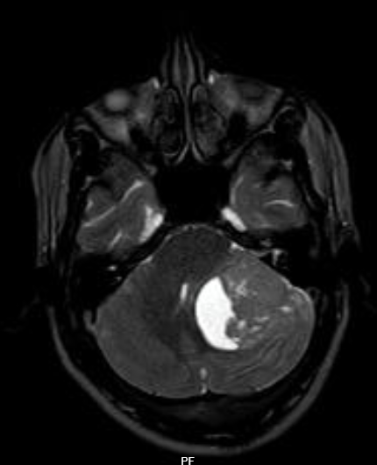

Slide 15
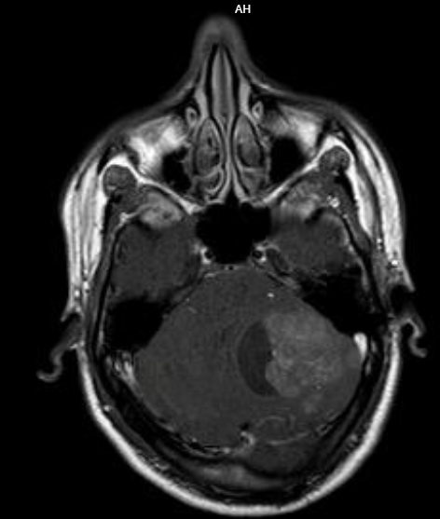

Slide 16
Hemangioblastoma
A fairly well defined intra axial heterogenous mass lesion showing solid and cystic components measuring approximately 4.2 x5 x 2.8 (AP X Tr X CC) cm with solid components showing heterogenous post contrast enhancement noted in left cerebello-pontine angle.On DWI, evidence of diffusion restriction noted.

Slide 17
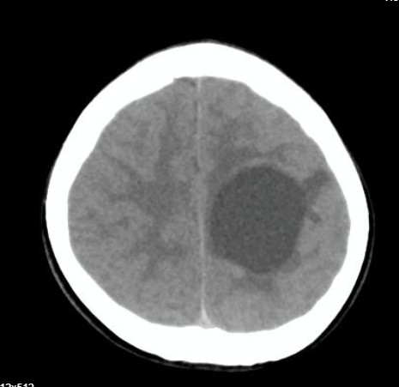

Slide 18
A well defined round cystic lesion[mean HU 19] noted in the cental semiovale of left parietal region ,on contrast study minimal wall enhancement noted with enhancing mural nodule in the superior aspect of the cystic lesion . No obvious calcification noted within the lesion. Diagnosis - Pleomorphic Xanthoastrocytoma.
DD – Pilocystic astrocytoma.

Slide 19
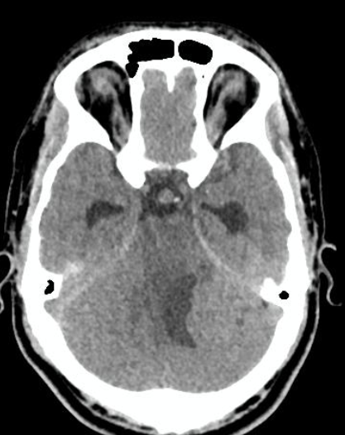
23y/M

Slide 20
Pilocytic astrocytoma
There is evidence of a well-defined solid-cystic lesion [Mean HU 42] having iso to hyperattenuating solid components along the lateral aspect, measuirng 40x 30x 27mm (ap x tr x cc) noted involving the left cerebellar hemisphere with perilesional edema and mass effect in the form of effacement of the adjacent foliae and cerebellopontine angle cisterns with compression and mild displacement of 4th ventricle causing mild upstream hydrocephalus. No evidence of calcification/hemorrhage noted within the lesion.
DD - Hemangioblastoma

Slide 21
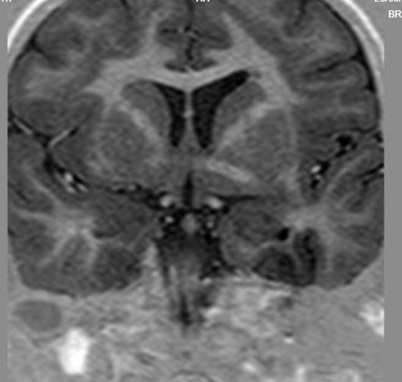

Slide 22
Band heterotopia involving both frontal and parietal lobes.
Normal appearing cortex noted with smooth band of grey matter noted in white matter in both frontal and parietal lobes. Periventricular white matter appears normal.

Slide 23
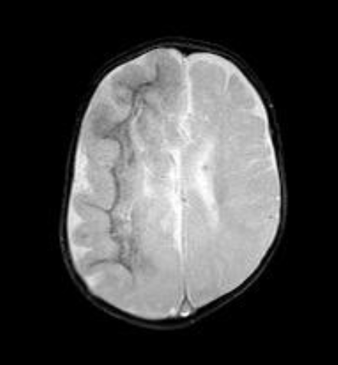

Slide 24
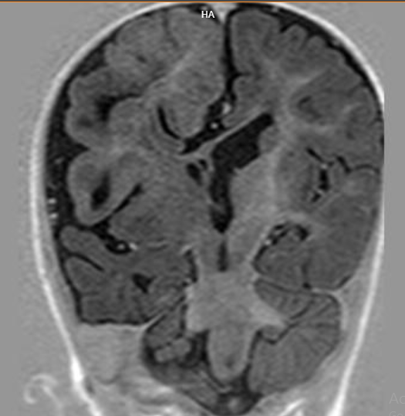

Slide 26
Hemimegalencephaly
Asymmetry of the cerebral hemispheres noted with generalized increase in volume of right cerebral hemisphere. Reduced gyral pattern, broad flat gyri with thickening of cortex ​and heterotopic gray matter , noted in right cerebral hemisphere .The frontal lobe of the right cerebral hemisphere is seen causing midline shift of 7.5mm to the contralateral side compressing the frontal horns and body of bilateral lateral ventricles White matter calcific changes noted in the right fronto-temporo-parietal region. Thining of the corpus collasum noted.

Slide 27
THANK YOU
You can share presentation, cases, events and articles On Radioloksabha.com
Register at https://www.radioloksabha.com/home.php
Download DNB/MD question papers, presentation and formats.

