Slide 1
Radioloksabha spotters series- VIII
Radioloksabha is a free educational website for medical students, residents and doctors to
share knowledge contributing to world of Radiology
Dr Pavankumar(DMRD, DNB) . Dr Anju (MD). Dr Saarah khan ( MD) . Dr Ashok sharma(MD)
we support FOAMrad - Free open access radiology education

Slide 2
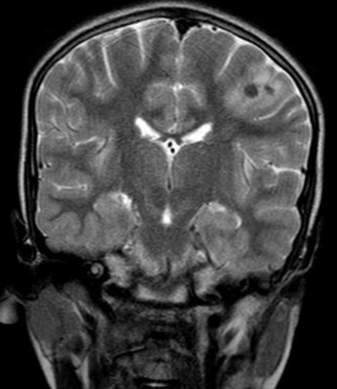

Slide 3
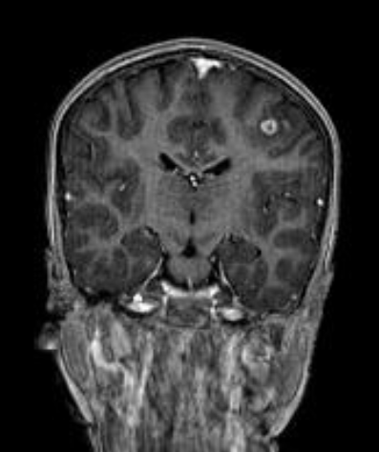

Slide 4
Vesicular stage of neurocysticercosis
A well-defined lesion measuring 8x8x7mm [ApxTrxCc], which is isointense on T1WI and hypointense on T2WI/FLAIR, showing post-contrast peripheral enhancement with a focus of central enhancement and no diffusion restriction is noted in the left frontal lobe in the grey-white matter junction anterior to the central sulcus, with perilesional oedema. Another similar focus showing post-contrast enhancement is noted adjacent to the lesion. Both these foci show mild blooming on GRE. Cephalic index is decreased [BPD/occipitofrontal diam.-69] - s/o dolicocephaly.

Slide 5
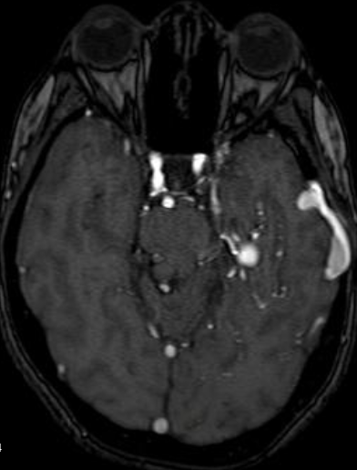

Slide 7
Dural arteriovenous fistula

Slide 9
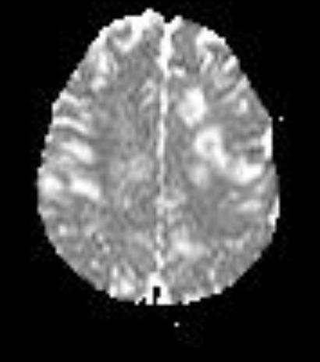

Slide 10
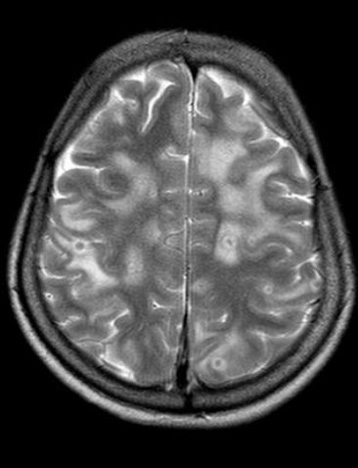

Slide 11
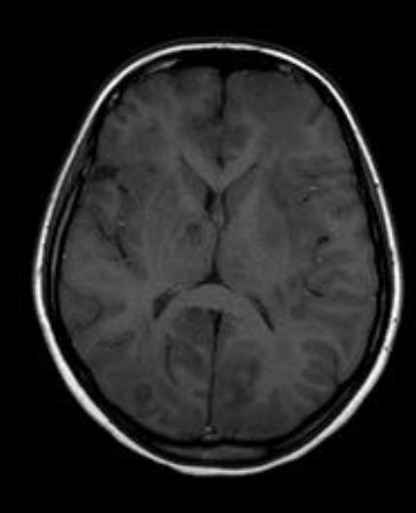

Slide 12
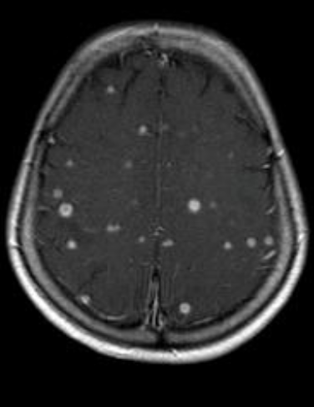

Slide 13
Neurocysticercosis
Multiple well defined ring enhancing areas with perilesional edema noted diffusely involving both cerebrum, cerebellum, midbrain and brain stem. Evidence of scolex noted. No evidence of calcification.

Slide 14
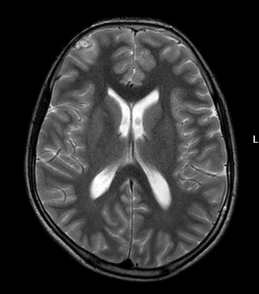

Slide 15
Features suggestive of neurocysticercosis in the right frontal and left temporal -Vesicular to colloid vesicular stage.

Slide 16
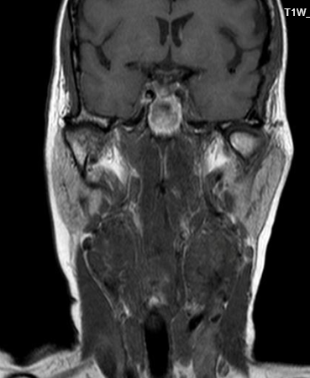

Slide 17
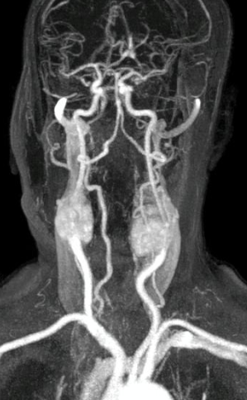

Slide 18
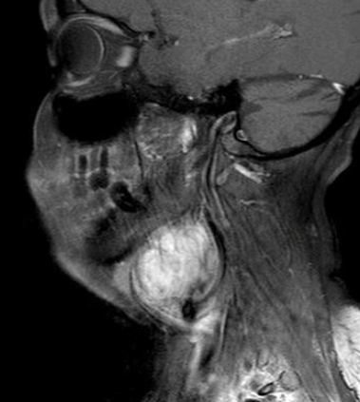
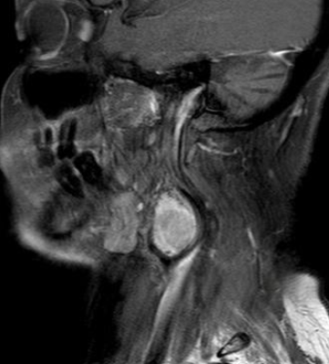

Slide 19
Bilateral paraganglionoma of the carotid body - ShamblinType III carotid body tumors

Slide 20
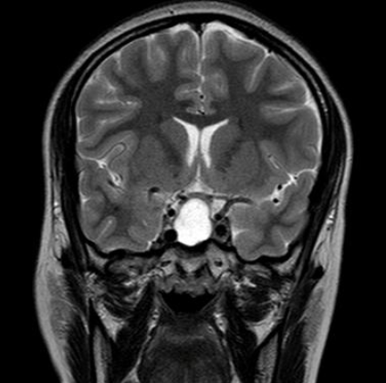

Slide 21
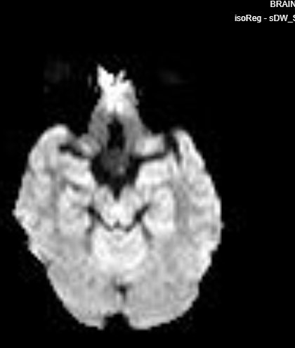

Slide 22
Rathke’s cleft cyst
The pituitary is enlarged measuring 22x18x21mm(ApxTr) . There is evidence of peripherally enhancing predominantly cystic lesion in sellar region with suprasellar extension. Anteriorly the lesion is seen indenting the optic chiasma.This lesion shows paralleling CSF intensiies with focal nodular enhancing areas within Peripheral restricted diffusion noted on DWI.

Slide 23
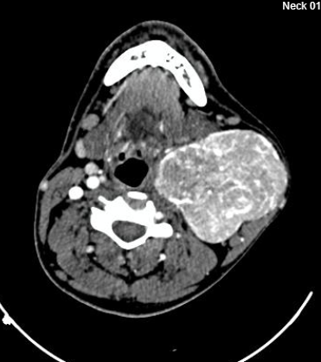

Slide 24
Paraganglionoma (Carotid body tumour)
A well-defined vividly enhancing mass lesion with multiple arterial channels within in the left carotid space with epicentre of the lesion at carotid bulb causing splaying and circumferential encasement of the common carotid artery , carotid bulb, internal carotid artery and external carotid artery.

Slide 26
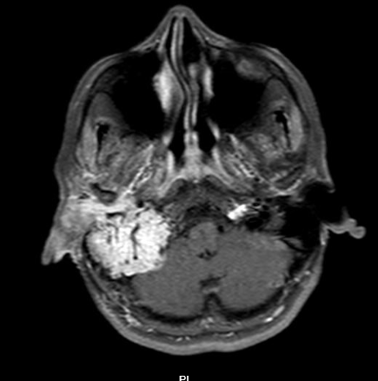

Slide 27
Right glomus jugulare paraganglioma.

Slide 29
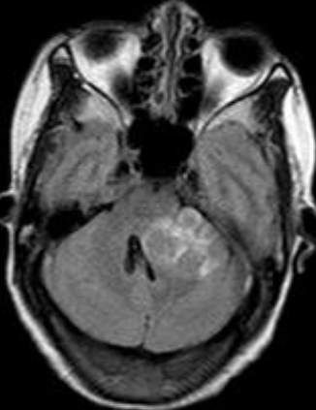

Slide 30
Cystic Schwannoma.
A lobulated extra axial lesion in the left cerebellopontine angle causing hydrocephalous.

Slide 31
THANK YOU
You can share presentation, cases, events and articles On Radioloksabha.com
Register at https://www.radioloksabha.com/home.php
Download DNB/MD question papers, presentation and formats.

