Slide 1
Radioloksabha spotters series- XI
Radioloksabha is a free educational website for medical students, residents and doctors to
share knowledge contributing to world of Radiology
Dr Pavankumar(DMRD, DNB) . Dr Anju (MD). Dr Saarah khan ( MD) . Dr Ashok sharma(MD)
we support FOAMrad - Free open access radiology education

Slide 2
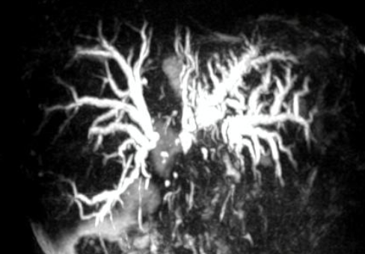
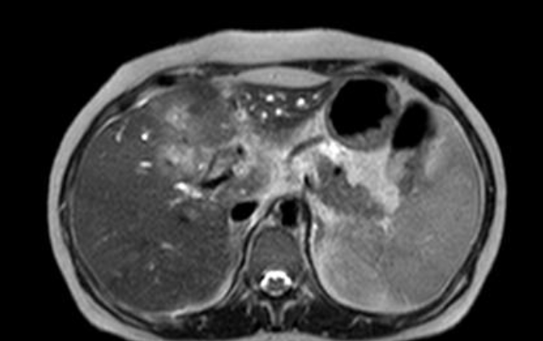
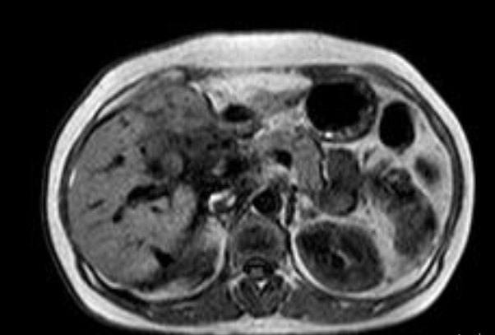

Slide 3
Hilar cholangiocarcinoma
Bilobar Central and peripheral intrahepatic biliary radicle dilatation noted more prominent on the left with irregular stricture seen in the liver hilum at the ductal confluence .-S/o Bismuth type IV non-communicating block with hilar strictures. The common bile duct is not significantly dilated. Ill defined areas of T2W/SPAIR hyperintensities noted involving segments IV,V,VI and VII.-S/O Cholangitic abscesses/infiltrative lesions. Free fluid noted in the perihepatic space and right para-colic gutter and right peural cavity-S/O Minimal ascites and minimal right pleural effusion, T1W hyperintenisty noted in the intrahepatic biliary ducts-S/O sludge/debris. The pancreatic duct shows normal position, length, and caliber with homogeneous internal structure and smooth contours.
IMPRESSION:
*IHBR dilatation with Bismuth type IV non-communicating block with hilar strictures. Possibilities include:- 1)Infiltrative malignant lesion. 2)Post cholecystectomy strictures. *Recommended correlation with ERCP or PTBD with brush cytology.

Slide 4
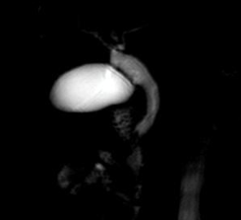
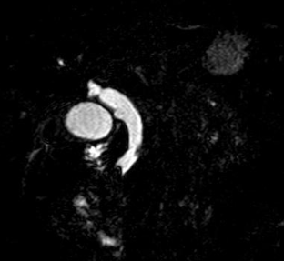
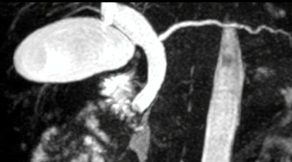

Slide 5
Choledocholithiasis
Filling defect noted in the common bile duct at the level of the ampulla of vater, measuring approx. 5.3x8 mm[TrxCc] causing abrupt cut off the common bile duct. Proximal dilatation of the common bile duct noted throughout its extent measuring 15mm at the porta. Proximal IHBR are also mildly dilated with the common hepatic duct measuring 11mm, right hepatic duct measuring 5.5mm and left hepatic duct measuring 5mm. The gallbladder is over distended ; however it has smooth borders and homogeneous contents. Cystic duct appears normal. The pancreatic duct appears mildly dilated measuring 5mm at the body. It shows normal position & length with homogeneous internal structure and smooth contours. It is seen joining the common bile duct at the 2nd part of duodenum and draining into the ampulla of Vater.
IMPRESSION:
Filling defect in the common bile duct at the level of the Ampulla of Vater-s/o choledocholithiasis Dilatation of proximal common bile duct, proximal IHBR and main pancreatic duct

Slide 6
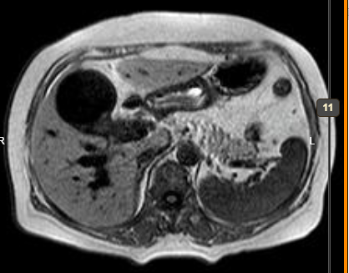
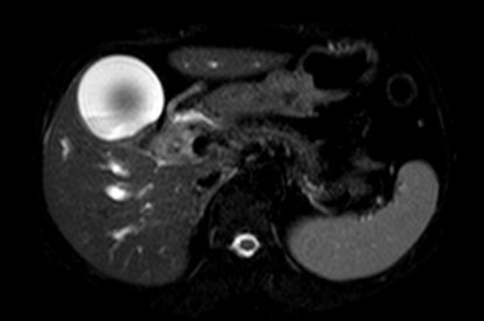

Slide 7
Cholangiocarcinoma
FINDINGS:​
Grossly distended gall bladder with sludge noted with no evidence of cholelithiasis. Gross dilalation of IHBR with dilation of right hepatic (measuring17mm) and left hepatic duct(measuring 18mm)noted with type IV biliary block causing abrupt cut off at the distal end of right and left hepatic ducts extending into proximal and mid portion of extrahepatic common bile duct noted for a length of 2.5cm with involvement of the cystic duct. Involved segment reveals illdefined thickening of the walls The distal CBD is visulaized measuring 5.4mm The pancreatic duct shows normal position, length, and caliber with homogeneous internal structure and smooth contours. Rest of the visualized abdomemn is unremarkable.
IMPRESSION:
Type IV biliary block causing upstream dilatation of biliary system with extesnion as described. - likely s/o hilar cholangiocarcinoma Suggested ERCP and biopsy for further evaluation.

Slide 8
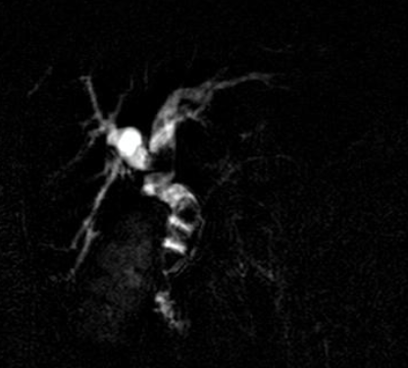
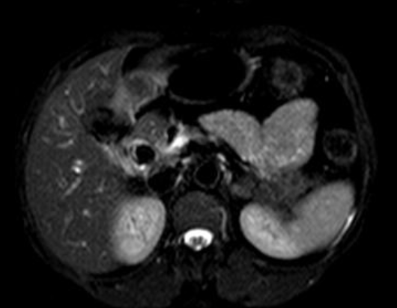

Slide 9
Choledocholithiasis
Multiple well defined hypointese calculi noted in the common hepatic duct (measuring 15x14mm) ,the proximal(measuring 11x4mm) ,mid(measuring 10x6mm) and distal(9x8.3mm) CBD causing dilation of the intraheaptic biliary radicals .The main pancreatic duct shows normal position, length, and caliber with homogeneous internal structure and is seen draining into the distal CBD Gall bladder not visualized. Diameters are as follows : Right hepatic duct measures-11mm Left hepatic duct measures- 13mm CHD measures-17mm Proximal CBD measures -14mm Mid CBD measures-12mm Distal CBD measures-12mm Main pancreatic duct measures-2.4mm The pancreatic duct shows normal position, length, and caliber with homogeneous internal structure and smooth contours.

Slide 10
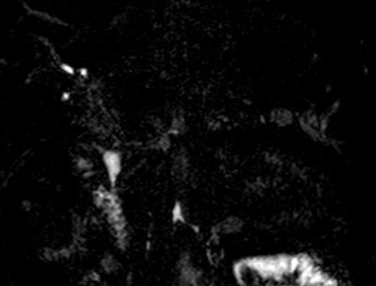

Slide 11
Benign stricture
Dilatation of the common bile duct [proximal aspect measuring 11mm,mid aspect 14mm ] with smooth tapering at the distal part just proximal to confluence with pancreatic duct noted.However the lumen shows homogeneous, fluid-equivalent intraluminal signal​.No evidence of choledocholithiasis Dilated common hepatic duct measuring 12mm. The right hepatic duct measures-3.1mm The left hepatic duct measures-4.7mm Central IHBR appears mildly dilated with sublte irregular walls.
IMPRESSION:
Dilatation of the common bile duct with smooth tapering at the distal part-likley to represent benign stricture.Suggested ERCP correlation. Central IHBR appears mildly dilated with sublte irregular walls -possibility of cholangitis to be considered.

Slide 13
Cholelithiasis
Multiple well defined T2W hypointense areas noted within lumen of gall bladder and neck of gall bladder.

Slide 15
Choledocholithiasis causing biliary obstruction
Other findings
- Cholelithiasis

Slide 16
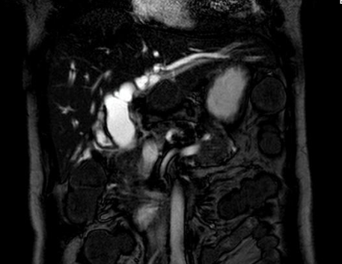

Slide 17
Neoplastic distal CBD stricture
Gall bladder - post cholecystectomy status. Abrupt narrowing of distal CBD causing dilatation of proximal CBD (measuring 23 mm), common hepatic duct (measuring 19 mm) and cystic duct (measuring 14 mm). Mild dilatation od intrahepatic biliary radicals noted.
Conventional non contrast enhanced images do not reveal a space occupying lesion of pancreatic head/ duodenum. The pancreatic duct shows normal position, length, and caliber with homogeneous internal structure and smooth contours.
IMPRESSION:
Distal CBD stricture as described - likely neoplastic etiology. Suggested HPE for furthur evaluation.

Slide 18
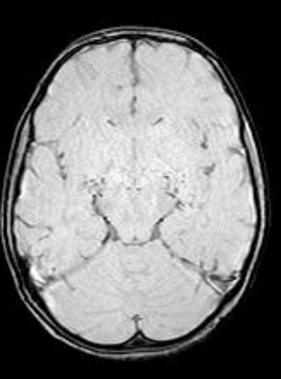

Slide 19
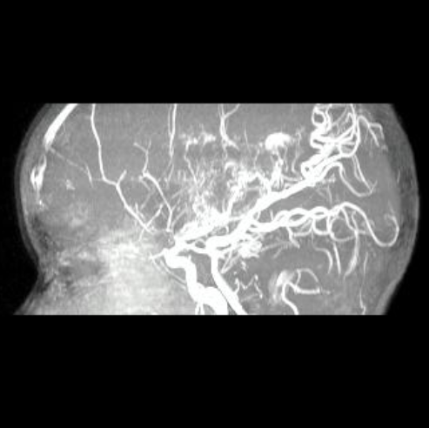

Slide 20
Grade III moya moya disease (Suzuki staging).
Stenosis of supraclinoid portion of both internal carotid arteries and bilateral anterior and middle cerebral arteries with multiple tortuous flow void in lenticulostriate, thalamoperforating and dural arteries - s/o abnormal moya moya collaterals giving puff of smoke appearance. Multiple linear FLAIR hyperintensities in the sulcal spaces of frontal, parietal and temporal lobes - s/o leptomeningeal collaterals. -- Features suggestive of grade III moya moya disease (Suzuki staging).

Slide 21
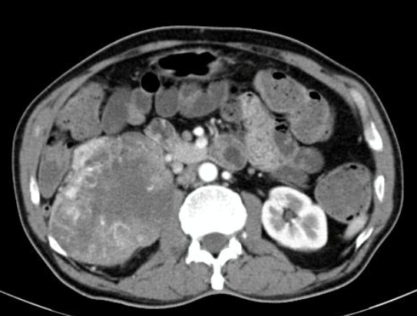
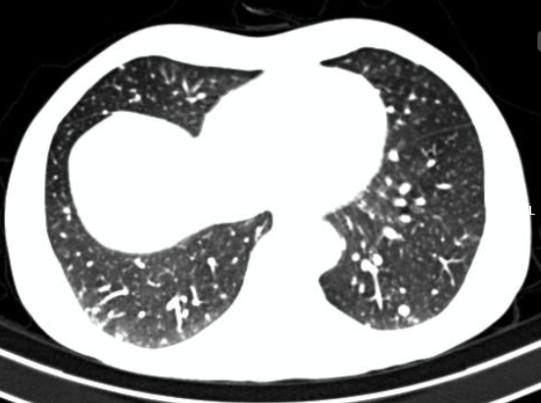

Slide 22
Renal cell carcinoma with metastasis
Heterogenously enhancing mass lesion arising from the mid and lower pole of right kidney with extensions as described - suggestive of Renal cell carcinoma.
Multiple nodular opacities involving the visualized segments of bilateral lungs- likely Metastasis.
Lytic bone lesion involving the S1, S2, S3, right 8th and 10th rib with surrounding soft tissue extensions- s/o Metastasis.

Slide 23
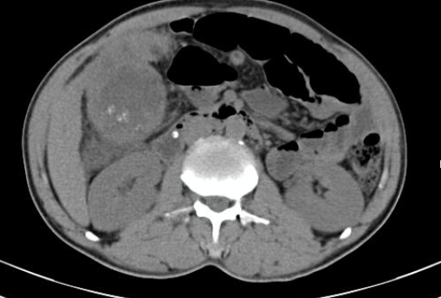

Slide 24
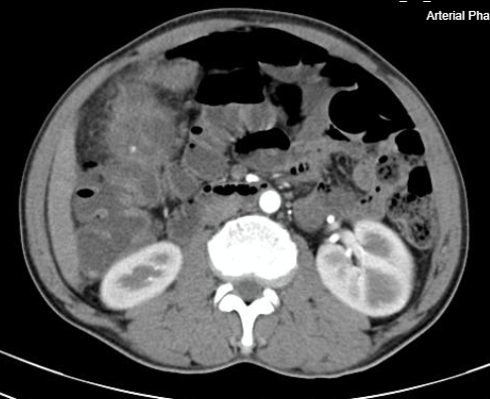

Slide 25
Carcinoma gall bladder and SMA syndrome
Circumferential heterogeneously enhancing wall thickening invovling fundus, body and neck of gall bladder extending into the cystic duct with the loss of fat planes with liver, significant peri-cholecystic fat stranding noted and multiple enhancing lymph nodes in the periportal region, aortocaval region , para-aortic region as described. *Heterogeneously enhancing lesion in the omental region adjacent ot the fundus region of the gall bladder - likely lymph nodal deposit. -- Features likely represent carcinoma gall bladder - Suggested Biopsy correlation from the lesion/ lymph nodal deposit

Slide 26
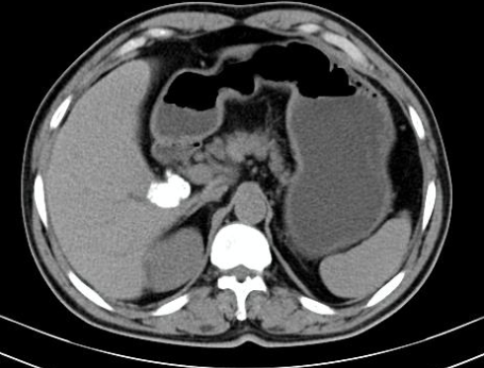

Slide 27
GB mucocele secondary to choledocholithiasis
Gall bladder: Appears grossly distended with normal wall thickness. Multiple well defined hyperdence foci (mean 495 HU) noted in the neck of gall bladder and in the cystic duct , largest measuring 15x16 mm in neck of gall bladder and 5x5 mm in the cystic duct.The cystic duct appears dilated measuring 9 mm, however common bile duct appears normal measuring 6.5 mm. Hyperdense attenuation of the gall badder noted – secondary to obstructive etiology - s/o mucocele.

Slide 28
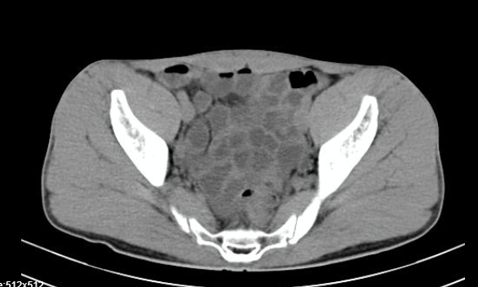
appendix
Appendix

Slide 29
Mucocele of the appendix
Base and body of the appendix are dilated with a maximum diameter of 18 mm with a hyperdense wall. With isodense contents within the lumen with normal tapering of the tip of the appendix noted.
On USG correlation : Dilatation of the base and body of appendix with hyperechoic wall and hyperechoic contents within the lumen - s/o mucocele of appendix

Slide 32
Carcinoma gall bladder and SMA syndrome
Circumferential heterogeneously enhancing wall thickening invovling fundus, body and neck of gall bladder extending into the cystic duct with the loss of fat planes with liver, significant peri-cholecystic fat stranding noted and multiple enhancing lymph nodes in the periportal region, aortocaval region , para-aortic region as described. *Heterogeneously enhancing lesion in the omental region adjacent ot the fundus region of the gall bladder - likely lymph nodal deposit. -- Features likely represent carcinoma gall bladder - Suggested Biopsy correlation from the lesion/ lymph nodal deposit

Slide 34
GB mucocele secondary to choledocholithiasis
Gall bladder: Appears grossly distended with normal wall thickness. Multiple well defined hyperdence foci (mean 495 HU) noted in the neck of gall bladder and in the cystic duct , largest measuring 15x16 mm in neck of gall bladder and 5x5 mm in the cystic duct.The cystic duct appears dilated measuring 9 mm, however common bile duct appears normal measuring 6.5 mm. Hyperdense attenuation of the gall badder noted – secondary to obstructive etiology - s/o mucocele.

Slide 35
appendix
Appendix

Slide 36
Mucocele of the appendix
Base and body of the appendix are dilated with a maximum diameter of 18 mm with a hyperdense wall. With isodense contents within the lumen with normal tapering of the tip of the appendix noted.
On USG correlation : Dilatation of the base and body of appendix with hyperechoic wall and hyperechoic contents within the lumen - s/o mucocele of appendix

Slide 37
THANK YOU
You can share presentation, cases, events and articles On Radioloksabha.com
Register at https://www.radioloksabha.com/home.php
Download DNB/MD question papers, presentation and formats.

