Slide 1
Radioloksabha spotters series- X –URO CONVENTIONAL
Radioloksabha is a free educational website for medical students, residents and doctors to
share knowledge contributing to world of Radiology
Dr Pavankumar(DMRD, DNB) . Dr Anju (MD). Dr Saarah khan ( MD) . Dr Ashok sharma(MD)
we support FOAMrad - Free open access radiology education

Slide 2
KUB /IVP/MCU/RGU SERIES
URO CONVENTIONAL PROCEDURES

Slide 4
FINDINGS:
Well defined radioopacity noted in the right lumbar region at the level of L3-L4 Both renal shadows are well seen. No abnormally dilated bowel loop with air fluid level noted. Underlying bony component is normal. Pre and pro peritoneal soft tissue planes are well maintained.
IMPRESSION:
Right proximal ureteric calculus-suggested IVP correlation

Slide 5
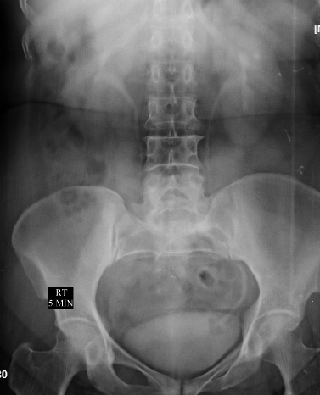

Slide 6
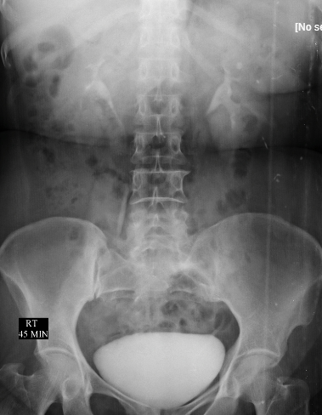

Slide 7
INTRAVENOUS UROGRAM IVU is done by injecting 60ml of non-ionic water soluble iodinated contrast medium intravenously and serial films are taken SCOUT FILM: Both renal shadows are well seen Well defined radioopacity noted in the left renal shadow at the level of L1-L2 disc space-Suggestive of renal calculus. ​Paravertebral soft tissue shadow is normal Under lying bony structures show degenerative changes in the form of osteophytes in the lumbar spine. NEPHROGENIC PHASE: Good and prompt excretion of contrast noted simultaneously by both kidneys. Both kidneys are normal in size, shape, position, axis and contour. FURTHER FILMS SHOW: Pelvicalyceal system is well delineated with contrast medium. No Evidence of dilatation of pelvicalyceal system noted. No delay in excretion Urinary bladder is well delineated with contrast. Urinary bladder is normal in shape. No abnormalities seen. No significant post void residue IMPRESSION: Left non obstructive renal calculus.

Slide 8
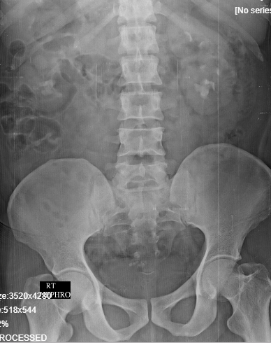

Slide 9
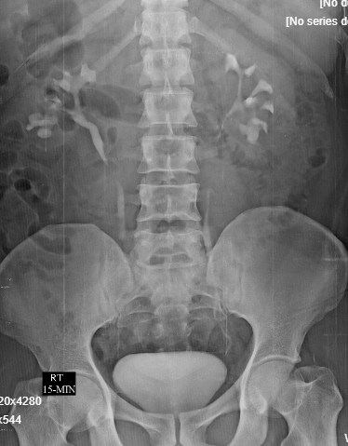

Slide 11
INTRAVENOUS UROGRAM SCOUT FILM: Both renal shadows are well seen Radiodense opacities noted in both renal shadows at the level of L2-L3 . ​Paravertebral soft tissue shadow is normal Under lying bony structures show no degenerative changes. IVU is done by injecting 60ml of non-ionic water soluble iodinated contrast medium intravenously and serial films are taken NEPHROGENIC PHASE: Good and prompt excretion of contrast noted simultaneously by both kidneys. Both kidneys are normal in size, shape, position, axis and contour.
FURTHER FILMS SHOW: 5 Min: Pelvicalyceal system is well delineated with contrast medium. No Evidence of dilatation of pelvicalyceal system noted. 15 Min: Pelvicalyceal system is well delineated with contrast medium. Both ureters are well delineated with contrast. Urinary bladder is well delineated with contrast. Urinary bladder is normal in shape. No abnormalities seen. 30 Min; Pelvicalyceal system is well delineated with contrast medium. No Evidence of dilatation of pelvicalyceal system noted. Urinary bladder is well delineated with contrast. Urinary bladder is normal in shape. No abnormalities seen. Delayed: Pelvicalyceal system is well delineated with contrast medium. Urinary bladder is well delineated with contrast. Urinary bladder is normal in shape. No abnormalities seen. IMPRESSION: Non - obstructive renal calculi in both kidneys. Normal IVP study

Slide 12
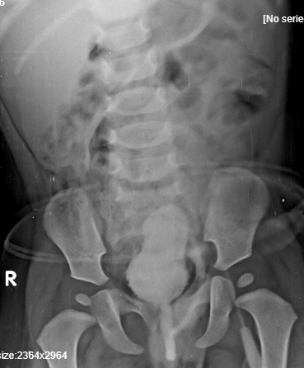

Slide 13
MICTURATING CYSTOURETHROGRAPHY
Procedure was done under aseptic precautions using non ionic contrast media.
Findings
Evidence of contrast filling the bladder noted.
Bladder is seen in its normal anatomical location.
Urinary bladder surface shows mild irregularity noted in partially distended state.
No evidence of contrast entering the lower part of ureter on both sides.
Prostatic part of posterior urethra is well delineated with contrast.
Contrast is seen beyond the prostatic urethra and membranous urethra is normal.
IMPRESSION:
No evidence of VUR on both sides. Cystitis-Suggested clinical correlation.

Slide 14
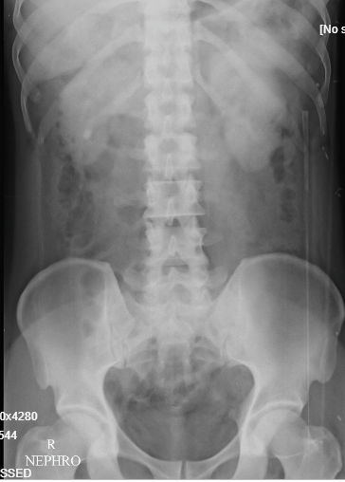

Slide 15
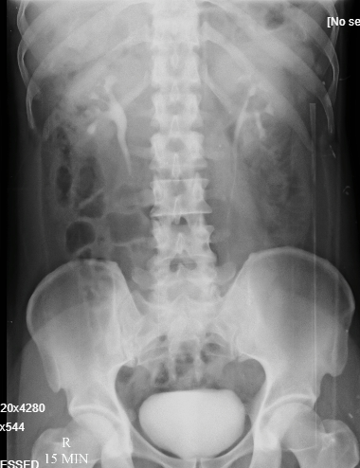

Slide 16
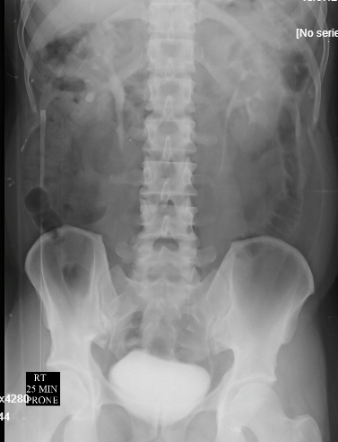

Slide 17
INTRAVENOUS UROGRAM
SCOUT FILM: Both renal shadows are well seen Evidence of radiodense opacities noted in right renal shadow - Likely renal calculi. ​Paravertebral soft tissue shadow is normal Under lying bony structures show no degenerative changes. IVU is done by injecting 60ml of non-ionic water soluble iodinated contrast medium intravenously and serial films are taken NEPHROGENIC PHASE: Good and prompt excretion of contrast noted simultaneously by both kidneys. Both kidneys are normal in size, shape, position, axis and contour. FURTHER FILMS SHOW: Pelvicalyceal system is well delineated with contrast medium. No Evidence of dilatation of pelvicalyceal system noted. Urinary bladder is well delineated with contrast. Urinary bladder is normal in shape. No abnormalities seen. IMPRESSION: Non obstructive right renal calculi. Normal intravenous urogram.

Slide 18
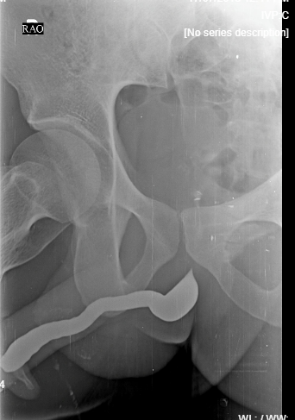

Slide 20
RETROGRADE URETHROGRAPHY
Procedure was done under aseptic precautions using non-ionic contrast media.
FINDINGS:
Anterior urethra is well delineated with contrast and is normal.
No evidence of abnormal dilatation/ stricture/ filling defect noted in the anterior urethra.
Contrast is seen filling the bladder partially.
IMPRESSION:
Normal anterior urethra .

Slide 21
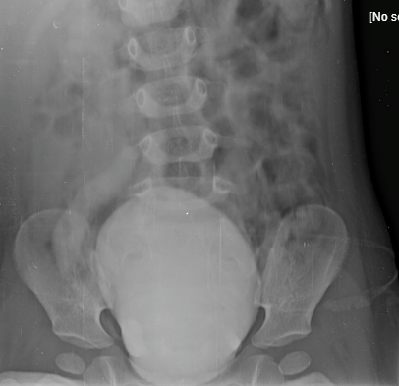

Slide 22
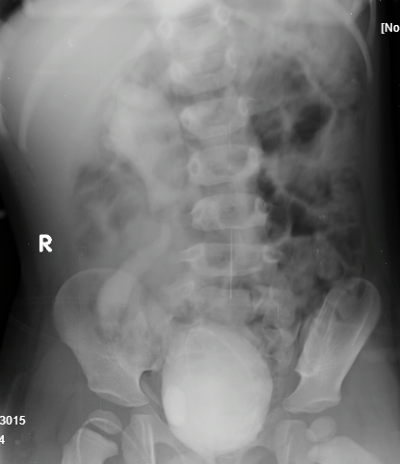

Slide 23
MICTURATING CYSTOURETHROGRAPHY
Procedure was done under aseptic precautions using non ionic contrast media.
Findings
Evidence of contrast filling the bladder noted.
Bladder is seen in its normal anatomical location.
Urinary bladder surface shows no irregularity.
Evidence of contrast entering the lower part of ureter on right side. There is reflux of contrast upto the right renal pelvis with gross dilatation of renal pelvis and
Prostatic part of posterior urethra is well delineated with contrast.
Contrast is seen beyond the prostatic urethra and membranous urethra is normal.
IMPRESSION:
In a known case of right VUR, post-ureteric implantation, present study reveals, grade IV VUR on right side.

Slide 24
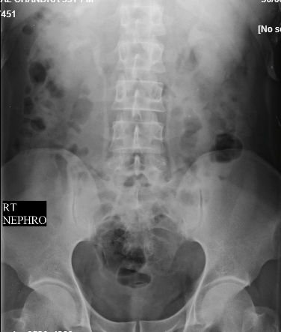

Slide 25
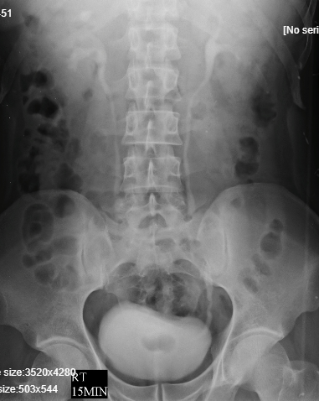

Slide 26
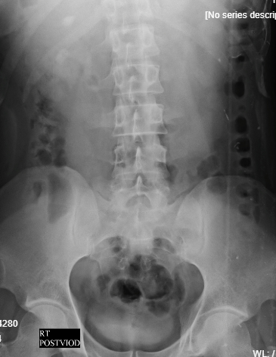

Slide 27
INTRAVENOUS UROGRAM
SCOUT FILM: Evidence of two radiodense opacities noted at the level of T12 and L2 vertebrae on the right side. Both renal shadows are well seen ​Paravertebral soft tissue shadow is normal Under lying bony structures show no degenerative changes. IVU is done by injecting 60ml of non-ionic water soluble iodinated contrast medium intravenously and serial films are taken NEPHROGENIC PHASE: Evidence of two radiodense opacities noted at the level of T12 and L2 vertebrae on the right side. Good and prompt excretion of contrast noted simultaneously by both kidneys. Both kidneys are normal in size, shape, position, axis and contour. FURTHER FILMS SHOW: Evidence of two radiodense opacities noted at the level of T12 and L2 vertebrae on the right side. Pelvicalyceal system is well delineated with contrast medium. No Evidence of dilatation of pelvicalyceal system noted. Urinary bladder is well delineated with contrast. Urinary bladder is normal in shape. No abnormalities seen. Om ultrasound correlation: Evidence of two hyperechoic foci with posterior acoustic shaowing noted in the right kidney, largest measuring 11mm in the lower pole. IMPRESSION: Right non- obstructive renal calculi.

Slide 28
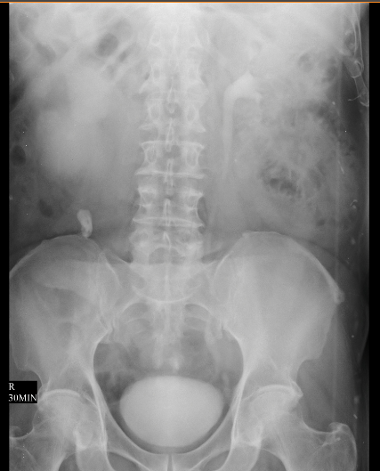

Slide 29
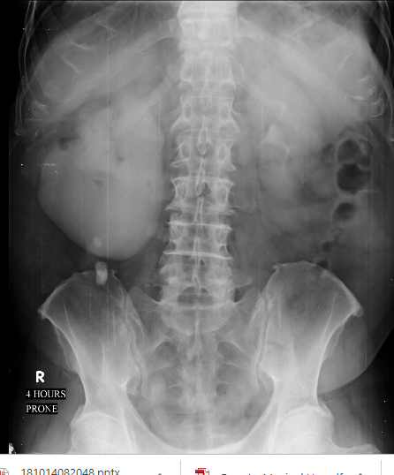

Slide 30
INTRAVENOUS UROGRAM
SCOUT FILM: Both renal shadows are well seen. Radiodense opacities noted in the right paravertebral region at the level of L3 and L4-5-S/O ureteric calculus. ​Paravertebral soft tissue shadow is normal Under lying bony structures show degenerative changes. IVU is done by injecting 60ml of non-ionic water soluble iodinated contrast medium intravenously and serial films are taken NEPHROGENIC PHASE: Contrast is not seen outing the renal parenchymal by the right kidney. Good and prompt excretion of contrast noted by left kidney. Both kidneys are normal in size, shape, position, axis and contour. ​FURTHER FILMS SHOW: Pelvicalyceal system is well delineated with contrast medium. Delayed contrast excretion noted in the right kidney [5mins] film with dilatation of pelvicalyceal system and ureter upto the radiodense opacity. However, no contrast is seen beyond the radiodense opacity. Urinary bladder is well delineated with contrast. Urinary bladder is normal in shape. No abnormalities seen.
On usg, there are hyperechoic foci with posterior acoustic shadowing noted in the dependant posrrtion of renal pelvis and the proximal ureter with upstream dilatation of ureter and pelvicalyceal system. IMPRESSION: Right sided renal calculus. Right sided obstructive proximal ureteric calculus causing grade III hydronephrosis.

Slide 31
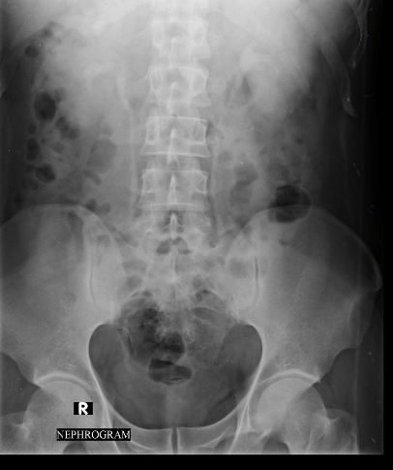

Slide 32
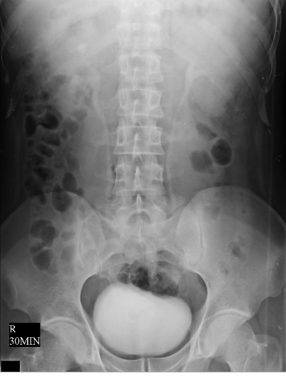

Slide 33
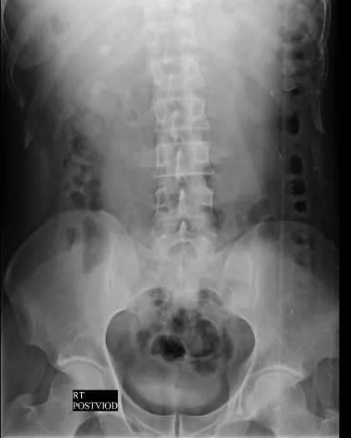

Slide 34
INTRAVENOUS UROGRAM
SCOUT FILM: Evidence of two radiodense opacities noted at the level of T12 and L2 vertebrae on the right side. Both renal shadows are well seen ​Paravertebral soft tissue shadow is normal Under lying bony structures show no degenerative changes. IVU is done by injecting 60ml of non-ionic water soluble iodinated contrast medium intravenously and serial films are taken NEPHROGENIC PHASE: Evidence of two radiodense opacities noted at the level of T12 and L2 vertebrae on the right side. Good and prompt excretion of contrast noted simultaneously by both kidneys. Both kidneys are normal in size, shape, position, axis and contour. FURTHER FILMS SHOW: Evidence of two radiodense opacities noted at the level of T12 and L2 vertebrae on the right side. Pelvicalyceal system is well delineated with contrast medium. No Evidence of dilatation of pelvicalyceal system noted. Urinary bladder is well delineated with contrast. Urinary bladder is normal in shape. No abnormalities seen. Om ultrasound correlation: Evidence of two hyperechoic foci with posterior acoustic shaowing noted in the right kidney, largest measuring 11mm in the lower pole. IMPRESSION: Right non- obstructive renal calculi.

Slide 36
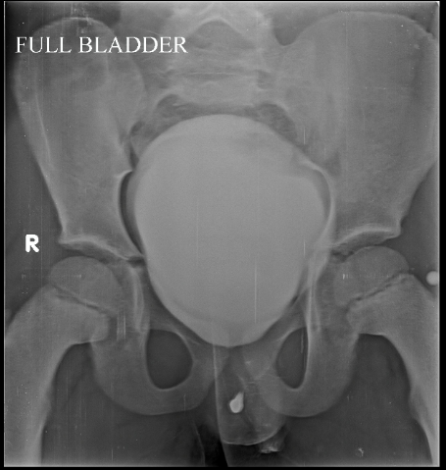

Slide 38
RETROGRADE URETHROGRAPHY
Procedure was done under aseptic precautions using non-ionic contrast media.
FINDINGS:
Anterior urethra is well delineated with contrast and is normal.
No evidence of abnormal dilatation/ stricture/ filling defect noted in the anterior urethra.
Contrast is seen filling the bladder partially.
IMPRESSION:
Normal anterior urethra .

Slide 40
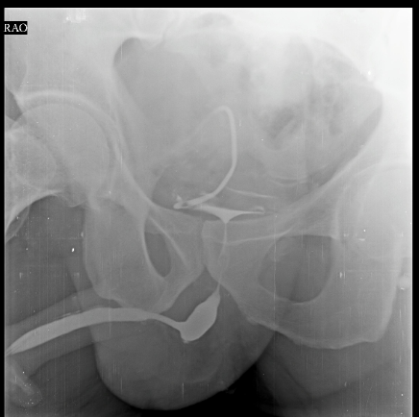

Slide 41
RETROGRADE URETHROGRAPHY
Procedure was done under aseptic precautions using non-ionic contrast media.
FINDINGS:
Anterior urethra is well delineated with contrast and is normal.
Evidence of smooth narrowing at distal part of penile urethra , however there is no mucosal irregularity noted.
Extravasation of contrast into para uretral glands noted - Likely sequalae of urethritis.
Contrast is seen filling the bladder partially.
IMPRESSION:
Soft stricture at distal part of penile urethra .

Slide 43
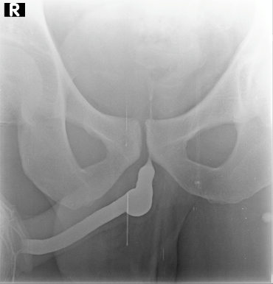

Slide 44
RETROGRADE URETHROGRAPHY
Procedure was done under aseptic precautions using non-ionic contrast media.
FINDINGS:
Anterior urethra is well delineated with contrast and is normal.
No evidence of abnormal dilatation/ stricture/ filling defect noted in the anterior urethra.
Contrast is seen filling the bladder partially.
IMPRESSION:
Normal anterior urethra .

Slide 45
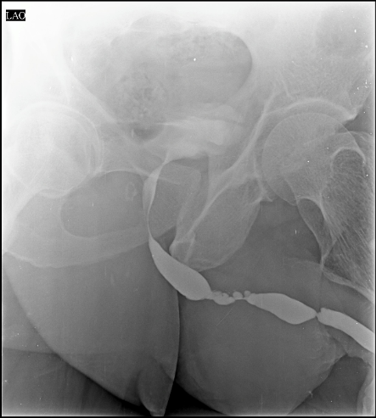

Slide 47
RETROGRADE URETHROGRAPHY
Procedure was done under aseptic precautions using non-ionic contrast media.
FINDINGS:
Narrowing noted in peno-bulbar and bulbo-membraneous urethra causing dilatation of urethra proximal to narrowing.
Mucosal irregularity as evidenced by outpouching of contrast noted at distal part of penile
Urethra and bulbo-membraneous junction.
Contrast is seen filling the bladder partially.
IMPRESSION:
Stricture involving peno-bulbar and bulbo-membraneous urethra.
Mucosal irregularity at distal part of penile urethra and bulbo-membraneous junction​ - Likely sequelae of urethritis

Slide 48
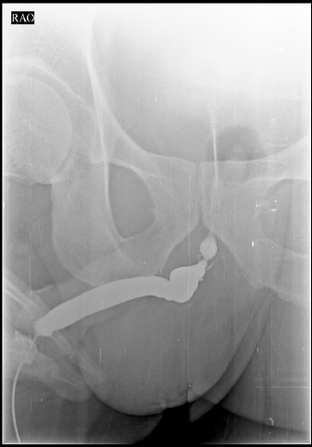

Slide 50
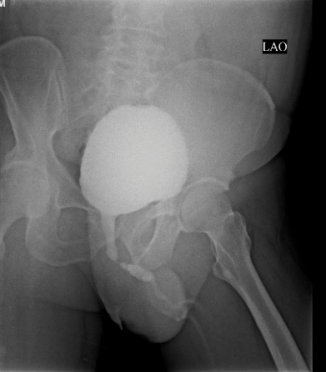

Slide 51
RETROGRADE URETHROGRAPHY
Procedure was done under aseptic precautions using non-ionic contrast media.
FINDINGS:
Anterior urethra is well delineated with contrast and is normal.
No evidence of stricture/ filling defect noted in the anterior urethra. Narrowing noted at bulbo-membraneous junction causing dilatation of anterior urethra.
Contrast is seen filling the bladder partially.
IMPRESSION:
Stricture at bulbo-membraneous junction of urethra .

Slide 53
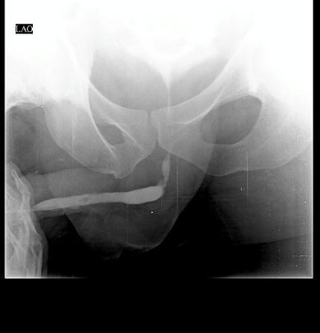

Slide 54
RETROGRADE URETHROGRAPHY
Procedure was done under aseptic precautions using non-ionic contrast media.
FINDINGS:
Narrowing noted at penobulbar juntion with pooling of contrast in the proximal part[Penile urethra]. Anterior urethra is well delineated with contrast and is normal.
Contrast is seen filling the bladder partially.
IMPRESSION:
Features suggestive of peno-bulbar stricture.

Slide 55
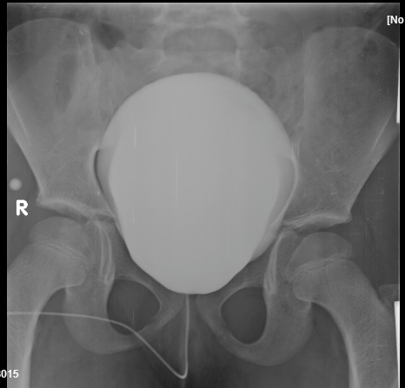

Slide 57
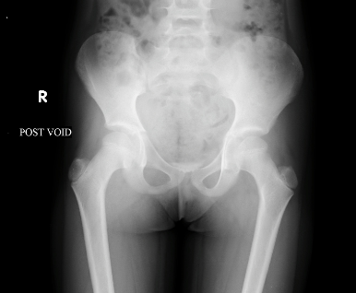

Slide 58
MICTURATING CYSTOURETHROGRAPHY
Procedure was done under aseptic precautions using non ionic contrast media.
Findings
Evidence of contrast filling the bladder noted.
Bladder is seen in its normal anatomical location.
Urinary bladder surface shows no irregularity.
No evidence of reflux of contrast into lower part of ureter on both sides. Visualized part of urethra appears normal.
IMPRESSION:
Normal Study.

Slide 59
IInd page

Slide 60
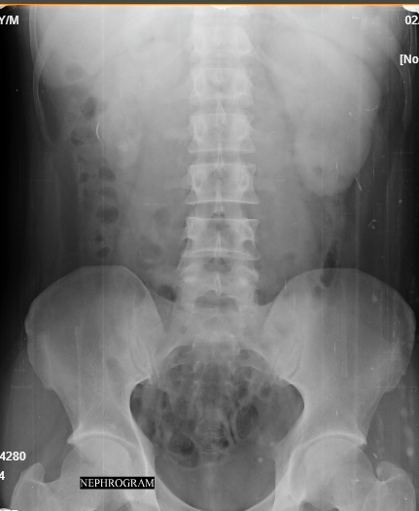

Slide 61
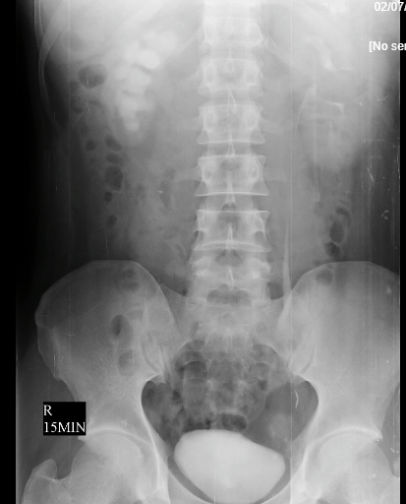

Slide 63
Right partial PUJ obstruction
SCOUT FILM: Both renal shadows are well seen Radiodense opacities noted in right renal shadow - Likely right renal calculi. ​Paravertebral soft tissue shadow is normal Under lying bony structures show no degenerative changes. IVU is done by injecting 60ml of non-ionic water soluble iodinated contrast medium intravenously and serial films are taken NEPHROGENIC PHASE: Good and prompt excretion of contrast noted simultaneously by both kidneys. Both kidneys are normal in size, shape, position, axis and contour. FURTHER FILMS SHOW: 5min,supine- Normal opacification of left pelvicayceal system noted with excretion and opacification left ureter.There is dilatation of right pelvicayceal system(moderate) ,however right ureter is not sen opacified by contrast. 15mins supine -Normal opacification of left pelvicayceal system noted with excretion and opacification left ureter.There is dilatation of right pelvicayceal system(moderate) ,however right ureter is not sen opacified by contrast. 15mins,prone-Normal opacification of left pelvicayceal system noted with excretion and opacification left ureter.There is dilatation of right pelvicayceal system(moderate) ,with opacification right ureter - suggestive of delayed excretion into right ureter. Left pelvicalyceal system is well delineated with contrast medium. Urinary bladder is well delineated with contrast. Urinary bladder is normal in shape. No abnormalities seen. IMPRESSION: Radiodense opacities over right renal shadow - suggestive of right renal calculi. Right sided grade II hydronephrosis with delayed opacification of right ureter(15mins prone )- possibility of partial right PUJ obstruction/ stricture to be considered.

Slide 65
Right non obstructive renal calculus

Slide 66
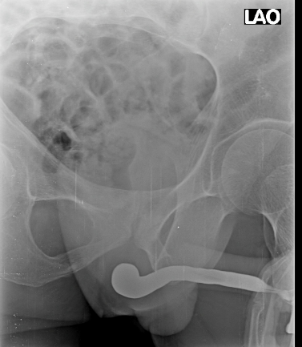

Slide 67
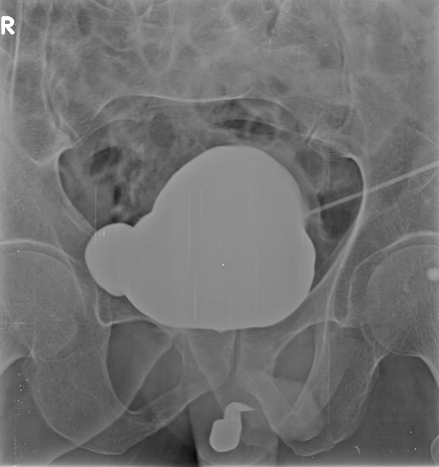

Slide 69
RETROGRADE URETHROGRAPHY
Procedure was done under aseptic precautions using non-ionic contrast media.
FINDINGS:
Anterior urethra is well delineated with contrast.
Abrutpt narrowing noted at the region of bulbo-membranous junction and mild dilatation of the bulbar urethra with non-passage ofcontast into the bladder. IMPRESSION:
Stricture urethra at the bulbo-membranous junction .

Slide 70
MICTURATING CYSTOURETHROGRAPHY
Procedure was done under aseptic precautions using non ionic contrast media through suprapubic catheter.
Findings
Evidence of contrast filling the bladder noted.
There is evidence of an outpouching noted at the right lateral aspect of the urinary bladder surface.
No evidence of contrast entering the lower part of ureter on both sides.
Prostatic part of posterior urethra is not delineated with contrast.
IMPRESSION:
Non visualized prostatic urethra- suggestive of stricture urethra. Bladder diverticulum involving the right lateral wall.

Slide 71
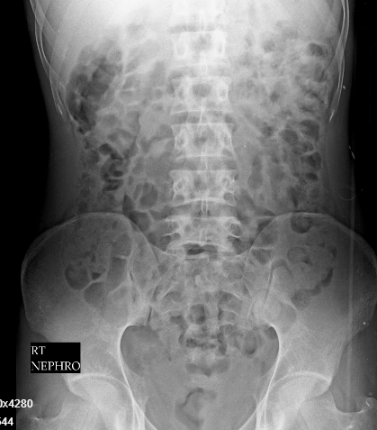

Slide 72
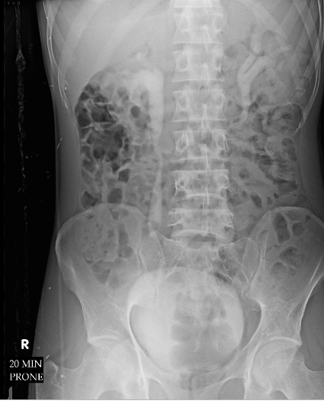

Slide 74
Genitourinary tuberculosis
INTRAVENOUS UROGRAM SCOUT FILM: Both renal shadows are well seen ​Paravertebral soft tissue shadow is normal Under lying bony structures show no degenerative changes. IVU is done by injecting 60ml of non-ionic water soluble iodinated contrast medium intravenously and serial films are taken NEPHROGENIC PHASE: Good and prompt excretion of contrast noted simultaneously by both kidneys. Both kidneys are normal in size, shape, position, axis and contour. FURTHER FILMS SHOW: Pelvicalyceal system is well delineated with contrast medium. Loss of papillary angles noted bilaterally with dilatation of right pelvicalyceal system with right ureter noted. Irregularity of the calyceal margins noted on the right side Hiked up renal pelvis noted on the right side. Urinary bladder is well delineated with contrast. Urinary bladder is normal in shape. No abnormalities seen. Bilateral prompt excreting kidneys

Slide 75
On Ultrasound correlation: RIGHT KIDNEY: There is evidence of two ill-defined hypoechoic lesions noted in the upper pole and mid region of right kidney with loss of papillary angles. Dilatation of the right pelvicalyceal system and ureter noted. Thickening of the vesicoureteric junction noted on the right side. LEFT KIDNEY: Evidence of a small ill-defined hypoechoic lesion noted in the lower pole of left kidney with loss of papillary angles and few calcifications. Mild dilatation of the left pelvicalyceal systems noted. URINARY BLADDER: Mildly thickened and irregular wall of the bladder noted. Echogenic floaters noted within the lumen of bladder. IMPRESSION: In a known case of genitourinary tuberculosis, present study reveals- Features of papillary necrosis of bilateral kidneys Right grade II hydroureteronephrosis

Slide 76
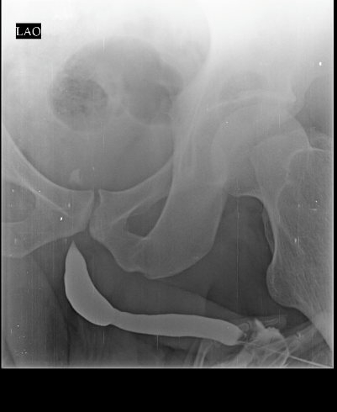

Slide 78
RETROGRADE URETHROGRAPHY
Procedure was done under aseptic precautions using non-ionic contrast media.
FINDINGS:
Mild dilatation of the bulbar urethra with stricture at the membrano-bulbar junction noted. Anterior urethra is well delineated with contrast and is normal.
No evidence of abnormal dilatation/ stricture/ filling defect noted in the anterior urethra.
Contrast is seen filling the bladder partially.
IMPRESSION:
Mild dilatation of the bulbar urethra with stricture at the membrano-bulbar junction

Slide 79
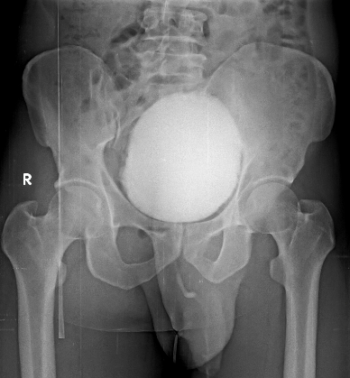

Slide 80
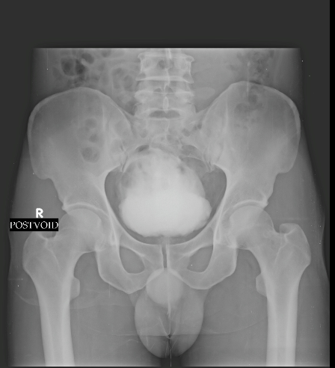

Slide 81
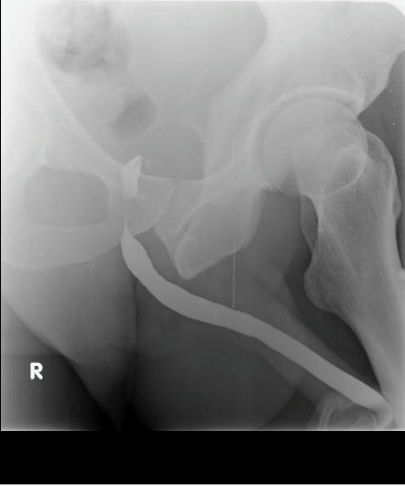

Slide 82
Cystitis with significant post void residue
MICTURATING CYSTOURETHROGRAPHY
Procedure was done under aseptic precautions using non ionic contrast media.
Findings
Evidence of contrast filling the bladder noted.
Bladder is seen in its normal anatomical location.
Urinary bladder surface shows mild irregularity- likely cystitis.
No evidence of contrast entering the lower part of ureter on both sides.
Prostatic part of posterior urethra is well delineated with contrast.
Contrast is seen beyond the prostatic urethra and membranous urethra is normal. On post void film, significant post void residue noted .
IMPRESSION:
Cystitis with significant post void residue.
Normal RGU study.

Slide 83
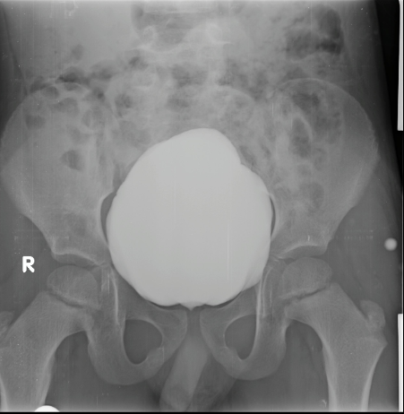

Slide 84
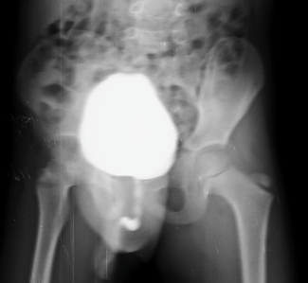

Slide 86
MICTURATING CYSTOURETHROGRAPHY
Procedure was done under aseptic precautions using non ionic contrast media.
Findings
Evidence of contrast filling the bladder noted.
Bladder is seen in its normal anatomical location.
Urinary bladder shows regular contour.
No evidence of contrast entering the lower part of ureter on both sides.
Prostatic part of posterior urethra is well delineated with contrast and is mildly dilated - post operative status.
Contrast is seen beyond the prostatic urethra and membranous urethra is normal. Good stream of urine flow noted. No significant post void residual urine noted.
IMPRESSION:
In a known case of posterior urethral valve, post fulgration status, present study reveals- No evidence of vesico-ureteric reflux/residual posterior urethral valve

Slide 88
Bilateral non-obstructive renal calculi

Slide 89
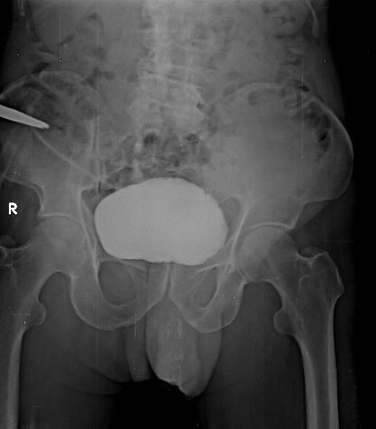

Slide 91
MICTURATING CYSTOURETHROGRAPHY
Procedure was done under aseptic precautions using non ionic contrast media through suprapubic catheter.
Findings
Urethra is not visualized . Evidence of contrast filling the bladder noted.
Bladder is seen in its normal anatomical location.
Urinary bladder is distended shows smooth inward indentations-possibly due to detrusor contractions.
No evidence of contrast entering the lower part of ureter on both sides.
Prostatic part of posterior urethra is not delineated with contrast.
IMPRESSION: Reviewing the RGU and MCU together , features suggestive of :-
Stricture involving the membranous and prostatic parts of urethra.

Slide 93
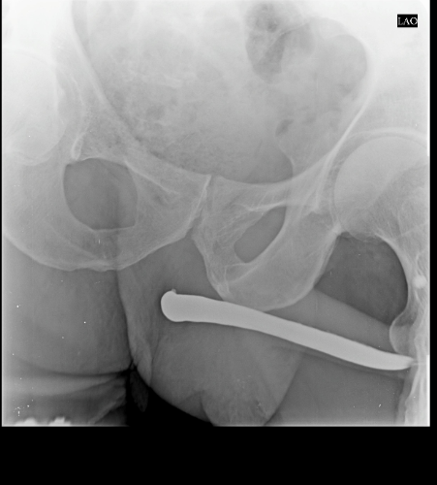

Slide 94
RETROGRADE URETHROGRAPHY
Procedure was done under aseptic precautions using non-ionic contrast media.
FINDINGS:
Penile urethra is well delineated with contrast and is normal. Stricture noted in membranous urethra causing balooning of urethra proximal to stricture.
Contrast is not seen beyond stricture and contrast is not filling the bladder.
IMPRESSION:
Stricture involving membranous urethra.

Slide 95
THANK YOU
You can share presentation, cases, events and articles On Radioloksabha.com
Register at https://www.radioloksabha.com/home.php
Download DNB/MD question papers, presentation and formats.

