Slide 1
Radioloksabha spotters/cases series- XV -MSK
Radioloksabha is a free educational website for medical students, residents and doctors to
share knowledge contributing to the world of Radiology
Contributing radiologists - Dr Pavankumar(DMRD, DNB) . Dr Saarah khan ( MD) . Dr Anju (MD) . Dr Ashok sharma(MD)
we support FOAMrad - free open access radiology education

Slide 2
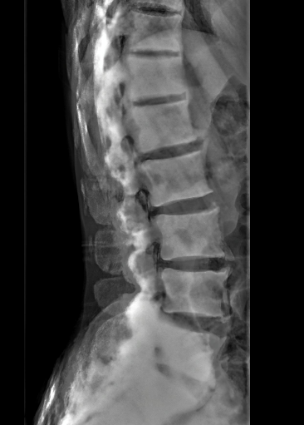

Slide 3
Renal osteodystrophy

Slide 4
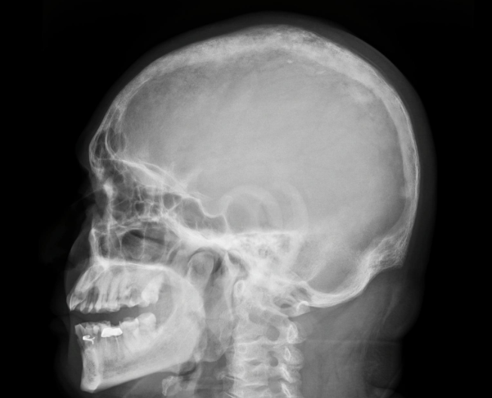

Slide 6
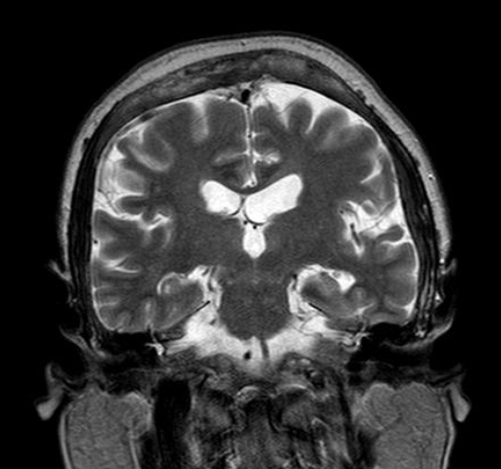

Slide 7
Paget’s disease
Markened thickening of bony calvarium noted. There is widening of the diploic space with ill-defined sclerotic and lytic areas noted within. The cortex appears thickened and irregular, causing deformity especially in the occipital region.
IMPRESSION:
Features suggestive of Paget's disease.

Slide 8
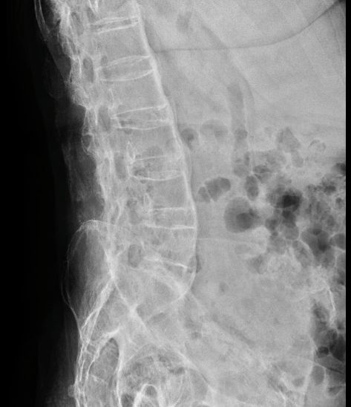

Slide 9
Ankylosing spondylitis
BILATERAL SYNDESMOPHYTES
DISC CALCIFICATIONS
ANKYLOSING SPONDYLITIS WITH INTERSPINOUS LIGAMENT CALCIFICATION
BILATERAL SACROILITIS WITH PROTRUSIO ACETABULI OSTEOPENIA OF THE VISUALIZED BONES

Slide 10
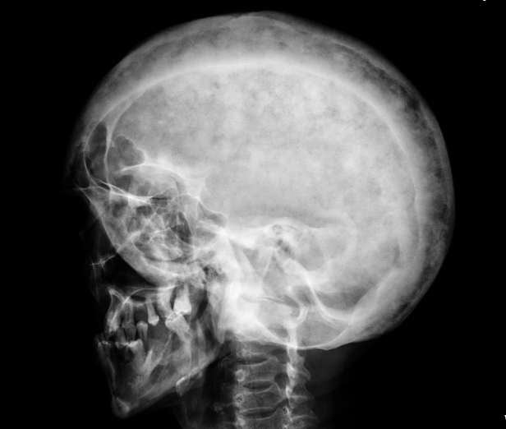

Slide 11
Paget’s disease
Cotton wool appearance of the skull with sclerotic and lytic lesions.
No evidence of fractures in the parts exposed.
Visualized soft tissue planes appear normal.
IMPRESSION:
Features suggetsive of Paget's disease

Slide 13
Ankylosing spondylitis

Slide 14
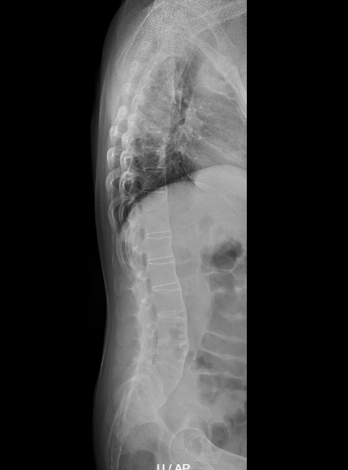

Slide 15
TROLLEY TRACK SIGN - Ankylosing spondylitis
Altered marrow signal intensity noted in few lower cervical, anterosuperior corners of multiple lumbae vertebrae and altered signal intety involving bilateral sacriliac joints.

Slide 17
DRAGGER SIGN - ANKYLOSING SPONDYLITIS
REDUCTION IN THE RIGHT HIP JOINT SPACE WITH DEEPENED ACETABULUM AND INTRAPELVIC EXTENSION OF THE ACETABULUM INTO THE PELVIC CAVITY - PROTRUSIO ACETABULI, COMPLETE FUSION OF THE SACRO ILIAC JOINT SPACES NOTED ON BOTH THE SIDES, OSSIFICATION OF THE SUPRASPINOUS AND INTERSPINOUS LIGAMENT, SYNDESMOPHYTE FORMATION NOTED BETWEEN THE LUMBAR VERTEBRAE THROUHGOUT - FEATURES CONSISTENT WITH ANKYLOSING SPONDYLITIS

Slide 18
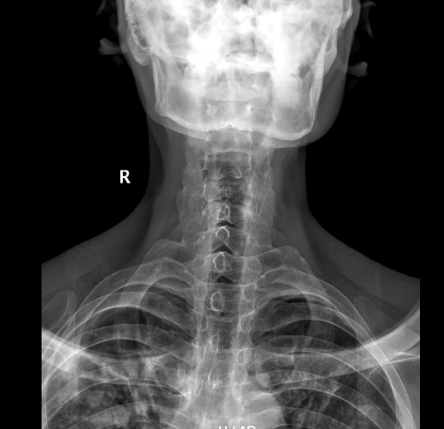

Slide 19
Ankylosing spondylitis

Slide 22
Hill sach’s defect
Bony defect [ measuring 7mm in width and 10.7mm in depth] with underlying edema and subchondral changes noted in the posterosuperior aspect of the humeral head.

Slide 23
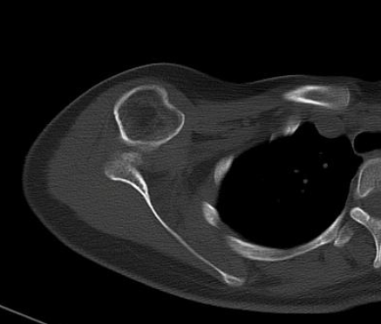

Slide 24
Anterior shoulder dislocation

Slide 27
Hill sach’s defect

Slide 28
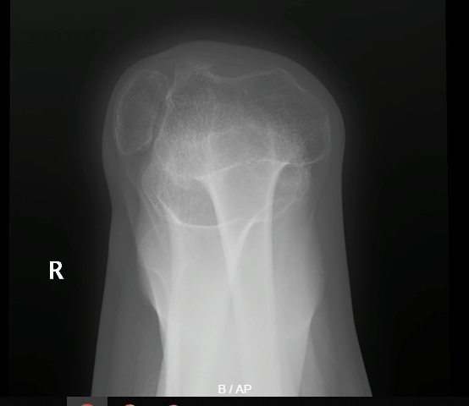

Slide 29
Right patellar dislocation

Slide 31
SEVER’S DISEASE
BILATERAL FLAT FOOT - PES PLANUS SCLEROSIS OF THE CALCANEAL APOPHYSIS BILATERALLY - SEVER'S DISEASE.

Slide 32
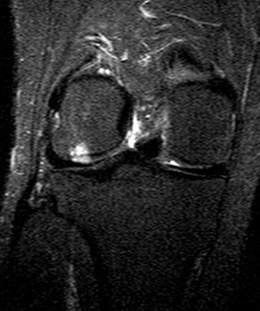

Slide 33
Stage I osteochondritis dessicans of the lateral femoral condyle.

Slide 34
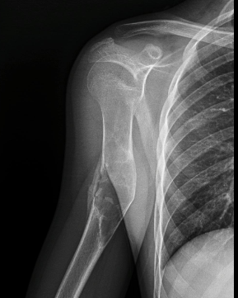

Slide 35
Unicameral bone cyst
Evidence of a central expansile lytic lesion with ground glass haziness, internal septation and fracture fragment within lesion.
There is thinning of cortex noted in the diaphysis of humerus with break in the cortx (medial and lateral wall).

Slide 37
Unicameral bone cyst
A fairly well-defined lucent area with peripheral sclerotic rim, in the superior aspect of the body of calcaneum, associated with mild flattening of the medial longitudinal arch of the foot .

Slide 38
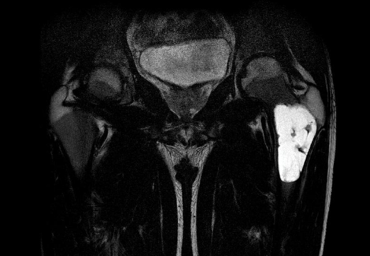
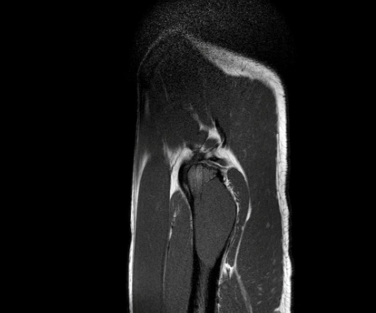
T2W
T1W

Slide 39
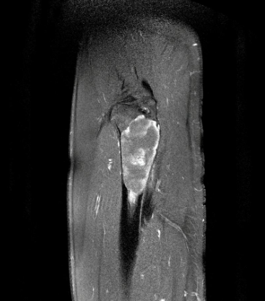

Slide 40
Unicameral bone cyst
Well defined expansile peripherally enhancing lytic lesion which is T1W hypo to isointense and T2W/STIR hyperintense noted involving the proximal diaphysis of the femur measuring -x- x -cm[ ApxTrxCc]. Few linear enhancing septae noted within the lesion. No e/o fluid-fluid levels. No e/o solid component within the lesion.
The lesion is seen _cm from the upper articular margin of the femur. Narrow zone of transition noted. Mild cortical thinning noted with no e/o breach. Thin solid periosteal reaction noted. No e/o greater trochanter involvement.

Slide 42
Extensive bone resorption of the left femoral head with superolateral dislocation of the left hip joint and with pseudoarticulation of the left femoral head with the ileum.

Slide 44
Fibrous dysplasia
Medullary cavity expansion at the proximal end of femur with cortical thinning.

Slide 45
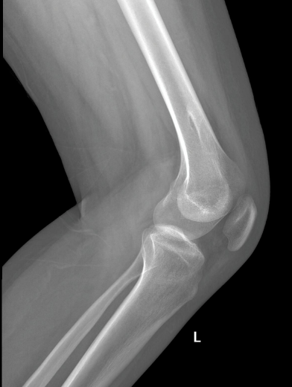

Slide 46
Osteochondroma

Slide 47
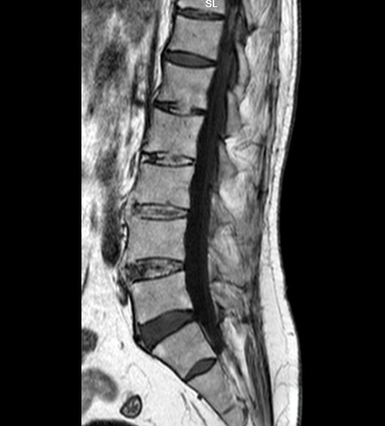

Slide 49
Ankylosing spondylitis

Slide 50
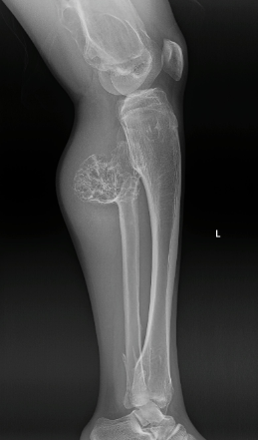
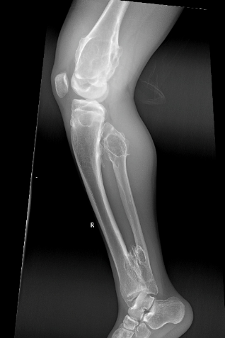

Slide 51
Multiple hereditary osteochondromatosis
Multiple pedunculated exostoses noted in the distal femur ,proximal and distal end of tibia and fibula, which are pointing away from the joint ,and here is an associated widening of the diametaphysis of distal end of femur and proximal end of tibia resulting in an Erlenmeyer flask deformity.
Evidence of a sessile exostosis noted in the proximal end of fibula showing corticomedullary continuity with ring and arc calcification

Slide 54
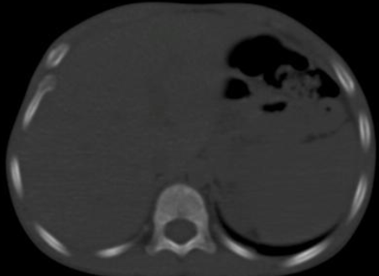

Slide 55
A large well defined, lobulated, pedunculated, exophytic, osseous mass lesion [mean HU:120] seen arising from the cortex of the body of the left third rib anteriorly. The lesion measures 6x7x6cm [ AP x Tr x CC] in its maximum dimensions. The lesion shows cortical expansion and medullary continuity. The lesion has dense calcifications peripherally. No cortical elevation/ periosteal reaction. On post-contrast study, no appreciable enhancement noted. The lesion has extensions as described: Medially, a part of the lesion is seen extending intrathoracically, however no extension into the lung parenchyma noted. Anteriorly the lesion is seen extending upto the sub-cutaneous plane. No breach in the skin noted. The lesion is seen abutting and indenting the 2nd rib superiorly and the 4th rib inferiorly, however no erosion noted.

Slide 56
Osteochondroma

Slide 57
THANK YOU
You can share pictures, videos, events, articles, presentations and cases
On Radioloksabha.com
Register at https://www.radioloksabha.com/home.php

