Slide 1
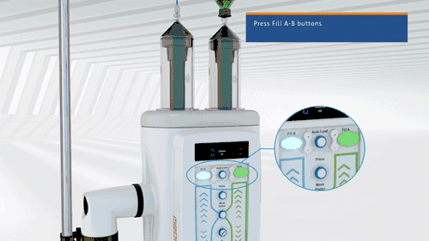
Pressure injectors
Presenter
Dr Sidharth S
PG Resident

Slide 2
INTRODUCTION
Routinely used in diagnostic & interventional radiology.
Involves a blend of concurrent processes in areas like computers, pressure, thermal, electricity, battery operations, non-ferromagnetic metallurgy, rheology, viscosity, syringe and catheter technologies.

Slide 3
INTRODUCTION
Ensure optimized opacification and delineation of normal anatomy.
Several imaging and interventional studies require pressure injectors.
CT angiography,
Three-phase abdominal organ studies,
Cardiac CT,
Stent analysis,
Perfusion CT and perfusion MRI,
Contrast-enhanced MR angiography (MRA),
Cardiac MRI.

Slide 4
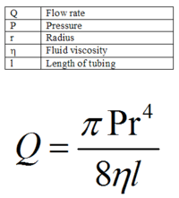
Basic physics of pressure injection
Poiseuille's law
Pounds per square inch is unit of pressure

Slide 5
Components of a pressure injector
Injector head.
Piston plungers.
Pressure tubing.

Slide 6
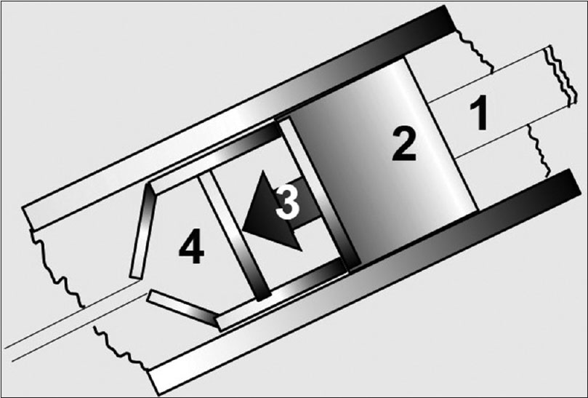
PISTON PLUNGER
Plunger drive ram, a drive motor that moves the drive ram, an elastic head, a stretcher rod, and a syringe .

Slide 7
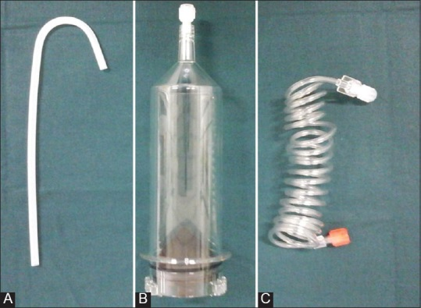
Pressure syringes
Transparent.
Latex free.
Syringes are pre-filled or manually loaded.
The injector system may be single (for contrast only) or dual syringe .
Pressure tubing and connectors transmit the selected amount, pressure, flow, and rate of contrast accurately, between the injector system and the patient.

Slide 8
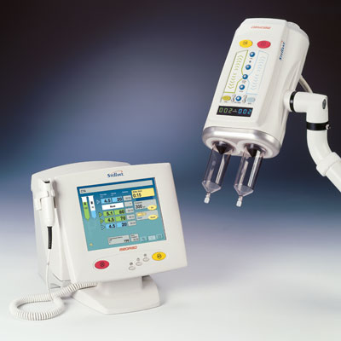
Displays
User-defined protocols to inject with variables of phase, rate, delay, and volume.
Colour pressure sensitive touch screen enables different colours for operations like loading, arming, and injecting.

Slide 9
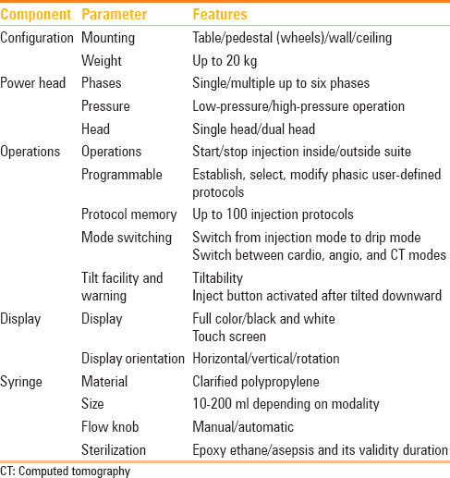
Operational features of pressure injector

Slide 10
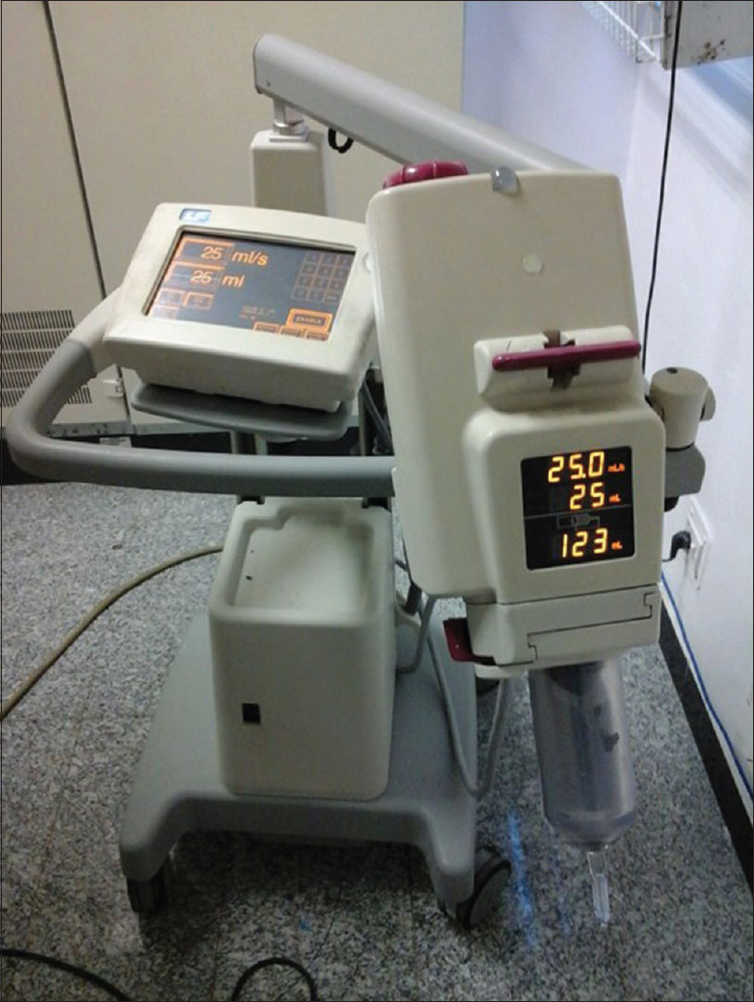
Angiography / DSA Pressure Injectors
Light, manoeuvrable.
Protocols with variables of phase, volume, rate and delay.
Wide range of injection rates up to 45 ml/sec for aorta.

Slide 11
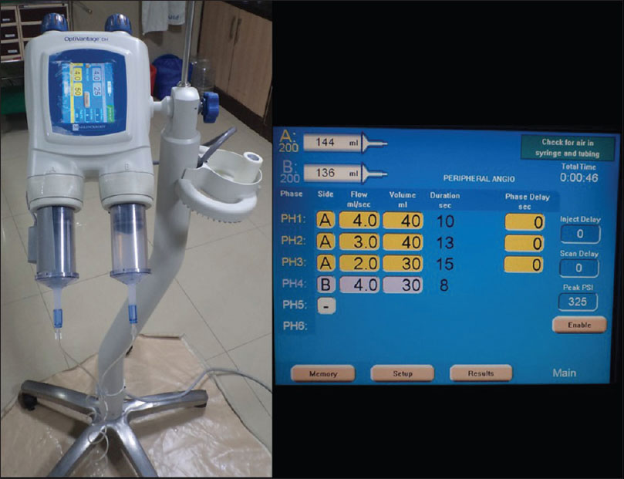
CT Pressure Injectors
Programmable user defined protocols.
Touchscreen that offers different colours for operations like loading, arming, injecting.
Availability of vendor specific sensors e.g. Power syringe volume sensors

Slide 12
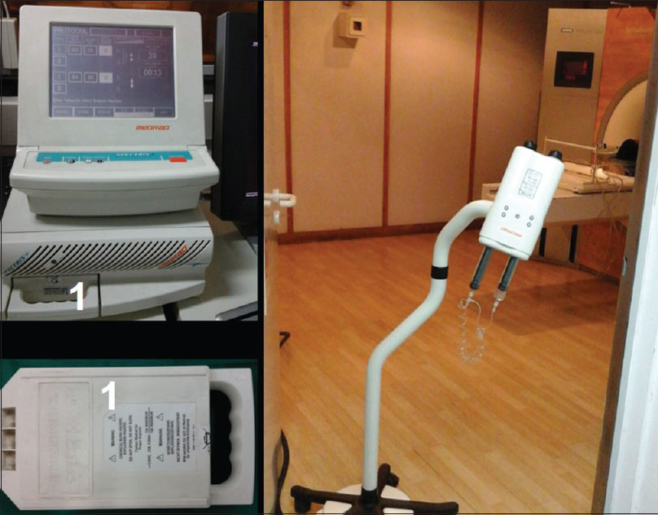
MR pressure injectors
Battery operations
Non-ferromagnetic status.
Availability of vendor specific sensors.

Slide 13
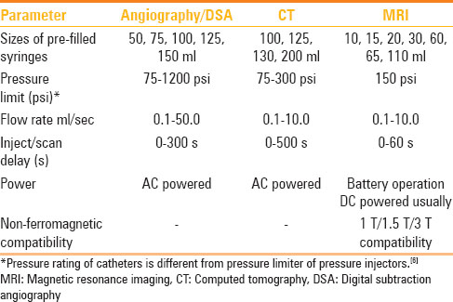
Pressure injectors and modalities

Slide 14
Few operational advantages in pressure injector
Multiphasic study: The advantage of the biphasic injection is that it can optimize and prolong contrast enhancement.
Timing bolus: A timing bolus injection of contrast medium followed by a saline flush is performed occasionally to determine the ideal scan delay for optimum image quality.

Slide 15
Saline chaser: The use of a saline flush immediately following contrast injection .
a double-barrel power injector is required for a saline flush.
It pushes the contrast material into the vascular system of the patient that would otherwise be left behind in tubing.
facilitates an optimal bolus shape.
The amount of contrast in image acquisition is marginally increased .
It clears the vascular access site of residual contrast after injection.

Slide 16
Warmer/heater: An inverse relationship exists between viscosity and temperature in liquids.
An increase in temperature of the contrast medium
Extrinsic warming of iodinated contrast material to body temperature minimizes the complications for high-rate (>5 ml/s) intravenous low osmolar injections

Slide 17
Prefilled disposable syringes: numerous advantages such as
lesser medication errors
reduction in the risk of infection.
improved efficiency.

Slide 18
Patient access in pressure injection
Common intravenous routes: preferred venous access site is peripheral intravenous, usually in antecubital or large forearm vein.
Ensure that the catheter lies within the venous system.
Three-phase exams should not be performed using intravenous access in hand veins or lower extremity

Slide 19
Other intravenous routes: They include peripherally inserted central catheters (PICCs), chest ports, central lines, and intravenous cannulas inserted into internal or external jugular vein.
Pressure injection of contrast media through central venous catheters for CT examinations is feasible and safe when the set hospital guidelines and injection protocols are followed.

Slide 20
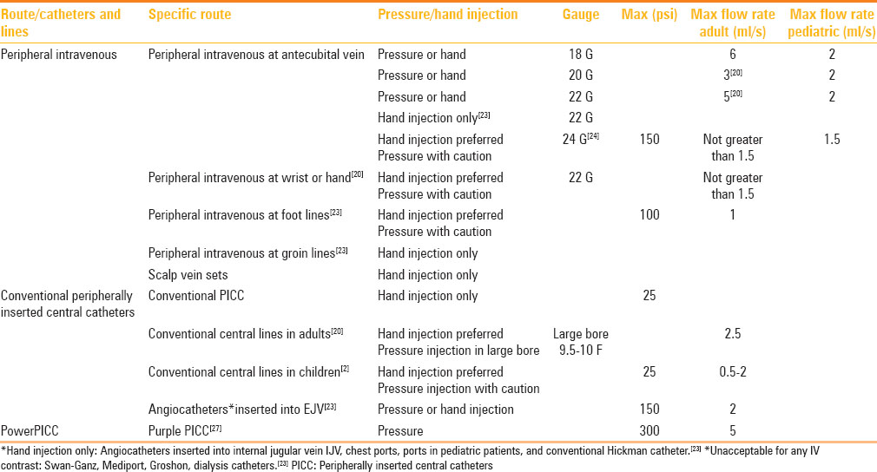

Slide 21
Paediatric cases: Issues unique to administration of intravenous contrast to neonates and children comprise use of shorter catheters, smaller volumes of contrast, slower injection rates, smaller gauge angiocatheters, and unusual vascular access sites.

Slide 22
Safety issues in pressure injection
Extravasation: incidence ranges from 0.1 to 0.9%.
Factors associated with higher extravasation rate include high flow rates with low-diameter intravenous catheters and location of intravenous catheter in hand.
Incidents to be documented.
] Treatment options includes elevation of affected extremity, use of cold compresses, aspirating the extravasated contrast, or local injection of corticosteroids

Slide 23
Preparation of the pressure injector system
minimizes the risk of extravasation or air embolism
Standard operating procedure is followed.
Include:
(a) clearing the syringe and pressure tubing of air.
(B) reorienting the syringe with the tubing directed downward.
(C) checking the position of catheter tip.
(d) If the venepuncture site is tender or infiltrated, an alternative site is acquired.
(E) enough play on the intravenous line, tubing, and pressure injector system should be permissible during concurrent table movement.
(F) good two-way communication with the patient should be established in each case

Slide 24
Air embolus: various effects such as dyspnoea, cough, chest pain, pulmonary edema, tachycardia, hypotension, and deficits like stroke.
intrathoracic veins, main pulmonary artery, and right ventricle, and occasionally in the intracranial venous structures.
Administration of 100% oxygen and placing the patient in left lateral decubitus position.
Sepsis: Using aseptic technique during loading/emptying the left over contrast and/or saline, preferred use of pre-filled syringes, and hand hygiene can prevent sepsis.
Changing the pressure syringe/tubing system is mandatory when it is accidentally contaminated with blood
Off-label pressure injector usage of contrast agents.

Slide 25
RECENT ADVANCES
Dual flow: wherein contrast and saline can be injected at the same time.
Simultaneous injection of variable amounts of contrast and saline syringes.
Syringeless pressure injectors: facilitates multiple contrast-enhanced CT (CECT) scans without the need for contrast reloading.
Syringeless systems allow higher contrast and saline loading capacity.

Slide 26
CT injectable PICC: Specially designed to tolerate the high pressures set to a maximum of 300 psi.
Available in single-, dual-, and triple-lumen configurations.
Power source and MR pressure injectors: Traditionally, MR pressure injectors are battery operated.
Uniquely utilizes a hydraulic mechanism.

Slide 27
NEW SENSORS IN PRESSURE INJECTORS
Extravasation detection, Syringe state detection, Autoloading & retracting, Air bubble detection, bolus shaping, IV integrity determination,

Slide 28
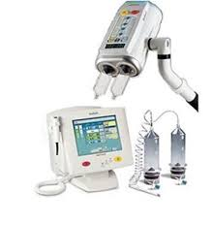
Medrad stellant
Used in CT.
Equipped with Flui-Dot indicators.
Air Expelled confirmation button/indicator icon on the injector head.
32 protocols in memory.
Buttons to save & recall protocols.
Syringe A, (green) is contrast and Syringe B, (blue) is flush.
Programming of up to six phases and editing the flow rate and volume.
KVO (Keep Vein Open) delivers small boluses of fluid from Syringe B at configurable intervals.

Slide 30
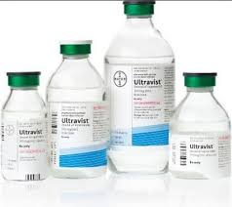
Iodopromide
Water soluble low osmolar.
Dosage: Upto 1.5g/kg.
1ml eq. to 300mg iodine.
Headache, nausea & vasodilation are most common side effects.
IV overdose – Electrolyte imbalance, renal failure, CVS & pulmonary complications.

Slide 31
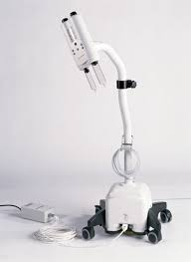
Medrad spectris solaris.
Non ferromagnetic
Equipped with Flui-Dot indicators.
Air Expelled confirmation button/indicator icon on the injector head.
3Tcompatible.
32 protocols in memory.
Buttons to save & recall protocols.
Syringe A, (green) is contrast and Syringe B, (blue) is flush.
Programming of up to six phases and editing the flow rate and volume.
KVO (Keep Vein Open) delivers small boluses of fluid from Syringe B at configurable intervals.

Slide 32
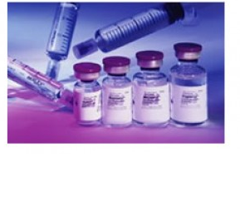
Gadopentetate Dimeglumine
Paramagnetic.
0.5mmol/ml of sol.
Dosage: 0.2ml/kg to 0.6 ml/kg.
Renal excretion.
Side effects ranging from nausea, inj. Site reactions, headache to nephrogenic systemic fibrosis *& anaphylactoid shock.

Slide 34
References.
Indian journal of radiology and imaging.
Textbook of radiology & imaging- David Sutton.
Radiopedia
Radiologysoultions.Bayer.com

