Slide 1
Hip ultrasonography in infants and children
Authors:
Alka Karnik
Dr. B Nanavati Hospital and Research Center, Sonosight Imaging Centre, Mumbai, India
Journal:
Indian J Radiol Imaging / November 2007 / Vol 17 / Issue 4
Presenter
Moderator
Dr.Vishwanath Patil
PG Resident
Dr. Vinay Raj
Senior Resident

Slide 2
Outline
Introduction
Developmental dysplasia of the hip
Examination technique
Graf’s Technique

Slide 3
Introduction
Hip USG was the first and most successful application of USG in the musculoskeletal system.
Dr. Graf was the first to realize the potential of USG.
Real-time and multiplanar USG evaluation of the hip was introduced soon thereafter by Novick G[2] and Harcke et al.
The sensitivity and specificity of USG for the diagnosis of hip dysplasia is nearly 100%.

Slide 4
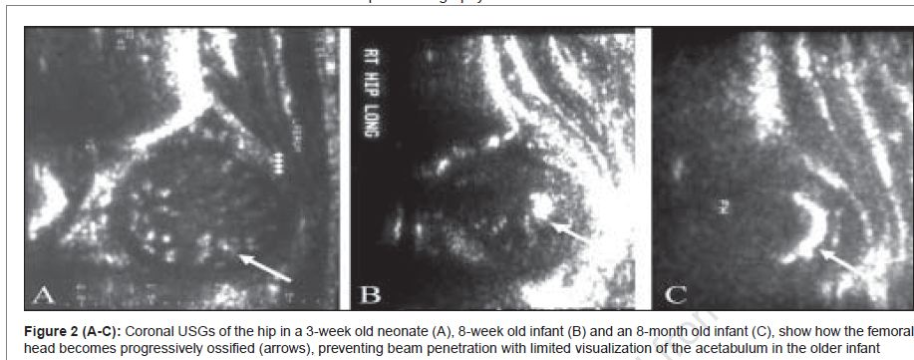
Introduction
The older child, once the ossification nucleus in the head is well-formed, adequate USG imaging of the acetabulum becomes difficult.

Slide 5
Introduction
USG of the hip is thus practical only up to 1 year of age, unless there is delayed ossification of the femoral head.
Draw backs
operator-dependent modality with a significant learning curve.
USG waves do not penetrate bony structures adequately.
Due to the presence of physiologic laxity, imaging is usually not performed on patients less than 2 weeks old.

Slide 6
Developmental dysplasia of the hip
DDH is a common disorder the affects 0.8% to 3.5% of children.
It occurs more oft en in girls and usually involves the left hip.
Universal screening of all infants or of all female infants, have shown a higher rate of diagnosis of DDH by USG.
Carry the burden of significantly increased follow-up costs

Slide 7
Developmental dysplasia of the hip
USG as a screening test is currently limited to infants at risk for DDH.
Breech presentation.
Family history of DDH.
club foot.
congenital torticollis and metatarsus adductus.
All infants with a positive physical examination should be imaged.

Slide 8
Pathophysiology of DDH
Two major components
Instability .
Abnormal morphology.

Slide 9
Pathophysiology of DDH
Ligamentous instability
Malposition of the femoral head out of the acetabulum
Femoral head becomes flattened postero-laterally.
Absence of the femoral head leads to a shallow and dysplastic acetabulum.
The capsule thickens and the labrum hypertrophies

Slide 10
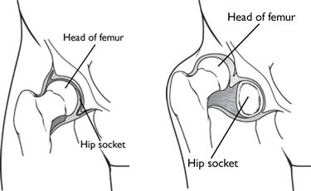
Pathophysiology of DDH
The space between the femoral head and acetabulum becomes filled with fibro-fatty tissue (pulvinar).
The femoral head moves further supero-laterally, the labrum is inverted and is deformed
The capsule thickens and may develop an hourglass
deformity

Slide 11
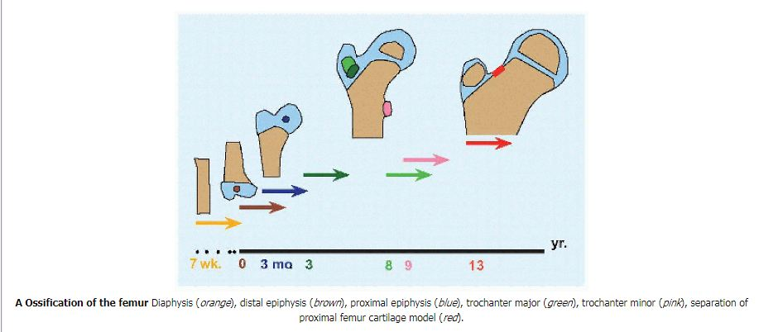
Pathophysiology of DDH
General consensus is that any diagnosis after the age of three months, is a late diagnosis.
Röntgenogramme for hip dysplasia becomes more reliable after appearance of the proximal epiphysis of the femur.

Slide 12
Examination technique
Imaging is conducted with a linear transducer.
Sector probe-evaluation through small windows in a plaster cast during treatment.
Two distinct methods of examination
Static method introduced Dynamic method
by Graf described by Harcke et al

Slide 13
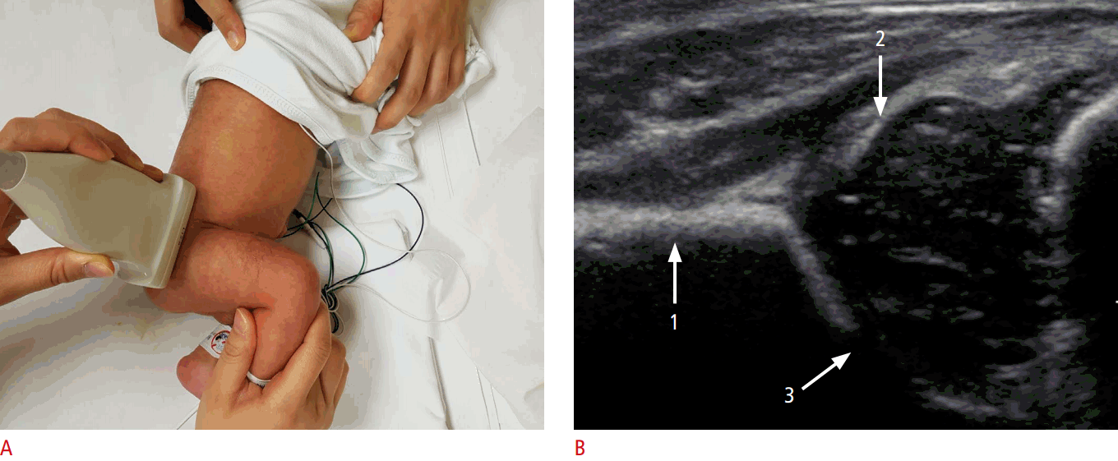
Graf’s Technique
The child is placed in a foam-padded trough in a lateral position and the hip is flexed to 90°.
The ultrasound probe is placed in a coronal plane parallel to the spine and a coronal section is obtained though the middle of the acetabular roof.

Slide 14
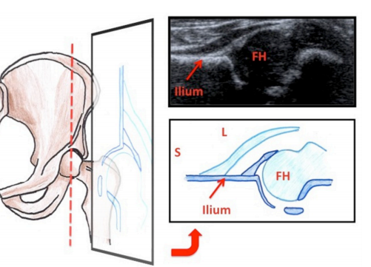
Graf’s Technique
Standard plane is identified by the presence of the following three points.
Lower limb of the bony ilium, in the depth of the acetabular fossa.
The middle of the acetabular roof
The acetabular labrum

Slide 15
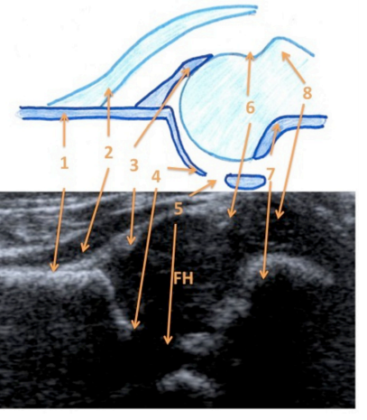
Anatomical structures of the infant hip (as seen on coronal ultrasonography). 1, ossified external wall of ilium; 2, psoas muscle; 3, labrum; 4, lower limb of the os ilium; 5, triradiate cartilage; 6, Synovial fold; 7, chondro-osseous junction at the femoral neck, 8, greater trochanter.

Slide 16
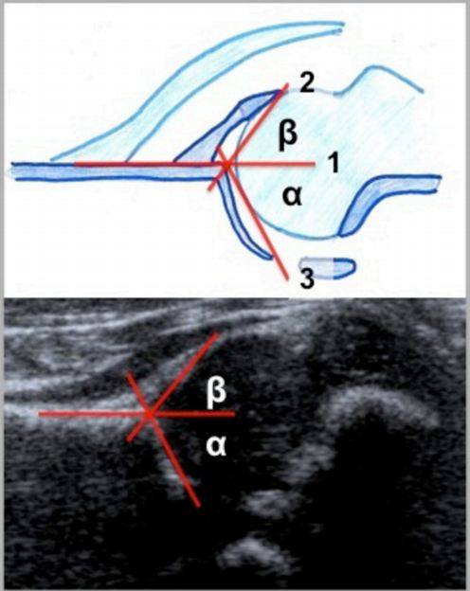
Graf’s Technique
A line is drawn parallel to the ossified lateral wall of the ilium (baseline).
A second line is drawn along the roof of the cartilaginous acetabulum to
give the beta angle.
A third line is drawn from the inferior edge of the bony acetabulum, at the triradiate cartilage, to the distal part of the ilium, tangential to the slope of the bony acetabulum (roof line).

Slide 17
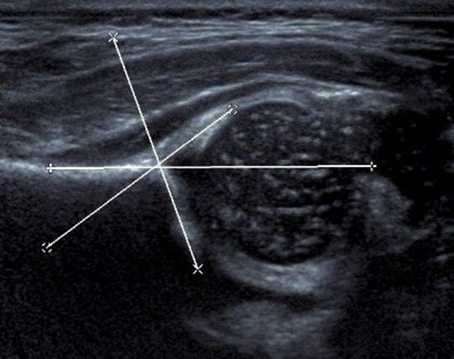
Graf’s Technique
Measurements made on this coronal view are the alpha
and beta angles.
The alpha angle denotes the slope of the bony acetabulum.
Beta angle denotes the slope of the cartilaginous acetabulum.

Slide 18
Normally, the alpha angle is greater than 60° and an angle less than 55 is considered abnormal.

Slide 19
It is important to identify type IIc and beyond (alpha angles
less than 50 degree) on USG, as these are unstable hips.

Slide 20
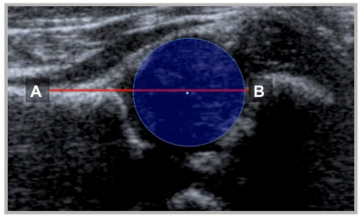
Femoral Head Coverage (FHC) and d/D Ratio
Morin has described it.
A line is drawn over the straight iliac line through the bony promontory and through the femoral head, gives the percentage coverage of the femoral head

Slide 21
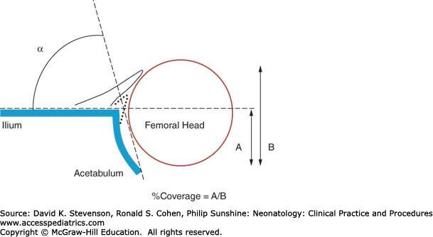
Femoral head overage
The lower limit of FHC in infants aged >1month is 50%.
Since the acetabular fossa cannot be visualized in older children; FHC is used only in the first year of life.
A=distance from the medial wall of the acetabulum to the level of the lateral bony rim
B= distance from the medial wall of the acetabulum to the lateral joint capsule

Slide 22
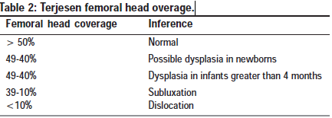
Terjesen femoral head coverage.

Slide 23
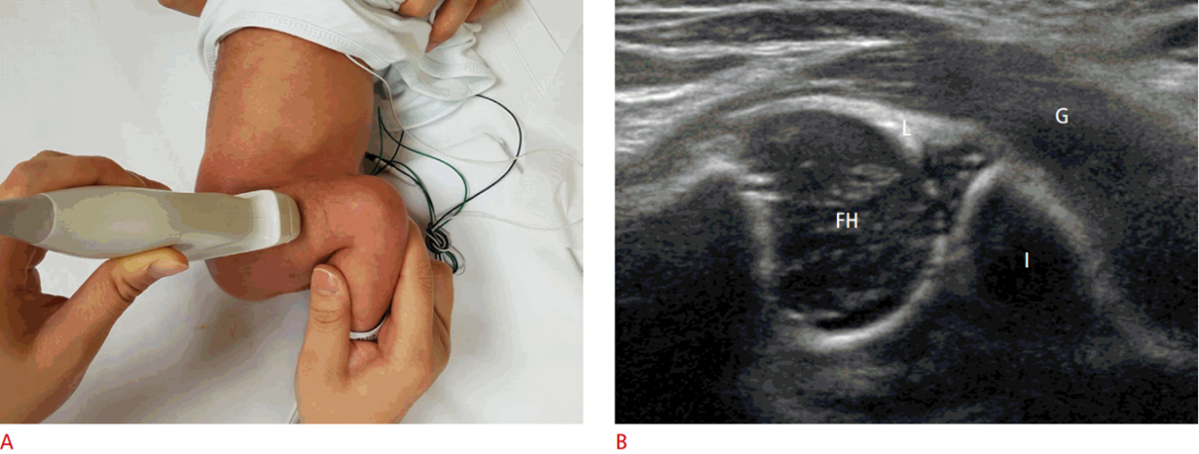
Dynamic Technique
The examination is conducted in the supine or lateral decubitus position
The dynamic technique is performed with the infant in both the lateral and supine position, and images are obtained in the coronal and transverse planes, both with and without stress.
hip and knee are flexed 90°, and the ultrasound transducer is placed perpendicular to the lateral aspect of the infant’s hip. B. Transverse ultrasound image shows gluteus muscles (G), the cartilaginous femoral head (FH), metaphysis, ischium (I), and labrum (L).

Slide 24
Stress views are achieved by holding the flexed hip in a mild degree of adduction and applying firm but gentle pressure towards the hip joint along the shaft of the femur Dysplastic hip will show subluxation.
The position of the femoral head is studied in three positions; neutral, flexion with adduction and flexion with abduction at rest. The same views are reevaluated after stress.

Slide 25
Harcke’s method of dynamic hip evaluation
To detect subtle instability, done in 4 steps:
1. Coronal neutral position: similar to Graf’s method, without angle
measurements
2. Coronal flexion: with 90º flexion, identify tri-radiate cartilage (TC),
transducer moved anterior to posterior (A-P).
Normal: when the transducer is posterior to the TC –
femoral head (FH) not visible.
Abnormal head position: when the transducer is posterior to the
TC – FH visible
With knee push-up: hip instability diagnosed by seeing FH move over
the posterior edge of the TC.
3. Transverse flexion: with 90° flexion.
Normal: Head lies above the “U” formed by the anterior and posterior
portions of the acetabulum, separated by the TC.
With knee push-up: instability – gap between the FH and the
acetabulum (TC / AP / PP) increases.
With hip in abduction and pull-down of knee: the dislocated hip is
relocated into the acetabulum.
4. Transverse neutral: Normal – FH in the “U” with its
centre towards the TC.
Dislocated – TC cannot be seen in this plane

Slide 27
Subluxable on application of stress
Figure 9 (A-C): Unstable hip. Coronal USG images show that the femoral head is centrally placed in the acetabulum at rest (A), with subluxation ,after stress (B). The diagram (C) shows the extent of subluxation

Slide 28
Subluxated
Figure 10: (A-C): Hip subluxation (incomplete dislocation). Diagram (A), coronal USG image (B) and transverse USG image (C), show that the
femoral head lies below the labrum with partial contact between the femoral head and acetabulum

Slide 29
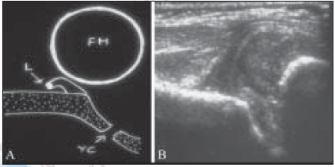
Dislocated
Hip dislocation. Diagram (A) and coronal USG (B)
show that the femoral head is completely out of the acetabulum, lying
in the soft tissues, lateral to the iliac bone

Slide 30
Dislocated
Hip dislocation. Coronal USG images of a normal left hip (A) and right hip dislocation (B, C). A concavity (arrow) is seen along
the iliac surface due to the pressure of the femoral head, leading to a pseudoacetabulum formation

Slide 31
Reporting format
Anatomical description including the normal / dysplastic
Appearance of the bony and cartilaginous acetabulum,
Appearance of the femoral head with its shape, size and status of the ossification center.
Dynamic study
Description of the position of the femoral head in relation to the acetabulum at rest and on application of stress.

Slide 32
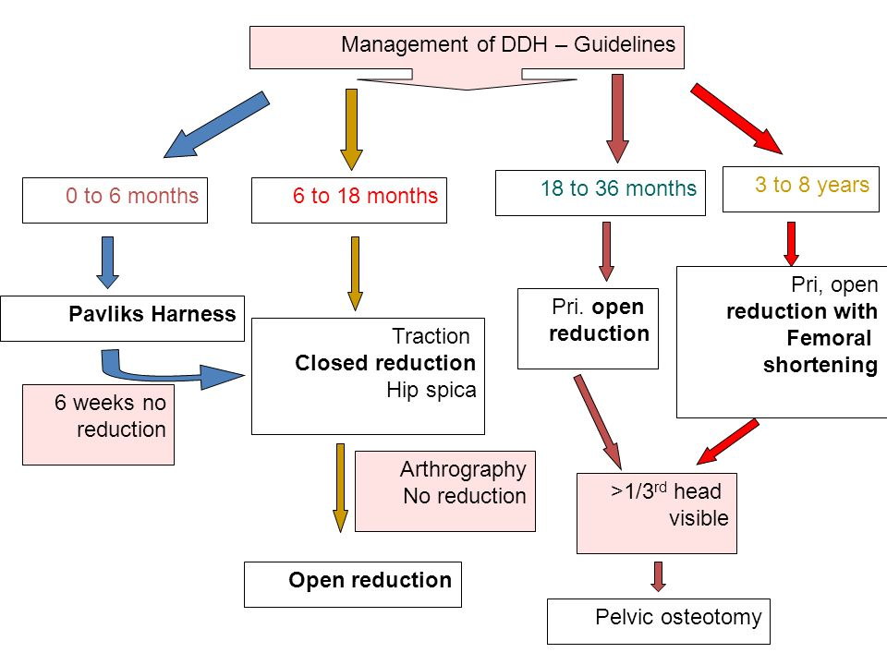
Treatment

Slide 33
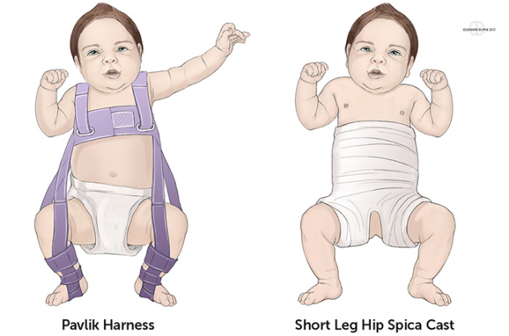
Follow-up
Application of a Pavlik harness (spika), in the abducted position.
USG can be used to follow-up and monitor treatment, after three months.
Should not be performed, unless specifically requested by the orthopedic surgeon.
The improvement in acetabular morphology, as well as the location of the femoral head, can be documented to assist treatment monitoring.

Slide 34
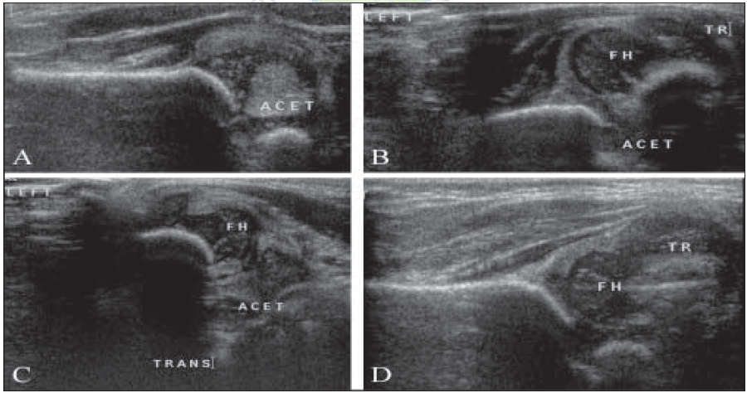
Follow-up
Hip dislocation with reduction. Coronal USG image (A) shows an empty acetabular cavity with dislocation of the femoral head
seen in the coronal (B) and transverse (C) images. Follow-up coronal USG (D), after 5 weeks in a Pavlik Harness shows stable reduction. Note
the improved slope of acetabulum

Slide 35
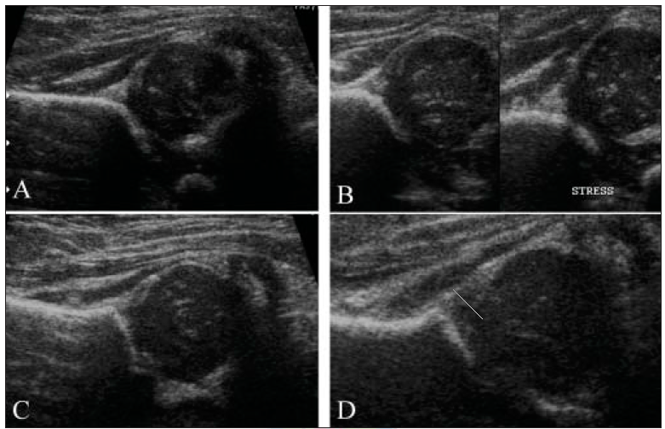
Follow-up
Hip dislocation with reduction. Coronal USG of the left hip shows subluxation (A) with stable reduction after 5-weeks in a Pavlik harness (C). Coronal USG of the right hip (B) shows subluxability after stress with stable reduction after 5-weeks in a Pavlik harness. Note the improved acetabular slope after reduction

Slide 36
Uses
USG of the hip is sensitive and specific in the detection of DDH
False-positive and false-negative rates are reported at 1% to 2%.
USG can also be Used to document the presence and location of the femoral head in proximal focal femoral deficiency (PFFD)

Slide 37
Sonographic evaluation of hip effusion
USG can detect very small amounts of intra-articular fluid. It is more sensitive than plain radiographs in diagnosing hip effusions.
It is however not always possible to differentiate between septic, traumatic and sterile effusions.
Diagnostic and therapeutic aspirations.
USG is useful in follow-up.

Slide 38
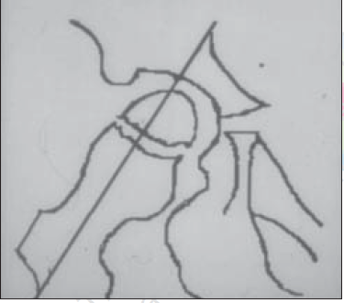
Examination Technique
The patient lies in the supine position with the hip in the neutral position or in 15-20° internal rotation.
Scan is oriented along the long axis of the femoral neck which shows the acetabular brim, femoral head, femoral neck and the ilio-femoral ligament.
The contralateral hip is always examined for comparison.

Slide 39
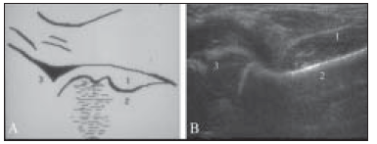
Sonographic appearance of effusion:
Anterior cortex of the femoral head and neck are important landmarks.
The joint capsule normally has a concave contour that parallels the femoral neck.

Slide 40
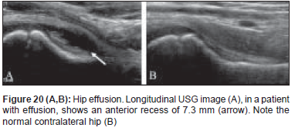
Sonographic appearance of effusion
In the presence of effusion, the joint capsule /ilio-femoral ligament is displaced anteriorly and the anterior contour becomes convex
The fluid-filled hypoechoic space seen between the cortex of the femoral neck and the ilio-femoral ligament increases to more 5 mm.
Asymmetry of 2 mm or more as compared to the contralateral hip is considered significant

Slide 41
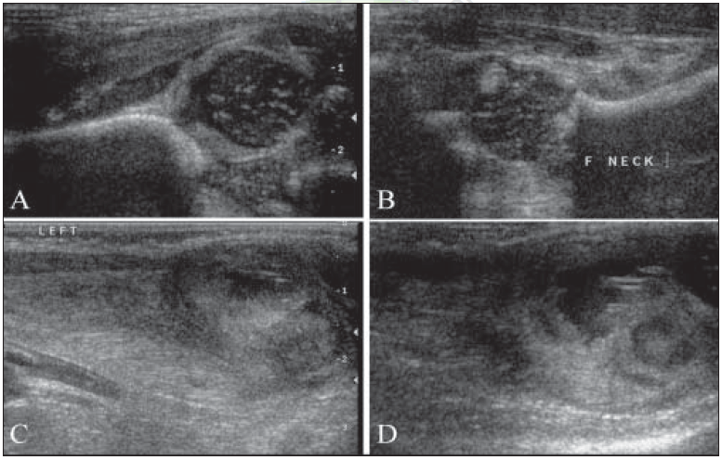
Septic arthritis. Coronal USG (A) shows subluxation of the femoral head with synovial thickening. Longitudinal USG (B) shows
fluid in the anterior ilio-femoral recess. Femoral osteomyelitis with a subperiosteal collection and soft tissue abscess are also seen (C, D)

Slide 42
Sonographic appearance of effusion:
Absence of internal echoes does not rule out septic arthritis and aspiration of the fluid is mandatory in clinically suspected infective joint disease.
Anechoic fluid is seen in transient synovitis and usually resolves after 6 weeks.

Slide 43
Color Doppler imaging
Epiphyseal flow can be identified in the normal femoral epiphysis.
Diminished or absent flow has been described as a risk factor for avascular necrosis.
RI increases with the amount of effusion.
A power Doppler USG may reveal increased flow in the capsule in inflammatory arthritis.

Slide 44
3D USG:
3D projection offers imaging in the sagittal and craniocaudal projections, hence there is better demonstration of the position of the femoral head with respect to the acetabulum.
Slow data acquisition and suboptimal reconstruction. Therefore, it is not considered practical yet for routine use.

Slide 46
Conclusion
USG is an extremely useful tool for the evaluation of some pediatric hip diseases.
In the assessment of infants with DDH, it is the imaging modality of choice.
Its role in a child with a painful hip is limited to documenting the presence of joint effusion and in guiding aspiration.
USG cannot reliably differentiate between sterile and infected effusions.
The role of color Doppler and 3D USG is at present limited.

Slide 47
References
1.Graf R. The diagnosis of congenital hip-joint dislocation by the
ultrasonic Combound treatment. Arch Orthop Trauma Surg
1980;97:117-33.
2.Novick G, Ghelman B, Schneider M. Sonography of the neonatal
and infant hip. AJR Am J Roentgenol 1983;141:639-45.
3.Harcke HT, Clarke NM, Lee MS, Borns Please Þ nd the att achment,
Thanks, MacEwen GD. Examination of the infant hip with real-time
ultrasound. J Ultrasound Med 1984;3:131-7.
4.Dezateux C, Godward S. A national survey of screening for congenital
dislocation of the hip. Arch Dis Child 1996;74:445-8.
5.American Academy of Pediatrics. Clinical practice guidelines:
6.Terjeson T. Ultrasound as the primary imaging method in the
diagnosis of hip dysplasia in children aged < 2 years. J Pediatr
Ortho B 1996;5:123-8.

