Slide 1
CONGENITAL ANOMALIES OF HEAD,NECK AND FACE
PRESENTER:DR.SHAURYA AGARWAL
MODERATOR:DR.NABANITA DEKA,M.D
ASSOCIATE PROFESSOR OF RADIOLOGY,GMCH

Slide 2
HEADINGS FOR DISCUSSION
EMBRYOLOGY
INTERESTING CASES
MODALITIES AND PROTOCOLS FOR SCANNING
VASCULAR MASSES
ABNORMALITIES OF HEAD AND FACE
NECK ABNORMALITIES
Notes:
To add from hagga,intechopen,6 paged pdf,2 rsna,Radiology assistant

Slide 3
EMBRYOLOGY AND DEVELOPMENT
Mesenchyme for formation of head region is derived from paraxial and lateral plate mesoderm, neural crest, and thickened regions of ectoderm known as ectodermal placodes.
Paraxial mesoderm (somites and somitomeres) forms a large portion of the membranous and cartilaginous components of skull and all voluntary muscles of the craniofacial region
Neural crest cells originate in the neuroectoderm of forebrain, midbrain, and hindbrain regions and migrate ventrally into the pharyngeal arches, forming the entire face.

Slide 4
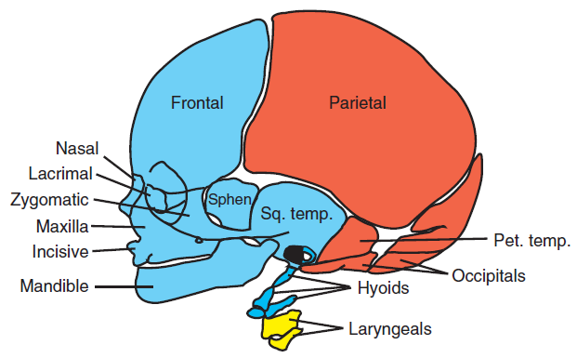
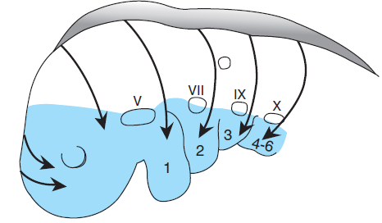
Mesenchyme for these structures is derived from neural crest(blue), paraxial mesoderm (red)and
lateral plate mesoderm (yellow)
Migration pathways of neural crest cells from forebrain, midbrain, and hindbrain regions into their final locations
in the pharyngeal arches.

Slide 5
EMBRYOGENESIS OF THE BRANCHIAL APPARATUS
The anatomic structures of the face and neck predominantly derive from the branchial apparatus, that develops between the second and seventh weeks of gestation
The branchial apparatus consists of six paired arches.
The cervical sinus of His appears by mesodermal growth cranially of the first arch and a portion of the second arch and caudally by growth of mesoderm lateral to the fifth-sixth arch.
Branchial abnormalities develop from incomplete obliteration of the branchial apparatus

Slide 6
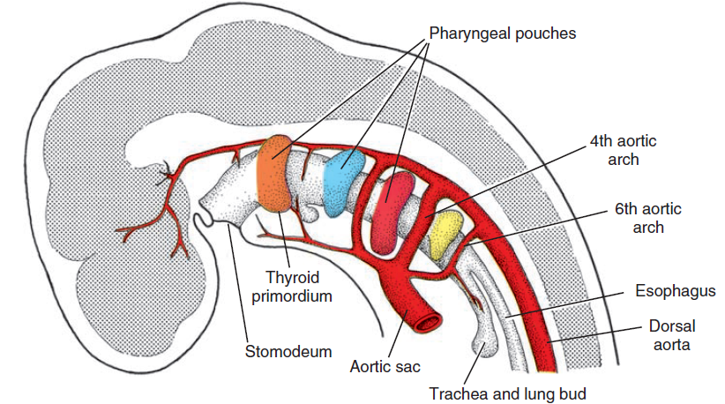
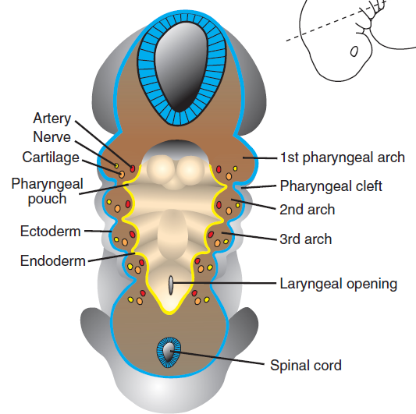
Pharyngeal pouches shown as outpocketings of the foregut and thyroid primordium
Each arch consists of a mesenchymal core
lined internally by endoderm and externally by ectoderm.
Each arch also contains an artery

Slide 7
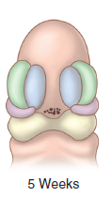
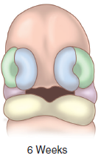
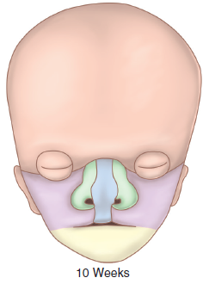
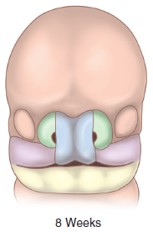
FACIAL DEVELOPMENT
When the embryo is 42 days old, five mesenchymal prominences can be recognized:
Frontonasal prominence cranial to the stomodeum
Median and lateral nasal prominences.
Maxillary and Mandibular prominences
Notes:
Fetal face development begins at 4 weeks gestation and rapidly progresses, with the completion of major events by 8 weeks gestation.
The frontonasal prominence forms the forehead and apex of the nose.
The medial nasal prominences form the nasal septum. The lateral nasal prominences form the nasal ala.
Maxillary prominences form the upper cheeks and upper lip and mandibular prominences form the lower cheeks, lower lip, and chin.

Slide 8
GESTATIONAL AGE WISE FACIAL DEVELOPMENT
4th Week: The optic discs are present posterolaterally.
5th week: The lens vesicles invaginate within optic discs.
6th week: The hyaloid vessels are present in the optic stalk.
Six auricular hillocks forms pinna of the ears.
Nasolacrimal duct forms from the medial corner of eye to the inferior meatus of nasal cavity
7th week: The central axis of the nose and philtrum are formed

Slide 9
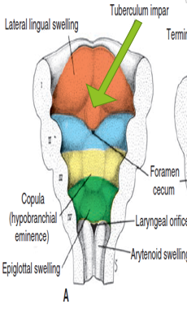
DEVELOPMENT OF TONGUE AND THYROID
The tongue develops from two lateral lingual swellings and one medial lingual swelling,the tuberculum impar,originating from 1st branchial arch.
Hypobranchial eminence is formed by the mesoderm of the 2nd,3rd,4th pharngeal clefts.
The thyroid appears as proliferation between tuberculum impar and hypobranchial eminence indicated by foramen cecum.
The thyroid then migrates infront of trachea and remains connected by tongue by thyroglossal duct.
Notes:
Ventral portion of pharyngeal arches seem from above.Not the foramen caecum,tuberuclum impar and lateral lingual swellings.

Slide 10
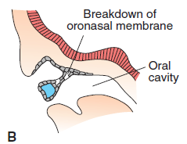
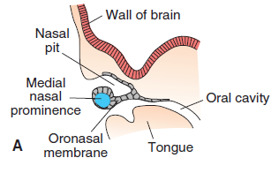
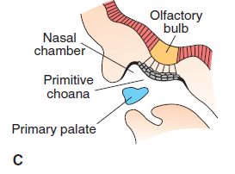
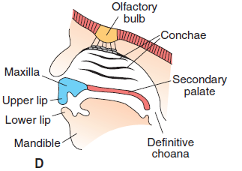
DEVELOPMENT OF NASAL CAVITIES
Notes:
During the sixth week,nasal pits deepens and initially seperated by the primitive oral cavity by oronasal membrane and later by the newly formed choanae.
This choanae lies each side of the midline and immediately behind the primary palate.
Later with the formation of secondary palate,definitive choanae is formed which lies at the junction of oral cavity and pharynx.

Slide 11
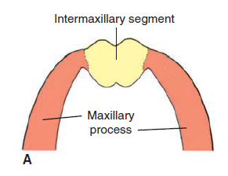
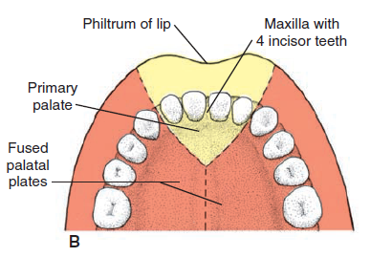
INTERMAXILLARY SEGMENT
As a result of growth of the maxillary prominences, the two medial nasal prominences merges and forms inter maxillary segment.
It is composed of (1) labial component, which forms the philtrum; (2) upper jaw component, which carries the four incisors; and (3) palatal component, which forms the triangular primary palate
Notes:
A. Intermaxillary segment and maxillary processes. B. The intermaxillary segment giving rise to the
philtrum of the upper lip, the median part of the maxillary bone with its four incisor teeth, and the triangular primary
palate.

Slide 12
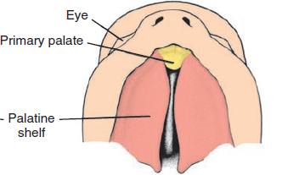
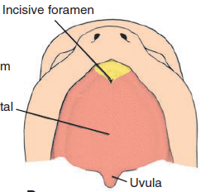
DEVELOPMENT OF SECONDARY PALATE
The main part of the definitive palate is formed by two shelf-like outgrowths from maxillary prominences.
These palatine shelves appear in the 6th week and directed downward.
In the 7th week the palatine shelves ascend to attain a horizontal position above the tongue and fuse forming the secondary palate.
Anteriorly, the shelves fuse with the triangular primary palate, and incisive foramen is the midline landmark between the primary and secondary palates.
Notes:
The tongue has moved downwards and palatine shelves have reached at horizontal position.ventral view shows the paltine shelves are horizontal.
The two palatine shelves have fused with each other and with the nasal septum.Incisive foramen occurs between primary and secondary palate.

Slide 13
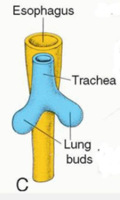
DEVELOPMENT OF THE NECK
The laryngotracheal diverticulum forms during the 4th week of gestation along the floor of the primitive mouth.
The distal end forms the lung bud. The endoderm of this diverticulum forms the epithelium of the larynx and trachea.
The 4th and 6th pharyngeal arches form surrounding cartilage and muscles.

Slide 14
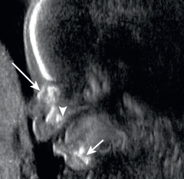
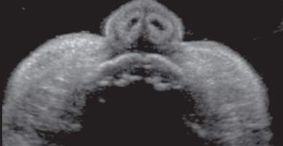
SONOGRAPHIC EVALUATION OF FETAL FACE
Sonographic evaluation of the fetal face is part of the routine anatomic survey in midpregnancy.
The facial anomalies are divided grossly into nose, orbit, lip, mandible, and palate anomalies.
Prenatal recognition of facial abnormalities can lead to the diagnosis of multiple syndromes and chromosomal anomalies.
Notes:
C) Profile of the face of a 17-week fetus shows a normal nasal
bone (long arrow), m
Nose and lips. Coronal sonogram of
normal nostrils and maxillary teeth of a different fetus at 33 weeks’ gestation.

Slide 15
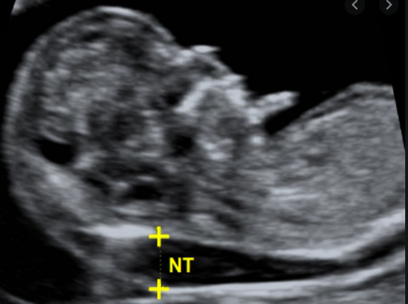
SONOGRAPHIC EVALUATION OF NORMAL FETAL NECK
Images are obtained to evaluate the cervical spine and airway.
The neck should also be evaluated for hyperextension.
The nuchal translucency is fluid collection posterior to fetal neck
Notes:
and is evaluated in suboccipital bregmatic plane, where landmarks cavum septum pellucidum, cerebellar hemispheres, and cisterna magna are visualised.
Thickened Nuchal fold measurements(6 mm or greater) are associated with fetal aneuploidy, cardiac defects and adverse pregnancy outcome.

Slide 16
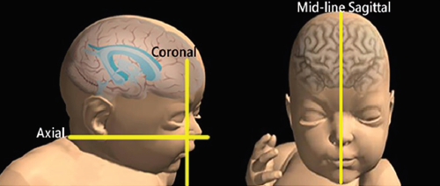
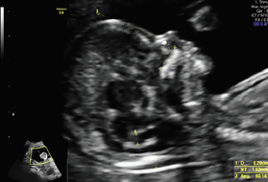
PLANES FOR SCANNING
SAGITTAL PLANES:
Helps to obtain the angle between the surface of the palate and the frontal bone, called the frontomaxillary facial angle.
This angle is increased in fetuses with trisomy 21 due to hypoplasia of the palate.
Nasal bone are visualized in midsagittal scans
Notes:
Normal fetal profile at 12–13 weeks. (B). Schematic representation of the scanning planes to be used for
obtaining axial and coronal views of the fetal face.
The median FMF angle was 77° (range 69°–103°; SD = 5.1°)

Slide 17
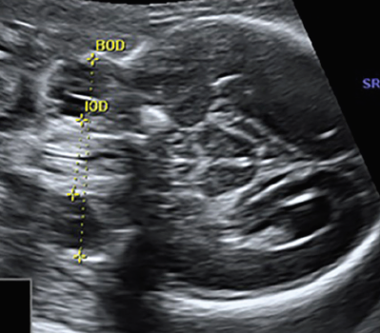
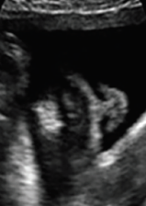
AXIAL PLANES
CORONAL PLANES
Coronal planes better visualizes the eyelids,lips, forehead, and nose(nostrils appear as two little anechoic areas)
Orbits may be visualized simultaneously, by means of an axial plane.
Notes:
The interocular distance (IOD) and binocular distance (BOD) are demonstrated in this scan. The lens is visible
inside the orbit.
Coronal anterior plane in a late first trimester (FT) fetus: The lens inside the corpus vitreum
B. The tip of the nose, the alae nasi, and the columna are seen above the upper lip. The nostril typically appears as two little anechoic areas.

Slide 18
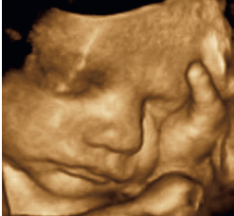
3D/4D imaging enables a more detailed survey and detects subtle fetal abnormality compared to 2D US by using various modes.
Various modes applicable to 3D/4D ultrasound are :Multiplanar mode,multislice,3D surface mode etc.
When counseling, the rendered images can help the parents to counsel about the severity of an existing malformation.

Slide 19
FETAL MRI
Ultrasound is limited by factors such as oligohydramnios, maternal body habitus, complex fetal anomalies, and operator dependency.
MRI has emerged as a valuable adjunct because of development of ultrafast sequences with few motion artefacts ,excellent soft tissue contrast,less operator dependency and excellent spatial resolution.
Notes:
However, MRI is expensive ,non availability at all facilities ,and maternal breath holding are its main limitations.

Slide 20
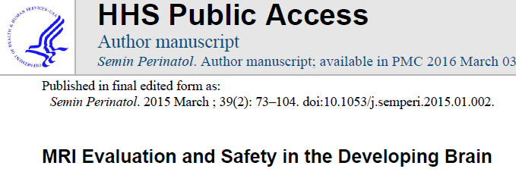
Fetal MRI is optimal at 18-22 weeks.
Static Magnetic Field Exposure:FDA has limits on magnetic field exposure of 4T for patients less than one month of age.
Specific Absorption Rate:Less than 3.2 W/kg over 10 minutes exposure in head
Acoustic Noise and Sound Pressure Levels :should not exceed 140 db

Slide 21
TECHNICAL PARAMETERS
T1-weighted sequences are obtained in order to detect mucine or blood.
T2-weighted images consist of ultra-fast-spin-echo sequences and steady-state free precession sequences
Dynamic sequences (cine T2 true sequence) may be used to improve tracheal or laryngeal obstruction by showing a fluid T2-hyperintense pouch during swallowing.
3D FIESTA help clarify small lesions as a cleft lip by decreasing the slice thickness to 1.6 mm.
Diffusion Weighted Imaging (DWI) is obtained to detect brain malformation associated.
Notes:
Fast Imaging Employing Steady-state Acquisition
Half fourieer acquisition single shot turbo spin echo

Slide 22
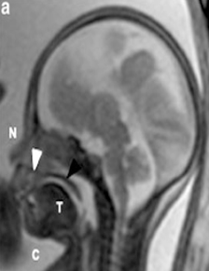
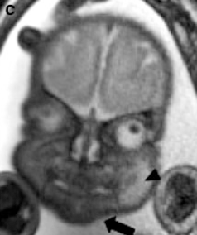
MR ANATOMY
Axial images better delineates continuity of bony palate, spacing of eyes and lens.
Sagittal T2 images allow better assessment of palate,tongue
,esophagus filled with T2 hyperintense fluid that is visualized during swallowing.
Coronal plans allows better delineation of continuity of lips and the philtrum
Sagittal T2 shows curvature of nose,alveolar arch,palate and tongue
Coronal T2 show continuity of upper lip,philtrum and chin.

Slide 23
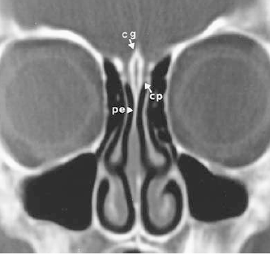
ROLE OF CT SCAN
CT scan demonstrates the bony structures better.
It is useful for confirmation of bony abnormalities detected on antenatal US associated with fronto-nasal masses ,congenital atresia and other syndromes.
Images are obtained with bone algorithm at interval of 3 mm
Normal anatomy of the nasofrontal region
Notes:
Normal anatomy of the nasofrontal region Coronal CT scan demonstrates
the ossified crista galli (cg), the cribriform plate (cp),
and the perpendicular plate of the ethmoid bone (pe).
Normal anatomy of the nasofrontal region Axial CT scan shows the nasolacrimal
duct (nl), pituitary canal (pit), and a normal cleft between the paired nasal bones (arrow).

Slide 24
ABNORMALITIES OF THE HEAD
Abnormal Size
The HC gives proper estimates of gestational age.
However,if HC is three SD below the mean, microcephaly is diagnosed,seen in trisomies and holoprosencephaly.
If HC is greater than 3 SDs, macrocephaly is detected leading to cephalo-pelvic disproportion and difficulty in delivery.
Anencephaly is the most severe form characterized by a defective calvarium and scalp whereas ineincepahly is occiput defect with cervical vertebrae absence.
Notes:
fixed fetal head retroflexion

Slide 25
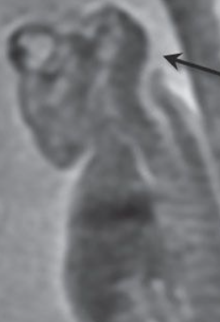
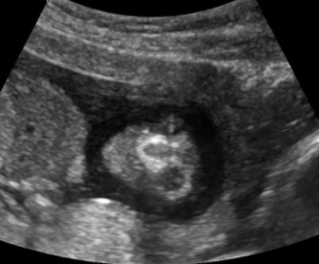
Sagittal T2-weighted image showing anencephaly and absent brainstem
Notes:
Anencephaly at
20 weeks. Sagittal
T2-weighted image shows
absent calvarium and
supratentorial brain
(arrowheads); a profoundly
hypoplastic hindbrain is
visible (arrow)

Slide 26
ABNORMAL SHAPE
Craniosynostosis:Craniosynostosis describes a group of disorders in which there is premature fusion of one or several of the cranial sutures.
Craniosynostosis can be isolated or associated with syndromes including Apert, Crouzon, Pfeiffer, Carpenter and thanatophoric dysplasia.
Imaging plays an essential role in recognition of craniosynostoses, identification of coexisting brain anomalies,preoperative treatment planning, and postoperative followup.

Slide 27
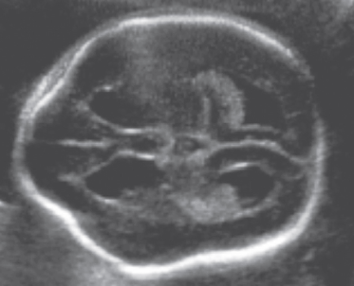
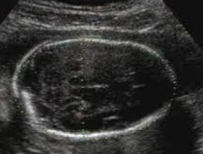
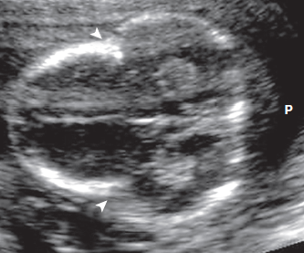
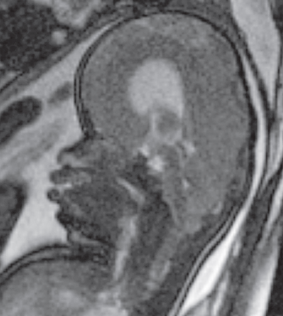
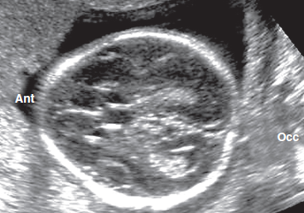
Lemon Shaped Skull
Dolicocepahly
cloverleaf skull
strawberry shape
Turribrachycephaly
Notes:
Dolichocephaly is described as long and narrow cranium seen in fetuses in breech position
Brachycephaly is described as round head caused by premature fusion of the coronal sutures.
Turricephaly is described as "towering" skull caused by bicoronal or bilambdoid synostosis.
A lemon-shaped skull, with indentation of the frontal bones, seen with open neural tube defects and the Chiari II malformation
A strawberry-shaped skull is flattening of the occiput and narrowing of the bifrontal portion of the cranium seen with trisomy 18
A cloverleaf-shaped skull is seen thanatophoric dysplasia.

Slide 28
SYNDROMES ASSOCIATED WITH CRANIOSYNOSTOSIS
APERT’S SYNDROME
Acrocephalosyndactyly type I includes brachycephaly and symmetric syndactyly associated with a mitten like deformity of the hand.
Shallow orbits with hypertelorism are characteristic ocular findings.
The airways may be compromised by hypoplasia of the posterior choanae.
Spinal fusion anomalies and midfacial hypoplasia are also common.

Slide 29
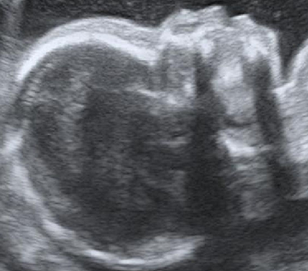
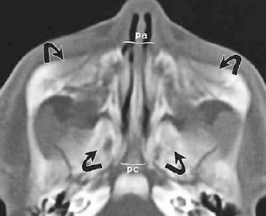
Sonogram showing prominent forehead and midfacial hypoplasia
Postnatal CT scan shows midface hypoplasia ,narrowing of pyriform aperture and posterior choanal stenosis
Notes:
Sonogram showing a fetal profile with prominent forehead, mifdacial hypoplasia, and depressed nasal bridge at 21 weeks of gestation
Apert syndrome (a) Axial CT scan demonstrates
shallow proptotic orbits (arrowheads) and gradual narrowing of the nasal cavity from front to
back (arrows). (b) Axial CT scan demonstrates midface hypoplasia (arrows), narrowing of the pyriform
aperture (pa), and posterior choanal stenosis

Slide 30
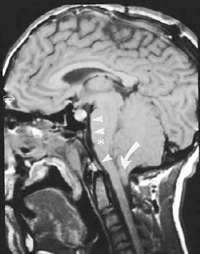
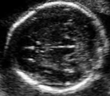
CROUZON’S SYNDROME
Crouzon syndrome is characterized by brachycephaly,mid facial hypoplasia with vertically oriented brainstem, and cleft palate.
Cranial abnormalities include Chiari malformation, hypoplastic transverse sinus
Brachycephaly
Sagittal T1 MR image reveals steep clivus, vertically oriented brainstem and Chiari I malformation
Notes:
Crouzon syndrome (a) Sagittal T1-weighted MR image reveals a steep clivus (arrowheads), a vertically oriented brainstem (*), and a Chiari I malformation
(arrow). The signal voids in the calvaria are caused by sutures from previous cranioplasty. (b) Maximum-intensity-projection image from an MR venogram shows markedly abnormal venous drainage including absence of flow in the region of the jugular bulbs (*), multiple collateral veins (arrowheads), and hypoplastic transverse sinuses (arrows)

Slide 31
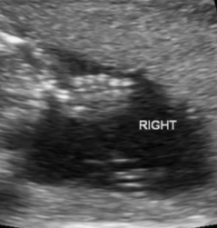
PFEIFFER’S SYNDROME
It is associated with broad, medially rotated thumbs and varus deformity of the great toes.
CARPENTER’S SYNDROME
It is associated with Craniosynostosis, polydactyly, syndactyly and cardiac defects
Polydactyly

Slide 32
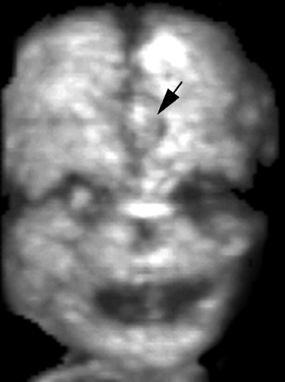
WORMIAN BONES
Wormian bones are ossicles located in the sutures or fontanelles and may be associated with-
Pyknodysostosis
Osteogenesis imperfecta
Cleidocranial dysplasia
Hypothyroidism
Hypophospatasia
3D US shows wormian bone between frontal bones of fetus with trisomy 18.

Slide 33
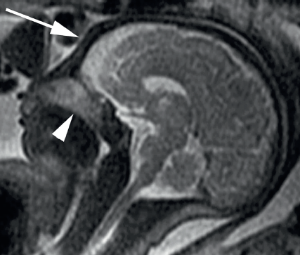
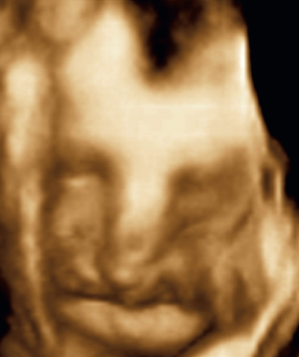
FOREHEAD ABNORMALITIES
Wolf-Hirschhorn (4p-) syndrome has an abnormally sloped forehead, the “Greek warrior facies” .
Frontal bossing is abnormal prominence of frontal bones seen in achondroplasia,acromegaly among others
Broad, flat nasal bridge and sloped forehead in Wolf-Hirschhorn
Frontal bossing with absence of the secondary palate
Notes:
Coronal three-dimensional and (B) sagittal
magnetic resonance images show a broad, flat nasal bridge and forehead at 34 weeks’ gestation, the so-called “Greek warrior helmet” facies.
Note sloped forehead (arrow in [B]) and absence of the secondary palate (arrowhead in [B] showing nasopharynx communicating with
oropharynx).
Nasofrontal angle =120
Naso mental angle =130
Naso facial=36

Slide 34
Notes:
A encephalocele or cephalocele is an abnormal protrusion of the brain and/or meninges through a defect in the skull and is considered a form of spinal dysraphism

Slide 35
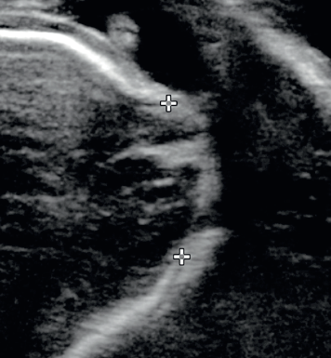
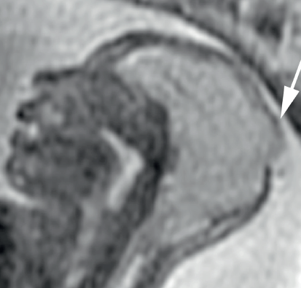
OCCIPITAL CEPHALOCELES
Occipital cephalocele are classified into occipitocervical , low occipital and high occipital (involving occipital bone only)
Associated abnormalities such as Chiari 2 and Dandy- Walker spectrum disorders
Saggital T2 image showing the high occipital defect in the skull
High occipital defect
Notes:
Axial sonogram shows high occipital defect (calipers) through which a small amount of dysplastic brain protrudes. (D) Sagittal magnetic resonance
image shows microcephaly and the high occipital defect in the skull (arrow).

Slide 36
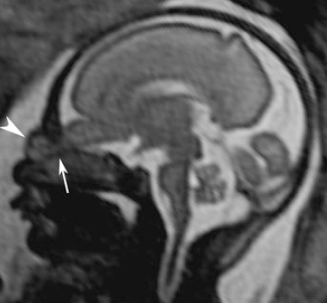
FRONTOETHMOIDAL (SINCIPITAL CEPHALOCELE)
MR shows a soft tissue mass in direct contiguity with the intracranial parenchyma.
In frontonasal cephalocele, brain herniates between the frontal bones above and the nasal bones below .
In naso ethmoidal type, the nasal bone is bowed anteriorly
Nasoorbital cephalocele
T2W image shows dysplastic frontal lobe herniation through the fonticulus frontalis
Notes:
Sagittal T2-weighted image
shows dysplastic frontal lobe
herniation (arrowhead)
through the fonticulus
frontalis (arrow)

Slide 37
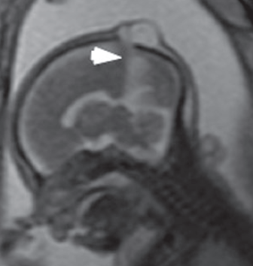
PARIETAL CEPHALOCELES
Parietal cephaloceles (atretic cephaloceles ) represent as lesions present as scalp masses near the posterior vertex.
Associated abnormalities include persistent falcine sinus and partial absence of the straight sinus.
T2-weighted images show a fluid-filled lesion between parietal bones and the falcine sinus
Notes:
T2-weighted images show a round and well-limited fluid-filled lesion between the parietal bones.
Note the falcine sinus (white arrowhead, b)

Slide 38
ORBIT ABNORMALITIES
Axial planes evaluates the presence of both orbits,their sizes and shapes and the measuring the BOD and IOD.
BOD is measured between the malar margins of vitreous, while IOD is obtained between the two ethmoidal margins of vitreous.
The sagittal view help to evaluate proptosis.
Notes:
Binocular distance

Slide 39
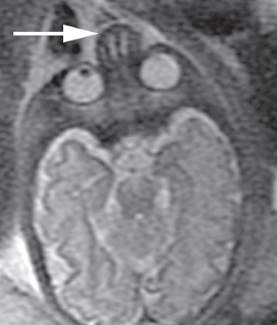
HYPOTELORISM
Hypotelorism is defined as interocular distance less than 5th percentile is associated with holoprosencephaly,ethmocephaly and cebocephaly
Pathogenesis: Defect in prechordal mesenchyme.
Axial magnetic resonance image shows the relatively small intraorbital distance and an abnormal nose
Notes:
,nasal maxillary dysostosis (Binder syndrome),

Slide 40
HYPERTELORISM
Hypertelorism is defined as interocular distance more than 95th percentile and associated with Apert syndrome,Crouzon and median facial cleft.
Coronal MRI shows hypertelorism and bilaterally absent palatal shelves
Axial sonogram shows hypertelorism

Slide 41
CYCLOPIA
Presents with one single orbital fossa, with bulbs and eyelids fused to a variable degree.
It is usually associated with arhinia with proboscis and holoprosencephaly
Notes:
probscis is a trunk-like appendage having one or two internal openings not communicating to the chonae.
Axial and sagittal scans of a fetus at 15 weeks of gestation show cyclopia and proboscis
Postnatal photograph of a different infant, demonstrating cyclopia with fused
globes, supraorbital proboscis, and absent nose

Slide 42
MICROPHTHALMIA AND ANOPHTHALMIA
They are associated with disorders like Walker-Warburg syndrome and Meckel Gruber syndrome.
In simple microphthalmia, the eye displays a total axial length at least two standard deviations below the mean for gestational age.
Complex microphthalmia is also associated with dysgenesis of anterior and/or posterior segment
Coronal magnetic resonance image show right anophthalmia and left microphthalmia
Notes:
A) Axial sonogram and coronal magnetic resonance image
show right anophthalmia (arrowhead) and left microphthalmia (arrow).
A case of anophthalmia prenatally on 3D US

Slide 43
PERSISTENT HYPERPLASTIC PRIMARY VITREOUS (PHPV)
MRI demonstrate an abnormal low T2 signal line through the central vitreous corresponding to Cloquet’s canal.
There is association with Warburg syndrome and retinal dysplasia.
Axial and sagittal T2W images show linear T2 hypointense structure corresponding to Cloquet’s canal with retinal detachment
Notes:
Axial (a) and sagittal (b) T2 weighted images show linear T2 hypointense structure
corresponding to a Cloquet’s canal (white arrow, a, b) with retinal detachment (white arrowheads, a, b)

Slide 44
COLOBOMA
Coloboma is a focal bulge in the globe resulting from incomplete closure of the optic fissure.
Coloboma may be associated with CHARGE syndrome
Axial sonogram of orbits shows outpouching from the posterior aspect of the globe
Axial MRI of the globes demonstrates bilateral colobomas
Notes:
(coloboma, heart defects, choanal atresia, restriction of growth and development, genital and ear anomalies)
Axial sonogram of orbits shows an abnormally small right globe
(arrowhead) and a fluid-filled outpouching from the posterior aspect
of the left globe (arrow), consistent with a coloboma.
Axial magnetic
resonance image of the globes demonstrates bilateral colobomas
(arrows). Note also the brain abnormality with a monoventricle,
in the holoprosencephaly spectrum.

Slide 45
CONGENITAL CATARACTS
Congenital cataracts show a rounded echogenic mass in the anterior portion of the globe.
Causes includes:
Arthrogryposis Chondrodysplasia punctata
Chromosomal abnormalities (21, 18, 13)
Infection(Rubella,Toxoplasmosis)
Echogenic lens
Notes:
Sonographic pictures of fetal cataracts at 24 weeks of gestation. Coronal views of echogenic lens

Slide 46
DACRYOCYSTOCELE
These occur due to obstruction of nasolacrimal duct and appear as cystic masses located inferomedially to orbit
There is no mass effect on the globe.
Differential diagnosis includes :
Teratomas (often solid or mixed and contain calcifications)
Hemangiomas (solid, echogenic with increased vascular flow)
Notes:
Axial sonogram at 35 weeks shows fluid collections anteromedial to each orbit, consistent with bilateral dacryocystoceles (arrows).
Axial (a),) T2-weighted images
show a cystic formation of the medial canthus (arrowhead) and the absence of hypertelorism

Slide 47
EAR ABNORMALITIES
For diagnosis of ear abnormalities, helix, concha, antihelix, tragus and lobule should be visualized.
Low-set ears are described as the helix joining the cranium at a level below plane passing through inner canthi,seen in Noonan`s syndrome.
Otocephaly is union of the ears on the front of the neck and is caused by failure of ascent of the auricles.
Sonography showing low-set ears and agnathia
Notes:
Week 28 fetal sonography showing low-set ears and skin tag (arrows) on two-dimensional
different 27-week fetus with agnathia, microstomia, and low-set, abnormally turned ears.

Slide 48
MIDFACE ABNORMALITIES
HYPOPLASIA
The midface is the area between the upper lip and forehead.
Midface hypoplasia occurs in syndromes such as Apert, Crouzon and trisomy 21.It is associated with micropthalmia.
3D view showing midface hypoplasia with microphthalmia

Slide 49
ABSENT NASAL BONE
The fetal nasal bone is evaluated in midsagittal plane at an angle between 45 to 135 to the facial plane.
Hypoplastic/absent nasal bone length is associated significantly with Downs syndrome
Total arhinia is defined as a flat nasal area with complete absence of olfactory bulbs.
Notes:
sagittal (b) T2-weighted images show
the absence of the nose, a midface retraction, and lips protrusion.

Slide 50
CONGENITAL MIDLINE NASOFRONTAL MASSES
These are the result of faulty regression of embryologic dural diverticulum from prenasal space.
The mass may be intranasal, extranasal, or combination.
These includes-
Findings that suggest intracranial extension include widening of foramen cecum and a bifid crista galli
Nasal gliomas
Encephaloceles
Dermoid
(midline glabellar fatty masses)
Epidermoid (fluid attenuation)
Hemangiomas

Slide 52
NASAL GLIOMA
Nasal gliomas result from sequestering herniated glial tissue appearing isointense to the gray matter on T1 and T2 sequences.
Most of them are extranasal(60%)occuring at the root of the nose
MRI allows differentiation of nasal glioma having mixed-signal-intensity from encephalocele.
Desquamation of lining cells of dermal sinus tract results in formation of dermoid/epidermoid tumors along tract.
Notes:
Intranasal gliomas are commonly confused with inflammatory
polyps, which usually lie medial to the middle turbinate, whereas
inflammatory polyps typically lie inferolateral to the middle turbinate.

Slide 53
T2 W reveals a round and well-limited mass of the nasal region displaying a signal similar to
gray matter signal on MR
Saggital T2 W images show bright signal intensity in glabella suggestive of dermoid cyst accompanied by a dermal sinus tract extending through foramen cecum.
Notes:
Nasal glioma, ultrasound scan and MRI images at 35 weeks. Sagittal T2 (a) and T1 (b)
weighted images, :The nasal glioma appears as
round and well-limited mass of the nasal region that displays a signal similar to
gray matter signal. Coronal (f) , 3D images from ultrasound scan show a mass of the nasal region

Slide 54
NASAL ENCEPHALOCELE
Frontonasal encephaloceles result from herniation of dura mater through foramen cecum and the fonticulus frontalis into glabella whereas nasoethmoidal encephaloceles occur due to herniation through foramen cecum into nasal cavity.
Differential diagnosis includes dermoid (midline) opposed to encephaloceles (lateral)to crista.
MRI demonstrates continuity of brain tissue via enlarged foramen cecum and intrathecal injection of contrast material may demonstrate a subarachnoid connection

Slide 55
Sagittal T1W image shows brain parenchyma within a glabellar mass with outward bowing of the inferior frontal bone and associated absence of the corpus callosum suggesting frontonasal encephalocele
Nasoethmoidal encephalocele demonstrating a nasal mass containing cerebrospinal fluid and brain parenchyma
Notes:
Frontonasal encephalocele with a midline mass. Sagittal T1 weighted MR image shows brain parenchyma within a glabellar mass (*). Outward bowing of the inferior frontal bone (arrow) and associated absence of the corpus callosum (arrowheads) are also noted.
Nasoethmoidal encephalocele Coronal T1-weighted MR image demonstrates a nasal mass containing cerebrospinal fluid (open arrows) and
brain parenchyma (solid arrow).

Slide 56
CLEFT LIP AND PALATE
They present with difficulty with feeding,otitis media, and difficulty with hearing and speech.
Central clefting includes Pierre Robin anomalad, whereas lateral clefting includes Treacher Collins.
Cleft lip usually result from failure of fusion of medial nasal prominences and maxillary prominence.
Palatal clefts usually are located between incisors and canines and are result of failure of fusion of one side of primary palatal process with secondary process

Slide 57
Complete cleft lip is defined as a cleft that fully divides the lip ,extends into nostril and associated with a cleft of the alveolus
An incomplete cleft lip involves a portion of the lip, but a band of soft tissue spans the cleft.
Associated Signs of Cleft Palate With Cleft Lip includes on axial and coronal views
Lips: cleft
Nares: flattened or deformed
Vomer: deviated away from side of cleft
Maxilla: wide gap
Orbits: hypertelorism
sagittal views: Profile: Micrognathia, Tongue: high position.
Notes:
Unilateral cleft lip with or without cleft palate due to non fusin of medial nasal process with maxillary process
Midline clft lip or palate is due to non fusion of two median nasal prominences
Lateral cleft lip/oblique cleft is due to non fusion of lateral nasal prominence wit maxillary prominence
Cleft palate is due to non fusion of primary palate/shelves of secondary palate

Slide 58
UNILATERAL CLEFT LIP AND ANTERIOR PALATE
NORMAL
ISOLATED CLEFT LIP
BILATERAL CLEFT LIP AND ANTERIOR PALATE
BILATERAL CLEFT LIP AND PALATE
ISOLATED CLEFT PALATE
Notes:
NORMAL

Slide 59
Nyberg et al proposed a ultrasonographic classification of CL with or without CP.
CL alone as type 1
Unilateral CL and CP as type 2
Bilateral CL and CP as type 3
Midline CL and CP as type 4
Facial defects associated with amniotic bands as type 5.
Notes:
Direct coronal (b) CT views show unilateral clefting of the lip, alveolar
ridge, and palate in a child with unilateral involvement.
The cleft extends between the incisors and canine tooth in
the region of expected fusion of the primary and secondary
Palate
Cleft lip (white arrow, a) with interruption of the palate (white arrowhead, b) is
associated with corpus callosum dysplasia (black arrowhead, a) and bilateral frontal polymicrogyria
(c)

Slide 60
UNILATERAL CLEFT LIP OR PALATE
In a unilateral cleft lip or palate, there is often an offset between the two sides of the cleft, described as the “greater segment” on the opposite the cleft, and the “lesser segment” on the side of the cleft.
Notes:
Coronal three-dimensional sonogram of the fetal lip and nose shows a normal right
nostril and lip, cleft left lip (arrow), and a downward-sloping left nostril at 29 weeks’ gestation.
Axial (a, T2-weighted images. Shows interruption of the upper lip (black arrow, a) is associated to a discontinuity of the primary
palate (white arrow, a), while the secondary palate is not involved (arrowhead, a).
Sagittal MRI shows an abnormally high position of the tongue, in keeping with a complete left cleft lip and palate.
Coronal SSFSE T2-weighted MR image reveals the wide complete CP (arrow) with amniotic fluid extending
from the oral cavity into the right nasal cavity. Compare with the left side, where the hypointense nasal septum extends inferiorly
to meet the hypointense left side of the hard palate.

Slide 61
BILATERAL CLEFT LIP OR PALATE
In bilateral cleft lip or palate, there will be premaxillary protrusion of intermaxillary segment
Notes:
Axial sonogram of 18-week fetus with bilateral complete cleft lip and palate shows
bilateral clefts in the tooth-bearing alveolus of the maxilla, with two tooth buds (T) displaced anteriorly in the intermaxillary segment
Oblique axial and sagittal MR images show bilateral
cleft lip and the anteriorly displaced intermaxillary segment of the maxilla (arrow).
Postnatal three-dimensional computed tomography reconstruction shows coronal craniosynostosis and the marked anterior position of the intermaxillary
segment (arrow).

Slide 62
MEDIAN CLEFT LIP OR PALATE
Midline clefting (Frontonasal dysplasia) include either inferior or A group and superior or B group
Patients with anomalies in the superior group are associated with hypertelorism, median cleft nose and cranium bifidum.
In the inferior group there may be deficiency of upper lip and philtrum.
3D US shows absence of the intermaxillary segment
Notes:
Axial and 3D US scan of the median cleft lip.
Midline facial deficiency in holoprosencephaly. a Tilted AP 3D reconstruction in a patient with lobar holoprosencephaly
shows absence rather than nonfusion of the intermaxillary segment
T2-weighted axial MRI view demonstrates fusion of gray matter across the midline in the region of the expected genu of corpus callosum. The septum
pellucidum is absent and the thalami are not fused

Slide 63
ISOLATED CLEFT OF SECONDARY PALATE
Isolated cleft of secondary palate is identified by abnormal oropharyngeal fluid flow with color Doppler imaging.
Syndromes associated with isolated clefts include Goldenhar syndrome and Pierre-Robin sequence.

Slide 64
UNUSUAL FACIAL (TESSIER) CLEFTS
These are asymmetrical clefts in unusual locations and may be the result of amniotic band syndrome
These clefts are classified by relationship of the cleft to the mouth, nose, and eye and are numbered from 1 to 14, with the midline designated as 0 and 14
The clefts 1 through 7 lies below the orbit and 8 through 14, above it.
Notes:
Classification of Tessier Clefts. These clefts are classified
by the relationship of the cleft to the mouth, nose, and eye sockets and
are numbered from 1 to 14 with the midline designated as 0. Knowledge
of these types of clefts is important for prenatal imaging, so that when
unusual clefts are seen, they can be recognized as part of this spectrum.

Slide 65
AMNIOTIC BAND SYNDROME
The amniotic band sequence consists of soft tissue derangements arising from tethering of the fetus by fibrous bands of amniotic tissue.
Amniotic band syndrome can lead to development of cephaloceles and clefts
Sagittal T2 image shows entrapment of the occipital lobe resulting into an encephalocele that protrudes into the amniotic sac.
Notes:
Amniotic bandsyndrome at 23 weeks.
Sagittal T2-weighted image shows compartmentalization of the amniotic sac into two parts, with entrapment of the occipital lobe (arrow) resulting into an encephalocele that protrudes into the amniotic sac. Notice anhydramnios surrounding the fetal head

Slide 66
SURGICAL MANAGEMENT OF CLEFT LIP/PALATE
AGE
SURGICAL TECHNIQUE
1-3 months
3 months
9-12 months
1-8 years
Above skeletal maturity
Lip taping and nasoalveolar molding
Cleft lip repair and placement of ventilation tubes
Cleft palate repair
Orthodontic treatment and alveolar bone graft
Mid face advancement and continued orthodontics

Slide 67
CONGENITAL ATRESIAS AND STENOSES
Congenital choanal atresias and stenoses result from tissue deficiencies or failure of resorption of epithelial plugs
They are usually associated with CHARGE syndrome
Saggital sonogram showing dilated nasal cavity
Notes:
Medial deviation of the right medial maxillary sinus wall is seen and leads to a funnel-like configuration of the nasal
cavity. There is hypoplasia of the inferior turbinate, and narrowing of the posterior nasal cavity

Slide 68
Postnatal CT features of choanal atresia/stenosis include width of less than 0.34 cm,medial deviation of medial maxillary wall and obstruction with proximal air-fluid level.

Slide 69
LOWER FACE ABNORMALITIES
MACROGLOSSIA
Macroglossia is described as abnormally enlarged tongue.
Diagnosis is established by considering the imaginary line between mandible and maxilla on the sagittal plane, with protruding tip of tongue past that line.
The etiology of macroglossia includes Beckwith-Wiedemann syndrome, trisomy 21 and lymphatic malformation

Slide 70
MICROGNATHIA
This finding is associated with Pierre Robin sequence and Stickler syndrome
Micrognathia describes a small mandible .
Pierre -robin sequence(anomalad) includes triad of micrognathia, glossoptosis, and subsequent airway obstruction.
T2W image at shows severe micrognathia,posteriorly displaced
tongue hiding the posterior cleft palate
Notes:
The term micrognathia describes a small mandible.
Pierre-Robin Sequence. Sagittal
T2-weighted image at
35 weeks shows a severe
micrognathia (white arrow)
and polyhydramnios. The
tongue is displaced posteriorly
(white arrowhead), hiding the
posterior cleft palate that was
discovered at birth

Slide 71
MICROSTOMIA
Microstomia is small mouth, associated with agnathia and otocephaly.
Overfusion of mandibular and maxillary processes laterally leads to microstomia
Ultrasound image showing agnathia microstomia

Slide 72
NECK ABNORMALITIES
Neck masses in foetus are midline and mostly benign, most common amongst them is cystic hygroma.
LOCATION
The thymus and thyroid, in pathology along the midline.
Dermoid cysts are also usually midline in location
Branchial abnormalities develop from paired branchial arches, and lie laterally.
Similarly,sternomastoid tumour and congenital sympathetic chain neuroblastoma will also lie laterally.

Slide 73
DIAGNOSTIC APPROACH
CYSTIC
SOLID
MIDLINE
OFF-MIDLINE
THYROID LESION
FIBROMATOSIS COLLI
ECTOPIC THYMUS
TERATOMA
RANULA(UPPER)
THYROGLOSSAL DUCT CYST(MIDDLE)
DERMOID CYST(LOWER)
LYMPHANGIOMA
BRANCHIAL CYST
VASCULAR MALFORMATION

Slide 74
RANULA
Ranulas are retention cysts of sublingual salivary gland due to duct stenosis or occlusion.
Plunging ranula results from rupture of duct and extravasation of this fluid into submental region.
Cystic lesion continuous with the sublingual salivary gland
Notes:
Here an image of a sixteen-year-old boy with a firm swelling under the tongue on the left side.
Ultrasound showed an anechoic mass continuous with the sublingual salivary gland

Slide 75
THORNWALDT'S CYST
Thornwaldt's cyst forms as a bulge on posterior-superior wall of nasopharynx due to closure of drainage duct and appearing intermediate-signal on T1W and high-signal on T2W
Cystic lesion showing T2 signal intensity in pharyngeal mucosal space in the midline
Notes:
T1: intermediate to high due to protein content
T2: High signal
Located in the pharyngea mucosal space in the midline on the posterior wall.

Slide 76
THYROGLOSSAL DUCT CYST
The thyroid gland forms as a diverticulum from anterior wall of pharynx,connected by the thyroglossal duct
if duct fail to regress, may differentiate into cysts, lying at or just below the hyoid in midline. They may contain normal thyroid tissue and can lead to papillary carcinoma
US reveals an anechoic well-defined cyst with increased acoustic through-transmission
MRI shows low signal on T1 and high signal on T2w
The differential diagnosis includes dermoid cyst and branchial cleft cyst.

Slide 77
CT demonstrates a low-attenuation mass with enhancing components concerning for a TDC complicated by papillary thyroid carcinoma.
Notes:
Move with hyoid

Slide 78
DERMOID/EPIDERMOID CYST
Dermoid and epidermoid cysts occur at midline closure.
Dermoids contain epithelial and dermal elements, whereas epidermoids contain only epithelial elements.
Ultrasound,CT and MRI shows presence of fat,with“sack-of-marbles” appearance on CT
Epidermoid shows T2 hyperintensity
Hyper-echoic dermoid cyst in the suprasternal notch.
Epidermoid cyst at floor of mouth
Notes:
Typical hyper-echoic dermoid cyst in the suprasternal notch.
Thyroglossal duct cysts move with protrusion of the
E[ tongue,while dermoid/epidermoid cysts are nonmobile

Slide 79
LYMPHATIC MALFORMATION
Lymphatic malformation can be microcystic(<1cm), macrocystic or both.
In conditions where there is difficulty in delivery,EXIT(Ex-utero intrapartum treatment) procedure has to be carried out.
Conventionally LM's have been subdivided into 1) cystic hygroma, 2) cavernous lymphangioma, 3) capillary lymphangioma, 4) vasculolymphatic lymphangiohaemangioma.
They can cause mass effect on fetal airway and may interfere with swallowing and feeding.
Notes:
Role of Imaging during an EXIT Procedure
Sterile intraoperative US is helpful in (a) mapping the placental edges to determine the opti-mal site for the hysterotomy incision, and (b) eval-uating the orientation of the fetal head and neck to assist in delivering the head and neck in the optimal orientation for intubation (Fig 1). Intraoperative US is routinely performed at our institution. Polyhydramnios, if present, should be decreased before the hysterotomy incision is made, and if there is a question about placental location, US can be used to provide guidance. If the EXIT procedure is being performed for a large cystic neck mass or the fetus has significant ascites, predelivery US-guided aspiration of the fluid pockets will not only decrease the size of the mass and improve the chances for airway access, but will also minimize the uterine incision and thereby decrease maternal morbidity (11). US can also be helpful for endotracheal intubation

Slide 80
ROLE OF IMAGING DURING AN EXIT PROCEDURE
Sterile intraoperative US is helpful in --
Mapping the placental location to determine the optimal site for the hysterotomy incision.
Evaluating orientation of fetal head and neck to assist in delivering in optimal orientation for intubation.
In cases of large cystic neck mass predelivery US-guided aspiration of fluid pockets decrease the size of mass

Slide 81
TYPES OF LYMPHATIC MALFORMATION
Cystic hygroma is the most common form of lymphatic malformation and is usually macrocystic.
This abnormality is highly associated with Turner syndrome and other chromosomal anomalies
They have a predilection for left side of posterior neck,extending into superior mediastinum
Cavernous lymphangioma: They are smaller than the cystic hygroma and subcutaneous in location.
Lymphangiohaemangiomas: Lymphangiohaemangiomas retain their venous communication,colour Doppler showing blood flow through the mass on its periphery.

Slide 82
Ultrasonography demonstrate multiple septated cystic spaces filled with hypoechoic fluid in a case of turner syndrome.
MRI shows a multilocular T2 hyperintense mass with septa that appear T2 hypointense
Notes:
Two-dimensional sonogram of left neck mass at 35 weeks showing complex cystic and solid
appearance.
Three-dimensional sonogram showing left-sided mass
Coronal and sagittal fetal magnetic resonance images show the complex mass, potentially blocking the airway

Slide 83
BRANCHIAL CLEFT ABNORMALITIES FIRST BRANCHIAL ANOMALIES
Embyropathogenesis: Anomalies arise from incomplete closure of first branchial cleft at the site of organ of origin of middle ear, external auditory canal, parotid,mandible, and maxilla.
MRI usually have low T1-weighted and high T2-weighted signal intensity.
MRI reveals rounded T2 bright cystic lesion within the right parotid gland.
Notes:
Therefore,first branchial apparatus anomalies can arise in the middle ear cavity, external auditory canal, superficial or deep lobes of the parotid gland, superficial to the parotid gland, at the angle of the mandible, anterior or posterior to the pinna, or along the nasopharynx

Slide 84
SECOND BRANCHIAL ANOMALIES
Can occur anywhere from tonsillar fossa to the supraclavicular region of neck.
It usually presents as a fluctuant non tender mass at the lateral aspect of the mandibular angle, appearing hyperintense on T1 and T2W.
With a fistula, ostium is noted at anterior border of the lower junction of the SCM.

Slide 85
BAILEY’S CLASSIFICATION
Second branchial cleft anomaly, type 1,anterior to SCM
Type 2,posterior to submandibular gland and anterior to carotid
Type 3 sinus/fistula,from tonsillar region to lower SCM
Type 4 in pharyngeal mucosal space in lateral pharyngeal wall
Notes:
Second branchial cleft anomaly, type 1. A, Axial contrast-enhanced CT image at the level of the thyroid cartilage demonstrates a nonenhancing rounded lesion (arrow) adjacent to the strap muscle
Second branchial cleft anomaly, type 2. Axial (CT images at the level of the submandibular gland demonstrate a rounded fluid-attenuation lesion located anterior to the right sternocleidomastoid muscle, anterolateral to the carotid space and posterior to the submandibular gland, resulting in mild mass effect and anterior displacement of the right submandibular gland (arrows).
Second branchial cleft anomaly, type 3 demonstrates a tract extending from the right tonsillar region to the right SCM
Second branchial cleft anomaly, type 4. Axial (contrast-enhanced CT images demonstrate a rounded nonenhancing cystic lesion in the right tonsillar fossa

Slide 86
In type III,from the external ostia,the tract courses between the internal and external carotid arteries before it terminates in the region of the tonsillar fossa.
In Bailey type III a “beak sign” is present, where the medial aspect of the cyst is compressed between the ICA and ECA
Notes:
They are located along the anterior border of the sternocleidomastoid muscle, lateral to the common carotid artery, and if more cranially between the internal and external carotid artery.
Sometimes a beak sign may be seen as a curved rim of the lesion pointing medially between the internal and external carotid.

Slide 87
THIRD BRANCHIAL ANOMALIES
MRI present as unilocular cystic mass above superior laryngeal nerve
Embryology. Third branchial anomalies are rare lesions,located posterior to common carotid
In fistula, external ostia will be anterior to lower SCM.
It then courses posterior to common carotid artery and enters pyriform sinus
Postnatally,barium swallow shows fistula extending from left piriform sinus to near clavicle
Notes:
Postcontrast axial CT image at the level of the mandible demonstrates a low-attenuation lesion in the posterior cervical space posterior to the carotid vessels and the sternocleidomastoid muscle

Slide 88
FOURTH BRANCHIAL ANOMALIES
Embryogenesis : They are likely due to failure of regression of the fourth branchial pouch or distal sinus of His.
They are in the form of a sinus tract that arises from the pyriform sinus,descends along tracheoesophageal groove, and continues into mediastinum.
Third branchial anomalies lie posterior to the internal carotid artery, whereas fourth branchial anomalies are anterior to it.
Notes:
Esophagram demonstrates a sinus tract from the left pyriform sinus (arrow).
MRIs demonstrate abnormal signal and enhancement with inflammatory changes in the left thyroid lobe (arrows)

Slide 89
CERVICAL EXTENSION OF THE MEDIASTINAL THYMUS
Incomplete descent of the thymus may present as solid midline mass or a cystic mass at thoracic inlet,causing dyspnoea or dysphagia due to compression.
Ultrasonography, CT and MRI will show the connection with the mediastinal thymus.
Notes:
Cervical extension of the thymus in a 7-year-old male presenting with a lump in the neck. USG (A) shows the characteristic " starry sky appearance " of the left lower cervical swelling (arrow) lying near the inferior pole of the left lobe of the thyroid (asterisk). CECT sagittal reformatted image (B) documents the anatomical contiguity (arrow) of this swelling with the mediastinal thymus

Slide 90
THYMIC CYST
They usually present as cystic neck mass near thoracic inlet parallel to carotid sheath
Differential Diagnosis: Branchial cleft cyst and epidermoid cyst
T2 fetal MR image and CT showing thymic cyst
Notes:
Thymic cyst. coronal (B) contrast-enhanced CT images demonstrate a cystic mass (arrows) in the lateral infrahyoid neck at the level of the thyroid gland.

Slide 91
CYSTIC POUCH IN ESOPHAGEAL ATRESIA
Esophageal atresia lead to a blind-ended pouch which can be seen with sonography and better with fetal MRI.
Other indirect signs are polyhydramnios, absent or small stomach, and a tracheoesophageal fistula
T2-weighted images show a fluid-filled cystic formation of the upper esophagus
Notes:
sagittal T2-weighted images show a fluid-filled cystic formation of the upper esophagus (white
arrowhead) and polyhydramnios
V: vertebral anomalies
hemivertebrae
congenital scoliosis
caudal regression
spina bifida
A: anorectal anomalies
anal atresia
C: cardiac anomalies; cleft lip
TE: tracheo-esophageal fistula +/- esophageal atresia
R: renal anomalies; radial ray anomalies
L: limb anomalies
polydactyly
oligodactyly
mnios

Slide 92
TRACHEO-ESOPHAGEAL FISTULA
Presents with feeding difficulties, polyhydraminios,respiratory difficulties and recurrent pneumonia.
Associated with VACTERL,trisomies and cardiac anomalies
Notes:
C,A,H,D,B
Lucency in the midline of the lower neck / thoracic inlet consistent with dilated upper esophagus. This contains a looped tube representing a failed attempt at passing a nasoenteric tube.
NG tube is appropriately sited.There was immediate opacification of the esophagus. On distension, a communication to the trachea is seen at the level of C7/ T1 . There is immediate opacification of the trachea and bronchi with contrast extending into the right upper lobe.

Slide 93
ECTOPIC THYROID GLAND
Any abnormality in descent of thyroid may result in an ectopic location
This is usually at the base of the tongue or in a pre-laryngeal and substernal position.
Postnatal MRI ,CT or radionuclide scanning show the location, size and activity of the functioning thyroid tissue.
Notes:
CT demonstrates a hyperdense soft tissue mass, of the same attenuation as normal thyroid tissue. It is hyperdense on account of the normal accumulation of iodine within the gland ^{1,3}.
Following contrast administration, the entire gland demonstrates prominent homogeneous enhancement (identical to the normal thyroid gland). There are occasional case reports of inhomogeneous contrast enhancement
Ectopic thyroid gland. Scintigraphy demonstrates a the anterior and b the lateral projection of the lingual thyroid

Slide 94
THYROID GLAND HEMIAGENESIS
Hemiagenesis of thyroid gland presents as mass due to hypertrophy of single thyroid lobe or thyroid dysfunction.
Ultrasonography shows absence of one side of gland with a normal appearing contralateral side and isthmus, producing so-called hockey stick sign.

Slide 95
THYROMEGALY AND GOITER
Fetal goiter is related to maternal Graves or Hashimoto thyroiditis, with antibodies that cross placenta and lead to fetal thyroid dysfunction.
Midline homogeneous solid mass in the anterior neck surrounding trachea and may interfere with fetal swallowing.
MRI shows a solid homogeneous anterior neck mass with variable T2 signal intensity. not compromising airway
Notes:
Twodimension and three-dimensional images of neck hyperextension in fetus with goiter at 24 weeks’ gestation.
coronal magnetic resonance images show that the enlarged fetal thyroid gland (arrows) does not compromise the airway

Slide 96
STERNOMASTOID "TUMOUR"
TUMOURS
Sternomastoid tumour, or "fibromatosis colli appears as mass through thickening of the sternomastoid muscle, commonly affecting middle to lower third.
Pathogenesis: intrauterine packaging defect.
The ultrasonographic appearances is classified into four types: (1) fibrotic mass (2) diffuse fibrosis mixed with normal muscle (3) diffuse involvement without normal muscle (4) fibrotic cord
On MRI enlarged mass is isointense on T1W and T2W
Hyperechoic thickened sternomastoid tumour
Notes:
Sternomastoid tumour. This shows a typical hyperechoic
thickened sternomastoid tumour compared with the
normal muscle

Slide 97
CERVICAL TERATOMA
Cervical teratomas are calcifed complex masses composed of cystic and solid elements.
They are usually anterolateral and can become large ,interfering with fetal swallowing.
Fat, giving a high signal on T1W and a signal void from calcification will help to distinguish it from cystic hygroma
Notes:
Three-dimensional sonogram at 34 weeks shows a right-sided cervical teratoma. Sagittal (B) and axial (C) T2-weighted
fetal magnetic resonance images.
Note visualization of the trachea (arrow), suggesting that the airway would likely be patent at birth.

Slide 98
ORAL TERATOMA (EPIGNATHUS)
They interfere with fetal swallowing and resultant polyhydramnios
On MRI, it appears as heterogeneous lesion with mixed T2 signal.
T2 heterogeneous mass with cystic and tissue components that distends the oral cavity
Notes:
sagittal (c) images show a T2 heterogeneous mass with cystic and tissue components that distends the oral cavity. Note
that the teratoma does not extend to the pharynx

Slide 99
DIFFUSE CUTANEOUS NEUROFIBROMA
Frequently present with overgrowth of subcutaneous tissues typically of head and neck.
Associated with NF-1
On MRI, lesion appears as T1 isointense,T2 hyper intense lesion with vivid contrast enhancement and thickened nerves

Slide 100
CERVICAL NEUROBLASTOMA
Neuroblastomas originates from neural crest, and occur anywhere having sympathetic neural tissue and may present as Horner's syndrome.
Plain chest X-ray and CT will show calcifications and intrathoracic extension.
Ultrasonography shows a solid mass with vascular displacement and calcification.
These lesions usually shows increased uptake of MIBG
MIBG I-123scan showing high uptake of the isotope in the lesion.
Notes:
MIBG 1231 scan, anterior projection, shows high uptake of the
isotope in the neuroblastoma

Slide 101
CONGENITAL VASCULAR MASSES
HAEMANGIOMA
They often appear as echogenic, solid masses containing detectable vascular channels on Doppler
Hemangiomas often increase in size during fetal life and can be infiltrative. It is frequently associated with PHACE syndrome.
Rapidly involuting congenital hemangioma (RICH) demonstrates full size of tumor at birth and regresses by 12 months of age.
Noninvoluting congenital hemangioma (NICH) is present at birth and grows in proportion to the patient and does not involute.

Slide 102
Ultrasound along power Doppler demonstrates a highly vascular soft tissue scalp mass
MRI show the left scalp mass with presence of multiple flow voids
Notes:
Axial sonogram shows a large, lateral and posterior soft tissue scalp mass (arrows).
Power Doppler view demonstrates the vascularity
of the mass.
Coronal postnatalmagnetic resonance images show the left scalp mass (arrows). With presence of multiple flow voids

Slide 103
CAROTID ARTERY ANEURYSM
Congenital carotid artery aneurysms due to a defect in the arterial wall seen in Ehlers-Danlos, Marfan's or Maffucci's syndromes.
CERVICAL AORTIC ARCH
It is usually a right-sided aortic arch and produce a pulsatile neck swelling or compression of the airways or oesophagus.
Plain films may show indentation of the trachea.
MRI will show the high position of the arch passing through thoracic inlet.

Slide 104
INTERESTING CASES
1) A 31 year old female,G1P0 came for anomaly scan on 27/02/2020 referred from GOPD
Notes:
ardiac defects
tricuspid regurgitation
atrial septal defect (ASD)
ventricular septal defect (VSD)
atrioventricular septal defect (AVSD)
tetralogy of Fallot (less common ¹)
abdominal
duodenal atresia
esophageal atresia
omphalocele (more common with trisomy 18 ⁹)
central nervous system
mild fetal ventriculomegaly
craniofacial/calvarial
short maxilla
mild brachycephaly
other
abnormal ductus venosus waveforms ⁶
cystic hygroma
hydrops fetalis
Adjunct features
Other features that may be present, but are neither a structural abnormality or a validated soft marker ⁸
hypoplastic 5th digit
wide iliac angle
shortened frontothalamic distance
short fetal ear length
brachydactyly

Slide 105
DOWN SYNDROME
Down syndrome (or trisomy 21) is the most common trisomy(1 in 800 live birth)
Risk factors : Increasing maternal age.
Pathogenesis: Meiotic non-disjunction
Imaging findings:
1st trimester: Nuchal translucency>3mm,absent/hypoplastic nasal bone
2nd trimester: soft tissue markers:
Structural abnormalities:
Echogenic intracardiac focus
Echogenic bowel
Hypoplastic/absent nasal bone
Aberrant right subclavian artery (ARSA)
ASD,VSD
Cystic hygroma

Slide 106
2) A 33 year old female,G2P1 at 18 weeks of gestation came for anomaly scan.
Notes:
Choroid plexus cyst
Strawbeery shaped skull
Micrognathia and radial ray defects
Club foot
Choroid plexus cyst
Strawberry-shaped skull
Abnormal cerebellum, cisterna magna
Neural tube defects
Cardiac defects
Omphalocele
Esophageal atresia
Diaphragmatic hernia
Clenched hands, overlapping index fingers
Radial ray anomalies, limb reduction defects
Clubfeet, rocker-bottom feet
Intrauterine growth restriction (especially with
polyhydramnios)

Slide 107
EDWARDS SYNDROME
Edwards syndrome (or trisomy 18) is 2nd most common autosomal trisomy(1 in 3000 live birth)
Imaging findings:
Cardiovascular abnormalities: ASD,VSD,PDA
CNS abnormalities: choroid plexus cyst,agenesis of the corpus callosum,
Facial/calvarial abnormalities: micrognathia,strawberry skull
Skeletal abnormalities: Radial ray anomalies,club foot
Notes:
A

Slide 108
3) A 29 year old female,G3P2L0 came at 22 weeks of gestation for USG.
Notes:
Sonographic Findings in Trisomy 13. (A) Alobar holoprosencephaly at 11 weeks. (B) Proboscis (arrow). (C) Postaxial polydactyly
on three-dimensional image at 14 weeks. (D) Three-dimensional scan of a third-trimester fetus shows a large, midline facial cleft.
Neural tube defects
Ventriculomegaly
Posterior fossa anomalies
Micrognathia
Cardiac anomalies
Omphalocele
Renal anomalies
Talipes equinovarus
3-4 Syndactyly
Asymmetric growth restriction
Abnormal placenta (hydropic changes or small)
Oligohydramnios

Slide 109
PATAU SYNDROME
Patau syndrome (or trisomy 13) is 3rd most common autosomal trisomy(1 in 6000 live birth)
Imaging findings:
Cardiovascular abnormalities: VSD,HLHS
CNS abnormalities: Holoprosencepahly,corpus callosal dysgenesis
Facial/calvarial abnormalities: Micrognathia,proboscis,facial cleft
Skeletal abnormalities: polydactyly,rocker bottom feet
Notes:
A

Slide 110
SUMMARY & CONCLUSION
Prenatal evaluation of fetal head, neck and face offers opportunity to identify many abnormalities.
These are essential to prenatal counselling and prognosis because of syndromic association.
Appropriate diagnosis allows for planning of appropriate mode of delivery and therapy when airway is potentially compromised.

