Slide 1
MR Defecography – Getting to the bottom of it
Dr Pavankumar, Department of Radio diagnosis, Aster CMI Hospital, Bangalore

Slide 2
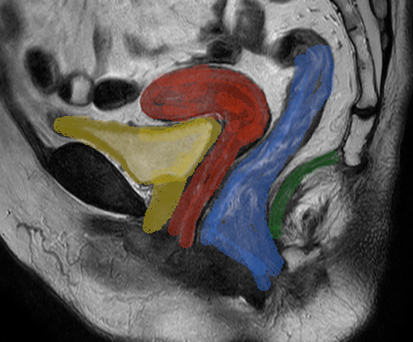
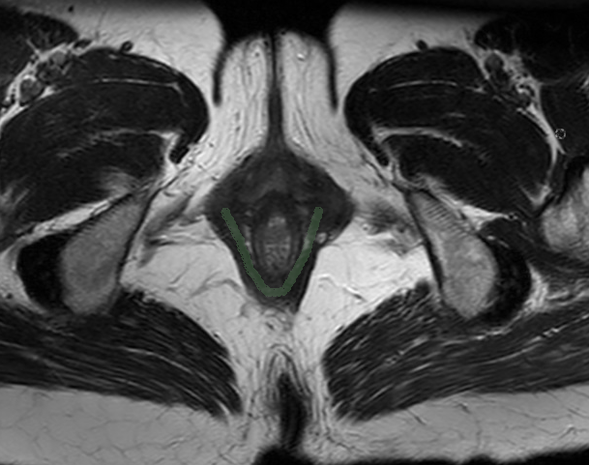
MR defecography – Normal Anatomy
Uterus
Rectum
Urinary bladder
Vagina
Levator ani
Anorectal junction
Anal canal

Slide 3
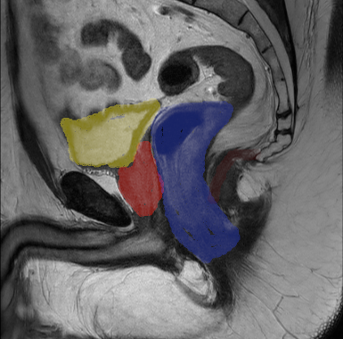
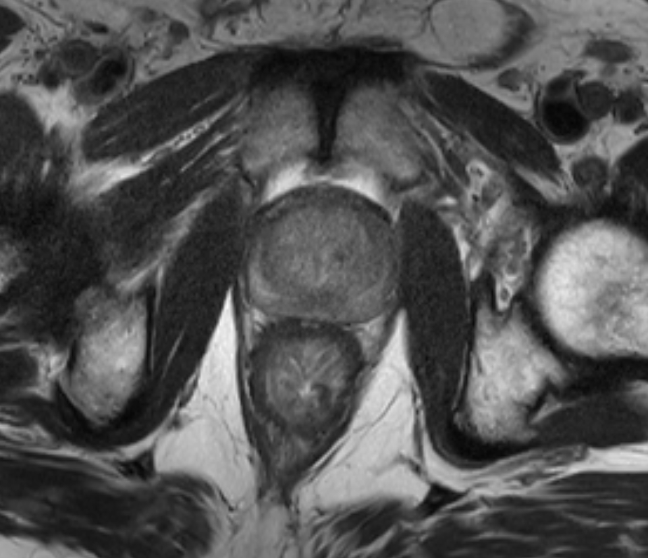
MR defecography – Male pelvis anatomy
Prostate
Rectum
Puborectalis muscle

Slide 4
Clinical features
Abnormalities to asses
Constipation
Incomplete defecation
Ansimus
Prolapse
Rectocele.
Vaginocele.
Cystocele.
Global pelvic weakness.
Omentocele.
Enterocele.
Rectal intussuception.

Slide 5
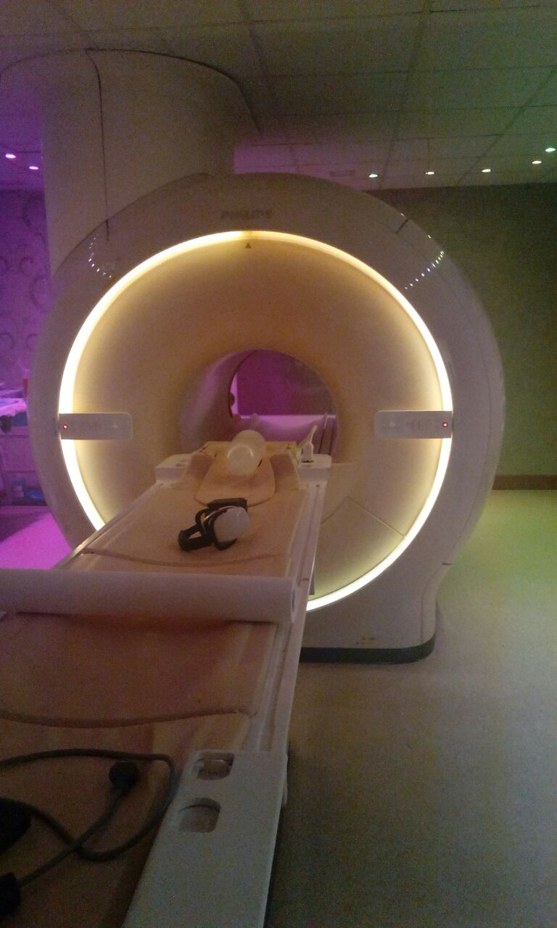
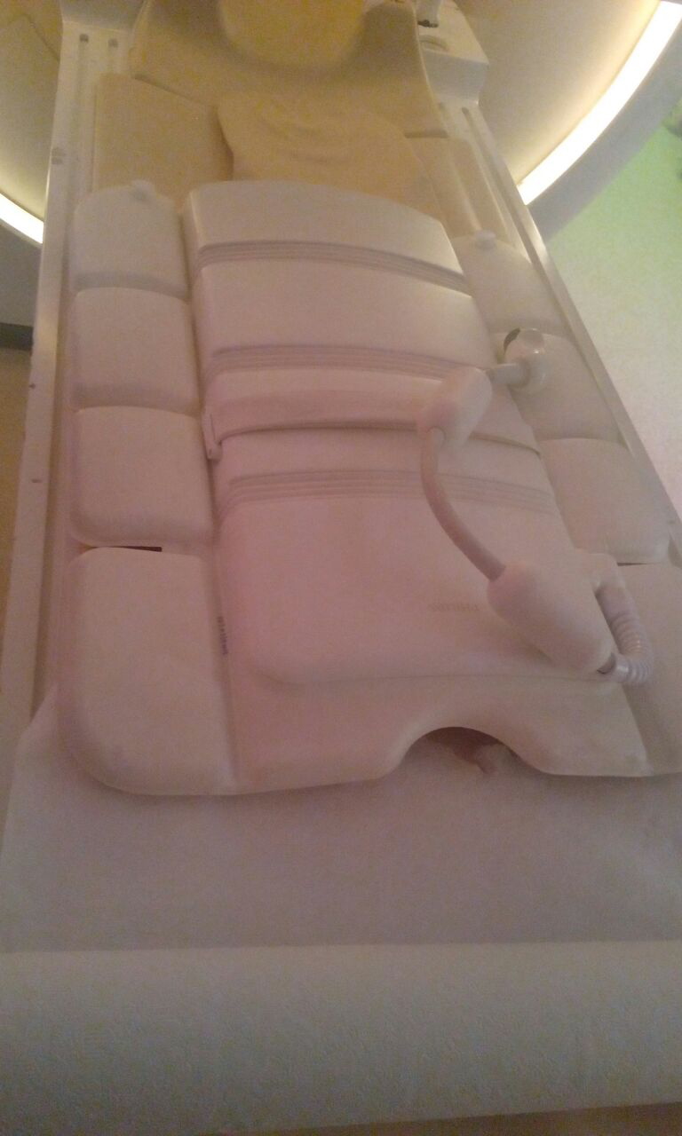
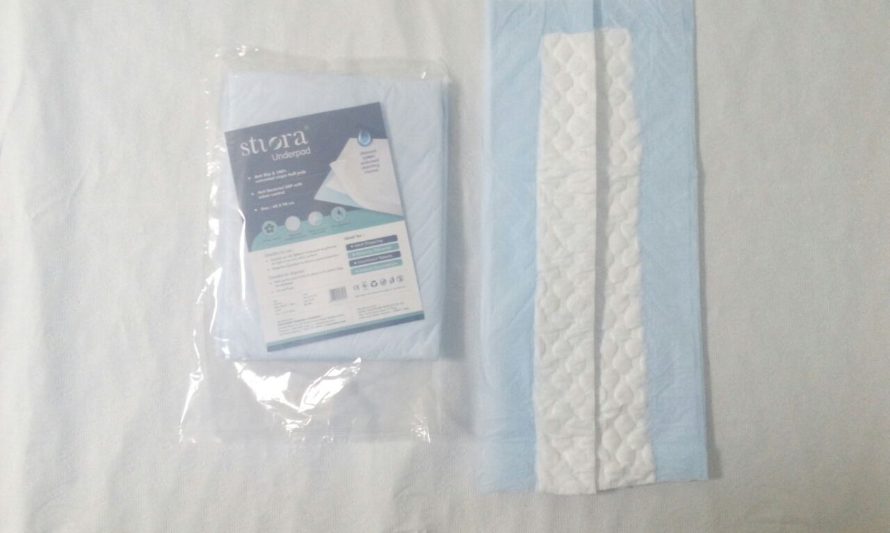
MR Defecography – Procedure requirements
MR machine
Body coil
Gel bottle
Tube
Diaper

Slide 6
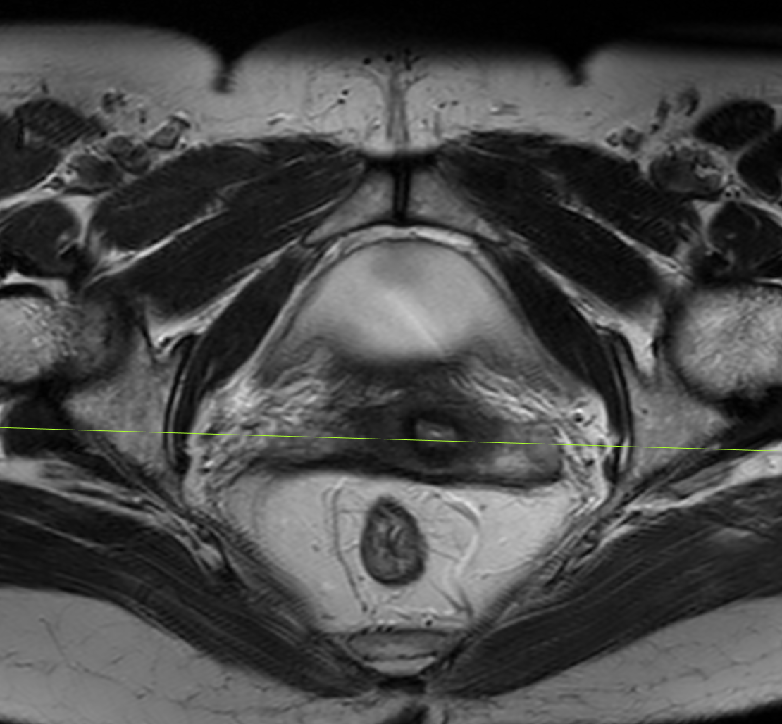
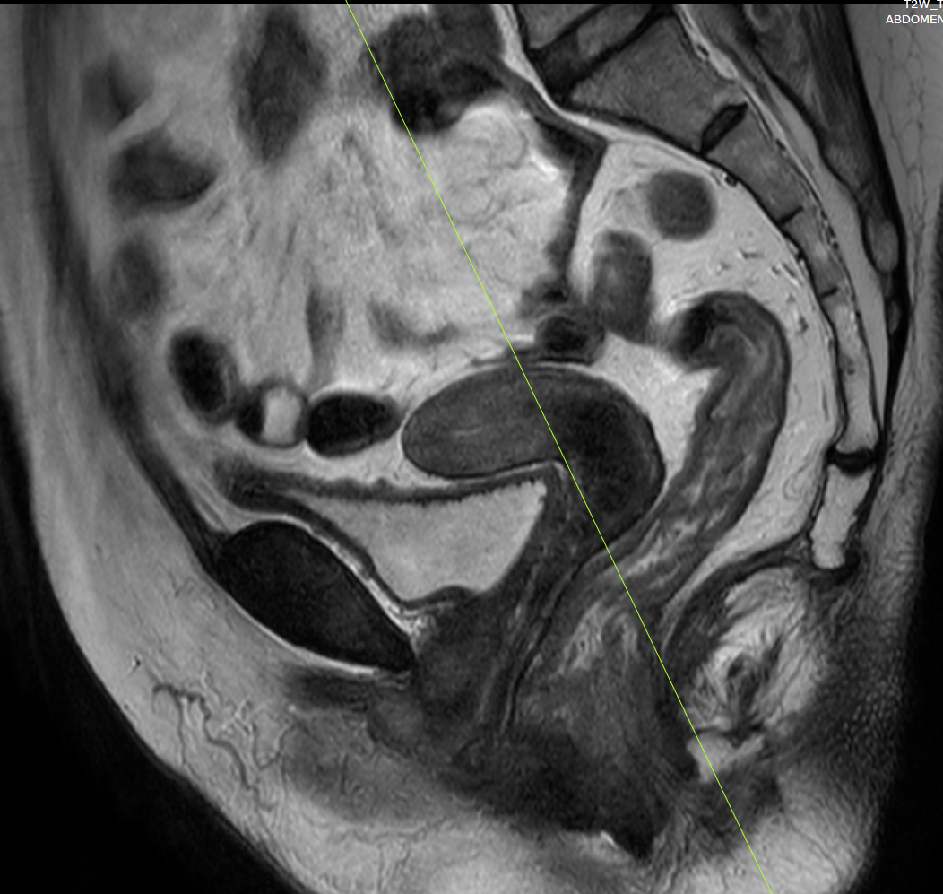
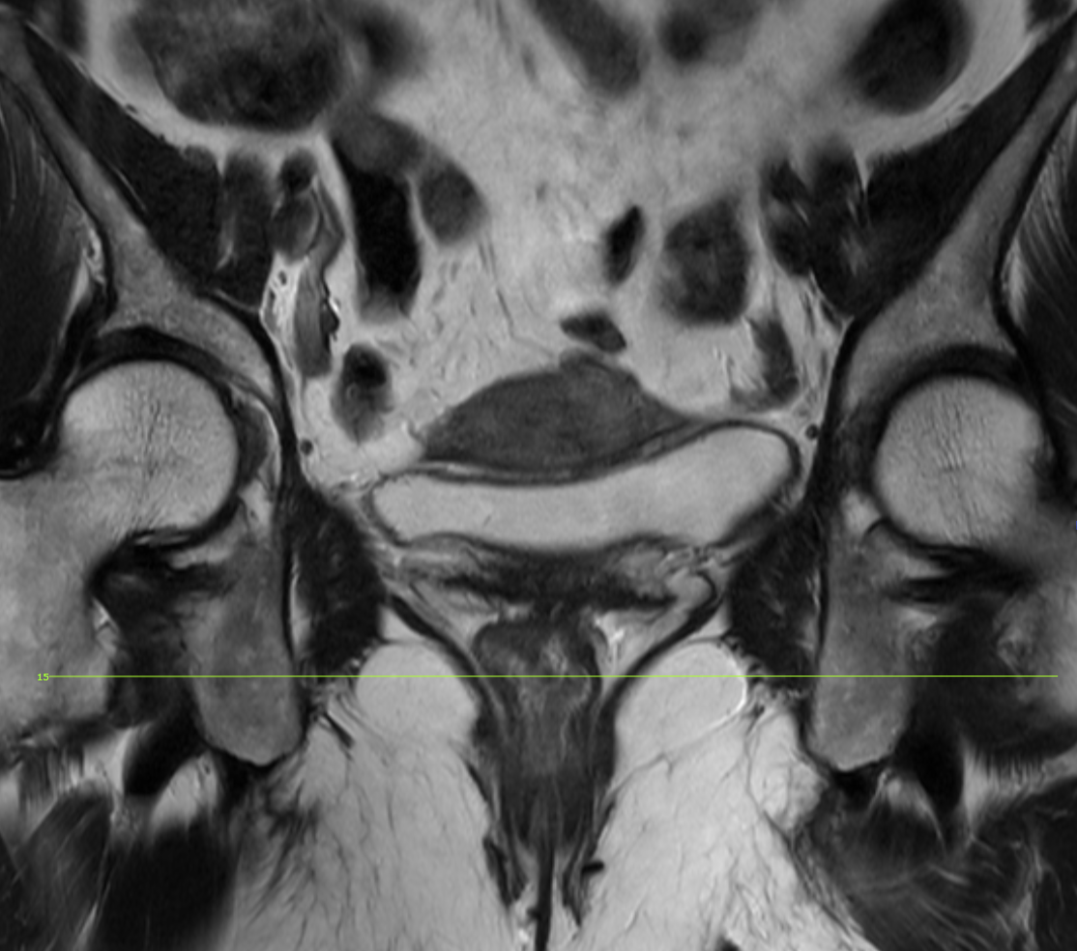
Patient preperation
No patient preparation required
150ml of ultrasound gel is inserted per rectum.
Sequences – Axial, coronal and sagittal T2W and dynamic sequences

Slide 7
Dynamic sequences are acquired in 4 of the following steps/stages
Rest
Squeeze
Strain
Defecate

Slide 8
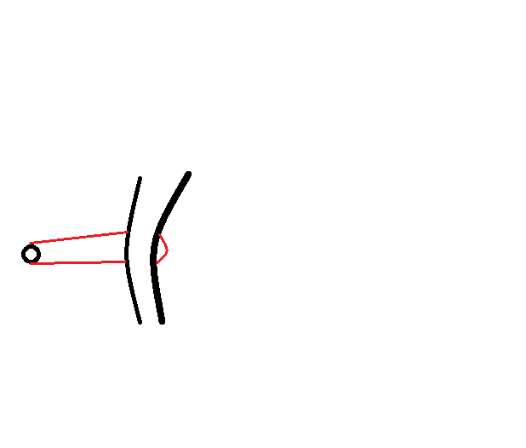
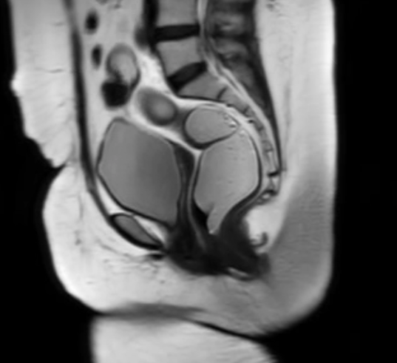
First phase – Rest
Diagramatic representation
Static image in rest phase
Dynamic MR/video in rest phase
Rectum
Puborectalis
Pubic bone
Anal canal

Slide 9
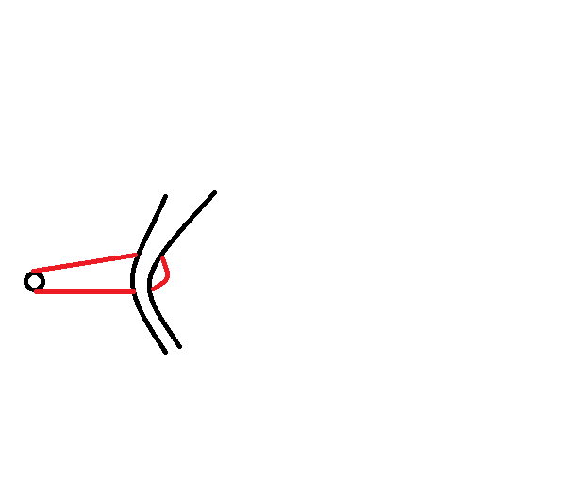
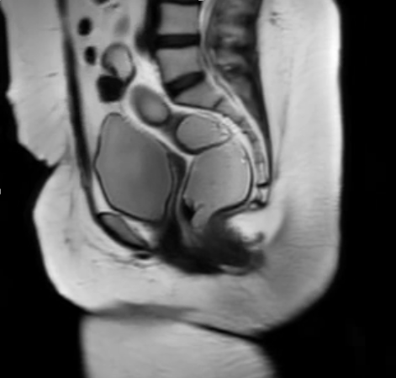
Second phase – Squeeze
Diagramatic representation
Static image in squeeze phase
Dynamic MR/video in squeeze phase
Rectum
Puborectalis
Pubic bone
Anal canal

Slide 10
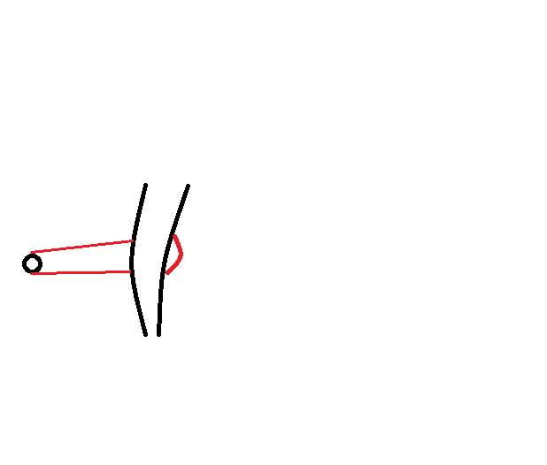
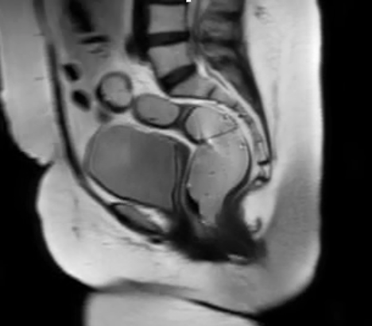
Third phase – Strain
Diagramatic representation
Static image in strain phase
Dynamic MR/video in strain phase
Rectum
Puborectalis
Pubic bone
Anal canal

Slide 11
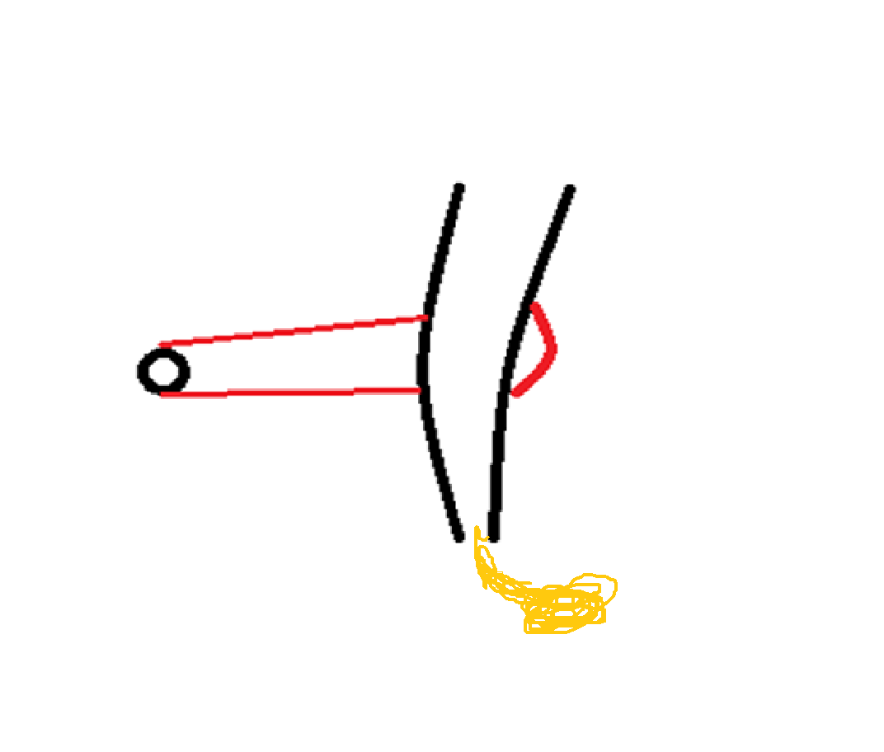
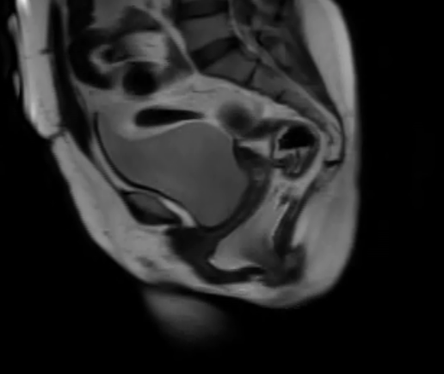
Fourth phase – Defecation
Diagramatic representation
Static image in defecation phase
Dynamic MR/video in defecation phase
Rectum
Puborectalis
Pubic bone
Mild rectal prolapse with Medium sized anterior rectocele
Anal canal

Slide 12
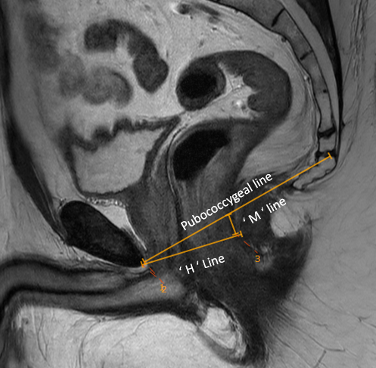
Measurements
Pubococcygeal line – A line joining the inferior aspect of pubic symphysis to the last coccygeal joint.
H line – Corresponds to the AP diameter of the Hiatus.
M line – Perpendicular distance between the pubococcygeal line and posterior anorectal junction.

Slide 13
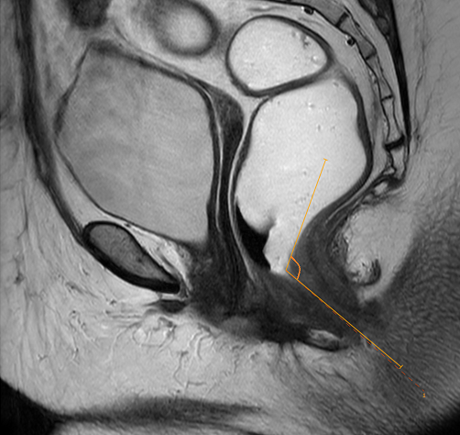
Measurements
Anorectal angle –
Formed by a line passing through the centre of anal canal and a line passing along the posterior wall of rectum.
At rest – 100- 127.
Decreases – During Squeeze.
Increases – During strain / Defecation.

Slide 14
Staging pelvic organ prolapse based on pubococcygeal line
Stage Measurement
Small organ prolapse
Medium organ prolapse
Large organ prolapse
Less than 3cm caudal to PCL line
3-6 cm caudal to PCL line
>6cm caudal to PCL line
Anterior Rectocele – Ventral prolapse of rectum for more than 2cm.
Classification –
Mild - <2cm.
Moderate – 2-4cm.
Severe - >4cm.

Slide 15
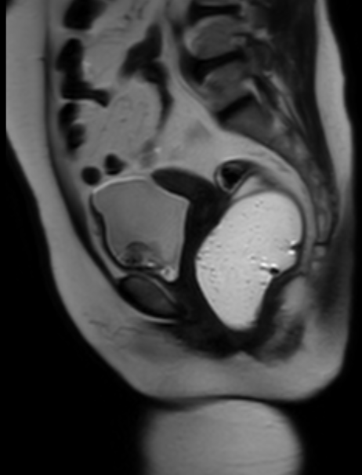
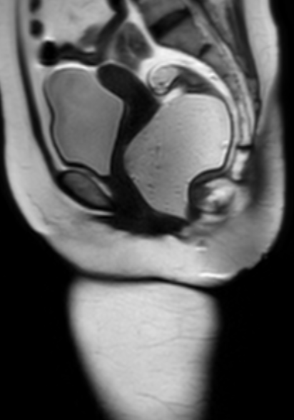
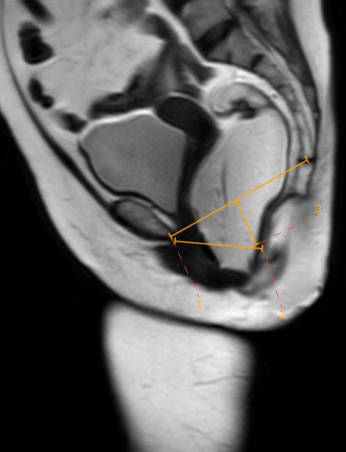
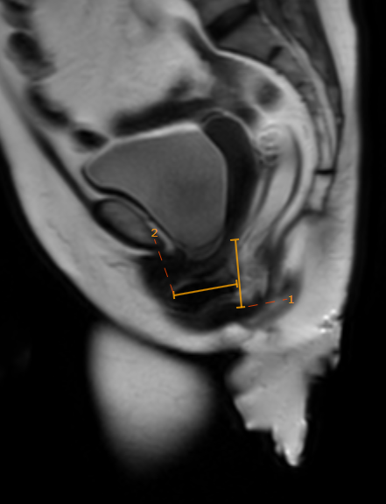
Case I – 54 year old female with dysynergic defecation.
Findings – Mild Rectal prolapse with (2.9cm) with large anterior rectocele(3.4cm).
Rest Squeeze Strain Defecate

Slide 16
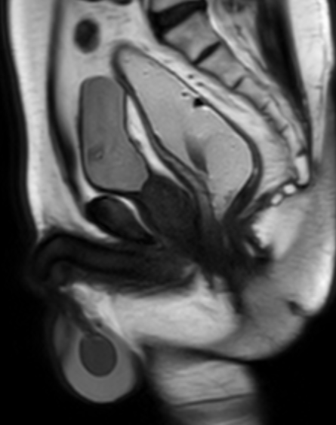
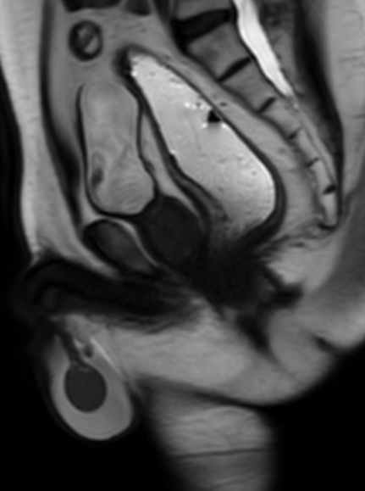
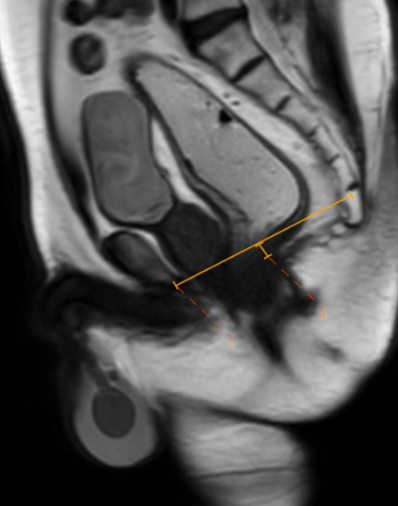
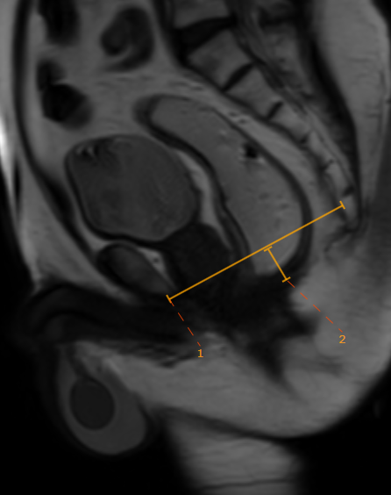
Case II – 67 Year old male with altered bowel movements and mass per rectum
Findings – Small rectal prolapse during strain and defecation phase (<2cm).
Rest Squeeze Strain Defecate
Hydrocele

Slide 17
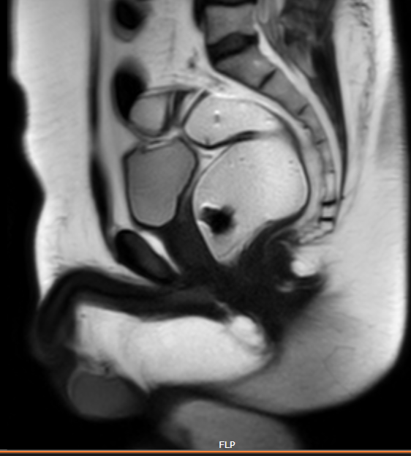
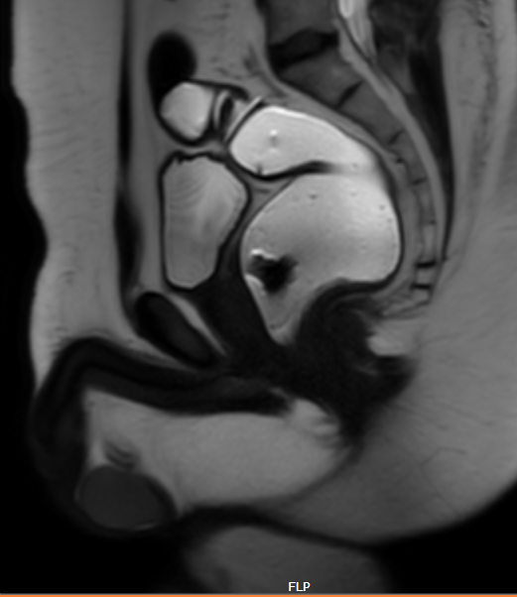
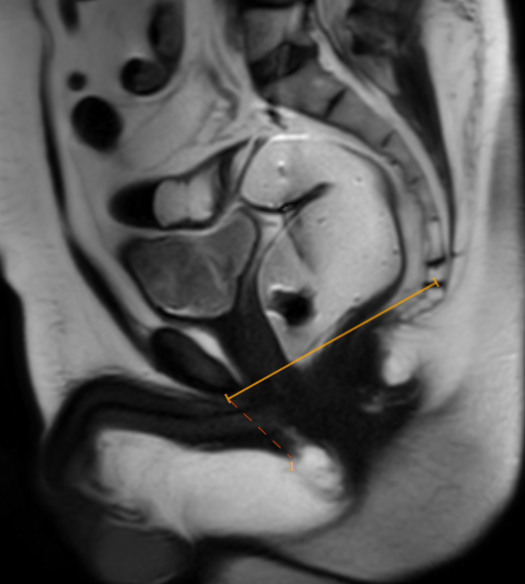
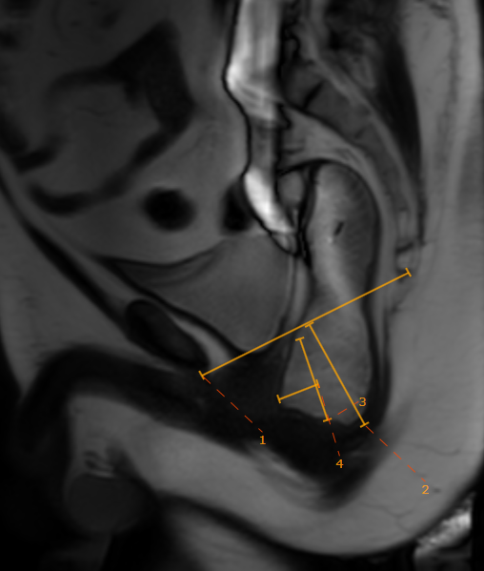
Case III – 37 Year old male with difficulty in passing stools.
Findings – Moderate Rectal prolapse with (5.6cm) with small anterior rectocele.
Rest Squeeze Strain Defecate
Rectocele
3

Slide 18
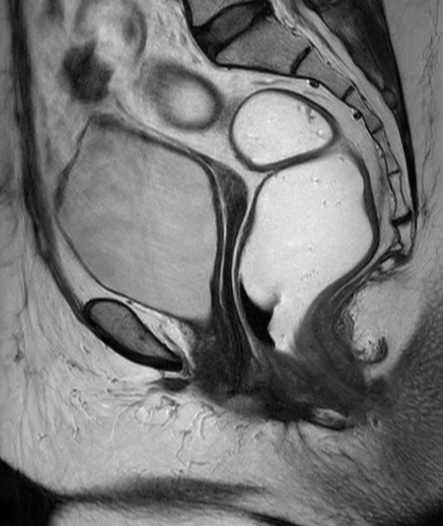
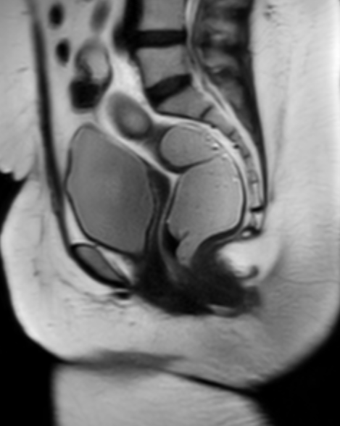
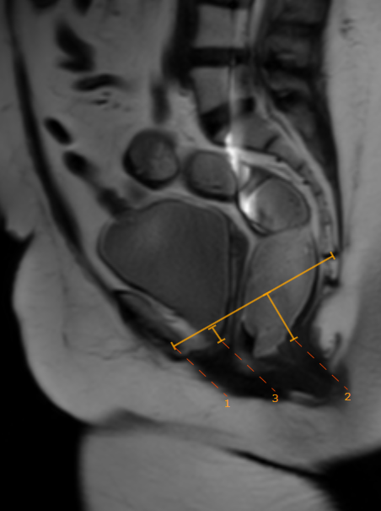
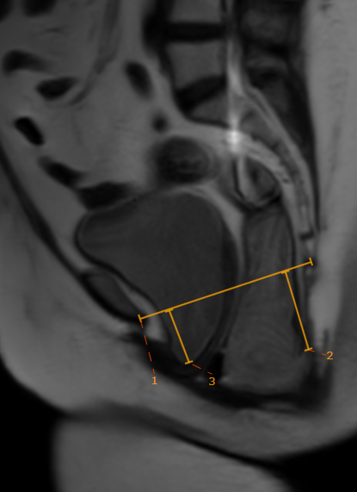
Case IV –61 year old female presented with history of constipation.
Findings – Global pelvic floor weakness, moderate Rectal prolapse with rectocele and cystocele.
Rest Squeeze Strain Defecate

Slide 19
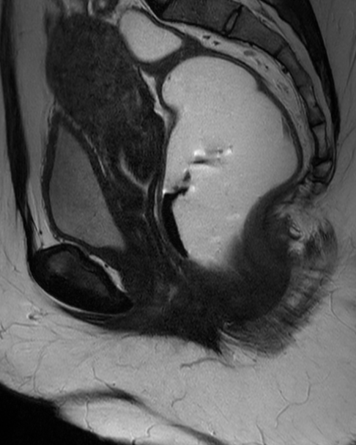
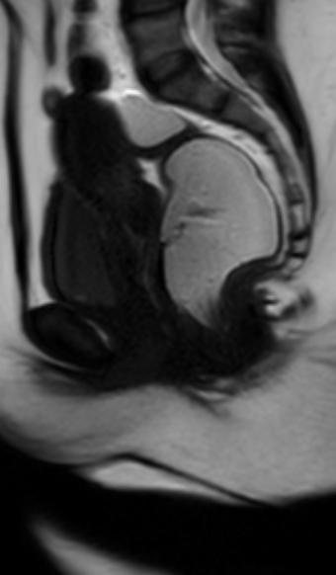
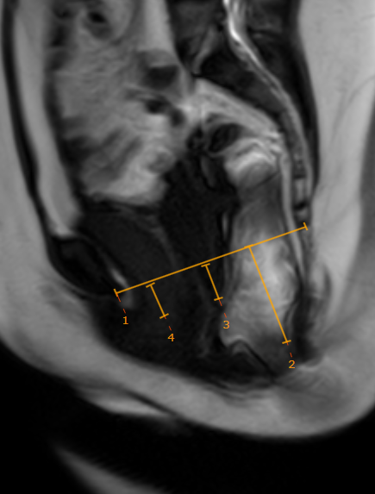
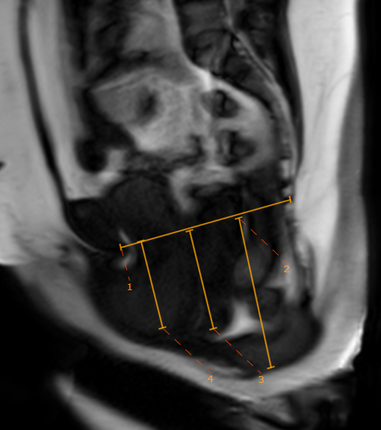
Case V –25 year old female presented with history of constipation.
Findings – Global pelvic floor weakness with large rectal prolapse, uterine/vaginal prolapse, moderate cystocele and enterocele.
Rest Squeeze Strain Defecate

Slide 20
Conclusion
No use of intravenous contrast and ionizing radiation.
It is superior to fluoroscopic defecography in providing the ability to detect associated abnormalities in the bladder and cervix/vagina.
Real time imaging- Providing dynamic evaluation of position of different structure in different phases.
The exam is fast (approx. 30 minutes).
Grading of severity of pelvic floor weakness and organ descent.

