Slide 1
Imaging in Transcatheter Aortic Valve Replacement (TAVR): role of the Radiologist
Presenter:Dr.Vishwanath Patil
Moderator:DR.Balasubramanyam S

Slide 2
Introduction
TAVR is a new technique to treat severe aortic stenosis in high-risk and nonsurgical candidates for symptom relief and extension of life.
• MDCT assessment of the aortic annulus is important for appropriate patient and device selection.
• Multidisciplinary approach is required for patient selection, procedure planning and performance.
• MDCT is required for assessment of the aortic root, iliofemoral or alternative vascular pathway.

Slide 3
Aortic valve apparatus anatomy
The aortic valve complex consists of the
a.aortic valve annulus,
b.commissures,
c.sinuses of Valsalva (SOV),
d.coronary ostia (CO) and
e.sinotubular junction (STJ).
Three aortic valve cusps are connected proximally to the wall of the left ventricular outflow tract (LVOT) [10] by three anchor points at the nadir (hinge point) of each aortic cusp.
Those nadir points, when virtually connected, form an oval-shaped, three-pronged coronet—the “virtual basal ring” (Fig. 1).
The orientation of this virtual basal ring, or aortic annulus, is double oblique and does not correspond to conventional axial, coronal or sagittalplanes of MDCT. This ring is the major target for transcatheter aortic valve prosthesis sizing.

Slide 4
Aortic valve apparatus anatomy

Slide 5
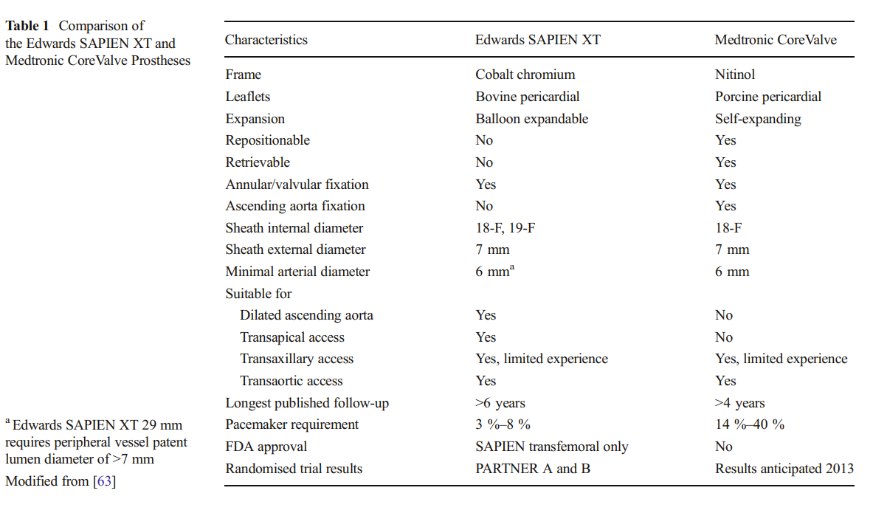
Patient selection for TAVR suitability

Slide 6
Pre-TAVR assessment of aortic root anatomy with echocardiography and MDCT
TTE, TEE and MDCT are currently the primary modalities for aortic root anatomy assessment.
Each imaging technique providing complementary information for optimal valve prosthesis sizing and THV selection.

Slide 7
Echocardiography assessment
Echocardiography is used to confirm severe aortic stenosis (aortic valve area of 4 m/s and mean gradient >40 mmHg).
It is also used to assess the
a.degree of aortic incompetence and other valvular diseases,
b.Left ventricular systolic ejection fraction
c.Diastolic dysfunction, as well as to estimate right-sided and pulmonary pressures.
TEE allows for realtime imaging during the TAVR procedure while assisting in device placement and positioning as well as assessing the degree of aortic regurgitation

Slide 8
MDCT assessment
Standardisation of scanning protocols,
The CT acquisition protocol should at least include a contrast enhanced ECG-gated or triggered scan of the aortic root reconstructed with 1.0 mm or less slice thickness preferably with several reconstructed phases but at least including a systolic phase.
A scan range that at least extends from the subclavian arteries to the superficial femoral arteries at the level of the femoral head is required.
Both scans may be obtained from a single acquisition but in most cases two separate acquisitions (one for the aortic root and one for the vascular access) during the same session are preferable.

Slide 9
No routine administration of β-blockers is used for scanning purposes because of concerns with underlying severe aortic stenosis.
Tube potential of 100 kV is suggested for patients weighing less than 90 kg or with a body mass index (BMI) less than 30, whereas a tube potential of 120 kV is usually indicated for patients weighing more than 90 kg (BMI >30).
Image acquisition triggering can be obtained automatically or by using a bolus injection technique for determining the transit time.
The region of interest (ROI) can be placed on the proximal descending aorta using a pre-selected HU threshold.
Arterial enhancement in studies performed with a 64-slice scanner demonstrates more consistency with the bolus injection technique, but requires higher contrast volume (typically an additional 20 ml of contrast medium).
The vast majority of medical centres imaging TAVR candidates follow one of the two two-step protocols

Slide 10
Contrast administration/volume
Fast anatomic coverage and low KV (70–80 kV), imaging is especially recommended in this fragile patient group to allow for a reduction in the amount of contrast agent [34].
A single injection of contrast agent for both acquisitions is recommended.
Around 50-ml contrast material in total at a flow rate of 3– 4 ml/s is often sufficient but should be adapted to the capabilities of the CT system and the body habitus of the patient.

Slide 11
Required Information from Preprocedural CT Examinations
The main elements of CT in annular sizing are:
– To define a cross-sectional double-oblique image orientation in the correct plane of the aortic annulus
– To obtain accurate and standardised measurements of different annular dimensions and height of coronary ostia.
– To implement these measurements in the selection process of a TAVI candidate in order to have the optimal prosthesipatient matching.
ECG-gated acquisitions are mandatory, with a preference for systolic measurements.
Evaluation of all potential access routes for suitability is mandatory.
For valve-in-valve procedures, simulated TAVI insertion is mandatory to assess potential coronary obstruction.

Slide 12
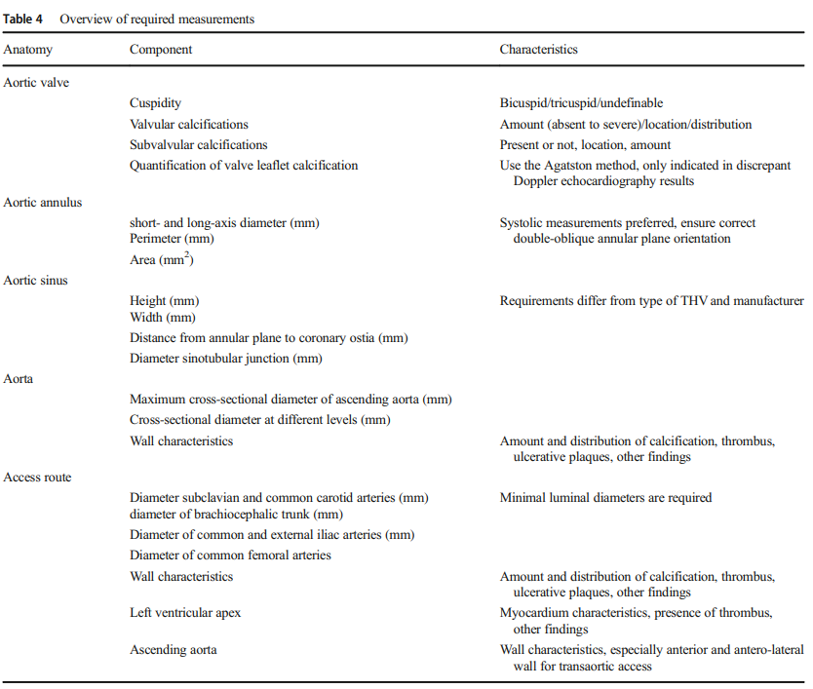
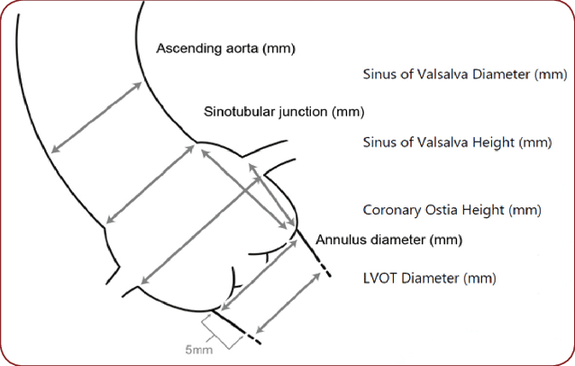
Required Information from Preprocedural CT Examinations

Slide 13
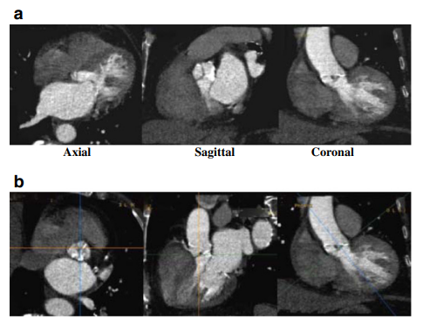
Sequence of images describing the step-by-step process of creating a plane that precisely corresponds to the aortic annulus
a Thin-sliced axial reconstructions (0.625 mm for GE and 0.5 mm for Toshiba) are used to create standard coronal, sagittal and transverse plane reconstructions.
b Coronal plane reference line is rotated to bring the former axial plane as close as possible to the plane of the valve

Slide 14
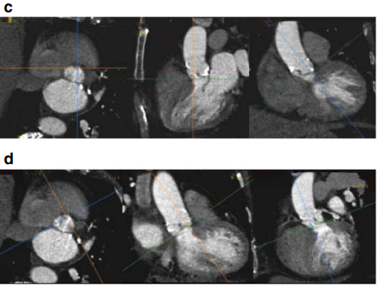
c.The reference line in the coronal image that controls the former axial plane is moved up and down to identify the lowest insertion point of the right coronary cusp, and the former axial plane is positioned exactly at the level of the right cusp insertion point.
d The reference line in the formerly axial plane is rotated such that the line that controls the former sagittal plane crosses the lowest insertion point of the non-coronary cusp (located approximately at the 8 o’clock position, *)

Slide 15
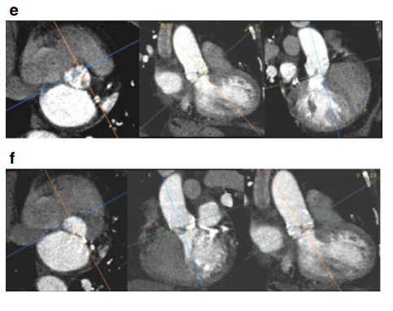
e Manipulation with the former sagittal plane, currently showing the lowest insertion of the right and noncoronary cusp. On this plane, the reference line of the former axial plane should be rotated until it crosses the two insertion points.
f On the former coronal plane the reference line of the former axial plane is rotated until the lowest point of the left coronary cusp appears on the formerly axial plane window. At this point the formerly axial plane is now rotated to represent the correct orientation and level of the aortic valvular plane. This image should be used to provide all the precise pertinent measurements

Slide 16
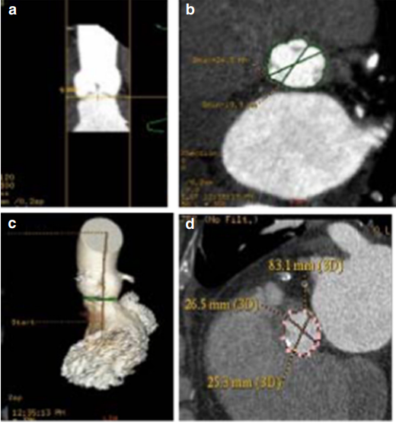
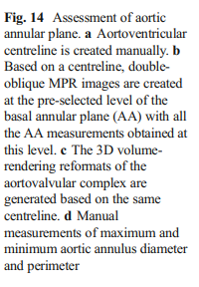
1.Aortic annulus diameters:
Long and short diameters are measured, and the mean diameter is calculated by averaging short and long diameters .
(2) The circumference (perimeter) of the aortic annulus can be either calculated under the assumption that the area corresponds to full circularity or measured manually.

Slide 17
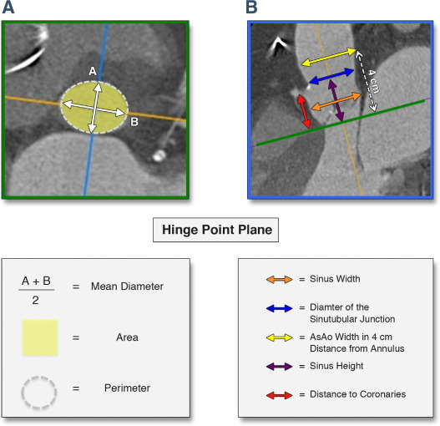
(3) Aortic annulus area can be calculated based on the mean diameter or measured manually using the planimetry technique.

Slide 18
Errors During Measurements at the Level of the Aortic Root.
False measurements, as well as correct aortic annular definition at the hinge-point plane, are illustrated.

Slide 19
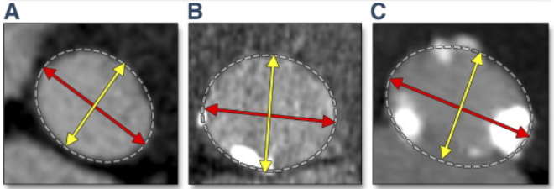
In cases of annuli without calcification , the valve size should be at least ≥1 mm bigger than the annular size. However,
in cases of moderate calcification , the valve size should be ≥0.5 mm bigger than annular size, and for
severe or diffuse calcification , the chosen valve size could be nearly equal to the annular size.

Slide 20
Aortic valve calcifications (AVCs) are either diffusely or focally located on the aortic surface of thickened aortic valve cusps.
If excessive, these calcifications may prevent appropriate alignment of the prosthesis, leading to gaps between the prosthetic valve and the aortic annulus and subsequent
a.paravalvular aortic regurgitation (leak), as well as
bincreased risk of annular rupture,
C.Device dislodgement or obstruction of coronary ostia due to opposition of calcified aortic cusp.
d.Calcification of the aortomitral continuity may increase the risk of annular rupture with balloon dilatation
AVC can be assessed in the cross-sectional view of the sinus of Valsalva (SOV) either qualitatively (mild, moderate, severe) or quantitatively using Agatston units (Agatston Score), the calcified volume score (in mm3 ) or mass score (in mg of CAHA), similar to the assessment of coronary calcifications [38, 43].
Agatston scores exceeding 3,000 are correlated with an increased incidence of paravalvular regurgitation after TAVR [44]. S
Semiquantitative scores assess the number of affected cusps, homogeneous versus more focal distribution of calcium and involvement of coronary versus non-coronary cusps.
Post-deployment balloon dilatation is required more frequently in patients with severe valvular calcification

Slide 21
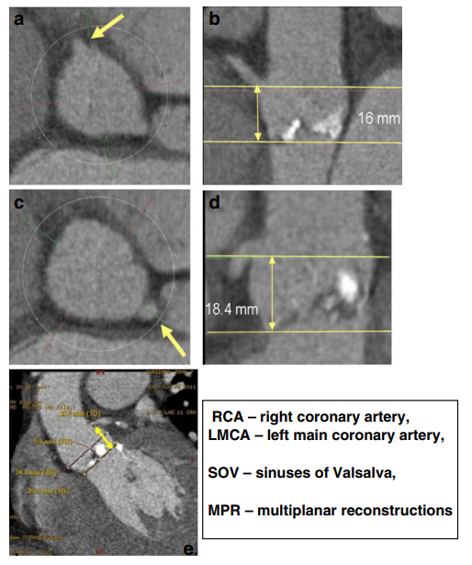
Distance of the coronary ostia to the aortic annulus plane:
Coronary arteries generally arise within the SOV, below the level of the sinotubular junction (STJ).
The right coronary artery generally lies higher than the left coronary artery, with average distance between the plane of the aortic annulus and coronary artery ostium (CAO) of 15.5 mm on the left and 17.3 mm on the right.
Degenerative aortic stenosis may result in longitudinal remodeling of the SOV with decreased distance from the aortic valve annulus to the CAO.
The combination of a relatively low-lying coronary artery ostium and a large native aortic valve leaflet can therefore obstruct the flow into the coronary arteries during device deployment.
The height of the CAO is determined by identifying the origin of the coronary artery from the cross-section MPR and then measuring the vertical distance between the inferior edge of the CAO and the aortic annular plane.
If coronary ostia height is more than 10– 14 mm in patients with planned THV implantation, the chance of obstruction is low.

Slide 22
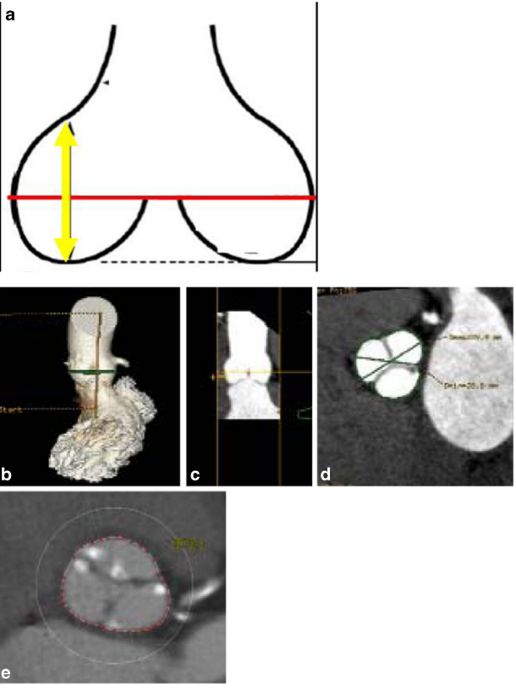
The width and maximal height of the SOV are important parameters for coronary perfusion with THV, determining whether the THV will be accommodated within the SOV without causing coronary occlusion from displacement of the native aortic valve leaflet.
As for the rest of the aortic valve apparatus, measurements of the aortic sinus diameter and height should be assessed on a double-oblique projection.
The SOV width assessment is particularly important for the CoreValve device with a
Minimum 27 mm required for the 26-mm prosthesis and 29 mm for the 29- and 31-mm prostheses;
The minimum SOV heightheight is 15 mm

Slide 23
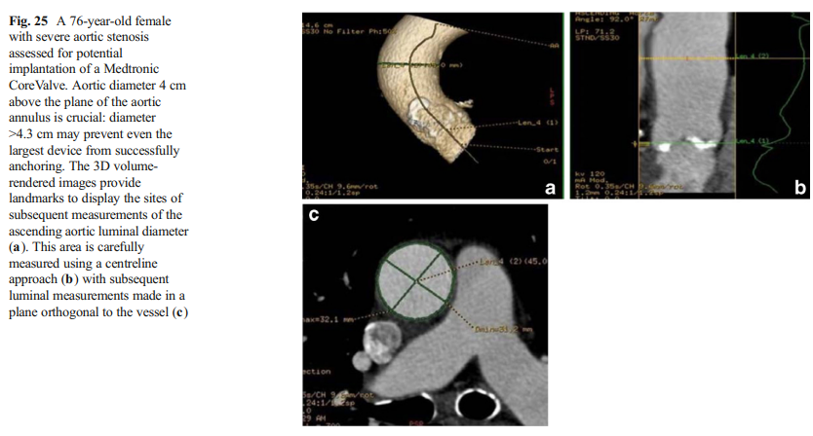
The diameter of the ascending aorta: For CoreValue devices, orientation of the direction of the device flow occurs when the frame contacts the inner and outer curvature of the aorta.
Ascending aortic dilatation of more than 43 mm (when measured 4 cm above the basal aortic annulus plane) precludes the use of the 29- and 31-mm CoreValve device.
Dilatation of more than 40 mm precludes the use of the 23and 26-mm CoreValve device.
Size is of less concern for valves that are short in length and confined to the aortic annulus and sinus of Valsalva such as the Edwards SAPIEN valve.

Slide 24
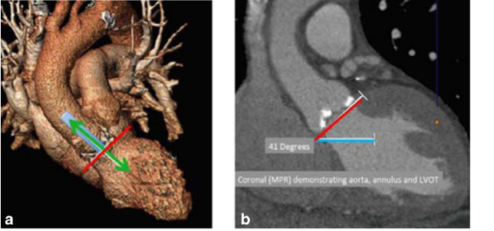
Additional features that might interfere with successful implantation:
a.The left ventricular outflow tract (LVOT) is the area between the basal annulus and the anatomic aortoventricular junction.
The degree of LV upper septal hypertrophy protruding into the LVOT can hinder accurate placement of the valve and present a significant risk of THV repositioning.
The aortoventricular angle is the angle between the proximal aorta, aortic annulus and LVOT
This angle is determined by the angle of the horizontal plane and the angle of the aortic annulus .
The aortoventricular angle is an important consideration when using THVs that are long in length and require deployment perpendicular to the native annular plane.
Each type of THV has a maximum aortoventricular angle for successful valve deployment, typically 70º for the iliofemoral approach and 30º for the subclavian approach, due to angulation from the right subclavian into the ascending aorta.

Slide 25
Peripheral vascular pathway, aorta, chest wall and left heart imaging
Imaging of peripheral access can be obtained with non-gated spiral acquisition to minimise radiation.
Peripheral access includes the
a.Iliofemoral,
b.Transsubclavian,
c.Transapical and
d.Direct aortic access routes.
Transapical and direct aortic access (ascending aorta) routes are assessed with the ECG-gated portion of the MDCT.
The common femoral artery should be included in the field of view when assessing femoral access.
Assessment of the axillary and subclavian arteries should be obtained with the patient’s arms placed along his/ her body to exclude pseudo narrowing of the imaged vasculature.

Slide 26
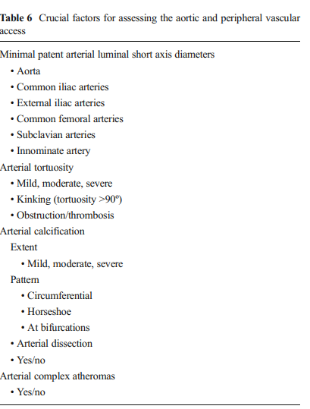
MDCT selection of patients with appropriate peripheral access has substantially reduced the risk of vascular complications from 30.1 % to 8 %.
A sheath-to-femoral artery ratio ≥1.05 has been shown to be associated with increased vascular complications and 30-day mortality [36, 48].
A standardised approach for peripheral access has been developed, adding significant reduction in vascular injury rates [48].

Slide 27
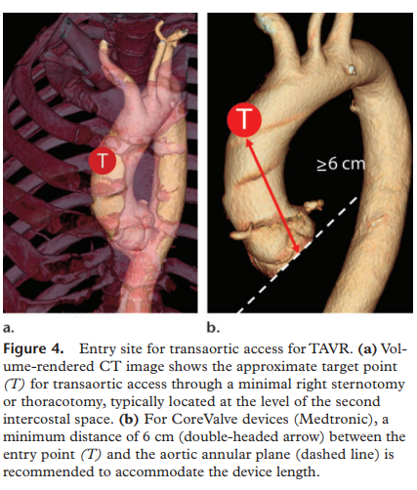
For all TAVR approaches, assessment of the entire aorta is done routinely as part of the pre-procedure protocol using curved MPR with subsequent creation of true perpendicular axial images for precise patent lumen diameter assessment.
For the transfemoral approach, the aorta is assessed to exclude the presence of an abdominal anekinking of the aorta, dissection or large thrombi protruding into the lumen and/or complex atheromas, as these are contraindications for transfemoral approach [11].
For the direct aortic approach,
assessment of the ascending aorta for the presence and pattern of calcification is of paramount importance, as calcium may interfere with direct puncture of the aorta.
In these cases, the ascending aorta from the aortic annulus plane to the origin of the brachiocephalic artery is assessed for the presence of aneurysmatic dilatation or circumferential/anterior calcifications.
For transapical access, assessment of the entire aorta is less crucial, unless a change in the approach is anticipated during the procedure.

Slide 28
Post-implantation imaging
Post-implantation imaging can be divided into
A.Immediately post-procedure.
B.Long-term follow-up.

Slide 29
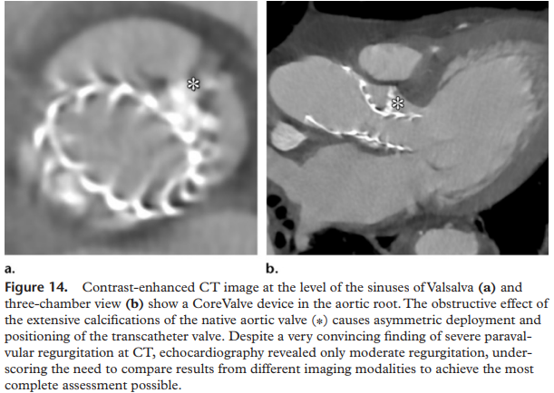
For the immediate assessment of valve position andhaemodynamic status, including the gradients and effective valve area, the modality of choice is TEE, which can be done in the hybrid procedure room.
Paravalvular and transvalvular regurgitation can also be estimated in real time, allowing appropriate steps to be taken to minimise complications and optimise device positioning.
Long-term follow-up
ECG-gated MDCT is useful in diagnosing prosthesis misplacement by careful inspection of the exact positioning of the device in relation to the aortic annulus plane.

Slide 30
Significantly
Low implantation may result in
Severe paravalvular regurgitation,
Residual aortic valve stenosis,
Mitral valve insufficiency,
Conduction abnormalities and, in
Extreme cases, device drop into the left ventricular cavity.
High implantation may result in
Paravalvular regurgitation,
Coronary flow obstruction and
Device embolisation into the thoracic aorta.

Slide 31
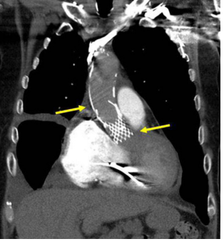
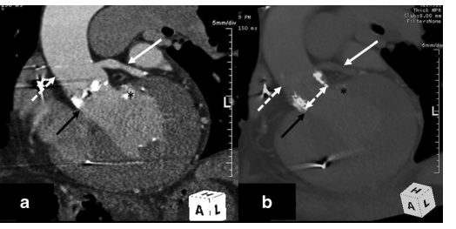
The exact definition of misplacement is specific to the TAVR device type.
The optimal deployment location of
Medtronic CoreValve® device requires that the most inferior edge of the device, the inflow portion, should be positioned approximately 4–6 mm below the aortic annulus plane.
the Edwards SAPIEN device is likely gained when 50 % of its height is below and 50 % of its height above the aortic annulus.

Slide 32
Summary
During the last decade transcatheter aortic valve replacement has become widely used in many centres across the world with good clinical outcomes.
MDCT plays an important role in assessing the aortic valve, aortic root and ascending aorta, as well as the access root for the procedure (i.e., ilio-femoral, direct aortic or subclavian) utilising the combination of multiplanar reconstruction and 3D imaging.
TAVR technology and equipment are rapidly advancing, with increased utilisation of advanced MDCT imaging contributing to continuing outcome

Slide 33
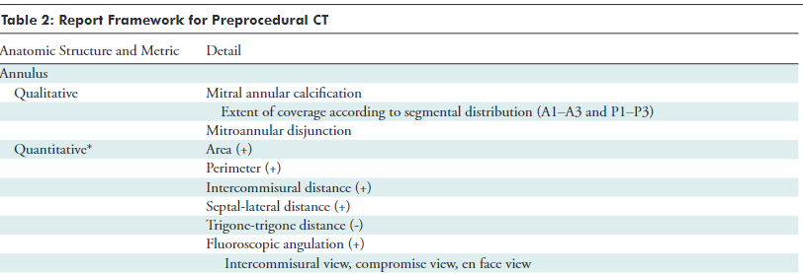
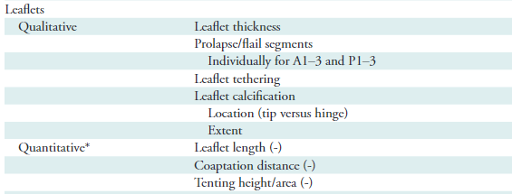
Mitral Valve Imaging with CT

Slide 34
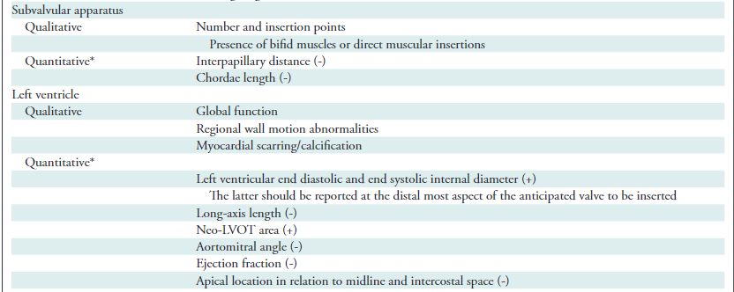

Slide 35
Thank you

